Slide 1
Presented by Michael Behrenfeld, Oregon State University

Slide 2
Name |  | Institute |  | Name |  | Institute |  | Name | Institute
Nicole Estephan (journalist) Lee Herrington (cameraman) |  |  |  | Derek Coffman |  | NOAA |  | Mike Lawler | UCI
 |  |  |  | Patricia Quinn |  | NOAA |  | Cyril McCormick | UCI
Roy Johnson | AMES |  |  | Patrick Finch |  | NSRC |  | Jack Porter | UCI
Sam LeBlanc | AMES |  |  | Steven Schill |  | NSRC |  | Eric Saltzman | UCI
Kistina Pistone | AMES |  |  | Eric Stith |  | NSRC |  | James Allen | UCSB
Yohei Shinozuka | AMES |  |  | David Van Gilst |  | NSRC |  | Craig Carlson | UCSB
Susanne Craig | DAL |  |  | Michael Behrenfeld |  |  |  | Stuart Halewood | UCSB
Mark Gibson | DAL |  |  | Luis Bolaños | OSU |  |  | Nicholas Baetge | UCSB
Brian Cairns | GISS |  |  | Consuelo Carbonell-Moore |  |  |  | Sasha Kramer | UCSB
Jacek Chowdhary | GISS |  |  | Cleo Davie-Martin | OSU |  |  | Norman Nelson | UCSB
Ken Sinclair | GISS |  |  | Nerissa Fisher | OSU |  |  | Anai Novoa | UCSB
Snorre Stamnes | GISS |  |  | Steve Giovannoni | OSU |  |  | David Siegel | UCSB
Andrzej Wasilewski | GISS |  |  | Jason Graff | OSU |  |  | Brandon Stephen | UCSB
Scott Janz | GSFC |  |  | Kimberly Halsey | OSU |  |  | Liz Harvey | UGeorgia
Matt Kowalewski | GSFC |  |  | Bethan Jones | OSU |  |  | Sean Anderson | UGeorgia
Kent Mccullough | GSFC |  |  | Kelsey McBeain | OSU |  |  | Markus Mueller | UI
Peter Pantina | GSFC |  |  | Allen Milligan | OSU |  |  | Felix Piel | UI
Chris Proctor | GSFC |  |  | Kristina Mojica | OSU |  |  | Arne Schiller | UI
Sam Xiong | GSFC |  |  | Eric Moore | OSU |  |  | Stephanie Ayres | UMaine
Bruce Anderson | LaRC |  |  | Bryce Penta | OSU |  |  | Emmanuel Boss | UMaine
Tim Berkoff | LaRC |  |  | Jennifer Schulien | OSU |  |  | Alison Chase | UMaine
Matt Brown | LaRC |  |  | Brian VerWey | OSU |  |  | Nils Haentjens | UMaine
Gao Chen | LaRC |  |  | Toby Westberry | OSU |  |  | Lee Karp-Boss | UMaine
Ewan Crosbie | LaRC |  |  | Kay Bidle | Rutgers |  |  | Jordan Snyder | UMaine
Alexis Eugene | LaRC |  |  | Ben Diaz | Rutgers |  |  | Jens Redemann | UO
Richard Ferrare | LaRC |  |  | Chris Johns | Rutgers |  |  | Tomas Mikoviny | UOSLO
John Hair | LaRC |  |  | Ben Knowles | Rutgers |  |  | Armin Wisthaler | UOSLO
Rich Hare | LaRC |  |  | Christien Laber | Rutgers |  |  | Gayantonia Franzé | URI
Dave Harper | LaRC |  |  | Maryam Asgari | Scripps |  |  | Susanne Menden-Deuer | URI
Chris Hostetler | LaRC |  |  | Raghu Betha | Scripps |  |  | Francoise Morison | URI
Yongxiang Hu | LaRC |  |  | Chia-Li Chen | Scripps |  |  | Andreas Oikonomou | URI
Mary Kleb | LaRC |  |  | Savanah Lewis | Scripps |  |  | Caitlin Russel | URI
Joe Lee | LaRC |  |  | Derek Price | Scripps |  |  | Chuanmin Hu | USF
Rich Moore | LaRC |  |  | Laura Rivellini | Scripps |  |  | Minwei Zhang | USF
Claire Robinson | LaRC |  |  | Lynn Russell | Scripps |  |  | Scott Doney | UVirginia
Amy Jo Scarino | LaRC |  |  | Georges Saliba | Scripps |  |  | Rachel Eveleth | UVirginia
Taylor Shingler | LaRC |  |  | Alyssa Alsante | Texas A&M |  |  | Bo Yang | UVirginia
Michael Shook | LaRC |  |  | Sarah Brooks | Texas A&M |  |  | Timothy Bates | UW
John Smith | LaRC |  |  | Brianna Hendrickson | Texas A&M |  |  | Alice Dellapenna | UW
Lee Thornhill | LaRC |  |  | Jessica Mirrielees | Texas A&M |  |  | Peter Gaube | UW
Eddie Winstead | LaRC |  |  | Joseph Niehaus | Texas A&M |  |  | Jim Johnson | UW
Luke Ziemba | LaRC |  |  | Elise Wilbourn | Texas A&M |  |  | Lucia Upchurch | UW
Alex Mignot | MIT |  |  | Jake Zenker | Texas A&M |  |  | Sean Kirby | Wallops
Hongyu Liu | NIA |  |  | Thomas Bell | UCI |  |  | Ben Van Mooy | WHOI
Bo Zhang | NIA |  |  | Mackenzie Grieman | UCI |  |  | Ivan Lima | WHOI
OSU
= Principal Investigator
= Project Manager
= Project Scientist / Deputy Scientist
= Ship-Science Logistics Lead
= Data Manager
= C-130 Platform Manger
= Flight Planner
= Meteorologist
Bold = Team leads
Red = Added post-selection
OSU
NAAMES Science Team
278 Total Participants
75 students / post docs
Notes:
I’m just the spokesman for a huge and amazing team!
37 primary team members added post-selection

Slide 3
Science

Slide 4
Phytoplankton Annual Biomass Cycles
Science
climax
NAAMES set out to evaluate ecosystem interactions during primary phases of the annual cycle in the context of the ‘Disturbance-Recovery Hypothesis’
decline
Each phase is a interdependent element of a repeating annual cycle
recovery
disturbance
mechanisms of the ‘declining’ and ‘recovery’ phases were, in particular, not well understood
pre-NAAMES

Slide 5
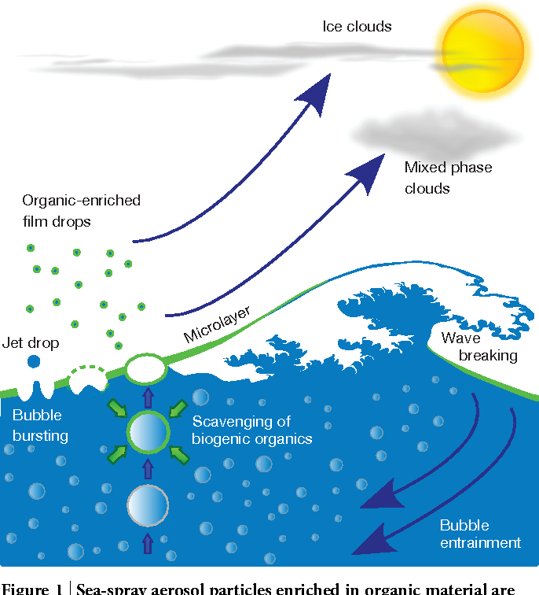
Science
NAAMES set out to evaluate seasonal impacts of marine plankton on aerosols and clouds
Notes:
A major uncertainty in climate predictions is the influence of aerosols on clouds
For a given humidity, a higher concentration of aerosols will result in smaller cloud droplets, brighter clouds, and greater albedo
In remote marine systems, aerosol loads can be vanishingly small, resulting in with more absorbing clouds with larger droplet sizes
A central objective for NAAMES was to provide new insight on the link between in-water aerosol precursors, air-sea transfer, primary and secondary aerosols, and clouds

Slide 6
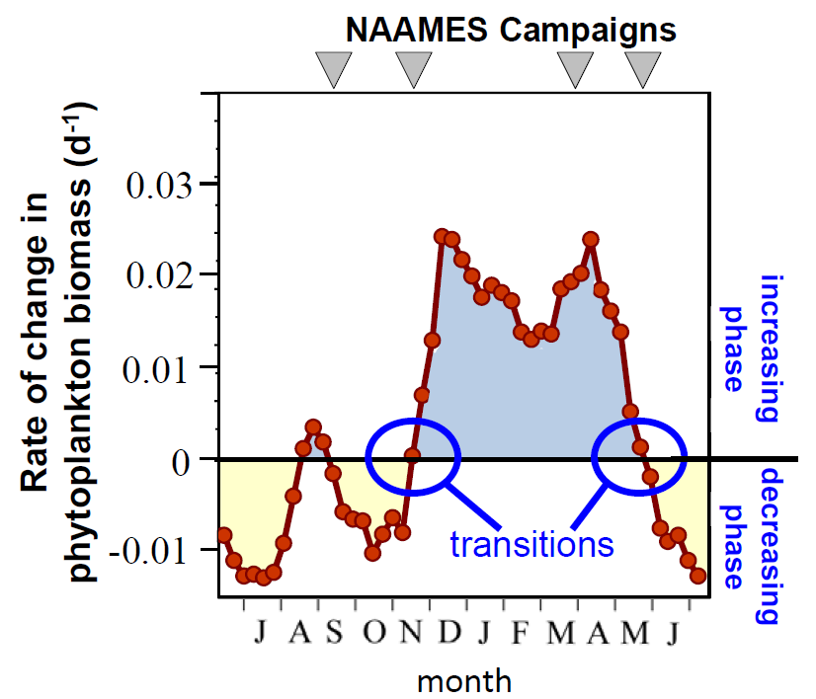
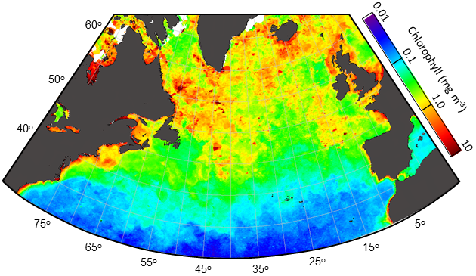
Deployment Strategy
Four field campaigns in Western Subarctic Atlantic
Campaigns target unique plankton events
Natural meridional gradient ensured targeted ‘states’
~2 months of variability in 14 days primary transect
Bloom initiation
Accumulation phase
Bloom climax
Deceleration phase
NAAMES
Study
Region
Notes:
NAAMES focused on the western subarctic Atlantic
The timing of key events in the annual plankton cycle differs from North to South along the primary transect of the NAAMES study region
This allowed NAAMES to capture the equivalent of 2 months of ecosystem states within a 14 day window
The observational objective was to sample roughly an equivalent annual cycle of ecosystem and aerosol states, not to follow a specific annual cycle
This gave a lot of flexibility in terms of the order of field campaigns and the direction the study region was occupied.
The 4 target events for NAAMES are based on the annual cycle in phytoplankton accumulation rates, as observed from space
Two events correspond to ‘transitions’ and two correspond to prolonged increasing and decreasing biomass phases

Slide 7
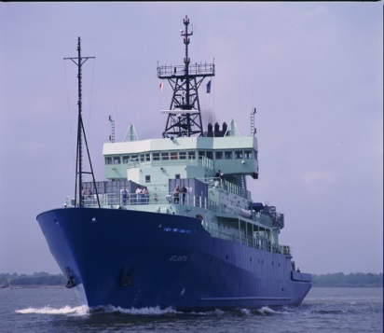
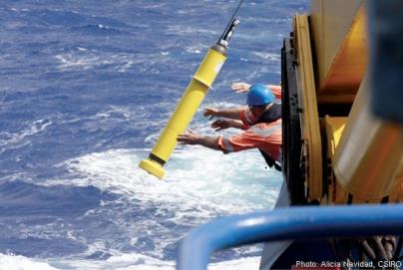
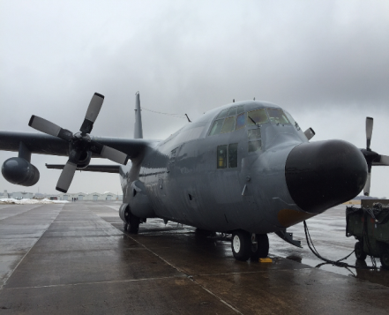
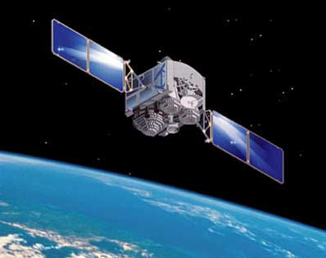
Ship: Detailed sampling of ocean ecosystems and aerosols
C-130: Broader spatial context for ship measurements, pre-station and post-station sampling
Floats: Multi-year sustained ecosystem/optical measurements and target sites for future stations.
Satellites: Basin-scale context of field measurements.
Modeling: Integration of field data for system understanding [Ocean circulation-ecosystem model (Doney), Aerosol modeling (LaRC)]
R.V. Atlantis
Bio-ARGO floats
NASA C-130
Satellites

Slide 8
Extensive Measurements
Phytoplankton carbon
Phytoplankton phosphorus
Phytoplankton pigments
Plankton cell concentrations
Total particulate carbon & nitrogen
Deep particle scattering layers
Diel animal migrations
Mesopelagic fish communities
Viral abundance
Bacterial biomass
Spectral absorption
Spectral attenuation
Spectral scattering
Spectral backscattering
Spectral water leaving radiance
Spectral upwelling irradiance
Spectral downwelling irradiance
Downwelling PAR
Number concentration
Size distribution
Liquid & total water content
Effective radius
Cloud depolarization
Liquid water path
Optical thickness
.
Precursor net production rate
Precursor consumption rate
Spectrum of precursor compounds
In-water DMS
In-water volatile organics
SeaSweep
Bacterial community composition
Zooplankton community composition
Phytoplankton community composition
Particle size distribution
Plankton Rates & Physiology
Physical & Chemical Properties
Aerosol Microphysical Properties
Continental / Anthropogenic Influences
Aerosol, Gas Composition
Plankton Stocks
Plankton Community Composition
Optical Properties
Cloud Microphysical Properties
Marine Aerosol Precursors & Sea-Air transfer
Bactivory
Viral lysis rate
Primary production rate
Phytoplankton division rate
Phytoplankton accumulation rate
Phytoplankton loss rate
Microzooplankton grazing rate
Bacterial production rate
Bacterial viral lysis rate
Variable fluorescence
Phytoplankton C:Chl
Photoacclimation
Physiological stress markers
Backscatter
Effective radius
Extinction, scattering, absorption
Number concentration
Size distribution
CCN spectra & droplet growth
Optical single scatter albedo
Aerosol depolarization
Aerosol f(RH)
NO₂, NO_{x}
Ozone
Aerosol optical depth
Aerosol vertical profile
Black carbon mass
Aerosol mass spectrometry
PTR-MS and API-CIMS trace gases
Radon
Carbon monoxide
FTIR organics
Aerosol mass spectrometry
PTR-MS and API-CIMS organic trace gases
Optical single scatter albedo
Volatile/non-volatile experiments
WIBS bioaerosol detector
Aerosol depolarization
Aerosol f(RH)
Mixed layer depth
Active mixing depth
Mesoscale eddies / currents
Fine-scale lateral density
Dissolved organic carbon
Colored dissolved organic matter
Macronutrients
Transparent exopolymer particles
Lipids

Slide 9
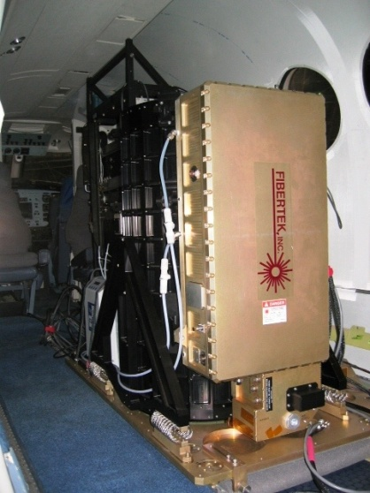
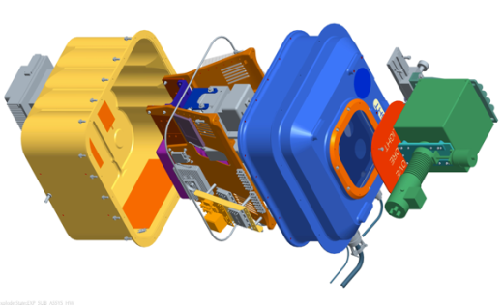
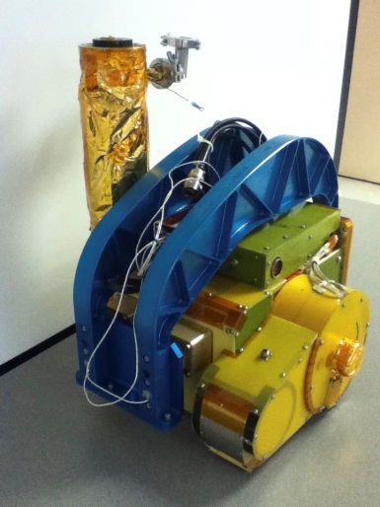
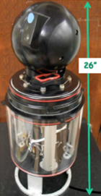
High Spectral Resolution Lidar (HSRL)
GeoCAPE Airborne Simulator (GCAS)
Airborne Remote Sensing
Aerosol backscatter
Aerosol extinction
Aerosol/cloud depolarization
Ocean diffuse attenuation
Ocean particulate backscatter
Chlorophyll concentration
Ocean cDOM absorption
Ocean particulate backscatter coefficient
Diffuse attenuation coefficient
Slant column atmospheric NO₂ & O₃
Euphotic depth
Research Scanning Polarimeter (RSP)
Spectrometer for Sky-Scanning, Sun-Tracking Atmospheric Research (4STAR)
Spectrometer for Sky-Scanning Sun-Tracking Atmospheric Research (4STAR)
High Spectral Resolution Lidar (HSRL)
GeoCAPE Airborne Simulator (GCAS)
Aircraft remote sensing atmosphere and ocean measurement
Research Scanning Polarimeter (RSP)
Spectral total & aerosol optical depth
Spectral cloud-transmitted zenith radiance
Trace gas column amounts (H₂O, NO₂, O₃)
Aerosol optical depth
Aerosol effective radius & variance
Aerosol single scatter albedo
Cloud top effective radius & variance
Cloud mean effective radius & variance
Cloud optical depth
Liquid water path
Cloud thickness
Cloud droplet number
Water leaving radiance
Chlorophyll concentration
Ocean cDOM absorption
Ocean particulate backscatter coefficient

Slide 10
Deployments

Slide 11
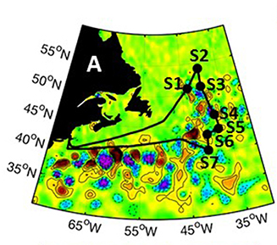
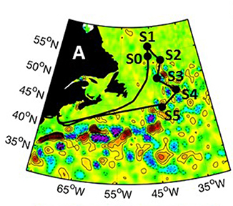
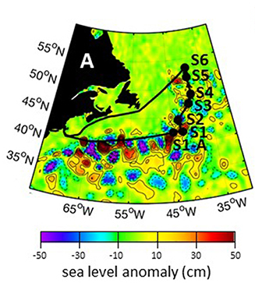
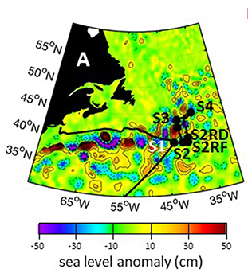
Field Campaigns
NAAMES 1
NAAMES 2
NAAMES 3
NAAMES 4
red = anticyclone
blue/purple = cyclone
Notes:
Cruise tracks plotted on top of sea level anomaly – provides a sense of the physical dynamics of the region.
NAAMES deployment plan was very flexible and stations were targeted to eddy and non-eddy water masses.
NAAMES was a logistically ambitious mission, with field campaign planned for periods when weather conditions in the subarctic Atlantic can be extremely inhospitable
Only during NAAMES 4 did the northern extent of the primary science transect get shorted due to weather

Slide 12
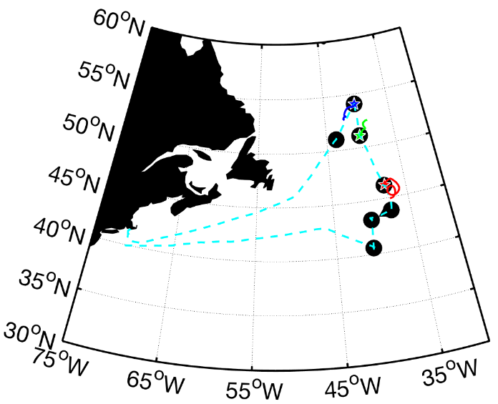
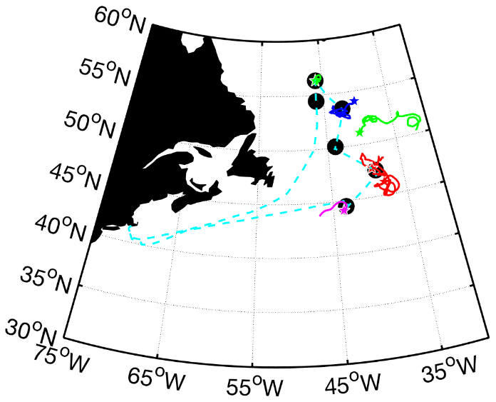
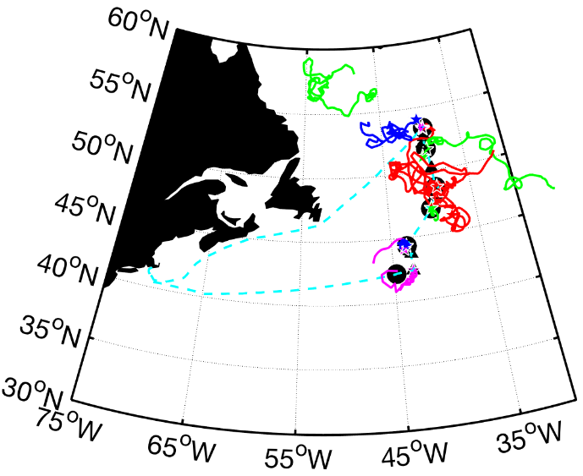
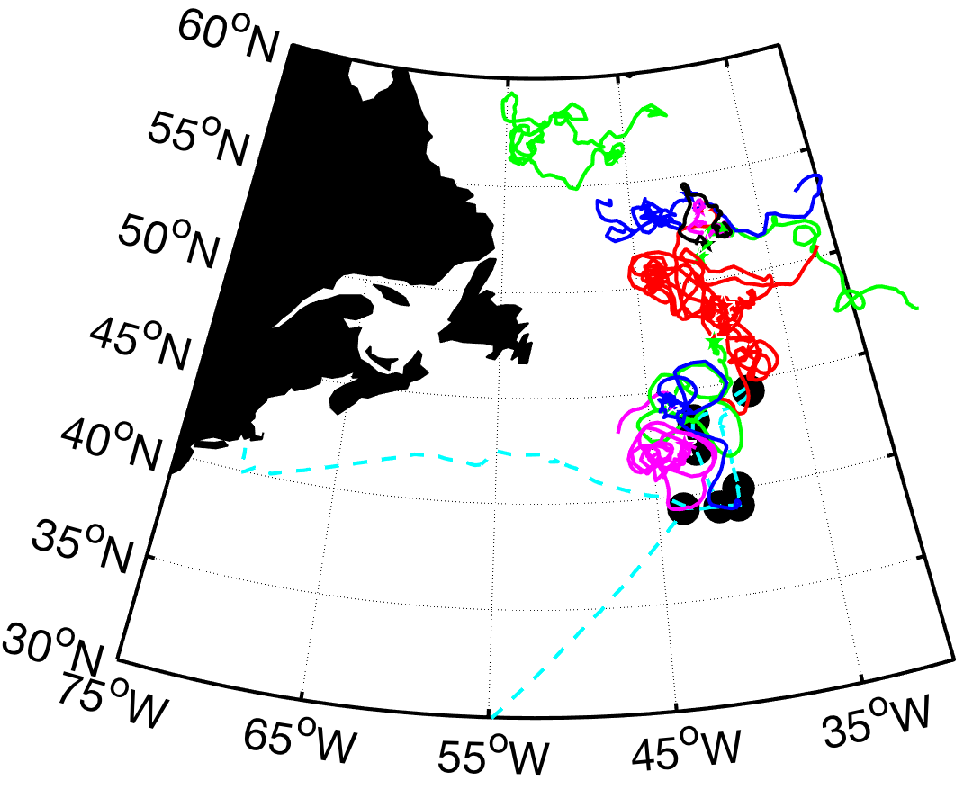
Field Campaigns
NAAMES 1
NAAMES 2
NAAMES 3
NAAMES 4
Ship Summary
Total stations | 32
cyclone | 7
anticyclone | 8
outside | 17
station w/float | 19
Transect data | 30K km
DAAC data | 63 GB
Notes:
Remember to explain what the colors mean
Bio-optical floats were deployed during NAAMES 1 – 3, targeting retentive eddies as much as possible
Floats not only provided longer term context, but also were targets for subsequent cruise stations
Stars show float deployment sites. Stars that are not on a black circle station were deployed during a previous cruise

Slide 13
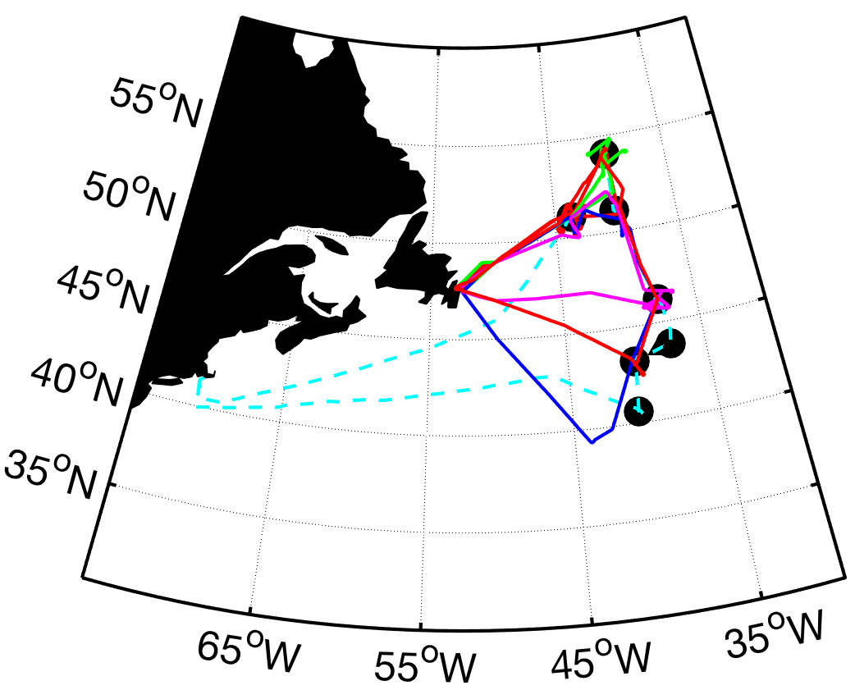
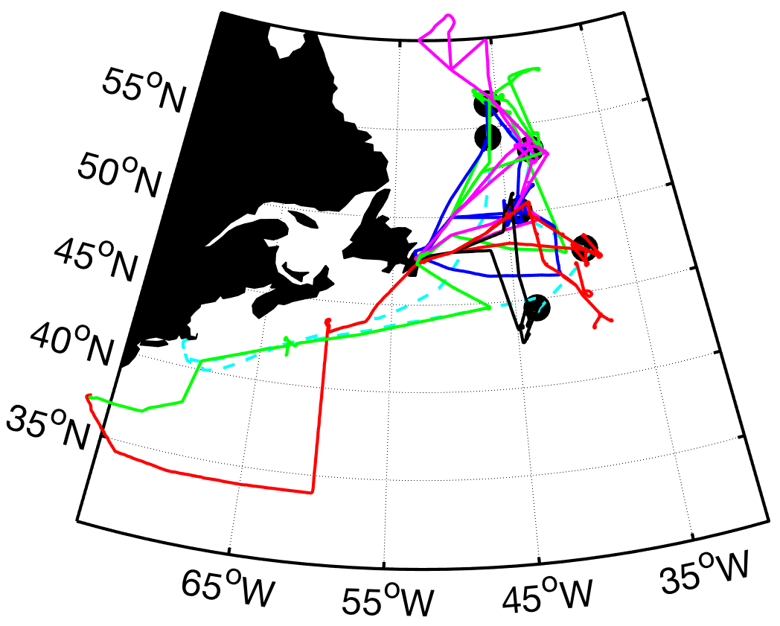
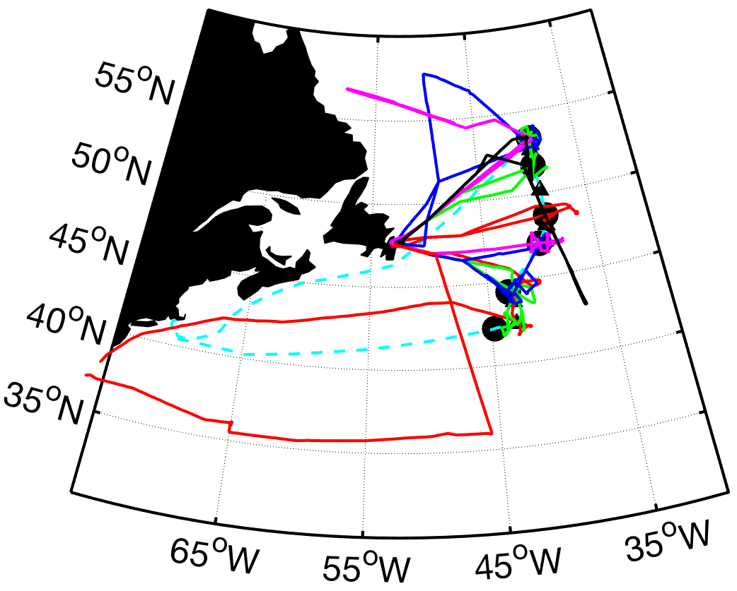
Field Campaigns
NAAMES 1
NAAMES 2
NAAMES 3
Statistic | NAAMES 1 | NAAMES 2 | NAAMES 3 | Total
Number Flights | 5 | 11 | 10 | 26
Flight Hours | 48 | 107 | 99 | 254
Total Distance (nm) | 11,814 | 26,330 | 24,317 | 62,461
Number Station Visits | 18 | 19 | 17 | 54
Float Over-flights | 6 | 3 | 10 | 19
CALIPSO Under-flights | 1 | 3 | 1 | 5
Total Flight Data (GB) | 6 | 11 | 8 | 25
Notes:
Remember to explain what the colors mean
no flights during NAAMES 4
on stations, we conducted pattern shown on chart 21

Slide 14
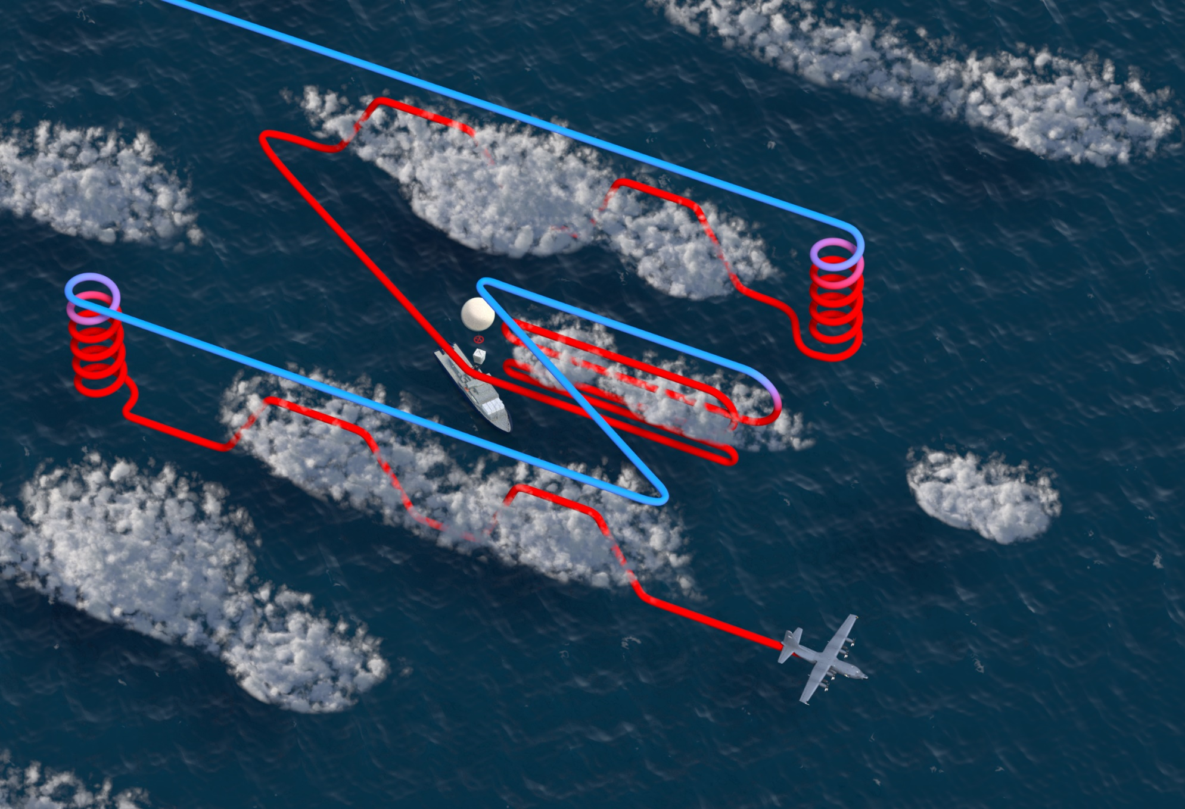
Field Campaigns
Station Flight Modules
Notes:
C-130 flights were important for gaining broader scale context for ship based measurements
When at station, the aircraft flight pattern collected measurements along a ‘z pattern’ to understand both horizontal and vertical variability in properties

Slide 15
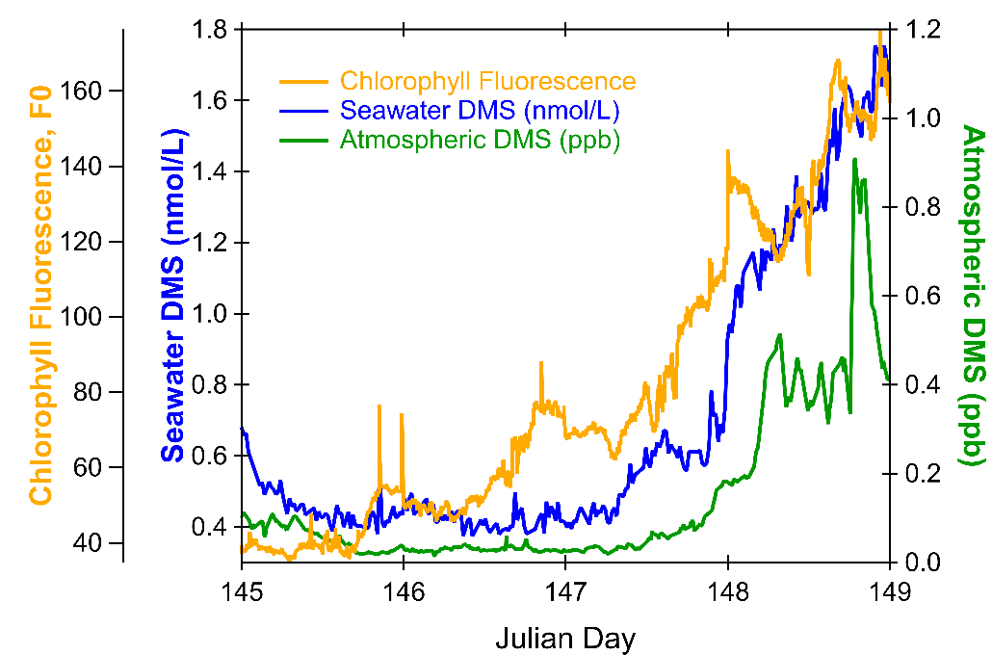
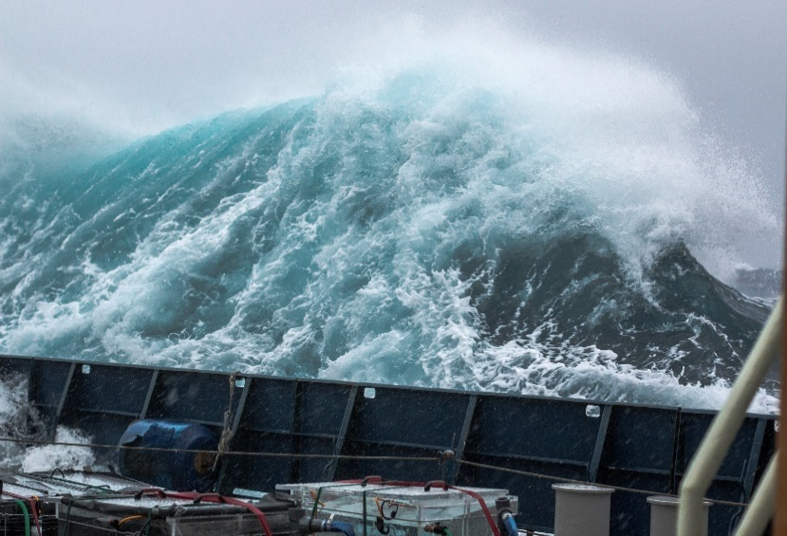
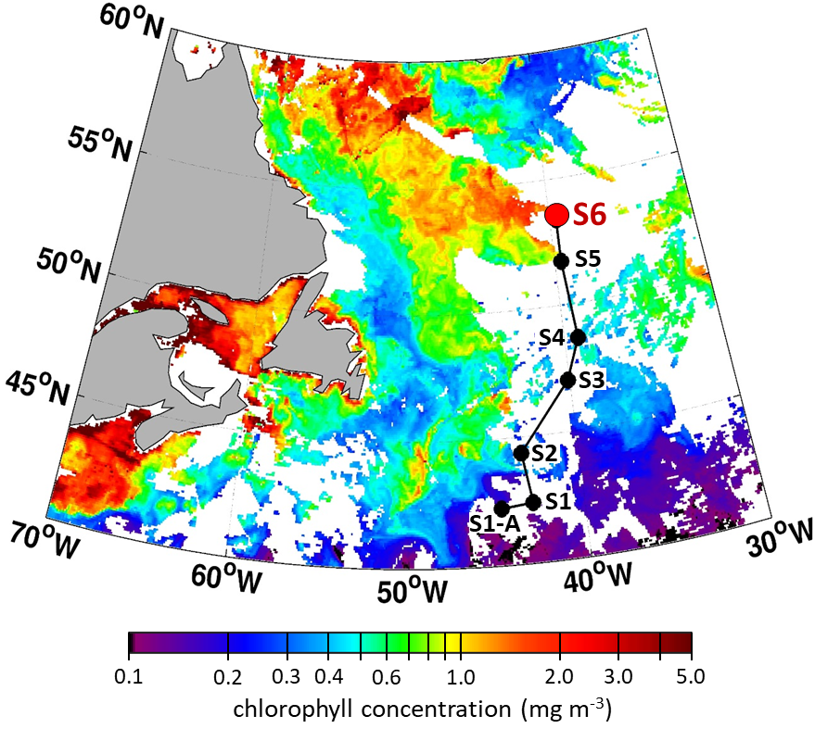
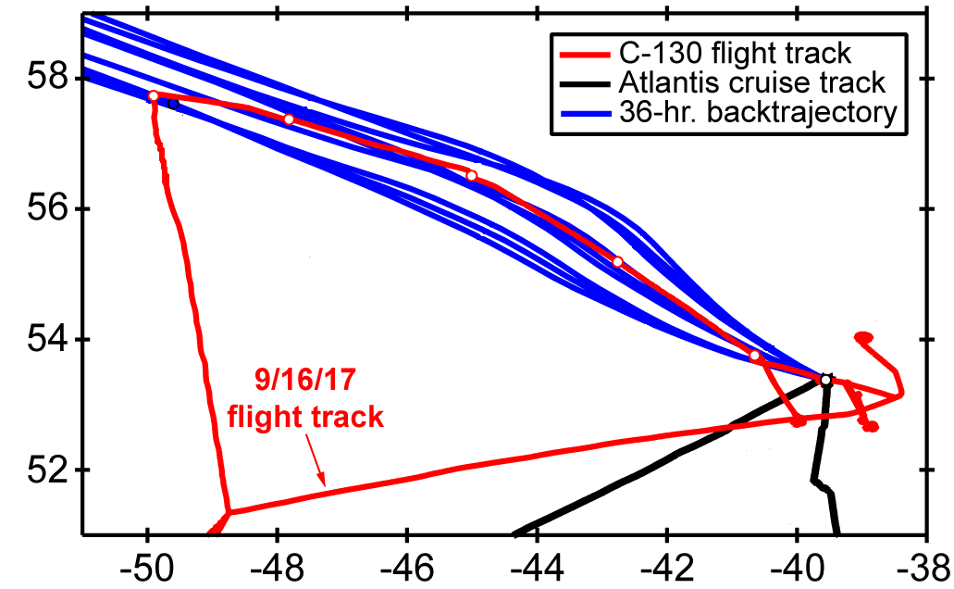

Field Campaigns
Event Responses
NAAMES 2
NAAMES 3
latitude
longitude
Notes:
NAAMES deployment flexibility allowed us to respond to unique and unforeseen events
During NAAMES 2, a large storm passed between stations 3 & 4 and mixed the water column to >200 meters, which was followed by 4 days of calm conditions
This allowed us to witness first hand a ‘disturbance – recovery’ event
We stayed on station for 4 days
Documented a thorough predator-prey uncoupling and tempo of recoupling, observed a bloom in phytoplankton, measured associated changes in in community composition and carbon cycling through the food web, and witnessed the relationship between blooming and subsequent seawater DMS levels
NAAMES 3 was targeting the declining phase of the annual cycle
A satellite image became available near the end of the primary transit (we were heading north this time) that indicated a large stock of phytoplankton
Assuming this was a dying population, we set up station 6 to target this event
We extended the duration of Station 6 and flew upwind transits to sample the air moving toward the station

Slide 16
Scientific Outcomes

Slide 17
Overall: Blooms and Community Composition
Observed annual cycle in plankton properties are consistent with the Disturbance-Recovery Hypothesis
‘Declining’ and ‘Recovery’ phase appear to be driven by minor temporal lags between phytoplankton growth and predatory losses
Surprise: Expectation of large diatom dominance during bloom climax was not upheld in the Western North Atlantic, likely due dampened magnitude of environmental variability and its link to size-dependent physiological adaptations

Slide 18
Overall: Ecosystems, Aerosols, & Clouds
Ocean emissions are often more important to aerosol burden than long-range continental transport in regions like the NAAMES study site
Production of precursor gases depends on ocean ecosystem community composition
Sulfate aerosols of marine origin are major sources of cloud condensation nuclei during biologically productive seasons
Surprise: Ocean ecosystems in the Western North Atlantic appear to have a minor impact on the organic content and CCN activity of primary sea-spray aerosols

Slide 19

Topic | Published | In Review | Draft | Total
1. Aerosols & Clouds | 2 | 1 | 0 | 3
2. Biochemistry | 2 | 1 | 1 | 4
3. Modeling/Algorithms | 4 | 2 | 1 | 7
4. Ocean Chemistry | 1 | 0 | 0 | 1
5. Ocean Ecosystems | 15 | 4 | 8 | 27
6. Ocean Optics | 1 | 0 | 0 | 1
7. Ocean Physics | 4 | 2 | 0 | 6
8. Oceans & Aerosol | 6 | 1 | 0 | 7
9. Remote Sensing | 14 | 0 | 0 | 14
10. Other Value Added Science | 4 | 0 | 0 | 4
Total >> | 53 | 12 | 10 | 75
NAAMES Publications
Go to: https://naames.larc.nasa.gov/ > Science > Publications for details
NAAMES Overview: Behrenfeld et al. 2019. Frontiers Mar. Sci.
Blooms Overview: Behrenfeld & Boss 2018. Global Change Biol.
NAAMES Special Issue (contributions still increasing)

Slide 20
Public Release Dates
Deployment | Atmosphere (ASD-AC) | Ocean (SeaBASS)
2015 | 02/15/2016 | 02/15/2016
2016 | 07/14/2017 | 08/15/2017
2017 | 11/15/2018 | 11/15/2018
2018 | 04/26/2019 | 09/30/2019
NAAMES Data Public Access Summary
100% of NAAMES Ocean and Atmospheric data are currently available through a NASA DAAC or other public archive*
* Profiling float data and IFCB images are not compatible with SeaBASS format and are archived in the ARGO GDAC and EcoTaxa, respectively.

Slide 21
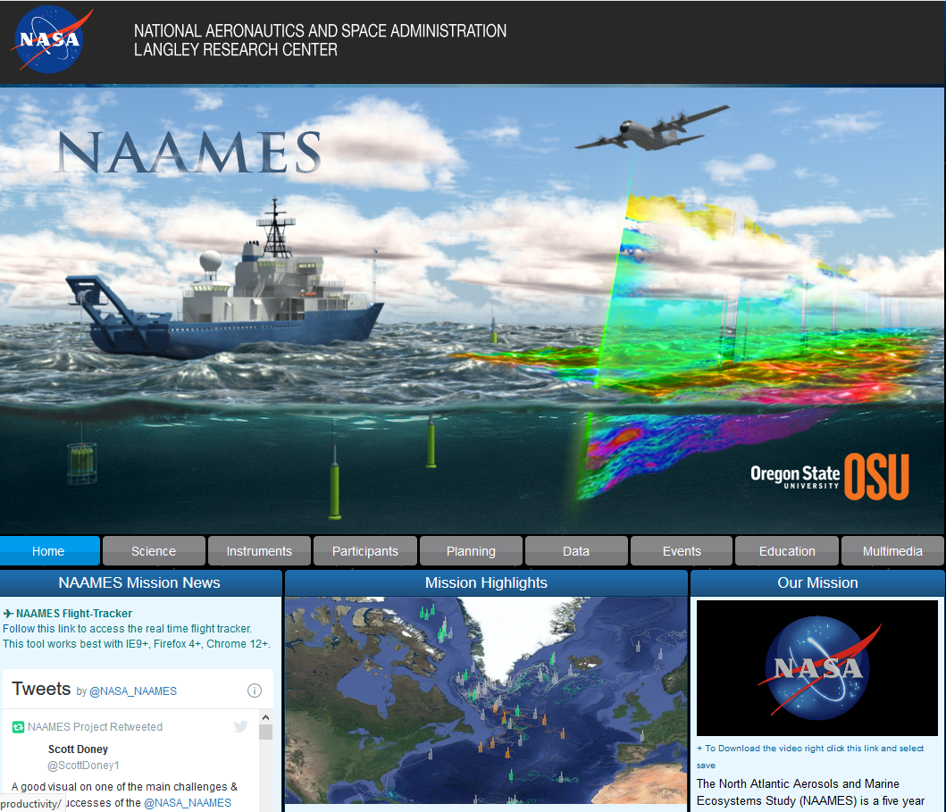
https://naames.larc.nasa.gov/
Visit the NAAMES website for lots more!

Slide 22

Thanks

Slide 23
NAAMES Science Question #1: How do environmentally-driven changes in phytoplankton growth rate and ecosystem interactions create a spring bloom, and what does this imply about future change?
Plankton Stocks
Ocean Optical Properties
Plankton Rates & Physiology
Physical & Chemical Properties
NAAMES Science Question #2: How are seasonal changes in community composition linked to bloom formation?
Plankton Stocks
Ocean Optical Properties
Plankton Community Composition
Physical & Chemical Properties
Interdisciplinary Questions
NAAMES Science Question #3: How do ocean-ecosystem emissions alter remote marine aerosol burden, spatial distribution, and properties?
Plankton Stocks
Aerosol, Gas Composition
Aerosol Microphysical Properties
Physical & Chemical Properties
Continental / Anthropogenic Influences
Marine Aerosol Precursors & Sea-Air transfer
NAAMES Science Question #4: How do these biogenic aerosols affect Cloud Condensation Nuclei abundance and, in turn, cloud microphysical properties?
Aerosol, Gas Composition
Aerosol Microphysical Properties
Cloud Microphysical Properties
Continental / Anthropogenic Influences

