Slide 1
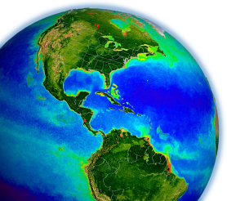
NASA OBPG
Satellite Ocean Color Update
Bryan Franz
and the
Ocean Biology Processing Group
NASA Goddard Space Flight Center
Ocean Color Research Team Meeting
26 & 28 May 2020
Virtual

Slide 2
Contents
Status of MODIS, VIIRS ocean color data quality
Temporal calibration issue with VIIRS on SNPP
Plans for the next multi-mission ocean color reprocessing
Evolution of SeaDAS

Slide 3
Current Ocean Color Processing Version R2018.0
Completed
VIIRS/SNPP (Dec 2017), MODIS/Aqua (Jan 2018), February 2018 (SeaWiFS), MODIS/Terra (April 2018), and VIIRS/JPSS1 (Sep 2018)
Purpose
incorporate updates to vicarious calibration due to revised MOBY time-series
incorporate updates to instrument calibration
no algorithm changes since R2014.0
first processing for VIIRS on JPSS-1
algorithms identical to SNPP VIIRS
instrument calibration as-is (no temporal calibration)
used SNPP for vicarious cal

Slide 4
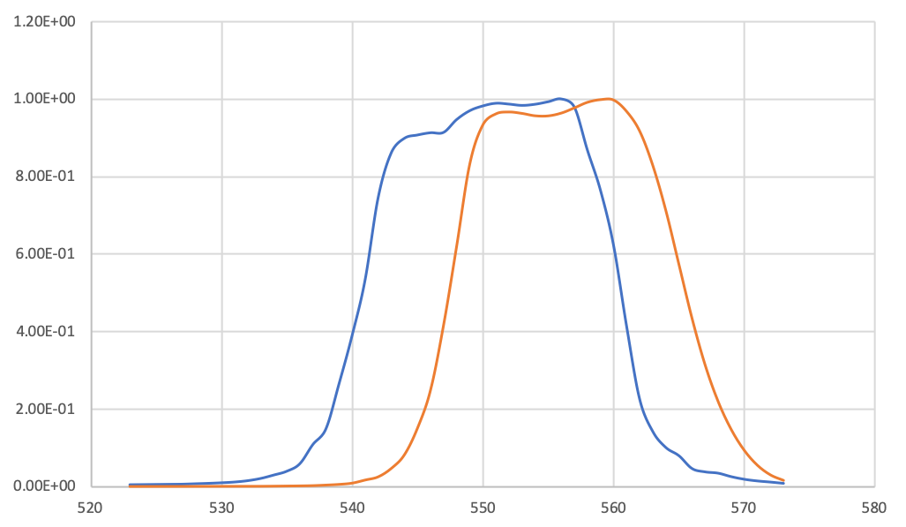
VIIRS Spectral Band Centers and Widths
Band Center and FWHM (nm)
SNPP VIIRS | J1 VIIRS
410 (20) | 411 (18)
443 (15) | 445 (17)
486 (19) | 489 (19)
551 (20) | 556 (18)
671 (19) | 667 (19)
745 (14) | 746 (13)
862 (38) | 868 (36)
1238 (26) | 1238 (26)
1601 (60) | 1604 (60)
2257 (46) | 2258 (52)
Relative Spectral Response of Band 4
JPSS1
SNPP
Wavelength (nm)

Slide 5
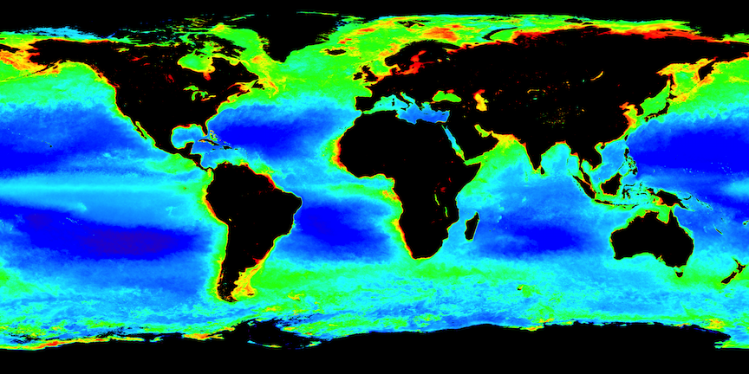


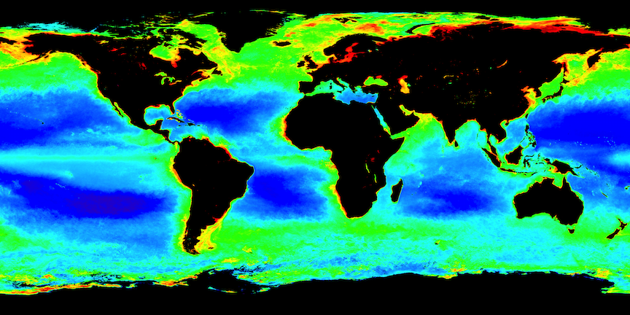
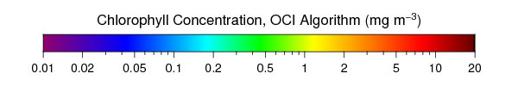
Annual Mean Chlorophyll Concentration for 2018
VIIRS
JPSS-1
SNPP
MODIS
Aqua
Terra

Slide 6
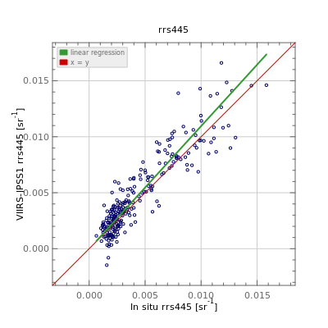
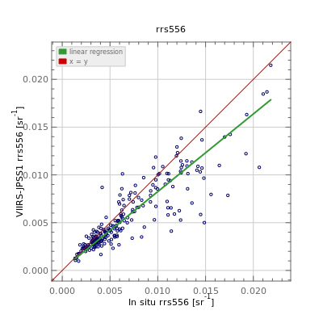
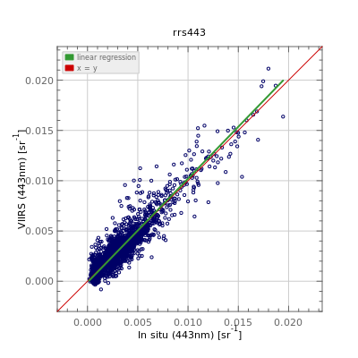
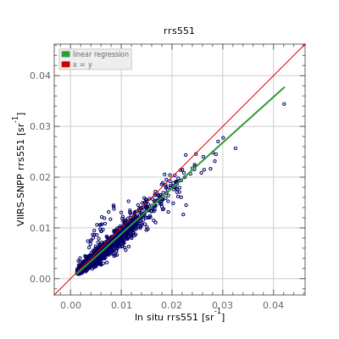
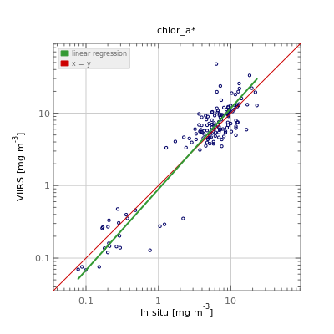
VIIRS R2018.0 Validation
Rrs(445)
Rrs(556)
Match-ups to SeaBASS and AERONET-OC
VIIRS/SNPP Rrs and Chlorophyll in very good agreement with in situ
VIIRS/JPSS1 Rrs in good agreement, but with larger differences based on limited match-ups
VIIRS/SNPP showed significant reduction in bias from R2014 to R2018 (not shown)
JPSS1
Bias = +0.0004 sr⁻¹
Bias = -0.0012 sr⁻¹
Chlorophyll
SNPP
Bias = +0.0000 sr⁻¹
Bias = -0.0007 sr⁻¹
Bias = 4%

Slide 7
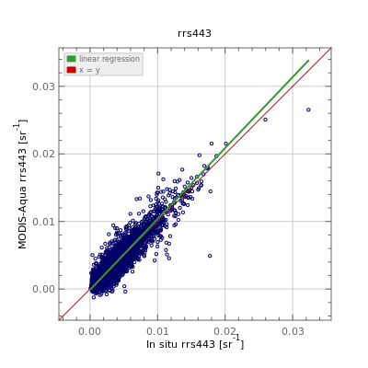
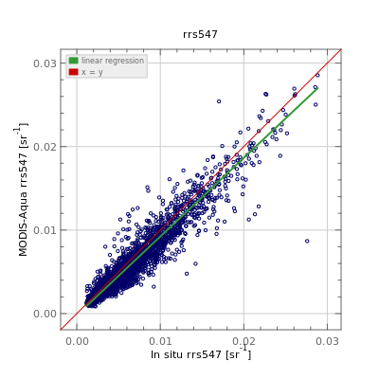
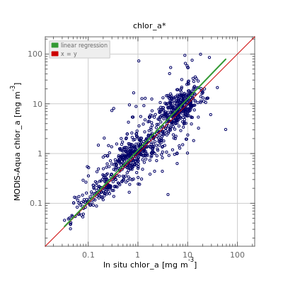
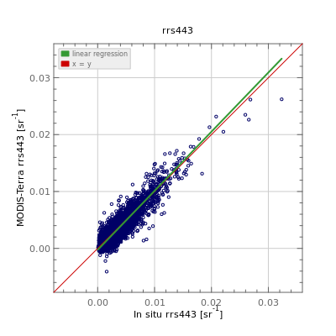
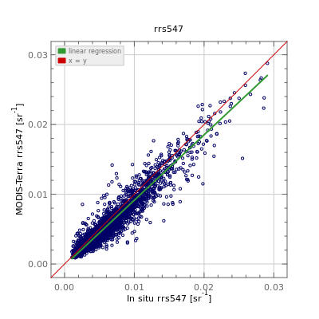
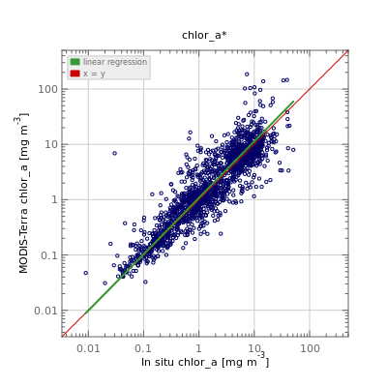
MODIS R2018.0 Validation
Rrs(443)
Rrs(547)
Chlorophyll
Match-ups to SeaBASS and AERONET-OC
MODIS Rrs and Chl from Aqua and Terra in good agreement with in situ
Mean bias in Rrs remains near zero
MODIS showed significant reduction in bias from R2014 to R2018 (not shown)
Aqua
Bias = +0.0001 sr⁻¹
Bias = -0.0005 sr⁻¹
Bias = 18%
Terra
Bias = -0.0001 sr⁻¹
Bias = -0.0006 sr⁻¹
Bias = 9%

Slide 8
In situ Rrs Match-up Statistics
field data from AERONET-OC and SeaBASS
λ (nm) | Mean Bias (sr⁻¹) |  | MAE (sr⁻¹)
 | Aqua | Terra | Aqua | Terra
412 | 0.00001 | -0.00031 | 0.00102 | 0.00106
443 | 0.00005 | -0.00014 | 0.00077 | 0.00079
488 | -0.00054 | -0.00053 | 0.00079 | 0.00078
531 | -0.00055 | -0.00053 | 0.00078 | 0.00076
547 | -0.00050 | -0.00055 | 0.00078 | 0.00079
555 | -0.00079 | -0.00080 | 0.00094 | 0.00094
667 | -0.00017 | -0.00018 | 0.00029 | 0.00030
678 | -0.00016 | -0.00019 | 0.00033 | 0.00036
λ (nm) | Mean Bias (sr⁻¹) |  | MAE (sr⁻¹)
 | JPSS1 | SNPP | JPSS1 | SNPP
410 | -0.00072 | -0.00036 | 0.00130 | 0.00105
443 | 0.00041 | 0.00002 | 0.00110 | 0.00077
486 | -0.00062 | -0.00063 | 0.00108 | 0.00088
556(1) | -0.00115 | -0.00071 | 0.00150 | 0.00088
671 | -0.00034 | -0.00020 | 0.00050 | 0.00029
MODIS (Aqua & Terra) and VIIRS/SNPP show very similar agreement with in situ measurements
MODIS/Terra does shows larger biases in blue bands relative to MODIS/Aqua
VIIRS/JPSS1 shows larger Mean Bias and MAE, based on limited match-ups, with no temporal calibration and no vicarious cal to MOBY

Slide 9
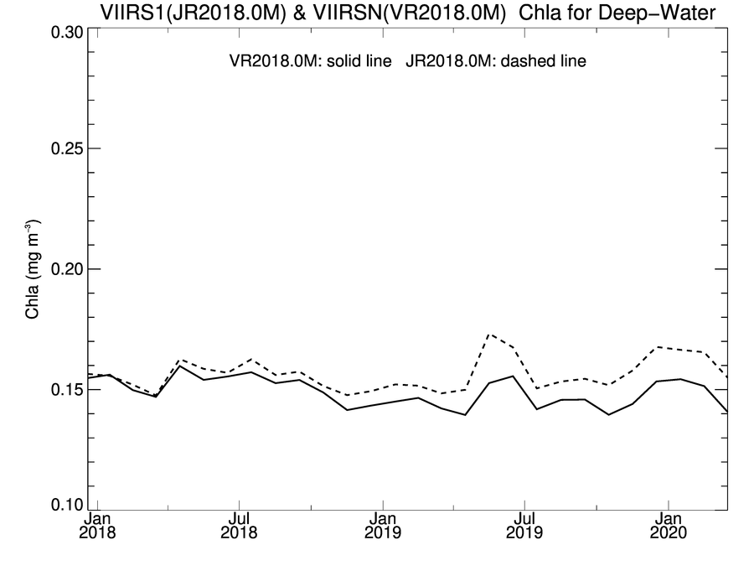
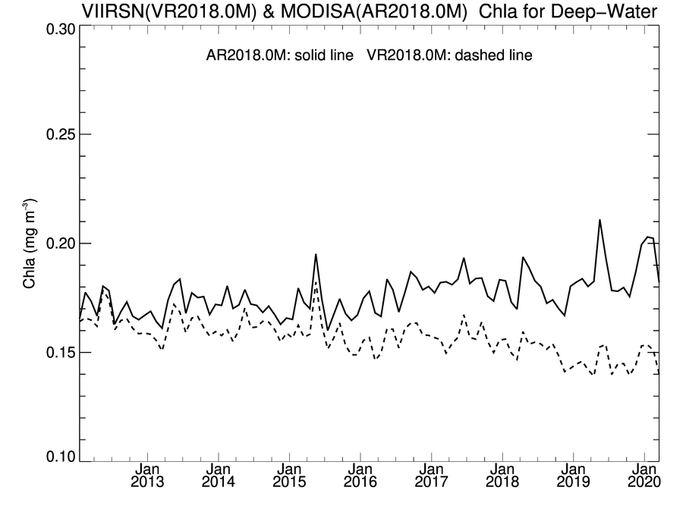
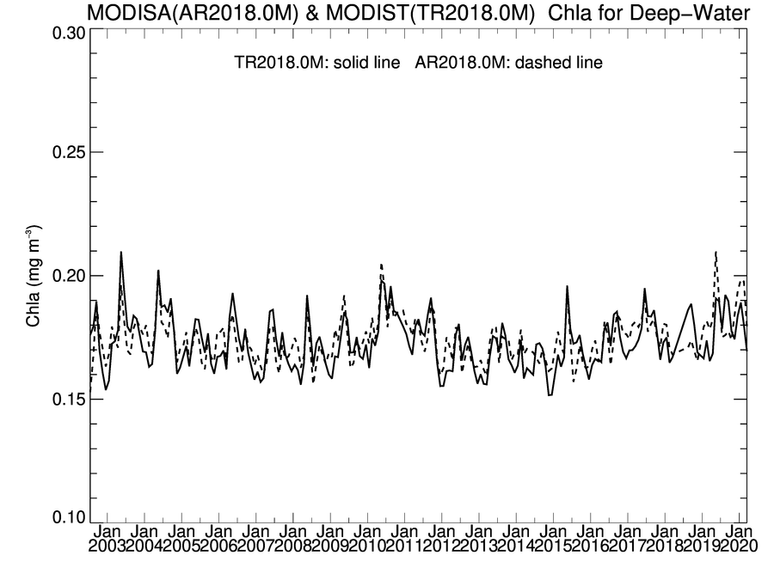
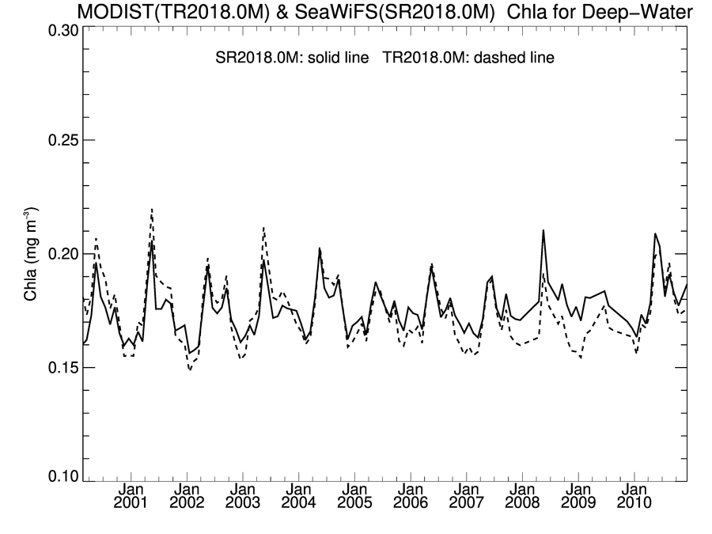
Global Deep-Water Chlorophyll Trends
Comparison trends over common mission lifetime
VIIRS/SNPP shows negative trend relative to VIIRS/JPSS1 & MODIS/Aqua
SeaWiFS, MODIS/Terra, MODIS/Aqua in good agreement, with short-term deviations
VIIRS/JPSS1 & VIIRS/SNPP
VIIRS/SNPP & MODIS/Aqua
Chl (mg m⁻³)
Chl (mg m⁻³)
MODIS/Aqua
VIIRS/JPSS1
VIIRS/SNPP
VIIRS/SNPP
MODIS/Aqua & MODIS/Terra
MODIS/Terra & SeaWiFS
Chl (mg m⁻³)
Chl (mg m⁻³)

Slide 10
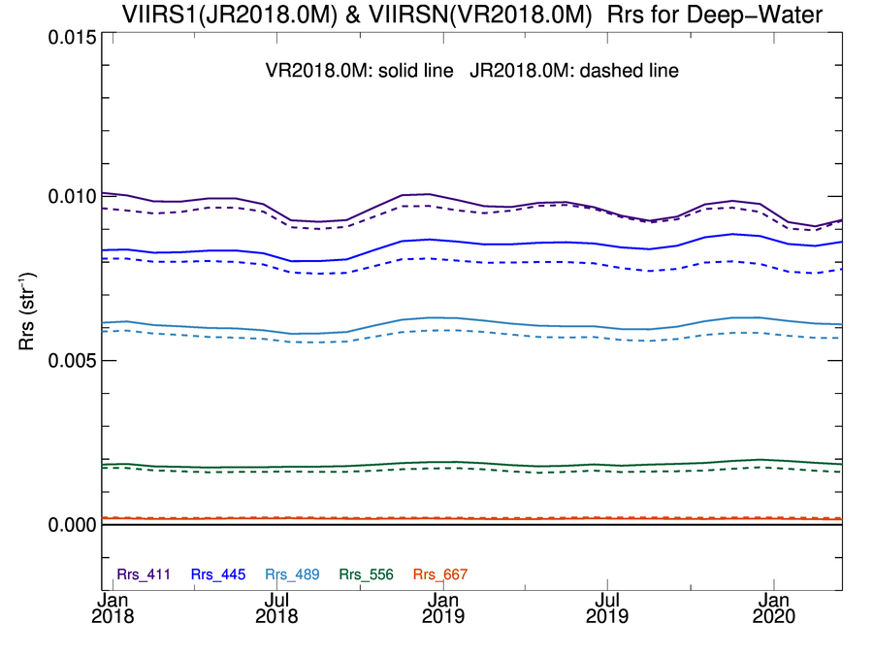
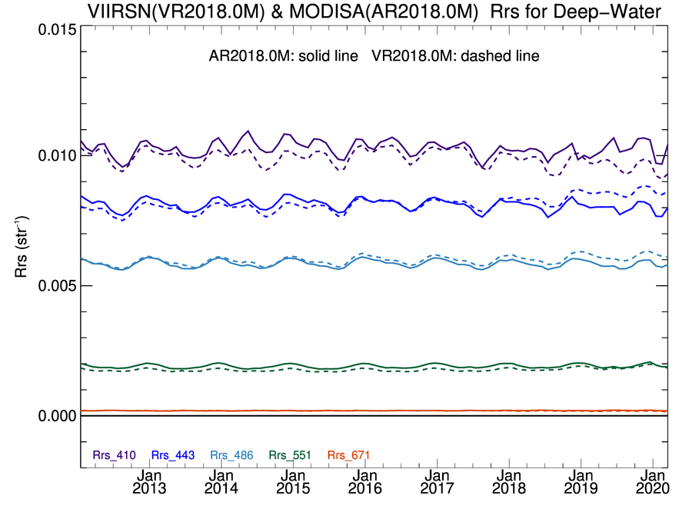
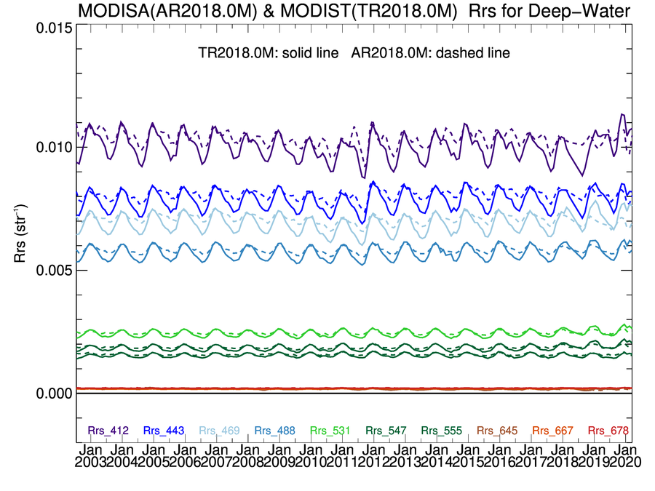
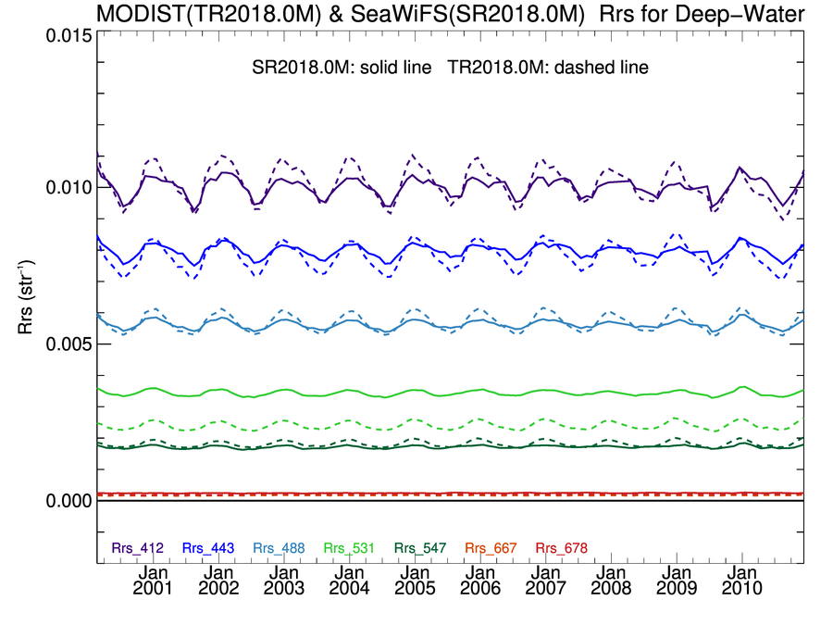
Global Deep-Water Rrs Trends
Comparison trends over common mission lifetime
VIIRS/SNPP shows bias and trends in blue relative to MODIS/Aqua and VIIRS/JPSS1
SeaWiFS, MODIS/Aqua, and MODIS/Terra show good agreement.
VIIRS/JPSS1 & VIIRS/SNPP
VIIRS/SNPP & MODIS/Aqua
Rrs (sr⁻¹)
Rrs (sr⁻¹)
MODIS/Aqua & MODIS/Terra
MODIS/Terra & SeaWiFS
Rrs (sr⁻¹)
Rrs (sr⁻¹)

Slide 11
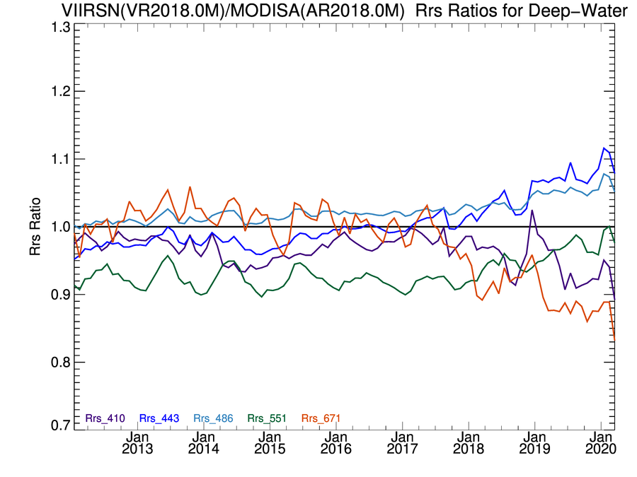
VIIRS/SNPP & MODIS/Aqua R2018.0 Rrs Ratios
VIIRS/SNPP & MODIS/Aqua
Comparison trends over common mission lifetime
positive trends in 443, 486, and 551,
negative trends in 412 and 671

Slide 12
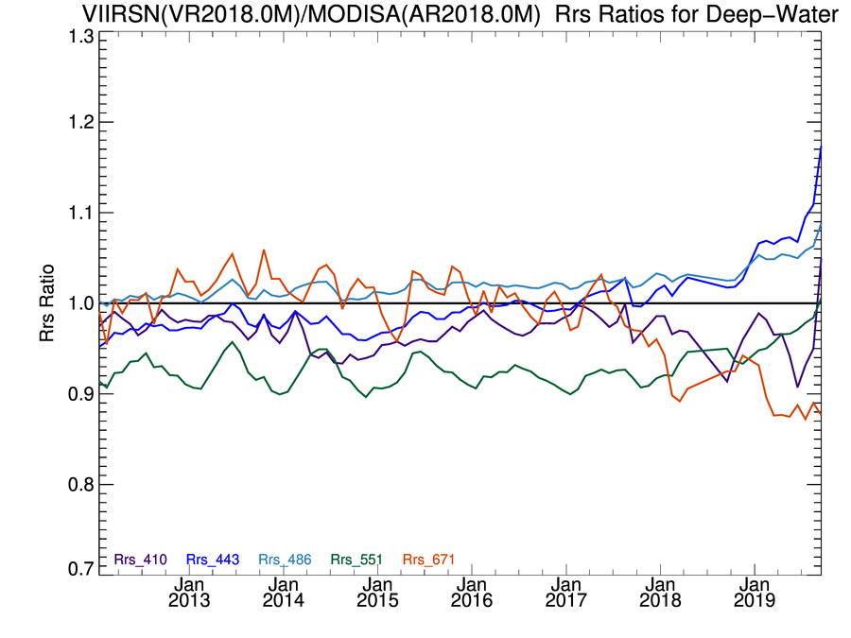
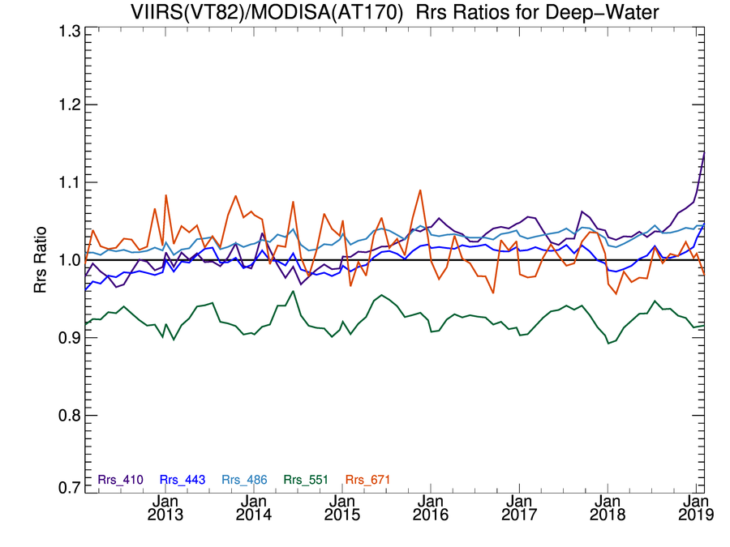
VIIRS/SNPP Calibration Update
VIIRS/SNPP & MODIS/Aqua
Calibration Changes for Next Reprocessing
extension of lunar/solar time-series with new measurements
revised model for temporal fit to lunar time-series (exponential in time + linear with libration), used to correct the solar time-series
no lunar correction applied to M5,6,7 (no detectable trend)
temporal gain adjustments for impact of modulated RSRs on ocean/atmosphere signal, for bands M1-M7
R2018.0
Rrs Ratio
Test Processing
Impact to Rrs Timeseries
reduces trends in blue relative to MODIS/Aqua (and J1 VIIRS)
brings 412 into family with other blue bands (443, 486), suspect trends reduced
testing/refinements on-going in preparation for reprocessing
Rrs Ratio

Slide 13
NASA Ocean Color Reprocessing 2020.0
Planning for Spring 2020, first major update of algorithms since R2014.0
updates to ancillary data sources
from NCEP/TOMS-OMI/etc. to MERRA-2 assimilation product
updates to atmospheric correction methods and tables
multi-scattering aerosol selection, improved gas corrections (H2O), bug in Rayleigh tables at extreme solar zenith, instrumental error propagation
updates to pure seawater optical properties (nw, aw, bbw)
apply temperature & salinity dependence (e.g., Werdell et al. 2013), bug in pure-water aw/bbw (off by few nm)
updates to masks and flags
reduced straylight masking (Hu et al. 2019, JGRO), absorbing aerosol flag based on MERRA-2 transport model
updates to derived product algorithms
Chl coefficient update (Hu et al. 2019, JGRO; O'Reilly and Werdell, 2019), PIC, PAR, etc.
new products
Rrs uncertainties (TBD), new standard/provisional products (TBD)

Slide 14
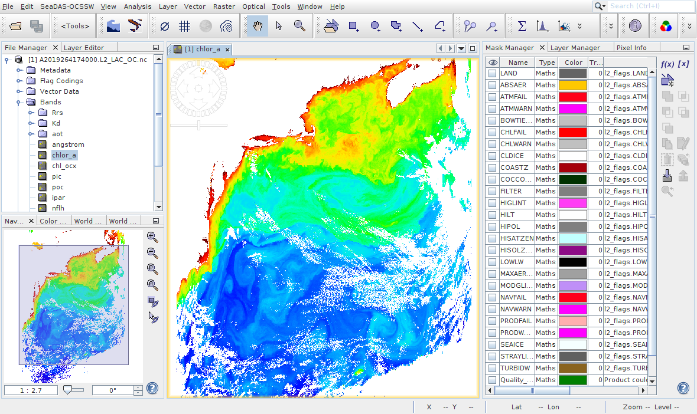
SeaDAS 8: moving from BEAM to SNAP
SeaDAS Toolbox
Released in 2019
Can be installed within the ESA SNAP
Contains NASA Ocean Color processing tools currently in SeaDAS 7.
SeaDAS 8
Beta release planned for Summer 2020
Built on SNAP framework, modified GUI
Includes SeaDAS-Toolbox and Sentinel-3 Toolbox (other ESA toolboxes can be installed)
Enables continuation of joint development in visualization tools and capabilities.
SeaDAS 8 Visualization
SNAP = Sentinel Application Platform
(developed for ESA by Brockmann Consult)

Slide 15
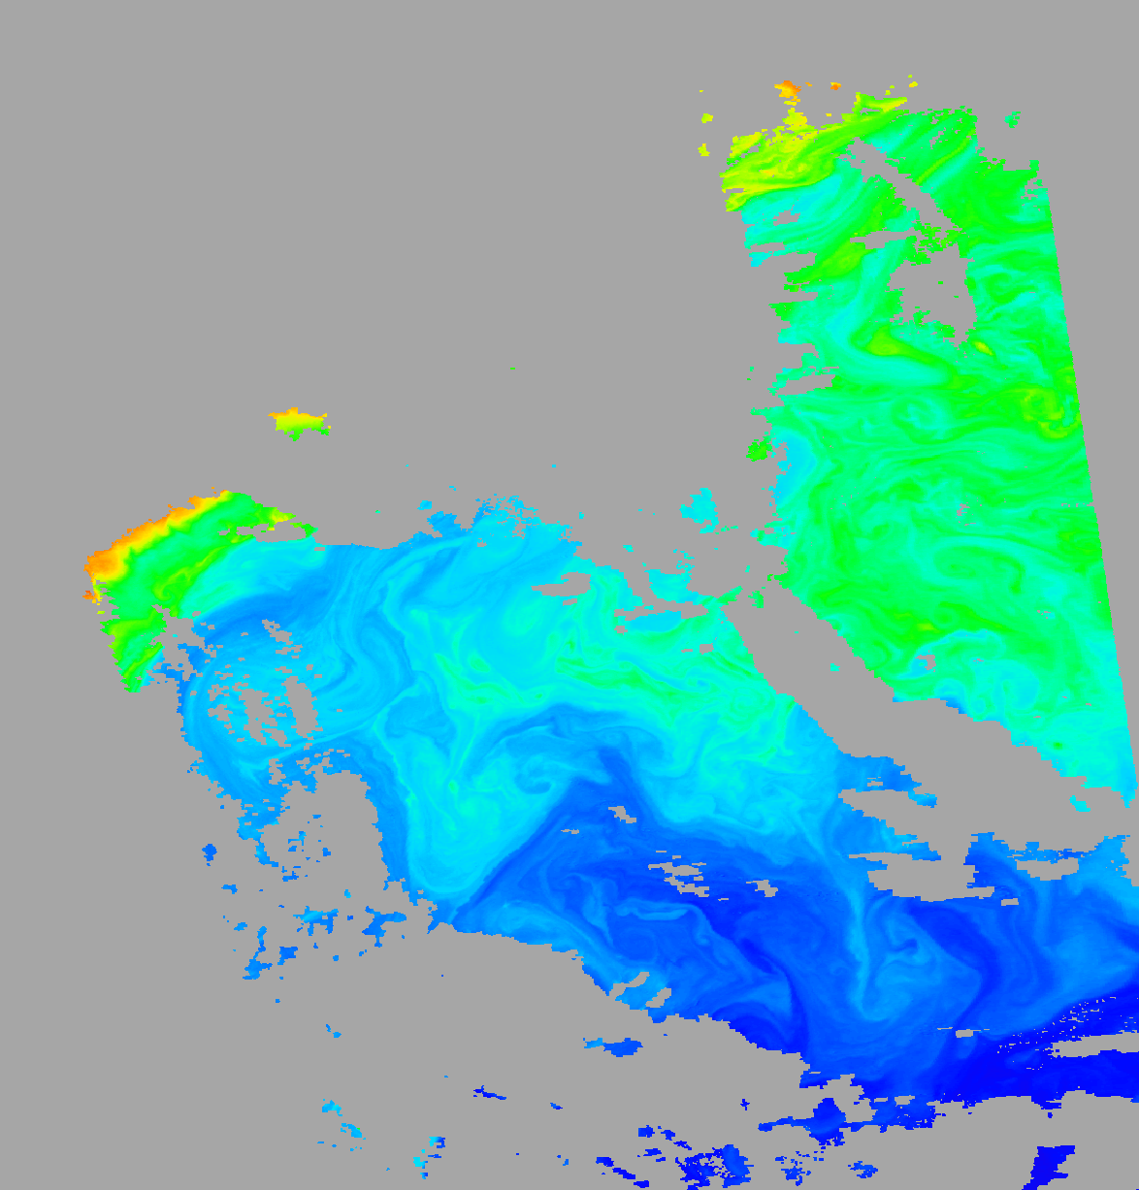
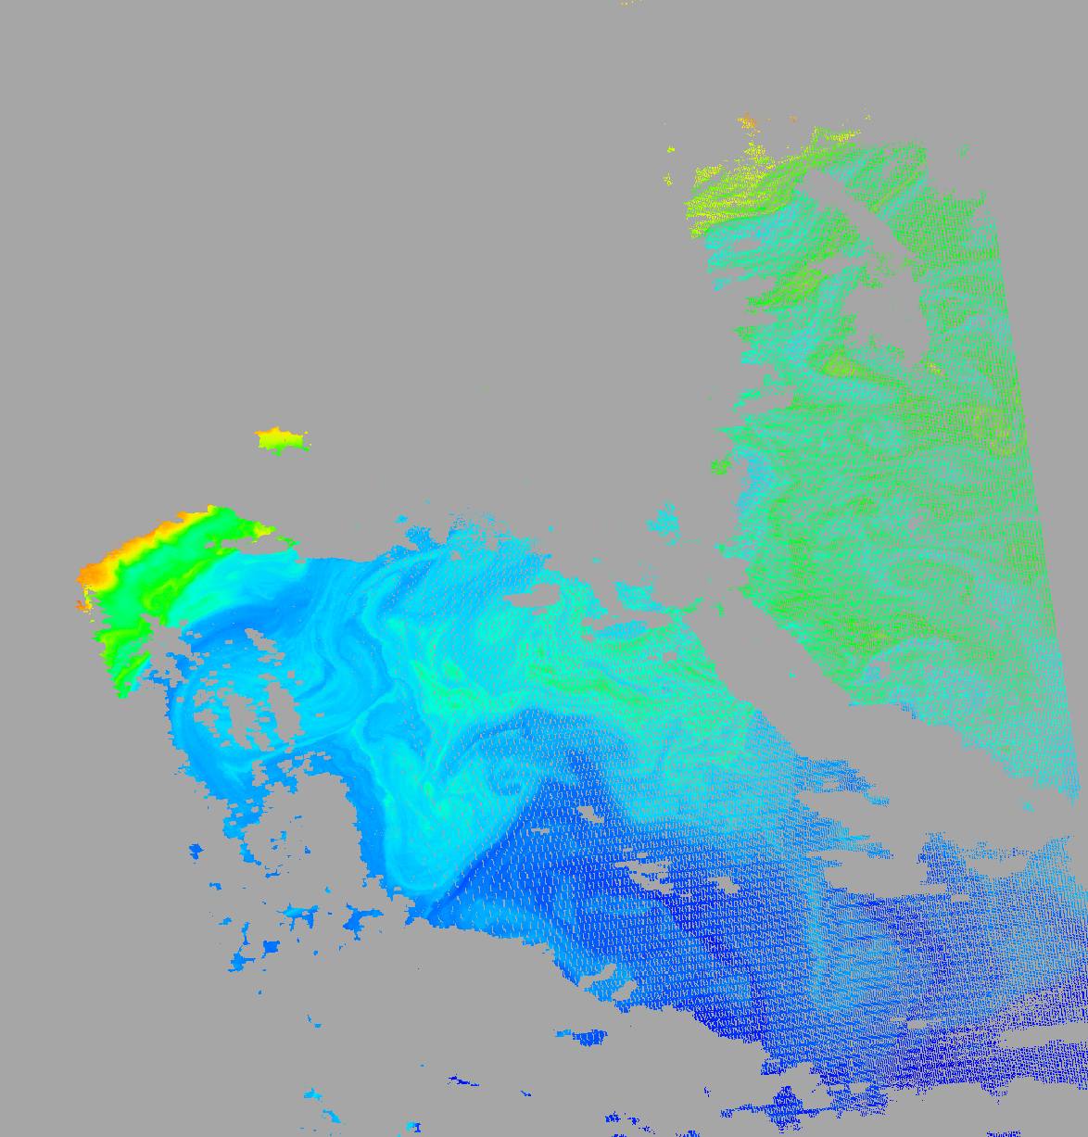
Higher Spatial Resolution Level-3 Products
Standard Level-3 products are based on binning from Level-2 native resolution into quasi-equal-area bins at 4.6x4.6km, using the center location of the observation.
Users frequently ask for higher resolution binned/mapped data products, or produce them with the standard binner in SeaDAS.
Result is poor quality imagery and invalid statistics due to pixel growth from nadir to scan edge.
OBPG developed an efficient mechanism to approximate the observational footprint of each pixel and weight the contribution into the fixed geographical bins.
Updated binner will be distributed with SeaDAS 8, and may be applied by OBPG to produce/distribute higher-resolution standard products.

Slide 16

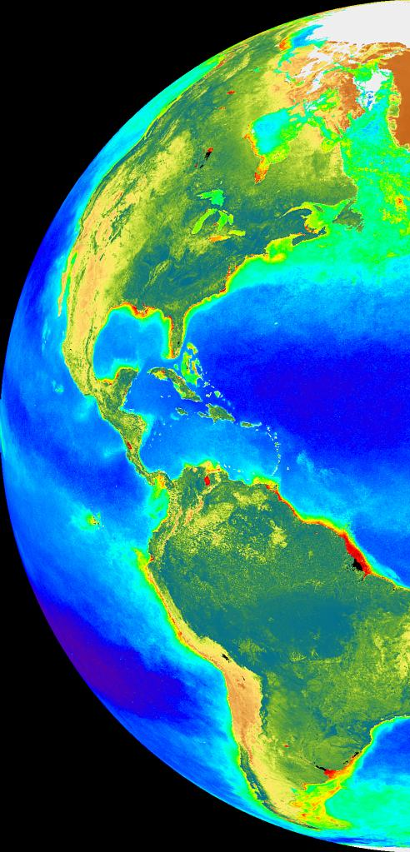
Summary
MODISA, MODIST, SeaWiFS R2018.0 looking good
SNPP VIIRS R2018.0 showing late-mission drifts, significant improvements expected with next reprocessing
JPSS1 VIIRS OC products now available, temporal calibration appears stable, vicarious calibration to MOBY should reduce biases
Consistently-processed L2/L3 OLCI products from S3A & S3B likely in next reprocessing (L1B currently available from OB.DAAC)
Still supporting GOCI, & heritage missions (SeaWiFS, HICO, etc.), and leveraging OBPG facilities for SeaHawk, PACE, and GLIMR
Next multi-mission ocean color reprocessing, R2020.0, now planned to start in Summer 2020 (calibration updates, algorithm refinements)

Slide 17

Questions?
Back-up

