Slide 1
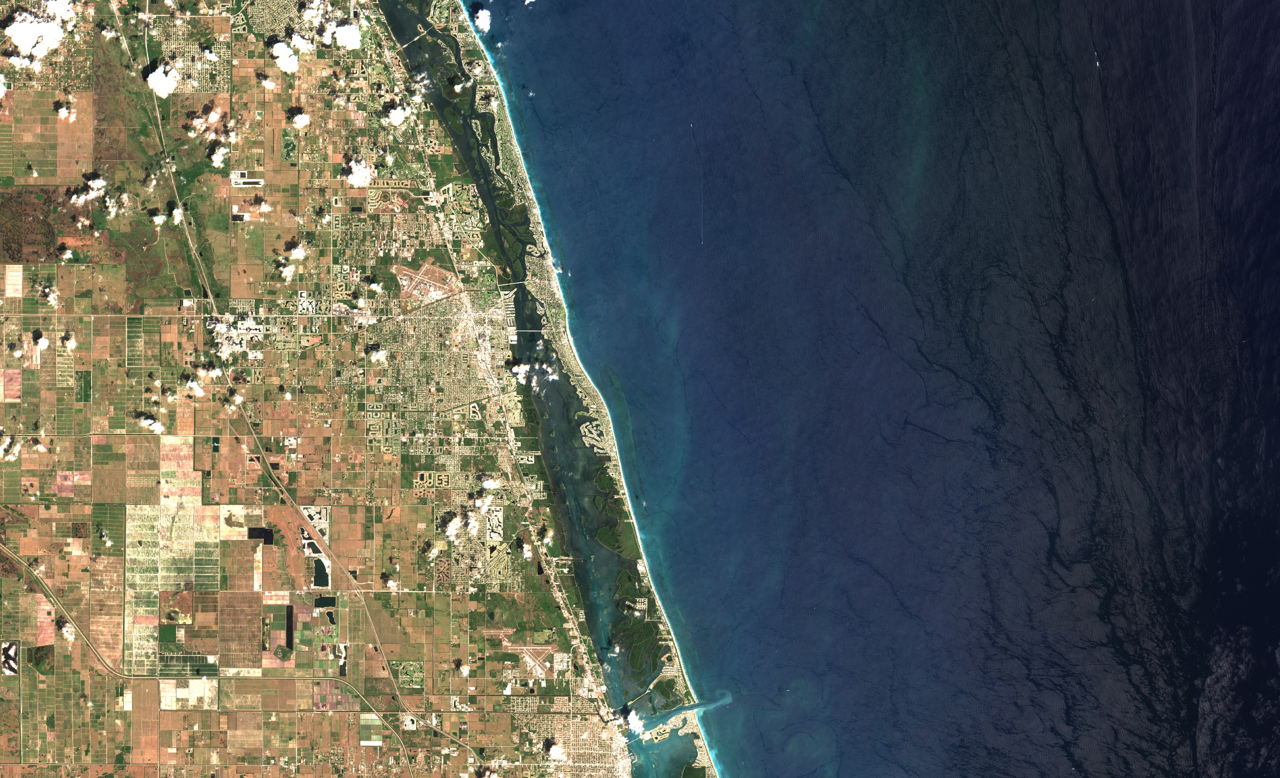
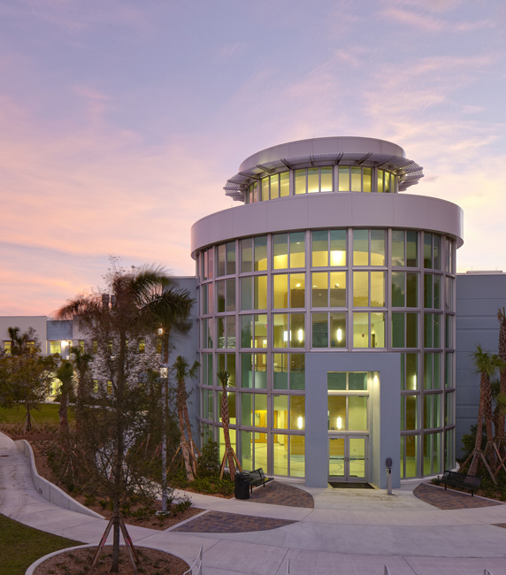

SlimSat-VNIR SlimSat-UV
Mike Twardowski
Bing Ouyang
Ed Malkiel
Graham Sandborn

Slide 2
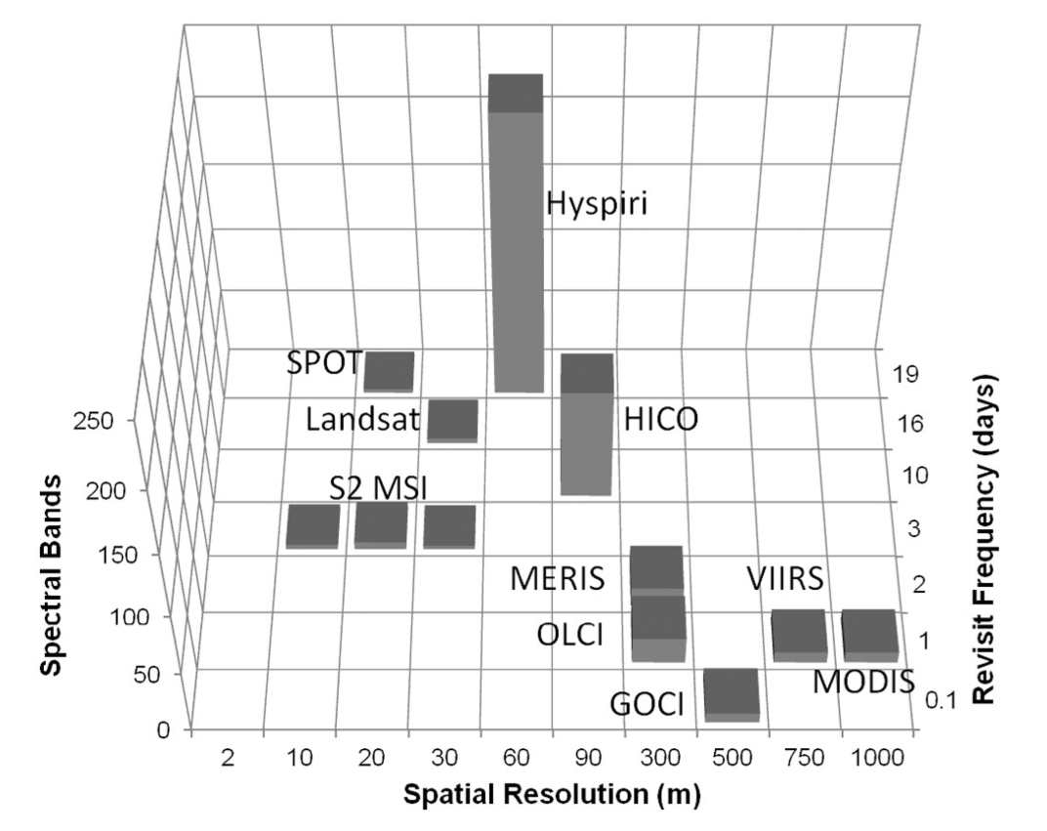
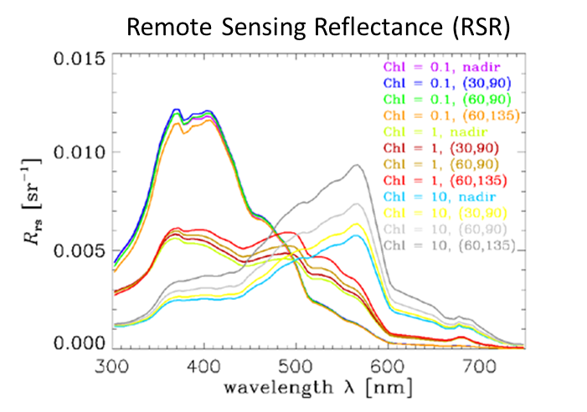
Global observer missions for ocean color
SBG
Mouw, Greb, Aurin, DiGiacomo, Lee, Twardowski, Binding, Hu, Ma, Moore, Moses, and Craig. 2015. Aquatic color radiometry remote sensing of coastal and inland waters: challenges and recommendations for future satellite missions. RSE, 160:15-30.
Hestir, Brando, Bresciani, Giardino, Matta, Villa, and Dekker. 2015. Measuring freshwater aquatic ecosystems: the need for a hyperspectral global mapping satellite mission. RSE, 167:181-195.

Slide 3
Coastal/inland missions for ocean color
SBG
CubeSat imaging systems have potential to supplement current and future global imagers
Mouw, Greb, Aurin, DiGiacomo, Lee, Twardowski, Binding, Hu, Ma, Moore, Moses, and Craig. 2015. Aquatic color radiometry remote sensing of coastal and inland waters: challenges and recommendations for future satellite missions. RSE, 160:15-30.
Critical region for coastal processes not currently being sampled…
Hestir, Brando, Bresciani, Giardino, Matta, Villa, and Dekker. 2015. Measuring freshwater aquatic ecosystems: the need for a hyperspectral global mapping satellite mission. RSE, 167:181-195.

Slide 4
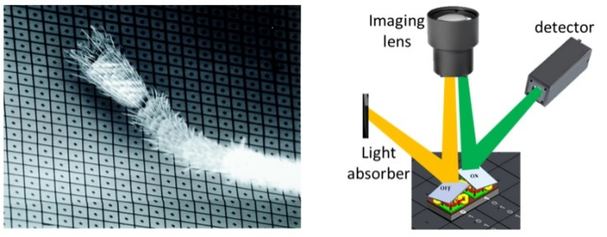
Intelligent image acquisition
Digital Micromirror Device
Array of millions of micromirrors
Each mirror has binary reflection response
Dither patterns (off/on patterns) can be adjusted up to 40 kHz
Allows highly flexible front-end optical filtering
ant leg

Slide 5

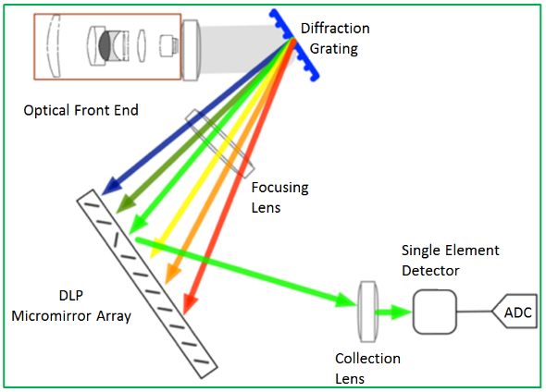
Spatial Line Image Modulator (SLIM) Design
Spatial line imaging
50 km
Insert Digital Micromirror Device (DMD) in optical path
Image a linear spatial scene onto the DMD in the vertical dimension V, hyperspectral dispersion in horizontal dimension N
Replace typical CMOS/CCD array with sensitive single detector (e.g., PMT or APD)
Use filter codebooks to program DMD dither patterns – tune for SNR, science application
Image reconstructed at ground station using complimentary codebook

Slide 6
SlimSat benefits relative to typical array imaging
Simple, low SWaP-C optical design
High spectral and spatial resolution possible
A single PMT (or APD) detector (or multi-detector array) with higher sensitivity, dynamic range (up to 2 orders higher), and SNR
DMD dither pattern can be changed in flight to optimize spatial-spectral resolution, SNR for a given scene/algorithm
DMD filtering can be used to mitigate blooming/saturation effects for bright land and cloud features adjacent to dark water
Less data volume transmitted with near-lossless compression to reduce redundant data loading

Slide 7
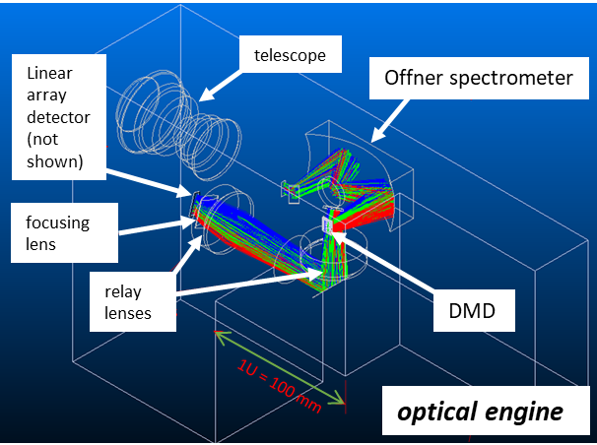
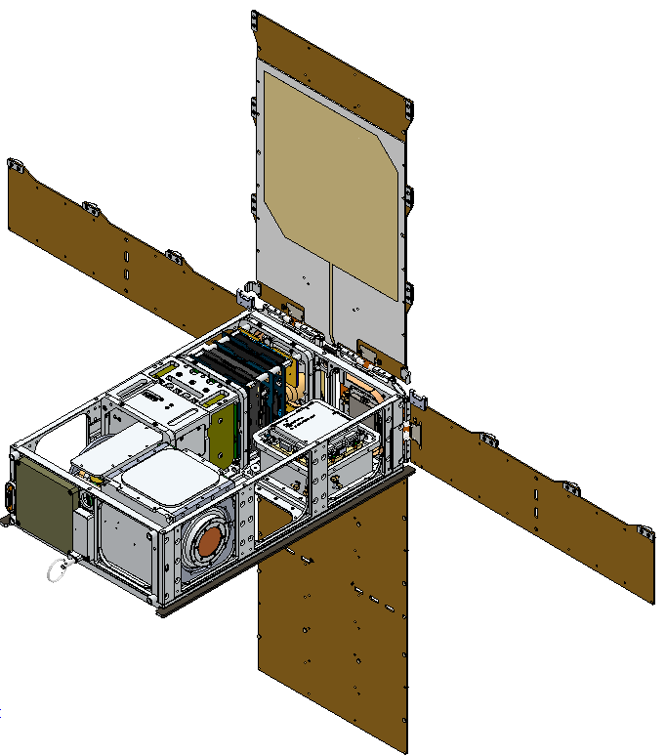
SlimSat payload
3.5U payload
30 cm
Pumpkin SUPERNOVA 6U Bus

Slide 8
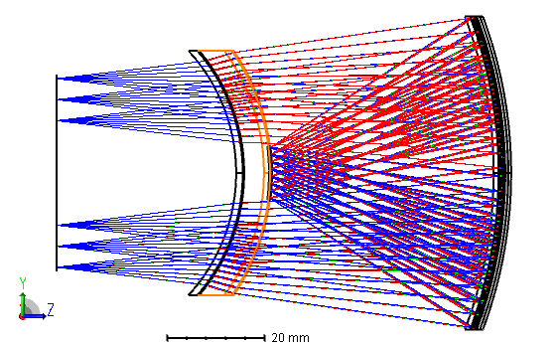
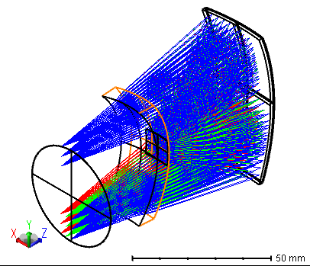
Offner spectrometer
Grating: 300 lpm; 80% efficiency
meniscus lens
grating
93 x 67 x 32 mm

Slide 9
Sensor specifications
Parameter | Value
Spectral range | VNIR: 420-840 nm UV: 300-500 nm
Spectral resolution | 5 nm (can be varied)
Spectral bandwidth | 5 nm (can be increased for SNR)
Swath width (per ONR) | 50 km
Along track distance (per ONR) | 200 km
Ground Spatial Resolution (per ONR) | 30 m
ocean albedo assumption
5% in blue
<0.5% in NIR
90 m GSD
spectrally bin to increase SNR in NIR
60 m GSD
30 m GSD
(bold values are fixed in design)
Resampling for Sentinel 2 bands gives 2x to 4x improvement

Slide 10
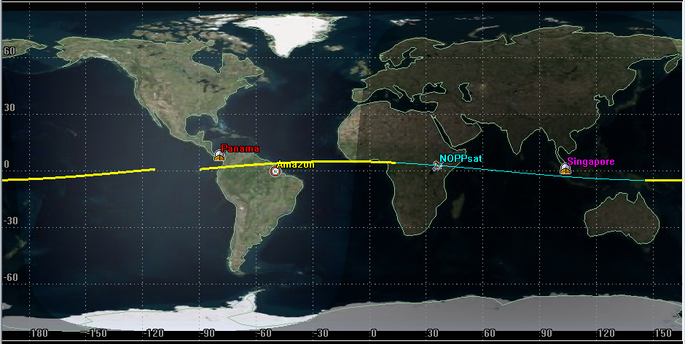
Orbital parameters
Equatorial orbit
Parameter | Value
Altitude | 500 km
Orbit period | 94 min
Ground speed | 6.6 km/s
Downlink comms | X-band
Uplink comms | S-band
Time over ground station link | 5-6 min
Focus region: Amazon plume
Multiple images through day, multiple solar zeniths, multi-view possible

Slide 11
Calibration
Radiometric calibration at IMO, Fremantle, AU
Vicarious calibrations during flight to global imagers, AERONET, field val, possibly WATERHYPERNET (K. Ruddick), future HYPERNAV, MOBY-NET?
Any compression errors evaluated by comparison with periodic full spectral and spatial scans
BRDF, interpixel variability evaluated by staring with swath oriented along-track
Monthly lunar scans to track long term drift
Dark field scans for background counts
GPS cal will be assessed over land, with any bias extrapolated to measurements over water

Slide 12
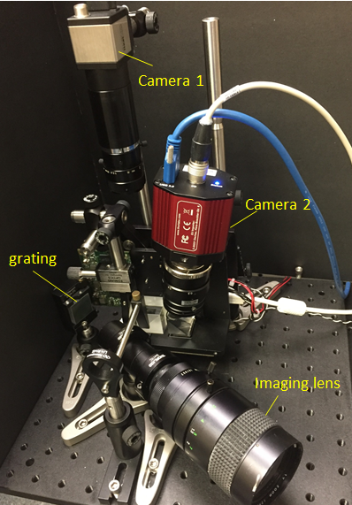
Summary
Phase B for SlimSat-VNIR and SlimSat-UV scheduled to start end of 2021
Flight operations testing at NIWC-Pac
Testing on HALE platforms with NIWC-Pac
Launches planned for 2024 with public data dissemination
Also ONR support for SLIM imagers for bioluminescence and thermal
Thank you
mtwardowski@fau.edu

