Slide 1
Ocean Lidar Update
Chris Hostetler ¹, Johnathan Hair ¹, Anthony Cook¹, David Harper¹, Xiaomei Lu², Yongxiang Hu ¹, Tory Scola¹, Kathy Powell¹, Amy Jo Scarino ², John Smith¹, Mike Behrenfeld³
¹ NASA Langley Research Center, Hampton, Virginia, USA
² Science Systems and Applications, Hampton, Virginia, USA
³ Oregon State University, Corvalis, Oregon, USA

Slide 2
Airborne Lidar

Slide 3
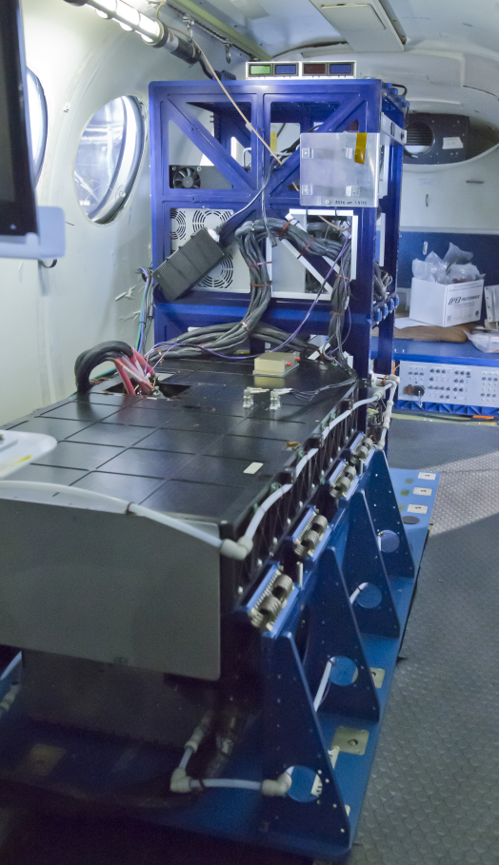
Ocean upgrade to HSRL-2 for completed in April 2019
Particulate backscatter at 355 and 532 nm
Diffuse attenuation at 355 and 532 nm
Chlorophyll fluorescence at 680 nm
CDOM fluorescence at 455 nm
PRELIMINARY
DATA
Relative Backscatter (532 nm)
Relative Backscatter (m⁻¹) (532 nm)

Slide 4
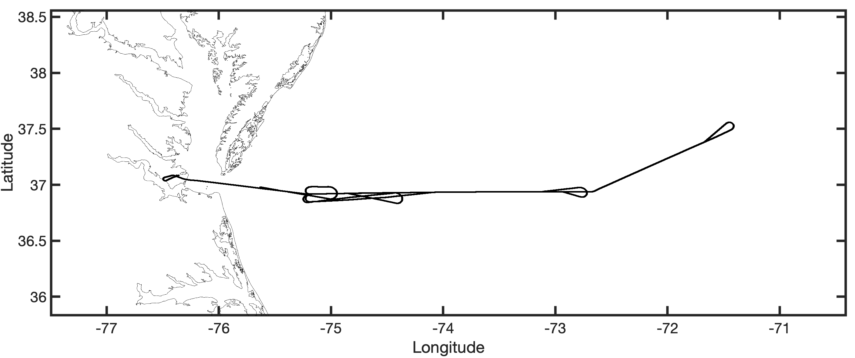
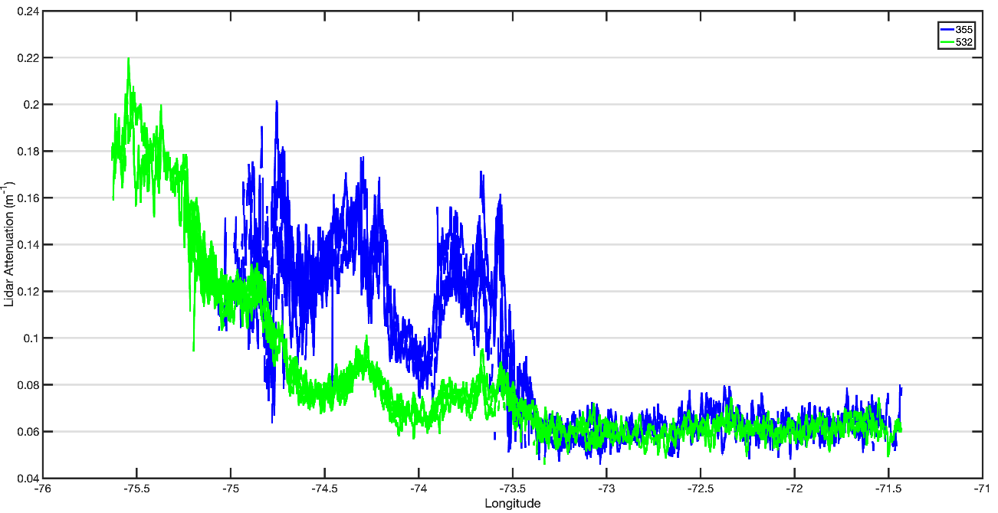
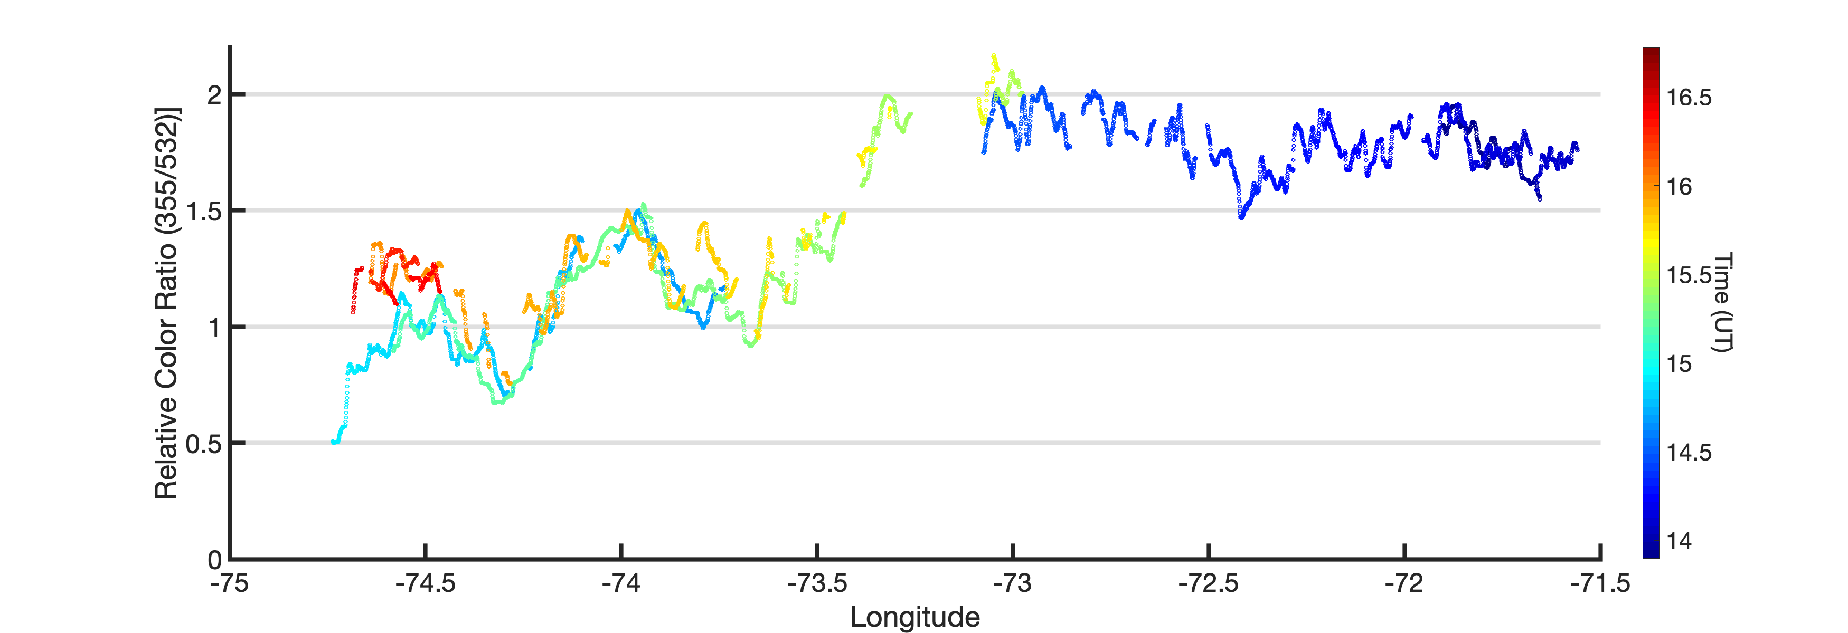
Two profiling wavelengths provide info on CDOM and particle properties
Variation in particulate backscatter ratio due differences in particle size and composition
Norfolk
Differences in K_{d} due to greater CDOM absorption at 355
PRELIMINARY DATA
0.24
0.24
532 K_{d}
532 K_{d}
0.22
0.22
0.20
0.20
355 K_{d}
0.18
355 K_{d}
0.18
0.16
0.16
Higher Values in mesotrophic water
Higher Values in mesotrophic water
0.14
0.14
Attenuation, m⁻¹
Attenuation, m⁻¹
0.12
0.12
0.10
0.10
0.08
0.08
Coastal Waters – lower ratios as expected (50% change)
Coastal Waters – lower ratios as expected (50% change)
0.06
0.06
0.04
0.04
-74.5
-74.5
-74
-74
-73.5
-73.5
-72.5
-72.5
-72
-72
-71.5
-75
-71.5
-76
-75
-76
-73
-73
-71
-75.5
-71
-75.5
Longitude
Longitude

Slide 5
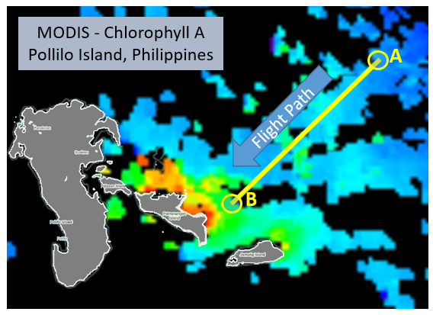
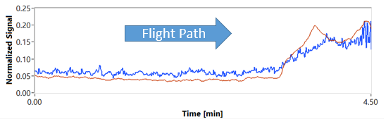


Laser-induced fluorescence of CDOM and chlorophyll
CDOM fluorescence measured at 455 nm
Chlorophyll fluorescence measured at 680 nm
Preliminary data – much work required ahead to calibrate these signals to account for variation in laser energy, atmospheric transmission, and water transmission
Chlorophyll & CDOM Flour Comparison
CAMP2EX - Sept 9th, 2019
Signal Normalization
Chlorophyl fluorescence normalized to 650-nm water Raman signal
$$\frac{680nm Fluor}{650nm Raman}$$
A
B
$$\frac{455nm Fluor}{532nm Brillouin}$$
CDOM fluorescence normalized to 532-nm Brillouin signal

Slide 6
Spaceborne Lidar

Slide 7
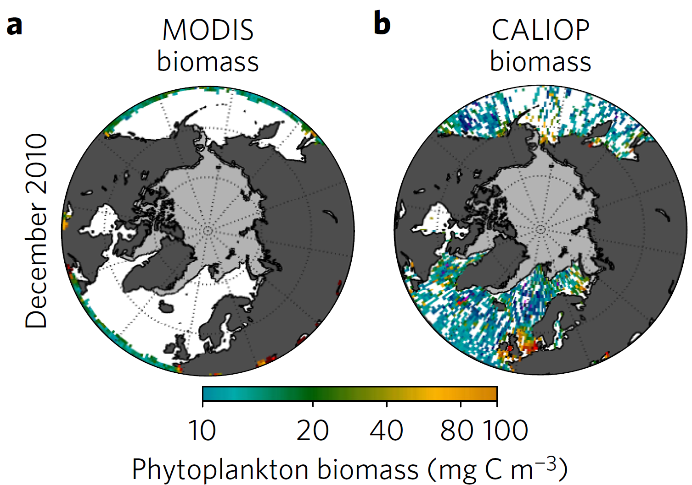
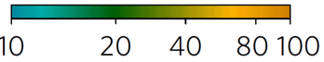
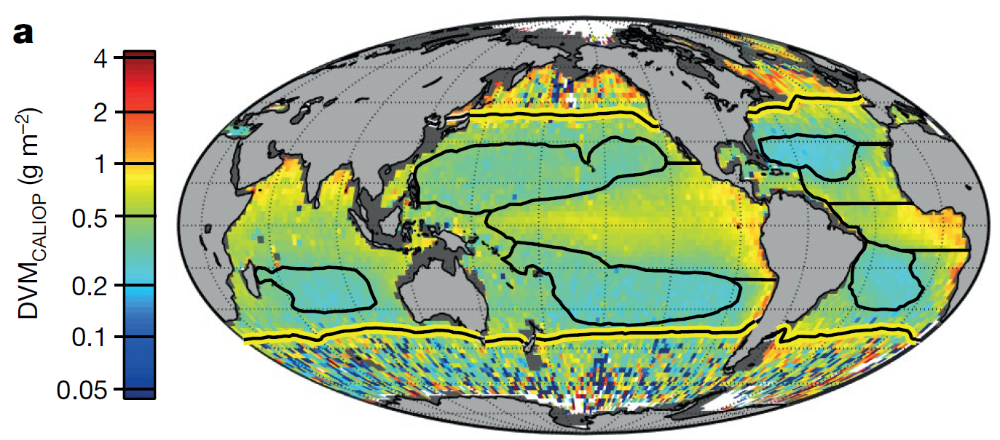
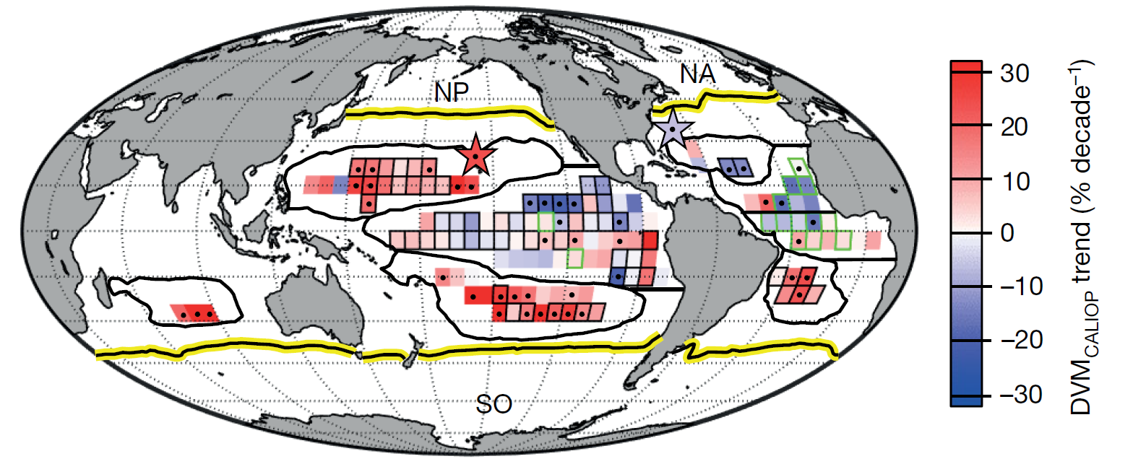
Much science has been done with CALIPSO
MODIS
CALIPSO
Phytoplankton boom-bust cycles
Behrenfeld et al., Nature Geoscience, 2017
Daily vertical migration of ocean animals
Behrenfeld et al., Nature, 2019
December 2010
Phytoplankton biomass (mg C m⁻³)

Slide 8
Antarctic spring ice-edge blooms (Xiaomei Lu, Yong Hu, et al.)
First observations of depth-resolved structure by ICESat-2
ICESAT-2 signal
Lu, et al., 2020, ‘Antarctic spring ice-edge blooms observed from space by ICESat-2.’ Remote Sensing of Environment, 194, p 248-263.
Acknowledgments: supported by CALIPSO/CloudSat science team and Dr. David Considine of NASA HQ
Notes:
Upper figure: ICESat-2 observed photons on October 16th, 2018 over ice-edge, the x-axis specifies locations along the ICESat-2 ground tracks and the y-axis is ICESat-2 reported photon altitude from ATL03 data products.
Middle figure: Ocean subsurface Attenuated backscatter profiles obtained from ATL03 photons of upper panel, the x-axis specifies locations along the ICESat-2 ground tracks and the y-axis is ocean penetration depth in meters.
Lower figure: Phytoplankton carbon biomass are retrieved from the attenuated backscatter profiles of middle panel; ICESat-2 observed ice-edge blooms are near right side of the lower figure that is near ice-edge; left side are far from sea ice-edge. The elevated values of carbon biomass on right side (red color) reflect the massive Antarctic spring ice-edge blooms.
Right figure: shows the sea ice concentration (15%-100%) on October 16th , 2018 with the red line indicates the ICESat-2 footprints where the ocean subsurface results are retrieved (middle and lower figures on left).
Reference paper: Lu, et al., 2020, Antarctic spring ice-edge blooms observed from space by ICESat-2. Remote Sensing of Environment 111827. https://doi.org/10.1016/j.rse.2020.111827

Slide 9
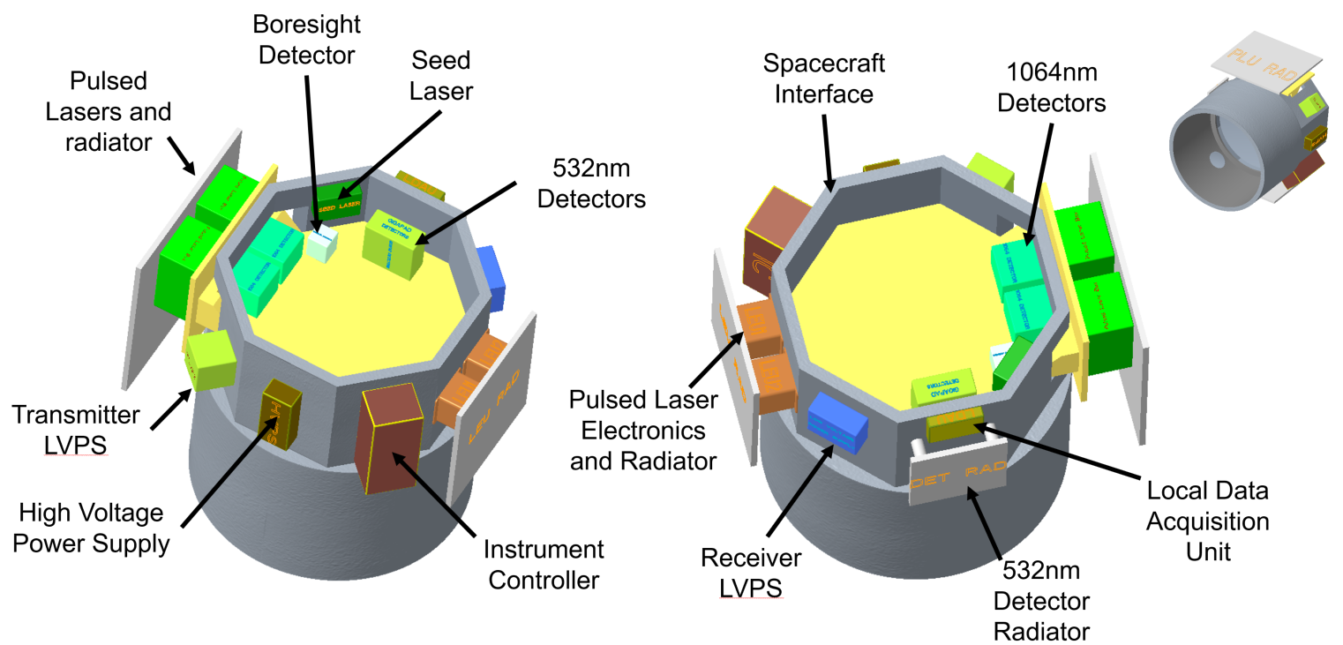
Aerosols – Clouds, Convection, & Precipitation (A-CCP) Mission
Decadal Survey mission
Launch in ~2030
Mission architectures include lidars
Two of the three lidar concepts under study have ocean profiling capability
Both implement the HSRL technique at 532 nm with 1-m vertical resolution
Downselect to final mission architecture options by January 2021
Science assessment of lidars currently focused on atmospheric capability only
Opportunity for ocean community input:
A-CCP Quarterly Forum
22 July 11am EDT

Slide 10
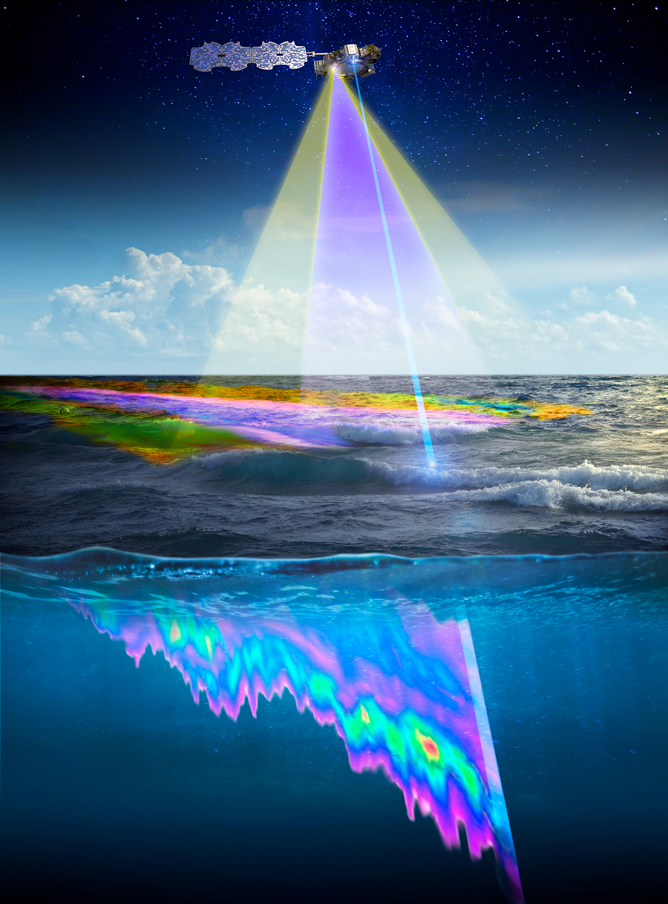
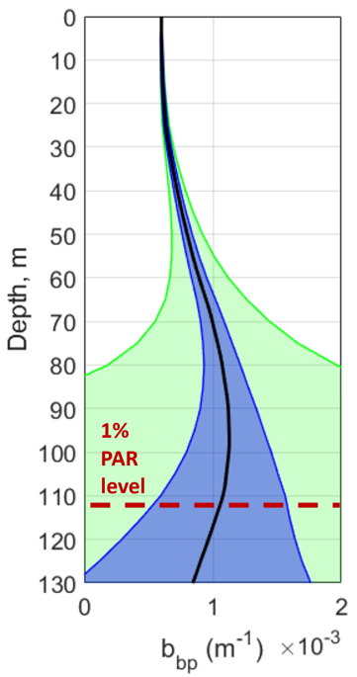
Further into the future: Ocean Blue lidar concept
High-efficiency 486 nm laser and advanced detector technology would enable an extremely capable SmallSat ocean HSRL for depth-resolved measurements of b_{bp} and K_{d}.
Left: SmallSat lidar concept
Use 1 slot on a propulsive ESPA ring satellite bus
Additional instruments in other ESPA ring slots, e.g., ocean color imager, polarimeter
Full ocean observing system deployed cost effectively via a shared launch.
Right: Simulated b_{bp} precision as a function of depth
Green: 532-nm 1-σ envelope
Blue: 486-nm 1-σ envelope
All else equal except the wavelength of the laser.
Laser power was assumed at 15 W, telescope diameter at 70 cm, detector QE at 50%, and horizontal/vertical averaging at 100 km/5 m.
532-nm
1-σ
532-nm
1-σ
486-nm
1-σ
486-nm
1-σ

Slide 11
Summary
Interest is increasing in ocean lidar
Airborne instruments continue to make advances
Great science has been done with CALIPSO
ICESat-2 showing impressive science results
Ocean capability on A-CCP lidar would provide an advance in information content and accuracy
Potential exists for ocean-optimized SmallSat satellite lidars

