Slide 1

ACE
Aerosol, Cloud, & Ocean Ecosystem Mission
Michael Behrenfeld

Slide 2

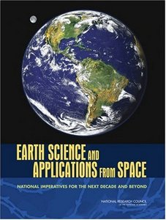
Aerosol, Cloud, Ocean Ecosystem (ACE) Mission
Objective: “…reduce the uncertainty in climate forcing in aerosol-cloud interactions and ocean ecosystem CO₂ uptake” – NAS Decadal Survey pg 4-4
  Aerosol & cloud science objectives are:
    characterize cloud types, droplet properties, cloud dynamics & feedbacks
    decrease the uncertainty in aerosol forcing as a component in climate change
    quantify the role of aerosols in cloud formation, alteration of cloud properties and changes in precipitation.
  Ocean ecosystem science objectives are:
    characterize and quantify changes in the ocean biosphere
    quantify the amount of dissolved organic matter, carbon,
    and other biogeochemical species to define the role of the
    oceans in the carbon cycle (e.g., uptake and storage)

Slide 3
ACE Instrument Payload
  HSR Lidar for aerosol/cloud heights, aerosol properties, & ocean particle load
  Multi-angle, swath polarimeter for imaging aerosol and clouds
  Ocean Ecosystem Spectrometer (OES)
  Dual frequency radar for cloud properties and precipitation
  IR multi-channel imager for cloud temperatures and heights
  High frequency swath radiometer for cloud ice measurements
  Low frequency swath radiometer for precipitation measurements
  Microwave temperature/humidity sounder
Black – Specified by NAS
Decadal Survey
Red – Cloud Science
Team Additions

Slide 4

OES – Expanded spectral resolution & range focused on enabling improved retrievals and expanded products
“Multispectral”
Ocean Bands
CZCS: 4
SeaWiFS: 8
MODIS: 9
VIIRS: 7
HERITAGE SENSORS OES
86 “hyperspectral” bands + 3 SWIR bands
26 “multispectral” bands
CZCS
(1978-1985)
SeaWiFS
(1997- )
MODIS
(2002- )
VIIRS
Products
Ultraviolet
No Measurements
Products
Ultraviolet
Absorbing aerosols
Dissolved organics
Phytoplankton pigments
Functional groups
Particle sizes
Physiology
Pigment fluorescence
Coastal biology
Atmospheric correction
(clear ocean)
Atmospheric
Correction
(coastal) &
Aerosol/cloud properties
Total pigment or Chlorophyll-a
but major errors due to absorption by dissolved organics
Atmospheric Correction/ MODIS chlorophyll
fluorescence
Visible
Visible
5 nm resolution (345 – 775 nm)
26 required “multispectral” bands
Atmospheric
Correction
(clear ocean)
NIR
NIR
Atmospheric
Correction
(coastal)
3 SWIR
bands
SWIR
SWIR

Slide 5
ACE Ocean Parameters & Climate Data Records
Field Accuracy Assessment Lead
3 Heritage CDRs
Normalized water-leaving radiances Stan Hooker
Chlorophyll-a Stan Hooker
Diffuse attenuation coefficient (490 nm) Stan Hooker
Inherent optical properties Norm Nelson, Emmanuel Boss
Spectral Kd Stan Hooker
Spectral RSR Stan Hooker
Particulate organic carbon concentration Darius Stramski
Primary production Mike Behrenfeld
Calcite concentration Barney Balch
Colored dissolved organic matter Norm Nelson, Antonio Mannino
Photosynthetically available radiation Robert Frouin
Fluorescence line height Mike Behrenfeld
Euphotic depth Zhongping Lee
Total suspended matter Rick Stumpf
Trichodesmium concentration Toby Westberry
12 ACE Candidate CDRs
Notes:
5

Slide 6
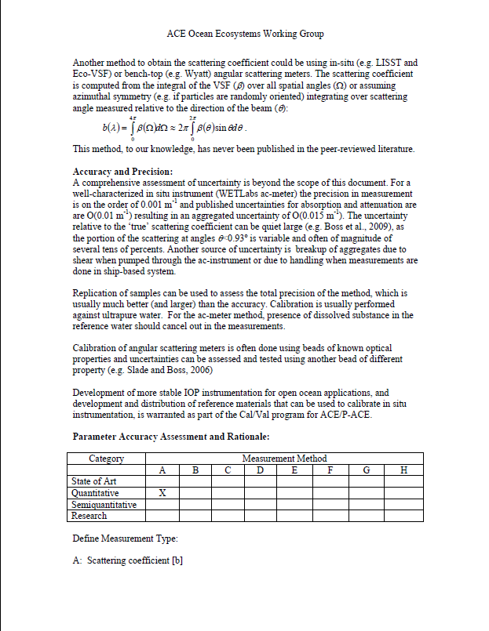
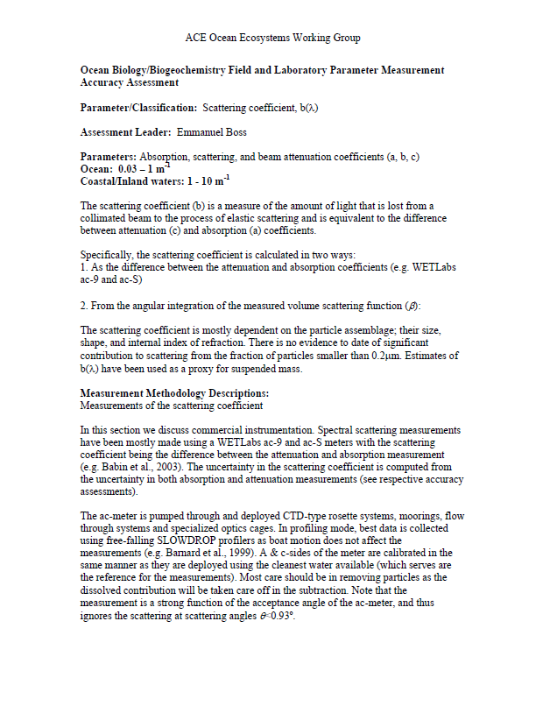
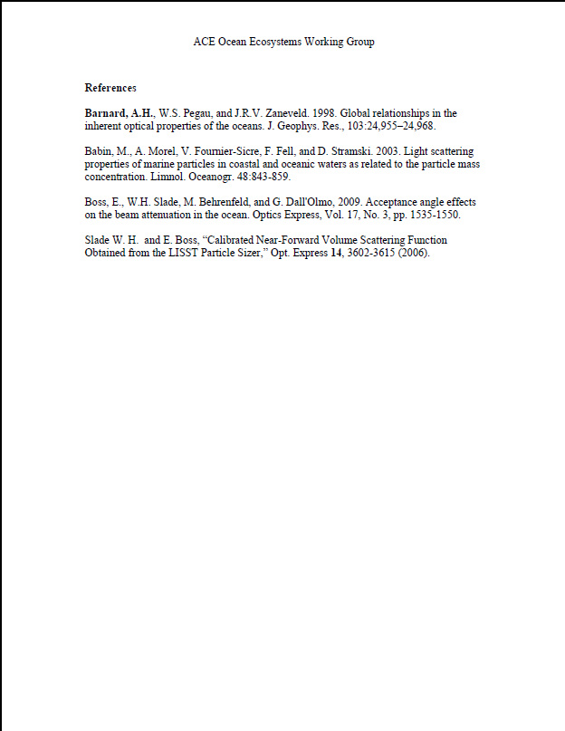
ACE Ocean Parameters & Climate Data Records
Field Accuracy Assessment Lead
7 Research products
Particle size distributions & composition Dave Siegel
Phytoplankton carbon Mike Behrenfeld, Joe Salisbury
Dissolved organic matter/carbon Antonio Mannino, Joe Salisbury
Physiological properties Mike Behrenfeld
Other plant pigment Stan Hooker
Export production
Taxonomic groups
PRODUCT ASSESSMENTS
      Parameter Description
      Measurement Methodology
      Error analysis
      Accuracy Assessment
Notes:
6

Slide 7
ACE 2011 Activities
Continue assessment of 22 ACE products – defining baseline and threshold ranges
PACE support – e.g., evaluating minimum requirements for water leaving radiance uncertainties / atmospheric corrections
UCSB Workshop – Carbon fluxes
9 other funded studies focused on advanced ACE ocean retrievals and aerosol properties
HQ review of NRC Decadal Survey Missions (December)

Slide 8
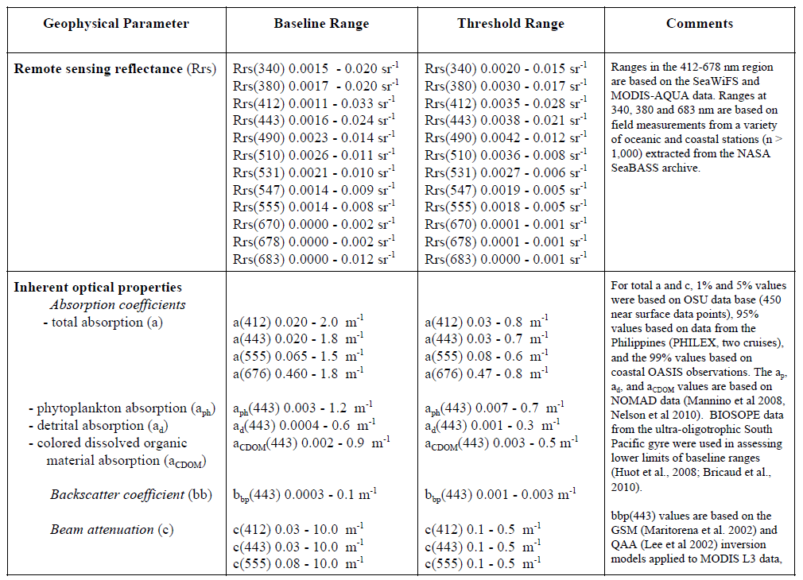
ACE Ocean Parameters – Baseline & Threshold

Slide 9
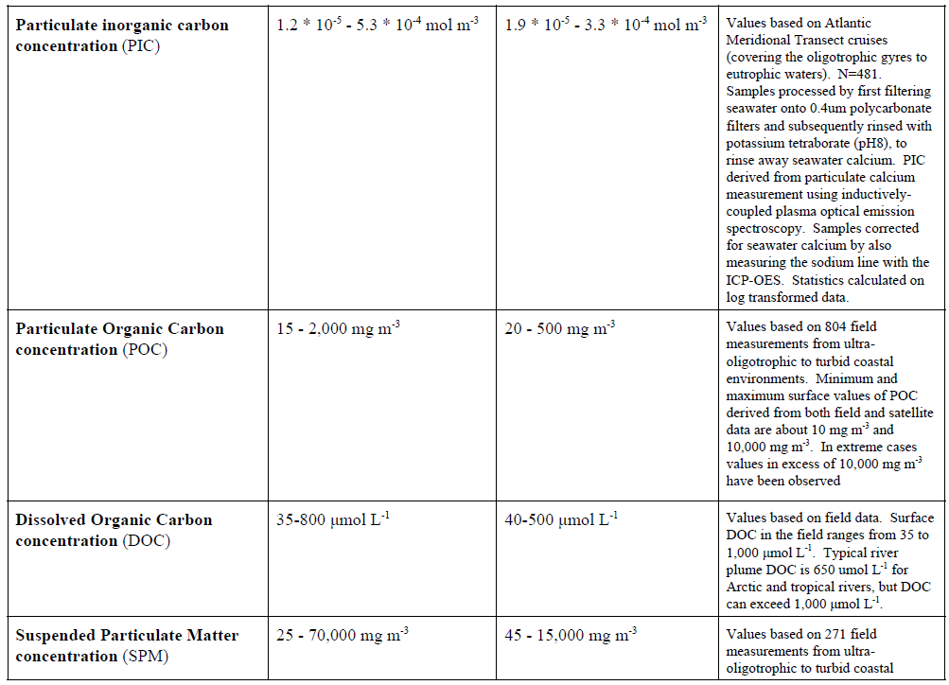
ACE Ocean Parameters – Baseline & Threshold

Slide 10
ACE Ocean Funded Activities
2011 Proposals
Zia Ahmad
Robert Frouin
Santiago Gasso
Stan Hooker
Stephane Maritorena
Nicholas Meskhidze
Dave Siegel
Menghua Wang
Yong Hu
Aerosols & Atm. correction
Atmospheric Correction
Aerosols & polarization
OSPREy modifications
UV bands for CDOM
Marine aerosols
Carbon workshop (June)
Atm. Corr. for dust coastal
Lidar subsurface/surface returns

Slide 11
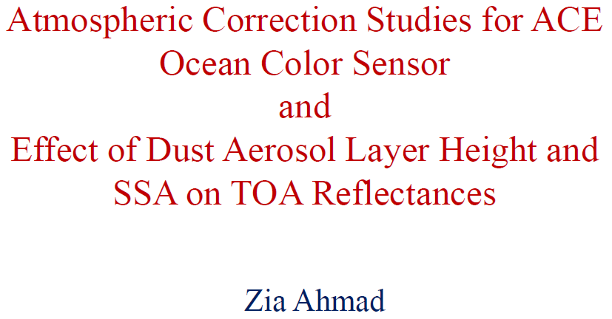
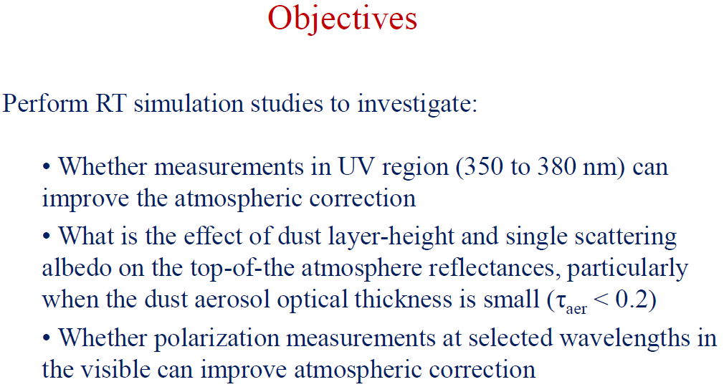
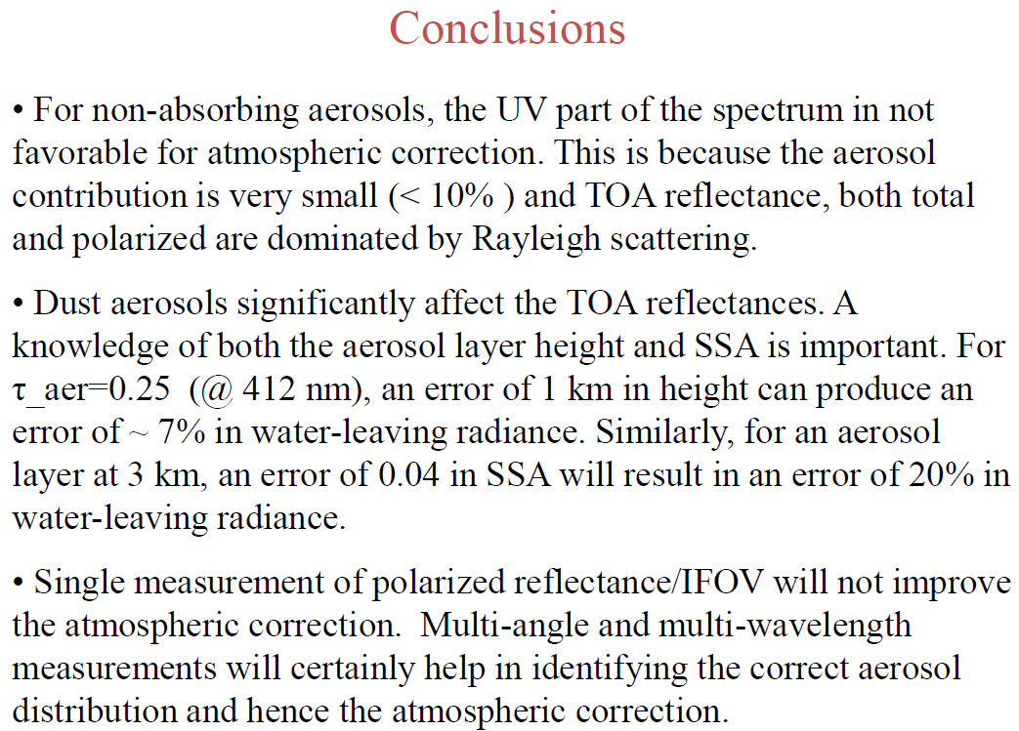
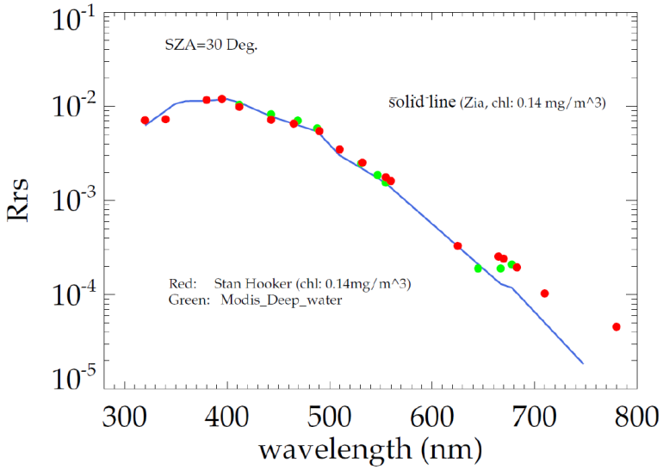
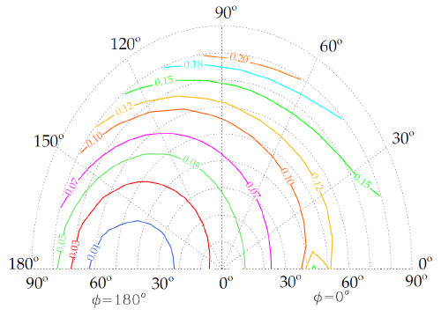

Slide 12
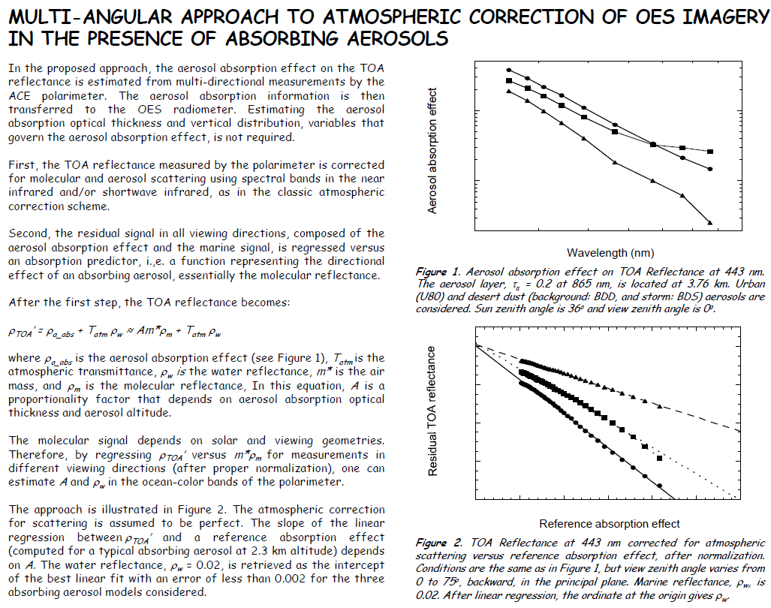
Objective: Use information from the ACE polarimeter to improve atmospheric corrections of OES data
Step #1: correct polarimeter TOA reflectances for molecular and aerosol scattering using NIR and SWIR bands, as with classic correction scheme
Step #2: use the residual signal in all polarimeter viewing directions to constrain aerosol absorption and then transfer this information to the OES atmospheric correction
Outcome: Approach shows significant potential, but additional work is needed to minimize regression errors

Slide 13
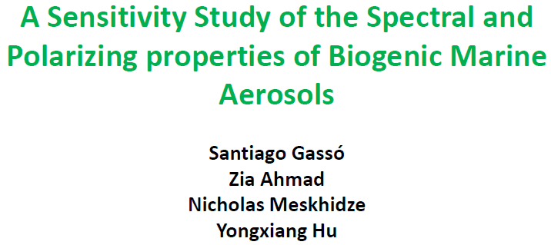
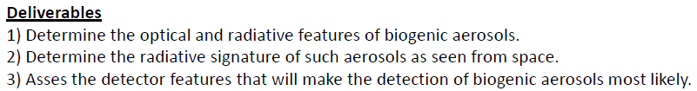
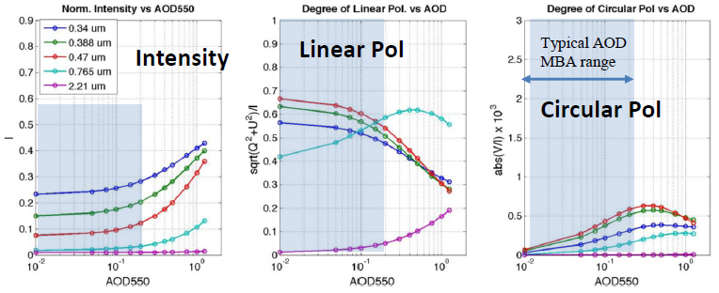
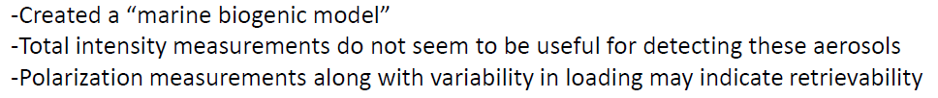
Objective: Modeling investigation on retrieval of marine biogenic aerosols (MBA)
evaluate typical microphysical properties based on laboratory, field, and modeling studies to date
identify suitable radiative transfer code for modeling
consider attributes of ACE intruments that may allow MBA retrievals
Outcome: (1) model constructed (2) total intensity measurements do not appear to be sufficient to retrieve MBA’s (3) multi-wavelength, multi-angle polarimeter measurements show some potential, but additional work is needed.
Objectives
Outcomes

Slide 14
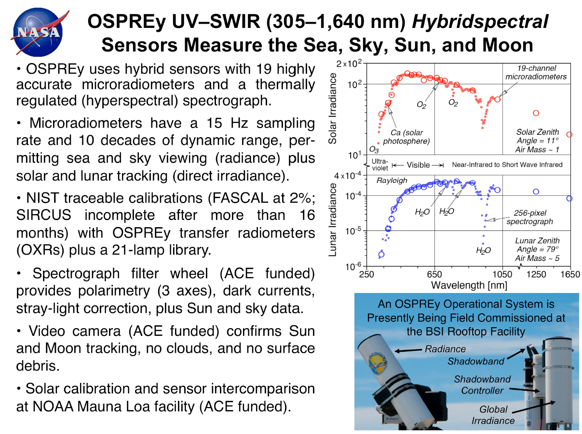
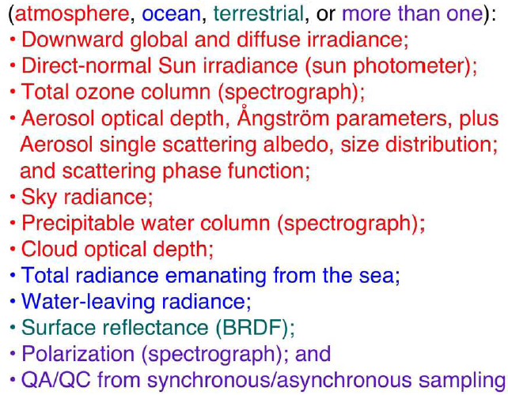

Slide 15
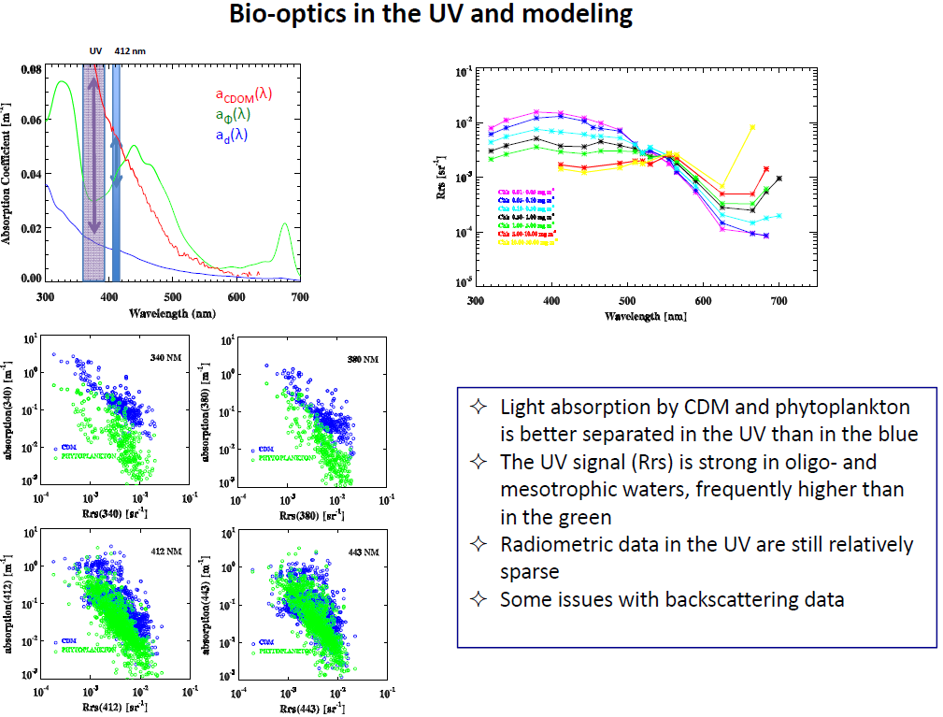
Stephane Maritorena
David Court

Slide 16
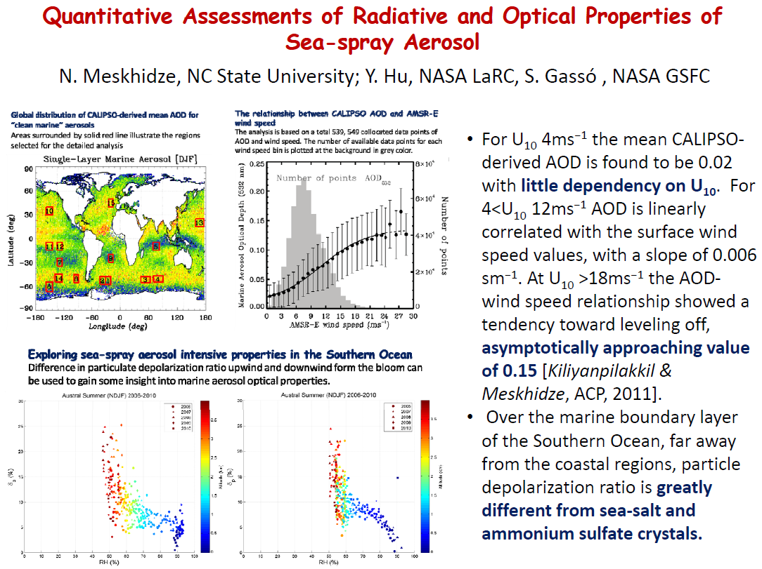

Slide 17
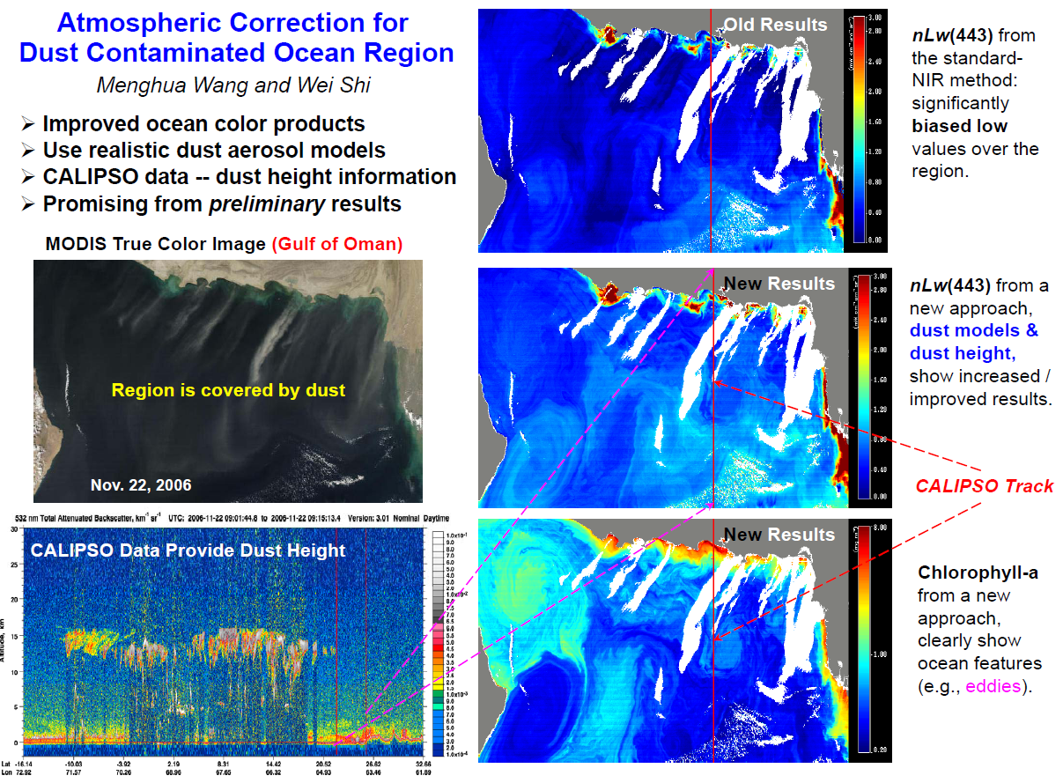

Slide 18
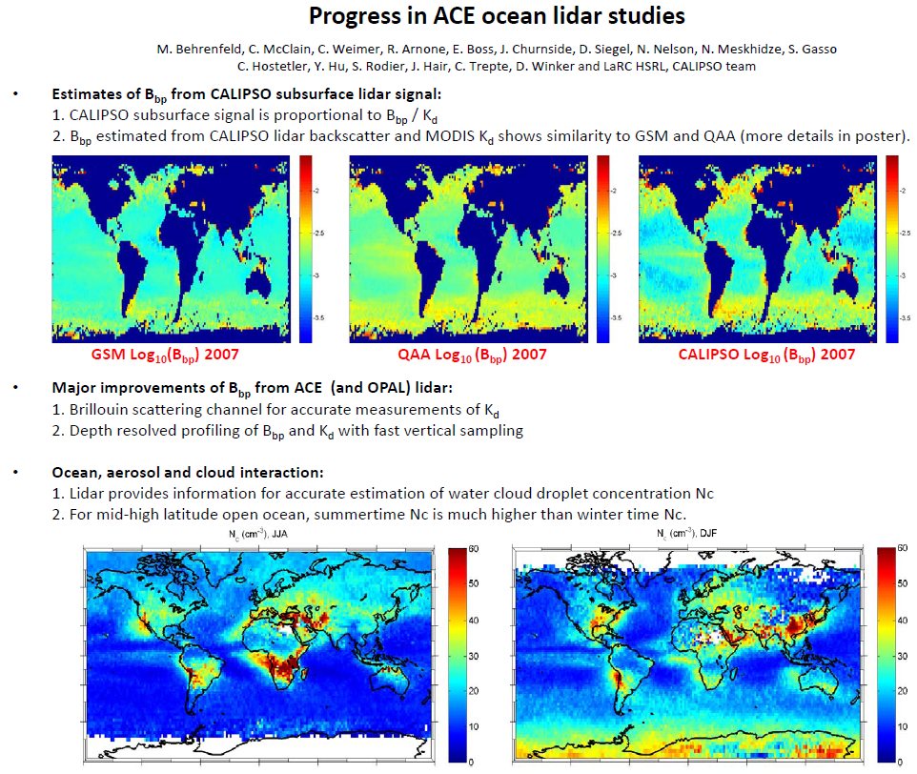

Slide 19
ACE 2012 Activities
3 funded studies
Chlorophyll fluorescence
Raman effects
Field study on carbon export

Slide 20
ACE
Aerosol, Cloud, & Ocean Ecosystem Mission
Thank You

