Slide 1
International Network for Sensor InTercomparison and Uncertainty assessment for Ocean Colour Radiometry (INSITU-OCR)
working toward high accuracy and consistency of essential climate variables from multiple satellite ocean color missions
…a joint CEOS/IOCCG initiative…

Slide 2
INSITU-OCR evolution
January 2010
Proposal for an international SIMBIOS-like activity at IOCCG#15
April 2010
Meetings at Oceans from Space conference in Venice:
Town Hall meeting on OCR-VC
Dedicated side–session on INSITU-OCR
October 2010
OCR workshop in conjunction with WGCV-IVOS conference at JRC
INSITU-OCR was introduced to space agency principals in the CEOS plenary in Rio, Brazil
February 2011
Discussion continued at IOCCG#16
March 2011
…and at CEOS SIT – Tokyo
November 2011
Working group formed
February 2012
Workshop held at Goddard
Today
You get to listen to me…

Slide 3
What is it, really?
Blend IOCCG plans with OCR workshop and WGCV-IVOS workshop recommendations
Review of current “best practices”
Discussion of gap-analysis for INSITU-OCR/CalVal
Cooperate to the next WGCV/IVOS comparisons (OCR)
Goal – a community white-paper on requirements for inter-agency initiative on INSITU-OCR
Harmonize existing OCR programs and identify gaps of networking as per schematic
Integrating and rationalizing inter-agency efforts for:
satellite sensor inter-comparisons
uncertainty assessment for remote sensing products
emphasis on requirements for the generation of Ocean Color Radiometry Essential Climate Variables (ECV)
A prioritized effort of the CEOS Ocean Color Radiometry Virtual Constellation (OCR-VC)
Core office – good idea?

Slide 4
Working group participants
Agency Representatives
EC/JRC – Giuseppe Zibordi (co-lead)
NASA – Sean Bailey (co-lead)
IOCCG – David Antoine
ESA – Philippe Goryl
CNES –Bertrand Fougnie
NOAA – Menghua Wang
NASA – Bryan Franz
NIST – Carol Johnson
JAXA – Hiroshi Murakami
EUMETSAT – Ewa Kwiatkowska
KORDI – Yu-Hwan Ahn
ISRO – Prakash Chauhan

Slide 5
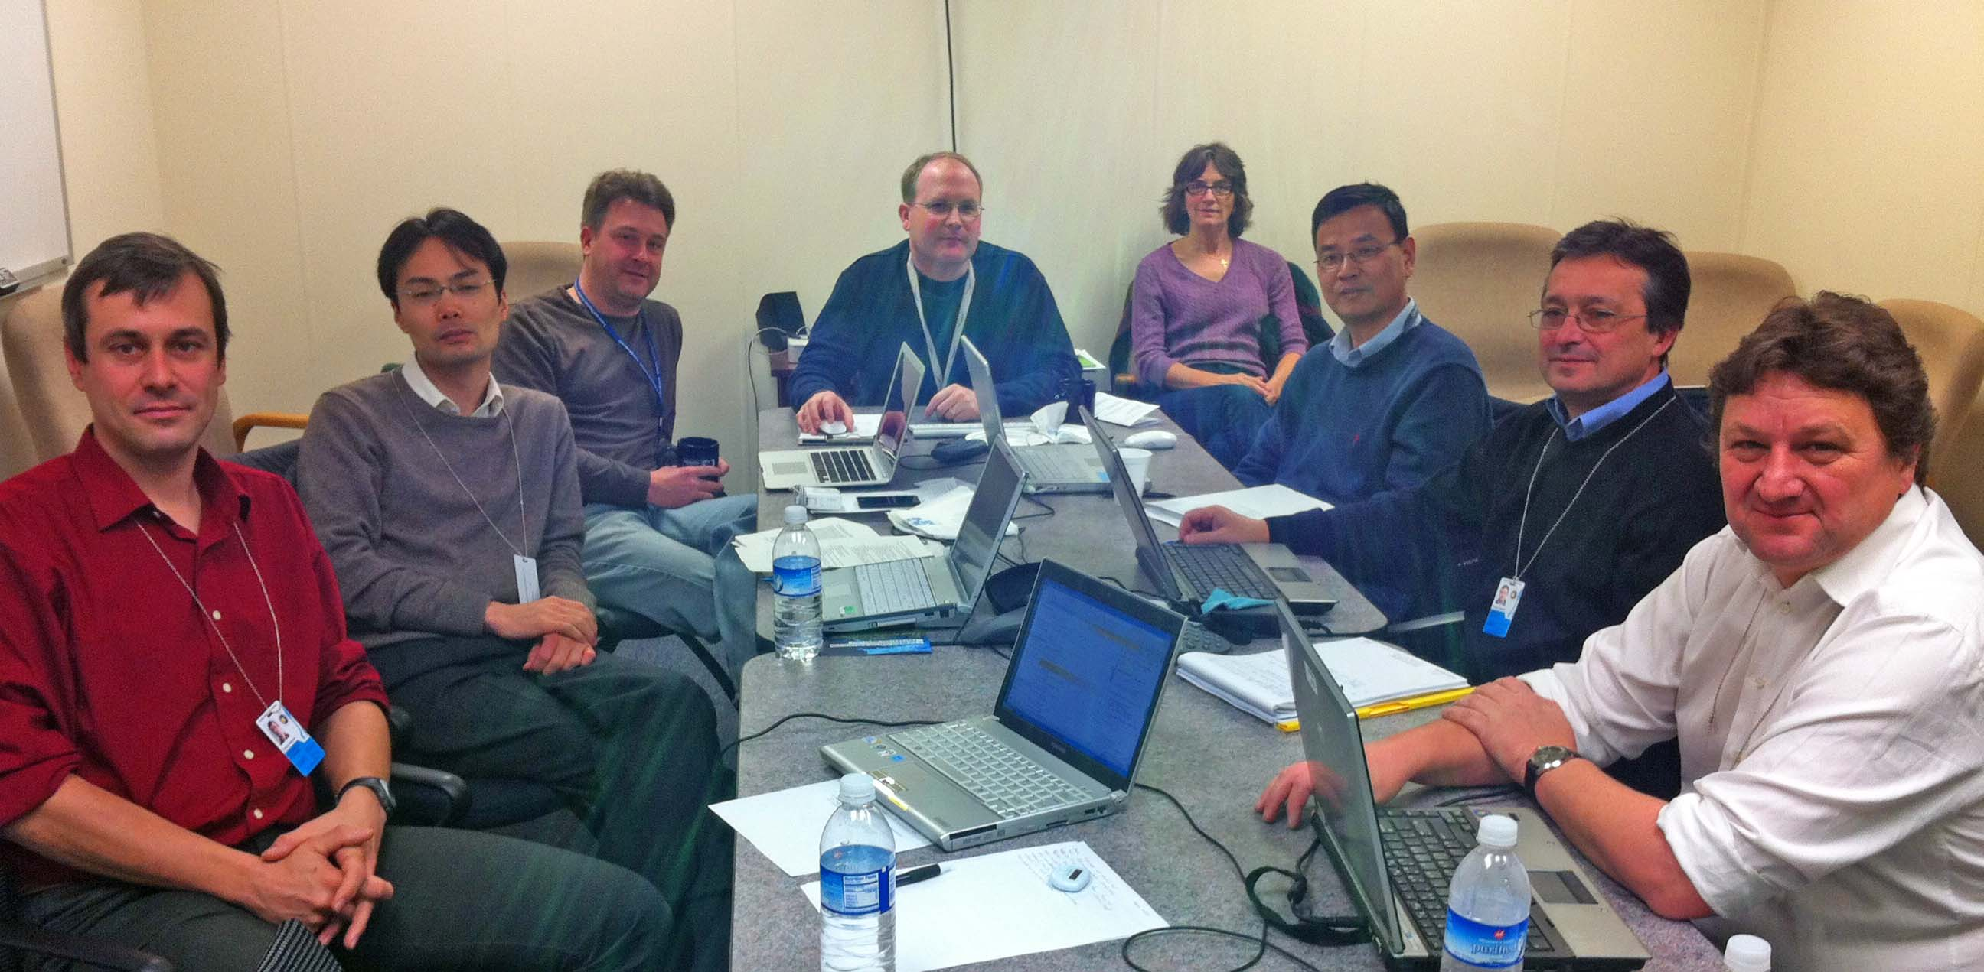
There was a meeting…

Slide 6
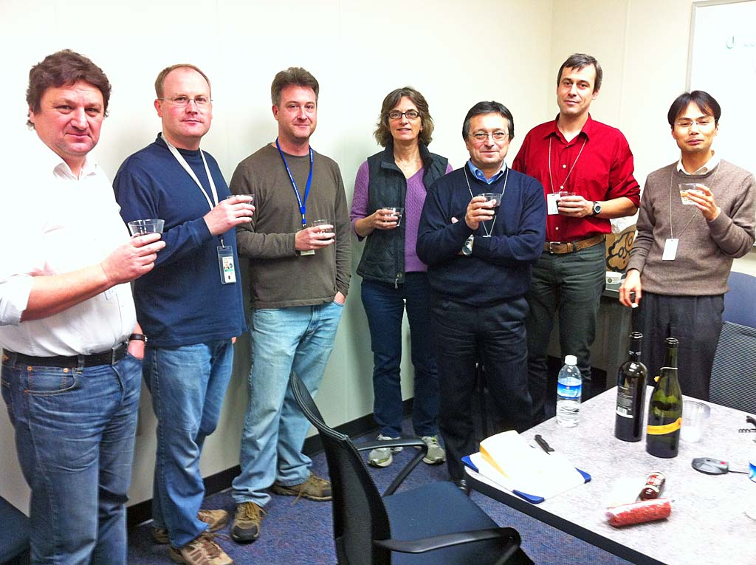
…we worked really hard…

Slide 7
…and came up with some recommendations
Primarily addressed to the Space Agencies contributing to the Ocean Color Radiometer – Virtual Constellation (OCR-VC)
Over 30 recommendations under 4 categories:
space sensor radiometric calibration, characterization and temporal stability
development and assessment of satellite products
in situ data generation and handling
information management and support

Slide 8
Calibration, characterization and temporal stability
Pre-launch calibration and characterization data
Comprehensive
Open access
Permanent working group on space sensors calibration
Vicarious Calibration
Support for calibration teams
Assess and correct for instrument degradation
Inter-comparisons from pre-launch through operations

Slide 9
Development and assessment of satellite products
Distribution of un-calibrated data
Common algorithms / open access to source code for processing algorithms
Development of regional bio-optical algorithms
Working group on algorithms topic
Require uncertainties for bio-optical algorithms
Support long term-measurement programs
Develop/maintain validation protocols
Generate Level-3 data products
Consistent set of ancillary data sources
Common aerosol models

Slide 10
In situ data generation and handling
Improving traceability of in situ measurements
Continuous consolidation and update of measurement protocols
Centralized open access data repositories should be established
Uncertainty budgets
Quality Assurance of in situ data
Priority for variables to be collected
General coordination of field campaign

Slide 11
Information management and support
Accessibility to data / distribution of large data volumes
Accessibility to documentation
Common data format for the storage of the satellite data
Support for open source data processing and visualization
Community processor for in situ data

Slide 12
The white paper
First draft went out for comment from the working group participants on March 15, 2012
Comments currently being incorporated
Anticipated delivery by the end of May 2012

