Slide 1
State of the Program: NASA Ocean Biology & Biogeochemistry
Paula Bontempi and Laura Lorenzoni
NASA Headquarters
NASA Ocean Color Research Team Meeting
18 May 2017

Slide 2
Announcements
Speakers – would like to post talks on the ocean color website, so please submit a copy to me via Email (paula.bontempi@nasa.gov). Please remember to remove any material you do not want posted.

Slide 3
Agenda
NASA Headquarters Update (Q&A)
Advanced Planning (OB&B program)
NASA Ocean Biology Processing Group and Satellite Mission Updates
PACE Mission and Science Team
Field Project Updates (NAAMES, SABOR)
Project Updates

Slide 4
Housekeeping
Uncosted carryover – FY15 and 16 and its impacts to ROSES 2016 OBB and EXPORTS
Reprofiling – an easy option but I need notice of this
Continuing Resolutions – and their impacts
NSSC Grants Status Update:
https://www.nssc.nasa.gov/grantstatus
Renewals – earlier is better on your progress reports

Slide 5
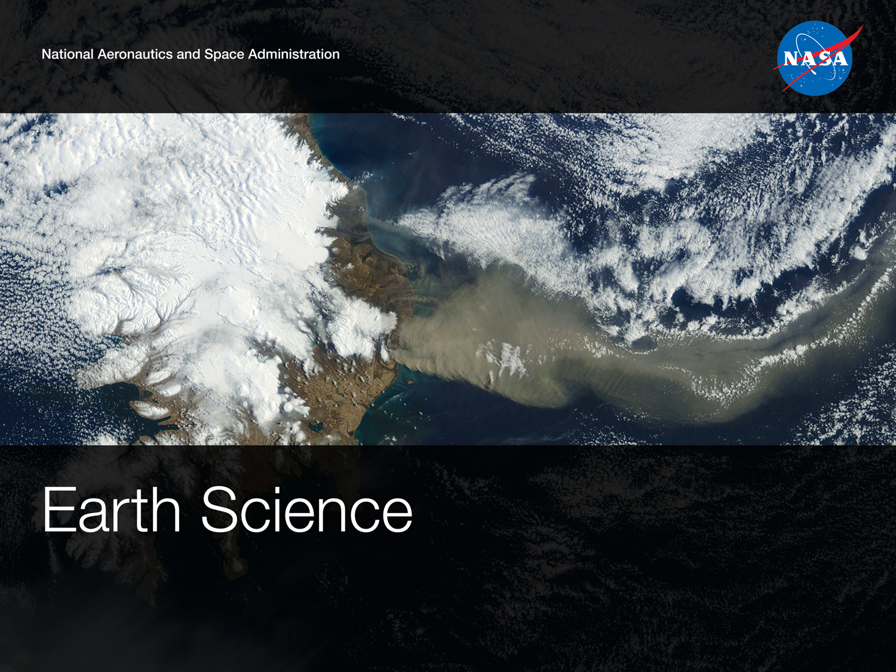
As of April 2017

Slide 6
ESD Budget/Program Overview
The FY17 Appropriation :
NASA’s Earth Science Division - $1.92 billion (same as FY2016)
$90 million for the Pre-Aerosol, Cloud, and Ocean Ecosystem, or PACE, mission
FY18 President’s Budget – to be released in detail on or about 22 May 2017
https://www.whitehouse.gov/sites/whitehouse.gov/files/omb/budget/fy2018/2018_blueprint.pdf
The President’s 2018 Budget requests $19.1 billion for NASA, a 0.8 percent decrease from the 2017 annualized CR level, with targeted increases consistent with the President’s priorities.
Provides $1.8 billion for a focused, balanced Earth science portfolio that supports the priorities of the science and applications communities, a savings of $102 million from the 2017 annualized CR level. The Budget terminates four Earth science missions (PACE, OCO-3, DSCOVR Earth-viewing instruments, and CLARREO Pathfinder) and reduces funding for Earth science research grants.
Eliminates the $115 million Office of Education, resulting in a more focused education effort through NASA’s Science Mission Directorate. The Office of Education has experienced significant challenges in implementing a NASA-wide education strategy and is performing functions that are duplicative of other parts of the agency.

Slide 7


























Formulation
Implementation
Primary Ops
Landsat 9
Extended Ops
PACE
NI-SAR
SWOT
TEMPO
JPSS-2 (NOAA)
RBI, OMPS-Limb
Sentinel-6A/B
GRACE-FO (2)
ICESat-2
Earth Science Instruments on ISS:
RapidScat, CATS,
LIS, SAGE III (on ISS), TSIS-1, OCO-3, ECOSTRESS,
GEDI, CLARREO-PF
CYGNSS
ISS
SORCE,
TCTE (NOAA)
NISTAR, EPIC
(NOAA’S DSCOVR)
QuikSCAT
SMAP
Landsat 7
(USGS)
Terra
Suomi NPP (NOAA)
Aqua
Landsat 8
(USGS)
CloudSat
CALIPSO
GPM
Aura
GRACE (2)
OSTM/Jason 2
(NOAA)
OCO-2
Notes:
Fleet - Earth Science Division - Missions (with color key; editable)
Dec. 15, 2015
Credit: NASA/J. Mottar
------------------------------
SLIDE INFO
UDATE EJD PER FREILICH DECISIONS FEB 4, 2016
Changed “Altimetry FO (Formulation in FY16) to “Sentinal-6A/B”
On Landsat 9, removed comma and TIRFF
Change I was going to make – “NISTAR, EPIC (NOAA’s DSCOVR) to green primary ops was already corrected
Dec. 15, 2015 – Updated: TEMPO changed to Implementation phase; NISTAR, EPIC changed to Primary Ops phase; ; OCO-3 and ECOSTRESS changed to Implementation phase; Aquarius removed; slide now fully editable. JMottar
May 18, 2015 – Added to SMD Multimedia Library.
May 18, 2015 – Updated the outdated 2014 version: TRMM was removed; NISTAR, EPIC (NOAA's DSCOVR) were added; SMAP icon was updated; moon at top left was removed; color key moved to top left.-JMottar
ID: I-EA-15-0040 (image)
ID: SL-EA-15-0068 (slide)

Slide 8
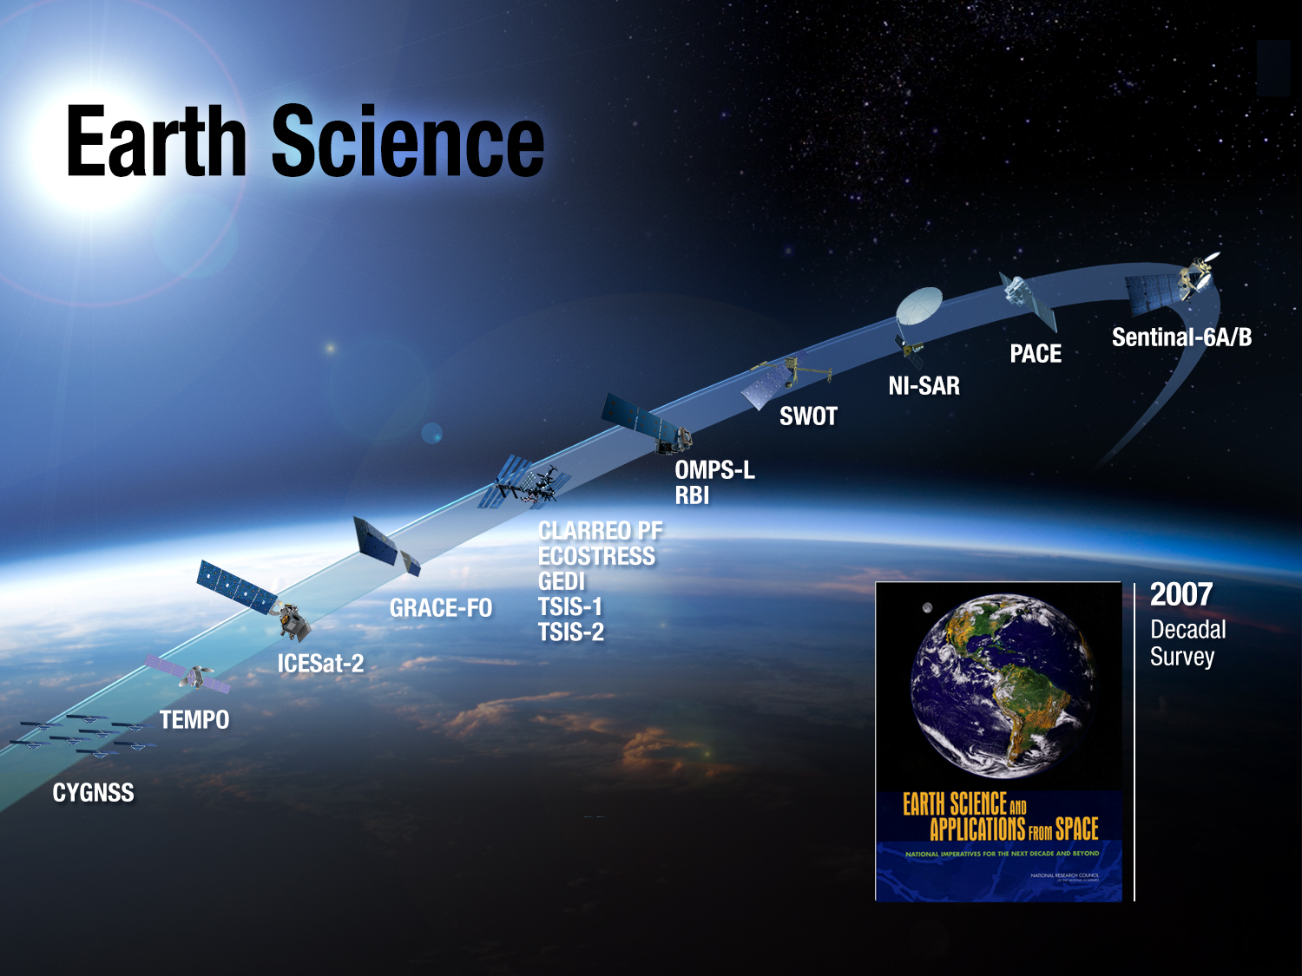
FY22
FY20/24
FY20
FY22
FY18/21
FY19/21
FY19
FY19
FY18/20
FY18
FY18
FY20/22
OCO-3 FY18
FY18
FY20/22
Launched

Slide 9
Venture Class Selections/Solicitations
Most recent Selection
EVS-1: CARVE, ATTREX, DISCOVER-AQ, AirMOSS, HS-3
EVM-1: CYGNSS
EVI-1: TEMPO (2020-;2018 Instrument Delivery)
EVI-2: GEDI (2019; 2018 del.); ECOSTRESS (10/2017; 5/2017 del.)
EVS-2: AtoM, NAAMES, OMG, ORACLES, ACT-America, CORAL
EVM-2: GeoCARB
EVI-3: TROPICS and MAIA (polarimeter)
Notes:
TJF 3/27/15: removed second page number.

Slide 10
Decadal Survey Status (1)
2007 Earth Science and Applications from Space is most recent Decadal Survey (Jan 2007); NRC mid-term assessment May 2012
“NASA responded favorably and aggressively to the decadal survey, embracing its overall recommendations for Earth observations, missions, technology investments, and priorities for the underlying science. As a consequence, the scientific and applications communities have made significant progress over the past 5 years.“ (Mid-Term Report overarching Finding)
All Legacy Missions launched: OSTM (2008), OCO-1 (2009*), Aquarius (2011), Glory (2011*), Suomi NPP (2011), LDCM (2013), GPM (2014), OCO-2 (2015)
Late 2017 completion date for 2nd ESAS Decadal Survey
Main 2007 Decadal Survey New Mission recommendations/status
Tier I
Venture Class: 3 strands, multiple solicitations in each strand, on-schedule, fully funded
SMAP: Launched 31 January 2015
ICESat-2: Oct 2018 launch
NI-SAR: Dec 2020-Sept 2021 launch; NI-SAR is radar component of
DESDynI; GEDI (EVI-2) contributes substantially to DESDynI lidar/ecosystem (late 2018)
CLARREO-Pathfinder: Reflected Solar Spectrometer flight to ISS - 2020 launch

Slide 11
Decadal Survey Status (2)
Main 2007 Dec. Survey Mission recommendations/status (cont.)
Tier II, III
SWOT: ~Oct 2020 launch (joint with CNES)
GRACE-FO: In Phase D for Feb 2018 launch (GFZ partner)
Pre-formulation: GEO-CAPE, ASCENDS, ACE, HyspIRI
PACE: In Phase A, Phase B review June 2017 - Design-to-Cost study, for development and launch by 2022/3;
PACE substantially covers ocean color component of Decadal ACE mission
Climate Architecture Missions (not included in Decadal Survey)
Altimeter Follow-On: NASA contribution (radiometer, GPS, Laser Retroreflectors, LV) to Jason-CS/Sentinel-6A (w/ESA/EUMETSAT/EU), 2020 LRD
FY17 budget request includes additional funding to allow efficient development of 2nd copy (Sentinel-6B)
consistent with Copernicus program plans (2024 LRD)
OCO-3: FY16 budget restarted OCO-3 development; FY17 request consistent with CY2017 launch to ISS

Slide 12
NASA Ocean Biology and Biogeochemistry & DS Advanced Planning
Ocean Biology and Biogeochemistry Advanced Planning (2015-2017)
From 2005 – 2007, NASA developed an OBB Advance Plan with a volunteer writing team
Evolution of the NASA 2007 OBB Advanced Plan (2007) – Earth’s Living Ocean – The Unseen World
Kick off at Ocean Carbon and Biogeochemistry Summer Workshop (20-23 July, WHOI) – D. Schimel (NASA JPL) & Natassa Romanou (NASA GISS) lead an open planning process with Heidi Dierssen (talk this AM)
One writing team (Group 1) and one review team (Group 2) – all volunteer
Public vetting/comment process – original timeline evolved – posted on CC&E Web page for public comment
Preparation for the next NRC Decadal Survey (to be delivered in 2017)
Decadal Survey for Earth Science and Applications from Space (2015-2017)
Steering Committee is set – Co-chairs are Waleed Abdalati (University of Colorado, Boulder) & William Gail (Global Weather Corporation)
I. Global Hydrological Cycles and Water Resources
The movement, distribution, and availability of water and how these are changing over time
II. Weather and Air Quality: Minutes to Subseasonal
Atmospheric Dynamics, Thermodynamics, Chemistry, and their interactions at land and ocean interfaces
III. Marine and Terrestrial Ecosystems and Natural Resource Management
Biogeochemical Cycles, Ecosystem Functioning, Biodiversity, and factors that influence health and ecosystem services
IV. Climate Variability and Change: Seasonal to Centennial
Forcings and Feedbacks of the Ocean, Atmosphere, Land, and Cryosphere within the Coupled Climate System
V. Earth Surface and Interior: Dynamics and Hazards
Core, mantle, lithosphere, and surface processes, system interactions, and the hazards they generate
Community Input: http://sites.nationalacademies.org/DEPS/esas2017/DEPS_170397

Slide 13
Plankton, Aerosol, Cloud, and ocean Ecosystem (PACE) Mission
Pre-Aerosol, Cloud, and ocean Ecosystem (PACE) is an ocean color, aerosol, and cloud mission identified in the 2010 report “Responding to the Challenge of Climate and Environmental Change: NASA’s Plan for a Climate-Centric Architecture for Earth Observations and Applications from Space Science”.
Science Objectives
Primary: Understand & quantify global aerosol & cloud dynamics, aerosol-ocean interactions, ocean biogeochemical cycling, and ecosystem function due to natural & anthropogenic forcings from environmental/climate variability and change: OCI (expanded SeaWiFS, MODIS heritage)
Primary: Extend key Earth system data records on global ocean ecology, ocean biogeochemistry, clouds, and aerosols (SeaWiFS, MODIS heritage)
Secondary: Understand and resolve/quantify the role of aerosols and clouds in physical climate (the largest uncertainty): polarimeter (MISR heritage)
Applied Sciences: enable carbon monitoring and management, contribute to better weather forecasting, and delineate the impacts of weather events on coastal ecosystems to enable resource management (early returns for ACE mission)
Talk by A. Mannino (Deputy Project Scientist) this AM
Risk | 8705.4 Payload Risk Class C
Launch | 2022/2023, budget and profile driven
Orbit | 97° inclination; ~650 km altitude; sun synchronous
Duration | 3 years
Payload | Ocean color instrument; potential for a polarimeter
LCC | $805M Cost Cap
Notes:
17

Slide 14
Vicarious Calibration & Data Validation
Vicarious Calibration and Data Validation (in situ)
FY15 – 17: ROSES 2014 A.3*** (Presentations in Vicarious Calibration Session on Monday, 15 May)
Issued jointly between OBB and ESTO
Allows lead time for concepts to mature prior to launch
Identifies technical development needs/risks for the approaches selected
FY19 – 21: ROSES 2018 (3 years)
Selects best approach and hardware (pre-launch) or further risk reduction on instrumentation, if needed, for:
Vicarious calibration of aerosol, cloud, ocean color (OCI) data products
Validation of all data products – in situ
Calibration/validation of polarimetry data products (TBD)
FY22 – 25: ROSES 2021 (4 years)
Perform cal/val during mission operations
Includes airborne and in situ measurements
Continue every year during mission extensions

Slide 15
Science Teams Pre-launch and Post-launch
Pre-launch Science Teams
FY15 – 17: ROSES 2013 A.25 (Presentation by E. Boss this AM)
Covers IOPs and Atmospheric Correction
Achieves consensus and develops community-endorsed paths forward for the sensor retrievals for the full spectrum of components within a given measurement suite
FY19 – 21: ROSES 2018 (3 years)
Allows lead time for scientific algorithm development prior to launch
Initiates interface between instrument developers and OBPG; OBPG and algorithm developers
Supports applications research along with research activities
At-launch Science Teams
FY22 – 25: ROSES 2021 (4 years)
Pre-launch algorithms and post-launch competed science/applications for ocean color instrument’s aerosol, cloud, ocean science, plus aerosol and clouds from polarimeter (TBD)
Post-launch Competed Science - options
Competed through ROSES 2025
After launch, joint funding among EOS project, R&A, and PACE mission budget, exploring additional funding from Applied Sciences
Mission contribution TBD
Continue during mission extensions

Slide 16
NASA PACE Opportunities in ROSES
Research Opportunities in Space and Earth Sciences - http://nspires.nasaprs.com/ - Annual release mid-February
Ocean Biology and Biogeochemistry – generally an annual competition
ROSES 2013 A.25 PACE Science Team - $3M/yr for three years [2014-2017]
IOPs
Atmospheric Correction
Science Team Leader – Emmanuel Boss w/Lorraine Remer, Deputy
ROSES 2014 A.3 Ocean Biology and Biogeochemistry - ~$10M/three years [2014- 2017]- Ocean color vicarious calibration approach and instrumentation competition
Future competitions (tentative)
ROSES 2018 PACE Calibration and Validation – Vicarious calibration system(s) OC; cal/val aerosols/clouds (OCI), plus polarimeter (TBD)
ROSES 2018 PACE Science Team – science team for algorithm development
Future - science team for new algorithms, science data analyses, (vicarious) & calibration approaches, data validation, field campaigns

Slide 17
Field Campaign Planning/Field Project Updates
Ship-Aircraft Bio-Optical Research (SABOR) campaign – A. Gilerson (talk this AM) - Projects funded under ROSES 2012 A. 3 Ocean Biology and Biogeochemistry
EXport Processes in the Ocean from Remote Sensing (EXPORTS) - Introducing a Science Plan for a NASA Field Campaign on the Ocean's Biological Pump – D. Siegel/ Univ. of California – Santa Barbara– Science Plan final, Implementation Plan drafted, data mining proposals funded and EXPORTS Science Competition under review
Two field campaign scoping proposals selected in ROSES 2013 A.3 OBB:
Arctic COastal Land Ocean InteRactions Scoping Study (Arctic-COLORS) – A. Mannino/NASA Goddard Space Flight Center – draft Science Plan through review and under revision – expected summer 2017
Scoping for Interdisciplinary Coordinated Experiment of the Southern Ocean Carbon Cycle (ICESOCC) – G. Mitchell/University of California – San Diego – SIO – draft plan in development
KORea/United States – Ocean Color (KORUS-OC) Field Campaign - prep work for GEO-CAPE mission with KORUS-AQ - 2016, Joint Science Team Meeting in April 2017

Slide 18
EXPORTS Timeline
EXport Processes in the Ocean from Remote Sensing Timeline (Tentative)
June 2014 – Draft Science Plan Delivered to NASA
July-August 2014 – Draft Science Plan posted for public comments
January 2015– Peer review of public comments
18 May 2015 – Science Plan Finalized
24 July 2015– NASA competition/Dear Colleague Letter for EXPORTS Science Definition Team and Team Leader – tasked to draft Implementation Plan(s) based on estimated EXPORTS program budget (31 Aug 2015)
September 2015– SDT Selected, work begins on Implementation Plan (Oct 2015)
July 2016 – vetting of draft Implementation Plan at OCB Meeting (w/NSF BoBP)
August 2016 – public comment period of Implementation Plan/SDT report
October 2016– SDT delivered final Implementation Plan to NASA
November 2016 – US NSF releases Dear Colleague Letter
January 2017 – NASA competition for EXPORTS Science, Team Leader
April 2017 – EXPORTS proposals due
June/July 2017 –EXPORTS Science and Team Leaders selected
August/September 2017 – EXPORTS begins (perhaps a kick off meeting at the Fall AGU)
2017-2022– EXPORTS Program – NE Pacific Field Campaign August-Sept 2018

Slide 19
NASA OB&B Research – Research Opportunities in Space and Earth Sciences
ROSES 2015 - http://nspires.nasaprs.com/ - Released 13 February 2015
New (Early Career) Investigator Program In Earth Science (NIP) – A.35 - ~$1.0M/yr for three years [every 1-2 yrs]
Outstanding scientific research and career development of scientists and engineers at the early stage of their professional careers (no longer an E/PO requirement)
In ROSES 2015, 115 proposals received, 22 selected
Not solicited in 2016, anticipated 2017
ROSES 2016 & 2017 - http://nspires.nasaprs.com/
NASA EARTH AND SPACE SCIENCE FELLOWSHIP (NESSF) PROGRAM 2016 ACADEMIC YEAR – each fellowship ~$30K/yr, raised to $45K/yr in 2017 [try to do annually – selection target for May 2017]
accredited U.S. Universities - Masters or Doctoral degrees in Earth and space sciences
Financial support from the Science Mission Directorate’s divisions: Earth Science, Heliophysics, Planetary Science, Astrophysics.
Students admitted to, or already enrolled in, a full-time Masters and/or Ph.D. program at accredited U.S. universities eligible (non-US citizens welcome)
Students may enter the fellowship program at any time during their graduate work
700+ applications to SMD, 391 to ESD, 159 in CC&E
ESD received 425 in 2016; 391 in 2015; 410 in 2014; 330 in 2013

Slide 20
NASA OB&B Research – Research Opportunities in Space and Earth Sciences
ROSES 2015 - http://nspires.nasaprs.com/ - Released 13 February 2015
Ocean Biology and Biogeochemistry – A.3– $8.3M/3 yrs– amended 3 December 2015, [15/71 selected July 2016]
Research in ocean ecology, specifically to prepare scientifically for new ocean measurements from the Pre-Aerosol, Cloud, ocean Ecosystem (PACE) mission recommended by "Responding to the Challenge of Climate and Environmental Change: NASA’s Plan for a Climate-Centric Architecture for Earth Observations and Applications from Space Science" (http://science.nasa.gov/media/medialibrary/ 2010/07/01/Climate_Architecture_Final.pdf) or to advance ocean ecology research based on data from historical, existing, and new sensors such as OCO-2;
Global data set development and modeling activities to enable a predictive understanding of the export and fate of global ocean primary production and its implications for the Earth’s carbon cycle, specifically in support of a planned field campaign in the Northeast Pacific and North Atlantic Oceans,
Studies to support the trilateral Galway Statement on Atlantic Ocean Cooperation of May 2013, among the European Union (EU), Canada, and the United States (US) (available at http://www.coopeus.eu/galway-statement/); and
Successor studies that offer to significantly advance the results of prior NASA Ocean Biology and Biogeochemistry research toward meaningful answers to important NASA goals, relevant USGCRP, and NOC carbon cycle and ecosystems research questions, and current and future NASA missions.

Slide 21
NASA OB&B Research – Research Opportunities in Space and Earth Sciences
ROSES 2016 A.29 NASA Data for Operation and Assessment – up to $2M/yr. – 15 / 56 selected [1 November 2016]
Operational Short-term Weather Prediction
Joint Center for Satellite Data Assimilation
Data and Methodology for Climate Projection Assessment - Data for Climate Projection Assessment; Methodologies for Climate Model Improvement
Ecosystem and coupled ecosystem-climate modeling
Advances in existing ocean ecological forecasts (regional and global) by assimilating multiscale physical, chemical, and ecological remotely sensed (NASA satellite) observations. Proposals must make not only make significant advances in regional ecological modeling to oceanographic operational forecasting, but also significant developments to effectively assimilate growing observational database to realize practical forecasting potential.
Proposals must integrate NASA satellite observations, particularly ocean color data, into operational assessments. GLACIER conference (http://www.state.gov/e/oes/glacier/index.htm) to address fisheries science in the Arctic ecosystem, with a goal of assessing the model skill to inform ecosystem resource management and decision/policy makers.

Slide 22
NASA OB&B Research – Research Opportunities in Space and Earth Sciences
ROSES 2016 A.5 Carbon Cycle Science - 4 federal agencies, $21.5M/3 yrs (NASA: $6.3 M; USDA-NIFA: $1.67M; DOE: $1 M; NOAA: $0.2M) – 28 / 135 Selected [19 December 2016]
Carbon research in critical regions (NASA, DOE, USDA-NIFA);
Carbon Dynamics in Tropical Terrestrial Ecosystems (moist forests and, woodlands/ savannas) (NASA)
Carbon Dynamics in Arctic/Boreal Terrestrial Ecosystems (NASA, DOE)
North American Continental Margins (NASA, USDA-NIFA)
Blue Carbon and Carbon in Associated Ecosystems (USDA-NIFA, NASA) ;
Carbon dynamics across managed landscapes, specifically: urban-rural, forested- agricultural and terrestrial-aquatic (USDA-NIFA, NASA);
The Impact of Rising CO₂ on Ocean Ecology (NASA, NOAA); and
Carbon cycle science synthesis research (NASA, USDA-NIFA)
ROSES 2016 A.28 Interdisciplinary Research in Earth Science – $34M/3 yrs - 28 / 96 Selected [20 March 2017]
Understanding the Global Sources and Sinks of Methane
Ecology at Land/Water Interfaces – Human and Environmental Pressures
Understanding the Linkages Among Fluvial and Solid Earth Hazards
Life in a Moving Ocean
Partitioning of Carbon Between the Atmosphere and Biosphere

Slide 23
NASA OB&B Research – Research Opportunities in Space and Earth Sciences
ROSES 2016 A.30 Remote Sensing of Water Quality – (Terrestrial Hydrology and OBB programs) – up to $2.3M/yr across the three topics [Target Selection June 2017]
Techniques to improve remote sensing of water quality
Atmospheric Corrections
Improving understanding of the link between optical and water-body properties
Employing remotely sensed water quality information to understand watershed dynamics and the impact on nearshore ecology and ecosystem health in the Arctic
Algorithm refinement to assess harmful algal blooms across North America

Slide 24
NASA OB&B Research – Research Opportunities in Space and Earth Sciences
ROSES 2017 A.7 Carbon Monitoring System- $3.7M/yr – [under review]
Continuing development towards a Carbon Monitoring System (CMS). CMS initiative directed by Congress in 2010, NASA initiated pre-Phase A, pilot studies, a scoping effort for a CMS
(http://carbon.nasa.gov/index.html).
Studies to produce and evaluate prototype monitoring, reporting and verification system approaches and/or calibration and validation data sets for future NASA missions, including, but not limited to, MRV work in support of REDD, REDD+, or SilvaCarbon projects.
Studies that address research needs to advance remote sensing-based approaches to monitoring, reporting, and verification (e.g., quantification of forest degradation; independent assessment of the accuracy of airborne remote sensing observations of biomass and carbon stocks; use of airborne flux observations and satellite remote sensing, as alternative methods for quantifying net carbon emissions/storage).
Studies that build upon, extend, and/or improve the existing CMS products for biomass and flux resulting from NASA’s first phases of CMS pilot studies; such studies may include, for example, product improvements, refined characterization and quantification of errors and uncertainties, and/or preparation and delivery of a mature product for long- term archive at an established NASA DAAC or equivalent data center.
Studies that can evaluate and enhance national reported carbon emissions inventories from bottom-up estimates from various sectors of emissions within the United States, and have the potential to be applied to reported national inventories from other nations.

Slide 25
NASA OB&B Research – Research Opportunities in Space and Earth Sciences
ROSES 2017 Program elements TBD –amendment this week – combination of the Science of Terra, Aqua, and Suomi NPP
A.xx The Science of Terra (ASTER, CERES, MISR, MODIS, MOPITT) and Aqua (AIRS, AMSR-E, CERES, MODIS)
Science Data Analysis including Multiplatform and sensor data fusion
Algorithms – New Data Products
Real- or Near-Real-Time Data Algorithms
A.xx Terra and Aqua – Algorithms – Existing Data Products – Migrated in to Mission Extension Proposals of the Senior Review (this month)
A.xx Suomi National Polar-orbiting Partnership (NPP) Science Team and Science Investigator-led Processing Systems for Earth System Data Records From Suomi NPP Products
Science Team (not SIPS)
Development of science quality standard data products using Suomi NPP measurements that will enable continuity of key standard Earth system data records from NASA’s EOS Terra, Aqua, and/or Aura satellites;
Development and demonstration of innovative and practical applications of NPP measurements;
Development of other new science data products from Suomi NPP measurements that will meet high-priority Earth science needs (a secondary priority); and
A Suomi NPP ST Leader and Discipline Leads.

Slide 26
NASA OB&B Research – Research Opportunities in Space and Earth Sciences
ROSES 2017 - http://nspires.nasaprs.com/ - Released 14 February 2017
Rapid Response and Novel Research in Earth Science – A.29 – (Laura Lorenzoni, POC) [rolling deadline] - No budget for this –funded out of core
Caveat to Proposers:
Read solicitation in its entirety. It has a number of specific requirements. Failure to meet them will result in a proposal being returned without review.
Rapid Response to Earth System Events
Novel Ideas in Earth Remote Sensing
Understand that NASA reserves the right to return or decline proposals to this solicitation based on internal review with limited feedback to the proposers.
Prior to proposal submission, contact the most relevant NASA program officer (http:// science.nasa.gov/researchers/sara/program-officers-list/#earth) and the current RRNES program officer. Proposers that forego this step run an increased risk of having their proposals declined or returned without review.
Proposals should normally be for support of one year or less, under the assumption that further work will be proposed to another program.
This solicitation is not intended to support mitigation of active disasters or immediate hazards. Contact the Disasters Program Manager in NASA’s Applied Sciences Division and/or the other most relevant NASA program manager directly to discuss expedited options (http://science.nasa.gov/researchers/sara/program-officers-list/#earth).
No longer support for "limited duration opportunity for an unanticipated research collaboration”

Slide 27
NASA OB&B Research – Research Opportunities in Space and Earth Sciences
ROSES 2017 - http://nspires.nasaprs.com/ - Released 14 February 2017
Topical Workshops, Symposia, Conferences – E.2 – (Max Bernstein, POC) – [rolling]
Topical workshops, symposia, conferences, other scientific/technical meetings that advance goals of Earth Science, Heliophysics, and Planetary Science.
Not limited to traditional in-person meetings of scientists, may include bringing together members of the scientific communities relevant to NASA - online discussion forums and web-based collaboration portals, especially in support of a traditional event. Proposals for multiple related events should be well justified.
Scientific/technical events of interest to SMD, not education, public outreach, admin.
Where other ROSES program elements specifically solicit for events, proposals must be submitted in response to those solicitations.
Must demonstrate relevance of event to SMD - how the scientific/technical area(s) will advance high-level SMD goals and objectives, and specific (existing or anticipated) outcomes identified in ROSES program elements, SMD roadmaps, other SMD program documents, the NASA Science Plan, findings in decadal surveys, or the reports of NASA advisory bodies or groups relevant to NASA. Targeted science, data analysis that leads to science, technologies, methods, and capabilities that enable the attainment of relevant goals. Must explicitly state from what source (e.g., ROSES program element, roadmap, or decadal survey) relevance derives.
Additional Earth Science Requirements

Slide 28
NASA OB&B Research – Research Opportunities in Space and Earth Sciences
Earth Venture Suborbital – (AO) – $150M/5 yr [every two years, target 5 selections]
complete, suborbital, principal investigator-led investigations to conduct innovative, integrated, hypothesis or science question-driven approaches to pressing Earth system science issues.
North Atlantic Aerosol and Marine Ecosystems Study (NAAMES) – M. Behrenfeld presentation this AM

Slide 29
OB&B Program Plans/Challenges
Field programs vs. regular solicited proposals
EXPORTS – Please make sure you provide input to Science Definition Team, plus the public comment period for the Implementation Plan this summer
Other field program planning (ARCTIC-COLORS, ICESOCC)
PACE development and feedback – future science teams
Final reports
Reporting our accomplishments both within and outside the agency
Copies of publications, ideally with an accompanying ppt slide(s) and narrative explaining the result(s) and scientific/societal significance
Elsa Yoseph (yoseph_elizabeth@bah.com)
Decadal Survey missions and OBB Advanced planning – feedback on draft plan
Uncosted carryover – will receive Email from me

