Slide 1


Slide 2
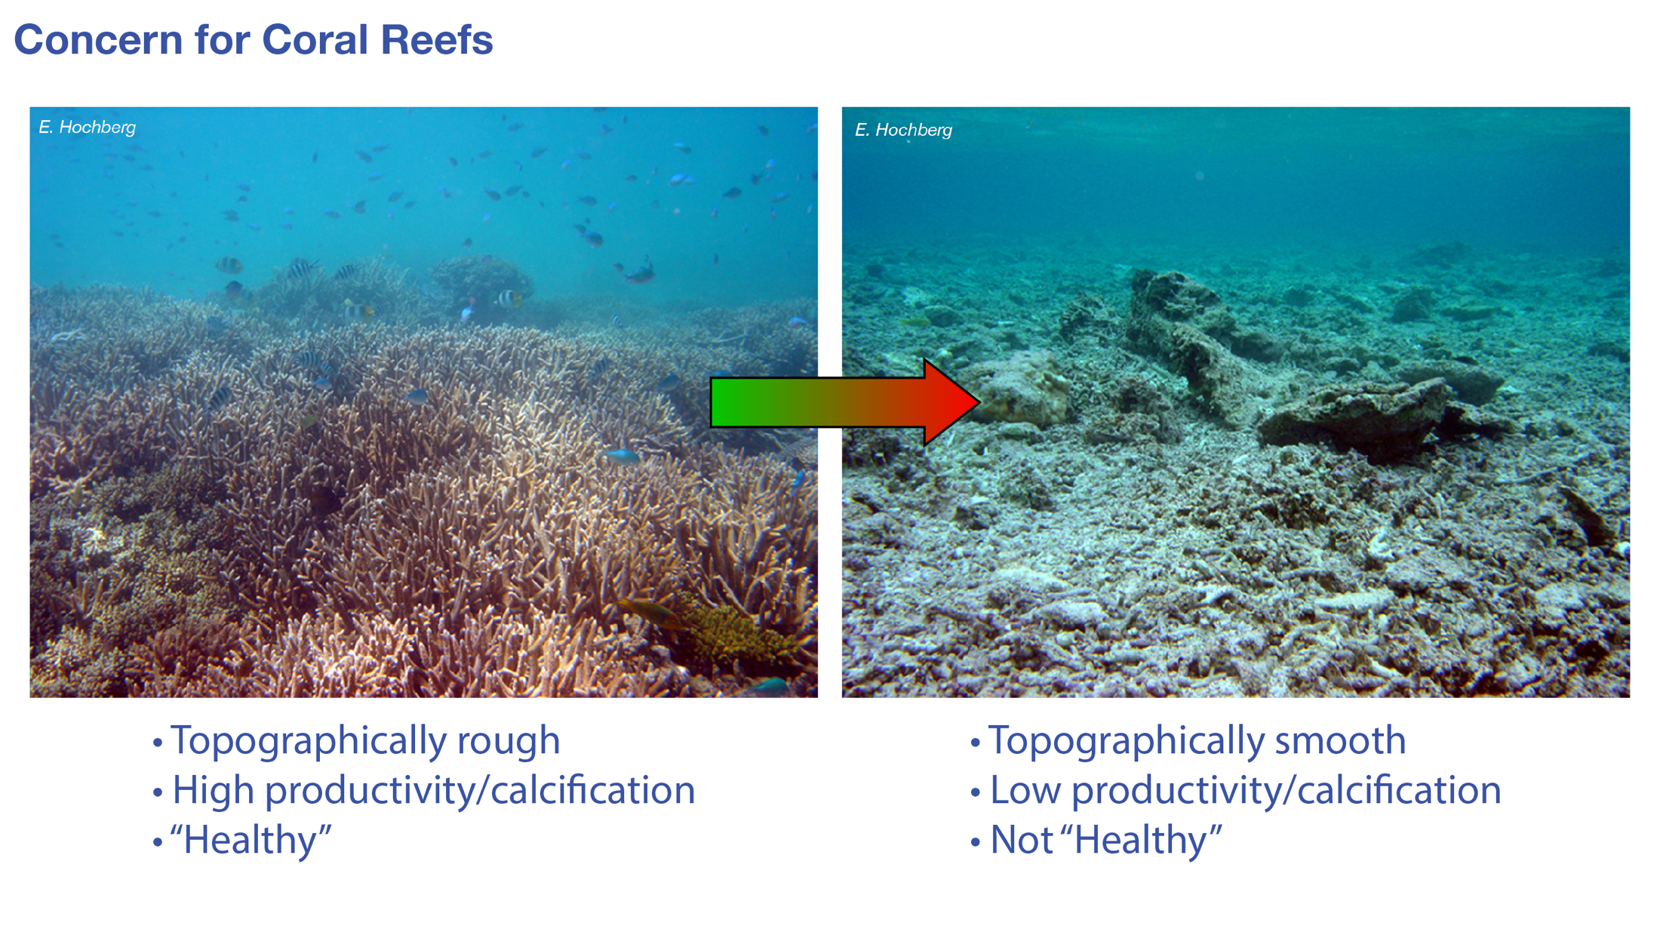

Slide 3
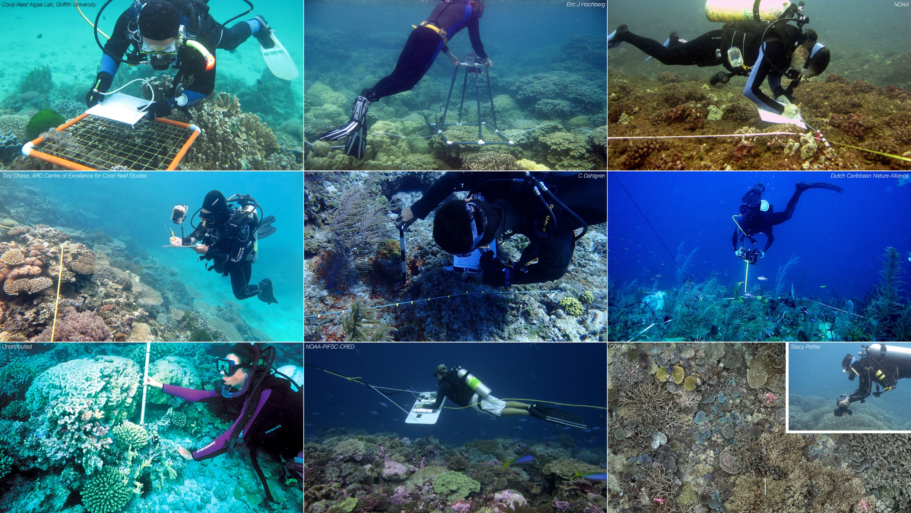

Slide 4
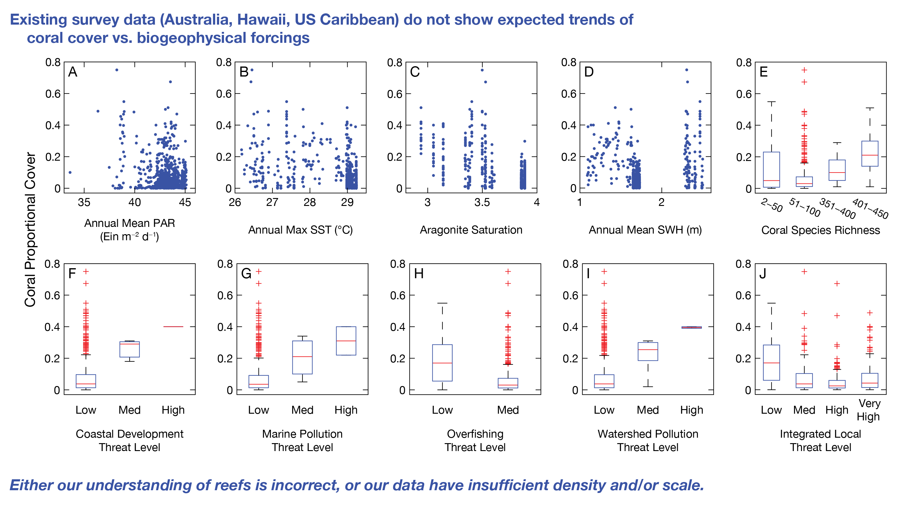

Slide 5


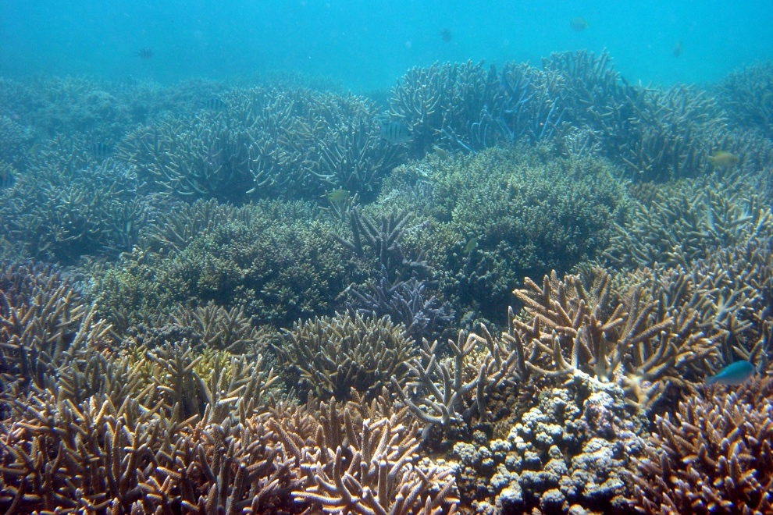

CORAL — COral Reef Airborne Laboratory
Principal Investigator:
Eric J. Hochberg (BIOS)
Project Scientist+Manager:
Michelle Gierach (JPL)
Project Manager (Emeritus):
William Mateer (JPL)
EVS-2 Mission Manager:
Jennifer Olson (LaRC)
Program Scientist:
Paula Bontempi (NASA HQ)

Slide 6
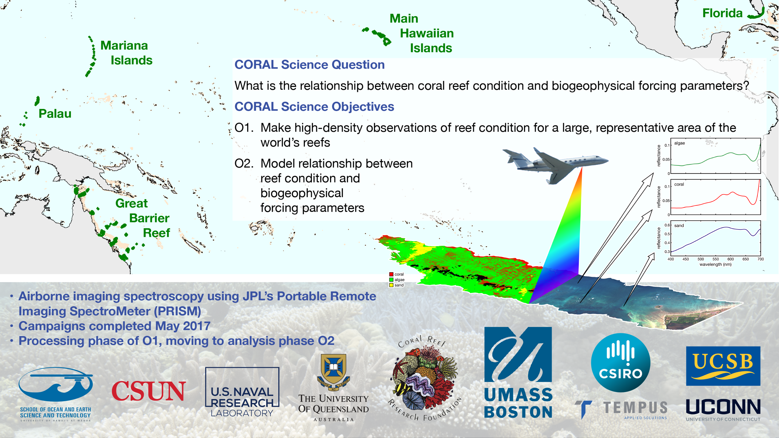

Slide 7

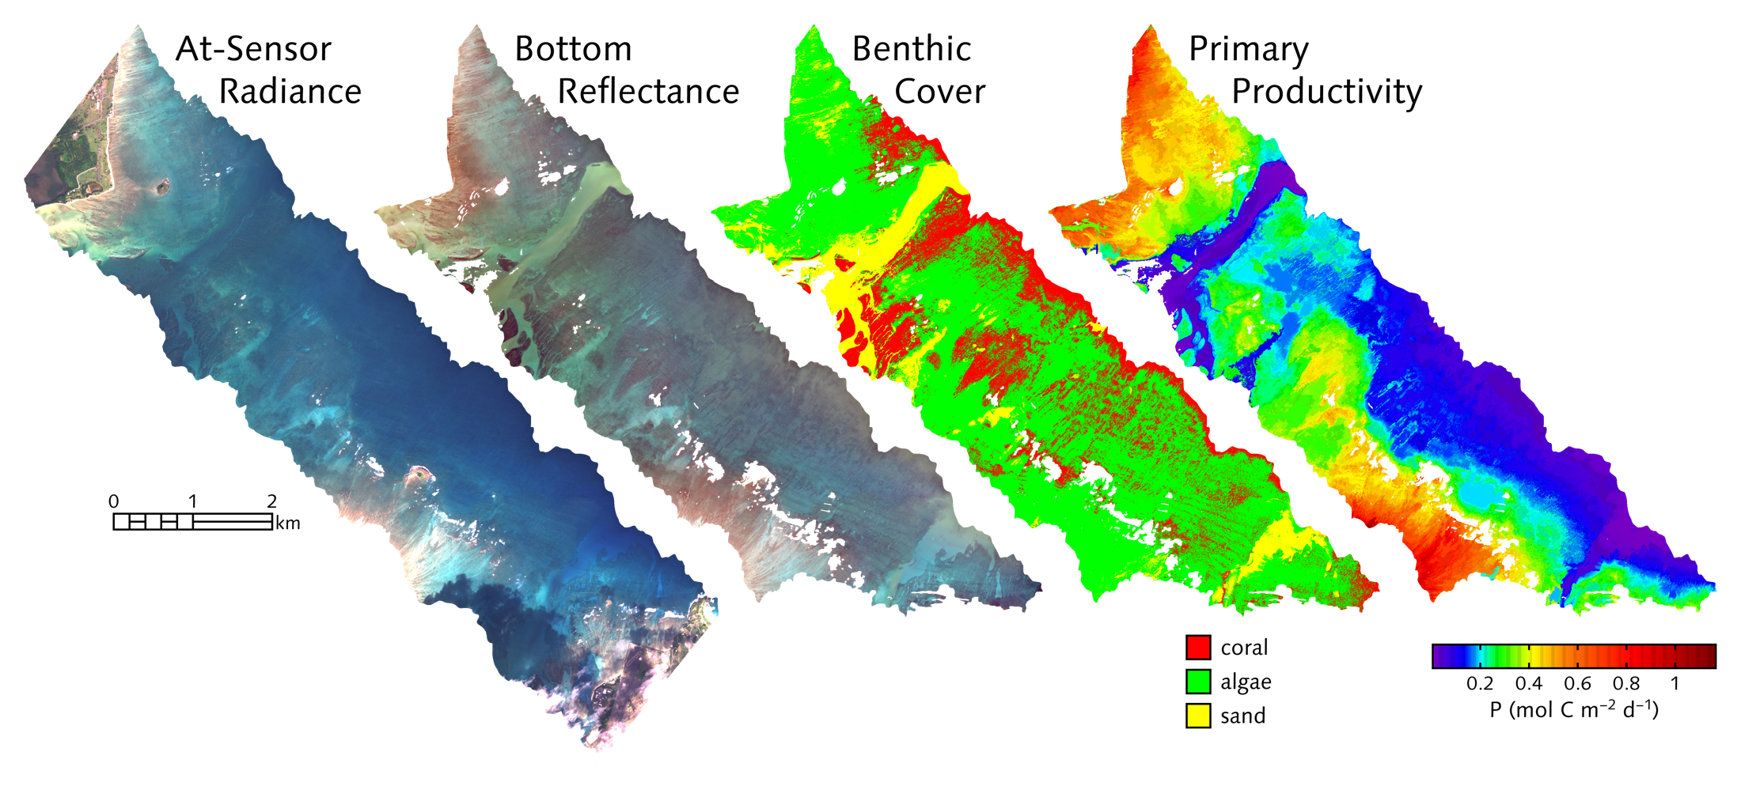
CORAL Image Products

Slide 8
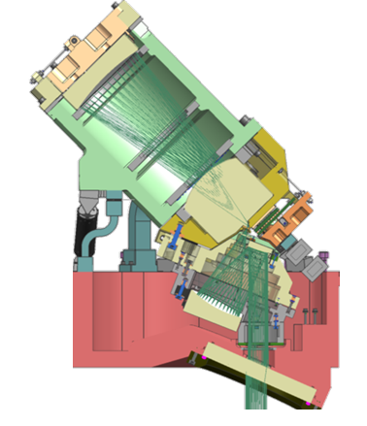
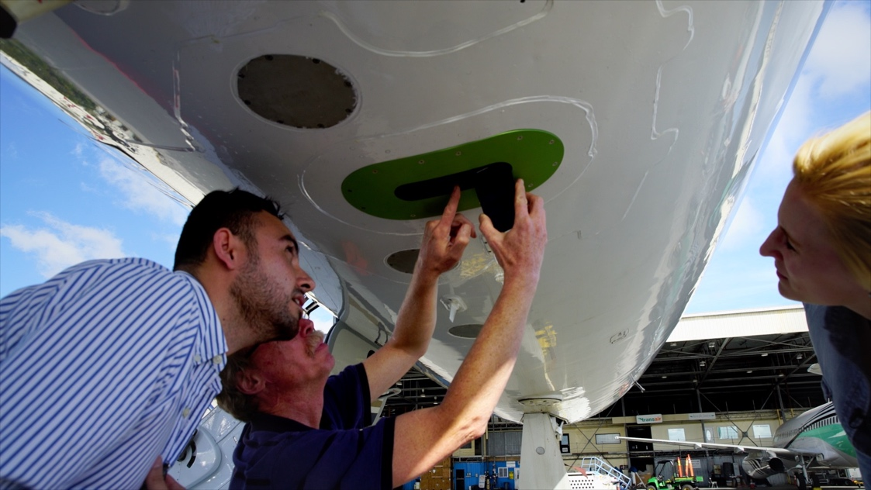
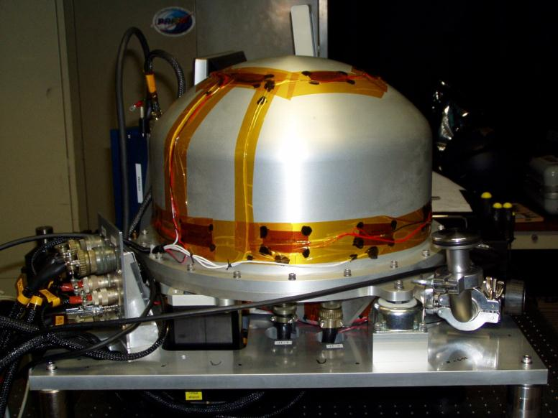
PRISM (Portable Remote Imaging SpectroMeter)
Observables/Parameter | CORAL Requirements | PRISM Performance
Spectral Range | 400-800 nm | 350-1050 nm
Spectral Sampling | ≤10 nm | 2.85 nm
Radiometric SNR | >300 @ 400-800 nm | > 600 @ 400-800 nm
Polarization Sensitivity | ≤1% | <1%
Spectral Uniformity Cross-Track, IFOV Mixing | >90%, <10% | >95%, <5%
Spatial Resolution | ≤10 m | @28kft ≤8 m

Slide 9
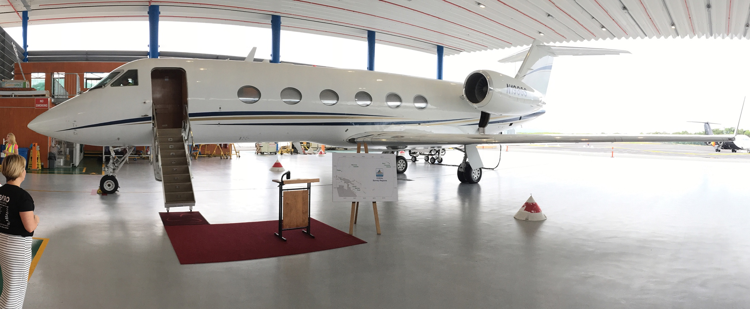
Tempus Applied Solutions G-IV

Slide 10
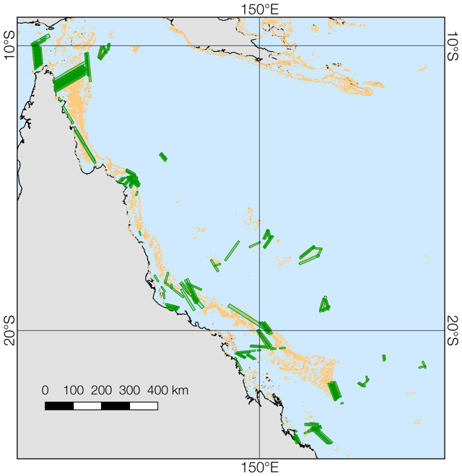
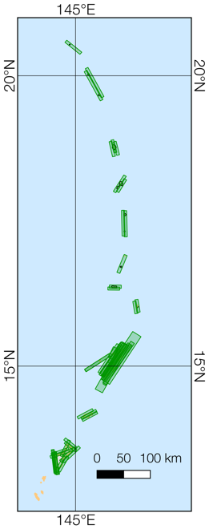
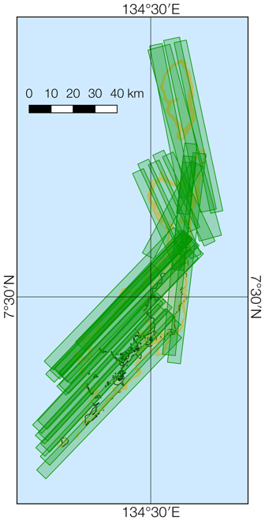
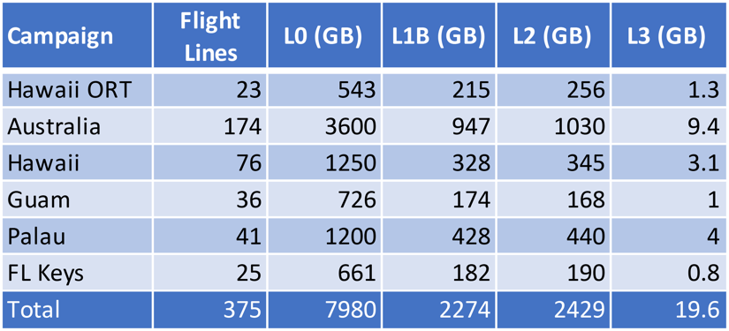
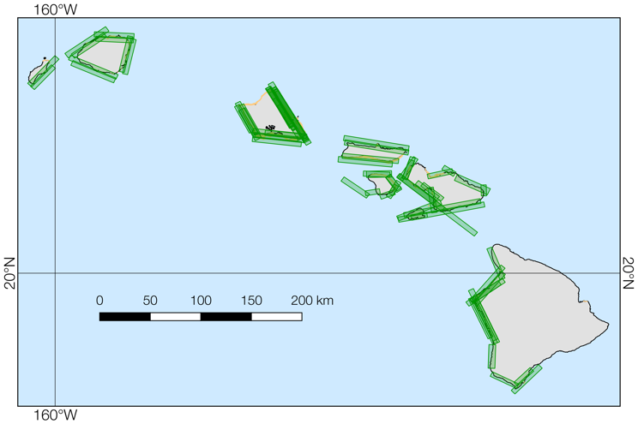
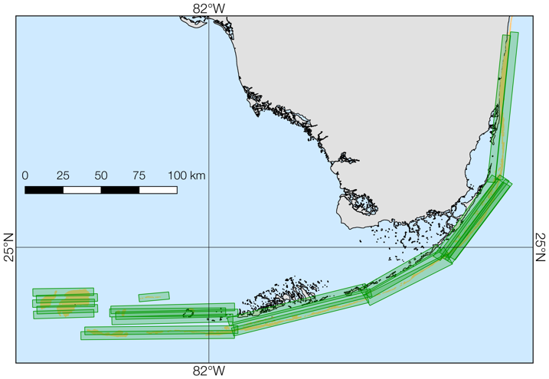
O1: Make high-density observations of reef condition for a large, representative area of the world’s reefs
Sep–Oct 2016
Apr 2017
May 2017
• L1B & L2 data available through CORAL data portal https://coral.jpl.nasa.gov/alt_locator/
• L3 & L4 data to be available upon QA/QC
• Validation available at OB.DAAC (SeaBASS) https://seabass.gsfc.nasa.gov/experiment/CORAL
Feb–Mar 2017
May 2017
Earth Surface Coverage
• 74,756.41 km²
Reef Coverage
• 10,000 km² (est.)
• ~2% world reef area
In-Water Validation
• All campaigns except Florida

Slide 11
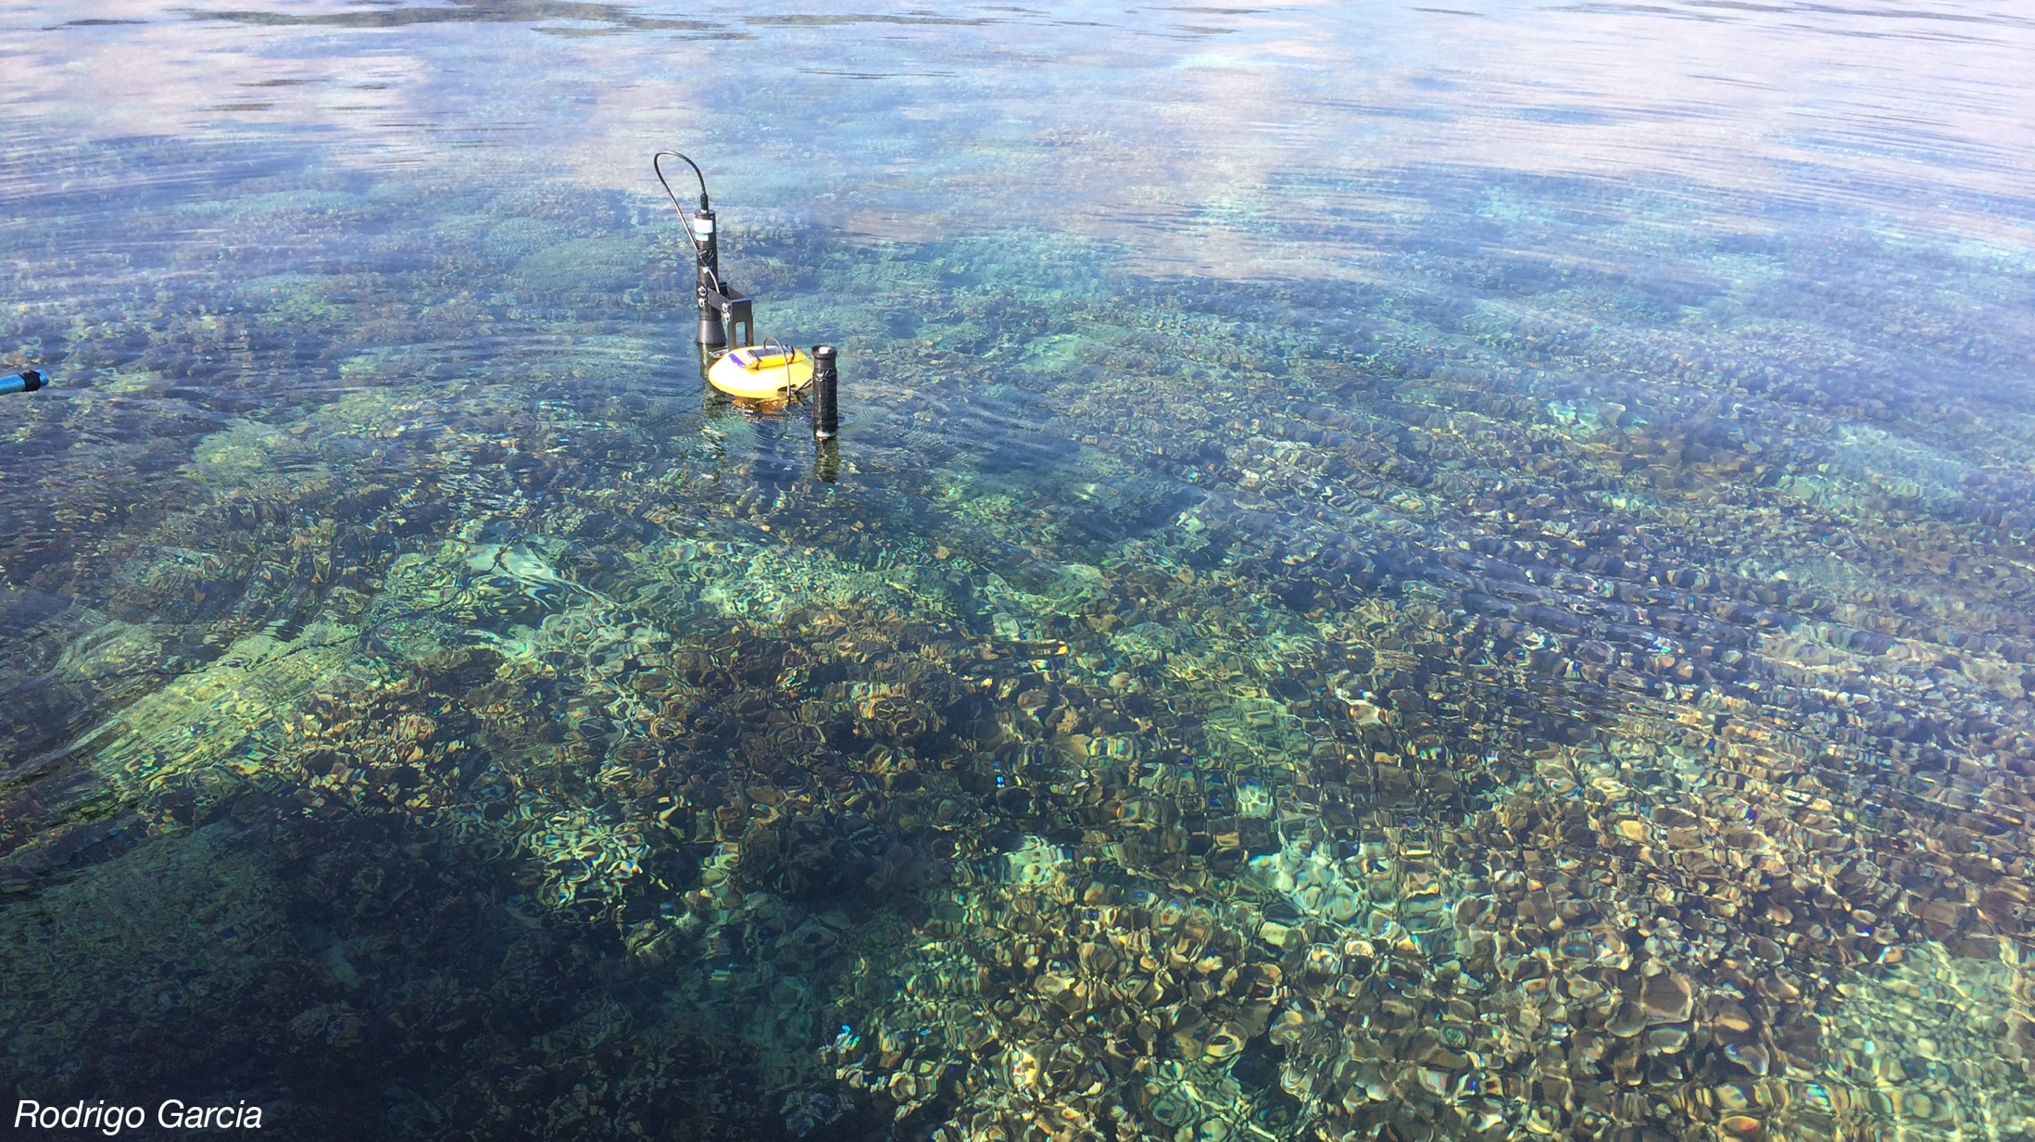
R_{rs}
• Water-leaving radiance
• Downwelling irradiance
>> Atmosphere correction validation

Slide 12
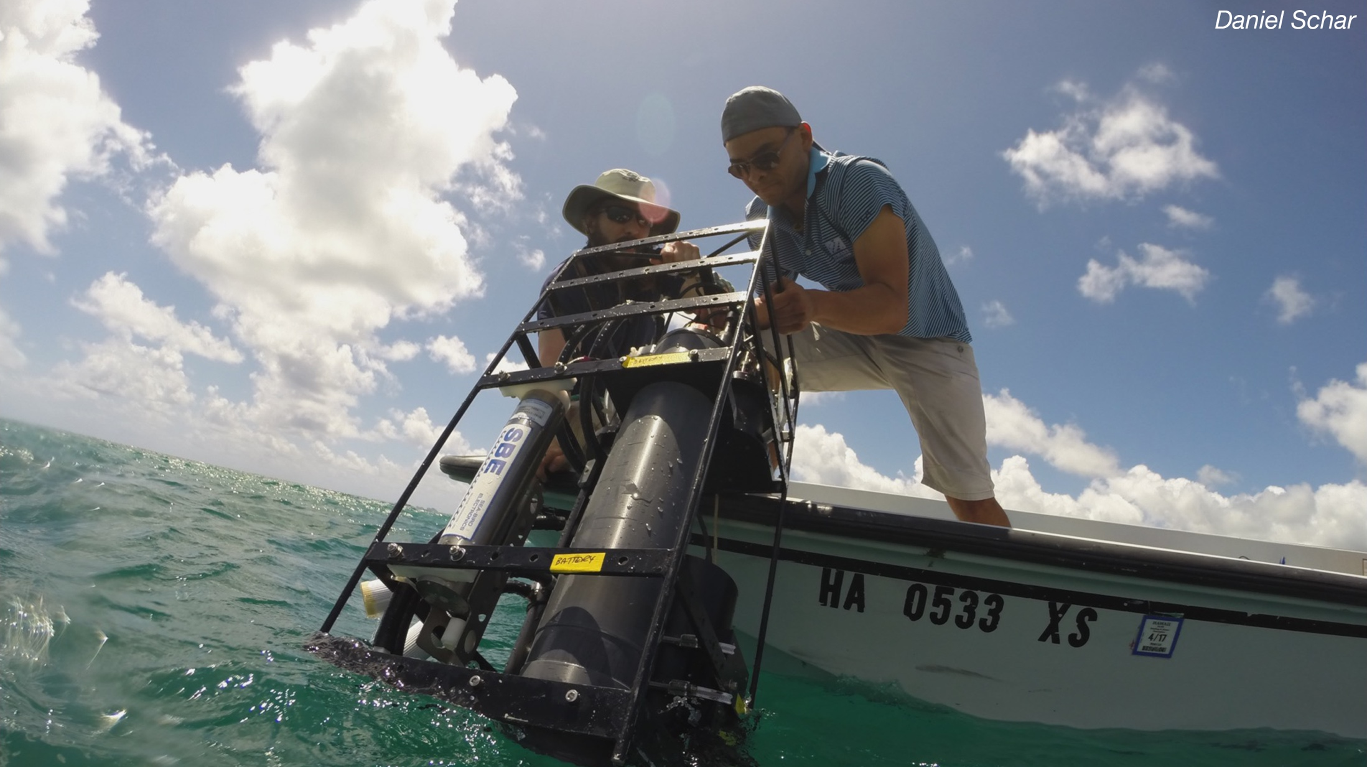
Water IOPs
>> Water column correction validation

Slide 13
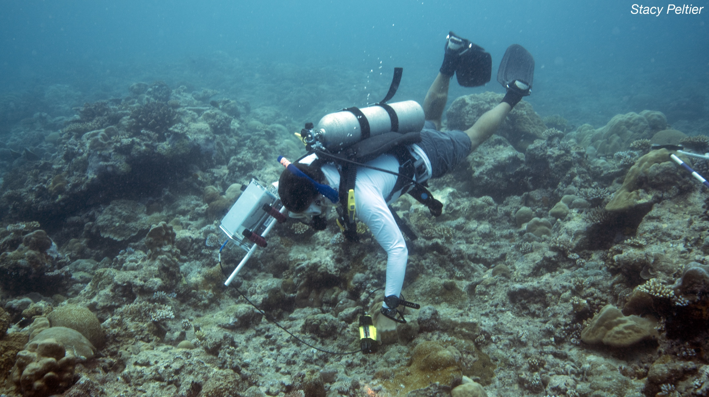
R_{b}
>> Water column correction validation

Slide 14
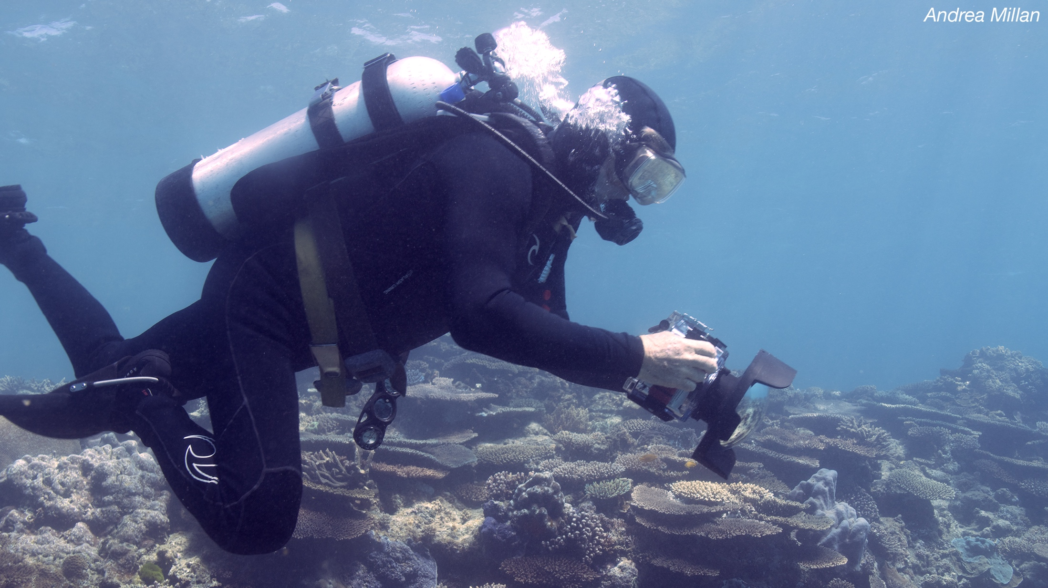
Photomosaics
>> Benthic cover validation

Slide 15
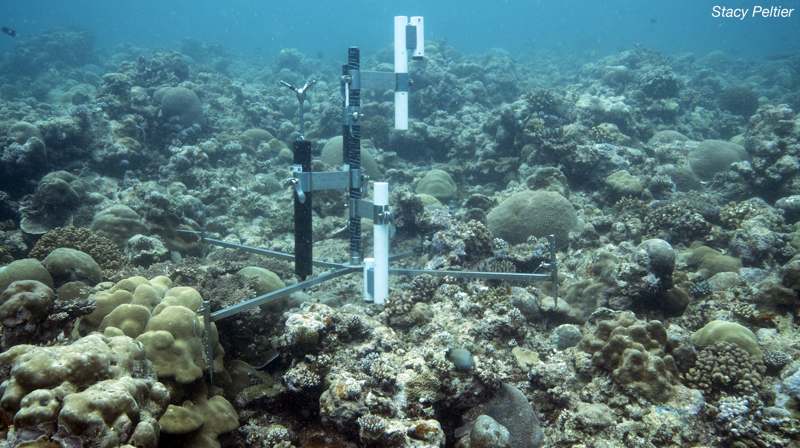
Community Metabolism
>> Reef function validation

Slide 16
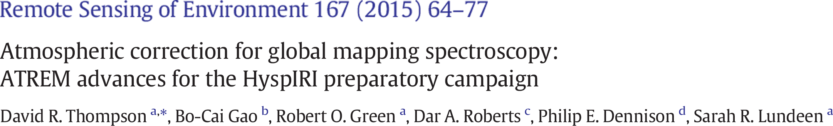
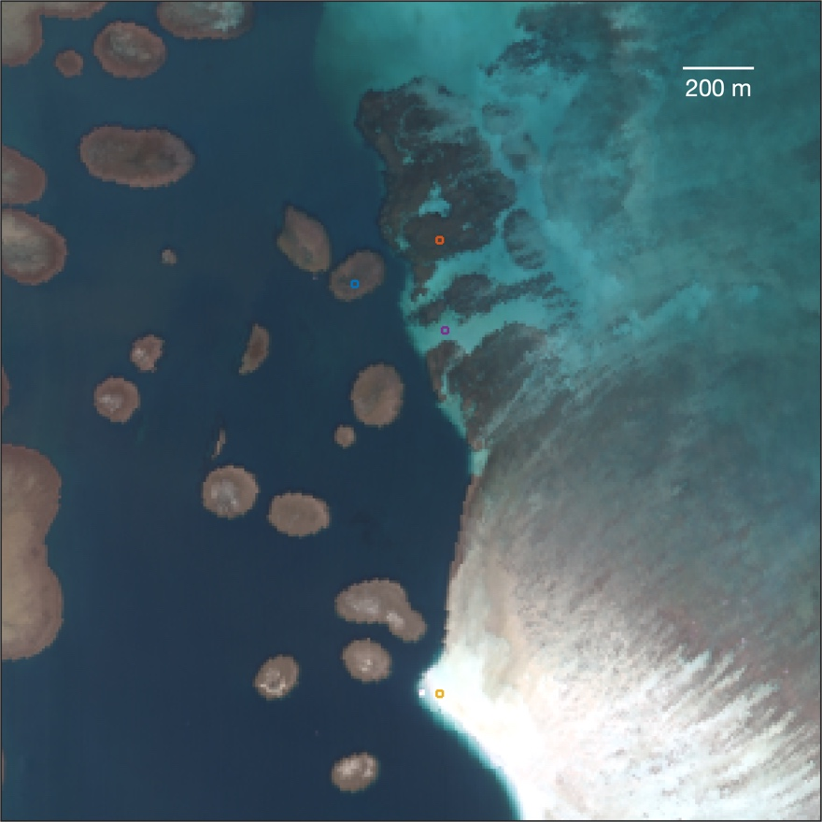
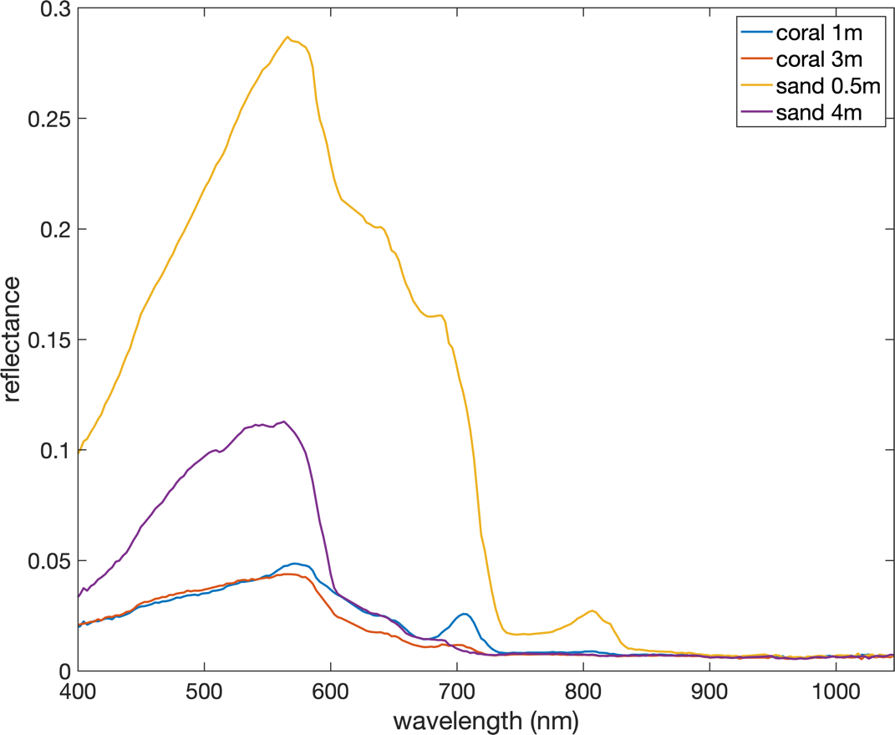
Atmospheric Correction

Slide 17
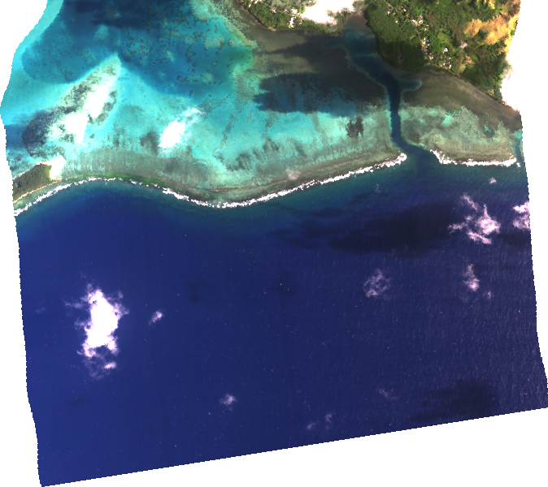
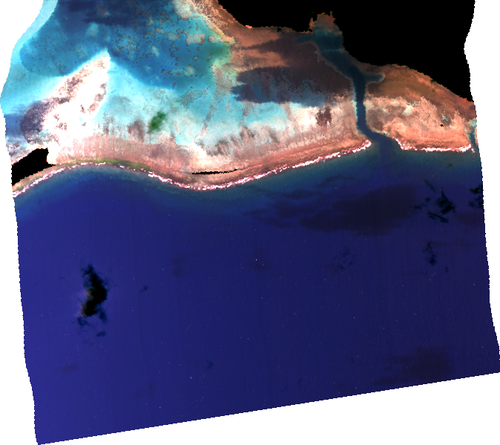
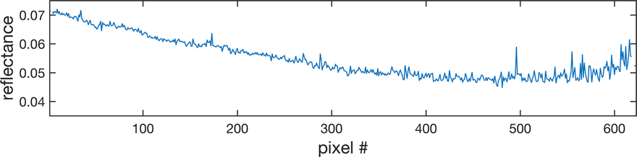
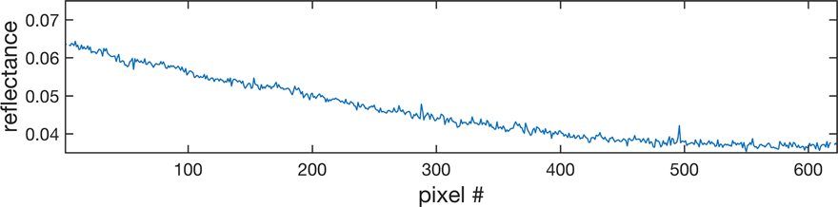
Glint Correction (and Incomplete Atmosphere Correction)
Original Retrieval
Deglinted

Slide 18
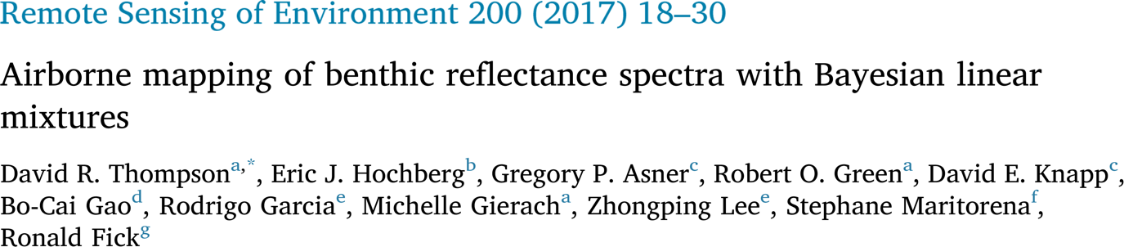
Water Correction & Benthic Retrieval

Slide 19
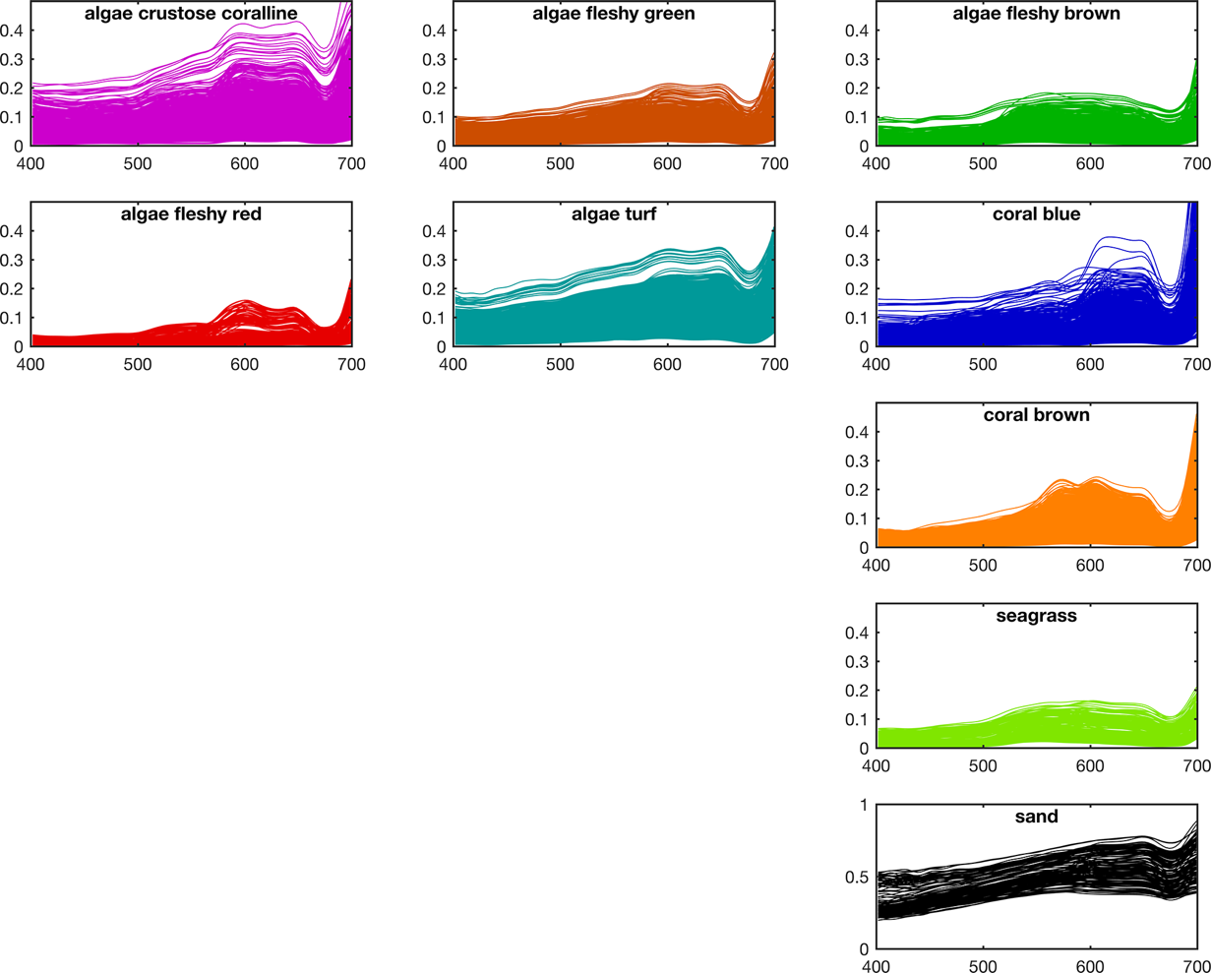
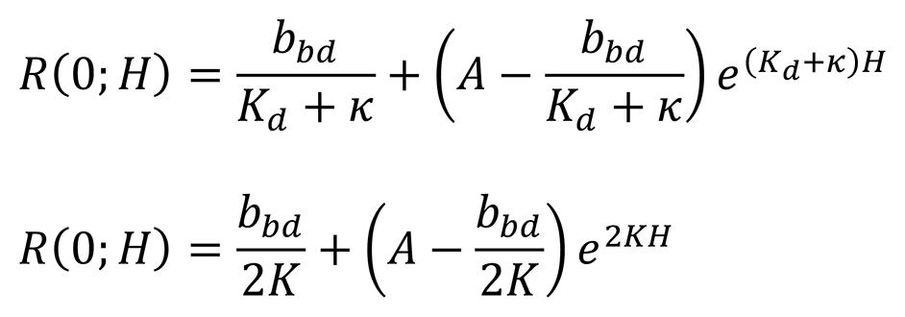
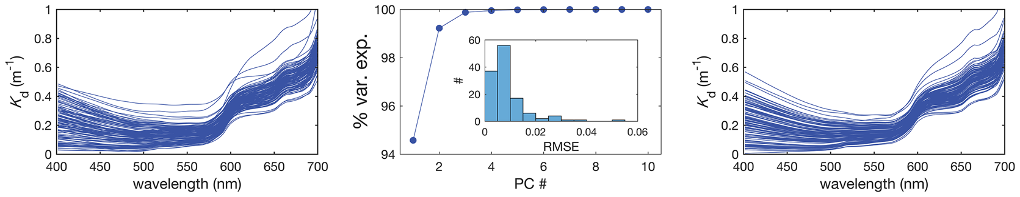
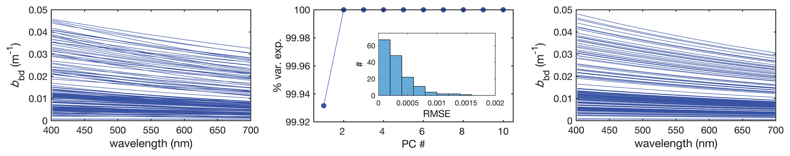
Water Correction & Benthic Retrieval

Slide 20
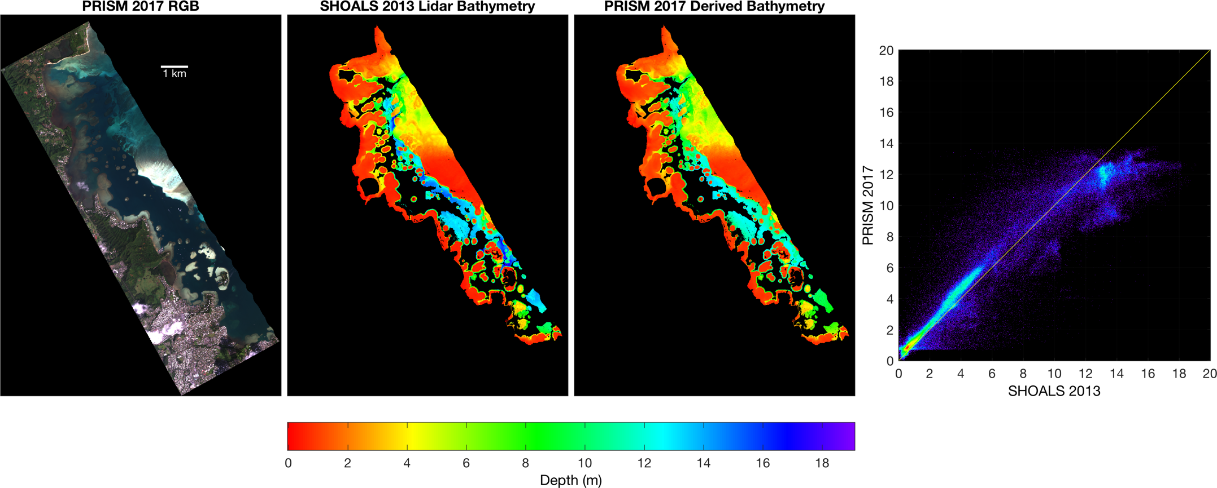
CORAL Retrievals — Depth (and AOPs)

Slide 21
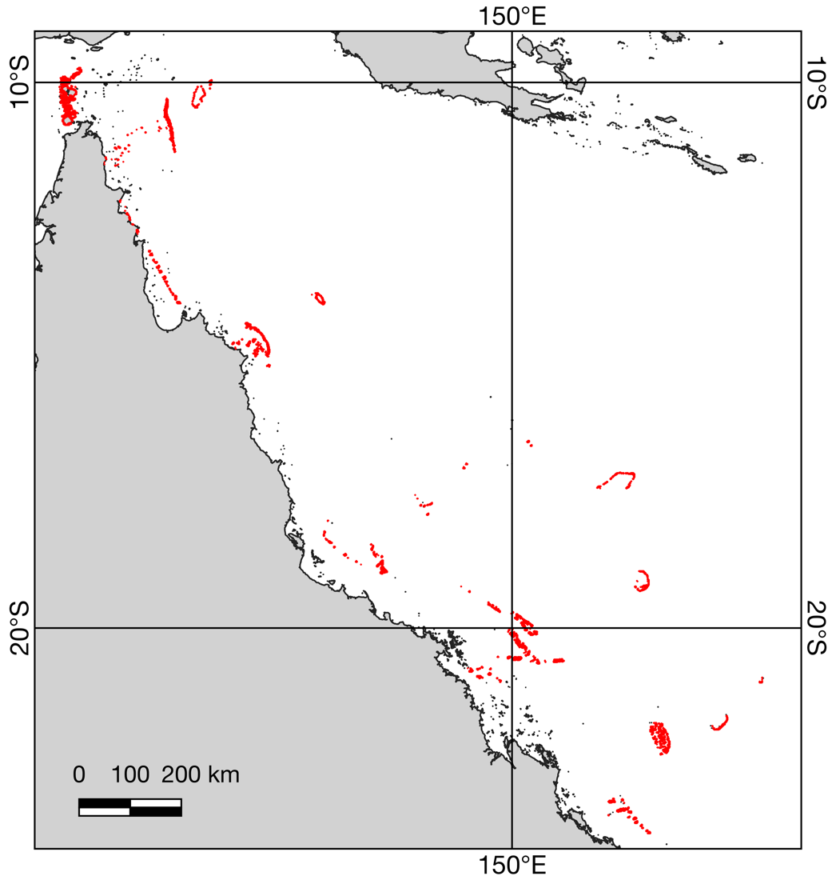
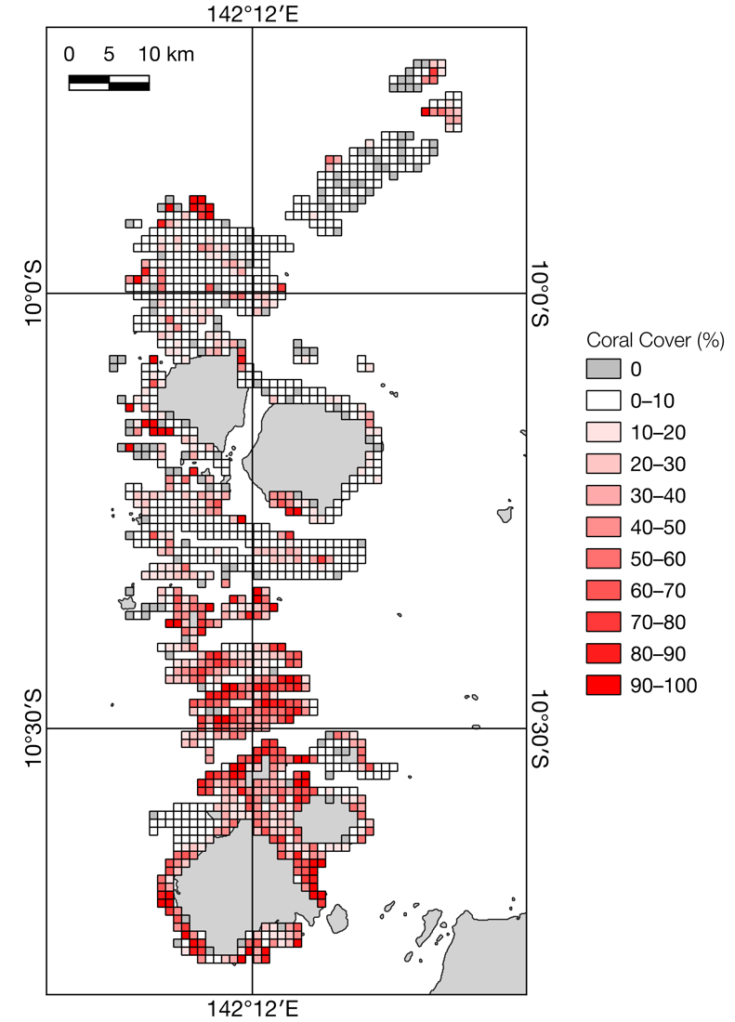
Provisional Results — Great Barrier Reef
Red highlights data locations

Slide 22
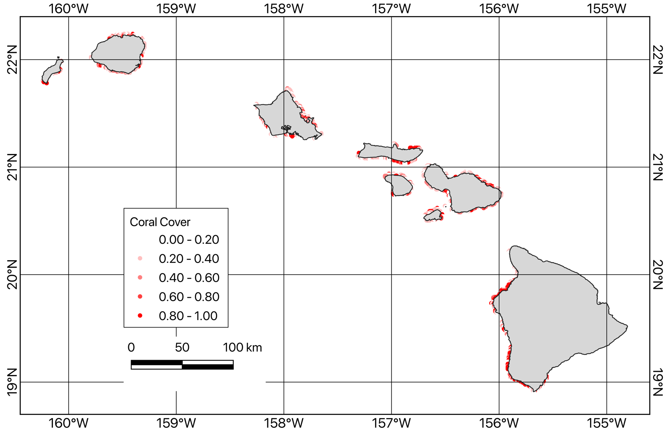
Provisional Results — Hawaii

Slide 23
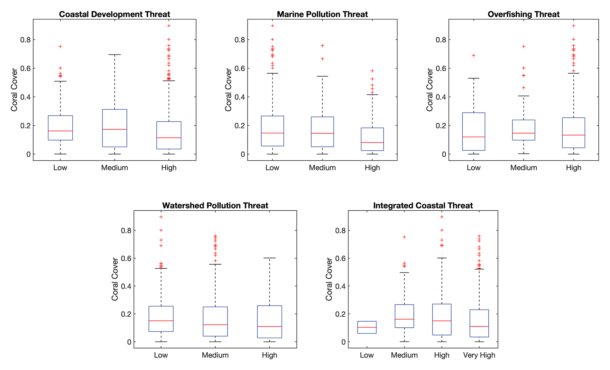
Provisional Results — Hawaii
*
*
*

Slide 24
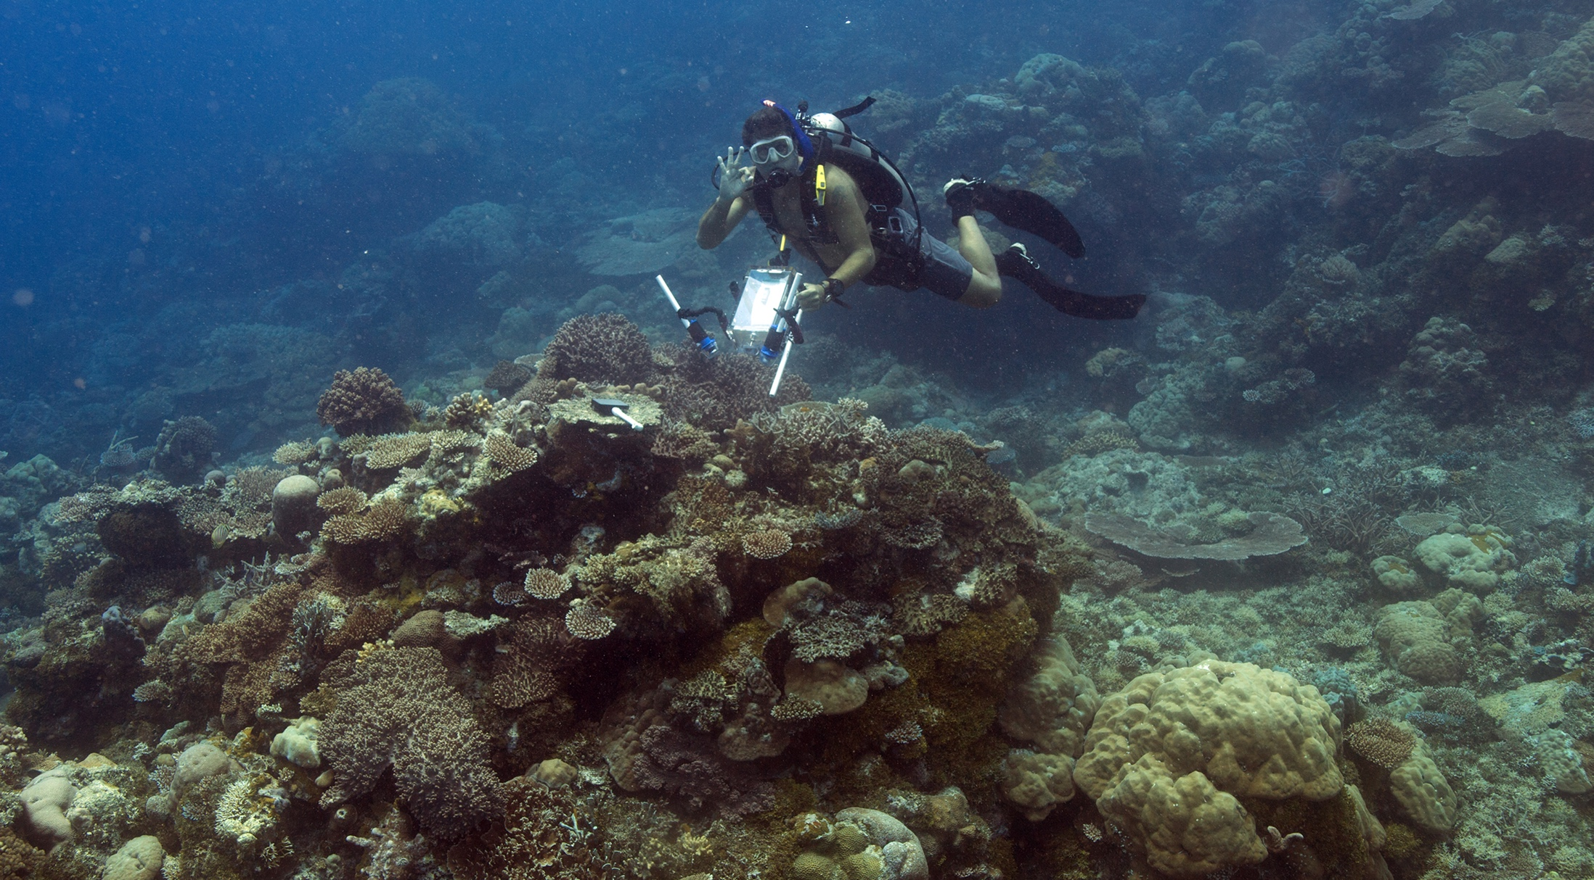
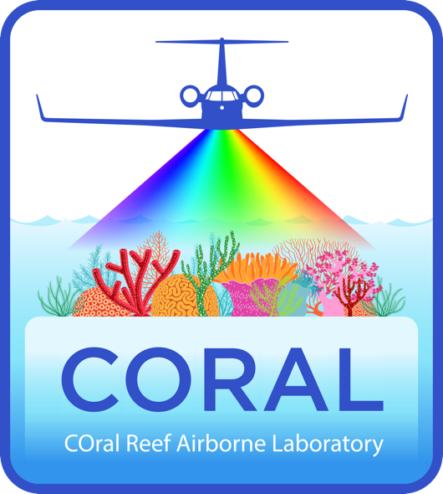
Thanks to NASA (Grant # NNX16AB05G)

