Slide 1



Variations in light absorption by phytoplankton, non-algal particles and colored dissolved organic matter in continental shelf waters of the northern Gulf of Mexico
Sumit Chakraborty and Steven Lohrenz*
The University of Southern Mississippi
*UMASS Dartmouth
NASA OCRT 2012
Seattle

Slide 2
Acknowledgements
This work was supported by funding from NASA (NNX10AU06G) and NSF (OCE-0752254).
Thank you:
Dr. Simon Wright and Dr. Harry Higgins for the latest version of CHEMTAX (v 1.95).
Dr. Donsang Ko for providing the current data from by the Intra-Americas Sea Ocean Nowcast/Forecast System (IASNFS).
Joe Metzger for providing the NOGAPS wind reanalysis products .
Sarah Epps for sharing the SPM data
Captain and crew of R/V Cape Hatteras, R/V Hugh. R Sharp

Slide 3
Outline
Introduction and Background
Light absorption constituents
Northern Gulf of Mexico study region
Patterns of light absorption
Relative contribution of phytoplankton, CDOM and NAP
Variations in spectral slopes
Regional and seasonal variability
Match-ups of MODIS derived Chla (OC3) and QAA products with in-situ data
Summary

Slide 4
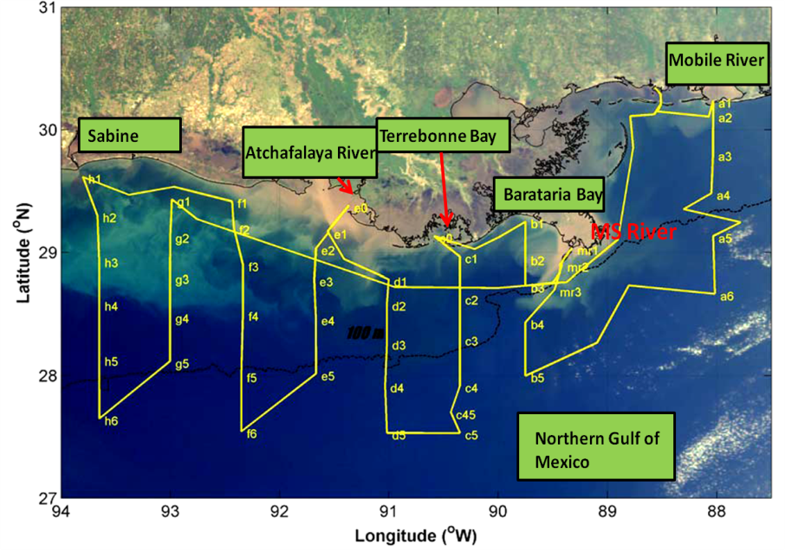
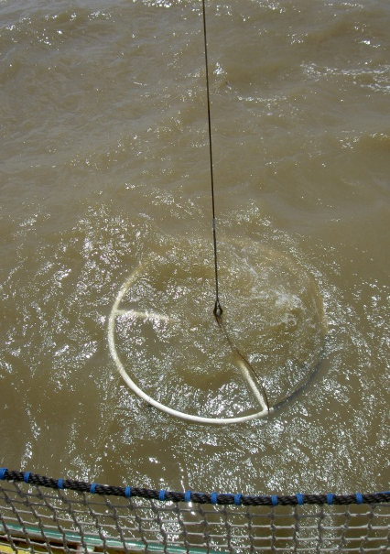
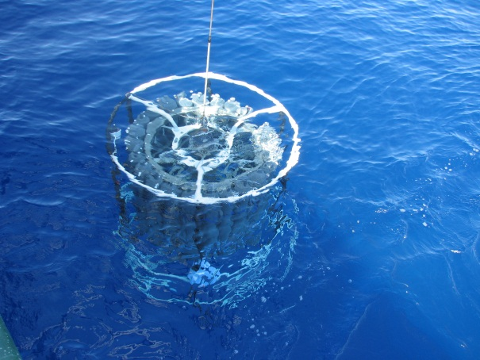
Light absorption
Absorption an inherent optical property and is the sum of individual components within the water column
a_{T}(w)= a_{w}(λ)+a_{CDOM}(λ)+a_{ɸ}()+a_{NAP}(λ)

Slide 5
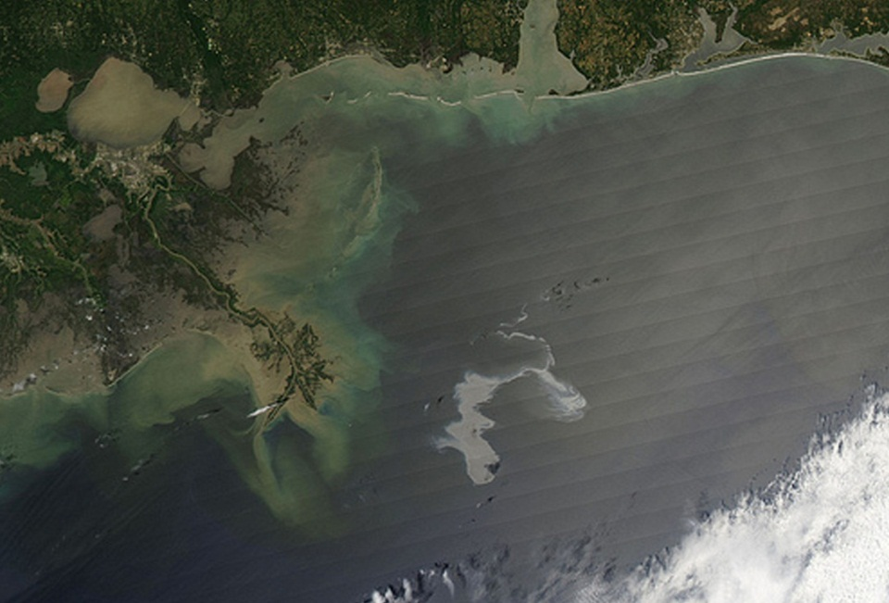

Issues
Coastal Eutrophication
Erosion
Hypoxia
Wetland loss and flooding
Tropical storms
2010 Oil Spill (unknown impact)

Slide 6
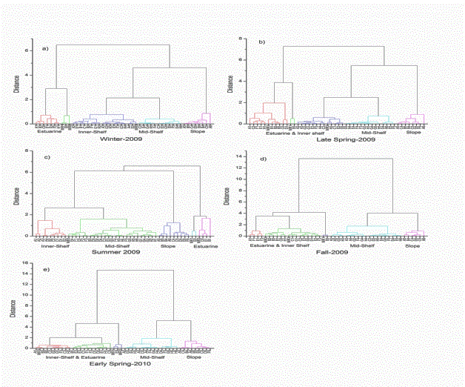
Present Study
GULF CARBON - A total of 5 cruise 9 transects across the continental margin of Northern Gulf of Mexico, Post Hurrincane Rita-2005
Water samples from CTD cast , filtered and stored for laboratory analysis
Cluster Analysis based on with T,S, Chla, Bottom depth – 4 major groups were obtained
Estuarine
Inner-Shelf stations
Stations at the Mid-Shelf
Stations representing the offshore (slope) waters
Notes:
cluster analysis as a thumbnail

Slide 7
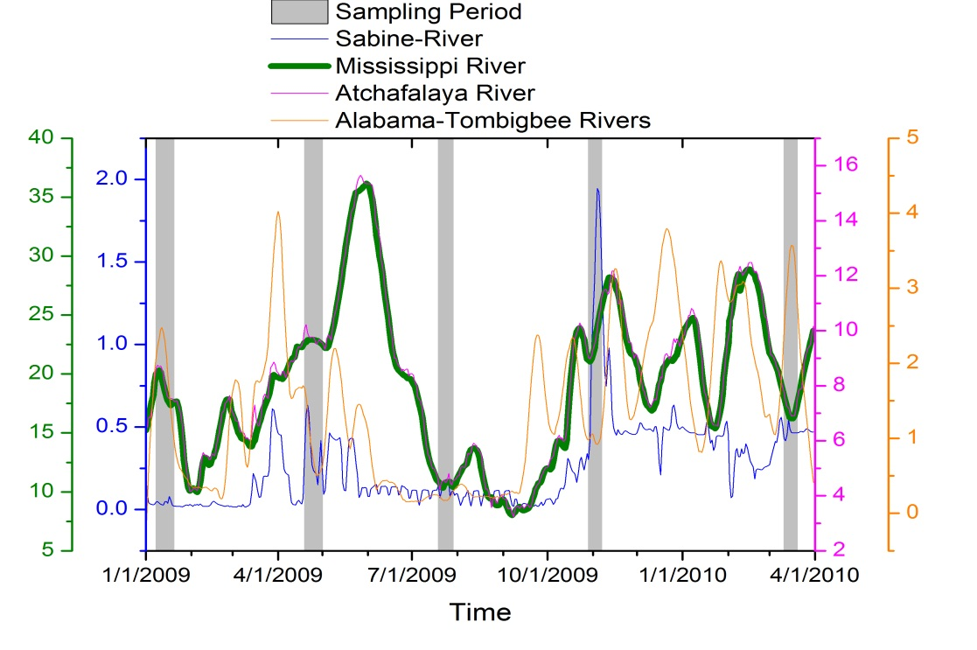
Regional hydrology
Salinity field Summer-2009
NOGAPS wind stress (N m⁻²) Summer-2009
Discharge in liters/sec (Data :http://waterwatch.usgs.gov)
Salinity –plume influenced (27.5-31.2) and non plume influenced (>34)
South-westerly winds (wind stress )
Notes:
Mean annual wind flow direction, persistent easterly winds moves the plume towards the west of the Mississippi delta
Prevailing southwesterly winds moves the plume in the western direction and are generally restricted at the inner-shelf
two events one in summer due to reversal of winds the MS river flow moved offshore affecting some stations of the continental slope and another event in Spring-10, which followed a period of high river discharge and strong southwesterly winds favoring upwelling and show how those influenced the optical properties.

Slide 8
Regional hydrology
Salinity field Spring-2010
NOGAPS winds stress March (1-7)-2010
Discharge in liters/sec (Data :http://waterwatch.usgs.gov)
Extension of low salinity waters from high discharge prior to the cruise
Upwelling favorable winds (Huang et.al (2012 in prep)
Temperature was ~ 2˚C lower at the slope stations compared to MODIS SST climatology
Notes:
Strong wind vectors at the slope

Slide 9
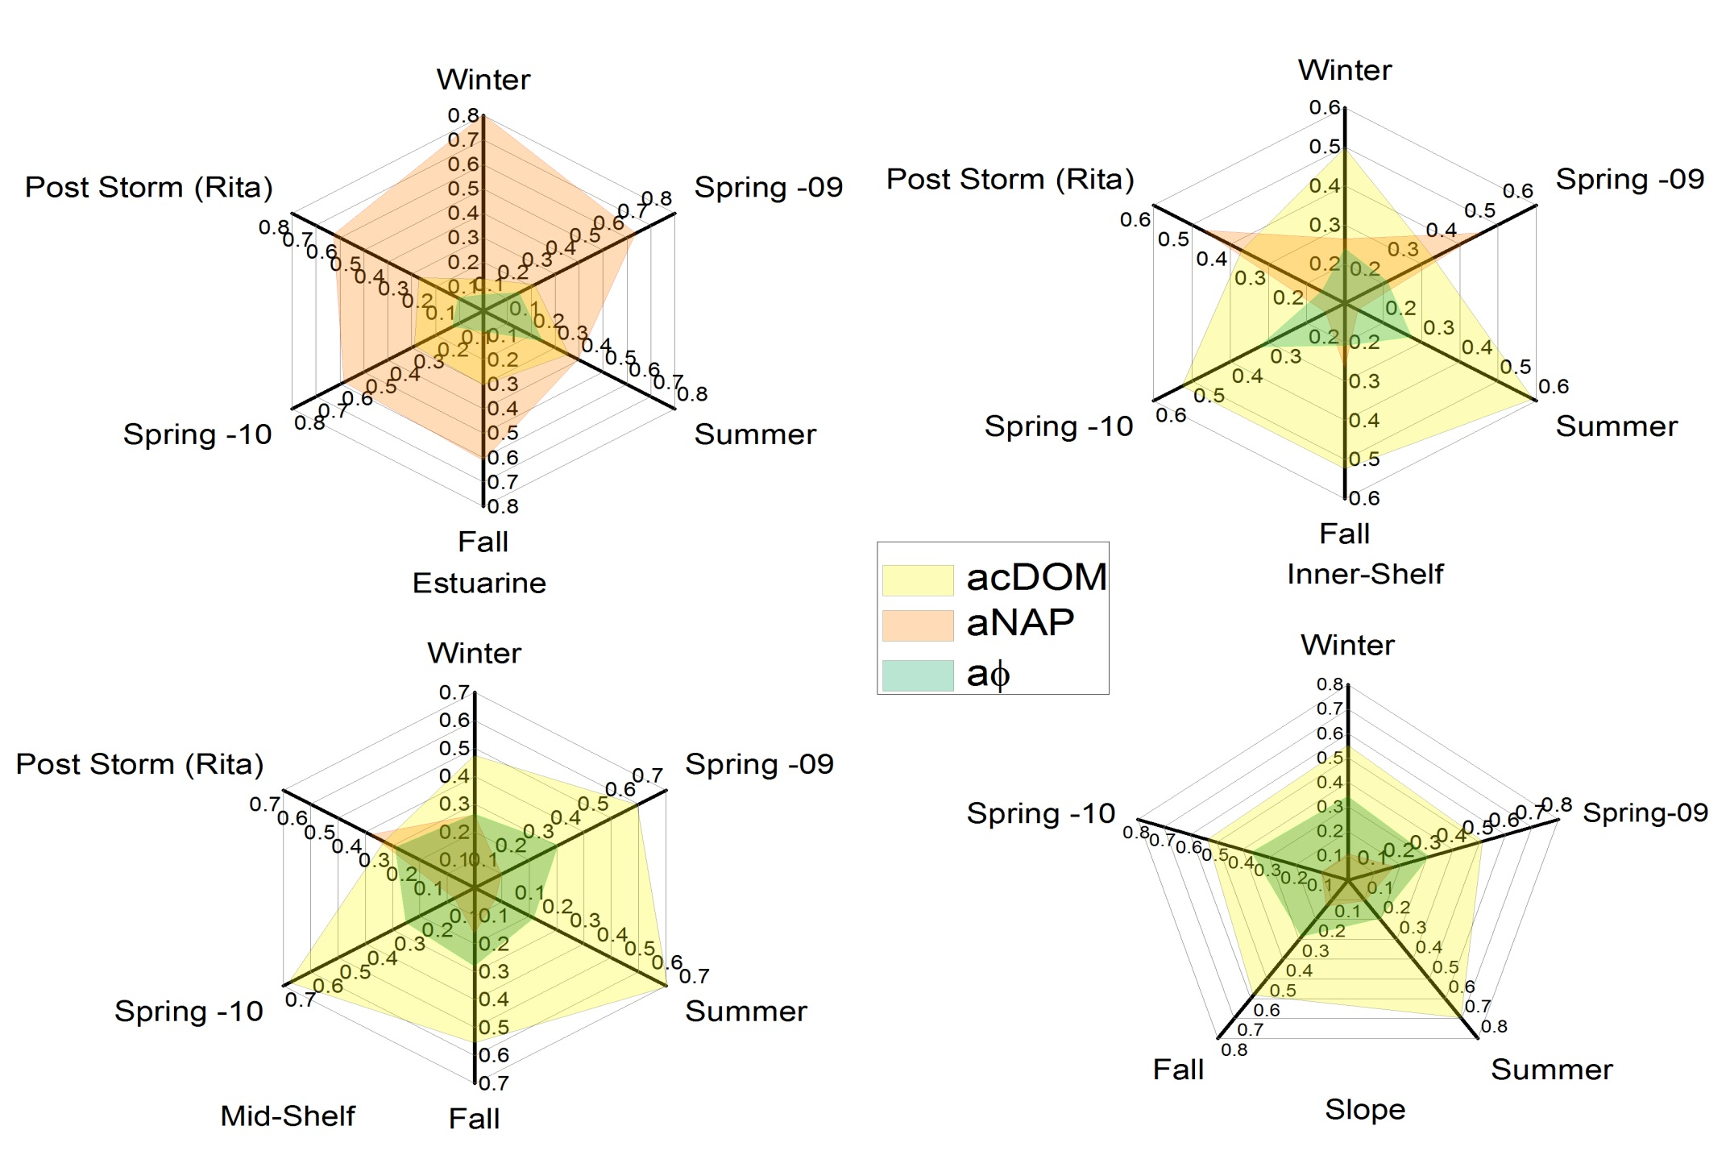
Relative contribution of each component to the total non-water light absorption (at 440nm)
Notes:
Other than the estuarine stations CDOM dominated the light absorption properties for the rest of the continental margin

Slide 10
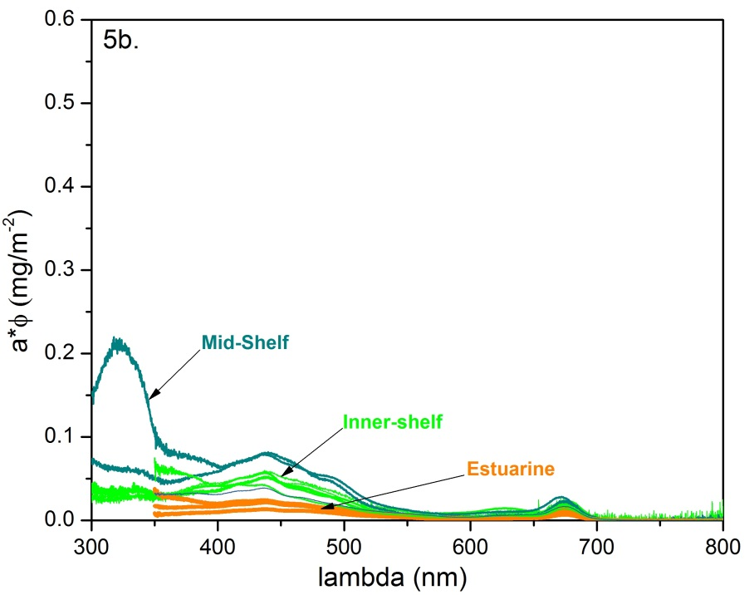
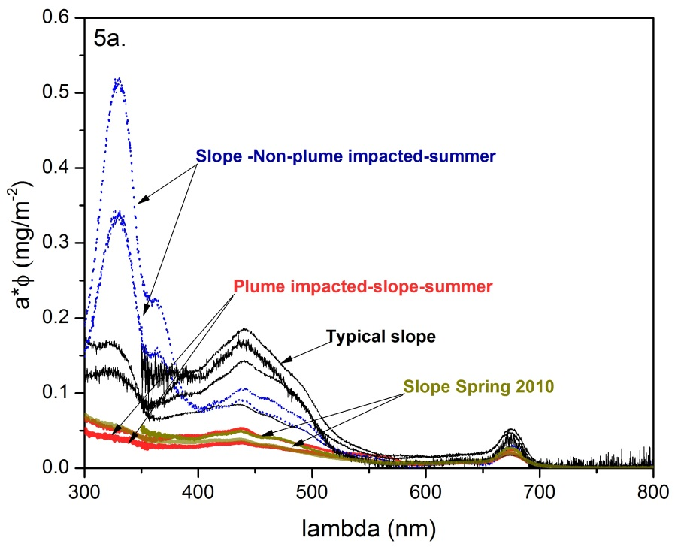
Chla –specific phytoplankton absorption
Tchla (2-42 mg m⁻³) – estuarine
(0.7-22.3 mg -³)- inner-shelf
(0.1-3.4 mg m⁻³)- mid-shelf
Tchla ( 0.04-3.8 mg ⁻³)
a _{ɸ} * tend to decrease with increasing Tchla
(e.g, Lohrenz et al(2003), Bricaud et al (2010))
Transition in phytoplankton size from estuarine to slope (open ocean conditions) stations

Slide 11
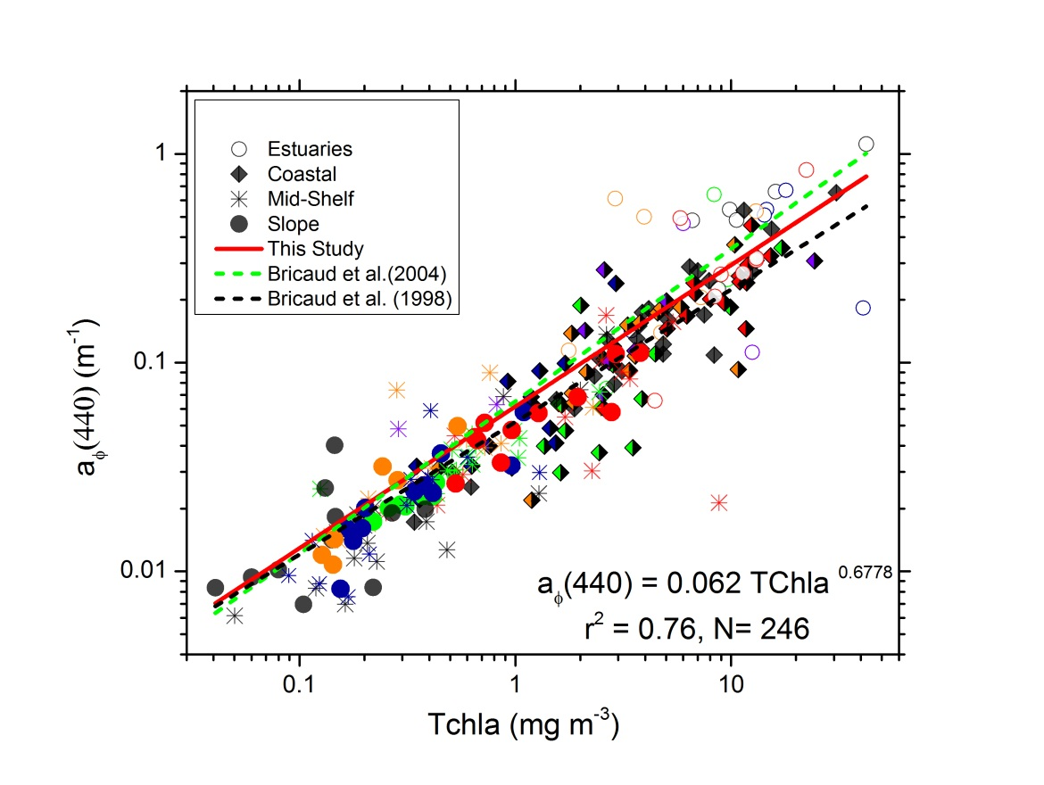
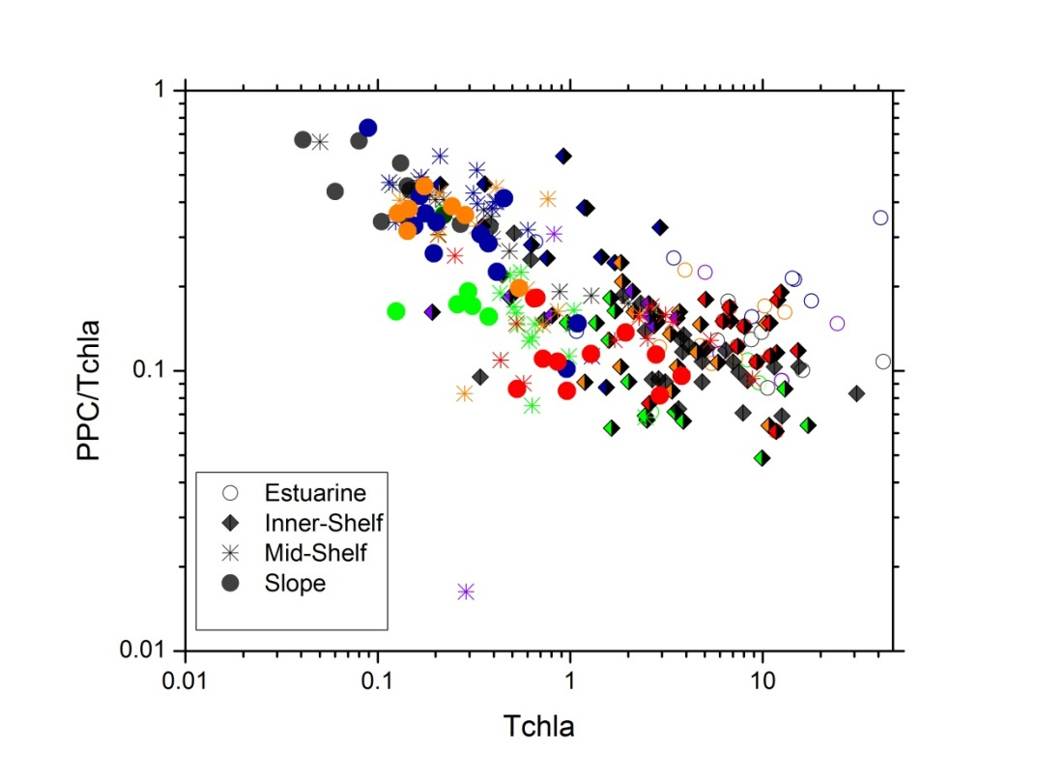
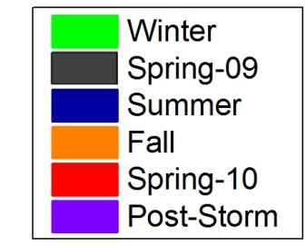
Phytoplankton absorption (440nm)
Inverse relationship with PPC/Tchla , highest values obtained at the slope stations suggesting higher photoacclimation at deeper waters –smaller size fraction, significant seasonal variation were also observed
No particular trend was observed with PSC/Tchla vs TChla

Slide 12
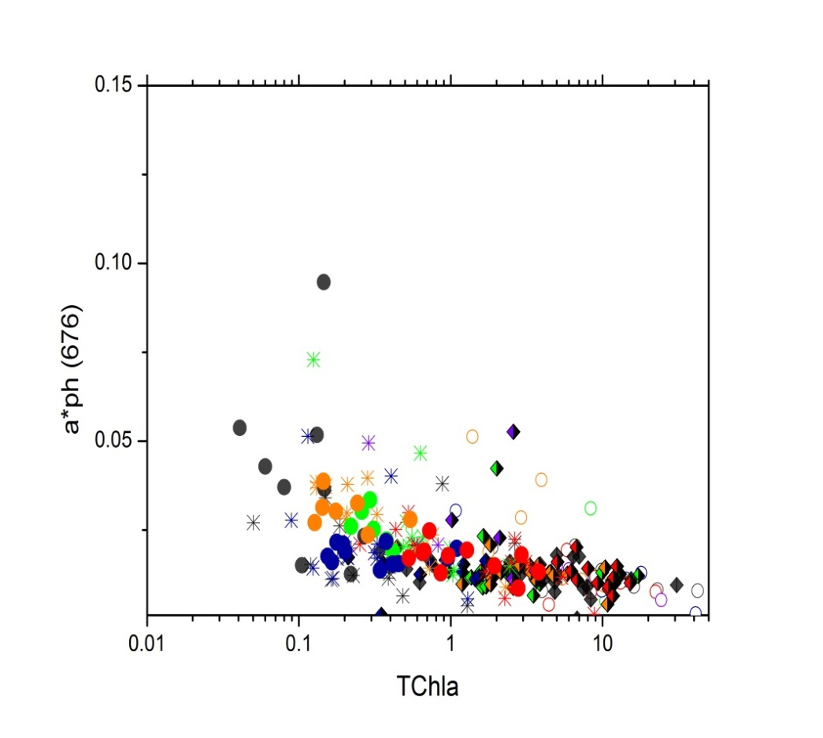
“ size index”, Bricaud et al. (2004)
a “rough estimator” of algal size
SI (µm) = [1*(Pico %) + 5*(Nano %) + 50* (Micro %)]/100
% of Micro, Nano and Pico derived from
DPA (Vidussi et al. 2001) and modified by
Hirata et al (2011)

Slide 13
Community structure derived from HPLC-CHEMTAX
Notes:
Quickly summarize chemtax graphs highlights and summarize

Slide 15
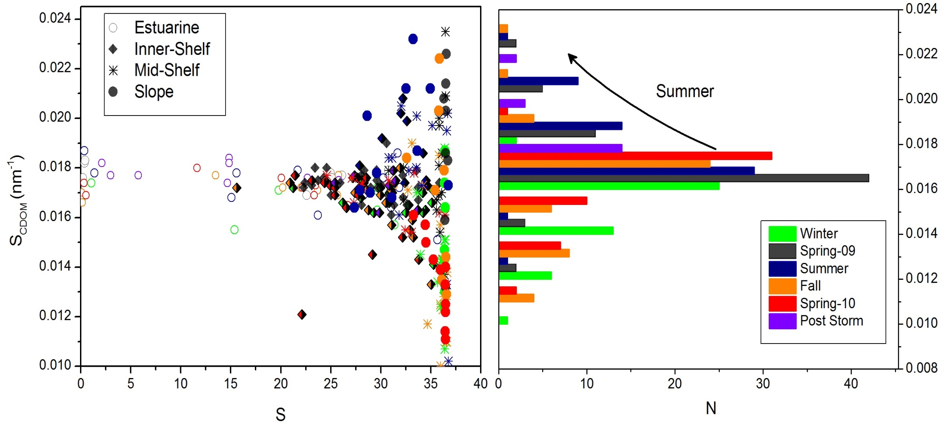
Light Absorption by CDOM
Large Spatial and Temporal variability in CDOM spectral slopes, much larger than some other large scale coastal scale studies (e.g. Babin et.al (2003))
S_{CDOM} (350-500), a_{cDOM}(λ)=a_{cDOM}(λ_{r})exp(-S_{cDOM}(λ-λr))

Slide 16
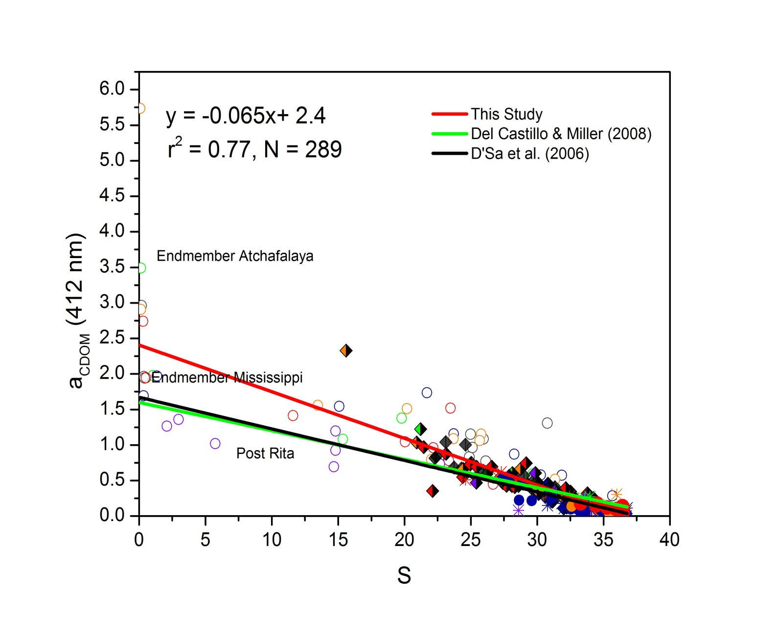
Significant difference between in Mississippi and Atchafalaya endmembers
Considerable scatter at mid-salinity implies potential source due to enhanced primary productivity or its bacterial degradation
Post storm low
Notes:
Transition offshore scene, larger gulf , arrows, we covered a larger temporal and spatial coverage

Slide 17
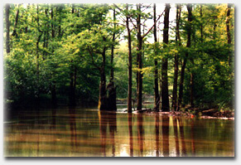
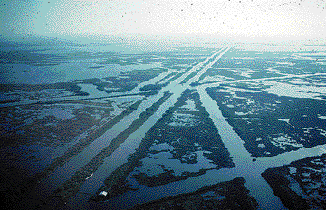
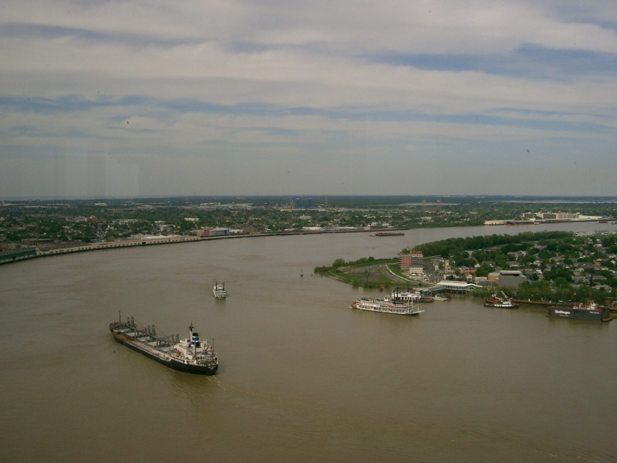
From USGS (Fact Sheet on Louisiana Coastal Wetlands)
A more pristine environment prevails at the Atchafalaya River Basins (Conmy et.al, 2004)
Canals dredged for navigation and hydrocarbon exploration in Louisiana
Notes:
Although both rivers originate from the same
source, the physical environments after branching
are much different, where the Mississippi is heavily
traveled by boats and has been altered by dredging
and locks. The Atchafalaya, in contrast, is a more
pristine river allowing for more leaching of organics
into the river.

Slide 18
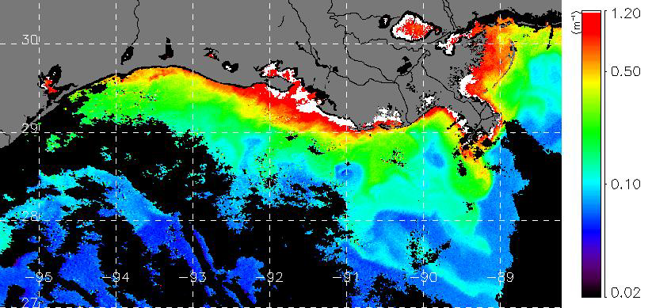
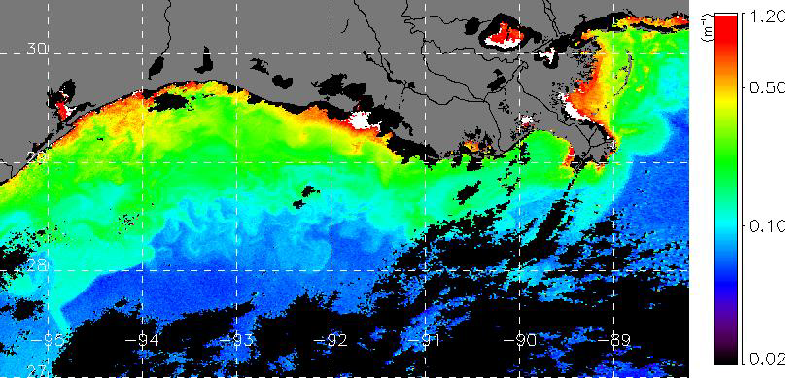
Pre Hurricane Rita
High CDOM at the inner-shelf prior to Hurricane Rita
Land fall and subsequent flooding
Post Hurricane Rita
Flux of offshore low cDOM waters
High Kd(490) Lohrenz (2008)
Satellite images from D’Sa and Korobkin (2006)

Slide 19
Light Absorption by NAP

Slide 20
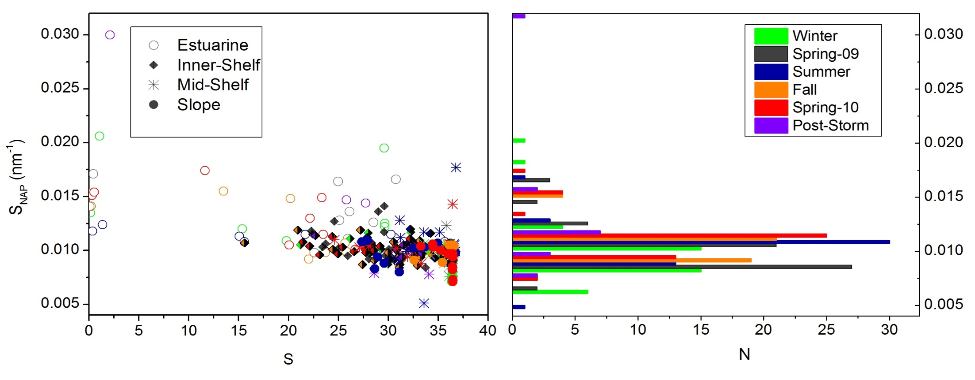
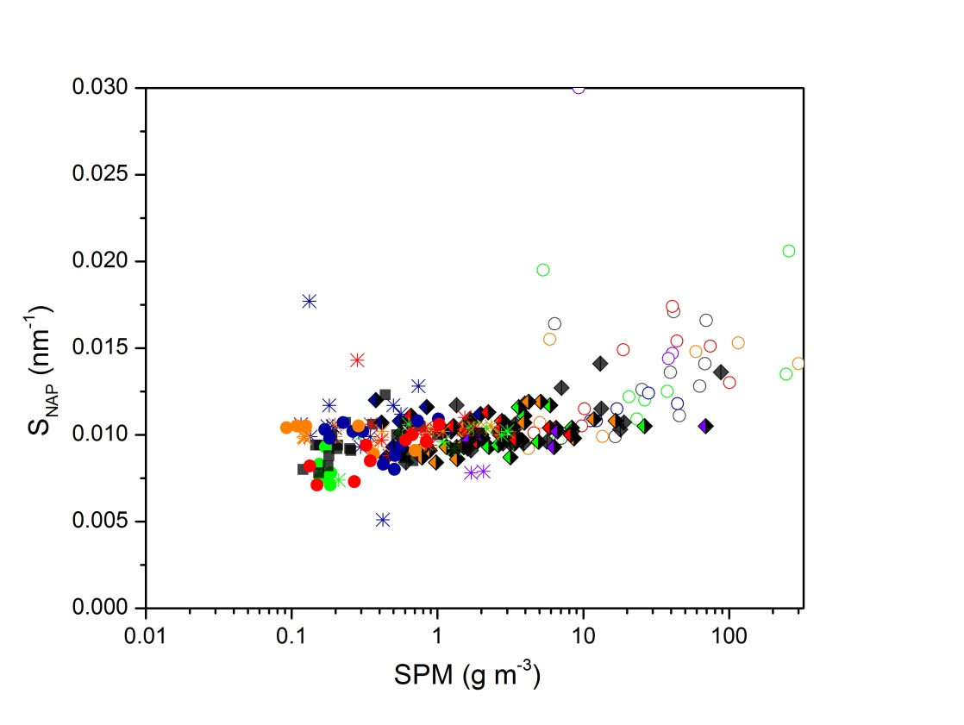
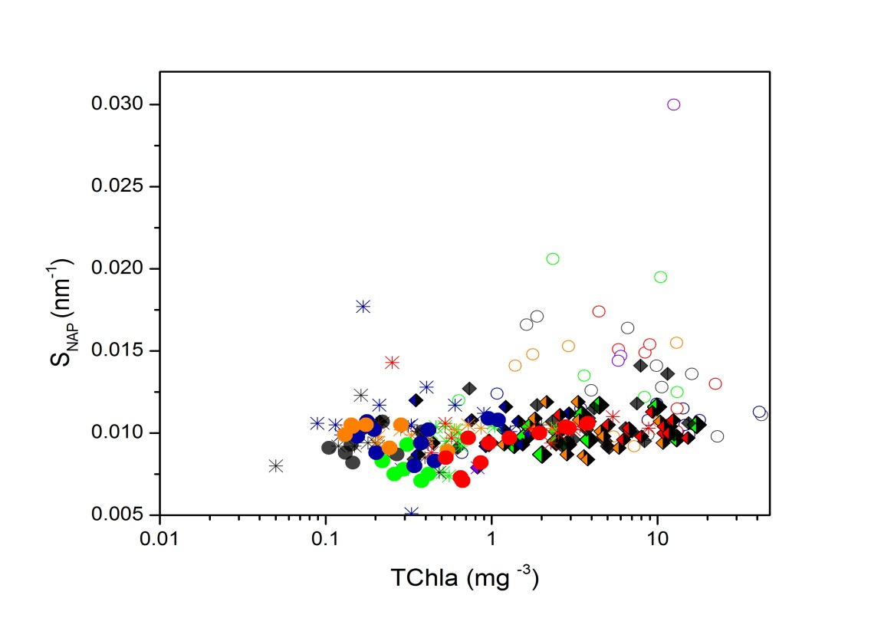
S_{NAP} (380-730)

Slide 21
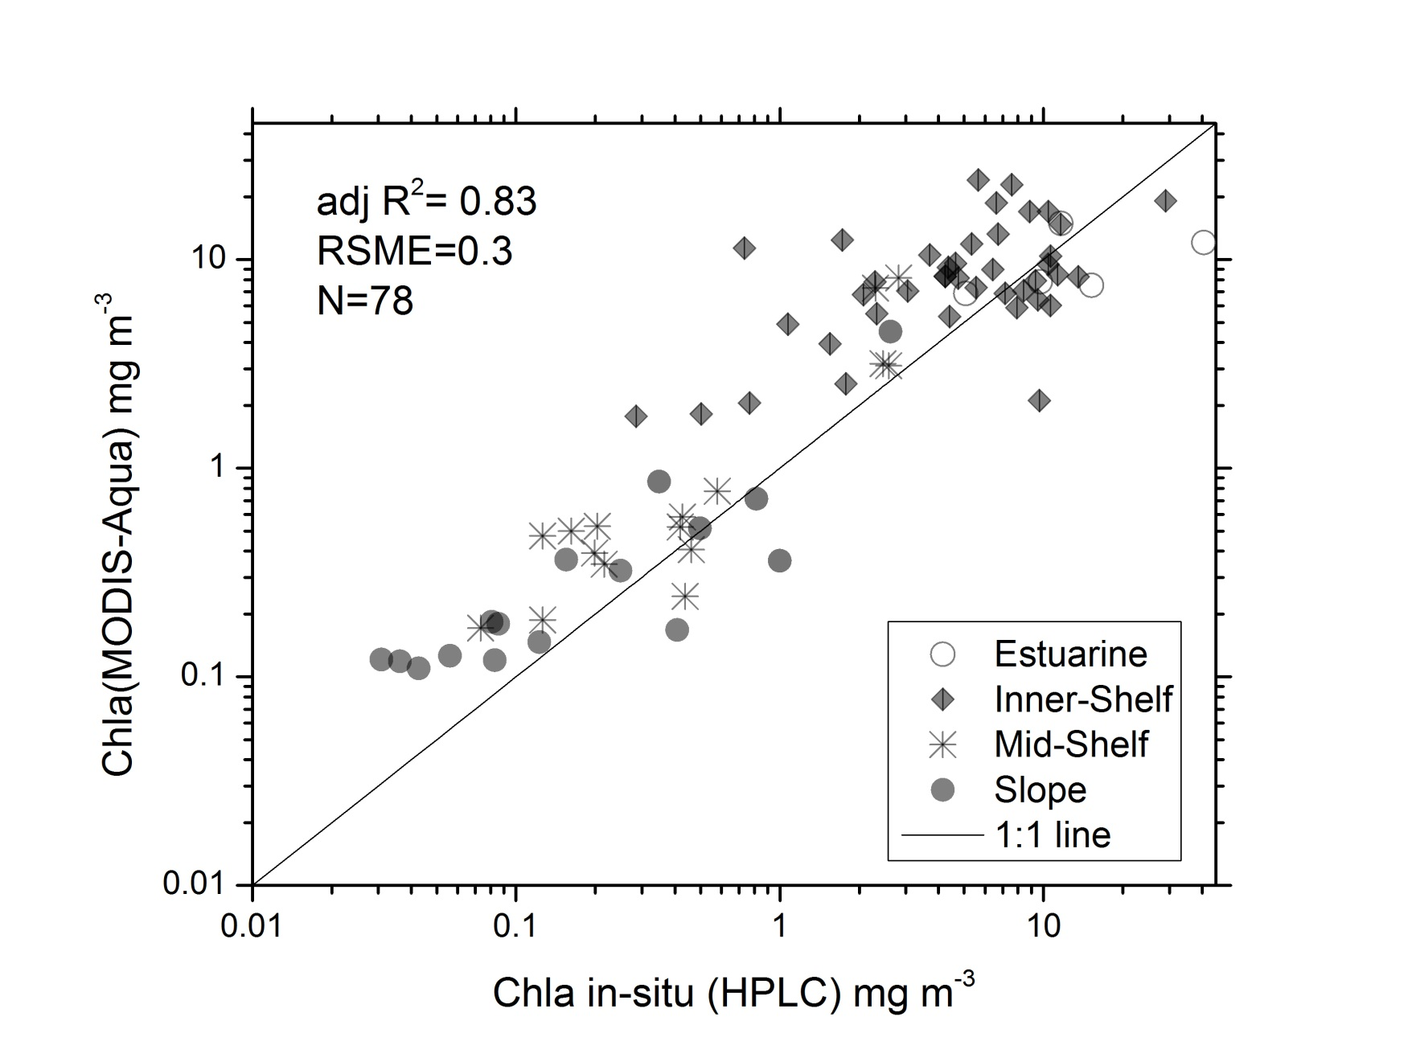
Ocean Color Implications

Slide 22
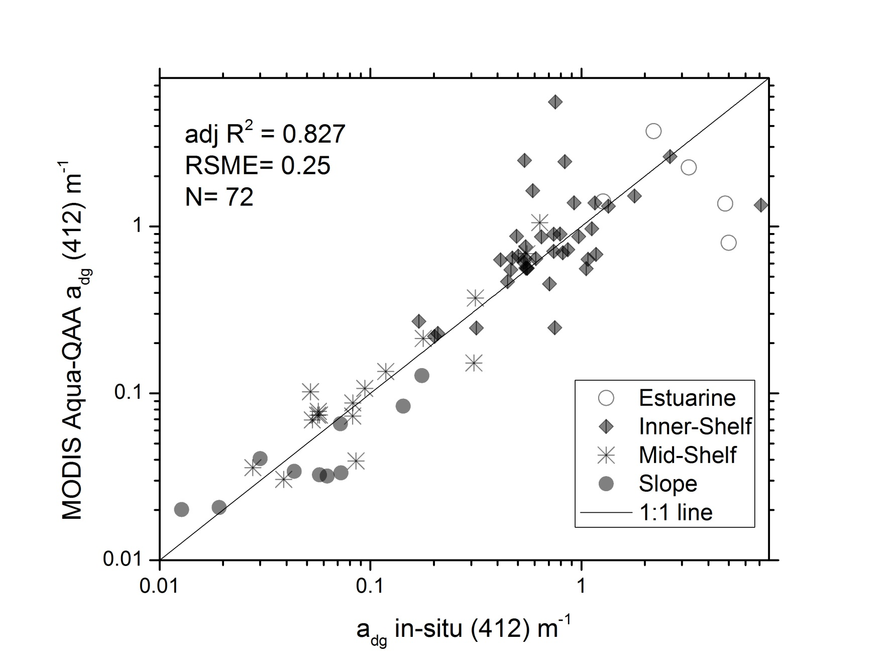
QAA match-ups

Slide 23
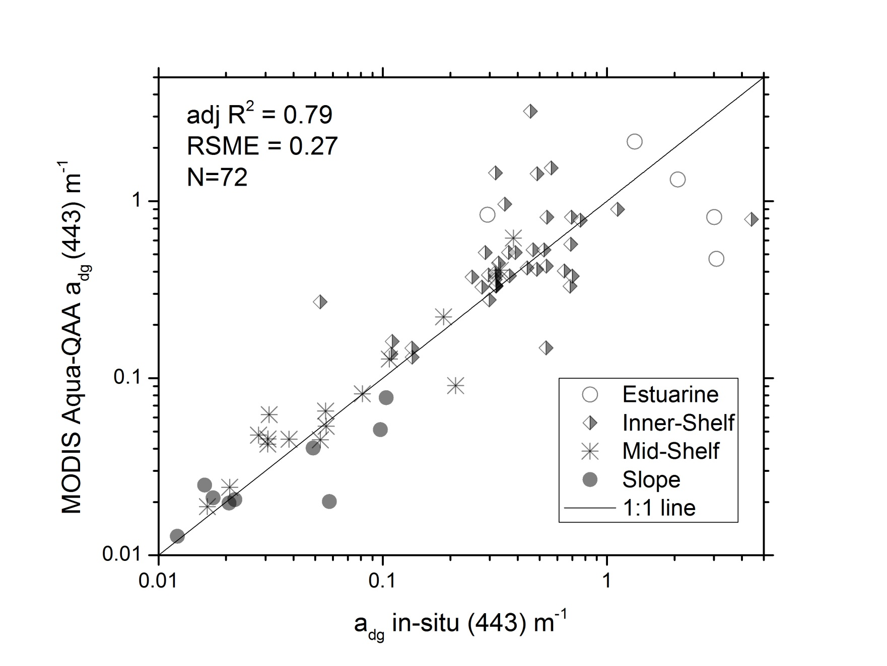
QAA match-ups

Slide 24
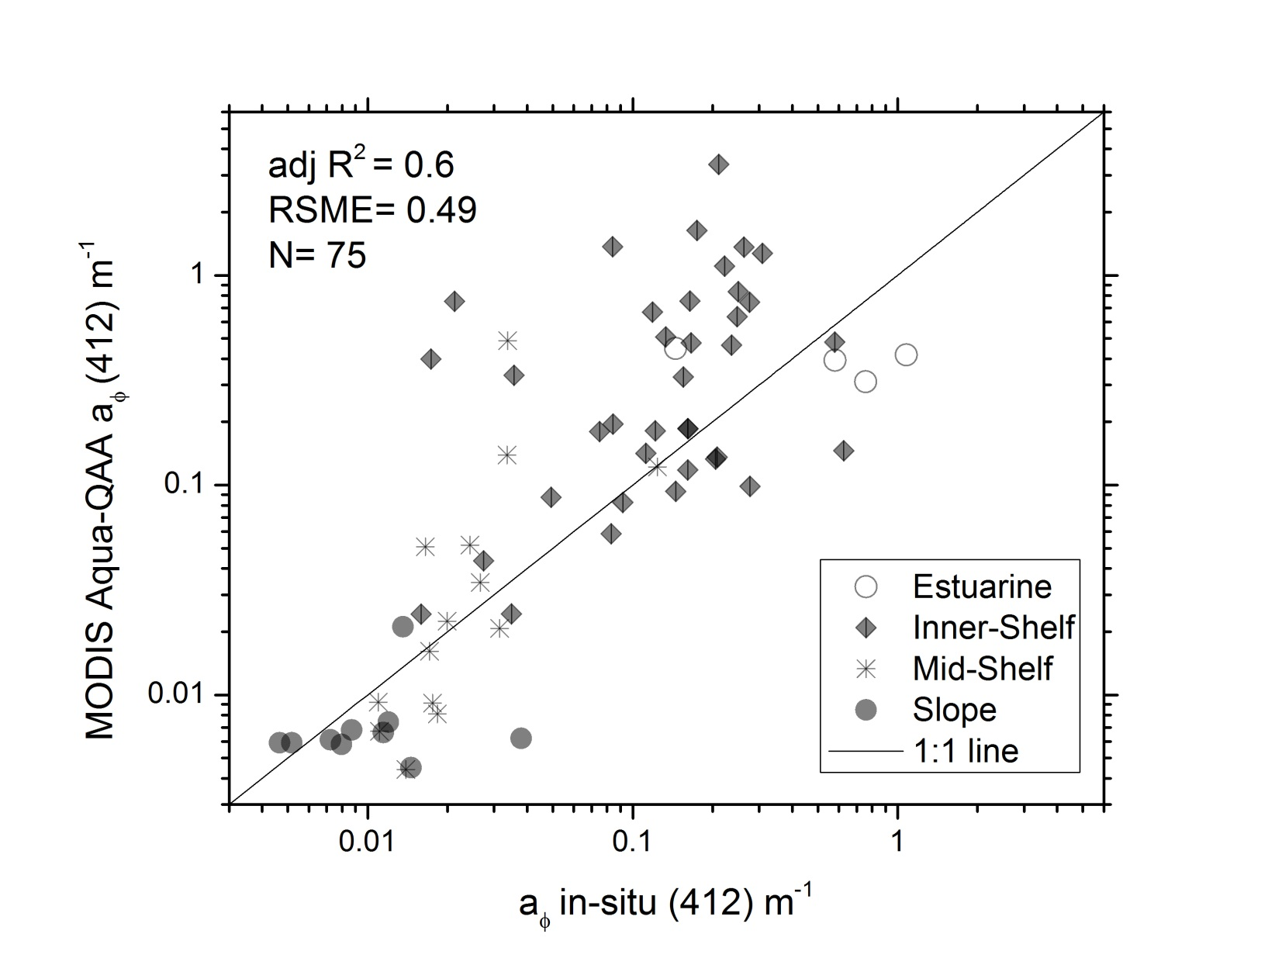
QAA match-ups

Slide 25
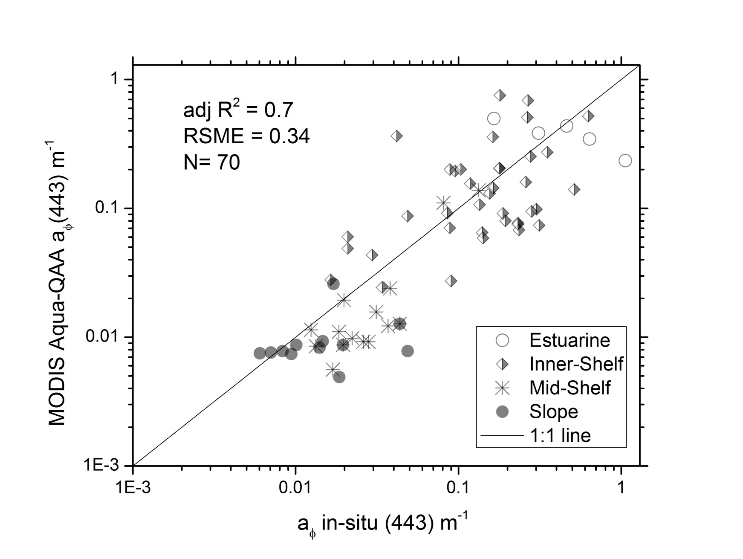
QAA match-ups

Slide 26
Summary
River discharge, winds and currents, are the important environmental forcing
Significant variability existed at the inner-shelf and slope station, short term events can have drastic impact on phytoplankton community and light absorbing components
Wider dynamic range of spectral slope values for CDOM and NAP
Over all the QAA performance were encouraging, though disprepancies between modelled and observed values were particularly at 412 and inner-shelf regions

Slide 27

Thank You

