Slide 1



Profiling floats, ocean color, and
ocean biogeochemistry
E. Boss (with K. Johnson and H. Claustre)
Introduction: what are profiling floats?
What science are they used for?
Current/upcoming activities associated with biogeochemical floats.
How can profiling floats fit in the Cal/Val activities of NASA B&B ? the BGC-float project.

Slide 2
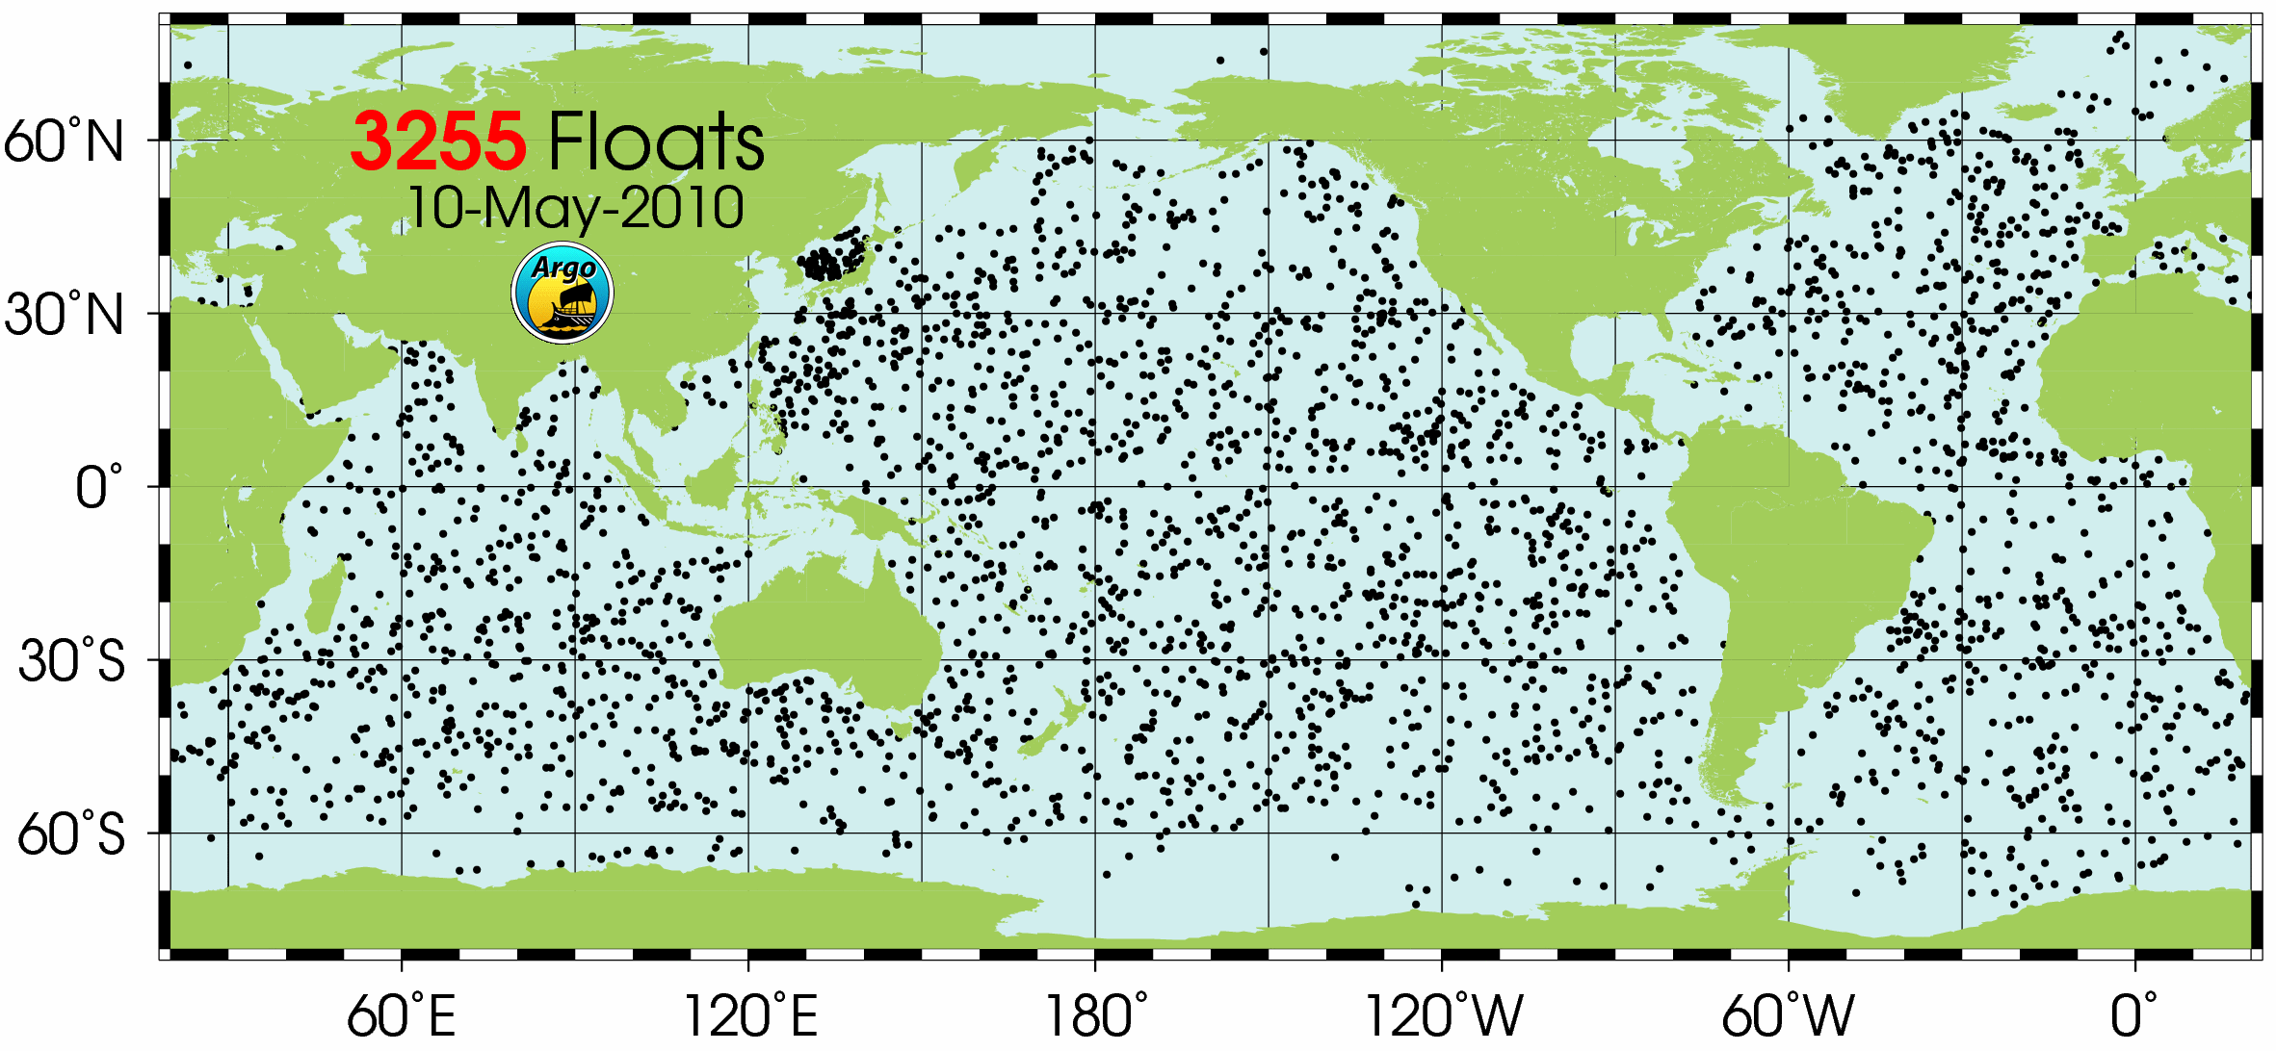
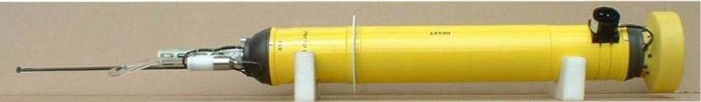
Argo program; Together with remote sensing, a global international ocean observatory (motivation: climate (T, S), altimetry, decadal variability).
Measure CTD, typically every 10days, from 2000m depth. O(300) profiles/float.
O(200) measure O₂. O(10) measure NO₃. All data available in quasi-real-time.
O(20) measure bio-optical parameters.

Slide 3
Science context (examples)
Current methods to estimate primary production from space agree within ~30%. A major limitation: lack information about sub-surface structure.
Heating rates of upper ocean (stratification) depend on absorption near the surface.
Estimate of flux of carbon to depth (the biological pump) are widely varying and spotty.
Test theories about O(1) processes coupling physics and biogeochemistry.
To understand the role of the oceans in climatically important biogeochemical processes we need an observation program that is sustained, representative, and highly resolving in time/space → Bio-Argo.

Slide 4
scientific context – link to remote sensing
Remote sensing : powerful, but has limitations:
restricted to the upper ocean layer
  => no access to most of the euphotic layer.
cloudy areas are unobservable by remote sensing
=> North Atlantic in the spring.
3. Calibration / validation : sea-truthing
  => dependant on moorings or cruises (spatio-temporal limitations).
→To reach its full potential, remote sensing must be complemented with in-situ measurements.

Slide 5
Scientific context: enabling technologies
Availability of high bandwidth communication (iridium)
Availability of higher power batteries/ additional batteries bays
Availability of low power sensors for:
Chl, POC (beam-c and scattering), O₂, NO₃, irradiance/radiance
In the pipeline: pH (expected 2012)
On-going demonstration projects

Slide 6
A little bit of history (published work of optics on floats):
K-SOLO float (G. Mitchell, M. Kahru, J. Sherman, 2000)
CTD+ 3-wavelengh downwelling irradiance (Ed) sensor (380, 490 and 555 nm), spring.
Carbon Explorers: SOLO float (J. Bishop et al., 2002, 2004, 2009) – CTD + transmissometer + b_{b}. Seasonal studies.
APEX+IOPs (Boss et al., 2008) – CTD + Fchl + b_{b}. 3yrs.
In parallel, CTD + O₂ is introduced (Kortzinger et al., 2004, Riser and Johnson, 2008) 8+years
Lately:
Biogeo-Argo (Whitmire et al., 2009) – APEX+ Fchl + b_{b} + O₂. Few months.

Slide 7
Some issues wrt optics on floats:
Optical sensors can be calibrated with a NIST certified procedure.
Variety of sensors/vendors to obtain chl and POC (pro/cons).
Conversion from optics to chl/POC involves some degree of uncertainty (O(±50%)). Some sources of uncertainty can be reduced (e.g. profiling at night, use of climatologies, sensors).
Large dynamic range in chl/POC (~3 orders of magnitude), makes these measurements extremely useful.
Values at depth provides a check on calibration/drift.
Regression with remote sensing over years provides additional check on calibration/drift.

Slide 8
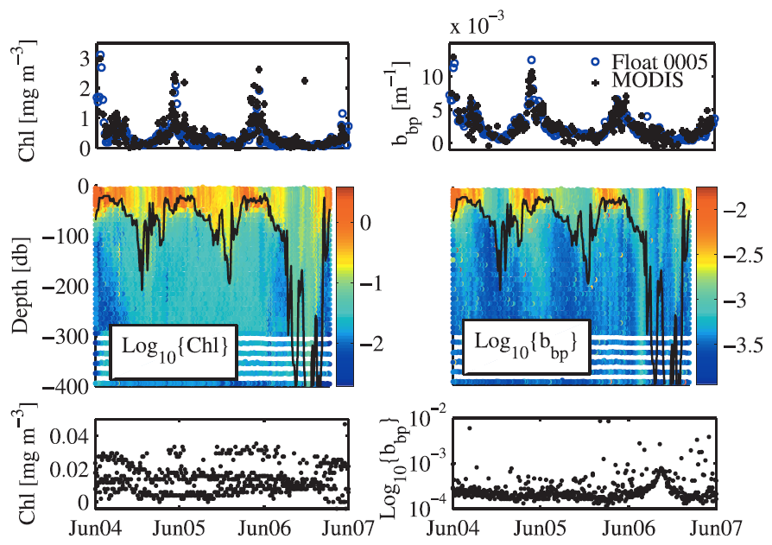
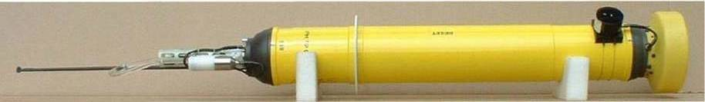
Example: no observed drift and good matchup with ocean color (3yrs every 5 days).

Slide 9
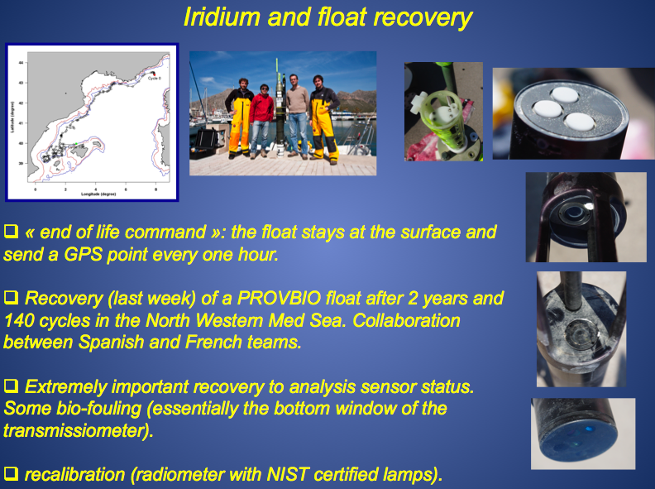
~$3000, T=13ºC at depth.

Slide 10
Westberry et al. (include floats near st. P & I):
St. I: 1st FLBB to 2000m

Slide 11
BIO-ARGO WG (IOCCG)
strategic context
Members: S. Bernard, J.F. Berthon, J. Bishop, E.Boss, C. Coattanoan,. K. Johnson, A. Lotliker O. Ulloa. Chair: H. Claustre
Our working group is involved in the preliminary steps before envisaging an (eventual) BIO-Argo program. We will need to make two types of recommendations
(1) Clear scientific and technical recommendations, keeping in mind that our first objective is linked to ocean color remote sensing (this is the primary mission given to us by IOCCG)
(2) Strategic recommendations which enhance the value of our work in a more multidisciplinary context (other groups: friend of oxygen on Argo, Argo itself)

Slide 12
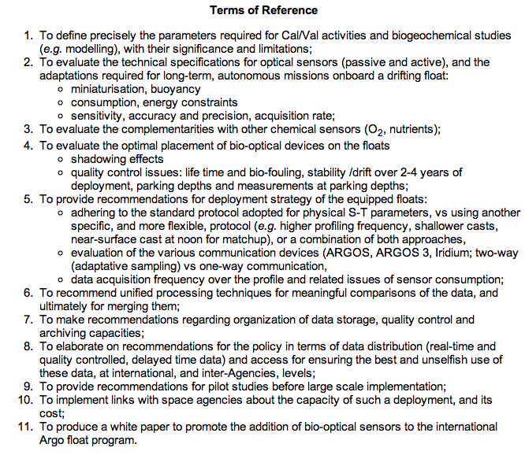
Coordinate, standardize, best-practices to deal with sensors & data.

Slide 13
Three types of ARGO like floats have been identified for bio-optical / bio-geochemical activities
Cal/Val float (remote sensing related activities)
Carbon float (dedicated carbon science missions)
Both require Iridium and are rather pricy. As a consequence will be used in limited numbers.
3. Bio-Argo: chl + POC sensors.
Designed for large programs (the workhorse). Does not require Iridium. Relatively cheap to implement in existing Argo (including O₂). Sensors price can be as low as $4,000.

Slide 14
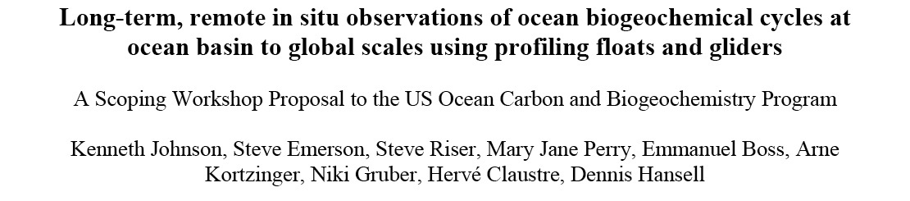
The implementation plan
Preparatory phase: This phase is already ongoing. Various groups (most of them represented in the WG) are developing and testing various configurations of floats.
Technology developments: several NOPP-funded projects.
Pilot studies: several are planned (AMOC, North Pacific, Europe) all involving O(25) biogeochemical floats or more.
28-30 april 2009, Monterrey

Slide 15

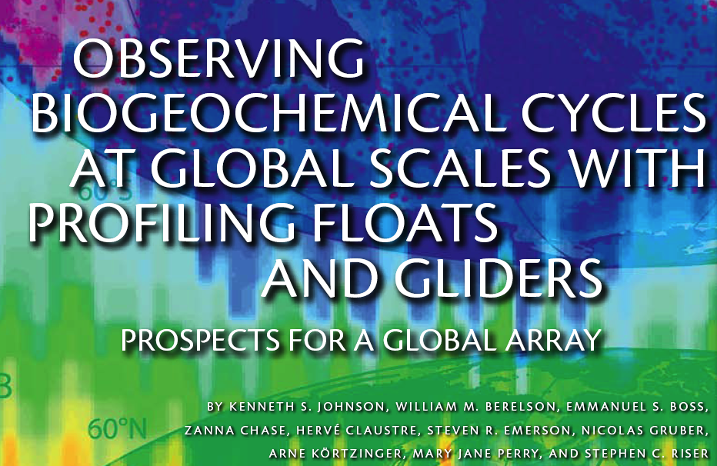
OCB Scoping Workshop on:
Oceanography (2009), 22(3), 216-225
Notes:
general poisiton paper in

Slide 16

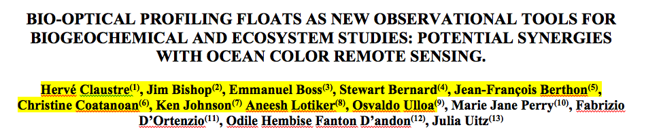
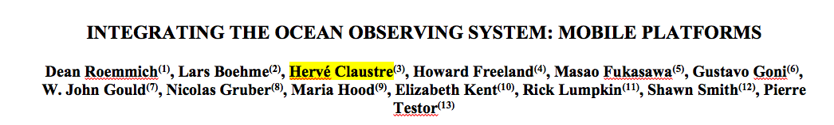
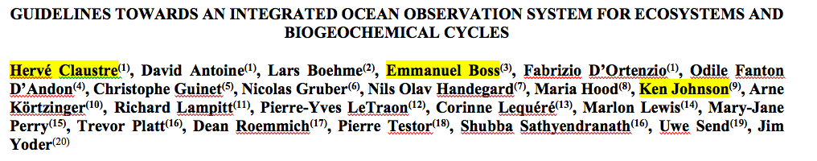
Community White paper (in press)
Plenary paper (in press)
Plenary paper (in press)
Hall, J., Harrison D.E. and Stammer, D., Eds., ESA Publication WPP-306, 2010.

Slide 17
Starting implementation : the next deployment plans
Who | Funds | # | Where | bb Chla | cp | PIC | bb(λ) | EdLu | cdom | O2 | NO3
Bishop | NSF | 3 |  | x | x | x
Westberry/ Boss | NASA | 3 | NP, NA | x |  |  |  |  |  | x
Boss et al. | NOPP | 5 | TBD | x | x |  | x | x |  | x
Claustre | Argo-France | 3 | Med. Sea | x | x |  |  | x | x
Claustre | ERC | 50 | NA, Gyres | x | (x) |  | x | x | x | x | (x)
Doxaran | Argo-France | 2 | River plumes | x | x |  |  | x | x
 | + CNES
Goes |  | 3 | amazon plume | x | x | x
Johnson/ Riser | NSF | 24 | HOTS, BATS, PAPA, SO | x |  |  |  |  |  | x | x
Riser/ Johnson | NOPP | 12 | TBD | (x) |  |  |  |  |  | x | x
Johnson/Riser/Martz | NOPP | 4 |  | x |  |  |  |  |  | x | x + pH
Babin |  | ~40 | Arctic, sub-polar | x | (x) |  | x | x | x | x | (x)
~150 floats with bio-optical capabilities (20000 profiles!)+ pending.

Slide 18
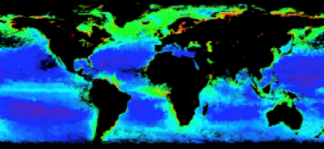
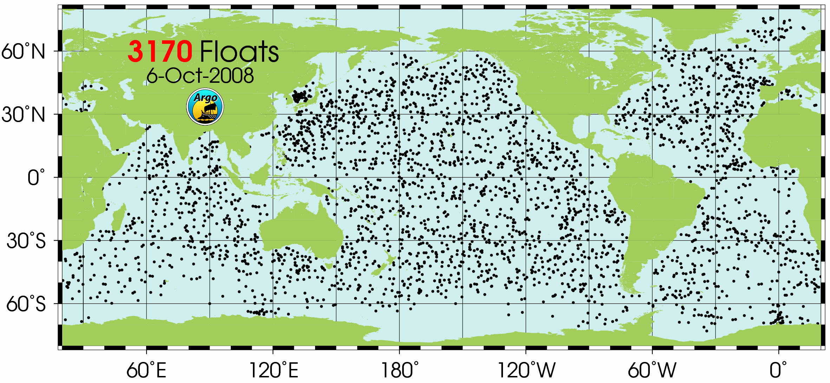
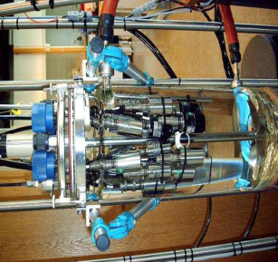
The key to success : “Bio”-data management
Very efficient data management (good examples are NASA’s Ocean Color and Argo)
Real-time delivery with real-time QC (operational data)
Delayed mode QC delivery after data reprocessing (scientific, climatic-trend value).
Generation of derived products
LOV-group is pushing in Europe to augment the Argo data center with personnel required to be integrated into Argo
Upstream of data management, QC and unified format, it will be essential to
  Establish best-practice manual / practical training / capacity building.
  Establish NIST-traceable calibration protocols.
  Support regular international inter-comparison exercises.
  Develop internationally agreed calibration centers.
French initiative: PABIM
AST-11: agree in principle. Need personnel.
Calibration of numerous optodes for O₂-Argo at Bergen
Notes:
Here The point of view of a biologist is that the management of bio-data… This is because of the use different platforms and different ways of measurement
We heard a lot of data format and data langage but this a real issue.
For the sole Chla which is a key measurement in ecosystem studies…
I would say that if such aspect has been developped supported as part of the JGOFS program it has beciome less prioritary as part of new progralmslike IMBER and SOLAS. This si essential for the success
Chla fluo, HPLC remote sensing sghould signify the same product with apporiate des traitements amont communs le plus tôt possible
If we want for exemple generate 3D/4D view of Chla in the ocean we will have to relate the remote sened Chla to the Chla detected by fluoresence on aglider or a float. parler de chloropgin

Slide 19
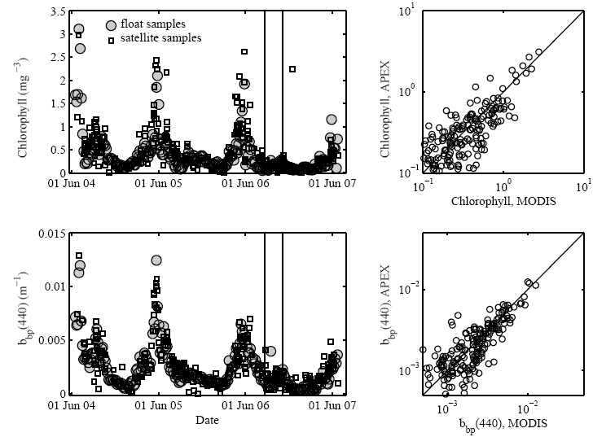
The use of floats for Cal/Val
Boss et al., 2008

Slide 20






FY09 NOPP BAA
Development, Assessment and Commercialization of a Biogeochemical Profiling Float for Calibration and Validation of Ocean Color and Ocean Carbon Studies
Boss, Lewis, Zaneveld, Webb, Woodward, Acker
Why would float be useful for Cal/Val activities?
Cal/Val activities need to be carried out continuously (similar to observing systems).
Current Cal/Val data is very limited in quantity of matchup and geographical extent.
What are the requirements for such activities?
Known precision and accuracies for in-situ measurements and derived proxies.

Slide 21
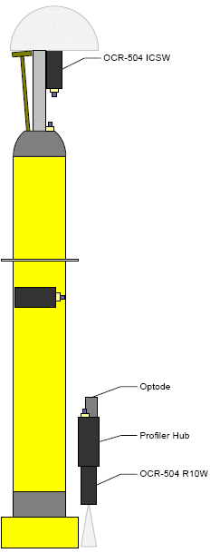
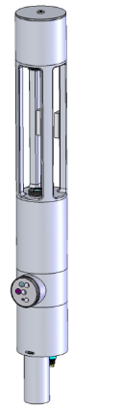
The BGC-float NOPP
Current design:
OBJECTIVES:
Integration of high precision bio-optical sensors (both active and passive) onto profiling floats.
Deployments of floats in interesting dynamic ocean regimes to demonstrate the efficacy of autonomous and sustainable technology for
  a.) the calibration and product validation of orbiting ocean color radiometers.
  b.) investigations of the dynamics of carbon in the upper ocean.
OCR-Ed
Optode
ECO-FLBB
C-Rover
ECO-triplet
Controller
OCR-Lu

Slide 22
The BGC-float NOPP
Current design:
Goals:
Novel integration of optical sensor packages to APEX profiling floats.
Rigorous evaluation of the capabilities and limitations of profiling floats for biogeochemical observations, including a thorough analysis of the uncertainties of float based measurements.
Development of software for display and dissemination of data.
Development of a novel web tool that will provide NASA’s products.
OCR-Ed
Optode
ECO-FLBB
C-Rover
ECO-triplet
Controller
OCR-Lu

Slide 23
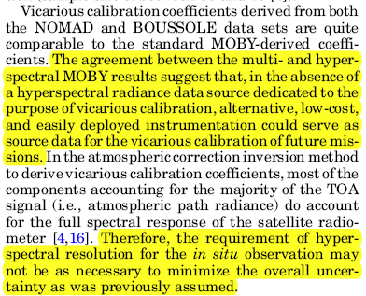
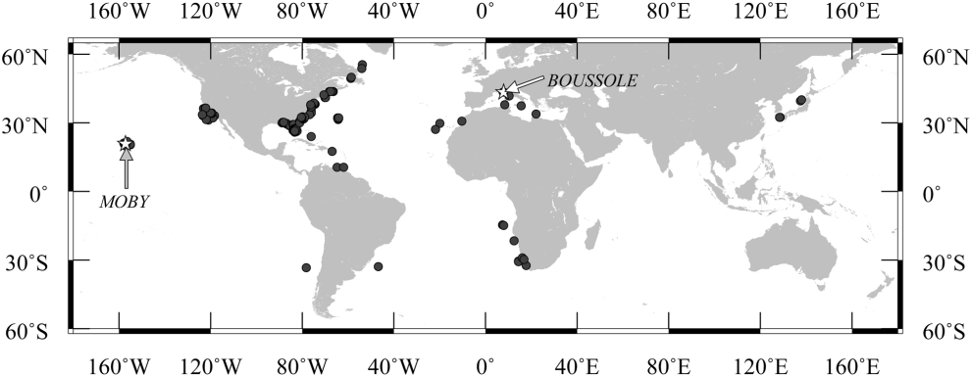
But could it to work for vicarious calibration?
Bailey et al., 2008
+ Voss’s SORTIE talk

Slide 24
Conclusions
Profiling floats and sensors are maturing fast.
Their use is expanding rapidly into biogeochemistry.
Urgent need for standardization and to adapt international real-time databases to deal with BGC data.
Following demonstrations, float could become part of NASA’s BB Cal/Val portfolio.
+ one more unrelated issue

Slide 25
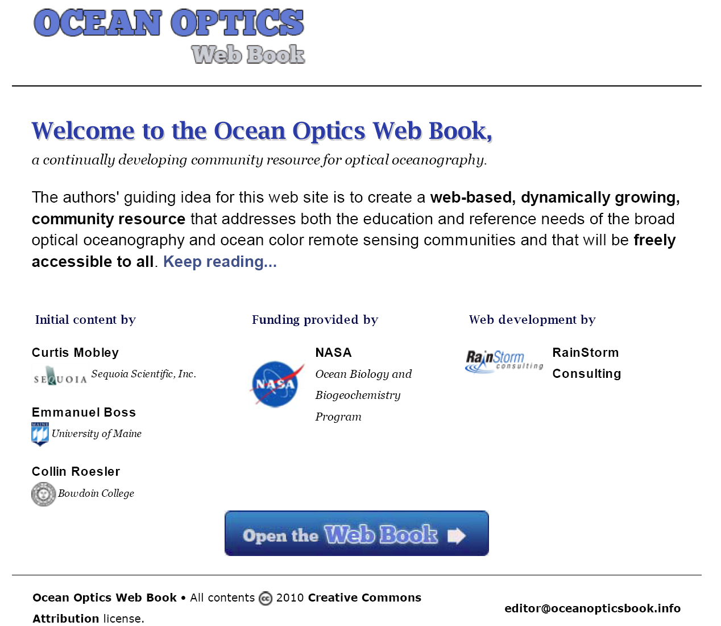
http://www.oceanopticsbook.info/

