Slide 1
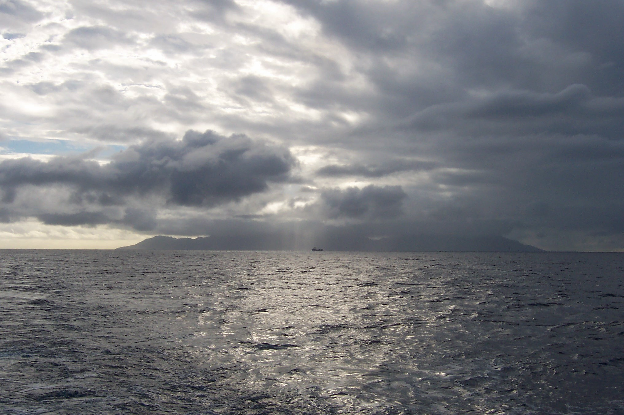
Development and Application of Picosecond Lifetime Analyses in the Upper Ocean for the Interpretation of Solar-Induced Chlorophyll Fluorescence Signals
Maxim Gorbunov, Fedor Kuzminov, Chengyi Yan, and Paul Falkowski
Institute of Marine and Coastal Sciences, Rutgers University, New Jersey
2012 NASA Ocean Color Research Team Meeting
Seattle, WA - April 24, 2012, 5:00 pm

Slide 2
Outline
Why to measure fluorescence lifetimes?
Development of Picosecond Lifetime Fluorometer for oceanographic research
Laboratory program to understand physiological mechanisms behind the variability in solar-induced fluorescence (SIF) yields
Field studies in biogeochemically diverse regions of the global ocean
Future directions
Gorbunov et al., Biochim. Biophys. Acta, 1807: 1591-1599 (2011);
Kuzminov et al., Biochim. Biophys. Acta, in press (2012);
Fadeev VV, Gorbunov MY, Gostev T, J. of Biophotonics, in press (2012)

Slide 3
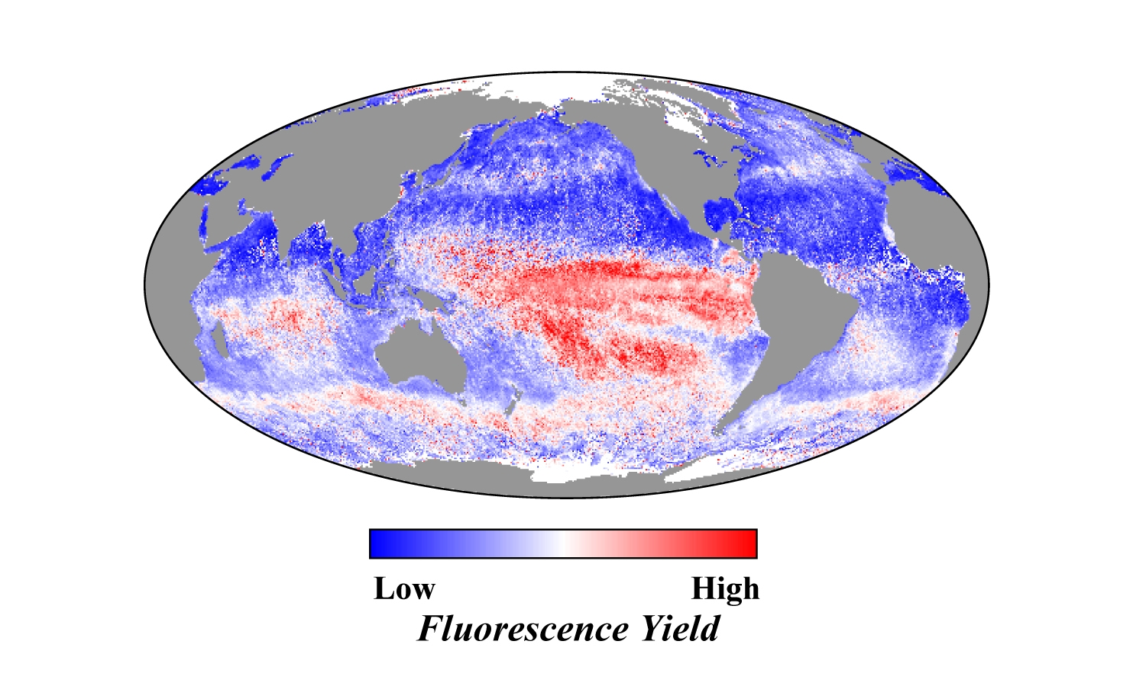
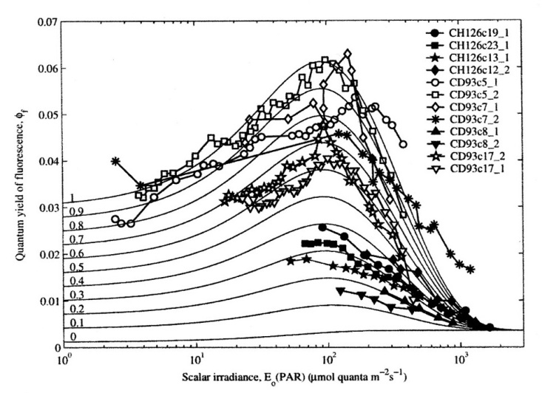
Background
MODIS maps of solar-induced fluorescence (SIF) and in-situ measurements of SIF revealed a huge variability (ca. 10x) in SIF yields in the ocean.
Mechanisms and interpretation of this variability remain poorly understood.
Very limited field studies of related processes.
NASA MODIS
Morrison, L&O, 2003
Behrenfeld et al., Biogeosciences, 2009

Slide 4
Objectives
To understand physiological mechanisms and factors that control the variability in SIF yields
To develop a set of sea-going instrumentation that helps to interpret satellite-based SIF signals

Slide 5
Problem
Measurements of the quantum yields of fluorescence are the key to our understanding of the variability in SIF.
Quantum yields are very difficult to measure even in the lab and virtually impossible to measure directly in the open ocean.
Solution
Picosecond fluorescence lifetimes are directly related to the quantum yields.

Slide 6
Theory of Fluorescence Lifetime (Why measure lifetimes?)
Fluorescence is a delayed emission which is characterized by the lifetime of fluorescence.
The lifetime is measured in absolute units.
The lifetime is directly proportional to the quantum yield of fluorescence (φ_{f}):
τ = φ_{f} x τ₀
where τ is the observed lifetime of the excited singlet state of the molecule; τ_{ο} is its natural lifetime.
The lifetimes of Chl-a fluorescence in living cells are strongly affected by physiology.
Chl-a fluorescence lifetimes vary between 0.3 and 2.5 ns.

Slide 7
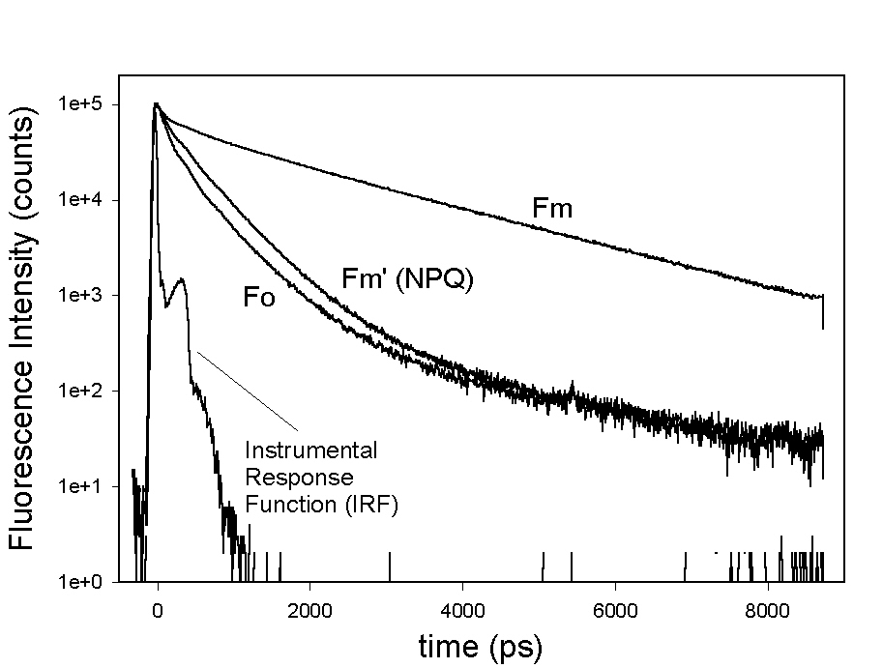
Picosecond Fluorescence Kinetics
Multi-component analysis if critical for in vivo Chl-a fluorescence kinetics
Strong light
(NPQ effect)
F_{o} |  | F_{m} |  | F_{m}’
t_{i} (ps) | a_{i} | t_{i} (ps) | a_{i} | t_{i} (ps) | a_{i}
69 | 0.275 | 67 | 0.316 | 69 | 0.247
194 | 0.336 | 200 | 0.201 | 205 | 0.381
530 | 0.385 | 994 | 0.136 | 640 | 0.365
2690 | 0.004 | 2270 | 0.347 | 2550 | 0.007
Average lifetime
298 ps |  | 984 ps |  | 346 ps

Slide 8
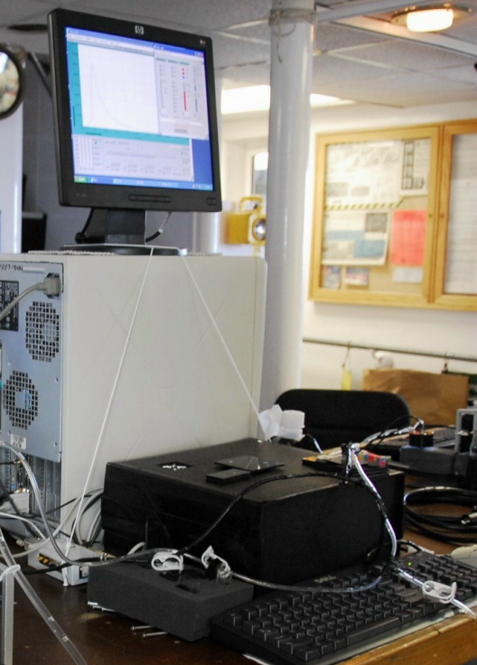
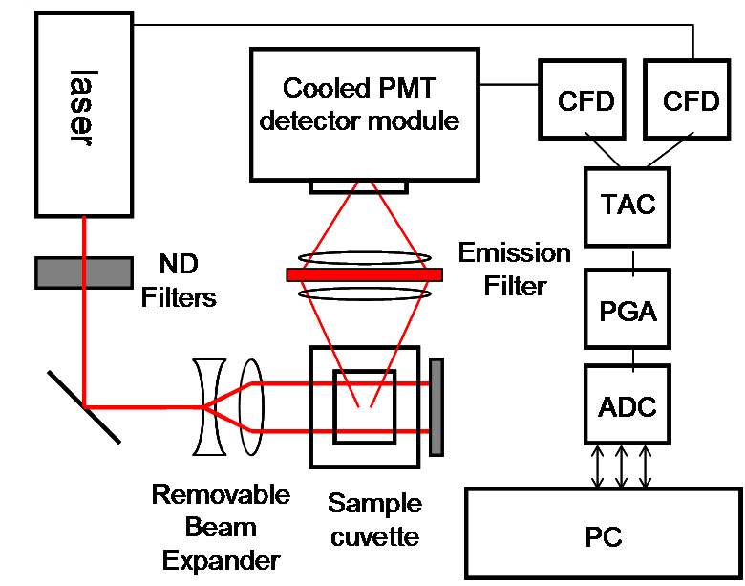
Instrumental Objective: to develop a sea-going Picosecond Lifetime Fluorometer

Slide 9
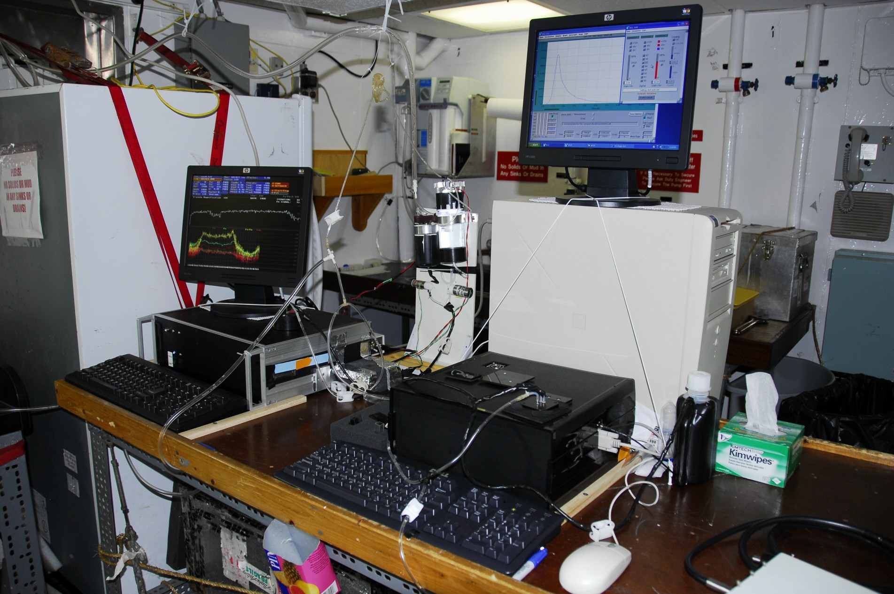
Picosecond Laser LifeTime Fluorometer & FIRe Fluorometer onboard R/V Oceanus
Picosecond Fluorometry => quantum yields and lifetimes
FIRe (Fluorescence Induction and Relaxation), or FRR => phytoplankton physiology (photosynthetic light-harvesting processes, photochemistry, electron transport rates)

Slide 10
Chl-a Fluorescence Decay Kinetics at Chl-a = 0.04 mg/m3 (Sargasso Sea)
Extreme sensitivity (down to 0.01 ug/L of Chl-a)
~2 orders of magnitude more sensitive than Ciencia Phase-Shift Fluorometer.
2-, 3-, or 4-component analysis

Slide 11
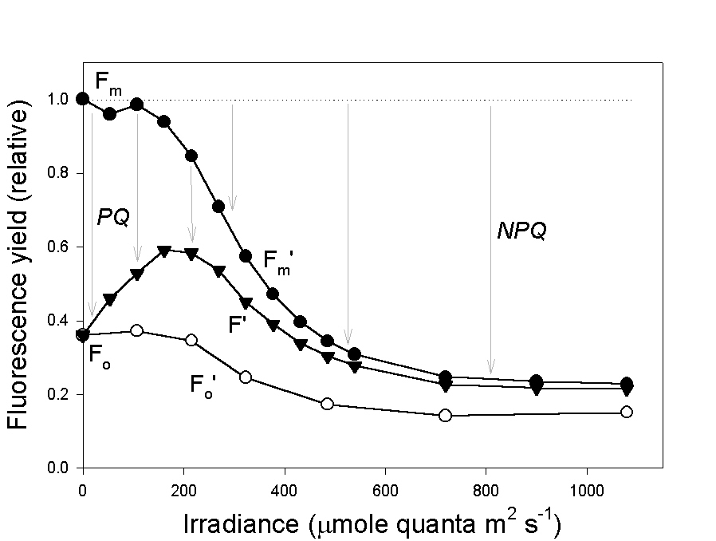
The Irradiance Dependence of Chlorophyll Fluorescence Yields
Quantum yields of fluorescence under high light (e.g., SIF) are controlled by the process of non-photochemical quenching (NPQ).
NPQ is a photoprotective mechanism that is activated under supra-optimal irradiance and thermally dissipates excess absorbed energy.
NPQ = (Fm – Fm’)/Fm’
NPQ varies from 0 to ~3

Slide 12
Laboratory Program
Designed to understand the mechanisms of non-photochemical quenching (NPQ) in diverse phytoplankton taxa.
How is NPQ affected by
Taxonomy;
Nutrient status;
Photoacclimation?
Practical implications for SIF analysis:
How variable are NPQ properties?
Can we apply a uniform NPQ correction procedure for the global ocean?

Slide 13
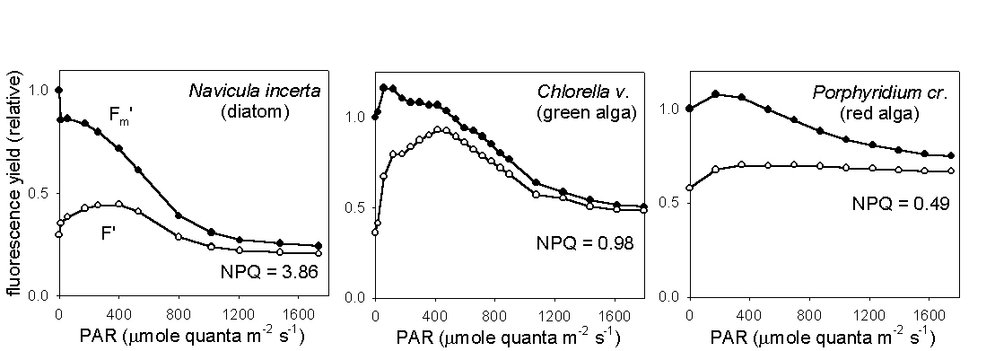
Taxonomic Variability in NPQ capacity
All oxygenic photosynthetic organisms evolved the NPQ mechanism, but the mechanisms differ between taxa.
Brown (diatoms and dinoflagellates) and green algae exhibit the maximum NPQ capacity.
NPQ capacity in cyanobacteria and red algae is much lower.

Slide 14
Biophysics and Biochemistry of NPQ
In eukaryotic algae and higher plants, NPQ is induced by ΔpH across the thylakoid membrane (energy-dependent quenching) and involves the xanthophyll cycle and conformational changes in LHCII.
Red algae exhibit ΔpH-dependent quenching, but no xanthophyll cycle
Cyanobacteria lack both pH-dependent quenching and xanthophyll cycle

Slide 15
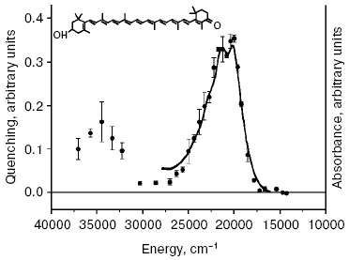
NPQ in cyanobacteria is induced by blue-green light and mediated by Orange Carotenoid Protein (OCP)
NPQ action spectrum matches absorption spectrum of OCP and the carotenoid, hydroxyechinenone.
Karapetyan N.V. , Biochemistry, 72: 1127–1135 (2007).
Rakhimberdieva et al., FEBS Lett. 574: 85-88 (2004).
Polivka et al., Biochemistry 44: 3994–4003 (2005).

Slide 16
NPQ in cyanobacteria: Key role of Orange Carotenoid Protein (OCP)
NPQ is not observed in cyanobacteria lacking OCP gene or OCP-deficient mutants
Wilson et al., Plant Cell 18 (2006) 992-1007.
Boulay et al., Biochim. Biophys. Acta 1777 (2008) 1344–1354.
No NPQ (lacking OCP)
Strong NPQ
Synechococcus sp. CCMP 2370
Synechococcus sp. CCMP 1379
Gorbunov et al., Biochim. Biophys. Acta, 1807: 1591-1599 (2011).

Slide 17
Kinetic Model for NPQ in Cyanobacteria
S₀
hν
S_{i}
k₂₃
S_{NPQ}
light reaction
dark reaction
k₃₁
OCPº → OCP^{r} → OCP^{r}+PBS
Dark High Light
Gorbunov et al., Biochim. Biophys. Acta, 1807: 1591-1599 (2011).

Slide 18
Kinetic Model for NPQ in Cyanobacteria
S₀
hν
S_{i}
k₂₃
S_{NPQ}
light reaction
dark reaction
k₃₁
OCPº → OCP^{r} → OCP^{r}+PBS
d[S_{o}]/dt = - σ F [S_{o}] + k₃₁ [S_{NPQ}]
d[S_{i}]/dt = σ F [S_{o}] – k₂₃ [S_{i}]
d[S_{NPQ}]/dt = k₂₃ [S_{i}] - k₃₁ [S_{NPQ}]
σ = σ_{opt} x η
Gorbunov et al., Biochim. Biophys. Acta, 1807: 1591-1599 (2011).

Slide 19
Quantum yield of NPQ state formation
σ = σ_{opt} x η
σ = 4.5 x 10⁻¹⁹ cm² (OCP in vivo)
σ_{opt} = 4.6 x 10⁻¹⁶ (echinenon, OCP carotenoid)
=> Effective quantum yield of NPQ state formation in vivo:
η = 0.1%
For comparison: Quantum yield of the OCPº → OCP^{red} photoconversion: η ~ 1% (Wilson et al., PNAS 2008)

Slide 20
Thermodynamic Analysis of NPQ reaction Rates
Arrhenius function:
K = A exp(-Ea/kT)
Activation energy of dark NPQ reaction:
Ea = 21 kkal/mol
Gorbunov et al., Biochim. Biophys. Acta, 1807: 1591-1599 (2011).

Slide 21
Thermodynamic Inferences:
Activation energies of Ea ~ 20 kkal/mol
and slow rates of ~ 0.1 s-1
- a fingerprint of prolyl cis-trans isomerisation, a rate limiting step in protein folding.
Where are the prolyl residues in the OCP protein structure that may limit the rates of NPQ formation?

Slide 22
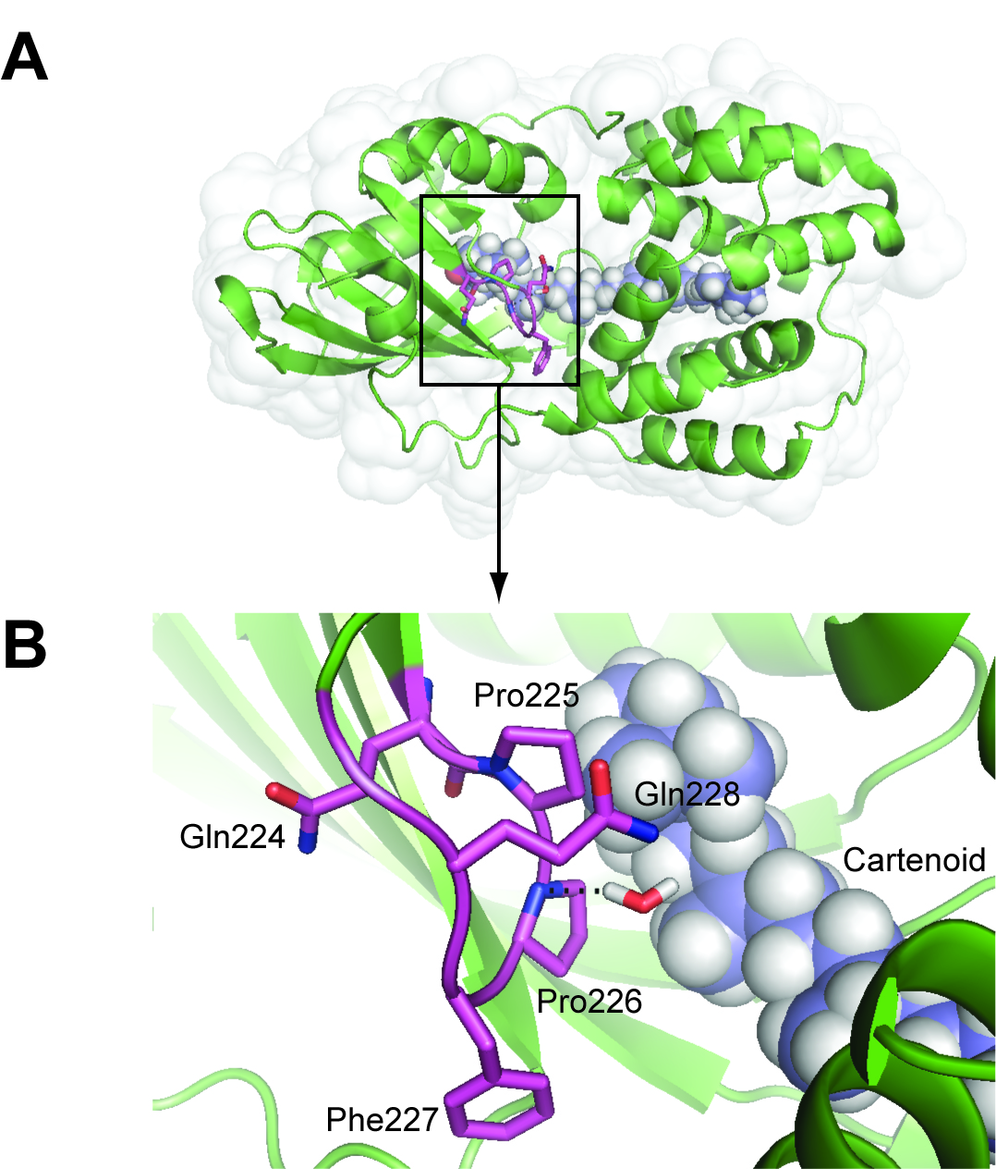
OCP Protein Structure Analysis:
…QPPFQ… - prolyl rich motif
highly conserved in all known OCP genes
Pro225 and Pro226 located near the photoactive site of the carotenoid
Prolyl cis-trans isomerisation of Pro225 and/or Pro226 is presumably the rate limiting step in NPQ activation
Gorbunov et al., Biochim. Biophys. Acta, 1807: 1591-1599 (2011).

Slide 23
Variability in NPQ in the ocean
Lab research reveals that NPQ may vary from 0 to ~ 3.0 (=> 5x variability in quantum yields) depending on species and physiological state
Taxonomy has a significant effect on satellite-based SIF yields (may account more than 50% of variability)
What is the range of variability in NPQ in the real world?

Slide 24
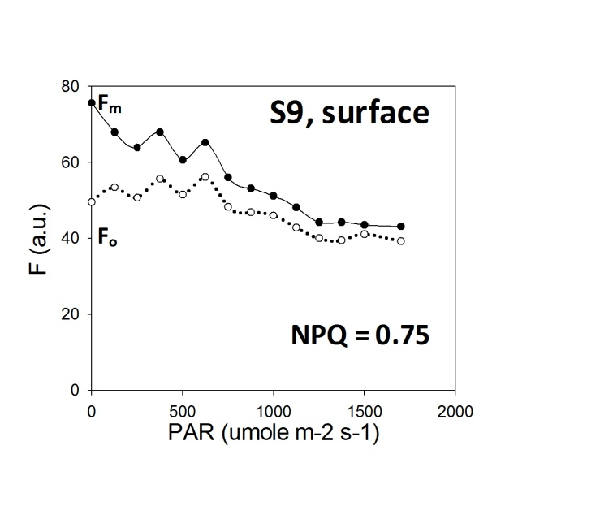
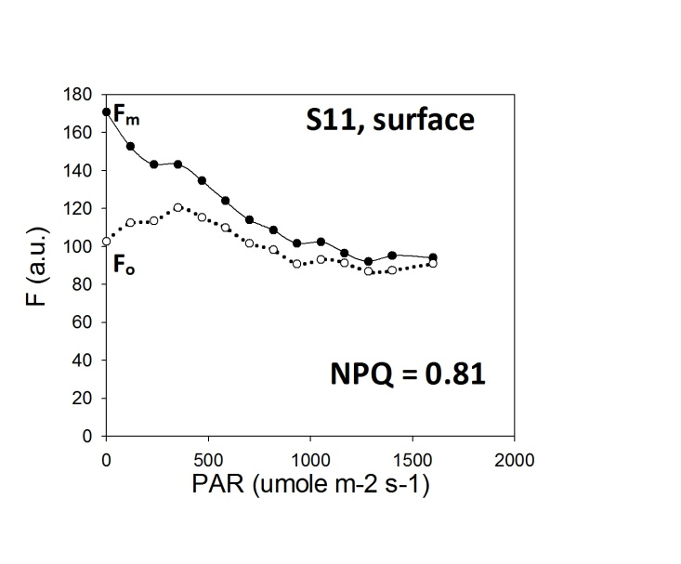
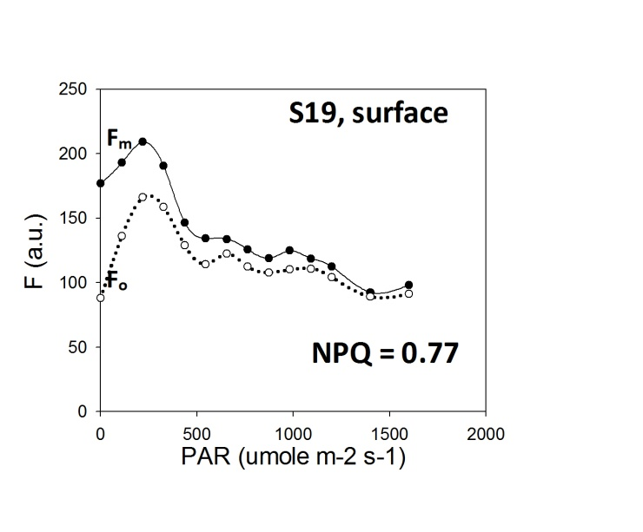
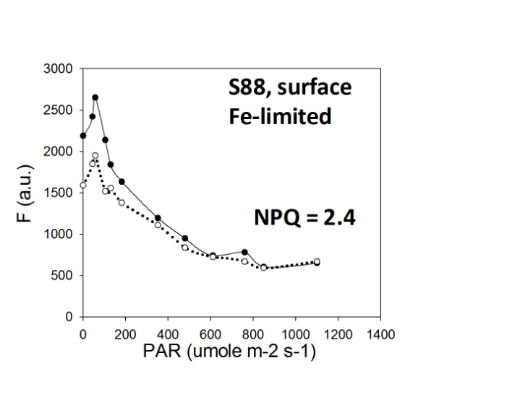
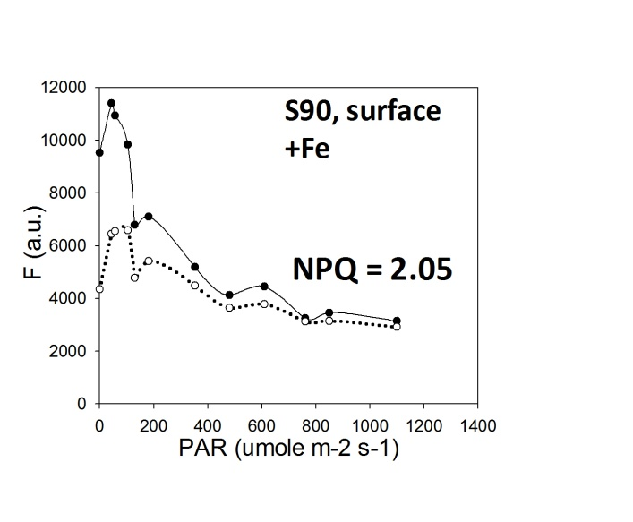
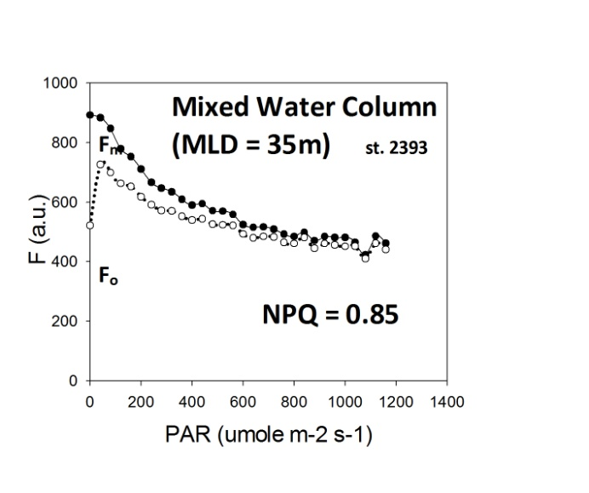
Variability in NPQ in the ocean
Sub-tropical Atlantic
Southern Ocean
Sub-Arctic Atlantic
NPQ = 0.80 to 1.2
4x variability in NPQ capacity in the global ocean

Slide 25
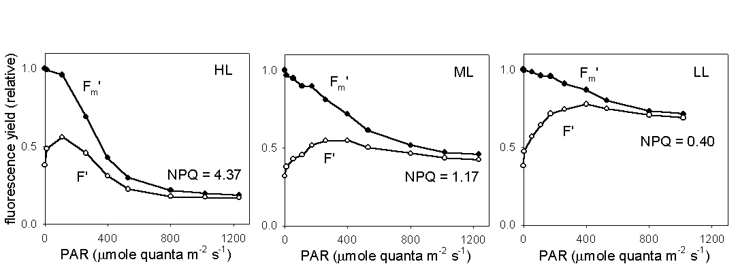
Effect of Photoacclimation on NPQ
diatom Dilytum brightwellii
NPQ increases with growth light intensity
Cells synthesize more xanthophyll pigments under HL

Slide 26
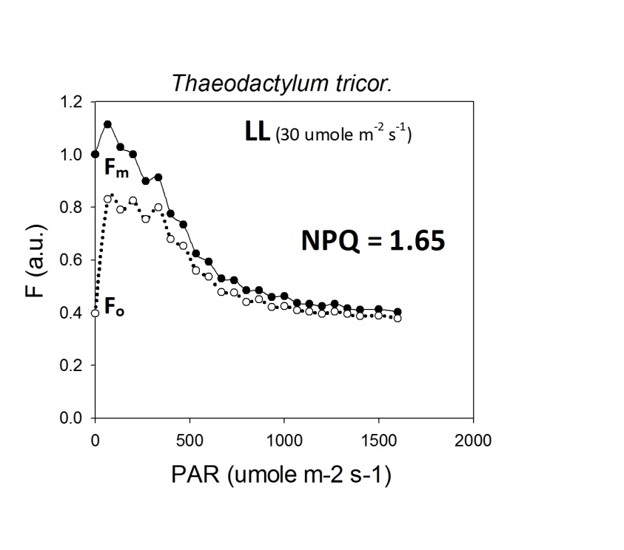
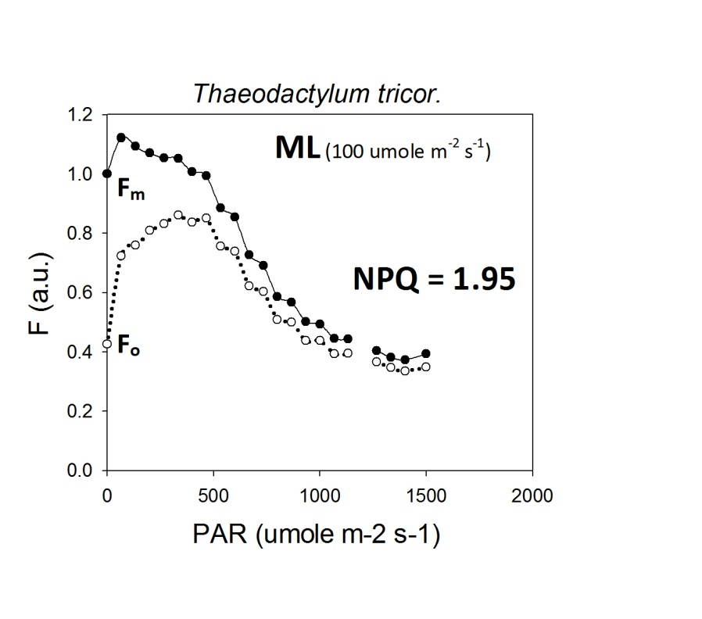
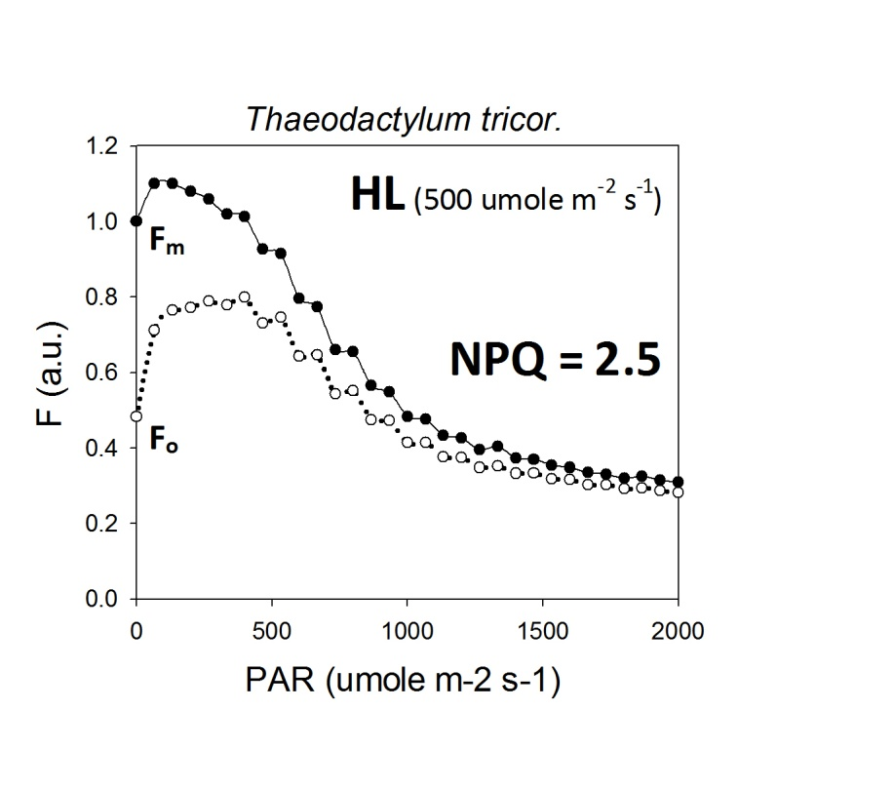
Effect of Photoacclimation on NPQ

Slide 27
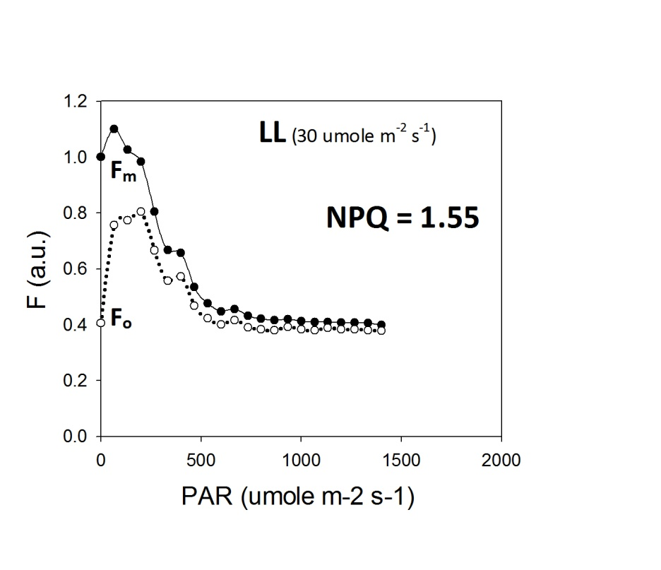
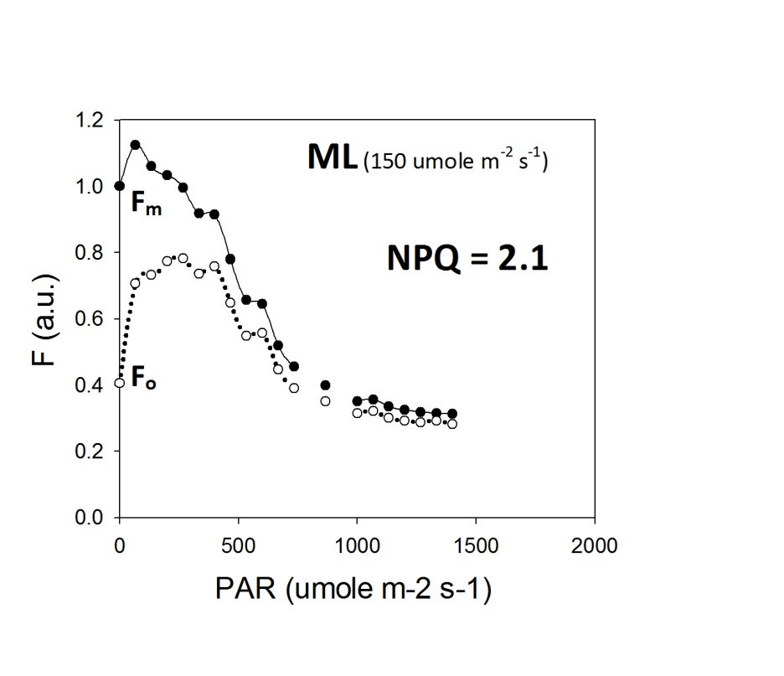
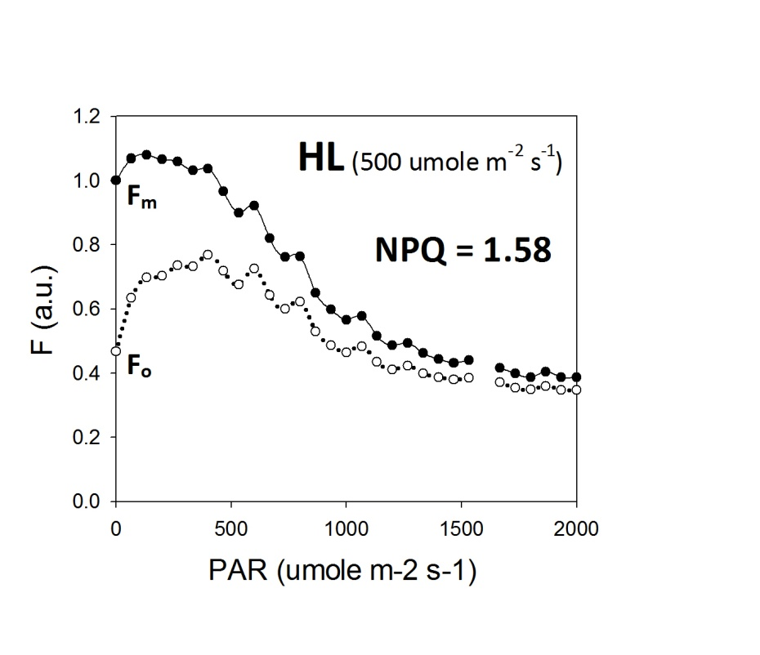
Effect of Photoacclimation on NPQ
diatom Thalassiosira weissflogii

Slide 28
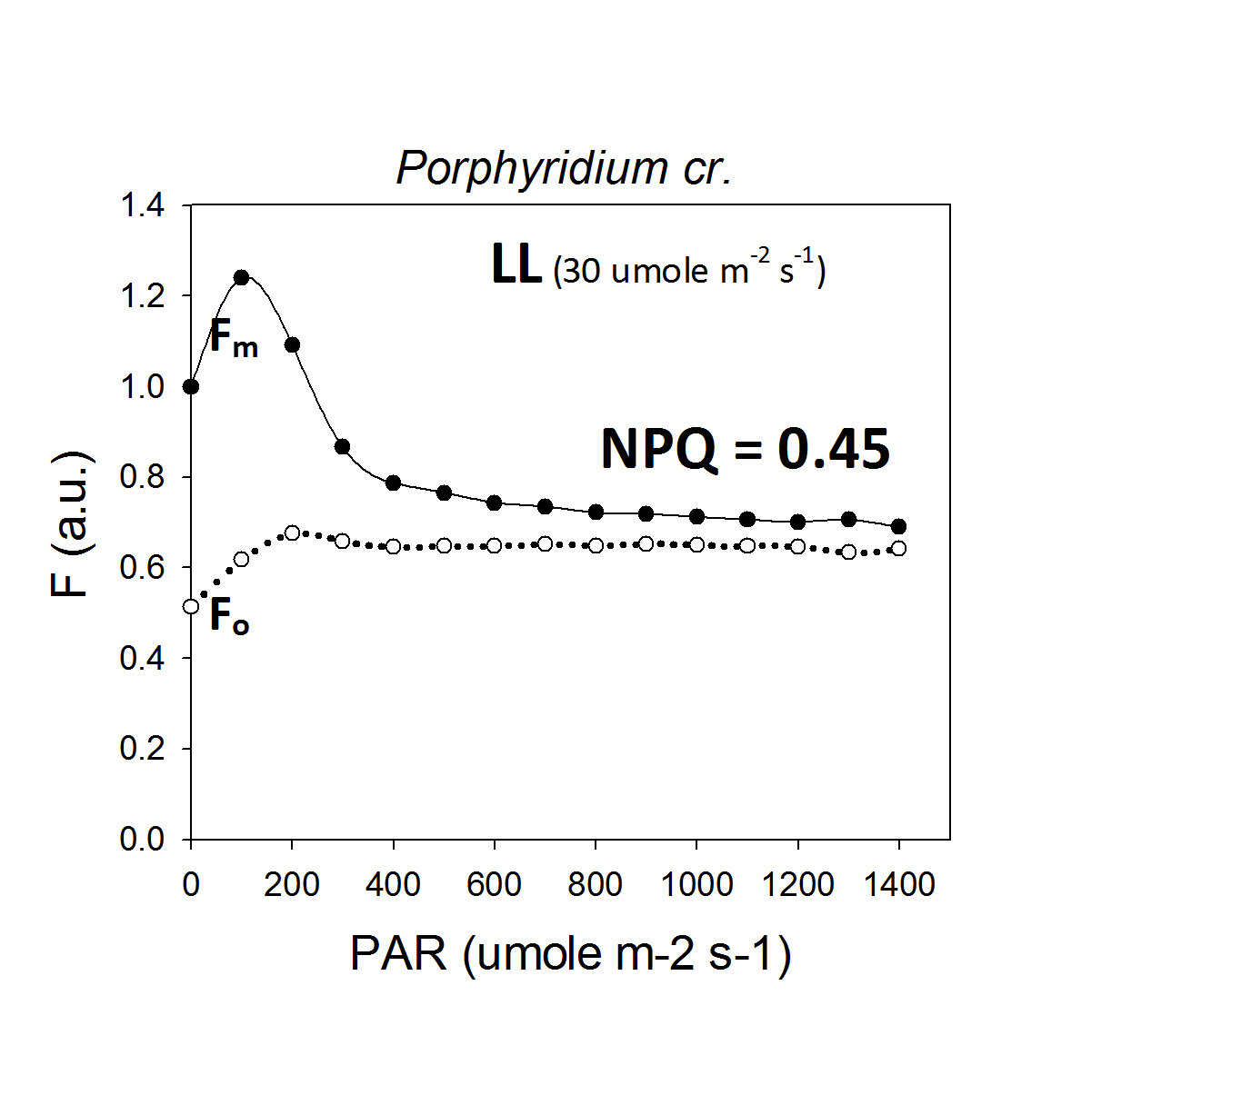
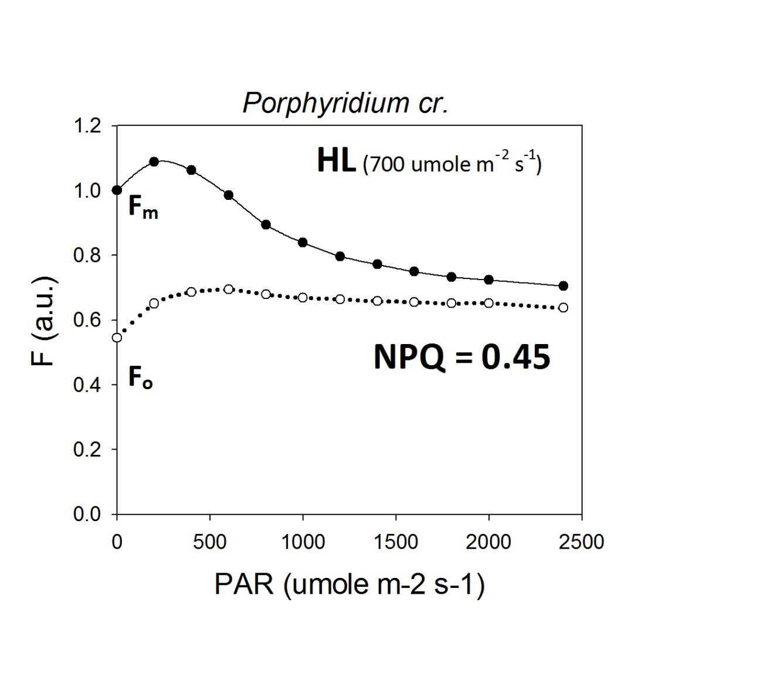
Effect of Photoacclimation on NPQ
Photoacclimation has no effect on NPQ capacity in red algae
NPQ is pH-dependent, but no xanthophylls cycle
Low NPQ capacity (=> higher quantum yields of satellite-based SIF)

Slide 29
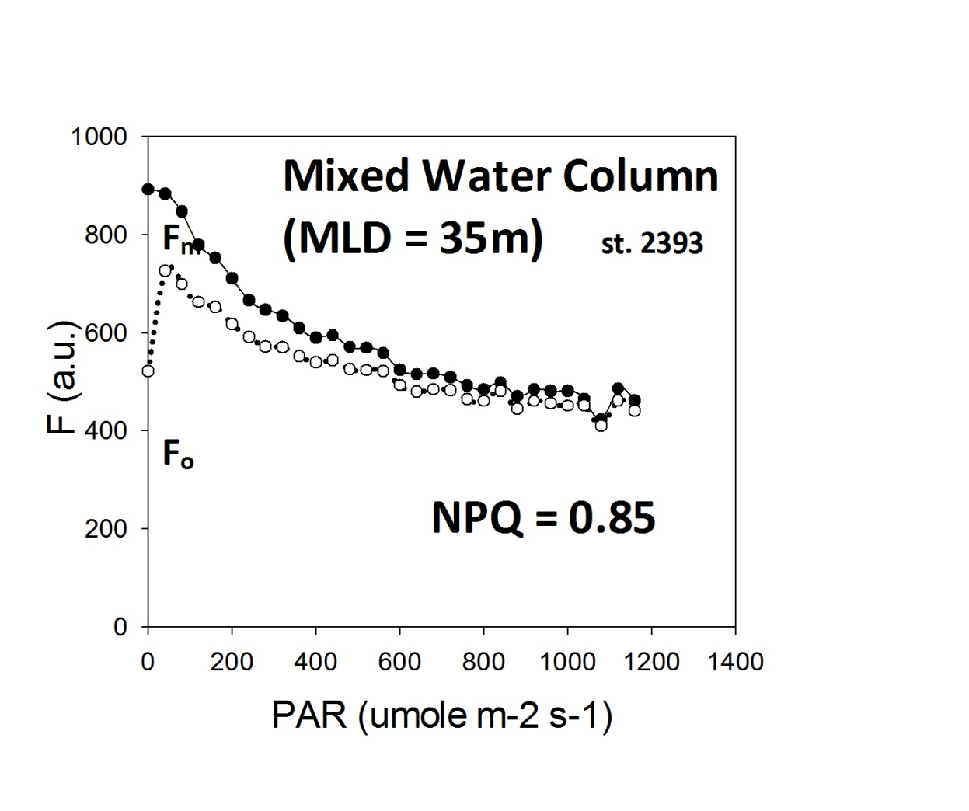
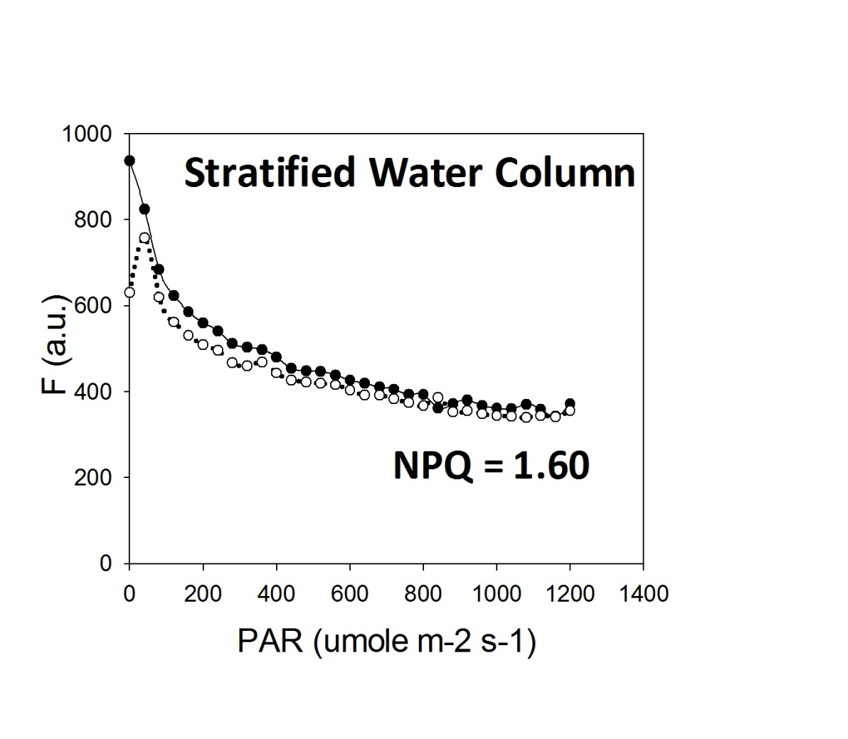
Effect of Vertical Mixing on Yields of SIF
(North Atlantic, Sept. 2010)
Acclimation to High Light in a stratified water column increases NPQ capacity and, hence, decreases the quantum yield of SIF
Acclimation of NPQ to HL is fast (~4-6 hours), even in cold sub-Arctic waters

Slide 30
Effect of Vertical Mixing on Yields of SIF
(North Atlantic, Sept. 2010)
Acclimation to High Light in a stratified water column increases NPQ capacity and, hence, decreases the quantum yield of SIF
Acclimation of NPQ to HL is fast (~4-6 hours), even in cold sub-Arctic waters

Slide 31

Effect of Vertical Mixing on Yields of SIF
(North Atlantic, Sept. 2010)
Acclimation to High Light in a stratified water column increases NPQ capacity and, hence, decreases the quantum yield of SIF
Acclimation of NPQ to HL is fast (~4-6 hours), even in cold sub-Arctic waters

Slide 32
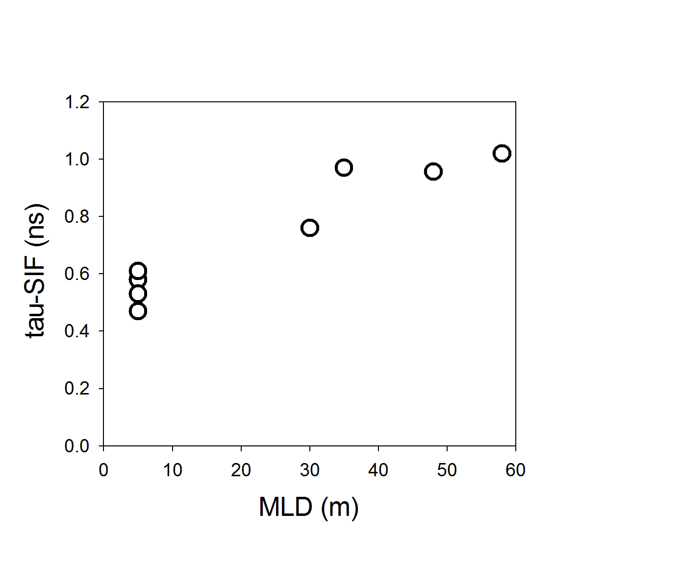
Effect of Vertical Mixing on Yields of SIF
(North Atlantic, Sept. 2010)
Acclimation to High Light in a stratified water column decreases fluorescence lifetimes and, hence, decreases the quantum yields of SIF

Slide 33
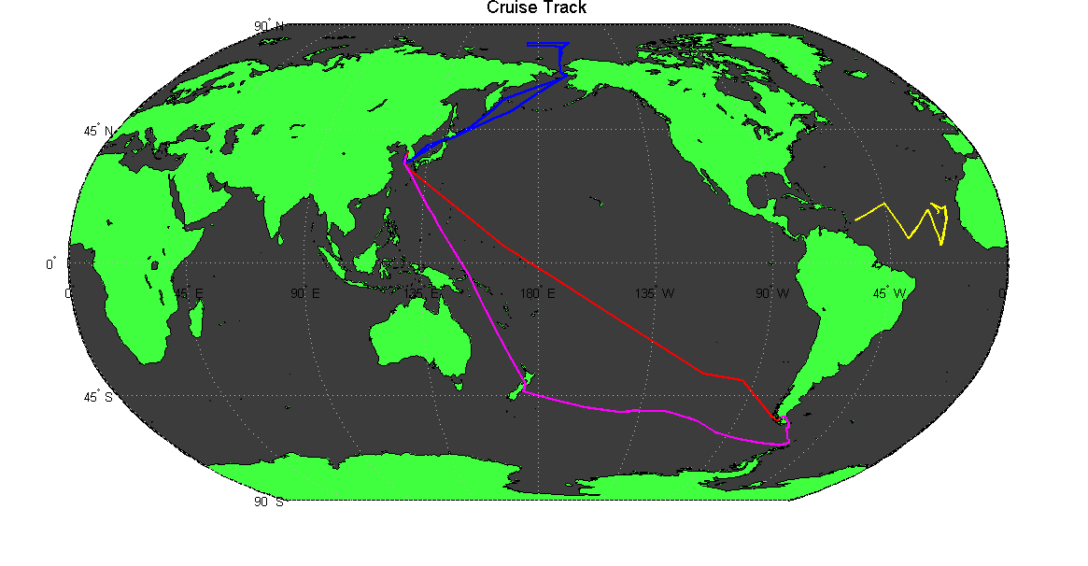
Field Program Completed
Over 300,000 measurements of fluorescence yields collected;
~ 40,000 miles of transects.

Slide 34
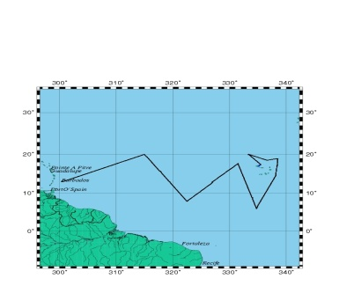
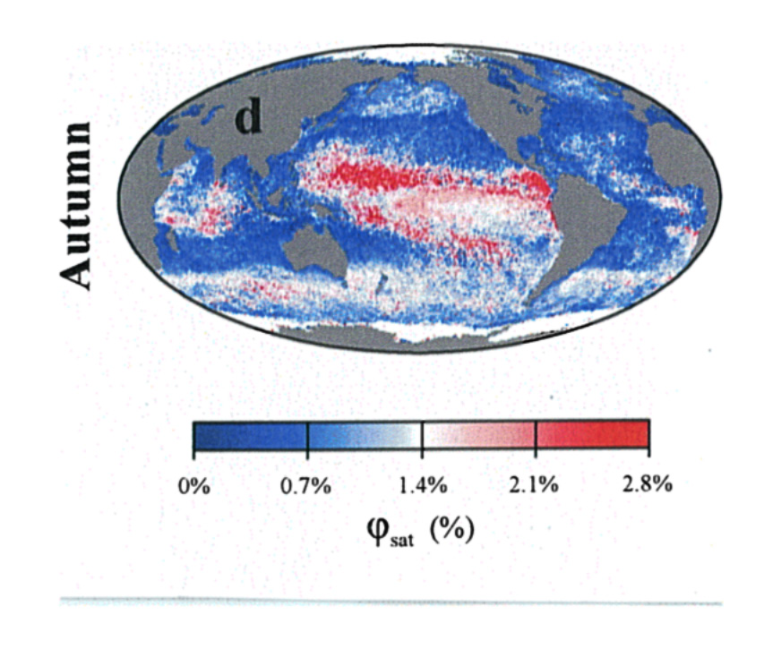
Variability of Fluorescence Lifetimes in Sub-tropical Atlantic (Aug.-Sept. 2008)
Fluorescence lifetimes and quantum yields are highly constrained across the Atlantic
Behrenfeld et al., Biogeosciences, 2009

Slide 35
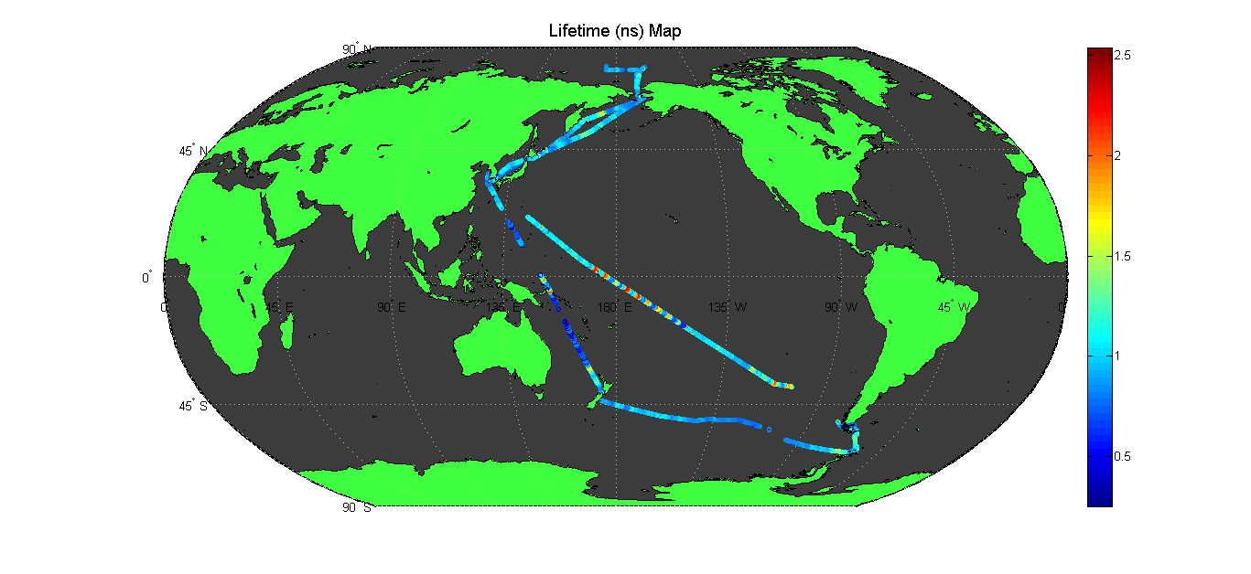
Variability of Fluorescence Lifetimes in the Pacific
~5x variability in fluorescence lifetimes in the Pacific
Strong physiological effects (due to nutrient status and taxonomy)

Slide 36

Variability in Chlorophyll Biomass

Slide 37

Variability in Photosynthetic Efficiency of PSII

Slide 38
Interpreting the Variability in MODIS SIF Yields

Slide 39
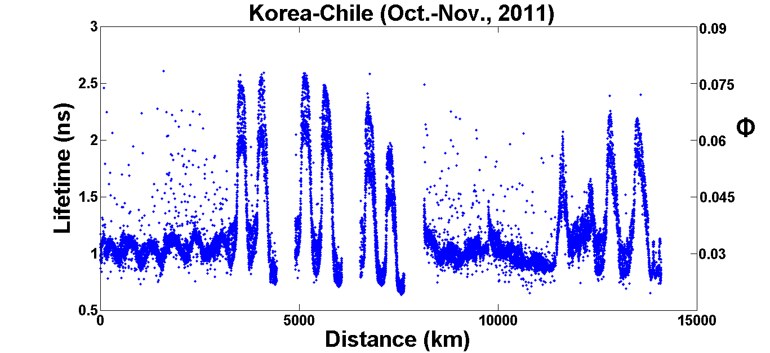
Variability of Fluorescence Lifetimes in the Pacific

Slide 40
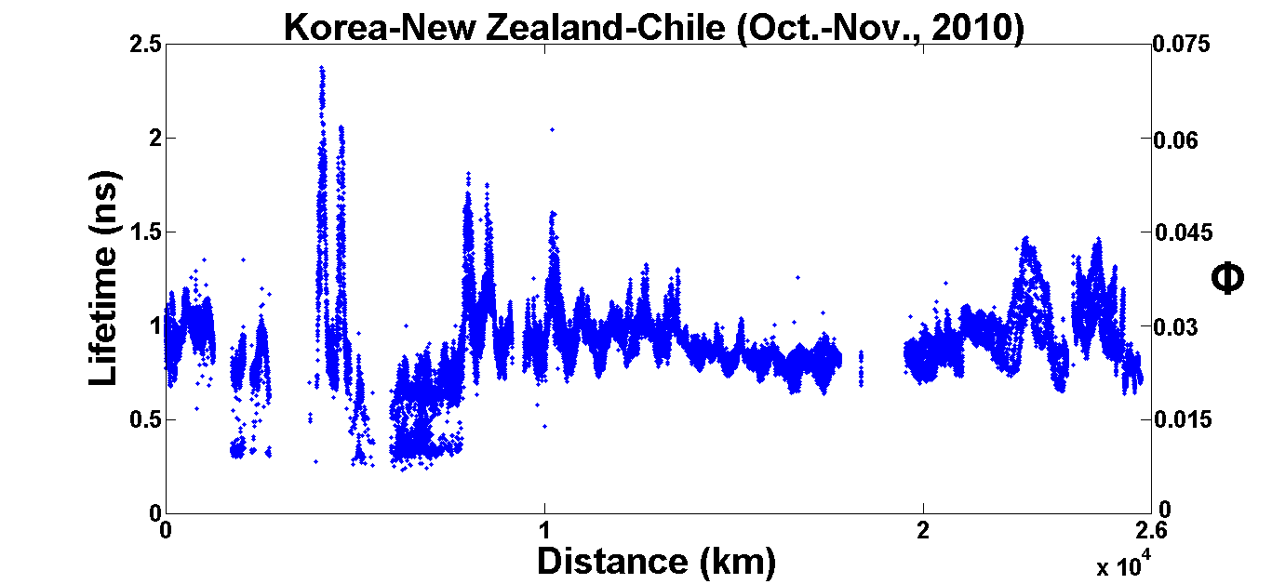
Variability of Fluorescence Lifetimes in the Pacific

Slide 41
Chl-a Fluorescence Lifetime Distribution in Near-Surface Layer (Araon, Oct 17, 2010)
F
(a.u.)
Lifetime
(ns)
Fv/Fm

Slide 42
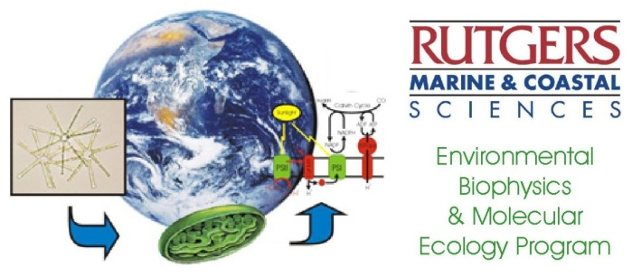

Conclusions
SIF yields reflects phytoplankton physiology and taxonomy in the ocean.
Phytoplankton taxonomy is as important in regulating satellite-based SIF yields as nutrient status (may account >50% of variability in SIF yields).
Photoacclimation (vertical mixing) may also contribute to the variability in SIF yields (may account ~20% of variability in SIF yields).

Slide 43
Future Directions
to complete an extensive field program in the Arctic, Pacific, and Southern oceans to complement the database of fluorescence lifetimes acquired previously.
to reconstruct the global distribution of fluorescence lifetimes and fluorescence yields in the ocean.
to correlate the distributions of fluorescence lifetimes and quantum yields with the variability in SIF yields retrieved from MODIS products.
to correlate the variability in fluorescence yields with chemical, hydrological, and biological data (nutrient availability, taxonomy, and physical forcing).

Slide 44
Acknowledgments
NASA Ocean Biology and Biogeochemistry Program (grant NNX08AC24G)
Crews of R/V Oceanus, Araon, and Akademik Ioffe
Dr. SangHoon Lee and Korea Polar Research Institute, Incheon for support during field campaigns

Slide 45
Thank you. Questions?

Slide 46
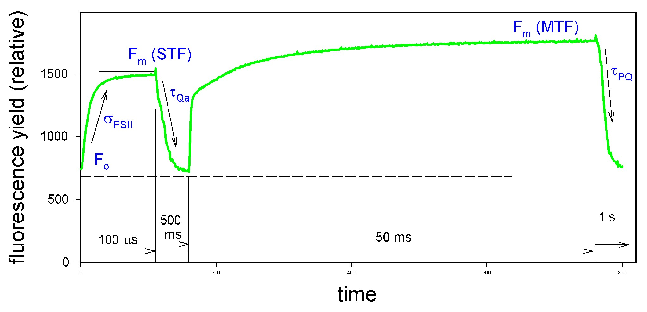
Fluorescence Induction and Relaxation (FIRe) technique
Q_{a}⁻ Q_{b} -> Q_{a} Q_{b}⁻ (~200 us)
PSII to PSI
e⁻ transport
(>5000 us)
Q_{a}⁻ Q_{b}⁻ -> Q_{a} Q_{b}⁼ (~800 us)
Q_{a}⁻ __ -> Q_{a}⁻ Q_{b} -> Q_{a} Q_{b}⁻ (~2000 us)

Slide 48
