Slide 1
Past and current IOCCG activities related to global ocean color CDRs, and rationale for an
International Ocean Color Science Team Meeting (“iOCST”)
David Antoine
Chair, IOCCG

Slide 2
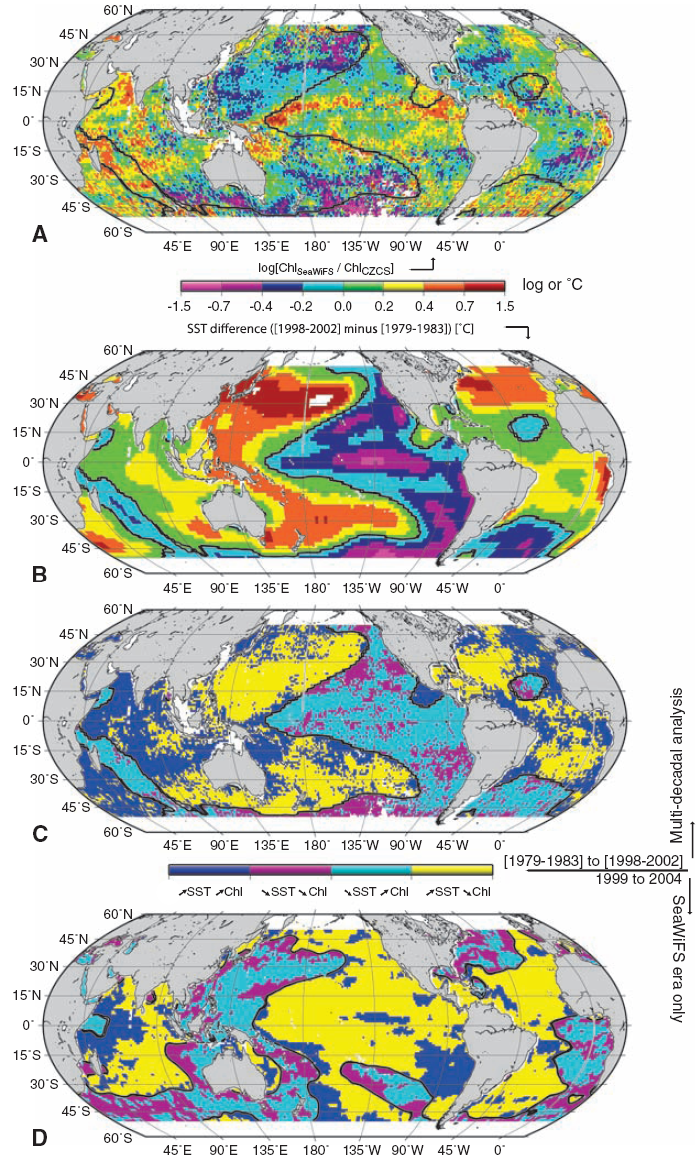
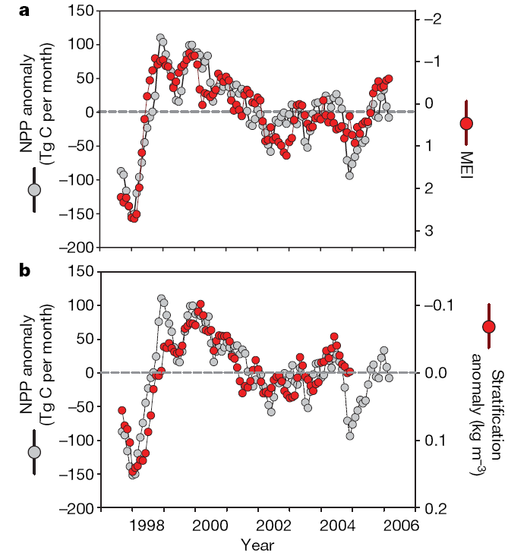
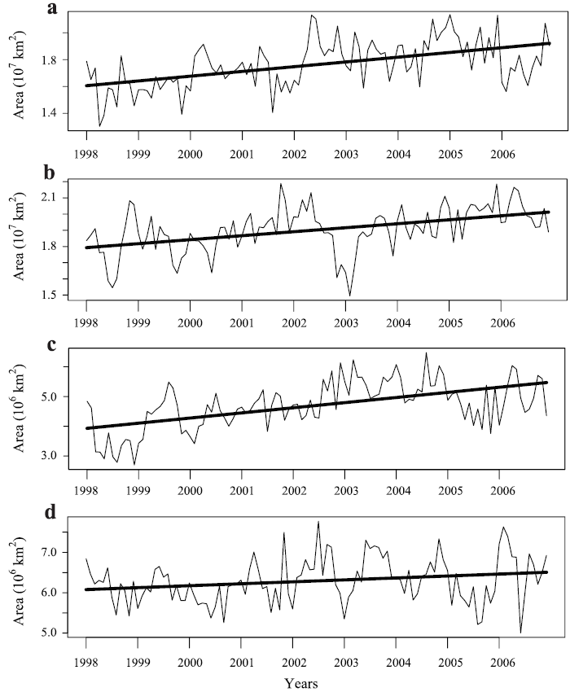
The need for “OCR CDRs”
Many indications exist of changes in marine productivity & ecosystems.
Understanding these changes and their relation to global changes in the physical environment (“global climate”) requires global, multi-decadal & multi-sensor time series (CQDRs);
see, e.g., NRC report “Climate Data Records from Environmental Satellites”, 2004
Behrenfeld et al., Nature, 2006
Polovina et al., Geophys. Res. Letters, 2008
Martinez et al., Science, 2009

Slide 3
Taking care of OCR CDRs is within the terms of reference of IOCCG
To serve as a communication and coordination channel between data providers and the global, user community of satellite-ocean-colour data, and so to maximize the benefits that accumulate from international investments in ocean-colour science and technology.
To construct a partnership, at the international level, between the space agencies and the users of satellite-ocean-colour data to develop and coordinate data utilization.
To work closely with the appropriate international bodies (including CEOS, IOC and SCOR), international scientific programs (such as IGBP and GOOS), satellite-ocean-colour-mission offices and other agencies (such as environmental and fishing agencies) to harmonize the international effort and advance ocean-colour science and its applications.
To develop a collective voice for the community of users of ocean-colour data and to articulate this voice to the appropriate international bodies, international scientific programs and space agencies.
To promote the long-term continuity of satellite ocean-colour data sets; the development of operational, ocean-colour data services and new generations of ocean-colour sensors; and the integration of data from complementary ocean sensors.
How much do we have progressed
in this domain?

Slide 4
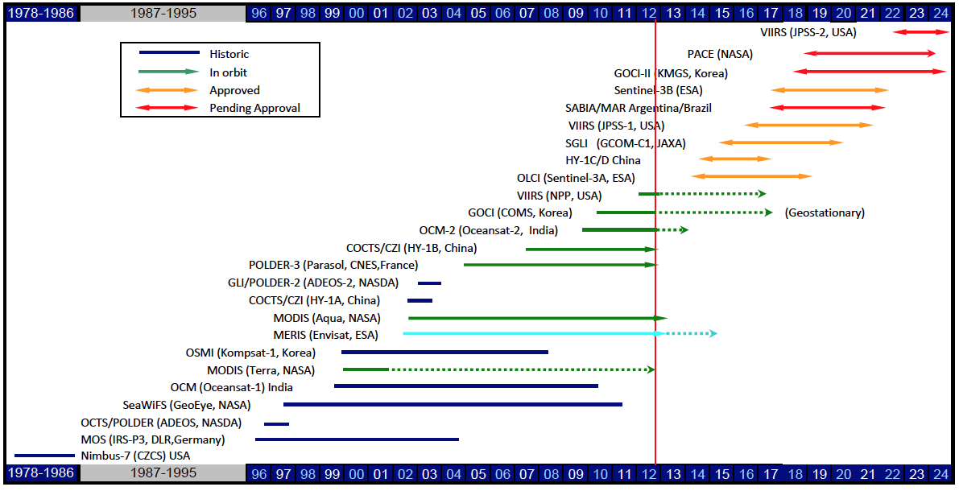
Where are we today?
(1) In terms of sensors providing global data sets:
The SeaWiFS mission has ended in Dec 2010
MERIS is likely terminated since April 8, 2012…
The two MODIS should provide data until 2013-2014
OCM-2 started data acquisition in fall of 2009 (until 2015 ?)
NPP-VIIRS started end of 2011 and JPSS-VIIRS should start providing data in 2013-2014
Sentinel-3 OLCI should start providing data in 2014
SGLI should start delivering data in 2015

Slide 5
Where are we today?
(2) In terms of building long-term data sets
Some major initiatives have been set up by space Agencies in order to pave the way for production of global CDRs or “CDR-like” data sets, e.g.:
NASA SIMBIOS (1998-2003)
NASA’s reason ocean color time series project (http://reason.gsfc.nasa.gov/ )
ESA’s DUE GlobCOLOUR project (2006-2009; http://www.globcolour.info/ )
NASA’s Ocean Color MEASURES Project (2008-2012) (http://wiki.icess.ucsb.edu/measures/index.php/Main_Page )
ESA’s Climate Change Initiative (first step: 2010-2013; http://www.esa-cci.org/ )
CEOS Ocean color (OCR) virtual constellation
http://www.ceos.org/index.php?option=com_content&view=article&id=128:ocr&catid=72:ocr&Itemid=71

Slide 6
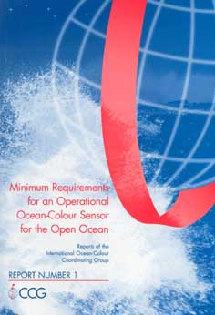


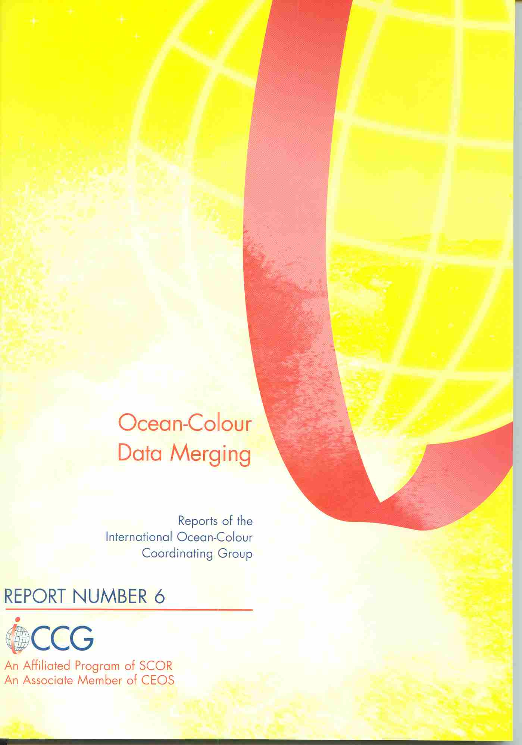
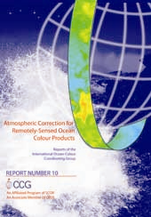
IOCCG reports directly related to CDR issues
Reports 1, 2, 4, 6, and 10

Slide 7
The situation after ~2013-2015 is unclear
We have on one side research missions near the end of their lifetimes and, on the other side, “operational” missions that may not totally fulfill the need
“Merging efforts” are already important, yet they remain relatively punctual and essentially “Agency-specific”
Can we continue just along these lines?
It is unlikely that we will get to the point of having
global, multi-sensor, multi-decadal,
ocean color CDRs if we only rely on “punctual” and essentially single-agency-based activities and “best-effort” international coordination.
International coordination is mandatory and useful (e.g., the Virtual constellation concept), yet it might be insufficient to reach our goals
So what ???

Slide 8
The IOCCG “roadmap” or
“Strategic document” for OCR CDRs
Review existing assets (missions and merging efforts), and propose some short-term and mid-term actions that could help in generating community-accepted long-term climate-quality ocean color data records (CDRs)
Implement these actions in the frame of IOCCG and the CEOS OCR-VC
Involve as much as possible the international OCR community
Several drafts have been circulated among the IOCCG; still needs to be finalized in order to become a reference document for IOCCG’s activities related to OCR CDRs (other IOCCG activities continue and do not need this)

Slide 9
Existing and possible short-term actions (2011-2013)
as currently identified in the IOCCG “roadmap for CDRs”
Currently active IOCCG working groups
Calibration of Ocean-Colour Sensors
Phytoplankton Functional Types
Bio-optical Instrumentation on ARGO Floats (report under press)
Ocean Colour from a Geostationary Orbit (report under press)
Mission Requirements for Future Ocean Colour Sensors
Harmful Algal Blooms
A new IOCCG working group on evaluation of ECV’s (Jim’s talk this morning)
Evaluating ECVs produced by different teams
Regular team meetings across agencies; short sabbaticals
Example: participation of 2 OBPG members to the ESA MERIS QWG. We could identify key actors and encourage
them to collaborate more actively on topics of interest for CDRs
The “International Network for Sensor InTercomparison and Uncertainty assessment for Ocean Colour Radiometry” (INSITU-OCR) (Sean’s talk this morning)
Recurrent IOCCG summer lecture series on “frontiers in OC science” (starts in July 2012)
Community consultation meeting (the overall goal of this IOCCG special session)
Broadening the community consultation through regular meetings

Slide 10
What’s a “community consultation meeting”?
Community gathering (fully open), with the objectives of:
Providing a forum for discussions on various topics (a sort of “extended town hall meeting”)
In our specific case: helping IOCCG in its oversight role
Building / reinforcing a scientific community on a given domain
Enrolling more people into community work than is feasible through the IOCCG meetings and WGs only
Producing synthesis documents of interest for the community in question
( ! Redundancy/conflict with IOCCG reports)
Reinforcing this community voice when it comes to high-level agency discussions
…
What a “community consultation meeting” is not
- A science conference
A committee meeting
An “happy few” restricted meeting
Not only talks; we need some concrete outputs

Slide 11
Why IOCCG should organize such a meeting?
Within mandate (extracts from IOCCG objectives: “To foster expertise in using ocean-colour data”, “To provide a common voice for the user community”, “To advocate the importance of ocean-colour data to the global community”, ….)
The community would better “appropriate” IOCCG
Organization; fully TBD at this stage
A few keynote invited scientific talks
Some Agency information talks
Posters
Splinter sessions on predefined topics of interest, including a few talks and significant time for discussion (need a chair and a rapporteur)
Synthesis session
People come on a voluntary basis (no travel support), except maybe for invited speakers
Agency reps encouraged to attend
Expected outcome
Meeting reports
Progressive building of scientific groups (science teams on various topics)
Increase exchange between OCR communities from the US, Europe, Asia etc..
Progressive building of community standards on various topics, in particular OCR CDRs

Slide 12
Overall goals, cont’d
Big Picture Integration of Science and Missions and many other topics, e.g.:
- Space Agencies updates
- International Flight Program Updates
- Field Campaigns
- Project Updates
- Student/Post-doc Updates
- Data Policy Updates
- Vicarious Calibration and Validation Activities
- Advance Planning Discussion
- Time Series for Earth System Data Records
- Advances in Modeling, Analysis, and Prediction
- Prospective Workshops
- New Frontiers for Ocean Observing
- Ocean Carbon, Biogeochemistry, and Interdisciplinary Research
- Feedback and Action Items

Slide 13
Proposal for a first meeting in spring of 2013
Would be sandwiched between the 2013 NASA OCRT meeting and an ESA meeting, in order to help giving momentum, by having many people from the US and European communities already there.
Location / dates TBD; would be a major city/hub for easy travel
- All details of content/organization/participation etc.. Will be brought forward during the
Discussion session at the end of the morning will aim at going into the details of what this meeting could entail

