Slide 1


Retrieval of size-partitioned phytoplankton carbon via the particle size distribution using coated spheres modeling.
Dr. Tihomir S. KosTadinov
California state university san Marcos
Liberal studies department
NASA OCRT Meeting
Busan, south korea
April 8, 2019

Slide 2
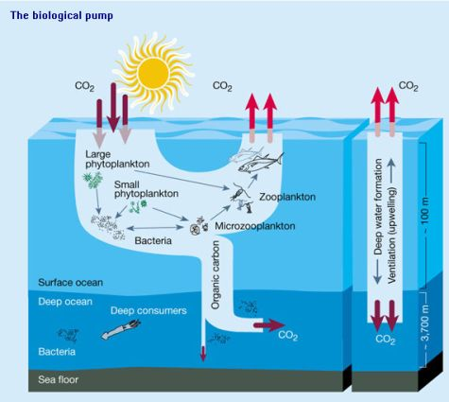
The Oceanic Biological Pump
Different species have various biogeochemical roles based on size:
  Size determines sinking rates & C sequestration
  Size is a master trait that also determines nutrient uptake, growth rate, etc.
Global RS retrieval of cell size & size-partitioned C is needed, in addition to Chl
PSD influences optics as well, so it links ecology, biogeochemistry & optics
Chisholm, 2000

Slide 3
Mie Scattering Theory & Solving for the Underlying PSD
Mie scattering theory solves the Maxwell equations for homogeneous spherical particles (can be extended for coated spheres)
Particulate
Backscattering
Coefficient =
Retrievable from space spectrally
b_{bp}(λ) efficiency solved by Mie theory
Goal of retrieval
Single particle optical properties depend on:
  Relative complex index of refraction m_{r}(λ)
  Size relative to the incident wavelength
  Shape & internal composition
Kostadinov et al. (2009)
Notes:
Power law size distribution
The algorithm is based on Mie Scat theory for homogenous spheres (we want to relax this assumption). Total Particulate backscattering coefficient is obtained if we integrate the backscattering coefficient across all particles of different diameters D, where the backscattering efficiency
Needs limits of integration -- adding extra parameters.
(1) Methodology of the KSM09 PSD retrieval: The integral computes backscattering, where the red part (bbp efficiencies) is theoretically modeled, the bbp is measurable from space, and the two PSD parameters (blue) are the goal of the retrieval. Running this in a forward model, we develop LUTs that are used to compute the PSD parameters in operational mode.
(2) Once N and epsilon are known we know the
(3) Single particle optical properties depend on:
Complex index of refraction m_{r}(λ) = n_{r} – i*n_{r}’(λ)
Size relative to the incident wavelength
Shape & internal composition

Slide 4
From Size to Volume to Carbon
Allometric Relationships:
        Cell C =a*V^{b}
Allows definition of three PSCs/PFT’s → % C = f(ξ)
  Picoplankton (0.5 – 2 μm)
  Nanoplankton (2 – 20 μm)
  Microplankton (20 – 50 μm)

Slide 5
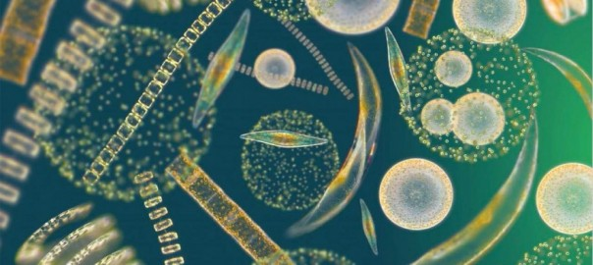
KSM09 Assumes Homogeneous Spheres, but Phytoplankton are shaped like this:
http://darwinproject.mit.edu
Goal: improve KSM09 and TK16 algorithms by implementing coated spheres
Coated spheres reproduce observed b_{bp} and c spectra much better ((Organelli et al., 2018), likely because they are able to better represent the structural complexity of phytoplankton cells that is responsible for their enhanced scattering

Slide 6
Inputs to Coated Spheres Mie Code
Core & coat real n
Core absorption
spectra
Coat n’ = 1e-4
Coat thickness – varies between 0.05 and 0.15 as fraction of radius
D_{min} = 0.1 um
D_{max} - varies b/n 20 and 200 μm, mean 107 μm
This results in mean volume-averaged n of ~ 1.08 for the particles. Organelli et al. (2018) use V-avg n ~ 1.06

Slide 7
Modeled Q_{bb}(D,520 nm) and b_{bp}(λ)
Homogeneous sphere is using same complex index of refraction as the core of coated sphere.
Notes:
Need to test with a homogeneous sphere with np equal to the volume-avg np of the comparable coated sphere.

Slide 8
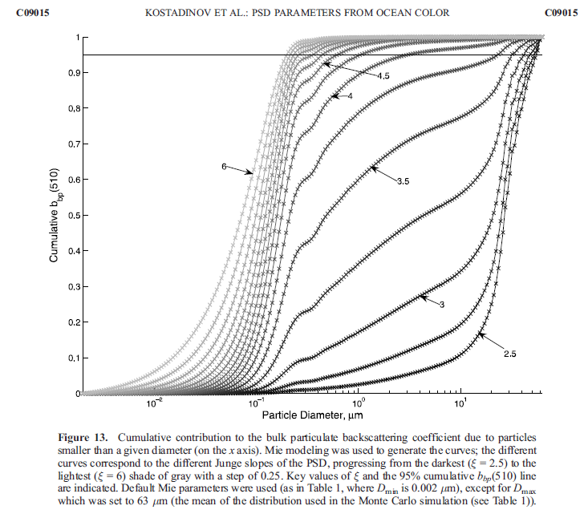
Cumulative b_{bp}
Kostadinov et al. (2009)
Coated spheres @ ξ = 4 → 80 % of b_{bp} is due to particles < 5 μm,
as opposed to < 0.5 μm for homogeneous spheres
b_{bp} and c are sensitive to similar size ranges – submicron particles are less important than homogeneous Mie predicts (Organelli et al., 2018)

Slide 9
Coated spheres PSD LUTs as compared to the homogeneous case (KSM09)
b_{bp} per particle is a larger number,
resulting from the higher Q_{bb}.
ξ is a stronger function of η for the coated spheres

Slide 10
Retrieved PSD Slope – May 2004
Coated spheres PSD slope retrievals are LOWER in eutrophic areas and HIGHER in the geostrophic gyres, as compared to the homogeneous KSM09 retrievals

Slide 11
Retrieved N_{o} – May 2004
Coated spheres retrievals are LOWER everywhere, but the decrease is more pronounced in eutrophic area
N_{o} should be very sensitive to the real indices of refraction chosen (note wider uncertainty bounds of LUT in log space).

Slide 12
Total Phyto C Retrievals
Coated spheres retrievals are LOWER everywhere (driven by N_{o} to first order), but the decrease is more pronounced in eutrophic areas
  This should alleviate exaggerations of C in eutrophic areas, and somewhat worsen underestimations of C in oligotrophic gyres
  Need to input realistic real n, e.g. as in Organelli et al. (2018), or tune for it.

Slide 13
Differences in retrievals for the fractional C-based PSCs
Fractional PSCs are a function of the PSD slope, allometric coeffs, and D_{min} & D_{max} chosen. The change mapped here thus reflects the change in the PSD slope LUT – higher slopes retrieved for high η values, lower slopes for low η values.

Slide 14
Concluding Remarks
Need to choose realistic inputs to the Mie code that reproduce real-world measured b_{bp} in the open ocean – e.g. Organelli et al. (2018),
  or tune for the Mie parameters, e.g. with global POC data.
Coated spheres Q_{bb} is not a well-behaved function for integration dD
Overestimation of total C in eutropic areas is improved, but underestimation in oligotrophic gyres gets somewhat worse
  This is driven by the effective average real index of refraction, uncertainty in n translates to uncertainty in particle numbers
Need validation @ PSD and phyto C level
Non-spherical modes should be used and compared as well

Slide 15
Acknowledgements & Disclaimers
The work presented herein was supported by NASA grant #80NSSC19K0297 to T.S.Kostadinov, I. Marinov and S. Maritorena
Any opinions, findings, and conclusions or recommendations expressed in this material are those of the author(s) and do not necessarily reflect the views of the National Aeronautics and Space Administration.

Slide 16
Thank You!

Slide 17
Extra Slides

Slide 18
bbp slope Histogram – May 2004

Slide 19
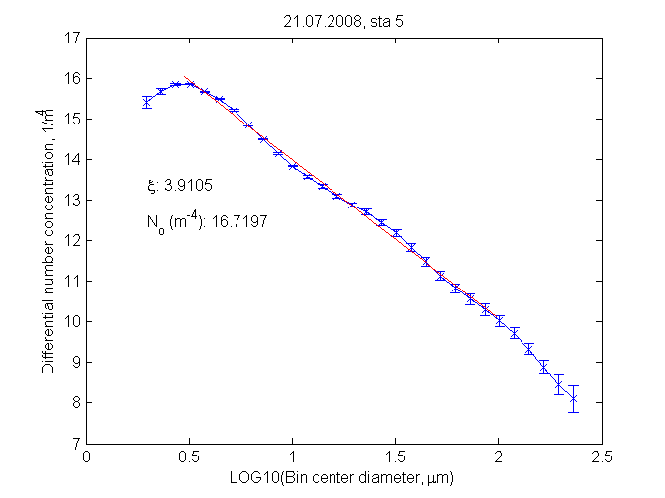
Describing the PSD
Ecological structure influences optical properties. PSD can link ecology and optics.
Example PSD measured by LISST-100X
34º12.26’N 119º55.69’ W
Power-law Size Distribution
  ξ = PSD slope
  D_{o} = 2 μm
  N_{o} = N(D_{o}), [m⁻⁴]
July 21, 2008
Santa Barbara Channel
California
log 10 of Number of particles N
ξ: 3.91
N_{o}: 16.7 m⁻⁴
Log 10 of Particle Diameter
Notes:
Xi parameter = slope; need to get it from satellites !!!
The connection between Optics and ecology is given by the Power Law size distribution, PSD
D is particle diameter, Do = reference diameter
N is the number of particles per volume of sea water normalized by the bin width dD
The PSD is usually parameterized as a power-law, and has ecological significance. However, there is also evidence of departure, for ex in coastal waters.
Example measure PSD from the Santa Barbara Channel with a LISST instrument. Illustrates the relatively good fit to power-law PSD that we use in all modeling.
Diameter in micro-meter.
Number concentration in m^(-4). Why?

