Slide 1
Mapping Eelgrass Beds Using Hyperspectral Airborne Imagery
Kelley Bostrom
University of Connecticut
NASA OCRT Meeting
May 12, 2010

Slide 2
Acknowledgements
University of Connecticut
  Heidi Dierssen
  Christopher Buonassissi
  Jeff Godfrey
  Dirk Aurin
  Kate Randolph
Florida Environmental Research Institute (FERI)
  Paul Bissett and SAMSON imagery
NOAA GOES-R and CICORE programs
NASA Ocean Biology and Biogeochemistry Program
ITT Visual Information Solutions Technical Support

Slide 3
Value of seagrasses
2nd most valuable aquatic resource (per area)
  (Costanza et al., 1997)
Economic factors
  Disturbance regulation
    Stabilizing the sediments
    Current moderation
  Nutrient cycling
  Food production
    Nursery and habitat for commercially important species

Slide 4
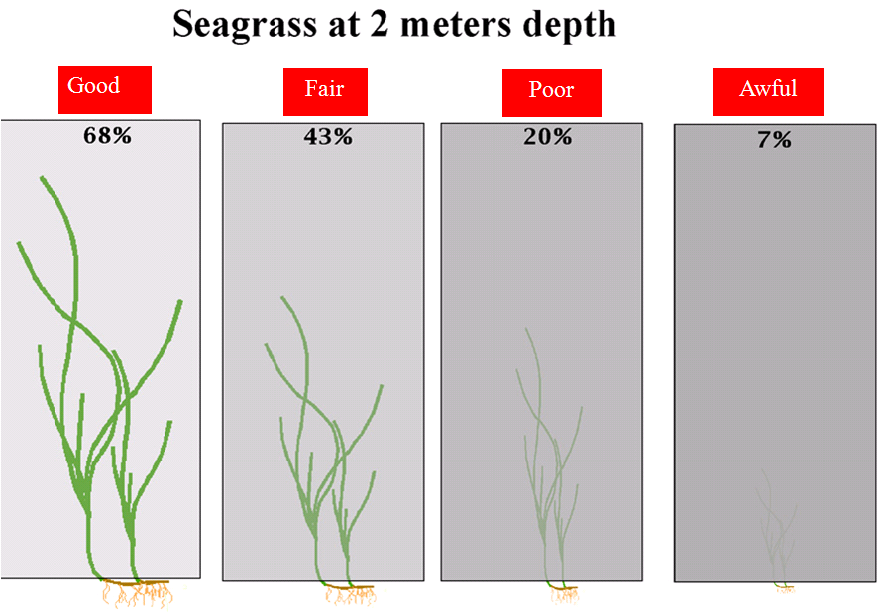
Water clarity
  Light limited Indicator species
death
Short, F. T. http://marine.unh.edu/jel/faculty/fred2/fredshort.htm

Slide 5
Monitoring seagrass
Current distributions need to be quantified
  Monitoring changes is important for resource management
Carbon limited
  Increasing atmospheric CO₂ may be beneficial
  Potential ecological winners
Precise, efficient measurement tools needed

Slide 6
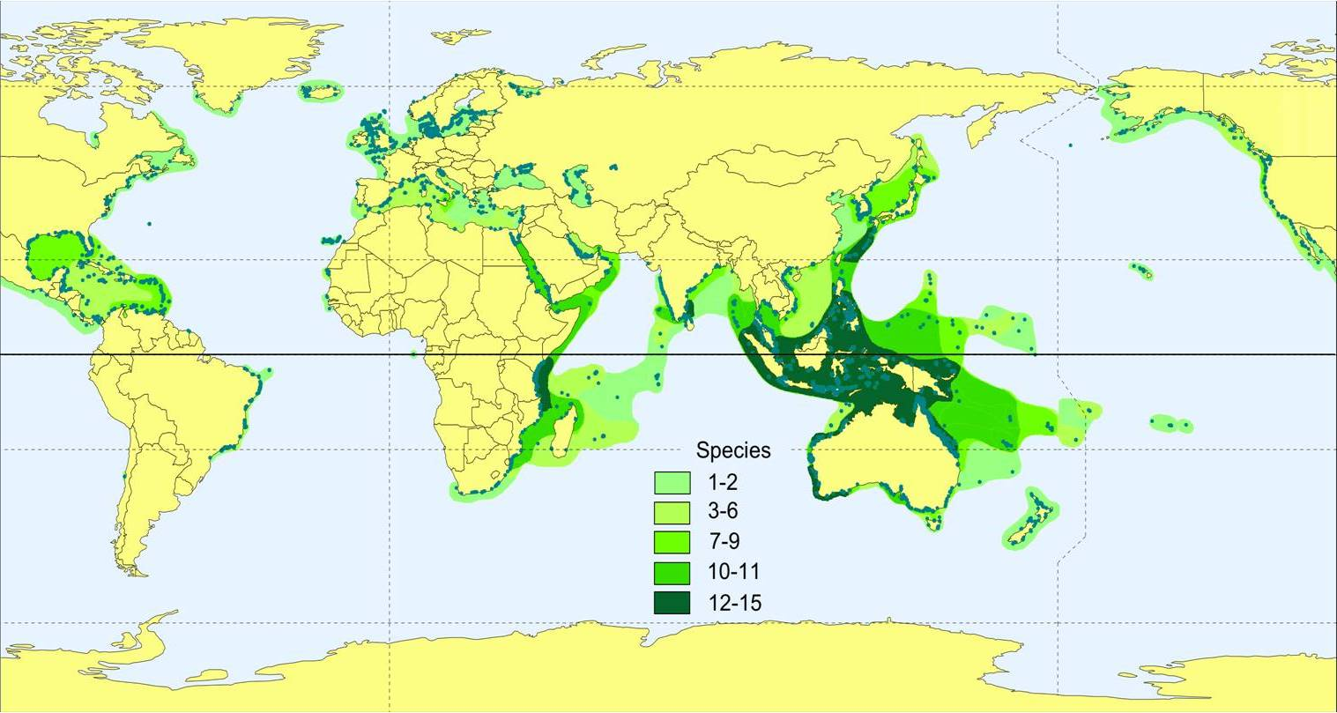
Seagrass distribution and diversity
Global distribution
Efficient mapping
Short, F.T, W.C. Dennison, T.J.B. Carruthers, M. Waycott. 2007. Global Seagrass Distribution and Diversity: A Bioregional Model. Journal of Experimental Marine Biology and Ecology 350: 3-20.

Slide 7
Mapping methods
In situ surveys
  Time and labor intensive
  Lack spatial resolution
Aerial photography
  Good for boundary mapping
  Not quantitative data
Ocean color remote sensing
  Quantitative data
  High spatial and spectral resolution

Slide 8
Study Objectives
Quantify eelgrass distribution and density in a shallow, turbid estuary
Determine analysis methods that can be used successfully in this challenging environment

Slide 9
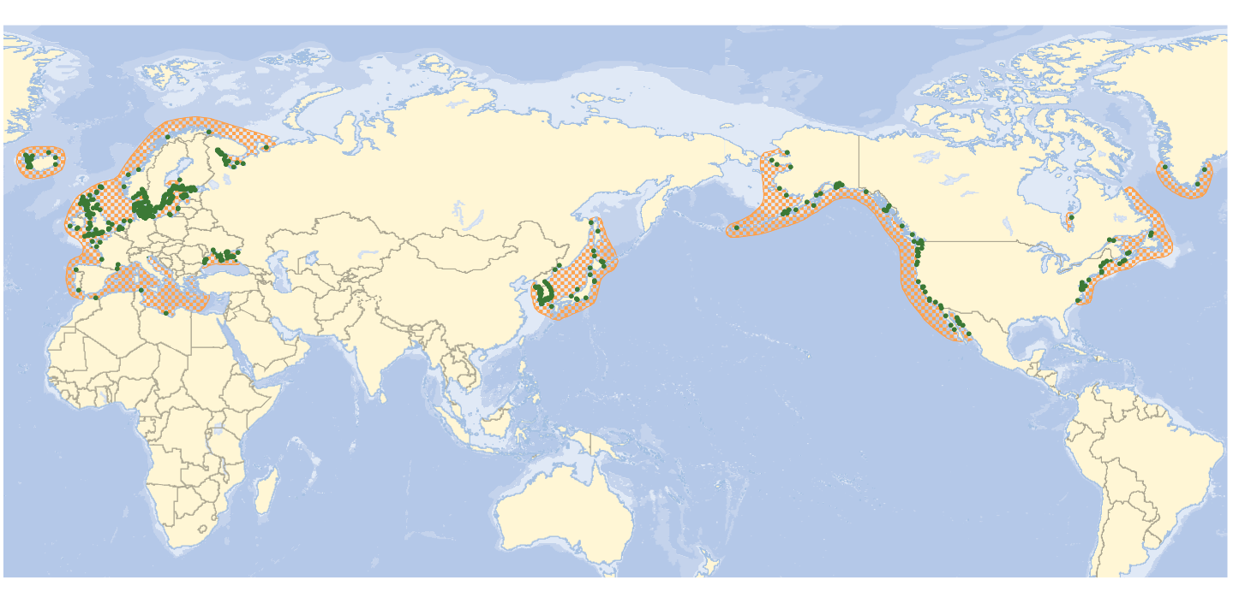
Distribution of Zostera marina (eelgrass)
Green, E.P. and Short, F.T. (eds.). 2003. World Atlas of Seagrasses. University of California Press, Berkeley, USA. 324 pp.

Slide 10
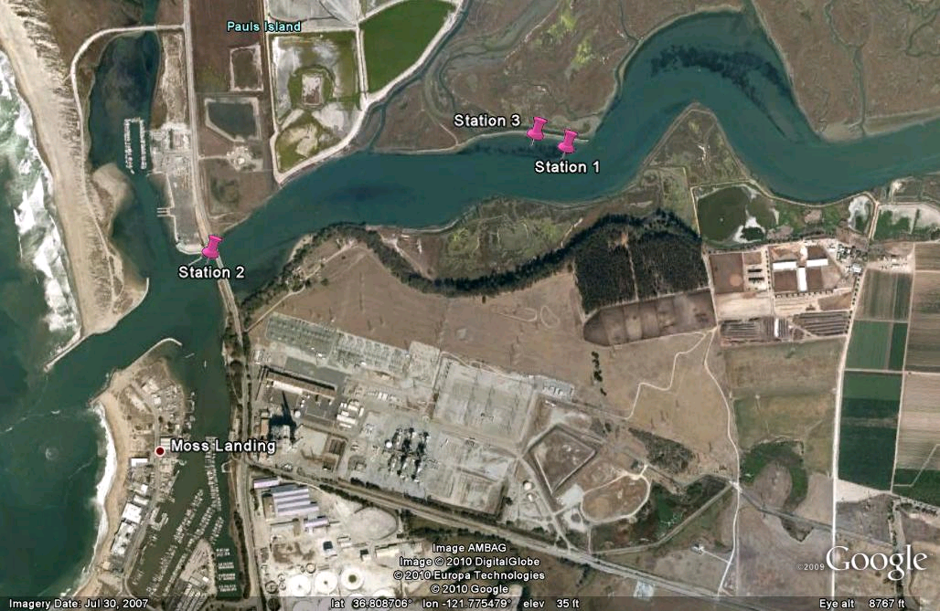
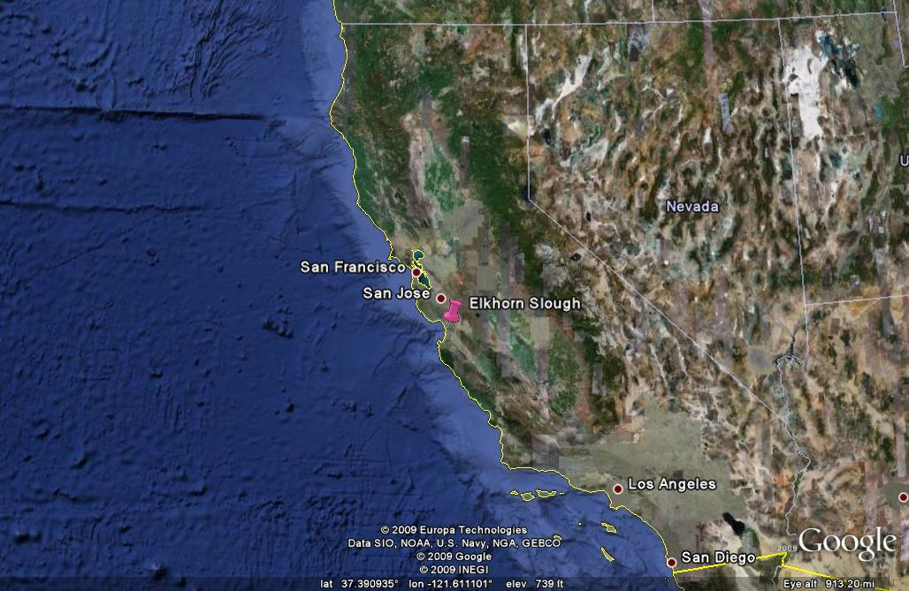
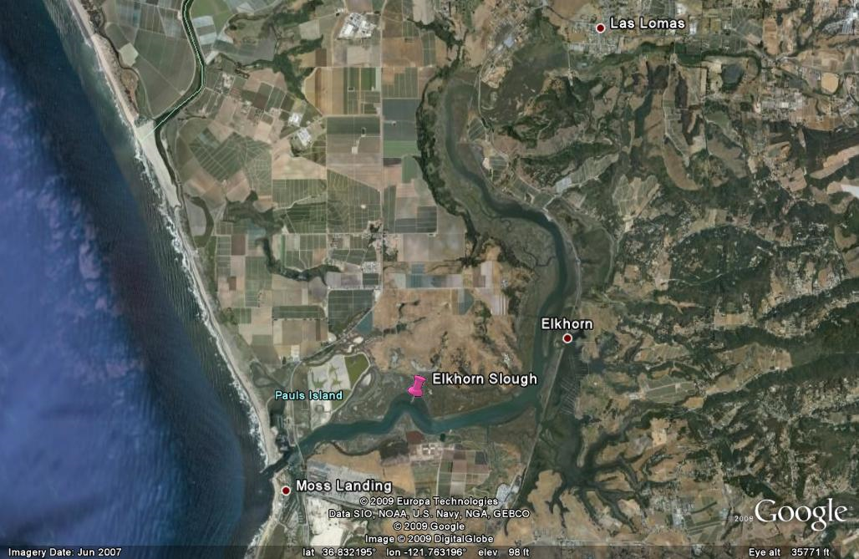
Study site: Elkhorn Slough, CA

Slide 11
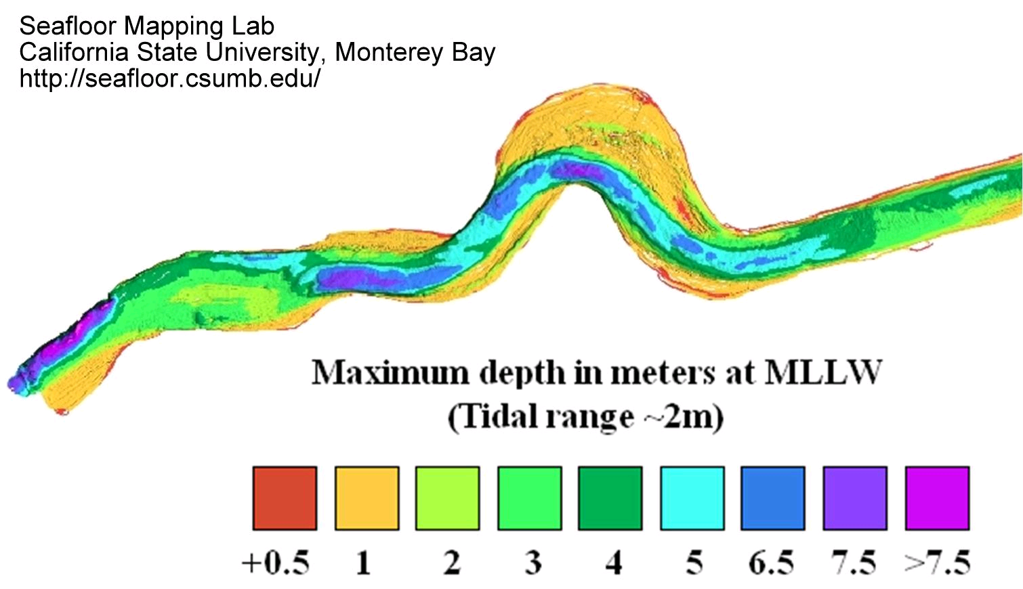
Elkhorn Slough bathymetry

Slide 12
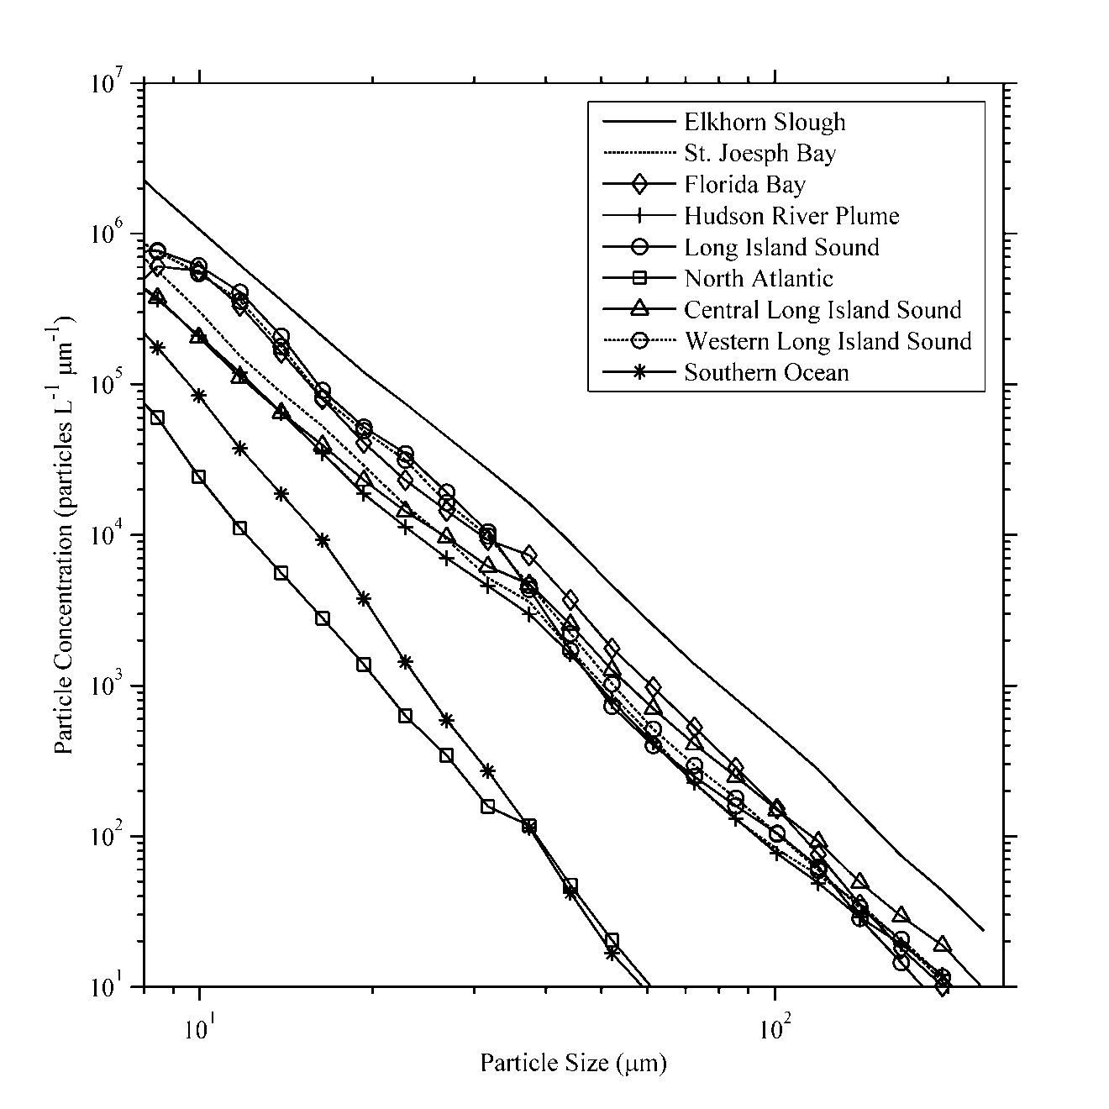
Elkhorn Slough
Buonassissi and Dierssen. Accepted. JGR
Notes:
Say the axes! Point out that because it has such high particle loads, it’s very difficult to do optics in!

Slide 13
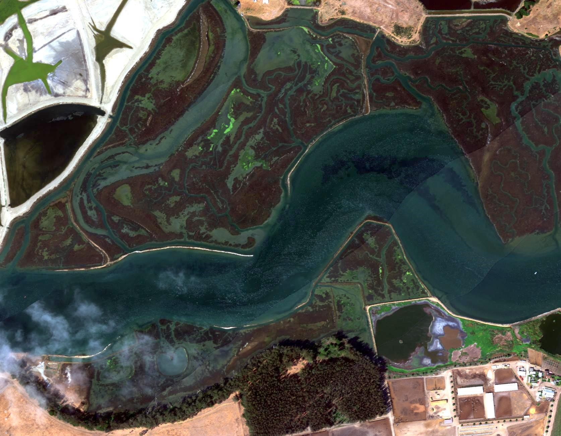
SAMSON imagery (FERI)
Flight on Sept 11, 2006
156 wavebands, 400nm to 900nm
Pixel size 1m²
200m wide
2km long
Swath
Notes:
Explain that SAMSON was on a plane, show the swaths

Slide 14
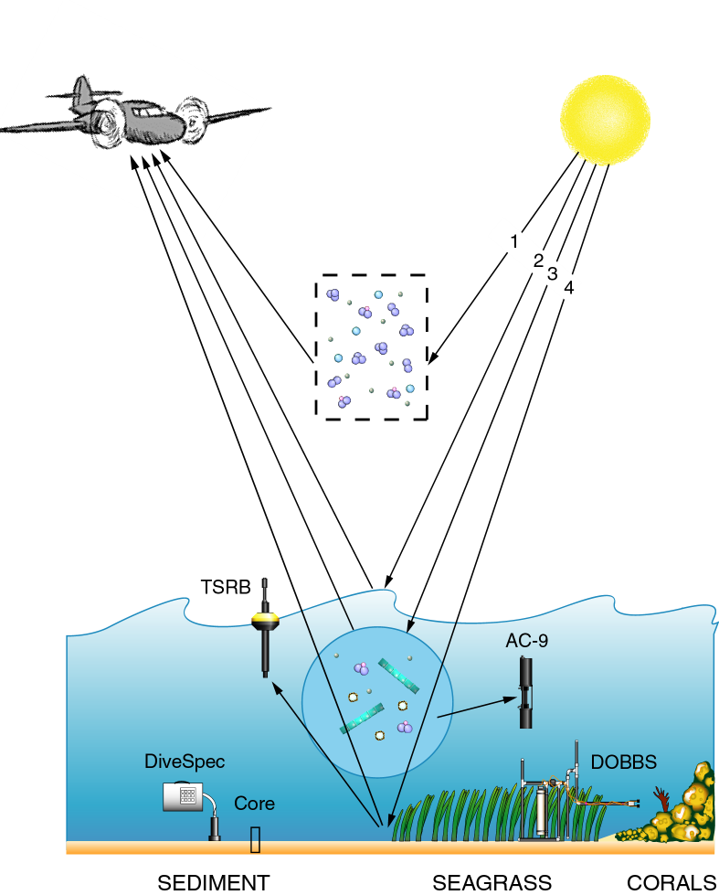
Figure by Eric Louchard
AC-9
Backscattering meter
HyperPro
Divespec
ASD and integrating sphere
LISST
FERI
Notes:
As many of you know, the remote sensing reflectance is the ratio of the water leaving radiance to the incident irradiance. However, very little of the light received by the instrument has reflected off the bottom; much of the signal is light reflected back from the atmosphere and the water column. To account for those factors so that we can focus on the light that has interacted with the benthos, a number of in-water measurements were taken. The atmospheric corrections were done by FERI. Our instruments included an AC-9, a hyperpro, a backscattering meter, an ASD, and a divespec.

Slide 15
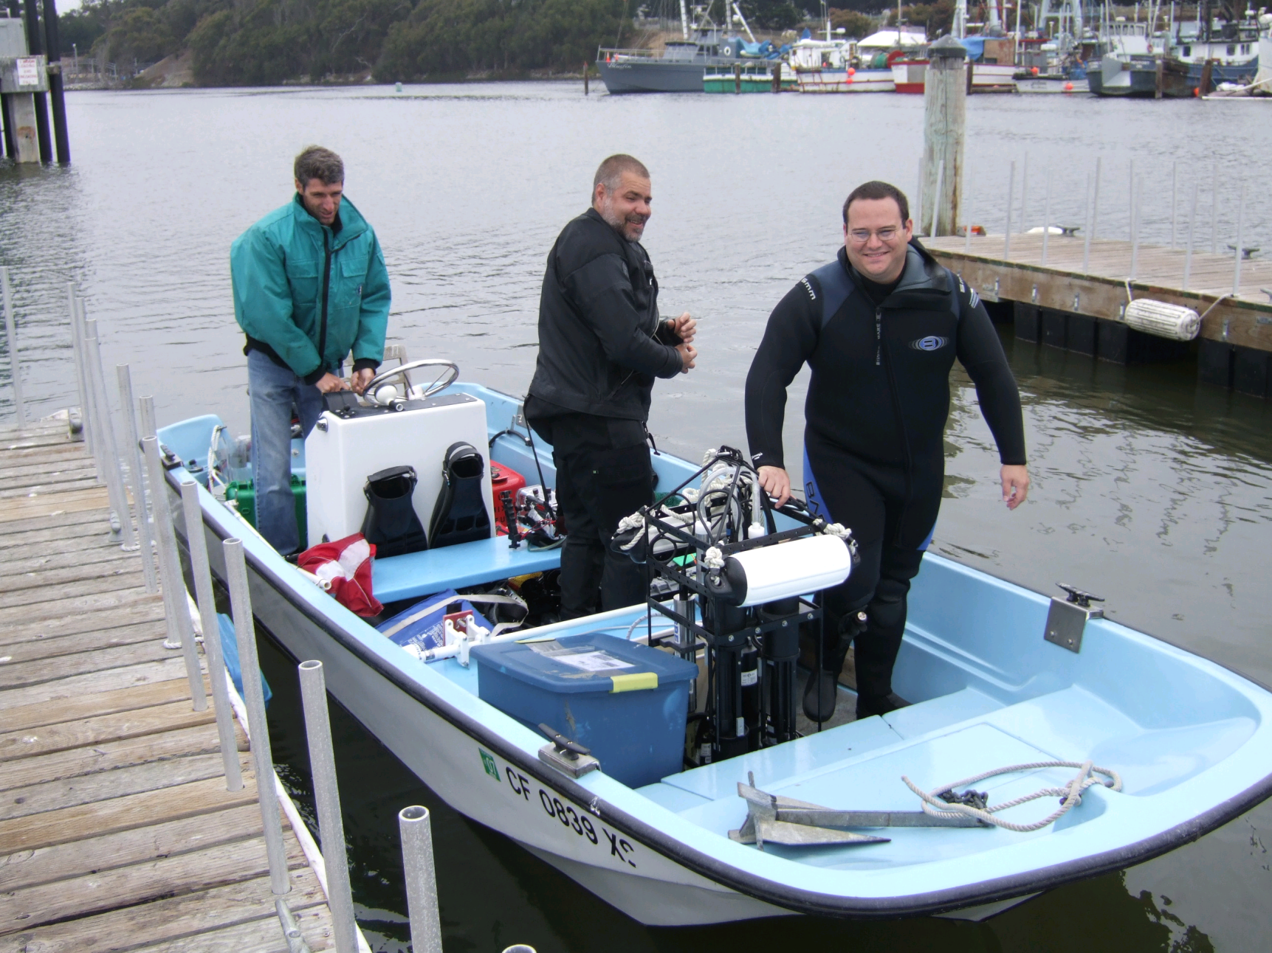
Data collection
Heidi Dierssen

Slide 16
Sampling Stations

Slide 17
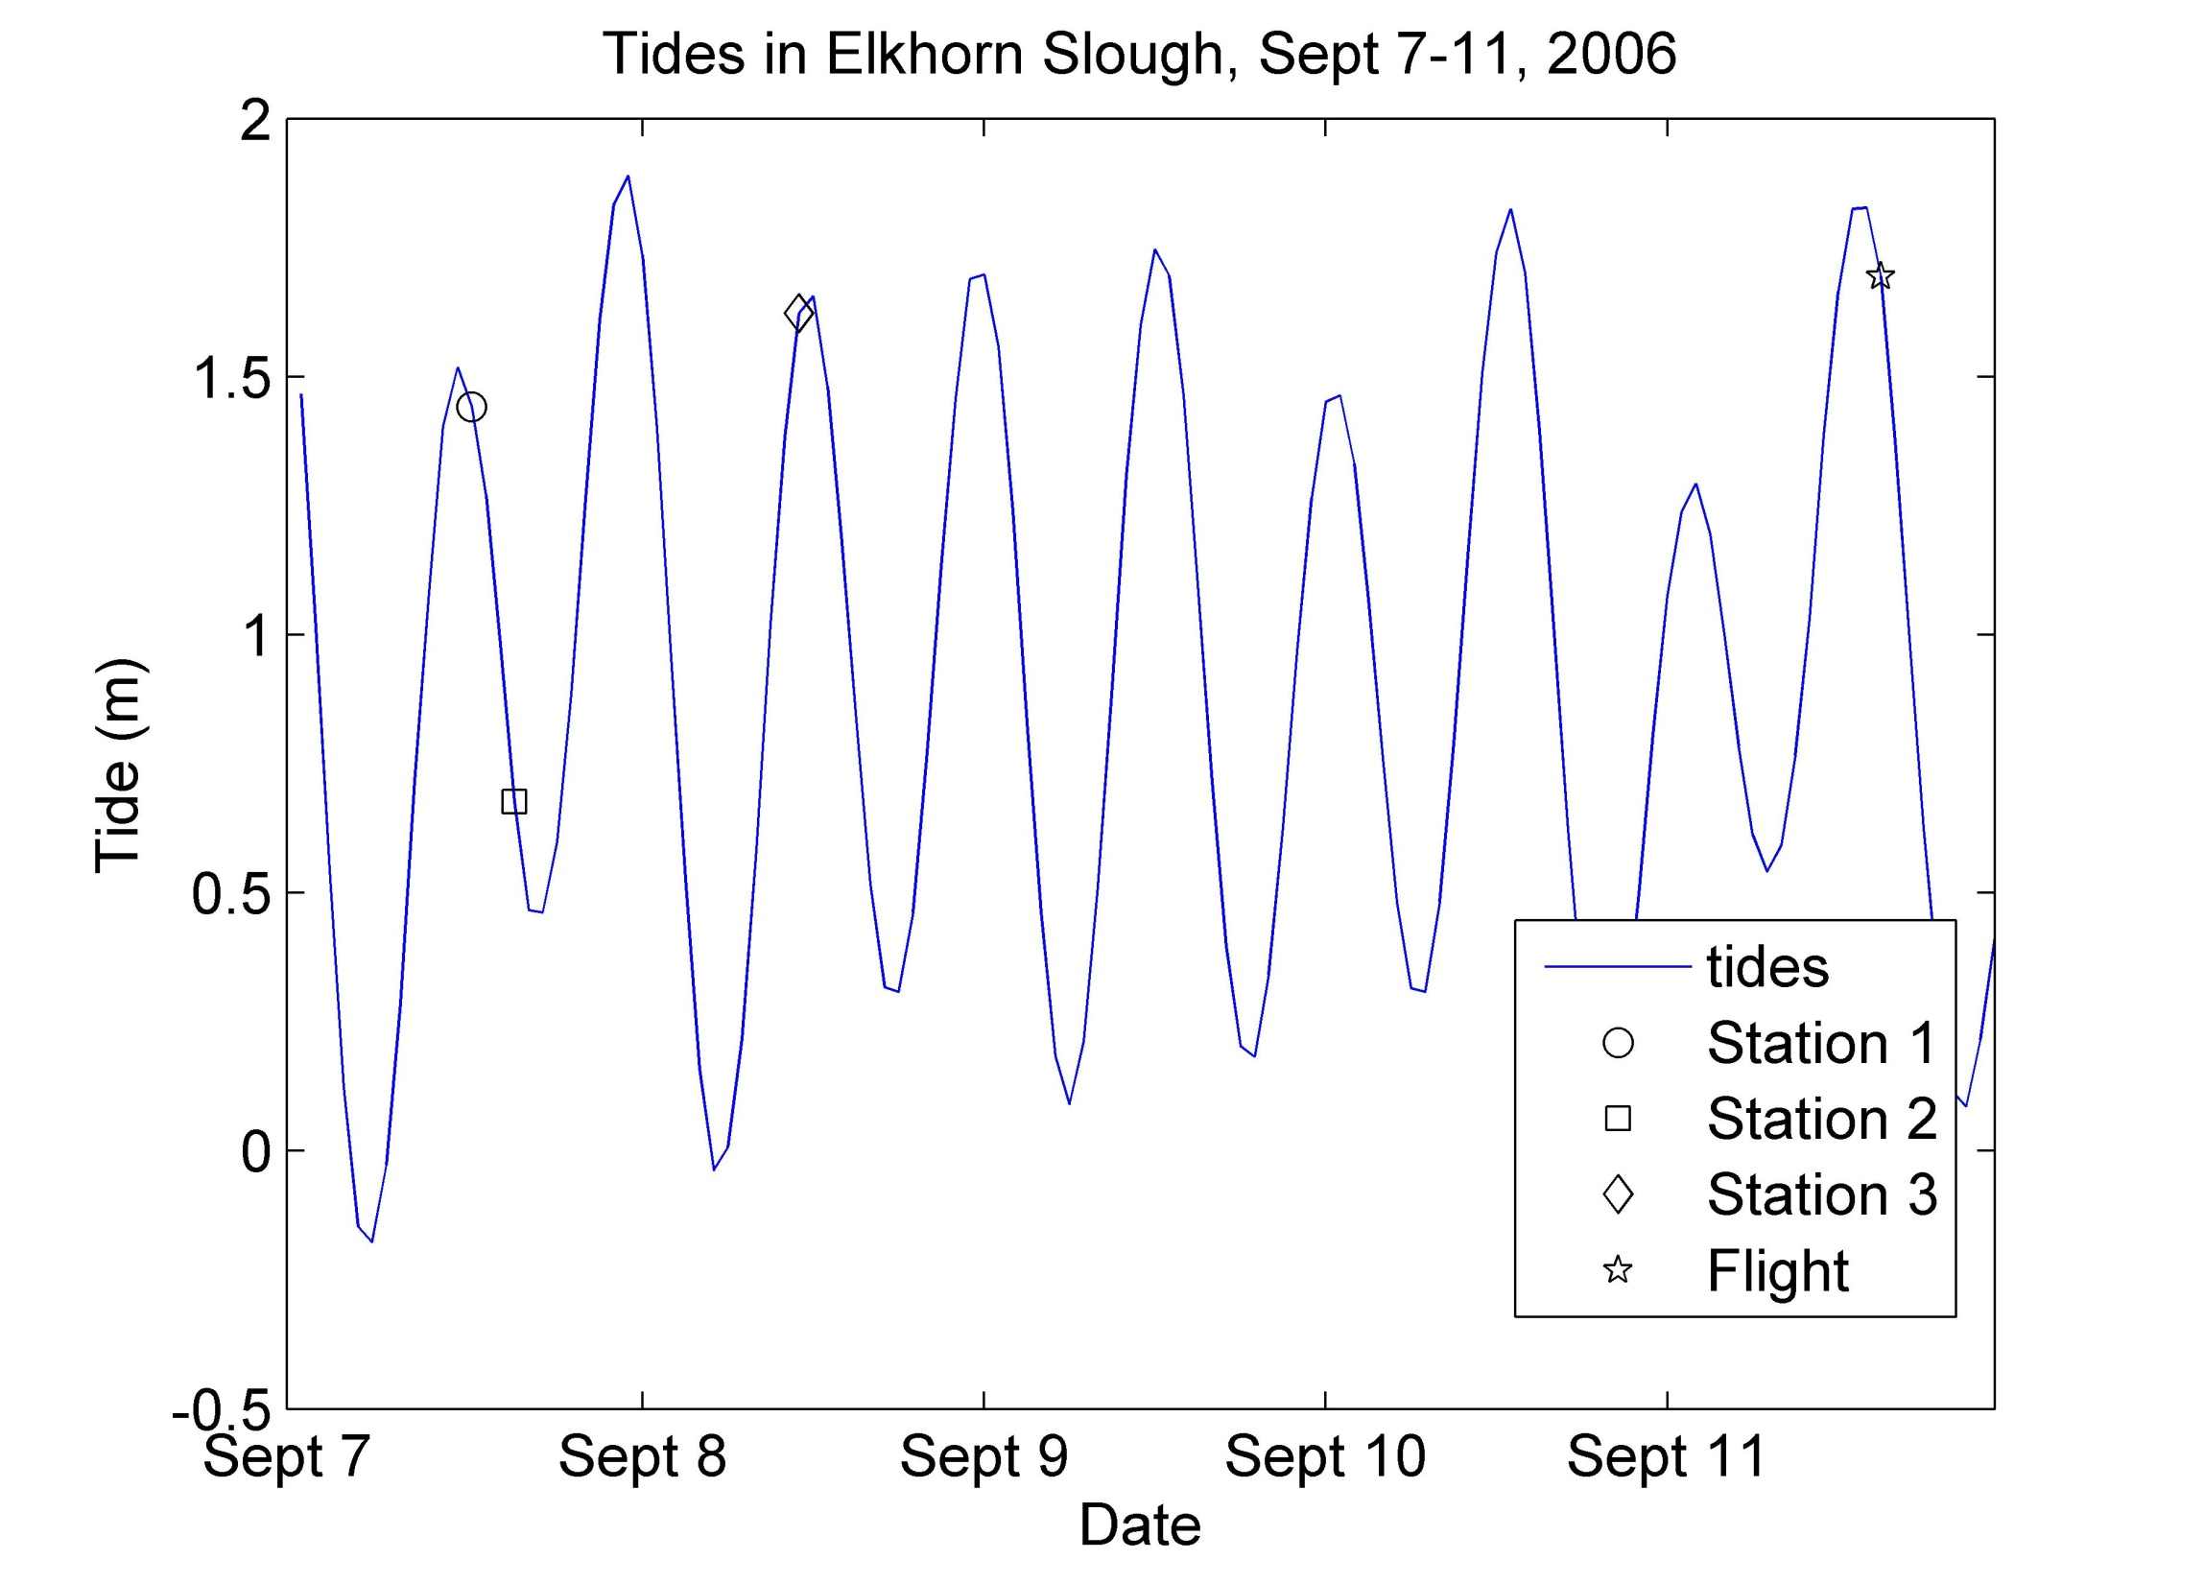

Slide 18
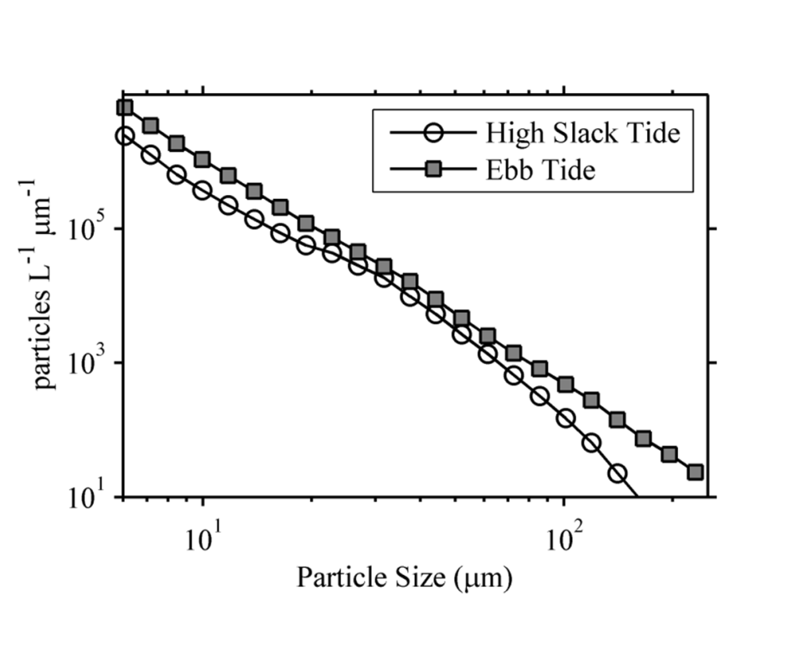
Particle Size Distribution
Buonassissi
and Dierssen. Accepted. JGR
Station 2
Station 3
Notes:
Read the axes

Slide 19
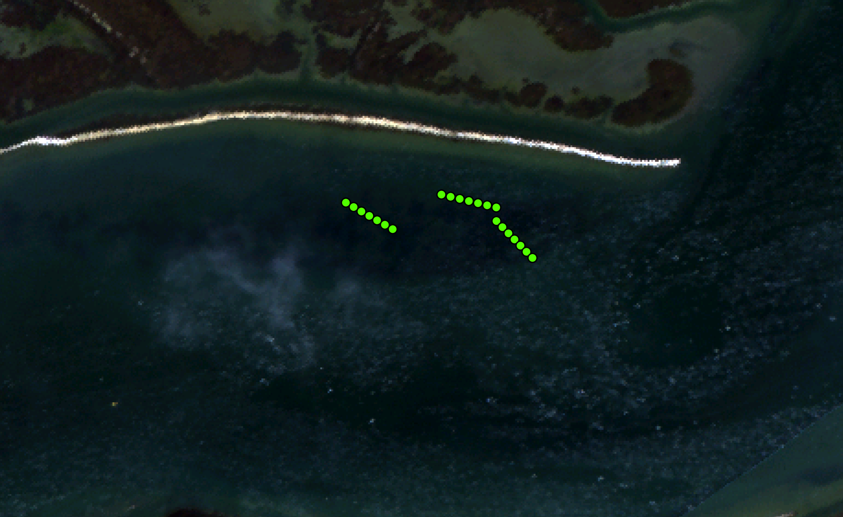
Transects
Sept 7, 2006
30m in length
2 – 2.5 m deep
Station 3
Station 1

Slide 20
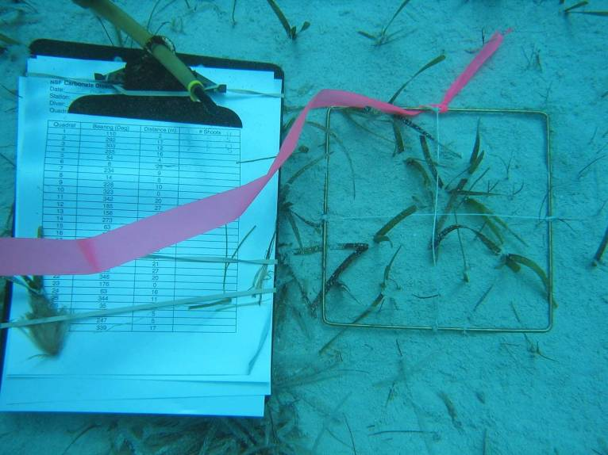

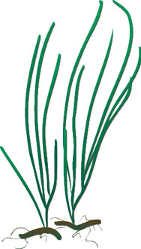

Transects
21 total stations
Counts of eelgrass shoot
density taken at 5m intervals
Quadrat size: 20cm x 20 cm = 0.04m²
Thalassia in the Bahamas
H. Dierssen
Notes:
Find the size of the quadrat

Slide 21

Leaf Area Index (LAI)
Height * width * # of leaves (m²)
Area of quadrat (m²)

Slide 22
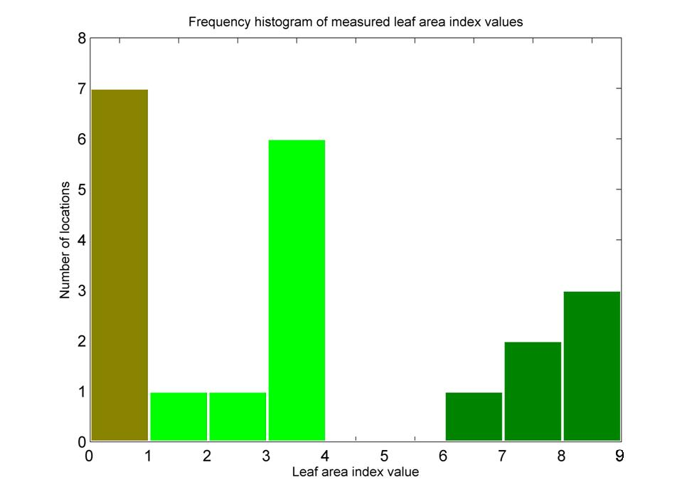
Bahamas
LAI ~3
Florida Bay
LAI ~9
Bare sediment
(7)
Dense
(6)
Sparse
(8)
Notes:
Read the axes, animate sparse/dense

Slide 23
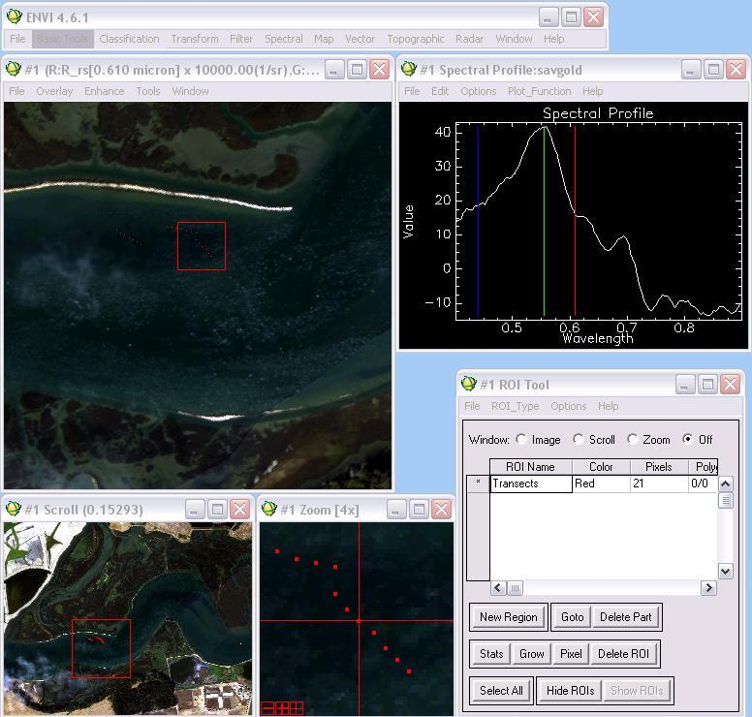
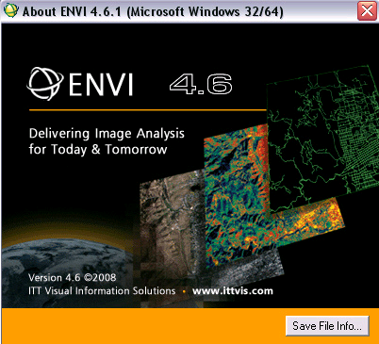
ENVI (ITT Visual Information Solutions)

Slide 24
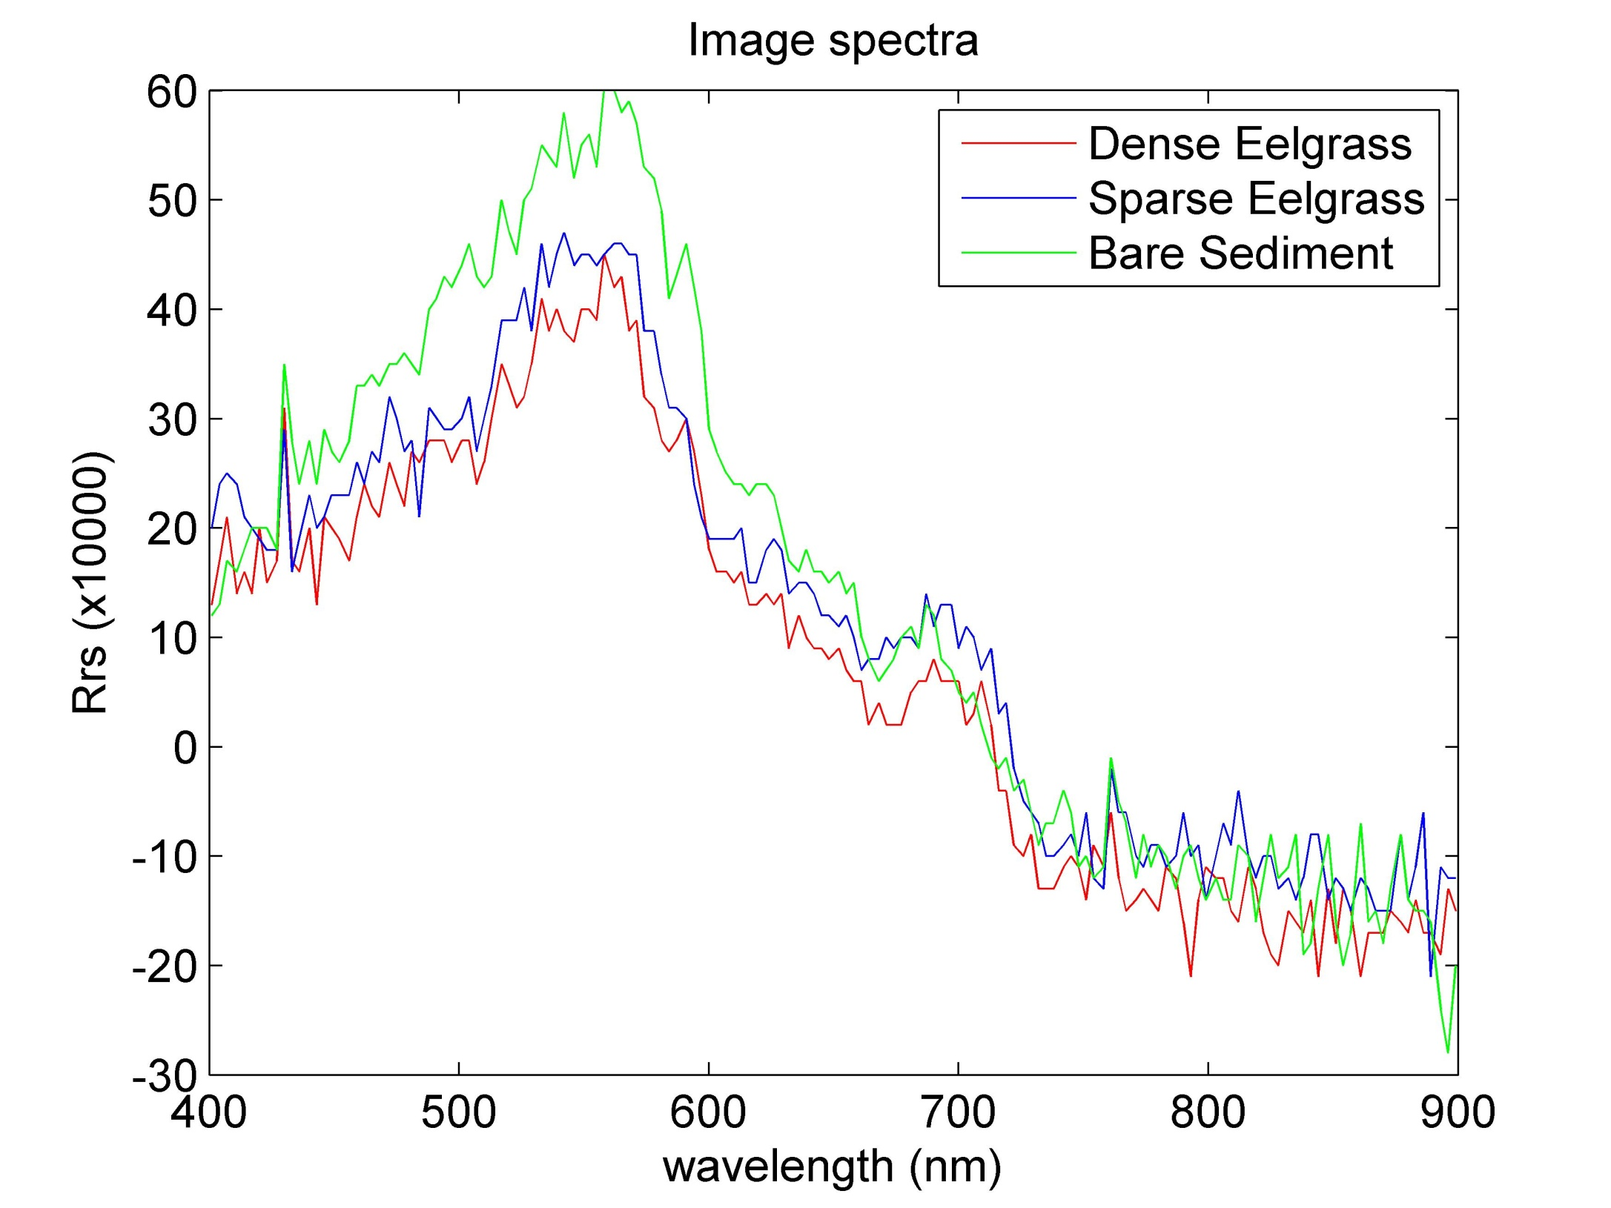
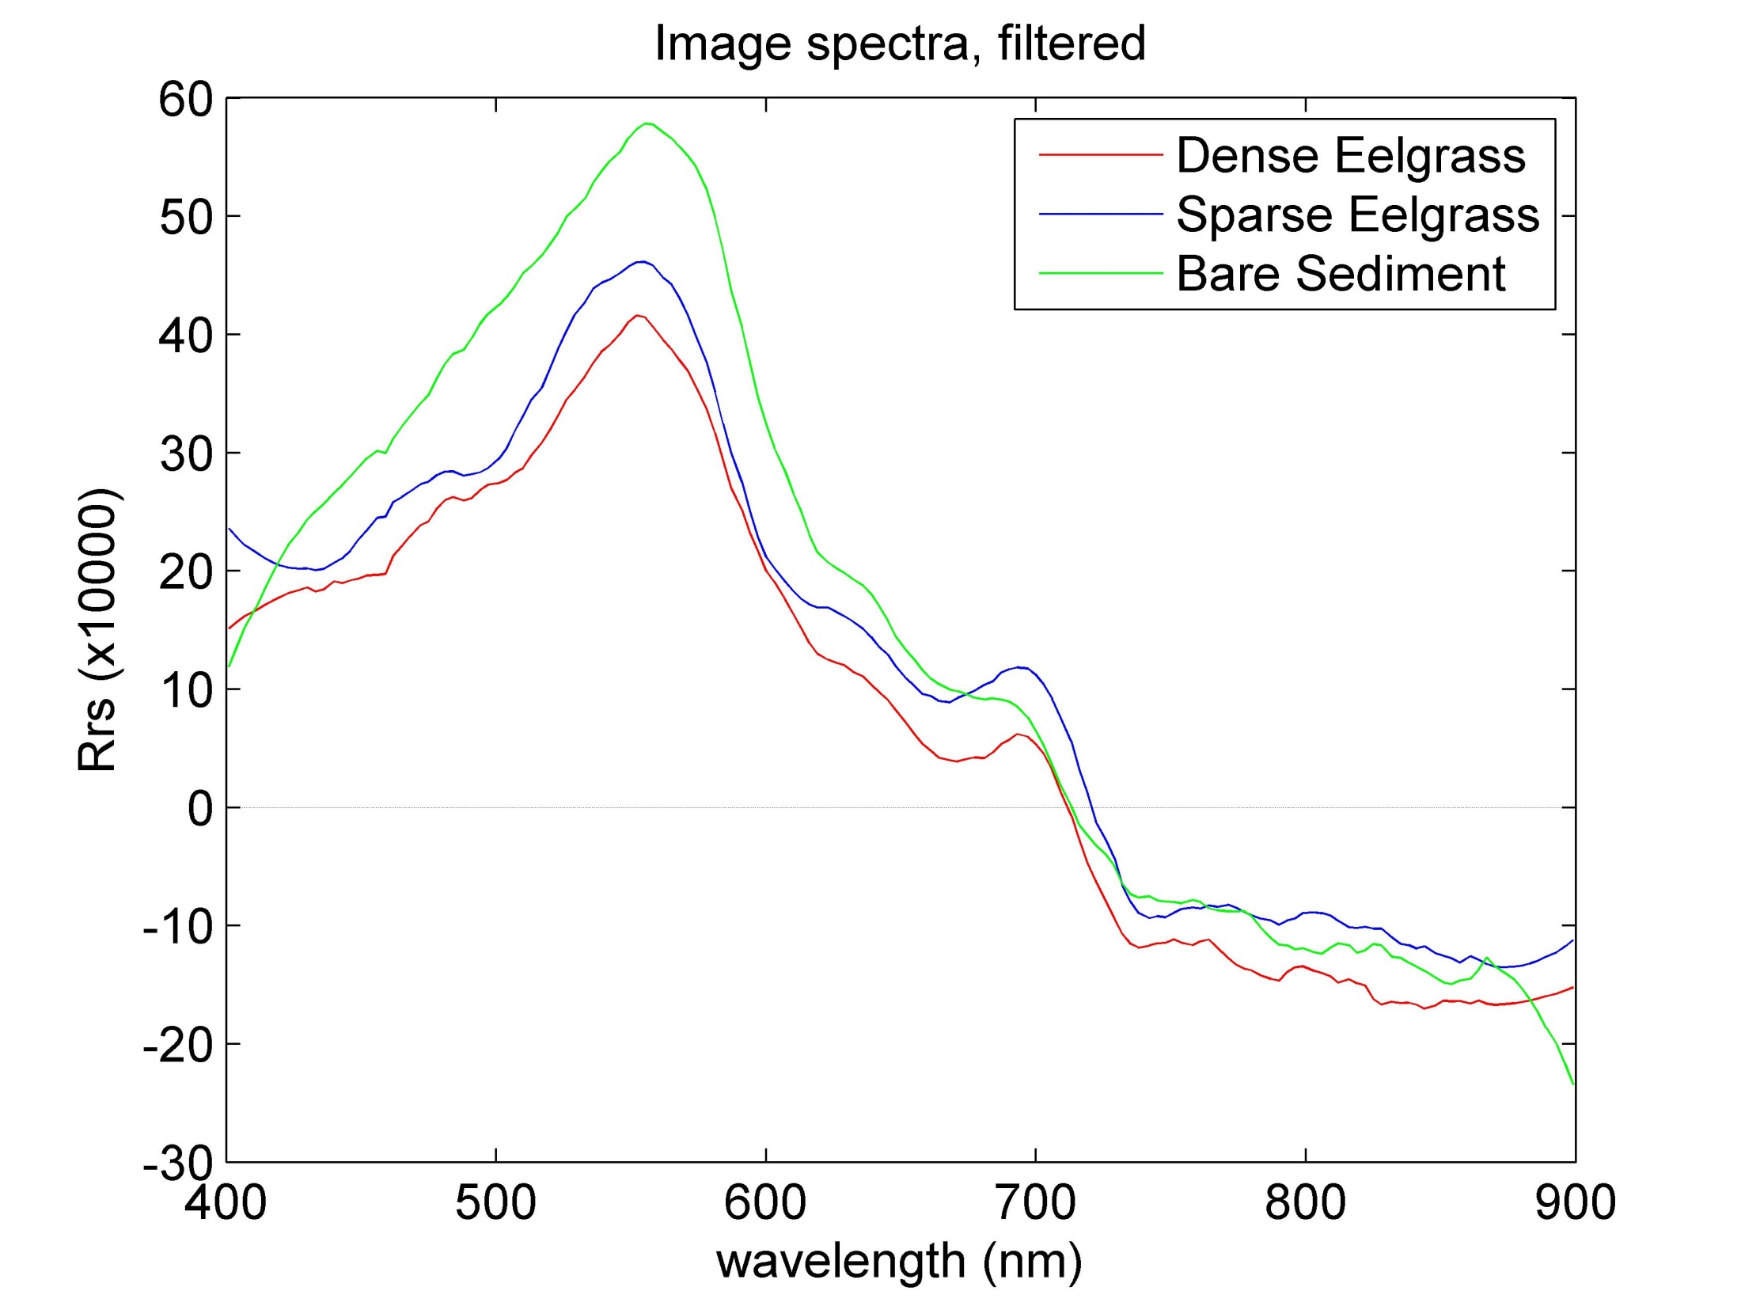
Atmospheric correction, NOAA GOES-R
Notes:
Read axes, all subsequent plots have same axes

Slide 25
Measured in situ
(transects)
Image spectra
Modeled
(Hydrolight)
Modeled
(Hydrolight)
OR
Spectral library
Classification algorithm
(ENVI)
mapped image of eelgrass beds

Slide 26
Spectral Library: Hydrolight
Water column
AC-9, station 1
Backscattering meter, station 1
Light
Date, time, cloud cover, lat/long
Hyperpro data
Benthos
Depth
Bottom reflectance, Divespec and ASD

Slide 27
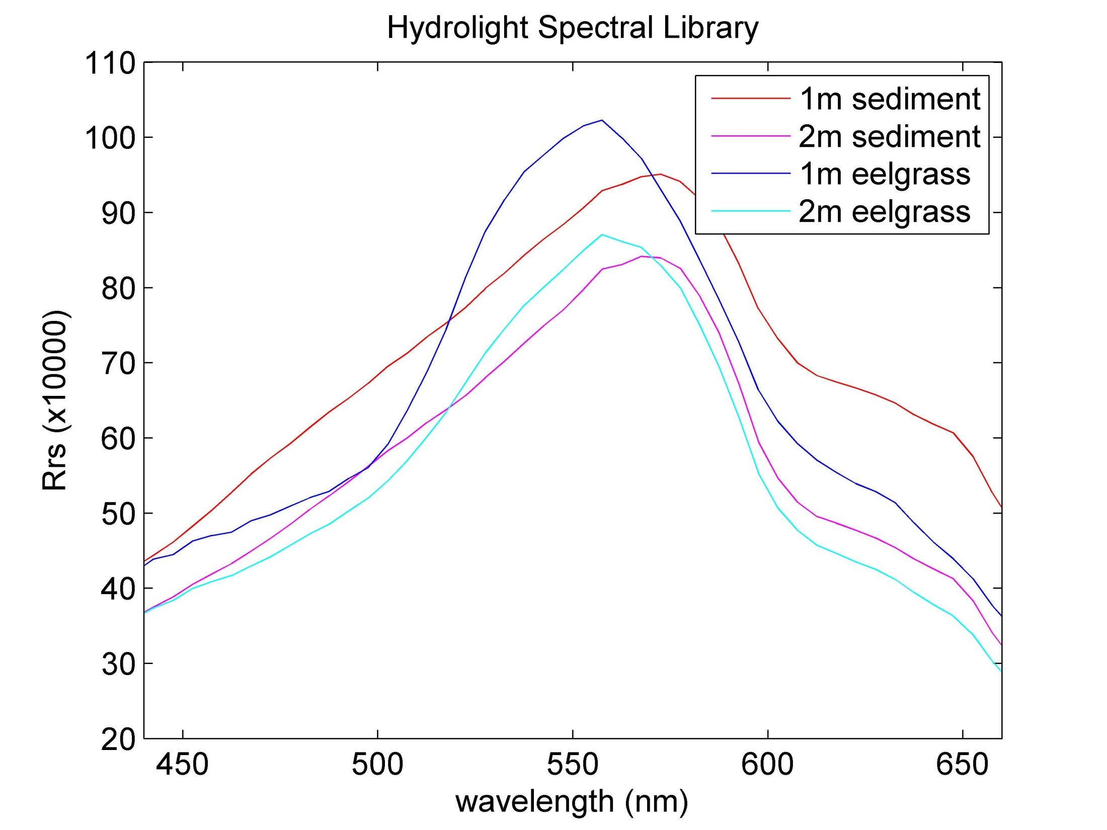
HL output

Slide 28
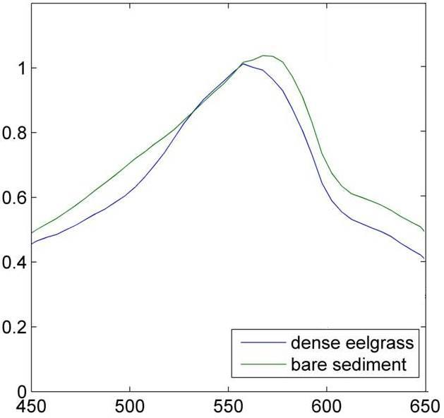
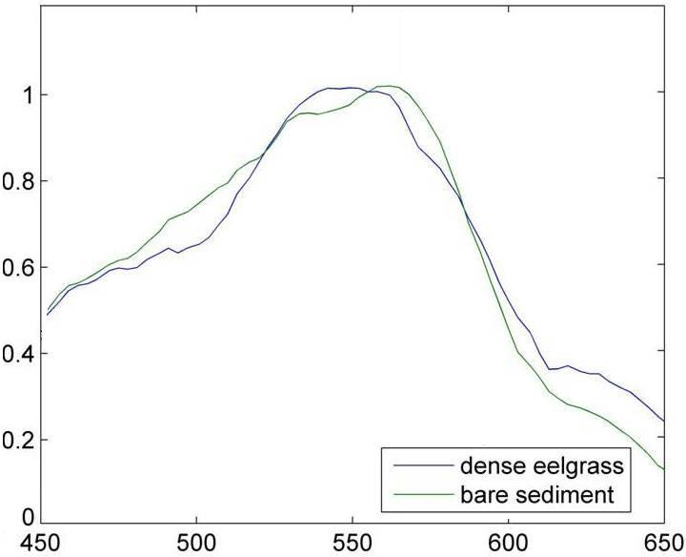
Reflectance of eelgrass normalized to 555nm
Hydrolight
Image

Slide 29
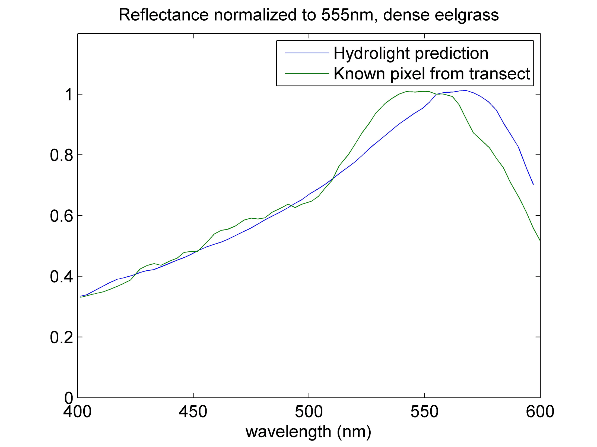
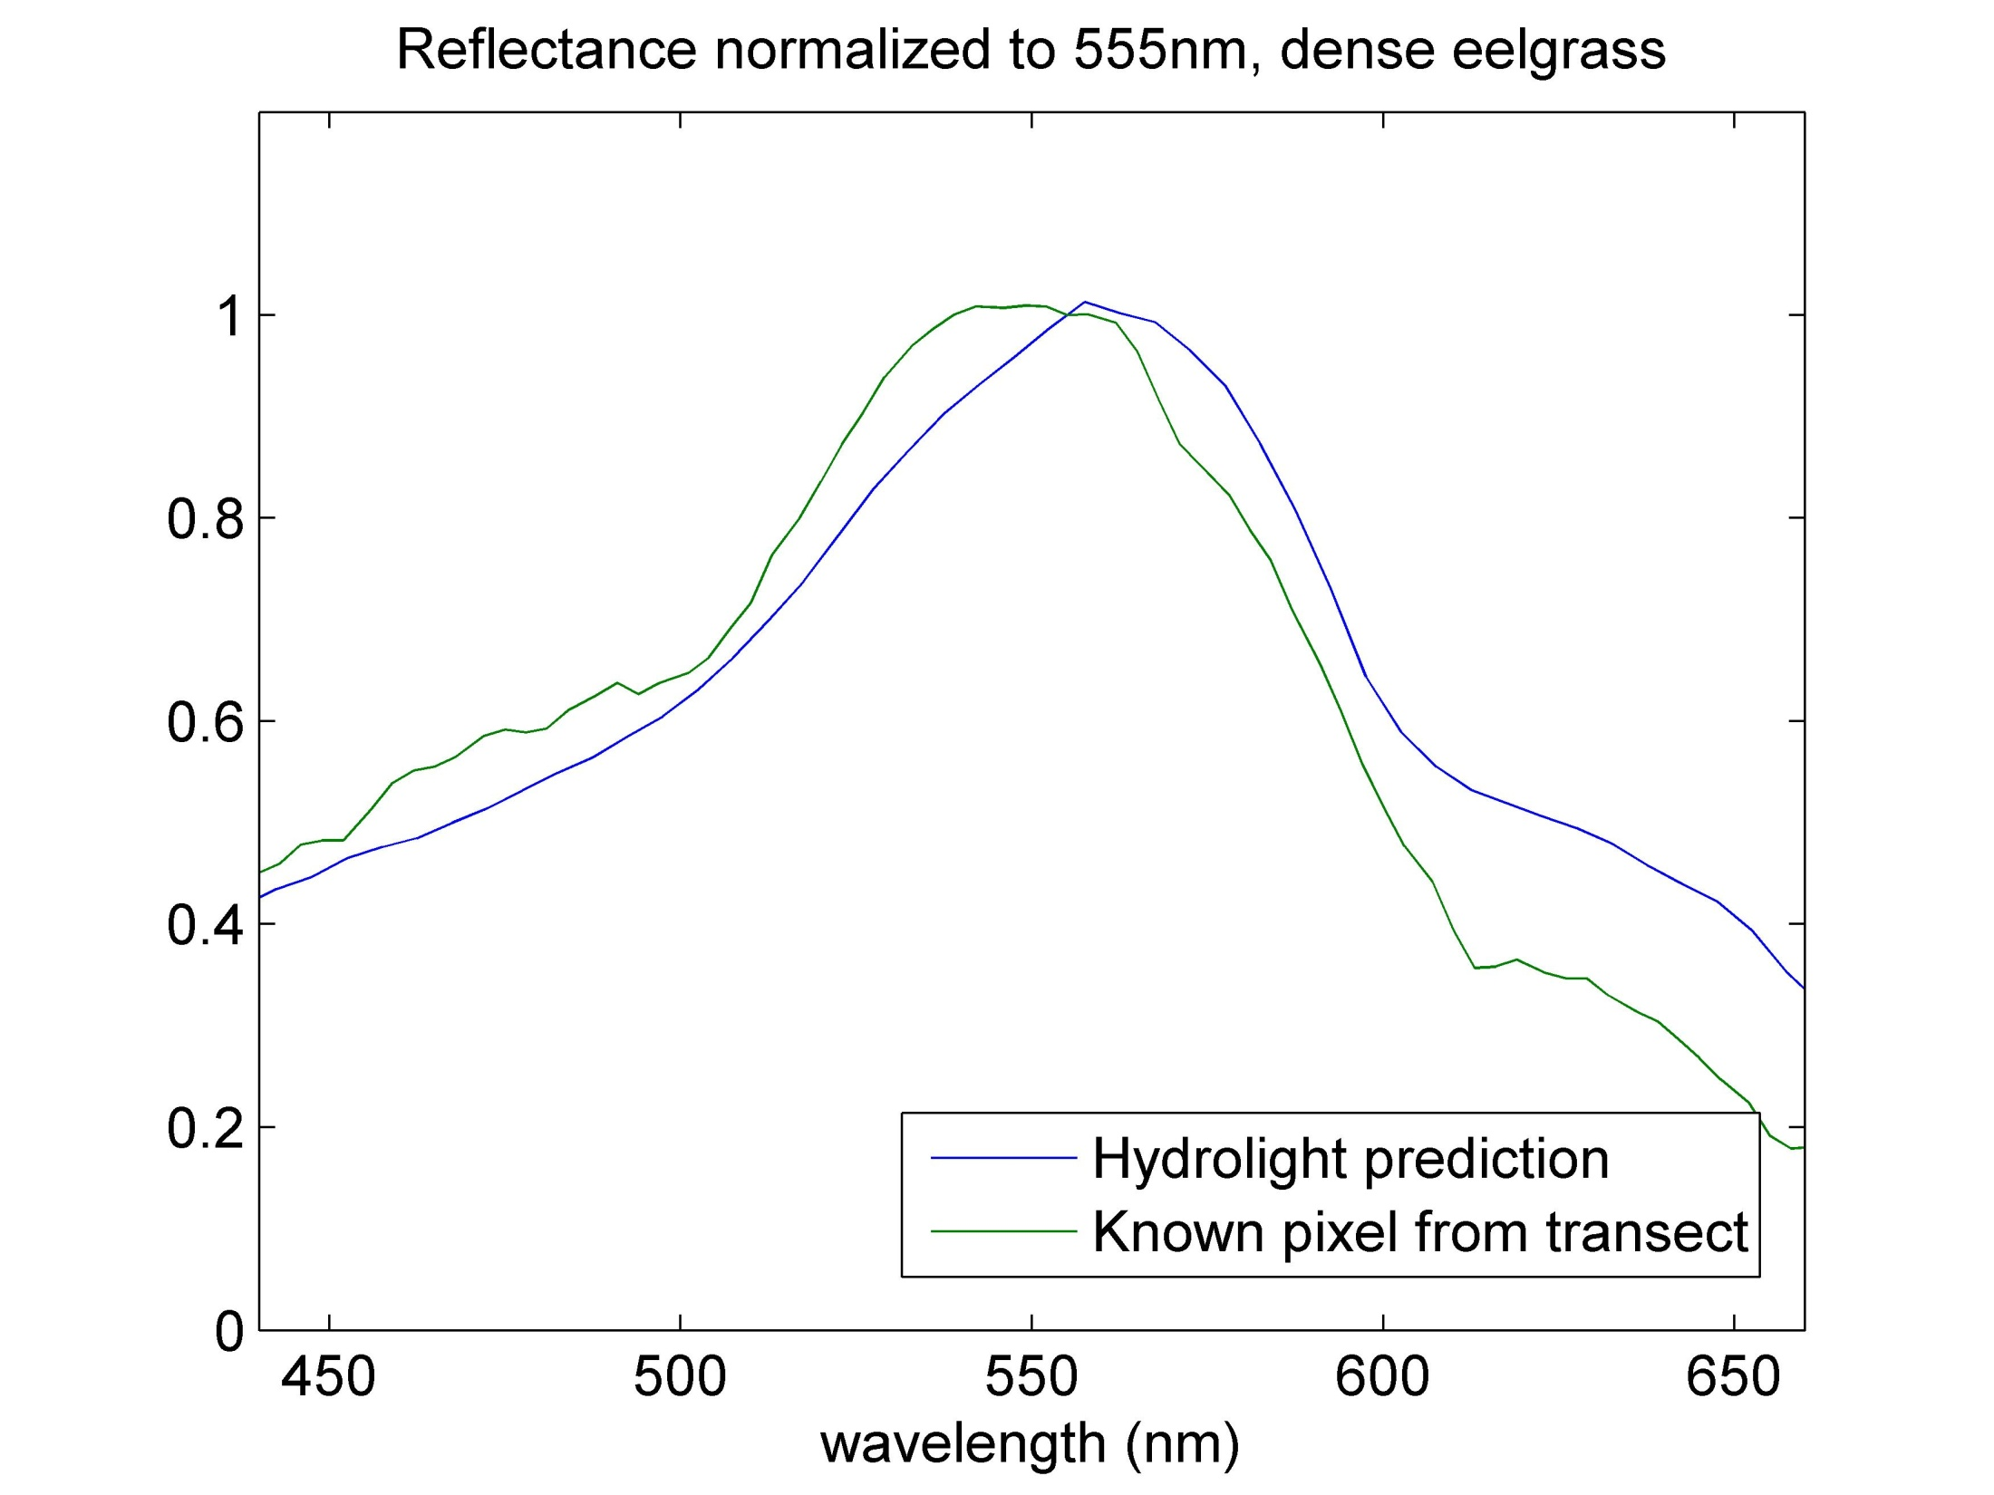

Slide 30
Measured in situ
(transects)
Image spectra
Modeled
(Hydrolight)
OR
Spectral library
Classification algorithm
(ENVI)
mapped image of eelgrass beds

Slide 31
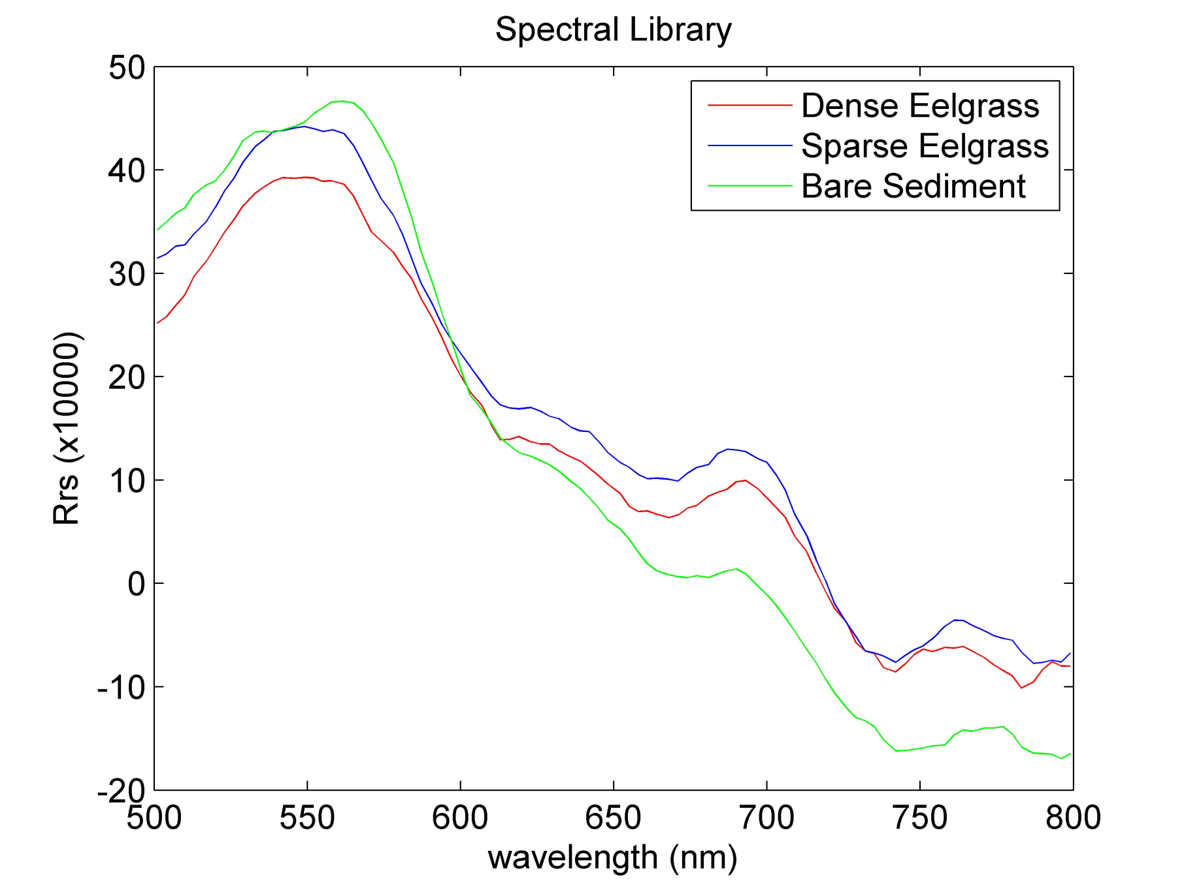
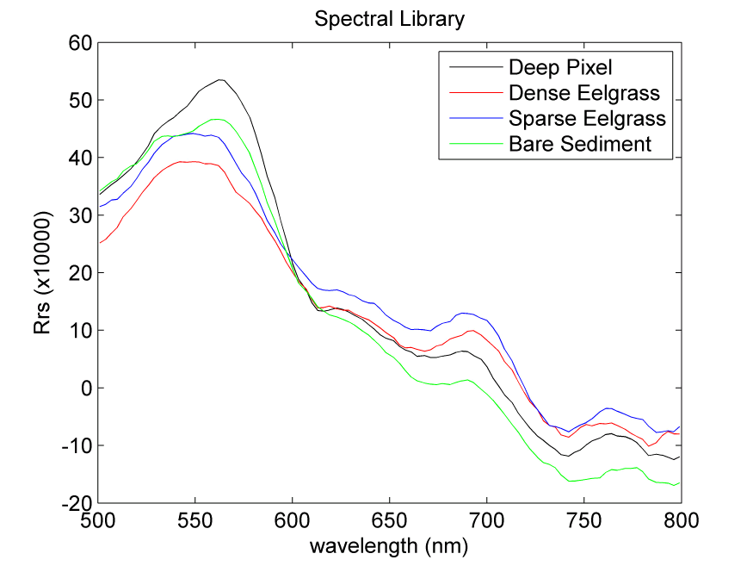
Spectral Library: Transects
Known bathymetry

Slide 32
Measured in situ
(transects)
Image spectra
Modeled
(Hydrolight)
OR
Spectral library
Classification algorithm
(ENVI)
mapped image of eelgrass beds

Slide 33
Spectral Information Divergence
Probabilistic approach to characterize spectral similarity and variability (C.-I Chang, 1999)
Useful in this environment
  Accounts for mixed pixels
Hyperspectral pixels
  Hundreds of bands
  Unknown interferers
Advantage over other methods

Slide 34
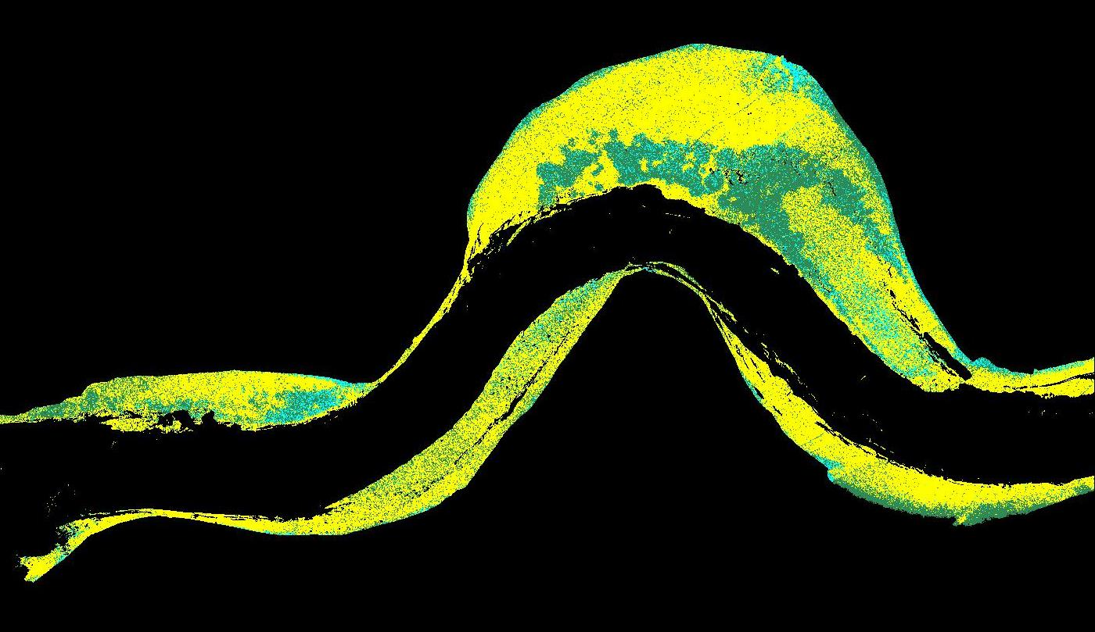
Results, 3 endmembers
(with bathymetry)
Dense Eelgrass
Sparse Eelgrass
Bare Sediment

Slide 35
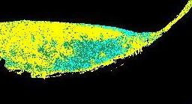
Results, 3 endmembers
(with bathymetry)
Dense Eelgrass
Sparse Eelgrass
Bare Sediment

Slide 36
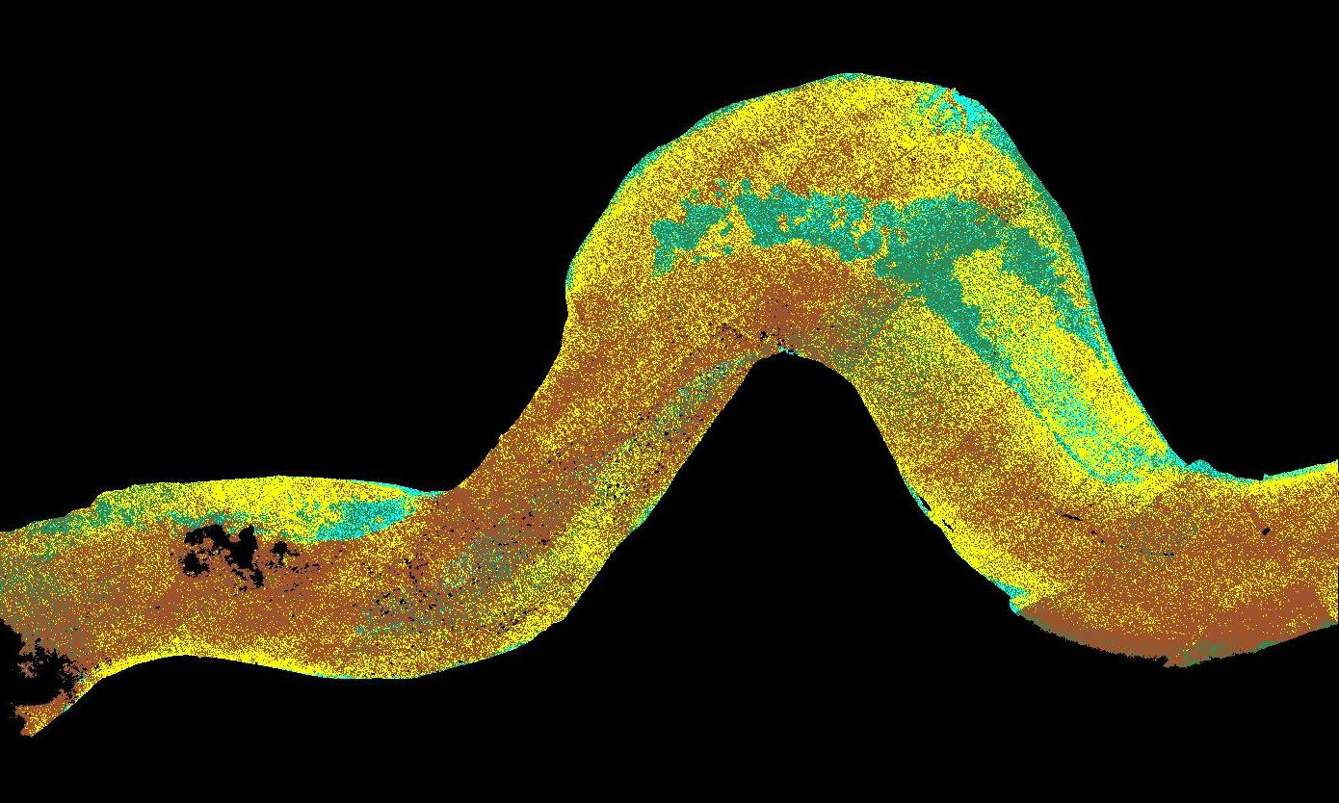
Results, 4 endmembers
(without bathymetry)
Dense Eelgrass
Sparse Eelgrass
Bare Sediment
Deep Water

Slide 37
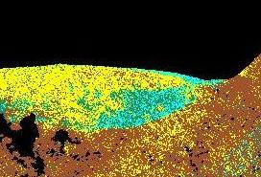
Dense Eelgrass
Sparse Eelgrass
Bare Sediment
Deep Water

Slide 38
Results, 3 endmembers
(with bathymetry)
Dense Eelgrass
Sparse Eelgrass
Bare Sediment

Slide 39
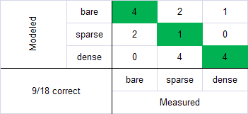

Accuracy of classification
18 validation points from transects
50% accuracy
83% accuracy
Transect point uncertainty
More errors in calculating density than in distribution

Slide 40
Summary
Despite working in a dark, challenging environment, we were able to quantify the eelgrass distribution and density with relatively good accuracy
Measured endmembers necessary for accurate classification
With the quantified classification method, estimates of LAI can be retrieved from image data

Slide 41
Future work
Improvement of classification and modeling
  Retrieval of bathymetry from image
    Two-step classification
  Model spectral library
Applications
  System net primary productivity estimates from LAI
  Climate change scenarios
  Monitor eelgrass ecosystem stability and health
  Environmental damage assessment

Slide 42
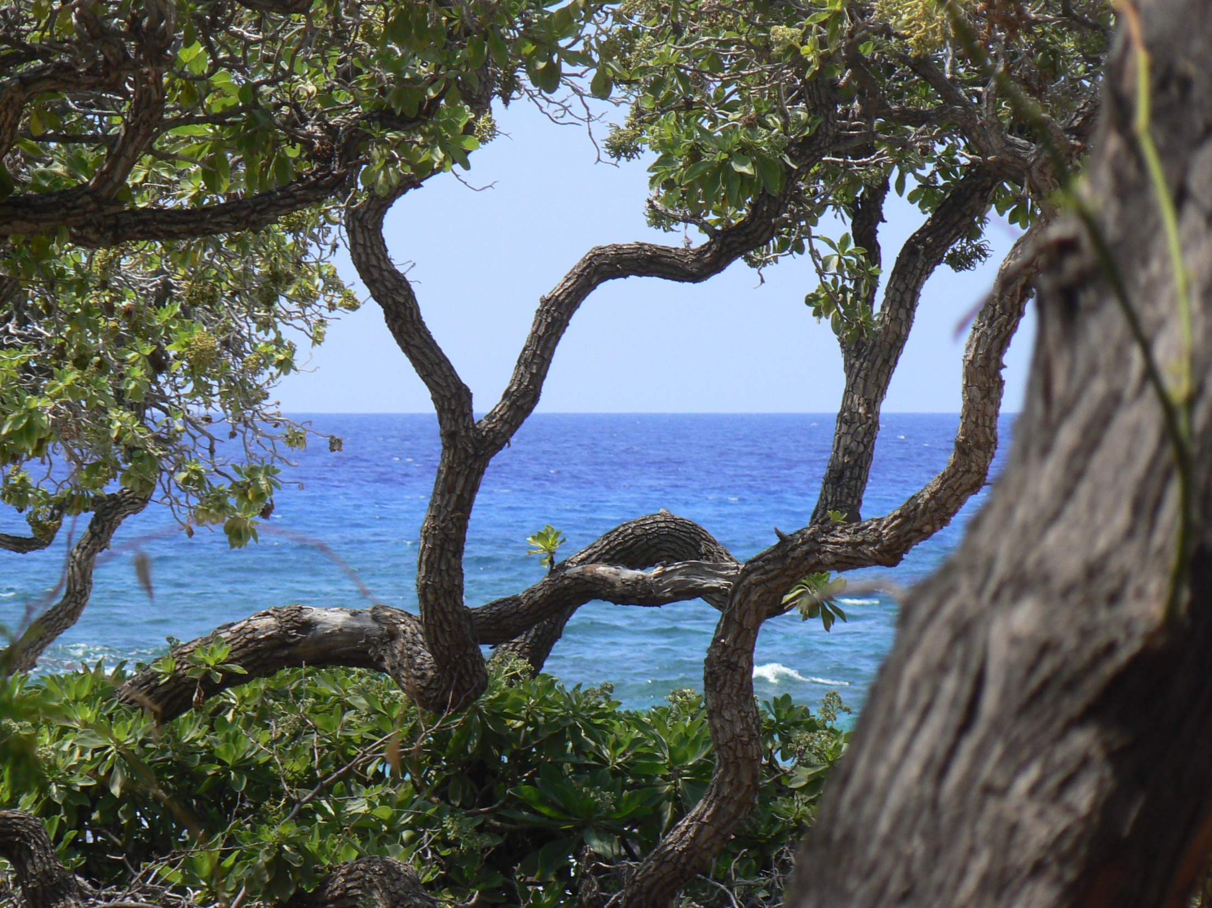
Thank you!

