Slide 1
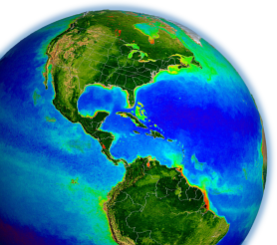
NASA OBPG Update
Bryan Franz
and the
NASA Ocean Biology
Processing Group
OCRT Meeting
23 April 2012

Slide 2
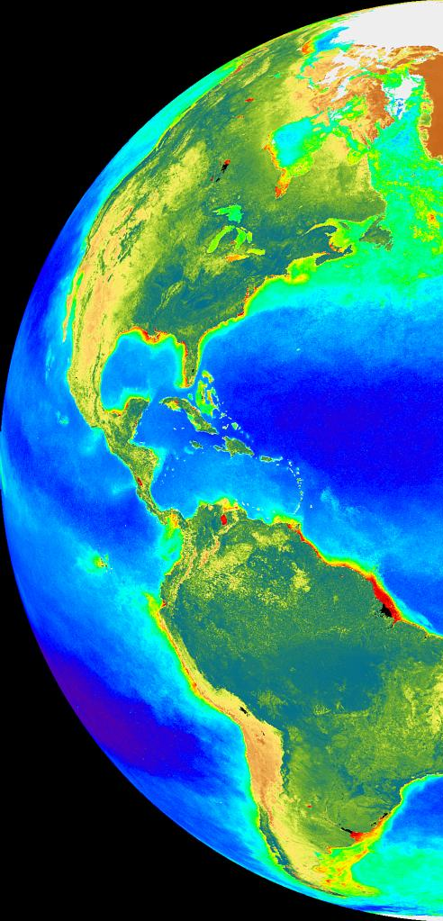
Outline
MODIS Aqua Reprocessing
VIIRS Data Access and Initial Results
MERIS Data Exchange
Notes:
all good news

Slide 3
R2010.0 Multi-Mission Ocean Color Reprocessing
Scope: MODISA, MODIST, SeaWiFS, OCTS, CZCS
Status:
SeaWiFS completed September 2010
OCTS completed September 2010
MODIST completed January 2011
MODISA completed June 2011
CZCS completed August 2011
Highlights:
consistent algorithms and methods for all sensors**
incorporated enhanced knowledge of sensor characterization**
regenerated all sensor-specific tables and coefficients
improved aerosol models based on AERONET
additional correction for NO2, improved turbid water atmos. corr.
http://oceancolor.gsfc.nasa.gov/WIKI/OCReproc.html

Slide 4
MODISA Temporal Calibration for R2010.0
Based on MCST preliminary Collection 6 calibration
solar diffuser absolute and relative temporal trend
lunar calibration for linear change in cross-scan response (RVS)
Notes:
primary responsibility lies with MODIS Calibration Support Team, Jack Xiong's group at GSFC

Slide 5
MODIS Lunar and Solar Calibration Trends
2002 - 2010
MODIS 412nm Responsivity Changes Since Launch
0%
10%
20%
Gain
30%
Solar
40%
Lunar
50%
60%

Slide 6
MODISA Temporal Calibration for R2010.0
Based on MCST preliminary Colection 6 calibration
solar diffuser absolute and relative temporal trend
lunar calibration for linear change in cross-scan response (RVS)
But significant errors remained (largest in 412 and 443) due to limitation of solar and lunar calibration to measure change in shape of RVS
OBPG developed additional correction using cross-calibration to SeaWIFS to derive time-varying change in RVS shape for 412 and 443, fixed RVS adjustment 488 – 678
Notes:
currently MODIS Aqua temporal calibration in the bliue is tied to seawifs

Slide 7
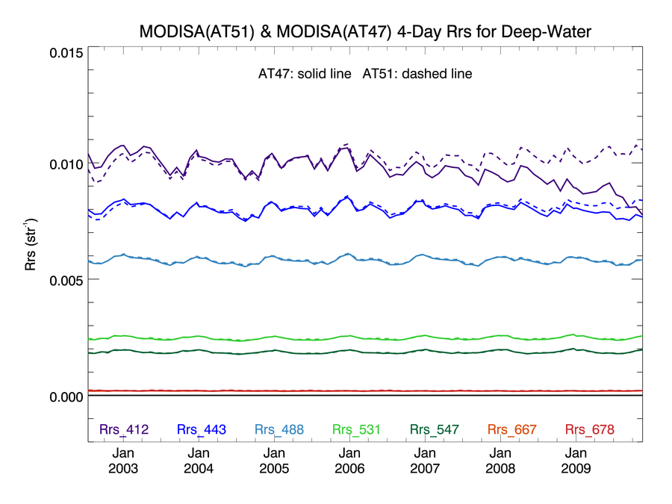
Effect of R2010.0 MODISA-SeaWiFS Cross-Cal
Global Deep-Water Rrs Trends
MODISA before
MODISA after
412
20%
443
Rrs (sr⁻¹)
490
531
547
667 & 678
Notes:
412 error induces erroneous trends in cdom/IOP products
443 also affected
why we needed SeaWiFS

Slide 8
MODISA Temporal Calibration for R2010.0
Based on MCST preliminary Colection 6 calibration
solar diffuser absolute and relative temporal trend
lunar calibration for linear change in cross-scan response (RVS)
But significant errors remained (largest in 412 and 443) due to limitation of solar and lunar calibration to measure change in shape of RVS
OBPG developed additional correction using cross-calibration to SeaWIFS to derive time-varying change in RVS shape for 412 and 443, fixed RVS adjustment 488 – 678
Meister. G., B.A. Franz, E.J. Kwiatkowska, and C. R. McClain (2012). Corrections to the Calibration of MODIS Aqua Ocean Color Bands Derived From SeaWiFS Data, T. Geo. Rem. Sens., 50 (1).
Notes:
currently MODIS Aqua temporal calibration in the bliue is tied to seawifs

Slide 9
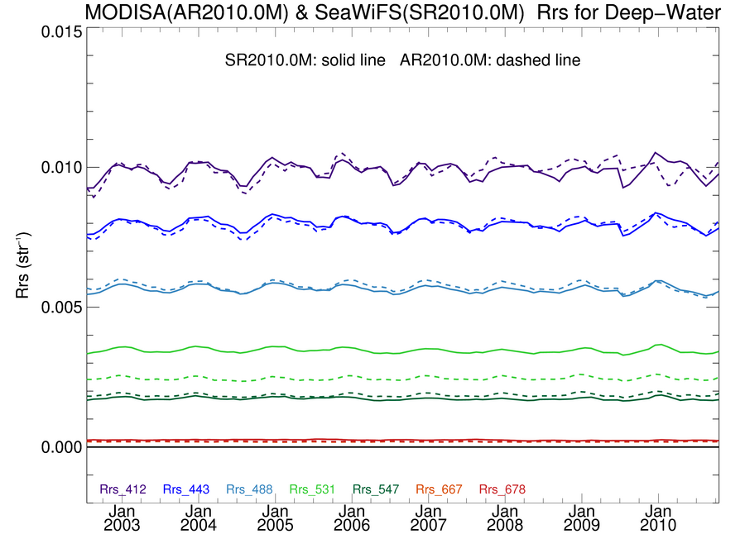
- after R2010.0 Reprocessing -
MODISA & SeaWiFS Rrs in good agreement
Deep-Water
solid line = SeaWiFS R2010.0
dashed = MODISA R2010.0
412
443
Rrs (sr⁻¹)
488 & 490
510
531
547 & 555
667 & 670

Slide 10
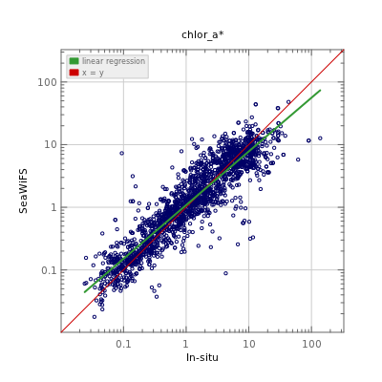
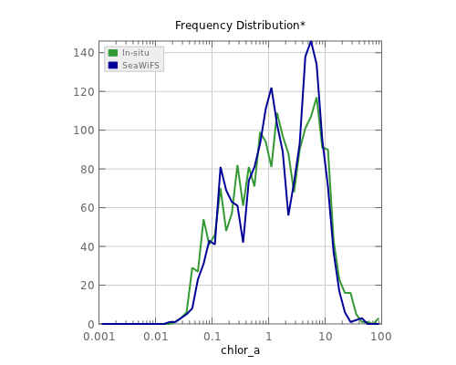
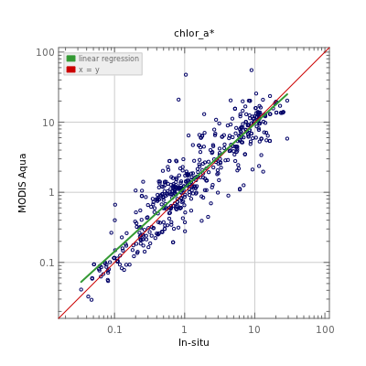
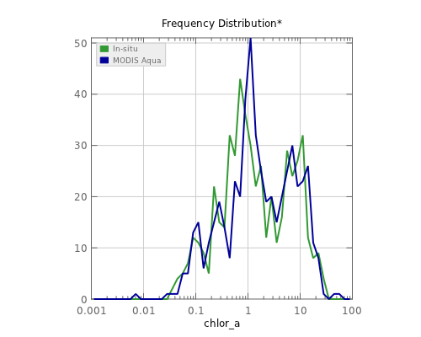
Chl_{a} in Good Agreement with Global In situ
SeaWiFS
vs
in situ
MODISA
vs
in situ

Slide 11
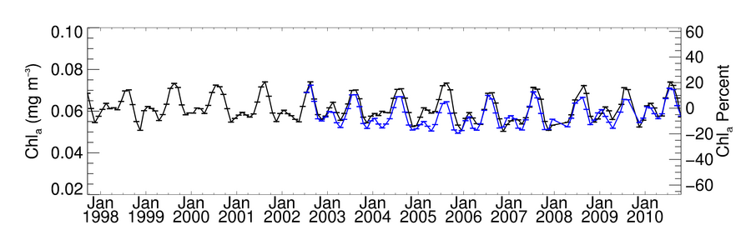
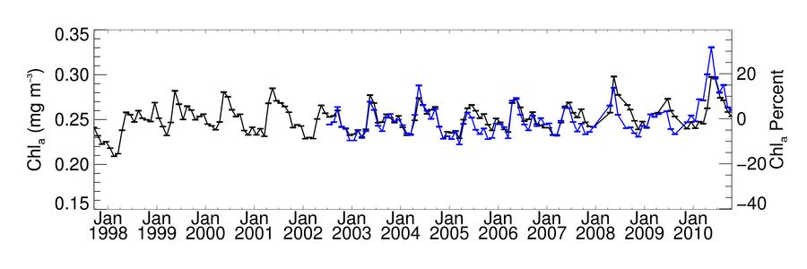
Global Chlorophyll Data Record after R2010.0
Oligotrophic Subset
SeaWiFS MODISA
Mesotrophic Subset
SeaWiFS MODISA
Notes:
bias in eutrophic waters
R^2 85-90% by water mass, mean ratios within 5%

Slide 12
but two things happened since the last reprocessing ...

Slide 13
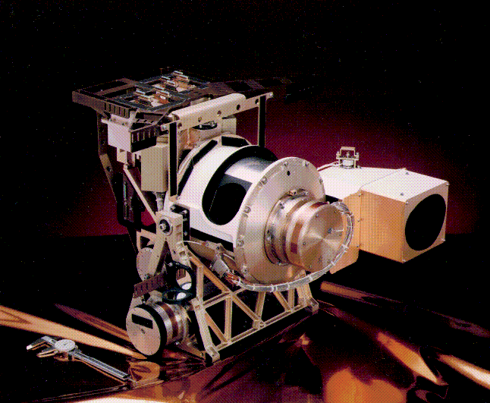
SeaWiFS
1997-2010
Notes:
everything changed
not a perfect instrument, but very good temporal calibration

Slide 14
MODIS Lunar and Solar Calibration Trends
More Erratic in 2011
MODIS 412nm Responsivity Changes Since Launch
0%
Solar
10%
20%
Lunar
Gain
30%
40%
50%
60%
Notes:
extrapolation of calibration was not valid

Slide 15
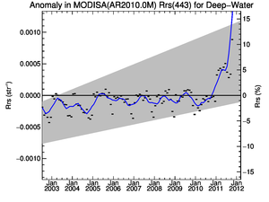
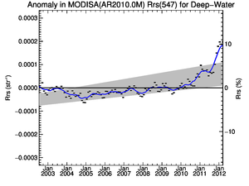
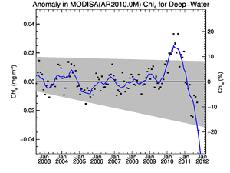
MODISA R2010.0 Temporal Anomalies (2002-2012)
Deep-Water
Rrs(443)
Rrs(547)
Chlorophyll
Big
Trending
Errors
in 2011
Notes:
good news, in a sense problem became large enough that other disciplines noticed (ocean color is the canary)

Slide 16
New Temporal Calibration Approach
MCST final calibration for Collection 6 uses Earth view data
lunar calibration + desert observations for 412 and 443
largely reproduces previous OBPG cross-cal results (validation!)
But still not quite good enough for ocean color
significant residual time-trend at 412 (due to scan-edge changes)
residual cross-scan and striping artifacts
New OBPG approach for residual RVS errors
vicarious calibration of Aqua L1B to Aqua L3 15-day Rrs
derive time-varying RVS shape per detector & mirror-side
relative to MCST C6
applied to all OC bands 412-678
Notes:
problem became large enough that other disciplines noticed (ocean color is the canary)
validation of OBPG calibration adjustments

Slide 17
OBPG Cross-Scan Corrections at 412nm relative to MCST desert-based calibration
412nm, Detector 5, Mirror-Side 1
Gain
2002
Mission Time
2012
Scan Pixel

Slide 18
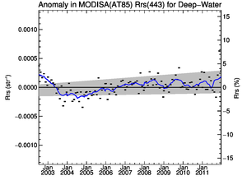
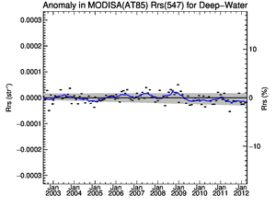
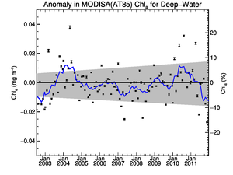
MODISA R2012.0 Temporal Anomalies (2002-2012)
Deep-Water
Rrs(443)
Rrs(547)
Chlorophyll
Much Better!
Notes:
still some issues in 412 in 2012 (not shown), will always be a problem, limits quality of IOP retrievals

Slide 19
MODIS Reprocessing
New approach for temporal calibration of MODIS-Aqua
ocean color time-series is now fully independent of SeaWiFS
MODIS-Aqua Reprocessing 2012.0 starting this week
only change is to temporal calibration and vicarious adjustment
forward-stream will be switched this week
level-2 processing should complete within 2 weeks
MODIS-Terra has similar issues
relies heavily on SeaWIFS for temporal RVS and polarization
waiting for "final" MCST C6 calibratiion
cross-calibrate Terra to Aqua to resolve polarization sensitivity
Both MODIS sensors are beyond design life
maintaining quality is an on-going challenge, user beware

Slide 20
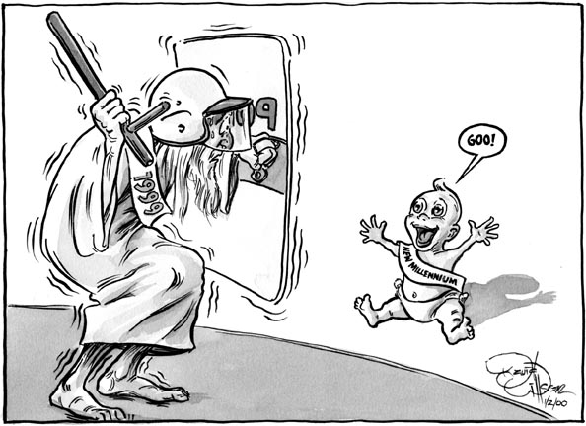
Welcome VIIRS
MODIS
VIIRS
VIIRS opened its eyes on 21 November 2011
Continuous imaging operations since 2 January 2012

Slide 21
OBPG Responsibilities on VIIRS
OBPG is serving as NPP Ocean PEATE
product evaluation and analysis tools element
supporting NASA NPP Science Team evaluation of ocean products
OBPG is also participating in the NPP Science Team
Turpie and McClain are the Science Team PIs
role is to evaluate the quality of VIIRS ocean color products

Slide 22
VIIRS Ocean PEATE
Supporting NASA NPP Science Team evaluation of ocean products
receiving, archiving, and distributing
all Level-0 granules (RDRs)
all Level-1B granules (SDRs)
select NOAA Level-2 granules (EDRs)
producing Level-3 evaluation products three ways
EDR ➔ Level-3 (NPPE stream)
SDR ➔ Level-2 ➔ Level-3 (NPPS stream)
RDR ➔ Level-1B ➔ Level-2 ➔ Level-3 (NPP stream)
distributing all data via OceanColorWeb to support ST evaluations

Slide 23
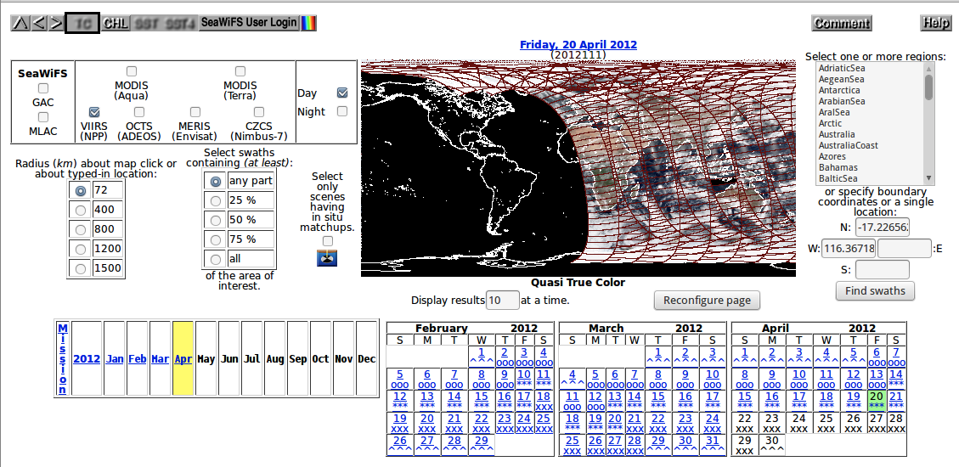
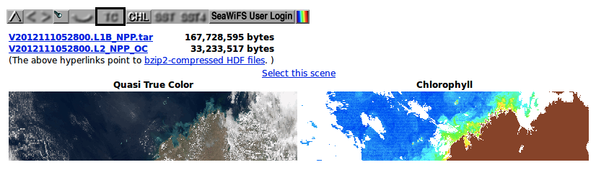
VIIRS Data Distribution via OceanColorWeb
-- for science team evaluation --
Notes:
Making data available to science team through standard interfaces, but accessble to all.
85-sec granules, 1000+ granules in a day (~2x MODIS)
tar contains 16 bands + geo file
l2 and l1 from OBPG calibration/processing
all three evaluation streams accessible from L3 browser
all data accessible from direct access archives, including RDRs
No user support.
No orders or subscriptions.
No extraction capability.

Slide 24
VIIRS Science Team
OBPG also participating in NPP Science Team
purpose is to evaluate VIIRS data quality
actual (EDRs, products) & potential (RDRs, instrument)
Evaluating potential using lessons learned from MODIS & SeaWiFS
focus on instrument calibration (prelaunch, solar, lunar)
apply standard (common) processing algorithms
vicarious calibration to "ground truth"
periodic reprocessing as calibration knowledge improves
VIIRS Instrument Calibration within OBPG
developed revised prelaunch cal
developed temporal calibration from solar diffuser observations
confirmed from lunar calibration analysis
developed mechanism to apply time-dependent cal in RDR to SDR
Notes:
Focus on potetial
Significant degradation in NIR bands (Tungsten Oxide deposition)
Kevin will provide details on this work

Slide 25
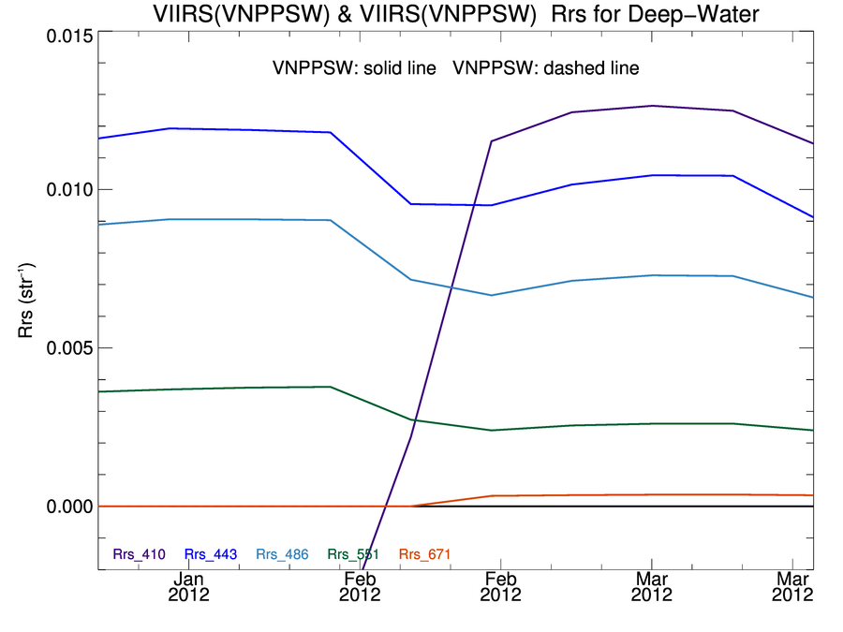
VIIRS Deep-Water Rrs Trends
NOAA L1Bs with OBPG L2 Processing
NOAA calibration update
Rrs (sr⁻¹)
Notes:
what you would get from products in CLASS (SDRs and EDRs)
february 6th cal update
no continuity in calibration, no reprocessing

Slide 26
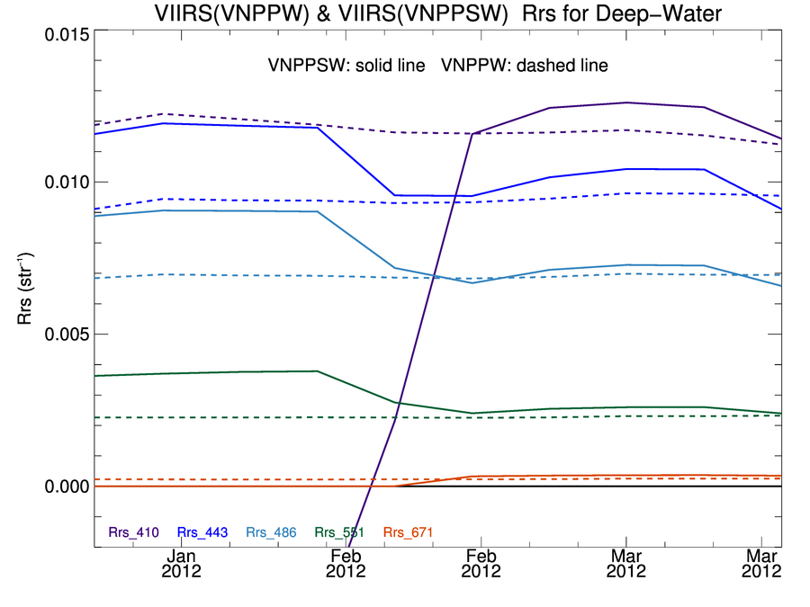
VIIRS Deep-Water Rrs Trends
NOAA L1Bs vs OBPG L1Bs, Both with NASA L2 Processing
NOAA calibration update
Rrs (sr⁻¹)
after OBPG instrument calibration & reprocessing
Notes:
much improved temporal stability after OBPG calibration and reprocessing

Slide 27
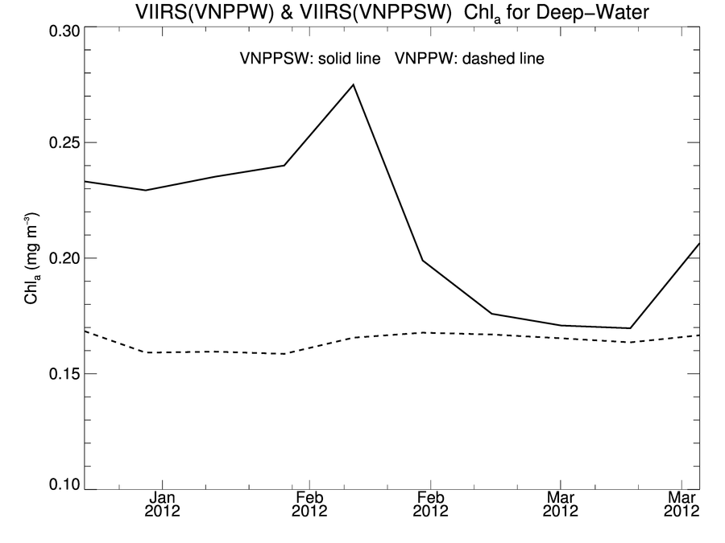
VIIRS Deep-Water Chl Trends
IDPS L1Bs vs OBPG L1Bs, Both with NASA L2 Processing
using NOAA standard calibration "as-is"
Chl_{a} (mg m⁻³)
after preliminary OBPG instrument calibration & reprocessing

Slide 28
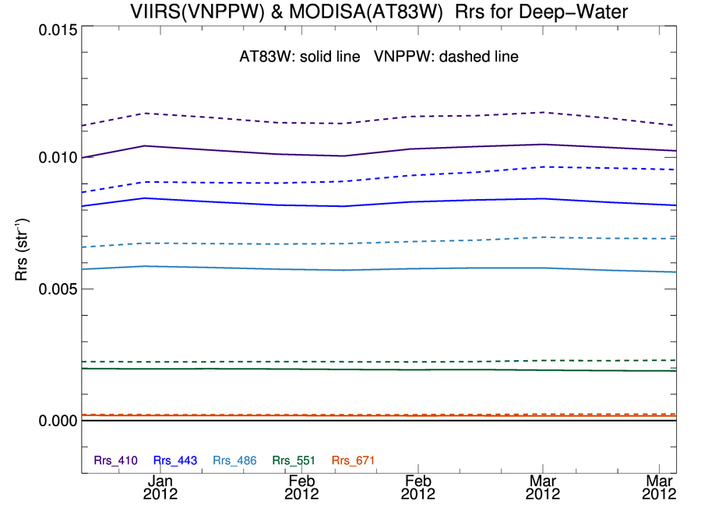
VIIRS & MODISA Deep-Water Rrs Trends
VIIRS OBPG L1Bs, MODISA OBPG Cal, NASA L2 Processing
solid line = MODISA (updated OBPG calibration)
dashed = VIIRS (preliminary OBPG calibration)
Rrs (sr⁻¹)
temporal stability is comparable (after recalibration)
biases to be resolved through vicarious adjustment
Notes:
Good agreement, needs more data to resolve biases through vicarious adjustment

Slide 29
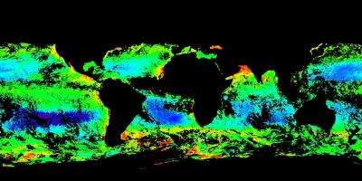
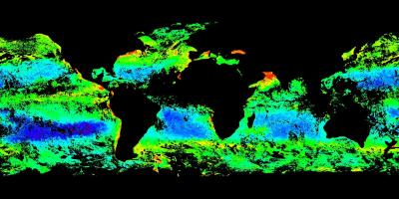
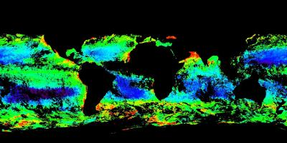
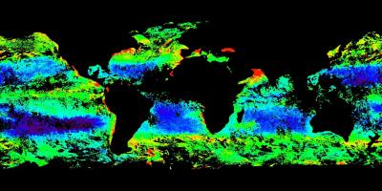
VIIRS & MODISA 8-Day Chl Images
NASA/OBPG Calibration & Processing
VIIRS
VIIRS
Early January
time
Late March
MODISA
MODISA
0.01 – 1.0 mg m⁻³
Notes:
same features, same dynamic range

Slide 30
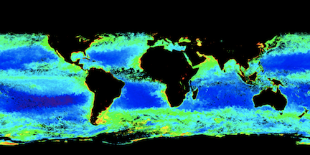
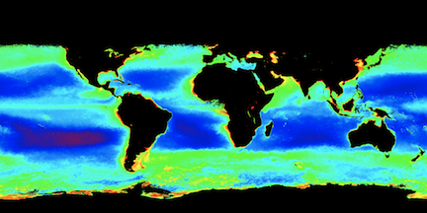
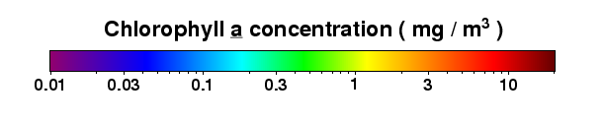
NASA/OBPG Calibration and
Processing Algorithms
January 2012
VIIRS
January Mean
SeaWiFS
Notes:
same dynamic range, well within the ball park

Slide 31
VIIRS Conclusion
Using a common processing approach and OBPG- derived instrument temporal calibration, and after a consistent reprocessing, VIIRS appears to have good potential for extending the current ocean color climate data record of SeaWiFS and MODIS
Notes:
at least wrt the chlorophyll data record (no new science, no fluorescence)

Slide 32
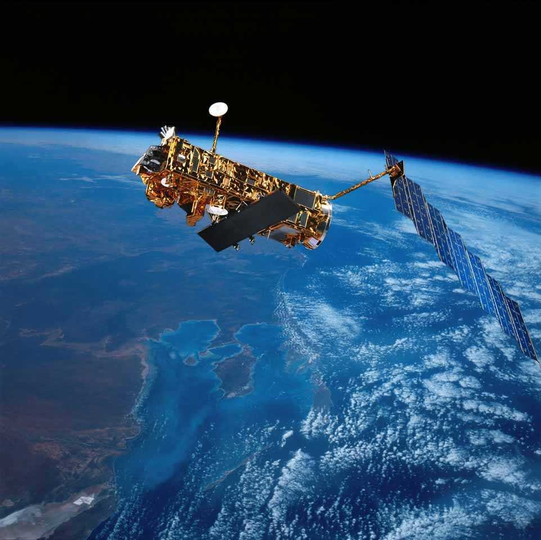
MERIS
2002-?
Notes:
instrument was performing well
3rd reprocessing finished last fall

Slide 33
NASA-ESA Data Exchange
Under NASA-ESA bilateral, NASA will recieve all MERIS data (with redistribution rights) in exchange for MODIS and SeaWiFS data.
OBPG has acquired entire archive of L1B MERIS RR (global 1.2km) data, and will be acquiring archive of L1B FR (regional 300m) data
Plan to process to Level-2 and Level-3 using NASA standard algorithms, software, and methods
All MERIS data will be accessible via OceanColorWeb (L1B RR data should be available by end of April)
OBPG will utilize MERIS for additional insight into MODIS & SeaWiFS calibration and algorithm performance
Notes:
adding user authentication

Slide 34
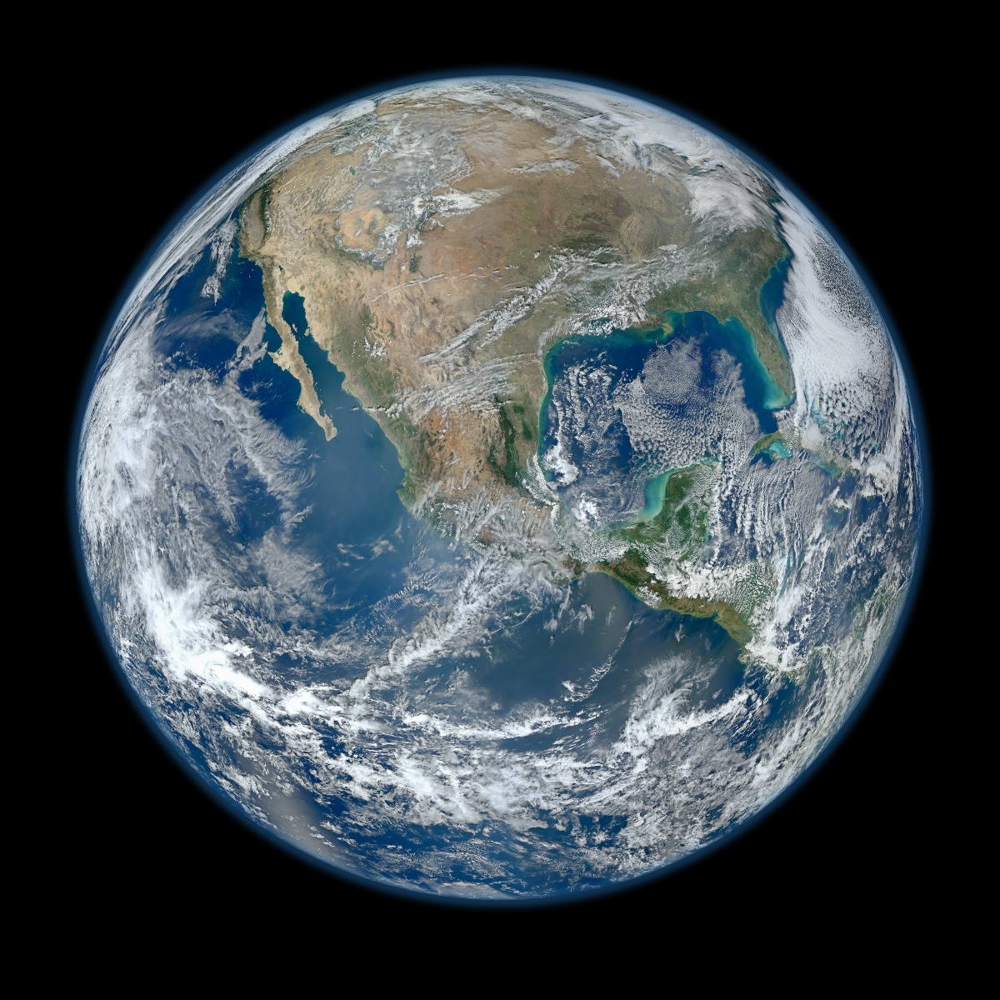
Notes:
lost two instruments, two instruments badly degrading, but viirs looks like it as the potential to provide measurements of sufficient quality to maintain the climate data record into the future.
*Updated February 2, 2012: According to Flickr, "The western hemisphere Blue Marble 2012
image has rocketed up to over 3.1 million views making it one of the all time most viewed images on the site after only one week."

Slide 35
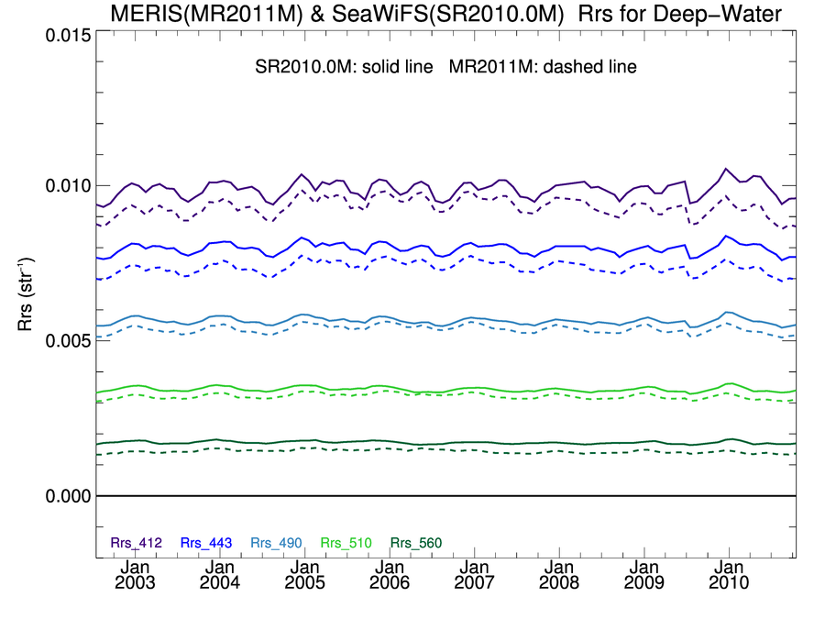
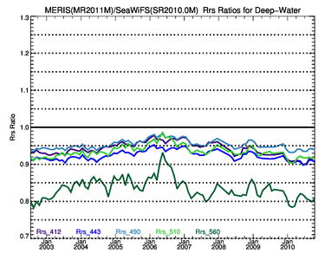
MERIS Rrs (3rd ESA Reprocessing) vs SeaWiFS
Deep-Water
solid line = SeaWiFS R2010.0
dashed = MERIS R3 (2011)
412
443
Rrs (sr⁻¹)
490
510
560

Slide 36
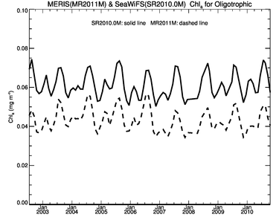
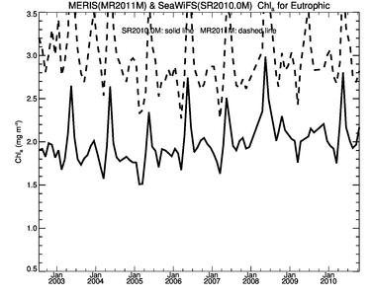
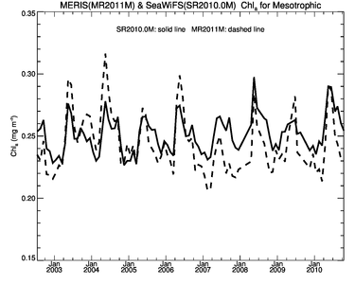
MERIS R3 Chlorophyll vs SeaWiFS 2010.0
Agreement Degraded
oligotrophic
eutrophic
mesotrophic

Slide 37
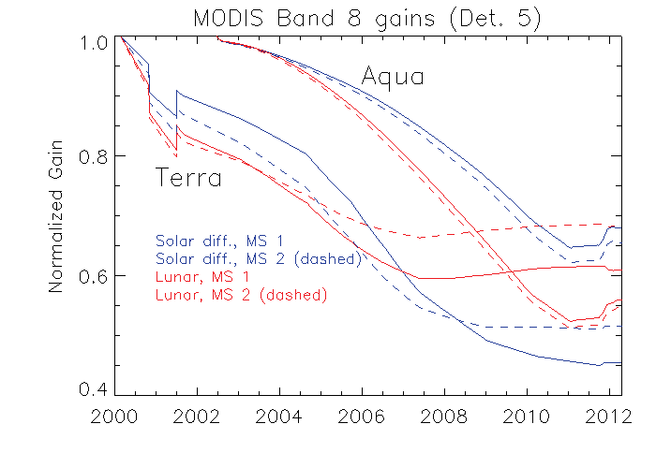
MODIS Lunar and Solar Calibration Trends
More Erratic in 2011
MODIS 412nm Responsivity Changes Since Launch
0%
Aqua
10%
20%
Terra
Gain
30%
40%
50%
60%
Notes:
extrapolation

