Slide 1
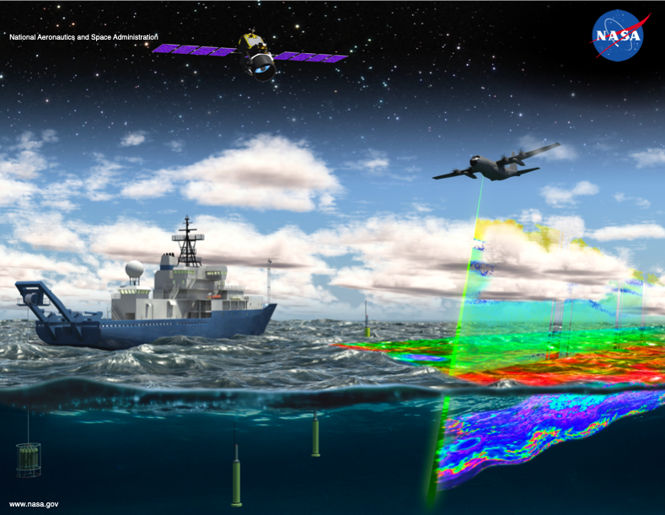
Earth Venture Suborbital-2:
North Atlantic Aerosols and Marine Ecosystems Study
Jason R. Graff
Notes:
Hi. My name etc.

Slide 2
What is NAAMES?
NASA Earth Venture Suborbital Program
NAAMES
• the first EV-S mission focused on studying the coupled ocean ecosystem and atmosphere
• five-year investigation to resolve key processes controlling ocean ecosystem function, their influences on atmospheric aerosols and clouds and their implications for climate

Slide 3
What is NAAMES?
Four targeted ship and aircraft campaigns in the North
Atlantic ocean, combined with the continuous satellite and in situ ocean sensor records
• enable improved predictive capabilities of Earth system processes
• inform ocean management and assessment of ecosystem change
PI - Mike Behrenfeld (OSU),
Project Manager - Mary Kleb (NASA LaRC),
Project Scientist - Chris Hostetler (NASA LaRC)
Notes:
Campaigns focused on key periods of the annual cycle in the North Atlantic using ship, aircraft, satellite, BioArgo floats and drifters
PI is Mike Behrenfeld, Project Manager is Mary Kleb, and Chris Hostetler is the Project Scientist
In total NAAMES has included 137 people (and growing) from 23 NASA and Univeristy campuses and beyond

Slide 4
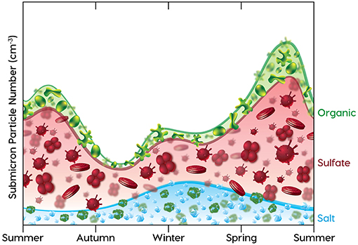
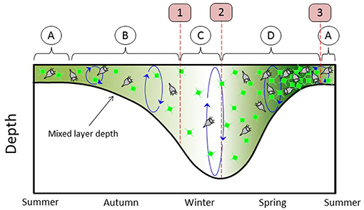
Capturing Annual Cycles
aerosols
organic
sulfate
salt
A
division ~ loss rates
Transitions
B
depletion
1
C
division > loss
2
D
accumulation
phytoplankton
3
Notes:
Figures from the NAAMES Overview paper in Frontiers in Marine Science – published as of March 2019
1. Stylized annual cycle of submicron aerosol number concentration (in the top panel) and plankton dynamics (midsummer to early summer.) (in the bottom panel.
Stresses the impact of the annual cycle in plankton dynamics on the overlying atmosphere
2. NAAMES was as series of four field campaigns focused on key periods of the annual cycles in plankton and aerosols.
3. Bottom panel is a simplified diagram of DRH that describes interactions between physical and biology, it identifies key events and phases in bloom-forming phytoplankton annual cycles
These events helped guide the design of NAAMES and our efforts to assess the impact of plankton dynamics on overlying atmospheric composition and processes.
4. Organic and sulfate containing aerosols consistent with marine sources in the atmosphere play important roles in cloud dynamics and influence cloud microphysical properties.

Slide 5
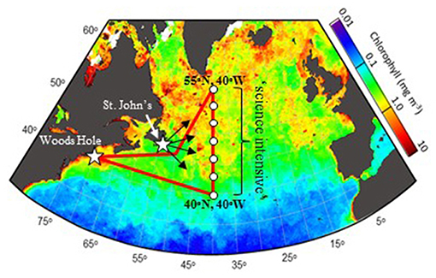
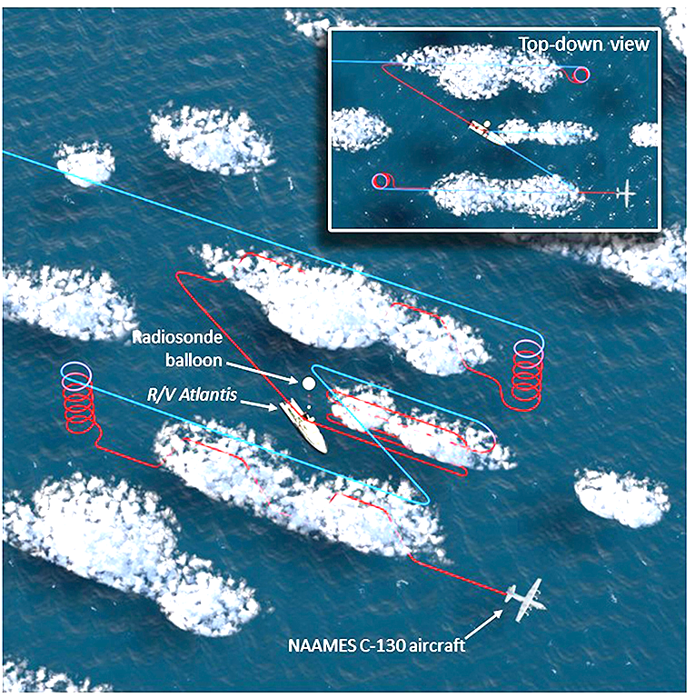
Planning
Efforts
R/V Atlantis out of Woods Hole, MA
N-S transect extends temporal observations as bloom progresses
C-130 flights out of St. John’s, Newfoundland
Flight patterns/modules to capture near- and far-field dynamics relative to ship
(HSRL, GCAS, 4STAR, RSP, LARGE)
Bio-Argo floats and satellites
Notes:
Bloom progresses from south to north with regard to peak concentrations of biomass
N-S transect provide the ability to capture a broader range of dynamics in a short period of time.
In the 14 day primary science transect a N-S transect captures ~2.5 months of an annual cycle.
2. C-130 flight plans included multiple modules or flight patterns near and distant from the ship as well as observing previous
and future targeted stations that extended our observations in those locations.
3. C-130 not just focused on clouds and aerosols For example the HSRL provides in-water profiling.
4. Autonomous floats and remote sensing provide continuous links between field campaigns.

Slide 6
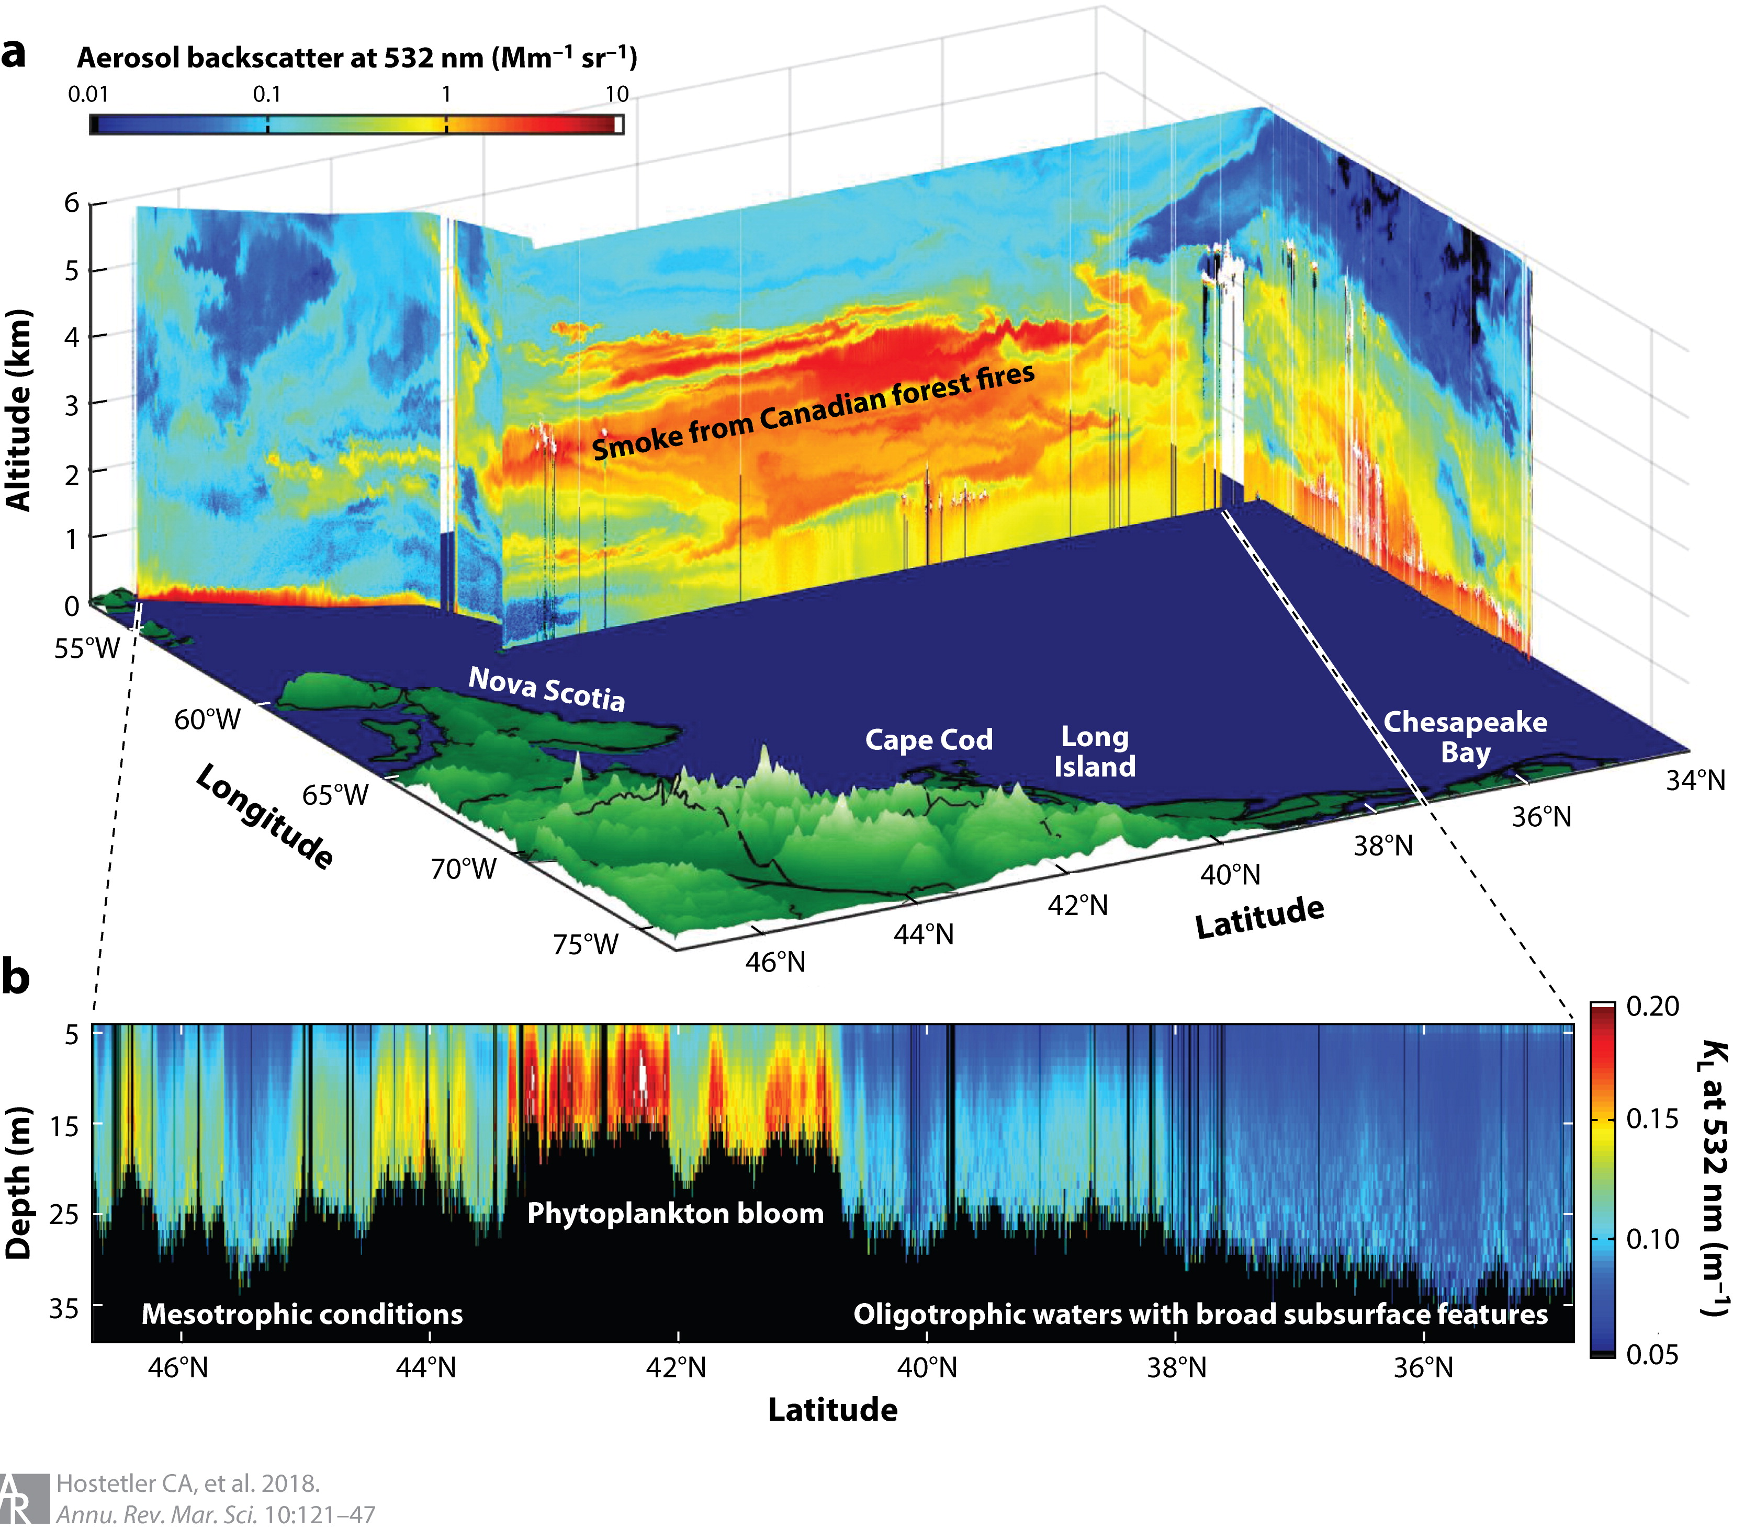
Application of lidar for atmosphere and ocean
Hostetler et al. 2018, Ann. Rev. Mar. Sci.
Notes:
Application of new technology during NAAMES
atmospheric and ocean retrieval curtains from a flight of the NASA HSRL-1 instrument during NAAMES

Slide 7
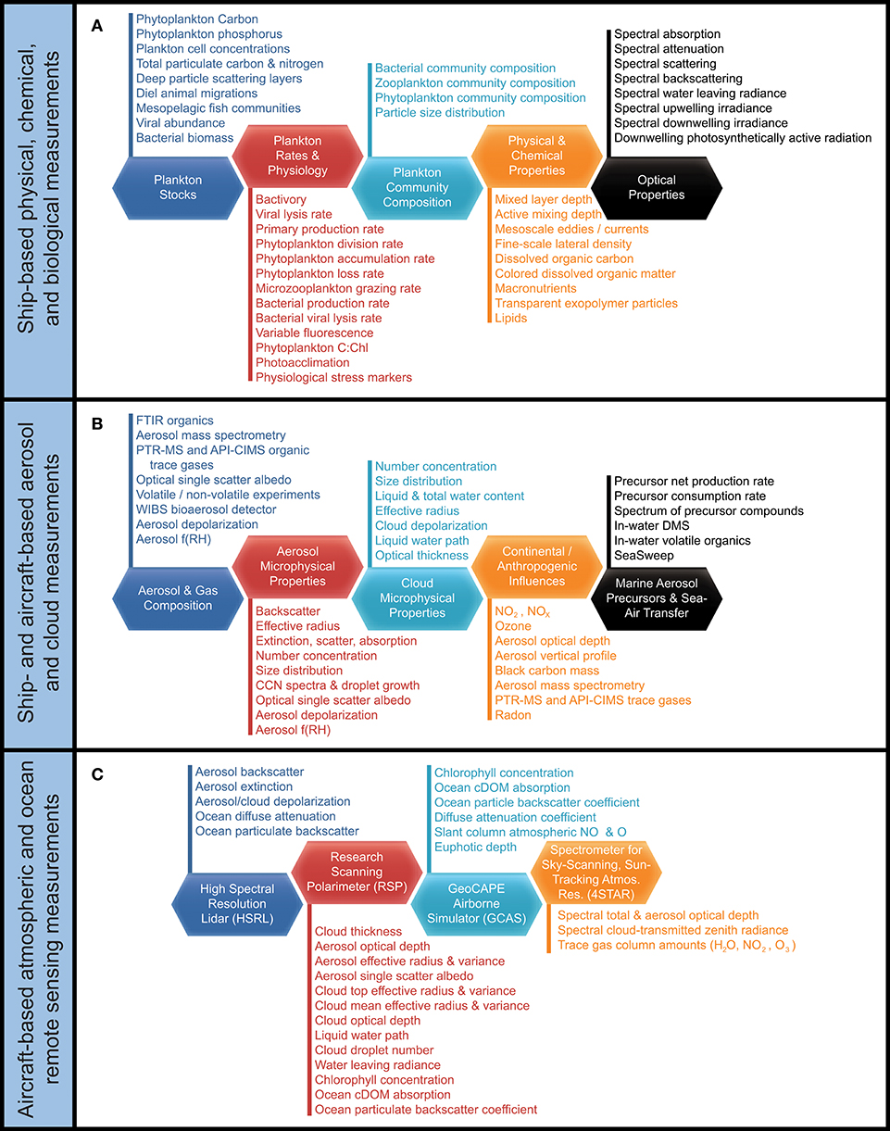
Ship
Notes:
point out the categories and large number of measurements

Slide 8
Ship/
Aircraft
Common
Measures
Notes:
Shared aerosol and cloud measures

Slide 9
Aircraft
Notes:
Atmospheric and ocean remote sending, e.g. HSRL

Slide 10
Linking seasonal dynamics
Field Campaigns
2
3
1
4
2
NAAMES 1 • Nov 2015
NAAMES 2 • May/June 2016
NAAMES 3 • Aug/Sep 2017
NAAMES 4 • Mar/April 2018
Bio-Argo floats and satellites provide observational links between field campaigns separated in time.
Notes:
Measurements from the previous slides were made in order to explore the annual cycles in plankton, aerosols, and their interactions.
NA1 – Bloom Initiation
NA2 – Bloom Climax
NA3 – Bloom Termination
NA4 – Accumulation Period
BioArgo floats and satellites provide observational links between field campaigns separated in time.
Allows us to observe multiple annual cycles and contextualize each field campaign at its given phase of the annual cycle.

Slide 11
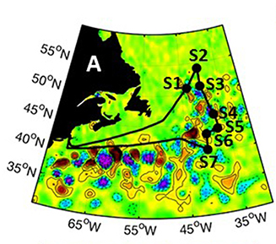
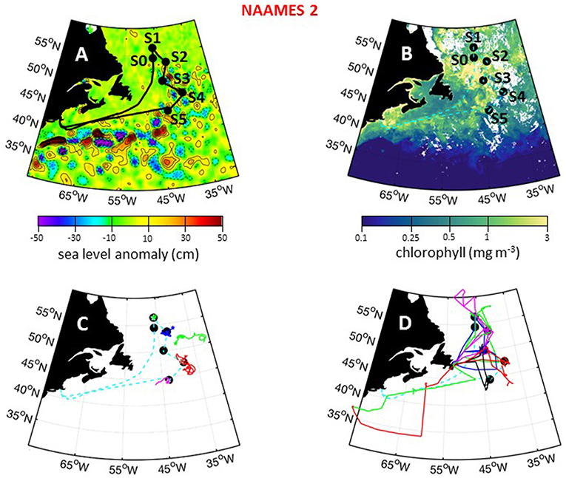
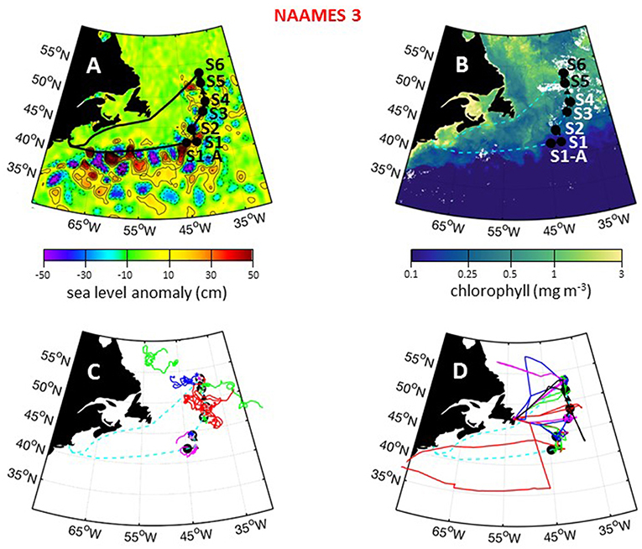
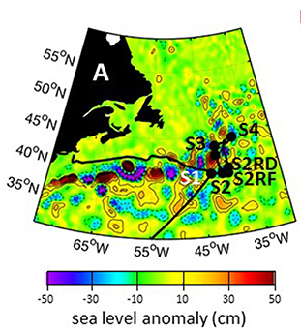
Field Campaigns
1
2
3
4
Notes:
Cruise tracks plotted on top of sea level anomaly – provides a sense of the physical dynamics of the region.
NAAMES stations were targeted to eddy and non-eddy water masses.

Slide 12
Field Campaigns
Floats
C-130
2
3
Notes:
Light blue is cruise track of RV Atlantis
Colors are specific to float# and flight paths

Slide 13
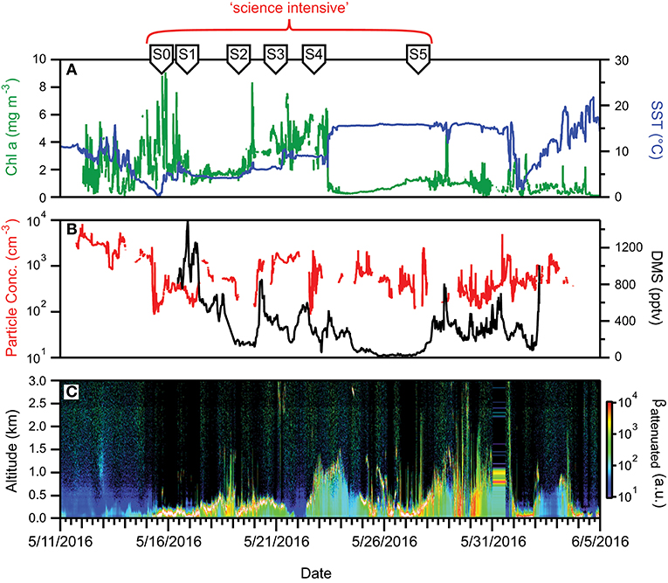
Bloom Climax
2
Notes:
Note the scale bars here for May
Wide dynamic range between May and the Aug/Sept cruise in marine and aerosol properties
Toggle between this and next slide.

Slide 14
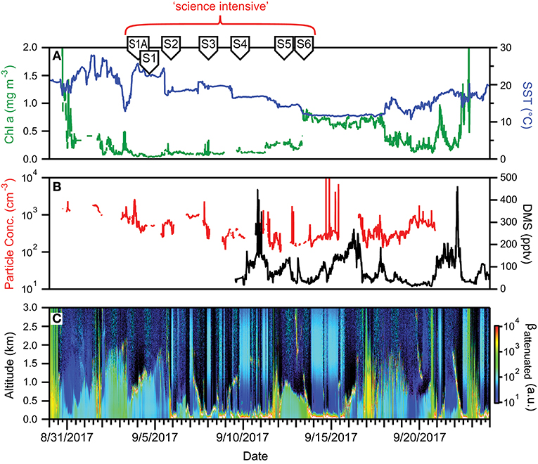
Declining Phase
3
Notes:
Not sure if I need panel C in these slides….clearly a difference between seasons…

Slide 15
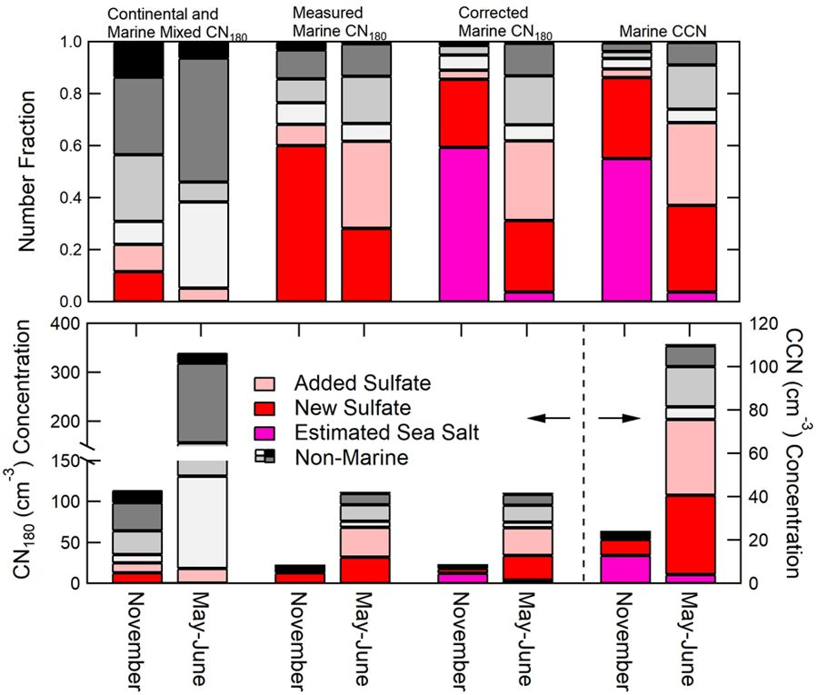
Marine aerosols (seasonally)
Contribution of particles with different chemical compositions in NAAMES1 (November) and NAAMES2 (May-June) and isolating the marine signatures/contributions seasonally
Sanchez et al. 2018, Nature Scientific Reports
Notes:
During NAAMES we had the opportunity to sample some of the most non-terrestrially influenced air masses sweeping down from the north through the Labrador Sea.
The air was so clean you could not see the steam from a cup of coffee as there were so few aerosols to absorb the water and make it visible.
The gradient in aerosol loads and chemical signatures have provided the means to isolate those of marine and continental origin, critical information that was lacking in models of CCN dynamics.

Slide 16
Ice nucleation by marine aerosols
Synechococcus
picoeukaryotes
nanoeukaryotes
Wilbourn et al. (in prep)
Texas A&M, Oregon State University
Notes:
Ice nucleation by marine aerosols directly impacts cloud albedo (brighter clouds reflect more sun).
The impact of specific member of the plankton community on ice nucleation are being explored as other studies have show that organisms ranging form viruses, bacteria, and phytoplankton may significantly impact ice nucleation in the atmosphere.
Using cell sorting technology to collect specific fractions of the phytoplankton community we were able to examine their potential as ice nucleating aerosols
-arrow is salinity of aerosols during cloud formation

Slide 17
Linking HSRL, water mass origin and plankton community
• High Spectral Resolution Lidar
• water mass tracking
• imaging flowcytometry / flowcytometry
Schulien et al. (in prep)
NASA LARC, SU, UMaine, UW-APL
Notes:
Here is another example of the use of the HSRL – this time crossing an eddy with significant differences in optical properties relative to those outside of the water mass.
Using state of the art water mass mass tracking algorithms has provided the ability to match up the C-130 overflight data with cruise tracks crossing the same water mass but separated in time.
Changes is particulate backscattering and linear depolarization ratio / bbp can be directly linked to changes in phytoplankton community size distributions and community members with different shapes.

Slide 18
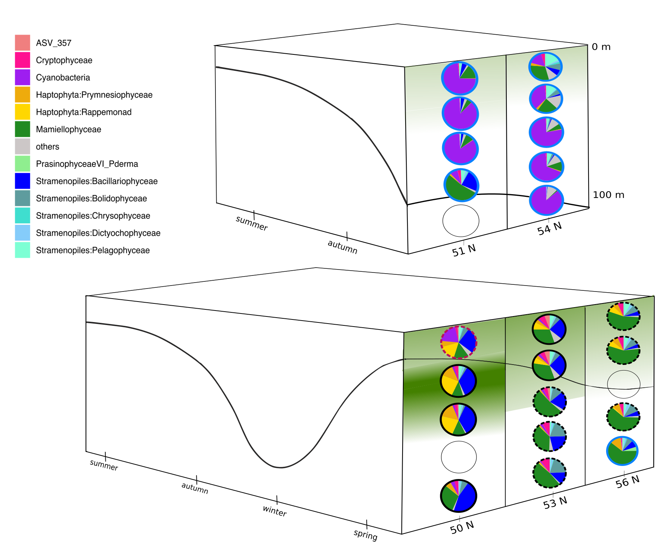
Molecular tools reveal seasonal bloom dynamics
Winter
MLD
Spring
MLD
Luis Bolaños et al. (in prep)
OSU, URI-GSO, UMaine, MBARI, UCSB, UW-APL
Notes:
The dilution recoupling hypothesis appears to be valid based on observations made throughout NAAMES with additional community dynamics being exposed through molecular approaches that were applied and can highly resolve the plankton community in some cases down to the species level.
Molecular identification of plankton communities reveals changes in the community structure and highlights the seasonal progression of the bloom from south to north.
Deep, northern station most similar to or clusters with winter time populations based on molecular identification
This work, in conjunction with other methods, is also revealing that blooms can be dominated by smaller phytoplankton and challenges the dogma that large diatoms will dominate blooms in the North Atlantic.

Slide 19
Highlights
NAAMES Publications
• 27 peer-reviewed to date
• 50+ planned for the coming year

Slide 20
NAAMES Data

Slide 21
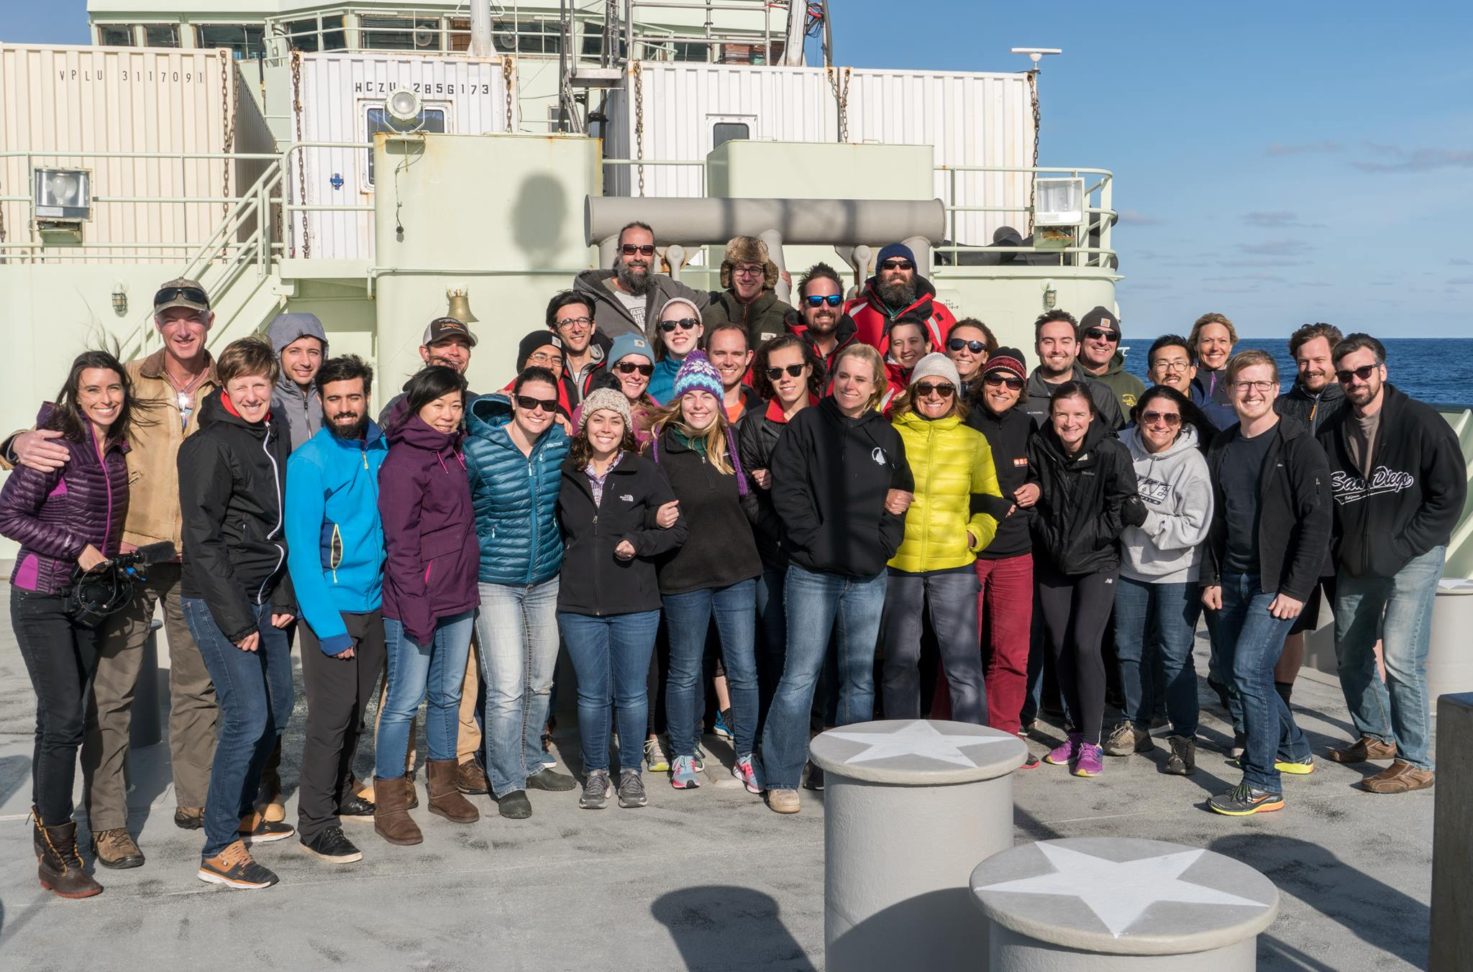
Thank you
> 200 people from > 25 institutions have contributed to the successful execution of the NAAMES project

