Slide 1
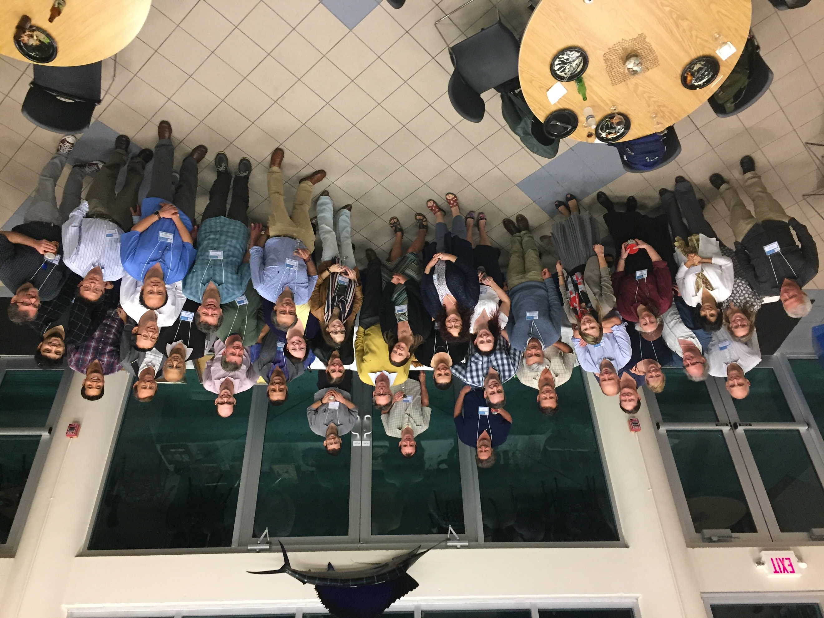
PACE (first) Science Team
Emmanuel Boss, Lorraine Remer & the PACE-ST
UMaine, UMBC & many other places

Slide 2
PACE-ST #1
Process of selection
Individual work
Work as part of the ST <- bulk of this presentation.
    During our tenure – input on polarimetry, coastal imager and gaps.
    Community papers – IOP inversion PiO, and special issue in Frontiers regarding atmospheric retrievals and AC.
In addition, many cross-disciplinary collaborations have taken place between scientists that were previously preoccupied with atmosphere or ocean-only science (see PACE website).

Slide 3
PACE-ST #1 Timeline
2014 – ROSES Program element for PACE Science Team
April 2014 – Proposal review
July 2014 – Selection
1 October 2014 – Phase A begins for Selectees
“...the ultimate goal for each of the two measurement suite teams is to achieve consensus and develop community-endorsed paths forward for the PACE sensor(s) for the full spectrum of components within the measurement suite. The goal is to replace individual ST [science team] member recommendations for measurement, algorithm, and retrieval approaches (historically based on the individual expertise and interests of ST members) with consensus recommendations toward common goals.”
Note: at the time of selection, PACE was NOT yet a mission.

Slide 4

PACE –ST #1 - charge
Provide a consensus report(s) outlining the path forward for producing operational algorithms for Atmospheric Correction and Inherent Ocean Properties (IOP) and on getting atmospheric products with PACE.
Develop community-endorsed path forward for PACE sensor(s).

Slide 5
Membership PIs (+ associates)
IOP
Steve Ackleson (+Moses)
Emmanuel Boss (Lead)
ZhongPing Lee (+Ondrusek)
Stephane Maritorena
Greg Michell (+Kahru)
Collin Roesler
Cecile Rousseaux (+Greg)
Dariusz Stramski
James Sullivan
Michael Twardowski
Maria Tzortziou (Applications)
Jeremy Werdell (NASA)
Xiaodong Zhang (+Slade)
Antonio Mannino (NASA)
Atmospheric correction
Jacek Chowdhary
Susanne Craig
Heidi Dierssen
Bryan Franz (NASA,+Ibrahim,+Knobelspiesse)
Robert Frouin
Bo-Cai Gao
Olga Kalashnikova (+Davis,+Diner)
Ali Omar (NASA, Applications)
Steve Platnick (+Coddington)
Lorraine Remer (Co-Lead+ Martins)
Brian Cairns (NASA)
Zia Ahmad (NASA)
+Zhai, Zu, Levy, Meyer, Zhang, Xu, Seidel, Hasekamp,Van Diedenhoven

Slide 6
How did we conduct the ST work?
Monthly telecons.
Yearly meetings, including an additional one in no-cost-extension year.
Meetings designed to maximize two-way communication.
As we were asked for input by NASA.
Briefed regularly other related NASA initiatives (GEO-CAPE and Hyspiri <- a new DS mission!).

Slide 7
Community products
The science team was also asked by NASA to assess the designs of the PACE radiometer and polarimeter and to determine the value of adding a high spatial resolution coastal camera. We also provided a gap analysis – science needed to be addressed prior to PACE flight.
Assembling hyperspectral in-situ datasets – Cecile Rouseaux
Creating a hyperspectral synthetic dataset – ZhongPing Lee
Comparison of absorption methodologies – Twardowski, Sullivan, Roesler, Stramski + colleagues
Applications – Maria Tzortziou & Ali Omar + early adopter program
Benchmark coupled ocean-atmosphere RT calculations –Chowdhary, Zhai and others.
Contribution to PACE’s website

Slide 8
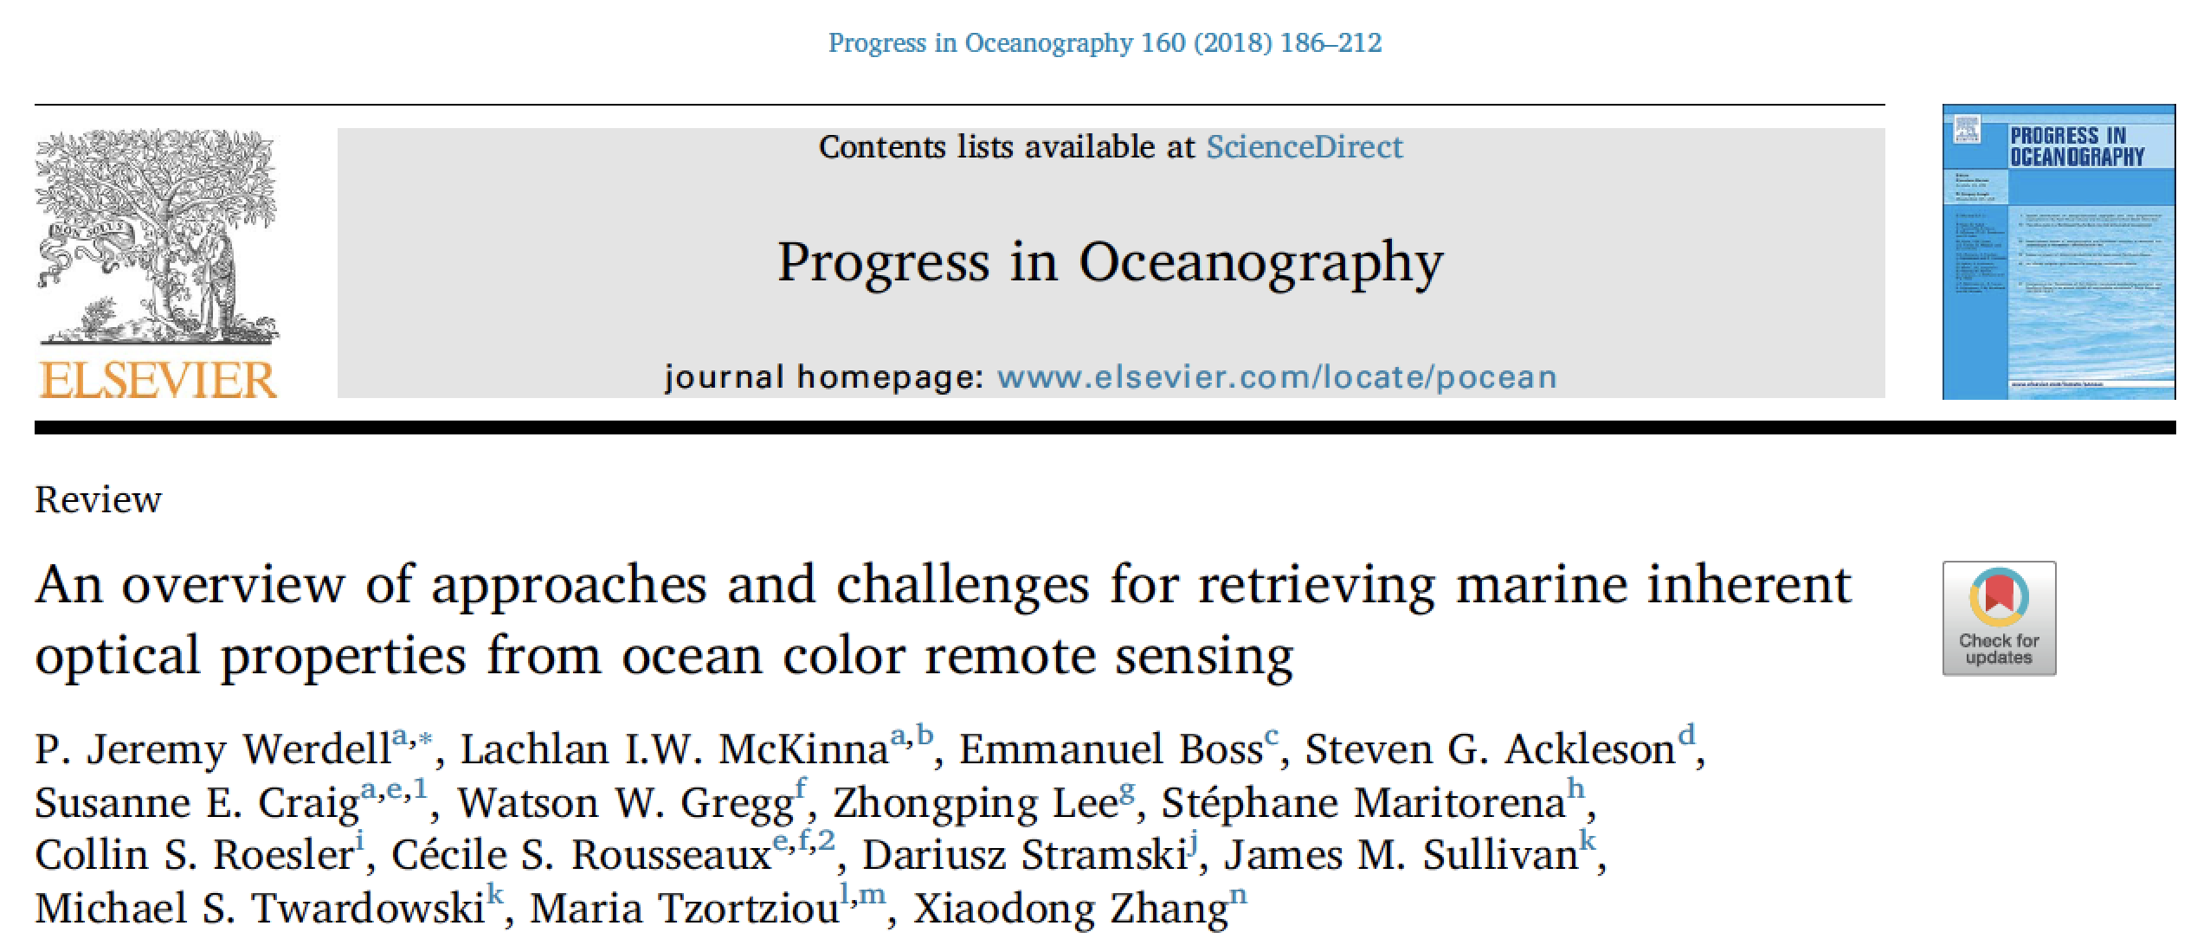
Communal research output
Includes: State-of-the-art, promising future directions and gap analysis.

Slide 9
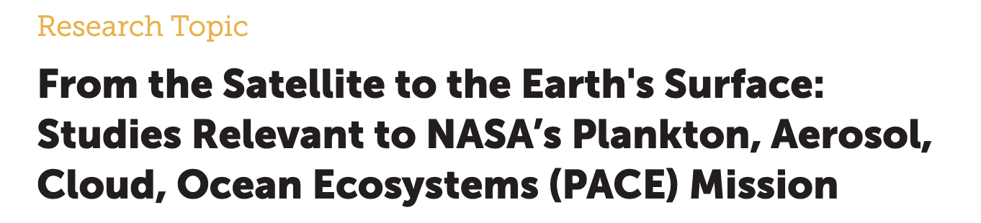
Communal research output
Special guest editors:
Oleg Dubovik
David Antoine
Chowdhary, et al. Radiative Transfer in Atmosphere-Ocean Systems. Front. Earth Sci., in review, (2018).
Frouin, R., et al. Atmospheric correction of satellite ocean-color imagery during the PACE era. Front. Earth Sci., in review, (2018).
Remer, et al., Retrieving aerosol characteristics from the PACE mission, Part 1: Ocean Color Instrument. Front. Earth Sci., in review, (2018).
Remer, et al., Retrieving aerosol characteristics from the PACE mission, Part 2: Multi-angle and polarimetry. Front. Earth Sci., in review, (2018).
Dierssen. H.M. 2019. Hyperspectral measurements, parameterizations, and atmospheric correction of whitecaps and foam from visible to shortwave infrared for ocean color remote sensing. Front. Earth Sci. 7:14. doi: 10.3389/feart.2019.00014
Werdell, J. and L. McKinna, 2019. Sensitivity of Inherent Optical Properties From Ocean Reflectance Inversion Models to Satellite Instrument Wavelength Suites, Frontiers in Earth Science. Front. Earth Sci. doi: 10.3389/feart.2019.00054

Slide 10
Lessons learned
Synergy between atmospheric and oceanic communities invigorates disciplinary science and forges new ideas for interdisciplinary studies.
The value of polarimetery across disciplines.
Consensus-built strategies for the path forward for ocean, atmosphere and atmospheric correction retrievals.
Identified gaps that need to be addressed to fully realize the potential of PACE science.
Identified six PACE applications areas, and began to engage potential early adaptors in the applied sciences community.

Slide 11
Looking Forward: current PACE Science Team call
Pre-launch Science Teams
  FY19 – 22: ROSES 2019 (4 years)
    Allow lead time for scientific algorithm development & applications development prior to launch
    Initiates interface between instrument developers and OBPG; OBPG/OB DAAC and algorithm developers; possible LaRC DAAC for polarimetry (not yet decided)
    “Each awarded PI will be expected to collaborate closely with other science and applications team members and will produce annual reports that detail recommended approaches for the given PACE data product(s) within their respective efforts. As a whole, the ultimate goal for the science and applications team is to achieve consensus and develop community-endorsed paths forward for the PACE data products on which they are working, as well as for the full spectrum of components within a given measurement suite (aerosols, clouds, and ocean color). The desire is to augment individual science and applications team member recommendations for measurement, algorithm, and retrieval approaches (historically based on the individual expertise and interests of PIs) with consensus input toward common goals, building on previous PACE science team consensus reports on, for example, inherent optical property retrievals and their gaps”.

Slide 12
Parting words
This is a new (and exciting) kind of ST:
Includes atmospheric and ocean scientists working on common as well as disciplinary goals. Great for new science!
A lot of energy is put into community work, in addition to ones own personal science interests.
Highly recommended opportunity to engage in new science and to be part of a great team. Call is in ROSES-19.

