Slide 1
The Pre- Aerosol, Clouds, and ocean Ecosystem Mission
PACE
a report from the Science Definition Team
http://decadal.gsfc.nasa.gov/pace.html
by:
Carlos E. Del Castillo
The Johns Hopkins University-APL
2012 NASA Ocean Color Research Team Meeting
April 23-25, Seattle, WA

Slide 2
What is the PACE mission?
The PACE mission will make global ocean color measurements to provide extended data records on ocean ecology and global biogeochemistry (e.g., carbon cycle) along with polarimetry measurements to provide extended data records on clouds and aerosols. Understanding of impacts and feedbacks of the Earth system to climate are critical importance.
The PACE mission was envisioned as an advanced Ocean Color Sensor provided by NASA and a Polarimeter (3MI) provided by CNES or ESA. CNES recently declined to provide the 3MI sensor. NASA is in conversations with ESA. Nothing more to report on this.
~$750,000,000

Slide 3
A Brief History of PACE
  In 2010 NASA HQ decided to implement PACE due to the outstanding issues for continuity of MODIS products for ocean color, aerosol, cloud from NPP and JPSS VIIRS.
  The guiding document is:
  Responding to the Challenge of Climate and Environmental Change: NASA’s Plan for a Climate-Centric Architecture for Earth Observations and Applications from Space
  http://science.nasa.gov/media/medialibrary/2010/07/01/Climate_Architecture_Final.pdf
25 July, 2011 NASA issued a Dear Colleague Letter inviting proposals for Science Definition Team (SDT) membership.
18 October, 2011 – NASA issued selection letters for the SDT.

Slide 4
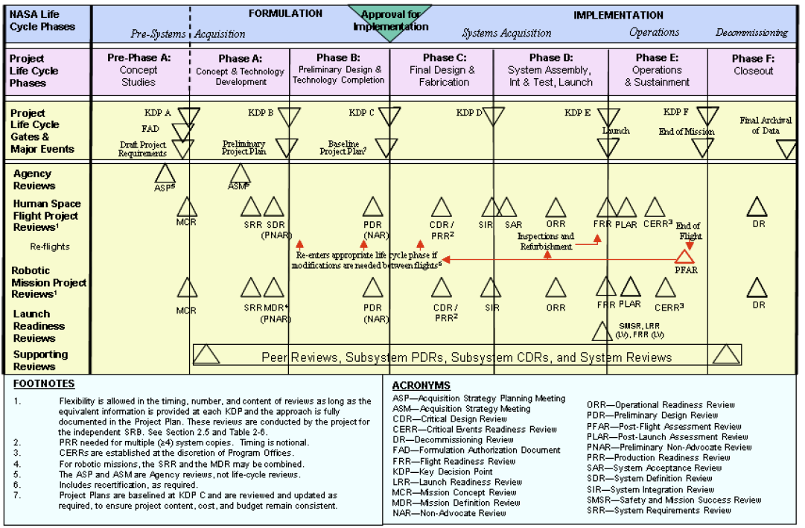

Slide 5
PACE time line
Targeting LRD of FY19 (end 2018) - +/- 1yr
25 July 2011 – PACE SDT DCL released
9 September 2011 – PACE SDT DCL applications due (50)
18 October 2011 – PACE SDT Selection
16-18 November 2011– First PACE SDT Workshop (Washington, D.C.)
14-16 March 2012 – Second SDT workshop (Washington, D.C.)
25-27 June 2012 – Third SDT workshop (Washington Marriott, Washington, D.C.)
July/August 2012 – SDT final report due
January/February 2013 – Target AO release
April/May 2013 – AO Proposals Due
Summer/Fall 2013 – AO review and Step 1 Selection
October 2013 – Phase A begins for Selectee(s)
Summer 2015 – Step 2 Selection, Phase B

Slide 6
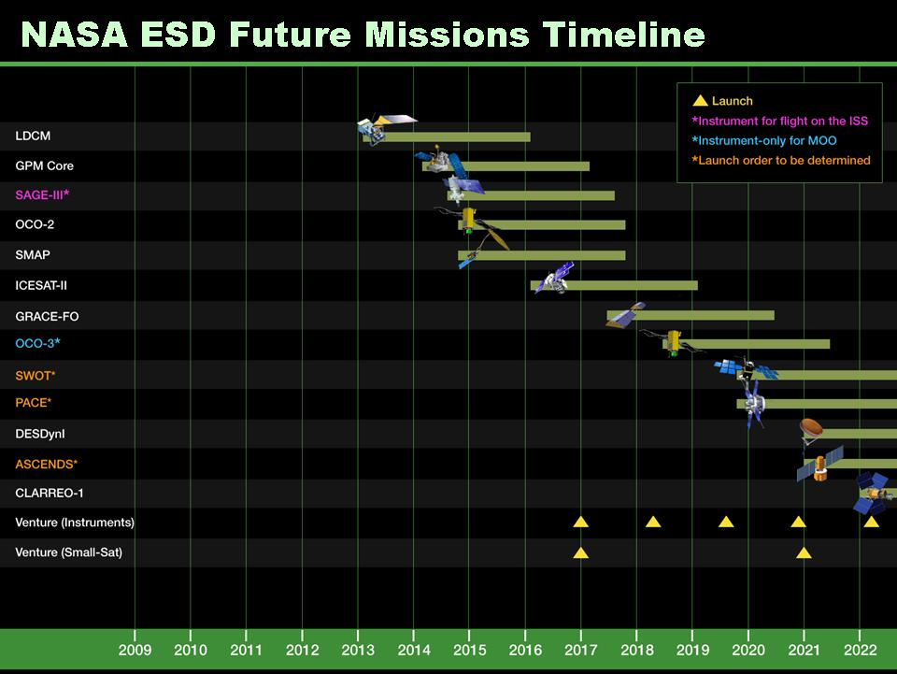

Slide 7
The PACE Science Definition Team
Atmosphere Aerosols & Clouds:
Cairns, Brian – NASA GISS
DaSilva, Arlindo – NASA GSFC
Diner, David – NASA JPL
Dubovik, Oleg – Univ. of Lille, France
Kahn, Ralph – NASA GSFC
Marshak, Sasha – NASA GSFC
Massie, Steve – NCAR
Platnick, Steve**- NASA GSFC (Deputy Chair)
Reidi, Jerome – Univ. of Lille, France
Ocean Biology and Biogeochemistry:
Antoine, David – LOV, France
Balch, Barney – Bigelow Lab
Behrenfeld, Mike – Oregon State Univ
Boss, Emmanuel- Univ of Maine
Del Castillo, Carlos* – Johns Hopkins – APL (Chair)
Franz, Bryan- NASA GSFC
Frouin, Robert – UCSD-SIO
Gregg, Watson – NASA GSFC
McClain, Chuck – NASA GSFC
Meister, Gerhard- NASA GSFC
Mitchell, Greg – UCSD-SIO
Muller-Karger, Frank – Univ of S. Florida
Siegel, David – UC-Santa Barbara
Wang, Menghua – NOAA NESDIS
Werdell, Jeremy- NASA GSFC (SSAI)
Atmosphere/Ocean:
Chowdhary, Jacek – NASA GISS
Terrestrial:
Huemmrich, K. Fred – NASA GSFC
Instrument Engineering:
Puschell, Jeffery – Raytheon
Commercial Data Use:
McNaughton, Cameron – Golder Associates, Canada

Slide 8
Science Definition Team Charter
The SDTs are charged with defining the science content of the mission and working closely with the engineering team to define a mission concept(s) that optimizes science, cost, and risk.
The SDT is also responsible for defining and defending the science value of the mission concept(s).
To accomplish this, SDT must work closely with engineering teams
SDTs should not work in a vacuum
  Build upon, use as input, previous work by other groups (Decadal Survey, IOCCG, ACE SWGs, NRC, etc.)
  The SDT is working on mission requirements, not just instrument requirements.
  The PACE SDT is not agnostic about cost.

Slide 9
Science Definition Team Responsibilities and Products
Unique Responsibilities:
Define mission science investigation(s) Use hierarchical format of Goals→Objectives→Measurements (or could be phrased as Science Questions->Measurements->Approaches->Instruments Requirements->Mission Requirements (STM))
Prioritize to extent possible
The definition of measurement requirements should be supported by detailed analysis
Link science content to strategic documents
Define Level 1 science requirements – as you are able/as needed
Define straw-man payload(s) – as you are able aas needed
including supporting analysis describing the needed capabilities of the instruments
With engineering team:
Participate in the various Working Groups created by the mission study teams
Derive mission requirements from science G→O→M
Define mission architecture
Conduct trade analyses
Determine data return necessary for the science investigations
Produce a System Requirements Document(s)

Slide 10
Science Definition Team Regulations
The PACE instrument(s) and mission could be assigned to a center, or competed. Members of the SDT could be involved in the competition.
Therefore:
All SDT meetings are open to the community and advertized in the PACE website.
Telecons are not open due to logistics. The chair takes notes during the telecon and distributes them to the SDT for comments. All the telecon agendas and notes will be posted in the PACE website
All documents generated by the SDT, as well as all reference documentation are posted in the PACE website
Final draft will be available to the community for review. The SDT will take comments under advisement.
The SDT will be disbanded before NASA HQ starts working with a possible AO. No one in the SDT will have input or access to the AO during formulation.

Slide 11
How the PACE SDT operates?
-Three meetings and ~weekly telecons
-off line communications between SDT members
-consultation with non-members and engineering team
The team is using the experience of the community with satellite sensors.
-During the first meeting, the SDT adopted a structure for the final report, devised a schedule, and assigned responsibilities for writing and developing studies.
-The SDT adopted the threshold –goal classification system to state science requirements.
-The SDT commissioned a series of engineering studies (IDL and MDL) to understand cost deltas between thresholds and goal requirements. Based on the results, the team will evaluate changes to the report.

Slide 13
Table of Contents

Slide 14
PACE Ocean Science Questions
1-What are the standing stocks, compositions, and productivity of ocean ecosystems? How and why are they changing?
  Quantify phytoplankton biomass, pigments, and optical properties, assess key phytoplankton groups (e.g., calcifiers, nitrogen fixers, carbon export), and estimate particle size distribution and productivity using bio-optical modeling, chlorophyll fluorescence, and ancillary data on ocean physical properties (e.g., SST, MLD, etc.). Validate these retrievals from pelagic to near-shore environments.
2-How and why are ocean biogeochemical cycles changing? How do they influence the Earth system?
  Measure phytoplankton biomass and functional groups, POC, PIC, DOC, PSD and productivity. Validate these retrievals from pelagic to near-shore environments. Assimilate PACE observations in ocean biogeochemical models to provide fields for missing observations (cf., CO2 stocks, air-sea CO2 fluxes, carbon export, pH, etc.).
3-What are the material exchanges between land & ocean? How do they influence coastal ecosystems and biogeochemistry? How are they changing?
Quantify particle abundance, dissolved material concentrations and their characteristics and optical properties. Validate these retrievals from coastal to estuarine environments. Compare ACE observables with ground-based and model-based land-ocean exchange in the coastal zone, physical properties (e.g., winds, SST, SSH, etc), and circulation (coastal connectivity, etc).

Slide 15
4-How do aerosols influence ocean ecosystems & biogeochemical cycles? How do ocean biological & photochemical processes affect the atmosphere?
  Quantify ocean photobiochemical and photobiological processes and atmospheric aerosol loads and distributions. Combine ACE ocean and atmosphere observations with models to evaluate (1) air-sea exchange of particulates, dissolved materials, and gases and (2) impacts on aerosol and cloud properties. Conduct field sea-truth measurements and modeling to validate retrievals from the pelagic to near-shore environments.
5-How do physical ocean processes affect ocean ecosystems and biogeochemistry? How do ocean biological processes influence ocean physics?
  Compare PACE ocean observations with measurements of physical ocean properties (winds, SST, SSH, OOI assets, etc.) and model-derived physical fields (ML dynamics, horizontal divergence, etc.). Estimate ocean radiant heating and assess feedbacks. Validate from pelagic to near-shore environments.
6- What is the distribution of both harmful and beneficial algal blooms and how is their appearance and demise related to environmental forcings? How are these events changing?
Measure phytoplankton biomass, pigments and key group abundance including harmful algae. Quantify bloom magnitudes, durations, and distributions, assess inter-seasonal and inter-annual variations, and compare variability to changing environmental/physical properties. Validate these retrievals from pelagic to near-shore environments.
7- How do changes in critical ocean ecosystem services affect human health and welfare? How do human activities affect ocean ecosystems and the services they provide? What science-based management strategies need to be implemented to sustain our health and well-being?
Establish close linkages between science, operational, and resource management communities early in the planning phases of the PACE mission and maintain the feedback mechanisms throughout the life of the mission. Ensure that the science community understands the requirements of the management and operational communities and engage the latter fully in science planning efforts. Estimate the social and economic impacts of ocean ecology, including biodiversity, biogeochemical processes, and biological and chemical stocks and fluxes. Understand the applications of PACE products for water quality assessments and pollution identification. Implement strong STEM education and capacity building programs scoped to address national and international needs.

Slide 16
In some cases, the SDT is very prescriptive in technical requirements and instrumental approaches. This is based on the experience that the OC community has accumulated from CZCS through present.
However, the SDT is mindful of not overprescribing in areas where technical innovation may offer novel approaches.

Slide 17
Ocean Science Measurement Goals (not ranked)
Noon equatorial crossing time (±10 min)
1-day global coverage
Coverage to a solar zenith angle >75o
Characterization of instrument performance changes to ±0.1% within 3 years and maintenance of this accuracy thereafter.
Overall instrument artifact contribution to TOA radiance retrievals of <0.2%.
No detector saturation for any science measurement bands up to 1.2 × Lmax
Spatial resolution of 1 km2 (±10%) at all scan angles
Along-track spatial resolution of 250 m2 to <1 km2 for inland, estuarine, coastal, and shelf area retrievals for all bands or a subset of bands.
Two or more SWIR bands within the wavelength range of 1240 to 2130 nm for atmospheric corrections over turbid waters with SNR as indicated in Table 1 and Appendix I.
Identified approach or measurement capacity for evaluating/measuring aerosol vertical distributions and type for improved atmospheric corrections.
Identified approach or measurement capacity for characterizing/measuring NO2 and/or ozone concentrations at sufficient accuracy for improving atmospheric corrections
Spectral subsampling at ~1-2 nm resolution from 655 to 700 nm for refined characterization of the chlorophyll fluorescence spectrum
SNR for bio-optical science bands greater than those shown in Table 1 and Appendix I
Spectral measurement band centered at 820 nm or 940 nm to determine water vapor content
Retrieval of normalized [rw(l)]N for open-ocean, clear-water conditions and standard marine atmospheres with an accuracy of the maximum of either 10% or 0.002 over the wavelength range of 350 – 395 nm

Slide 18
Outstanding Issues
Cost of augmenting the baseline ocean ecology sensor to accommodate more atmospheric research – IDL studies commissioned.
Class C vs. B or 5-10 years instead of 3-5
1 km vs. 250 m spatial resolution
Atmospheric corrections – To what extend are data in the UV useful without having more information about aerosols? No clear consensus within the SDT. However, it is clear that, as envisioned, the PACE sensor will provide ground-braking science even with current atmospheric correction protocols
Will ESA or NASA provide a polarimeter?
Will NASA compete a vicarious calibration system?
Launch vehicles- This is not an issue for the SDT, but it is an issue for the community.

Slide 19
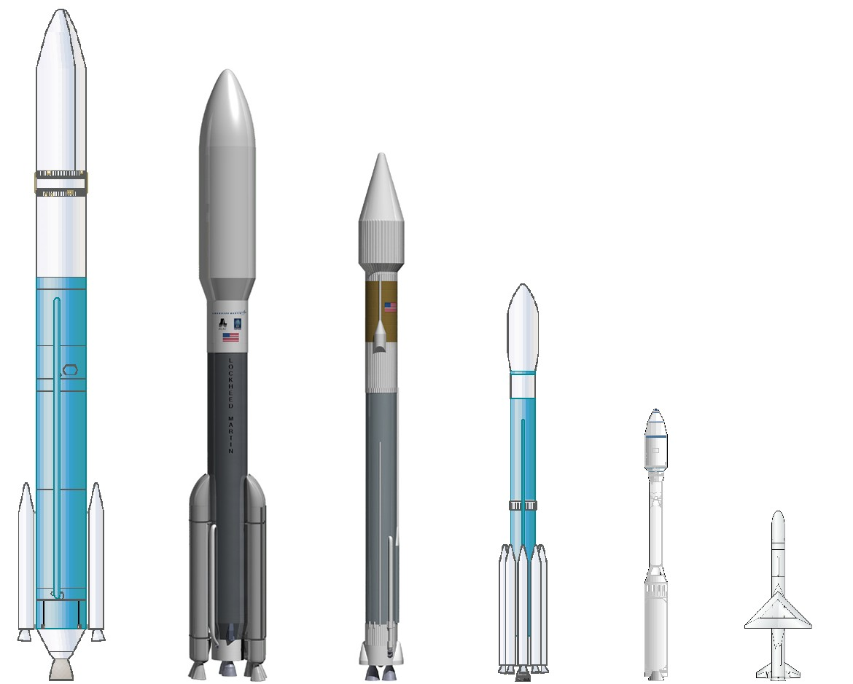
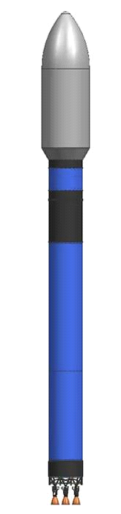





NLS II Launch Vehicles
The following vehicles are currently
listed in the NLS II Contract
X = Not offered
X = Not available
X = Not affordable
X = Not certified,
but possible
X
X
X
X
X
X
X
For detailed performance data see http://elvperf.ksc.nasa.gov
NOTE: Delta IV and Antares are not currently offered on NLS II
Only 5 left!

Slide 20
?

