Slide 1
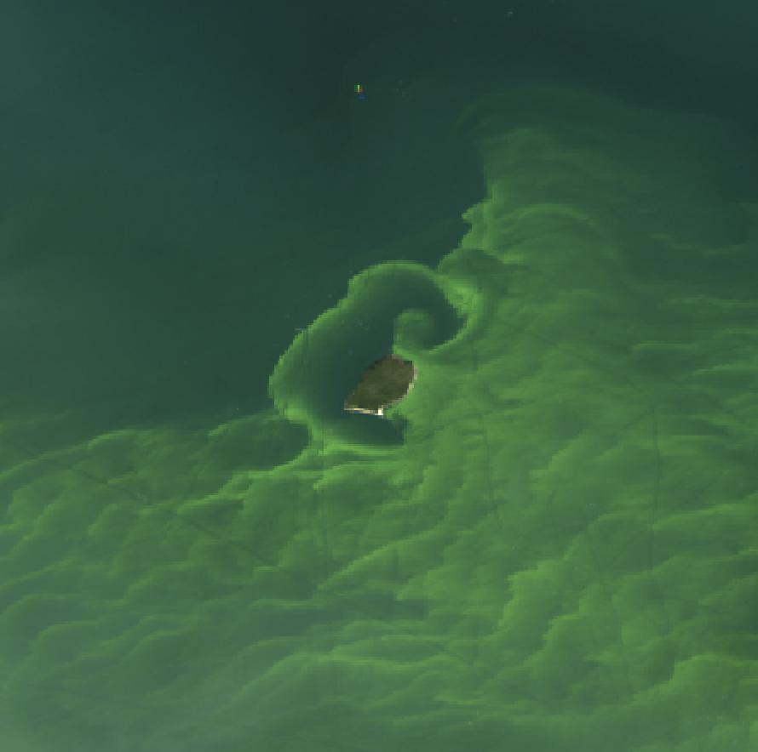

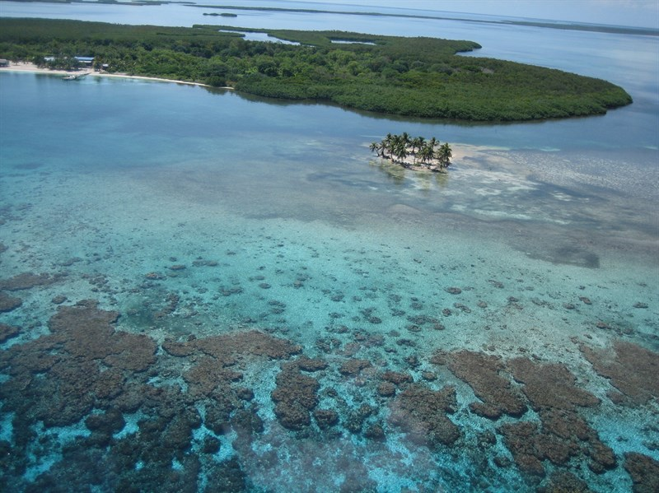


Atmospheric Correction Intercomparison eXercise (ACIX-Aqua)
ACIX-Aqua
Nima Pahlevan / SSAI
NASA Goddard Space Flight Center / Code 619
Dense Microcystis bloom - West Sister Island (Lake Erie) 09/27/2014

Slide 2
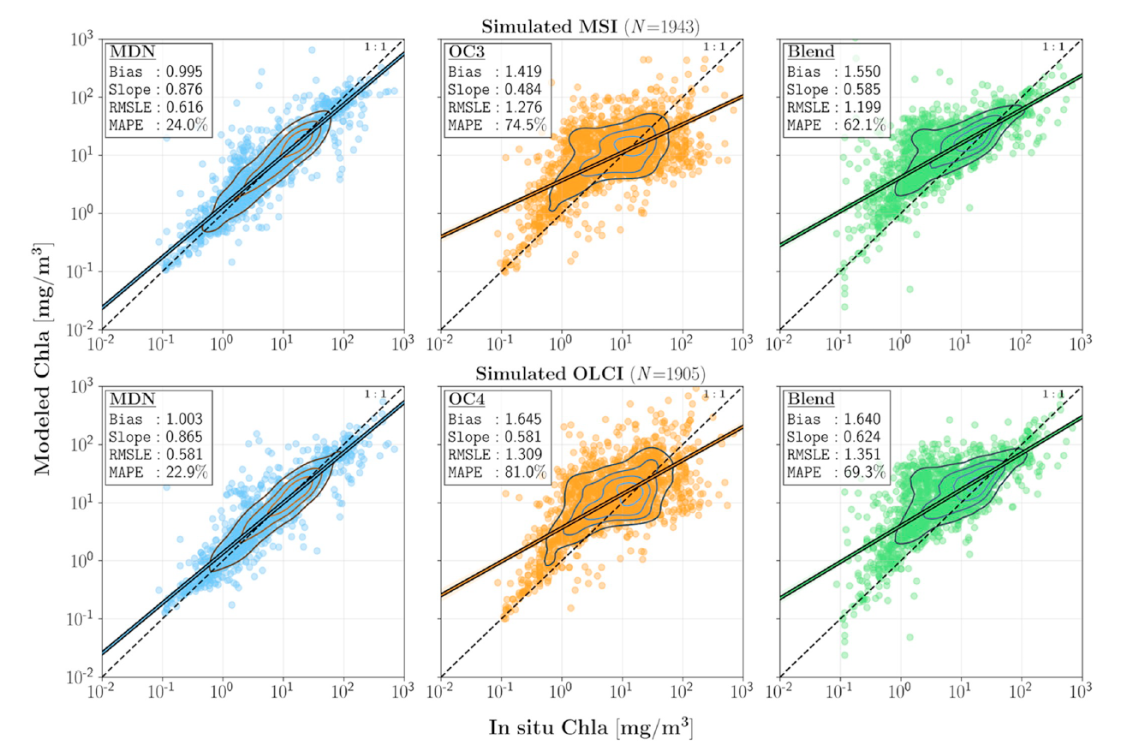
Product Developments
Universal algorithms (through a community-wide data sharing activity)
Chlorophyll-a retrievals for Sentinel-2/3 (MDN)
TSS/SPM/TSM retrievals (SOLID)
N ~ 2700
Pahlevan et. al. (2020). Seamless retrievals of chlorophyll-a from Sentinel-2 (MSI) and Sentinel-3 (OLCI) in inland and coastal waters: A machine-learning approach. Remote Sensing of Environment, 240, 111604. source code: https://github.com/BrandonSmithJ/MDN
Balasubramanian, et. al.. (2020). Robust Algorithm for Estimating Total Suspended Solids (TSS) in Inland and Nearshore Coastal Waters. Remote Sensing of Environment, 111768. source code: https://github.com/BrandonSmithJ/MDN/tree/master/Benchmarks/tss/SOLID

Slide 3
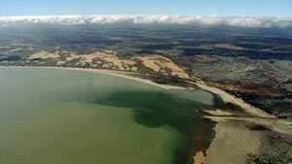
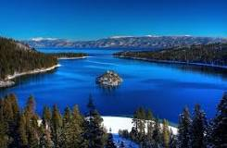
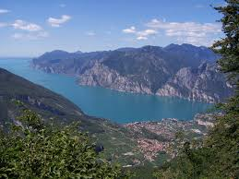
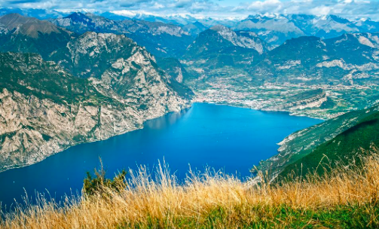
ACIX-Aqua: Objective
ACIX-Aqua
Provide guidance for global production of aquatic science products from Landsat (OLI) /Sentinel-2 (MSI) missions
Identify strengths/weaknesses of atmospheric correction (AC) processors
Inform users/agencies of the performances

Slide 4
ACIX-Aqua
ACIX-Aqua: General Info
8
15
Dec 2019
500
+ 700
Processing Team:
from various Space Agencies, R&D Companies,
Research Institutes
and Universities
Data Team:
AERONET-OC data (Phase I)
+ Freshwater data (Phase II)
# of valid matchups
with Sentinel-2A/B, and Landsat-8
Initial report
Work in progress to publish the results

Slide 5
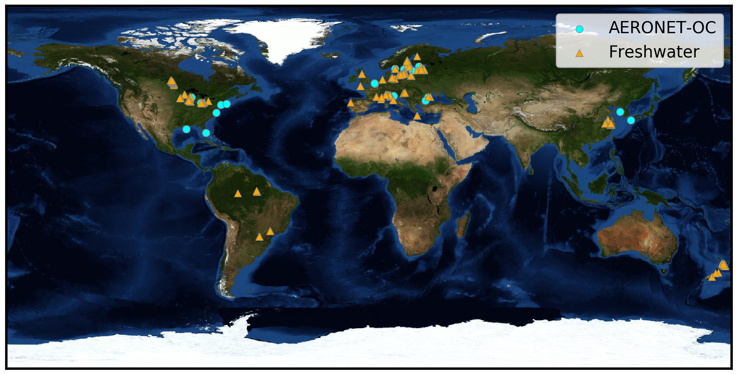
Matchups (geographic distribution)

Slide 6
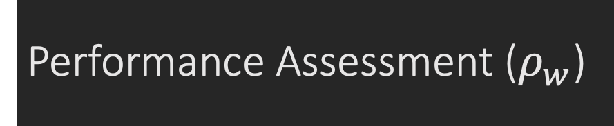
Performance Assessment ($ρ_{w}$)
OLI & MSI combined

Slide 7
Performance Assessment ($ρ_{w}$)
MSI data

Slide 8

How ${∆ρ}_{w}$Propagates to Products?
Sample products
Chlorophyll-a (Chla) & Total Suspended Solids (TSS)
Two possible approaches
Quantitative: use common matchups (n ~ 140) among AC processors
Qualitative: use in situ radiometric spectra to generate pseudo Chla and TSS measurements. The estimated Error and Bias metrics are therefore denoted by {Error} and {Bias}

Slide 9
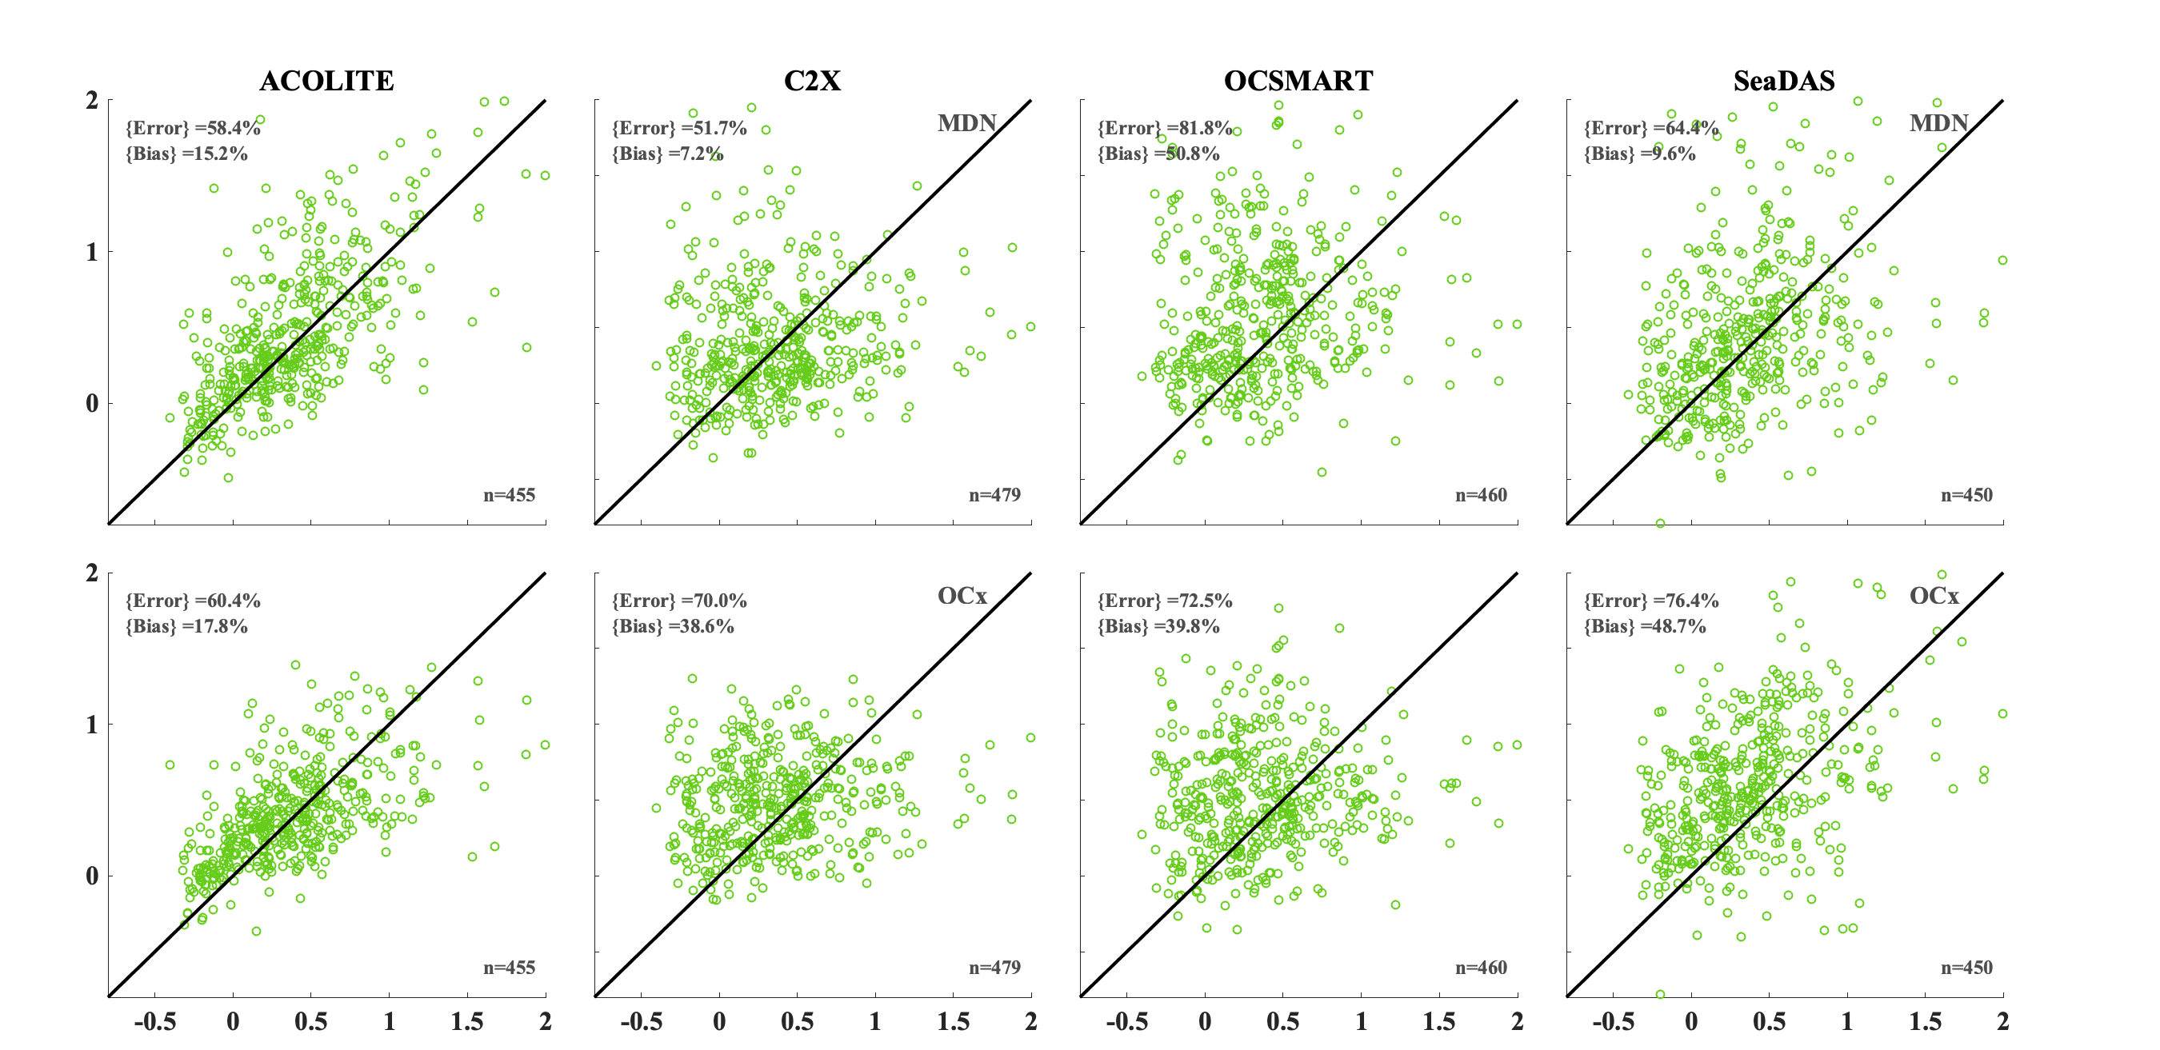
Impacts on Downstream Products: OLI-derived Chla (Freshwater)
Satellite retrievals [mg/m³] (log scale)
Pseudo Chla [mg/m³] (log scale)
Pseudo products are derived from the MDN model:
Pahlevan et. al. (2020). Seamless retrievals of chlorophyll-a from Sentinel-2 (MSI) and Sentinel-3 (OLCI) in inland and coastal waters: A machine-learning approach. Remote Sensing of Environment, 240, 111604.

Slide 10
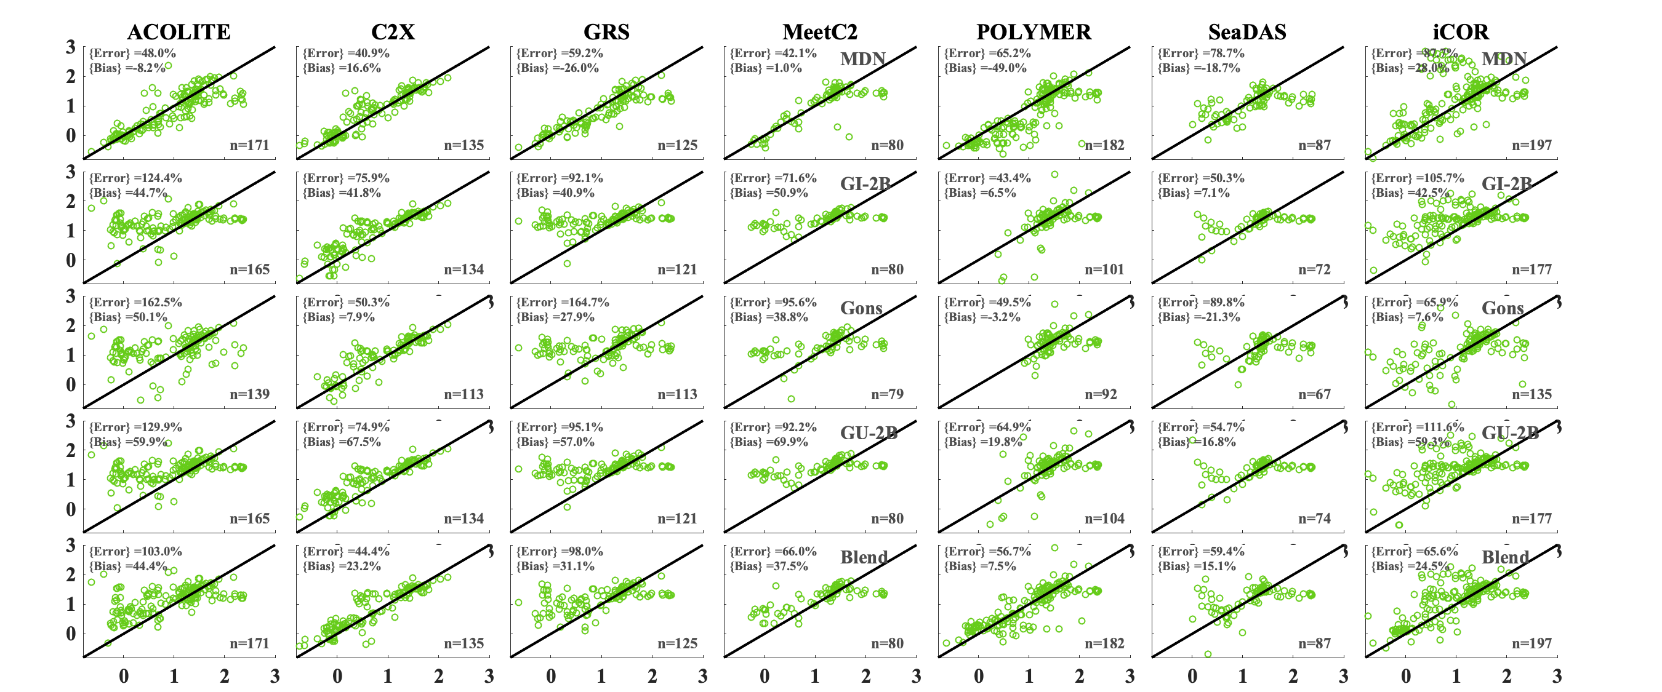
Impacts on Downstream Products: MSI-derived Chla (Freshwater)
Satellite retrievals [mg/m³]
Pseudo products are derived from the MDN model:
Pahlevan et. al. (2020). Seamless retrievals of chlorophyll-a from Sentinel-2 (MSI) and Sentinel-3 (OLCI) in inland and coastal waters: A machine-learning approach. Remote Sensing of Environment, 240, 111604.
Pseudo Chla [mg/m³]

Slide 11
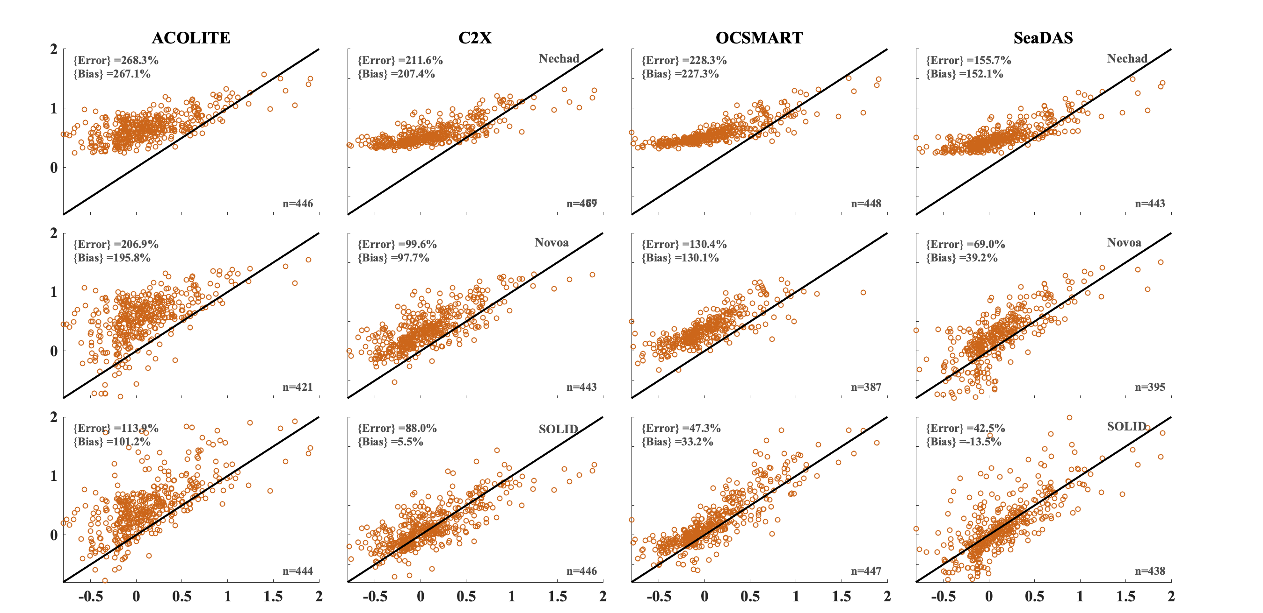
Impacts on Downstream Products: OLI-derived TSS (AERONET-OC)
Satellite retrievals [g/m³]
Pseudo TSS [g/m³]
Pseudo products are derived from the SOLID model:
Balasubramanian, et. al.. (2020). Robust Algorithm for Estimating Total Suspended Solids (TSS) in Inland and Nearshore Coastal Waters. Remote Sensing of Environment, 111768.

Slide 12
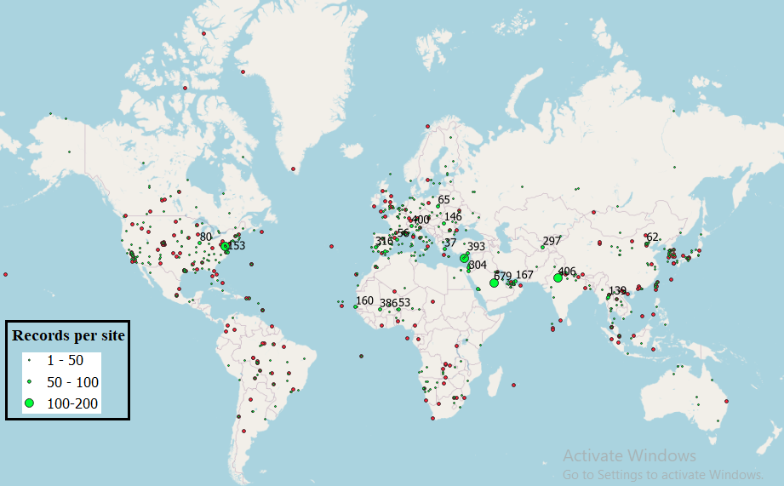
Conclusion
ACIX-Aqua
With 20-30% uncertainties in $ρ_{w}(470<λ<800 nm)$, estimated uncertainties in Chla and TSS products are 40-70%
Possible pathways forward
Machine-learning models are promising
Incorporate more representative (land) aerosol models

Slide 13










Partner Institutions
Krista Alikas (Tartu Observatory; Estonia)
Caren Binding (ECCC; Canada)
Ronghua Ma (NIGLAS; China)
Daniela Gurlin (Wisconsin DNR)
Wesley Moses (NRL)
Moritz Lehmann (U of Waikato, New Zealand)
Nguyen Ha (VNU; Vietnam)
Hubert Loisel (ULCO, LOG, France)
Mike Ondrusek (NOAA, MD)
John Schalles (U Creighton, NE)
Leif Olmanson (U Minnesota, MN)
Korean Institute of Ocean Science and Technology (KIOST)
Bunkei Matsushita (University of Tsukuba, Japan)
Cedric Fichot (Boston U, MA)
David O’Donnell (UFI, NY)
Steve Ruberg (NOAA GLER, MI)
Lin Li (Indiana U - IUPUI)
Tristan Harmel (GE, France)
Yannick Huot (U Sherbrooke, Canada)
Evangelos Spyrakos (U of Stirling; U.K.)
Steef Peters (Water Insight; Netherlands)
Mark Warren (Plymouth Marine Laboratory, U.K.)
Claudia Giardino (CNR, Italy)
NASA PIs (SeaBASS)

Slide 14
Backup

Slide 15
Data Team
Krista Alikas (U Tartu; Estonia)
Claudio Barbosa/Lino Augusto (Brazil)
Caren Binding (ECCC; Canada)
Ronghua Ma (NIGLAS;China)
Claudia Giardino / Mariano Bresciani (CNR; Italy)
Daniela Gurlin (Wisconsin DNR)
Yannick Huot/Simon Bélanger (Canada)
Moritz Lehmann (U of Waikato; New Zealand)
Nguyen Ha (VNU; Vietnam)
Tristan Harmel (Géosciences Environnement Toulouse)
Leif Olmanson (U of Minnesota; U.S.)
Natascha Oppelt (U of Kiel; Germany)
Steef Peters (Water Insight; Netherlands)
Evangelos Spyrakos (U of Stirling; U.K.)
Mark Warren (Plymouth Marine Laboratory, U.K.)
Processing Team (AC processor)
Quinten Vanhellemont (ACOLITE)
Kerstin Stelzer (C2X)
Tristan Harmel (GRS)
Antoine Mangin (MeetC2)
Yongzhen Fan (OCSMART)
François Steinmetz (POLYMER)
Nima Pahlevan (SeaDAS)
Sindy Streckx (iCOR)
ACIX-Aqua
Support Team
Sundarabalan Balasubramanian (NASA GSFC Team)
Christophe Bevy (ESA /ACRI Team)

Slide 16
ACIX-Aqua
CONCLUSIONS
Although some of the processors suggest promising results, they appear to yield inaccurate aquatic reflectance products ( > 20%) when robust retrievals across VNIR bands are desired
Research efforts for improving the performances are encouraged
Improvements will be made given lessons learned via ACIX-Aqua
SUGGESTIONS
Teams should highlight strengths of their processors.
Teams should evaluate dependency on geometry, environmental conditions, adjacent land, etc.
Current assessment is preliminary, and feedback is sought for improving the analysis.
DISCUSSION
Can we reach a consensus on uncertainty requirements by evaluating the corresponding impacts on downstream products?

Slide 17
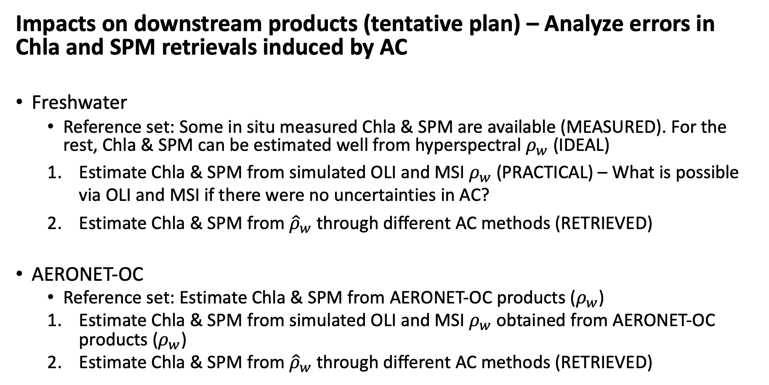
ACIX-Aqua
Impacts on downstream products (tentative plan) – Analyze errors in Chla and SPM retrievals induced by AC
Freshwater
Reference set: Some in situ measured Chla & SPM are available (MEASURED). For the rest, Chla & SPM can be estimated well from hyperspectral $ρ_{w}$ (IDEAL)
Estimate Chla & SPM from simulated OLI and MSI $ρ_{w}$ (PRACTICAL) – What is possible via OLI and MSI if there were no uncertainties in AC?
Estimate Chla & SPM from ${\hat{ρ}}_{w}$ through different AC methods (RETRIEVED)
AERONET-OC
Reference set: Estimate Chla & SPM from AERONET-OC products ($ρ_{w}$)
Estimate Chla & SPM from simulated OLI and MSI $ρ_{w}$ obtained from AERONET-OC products ($ρ_{w}$)
Estimate Chla & SPM from ${\hat{ρ}}_{w}$ through different AC methods (RETRIEVED)

Slide 18
ACIX-Aqua
Questions?
Submission to CTEP AERONET-OC
Phase I
Inter-comparison Analysis
2nd ACIX workshop
Report (MS 1)
Submission to Scientific Journal
Oct 2018
March 2019
May 2019
Sep 2019
Nov 2019
Dec 2019
May 2020
Sep 2020
Start
1st ACIX II-CMIX workshop
Product Extraction
Results Submission
Initial
Report Release 2nd ACIX workshop
Report (MS 2)??
Submission to Scientific Journal
Submission to CTEP Phase II
Notes:
Teams with large databases or those expecting to collect more data early Spring can provide portions of their data until early June next year.
Living Planet Symposium 2019 (May).

