Slide 1

Portable Remote Imaging Spectrometer (PRISM)
P. Mouroulis, B. Van Gorp, R. O. Green
Jet Propulsion Laboratory
California Institute of Technology

Slide 2
The PRISM Team
Pantazis (Zakos) Mouroulis: PI, optics
Byron Van Gorp: System engineer & mechanics
Robert O. Green: Calibration, radiative transfer
Daniel Wilson: Diffraction grating
Instrument team
K. Balasubramanian, David Cohen, Michael Eastwood, Brian Franklin, Linley Kroll, Scott Leland, Frank Loya, Alan Mazer, Ian McCubbin, Doug Moore, Scott Nolte, Otto Polanco, David Randall, Brandon Richardson, Jose Rodriguez, Chuck Sarture, Eugenio Urquiza, Rudy Vargas, Victor White, Karl Yee
Heidi Dierssen (UConn): Science lead
Bo-Cai Gao (NRL): Atmospheric correction algorithm
Joe Boardman (AIG): Orthorectification, geolocation
Science team

Slide 3
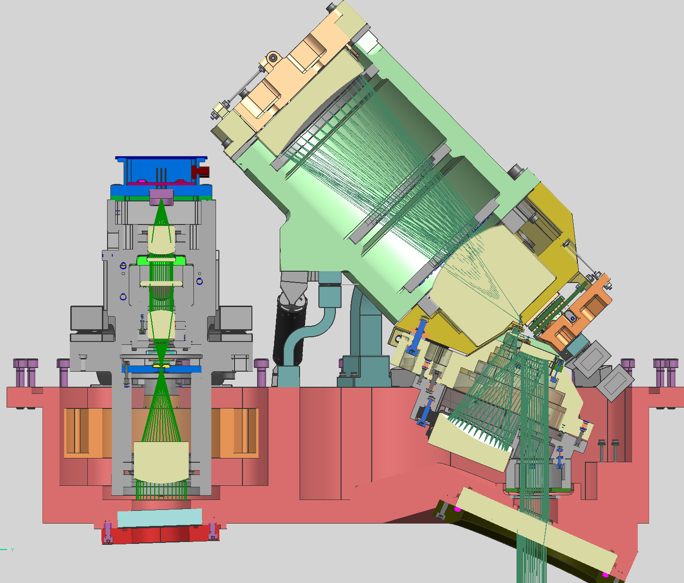
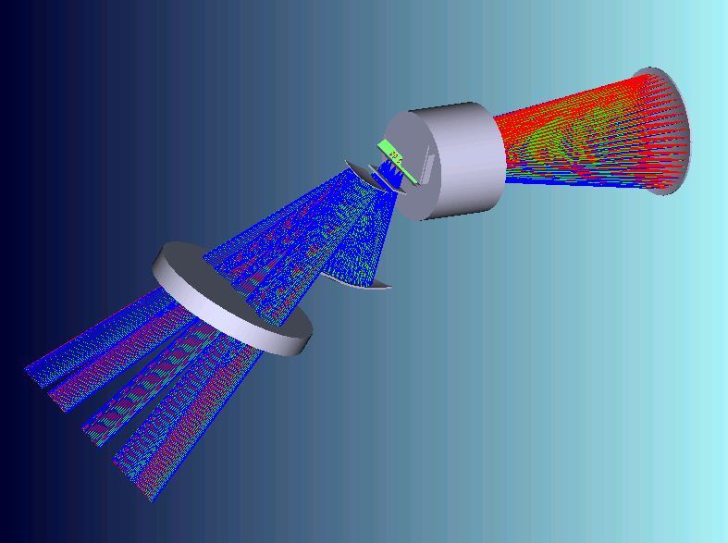
PRISM schematic
2-channel SWIR radiometer
spectrometer
vacuum enclosure
baseplate
telescope

Slide 4
Spectrometer parameters
Spectral | Range | 350-1050 nm
 | Sampling | 2.85 nm
 | Resolution (FWHM) | 3.5 nm
 | Calibration uncertainty | < 0.1nm
Spatial | Field of view | 31.7º
 | Instantaneous FOV sampling | 0.882 mrad
 | IFOV resolution (FWHM) | 0.97 mrad
 | Cross-track spatial pixels | 608
 | Ground resolution | 0.35 – 20 m
Radiometric | Range | 0 to max. beach R
 | Sampling | 14 bit
 | Stability | >99%
 | Calibration uncertainty | <2%
 | SNR | 2000 @450 nm*
 | Polarization variation: | < 1%
Uniformity | Spectral cross-track uniformity | >95%
 | Spectral IFOV mixing uniformity | >93%
* At AVIRIS equivalent integration time and spectral sampling Values in red are measured

Slide 5
SWIR channel parameters
Parameter | Channel 1 | Channel 2
Channel center (nm) | 1240* | 1610*
Bandwidth (nm) | 20* | 60*
FOV (mrad, FWHM) | 2.4 | 2.4
Boresight knowledge (mrad, relative to spectr.) | 0.05 | 0.05
Radiometric stability | 99% | 99%
SNR (@4.3 μW/cm² sr) | 300* | 100*
* Tentative values, SWIR characterization not completed.

Slide 6
PRISM integrates new technologies and design techniques to achieve performance
Performance metric | System parameter | Enabling technology
SNR | Throughput (F/No=1.8) | Dyson spectrometer and two-mirror telescope design
Dynamic range | Readout rate (176 Hz) | Teledyne HyViSI detector and JPL readout electronics
Polarization insensitivity | Angles of incidence, grating response | Optical design, grating groove design, coatings
Uniformity | Optical prescription | Dyson design, concave grating, lithographic slit
Stray light suppression | Optical surfaces, slit, grating | Coating and filter design, black Si slit, low scatter grating
Calibration stability | Operating temperature (~22º C), vibration response | Optomechanical design, detector mount, athermalization

Slide 7
PRISM spectral characteristics: spectral response functions
350-450 nm
650-750 nm
950-1050 nm

Slide 8
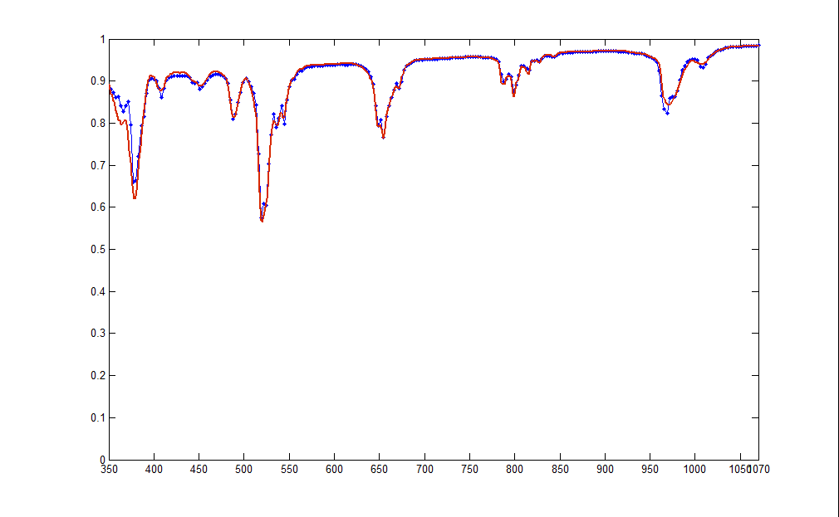
Test spectrum extraction
Spectrum of Er-doped spectralon panel received through PRISM (blue curve) and through reference ASD spectrometer (red curve).

Slide 9
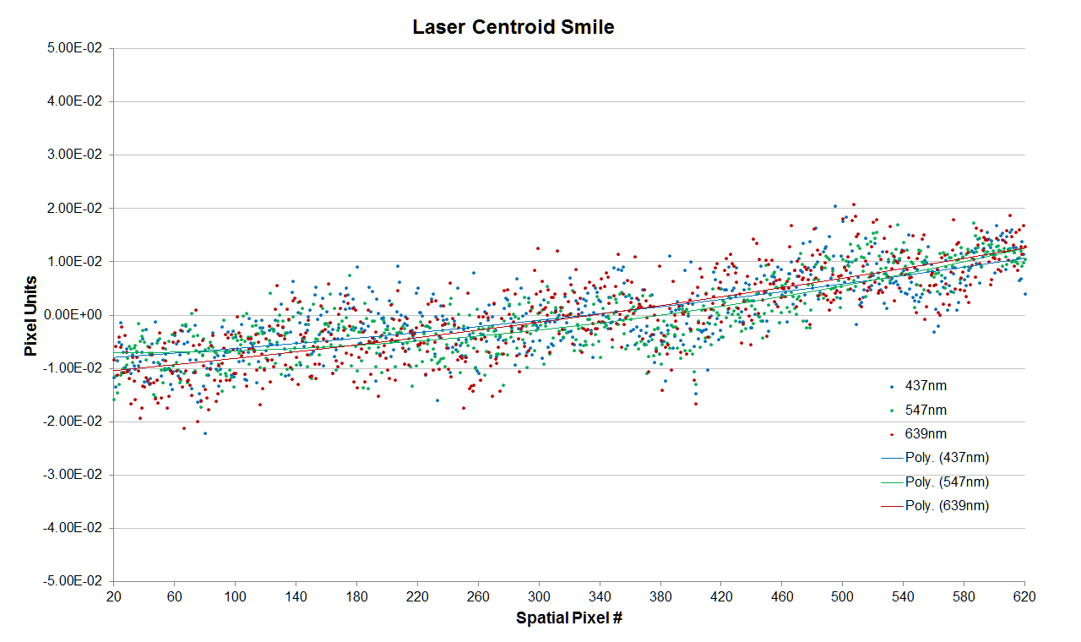
Spectral uniformity
Scatter plot of spectral channel centroids as a function of spatial location for three isolated wavelengths (Hg lamp 437 nm and 547 nm, and laser at 639 nm).

Slide 10
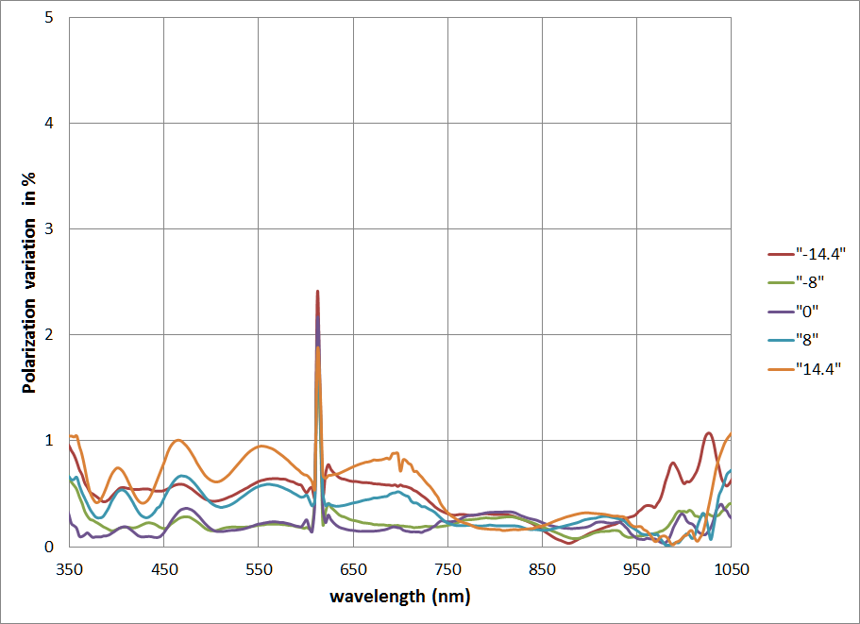
Polarization characteristics
Polarization variation throughout the spectral range for five positions spanning the field of view.
Variation = (I_{max}– I_{min})/(I_{max}+ I_{min})*100

Slide 11
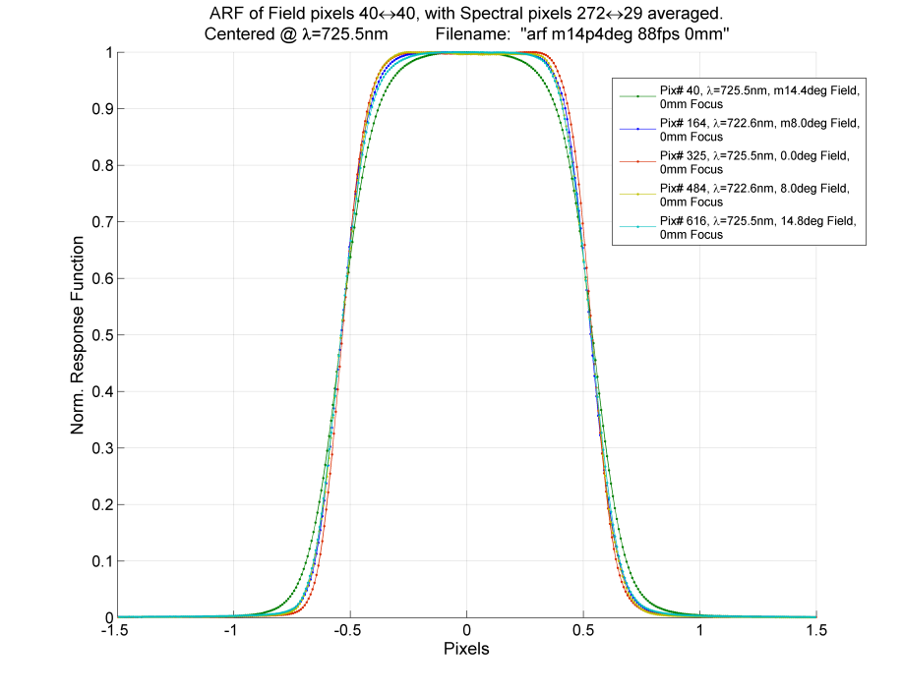
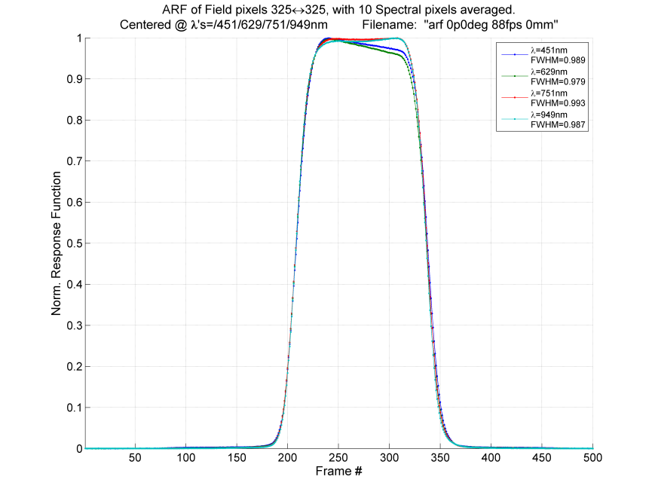
Spatial characteristics: Along-track response
Along-track spatial response functions (without flight motion blur) for all field positions.
Example along-track spatial response functions (without flight motion blur) for four wavelengths spanning the PRISM spectral range at a single field position.
FWHM =~1.1 pixel

Slide 12
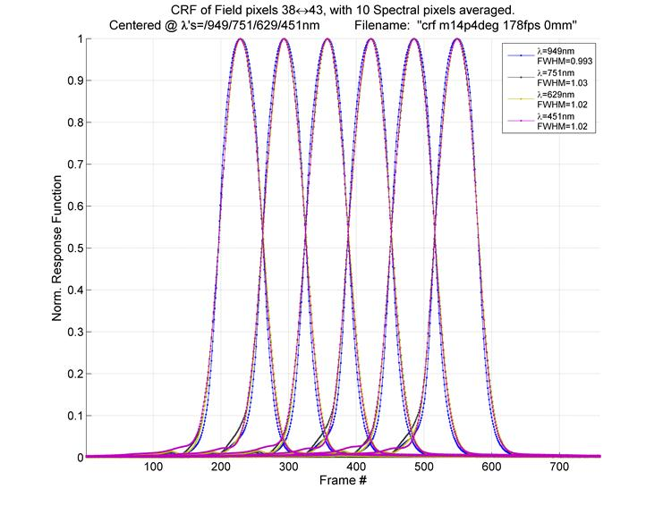
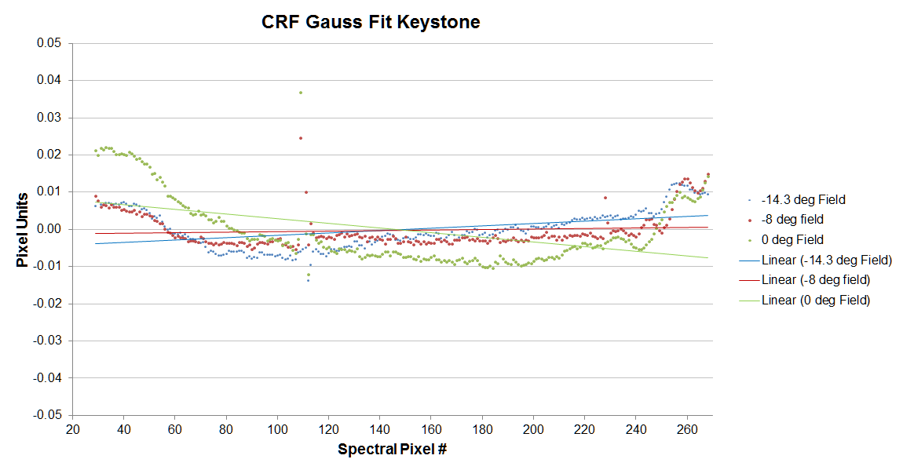
Spatial characteristics: Cross-track response
Example cross-track spatial response functions for four wavelengths spanning the PRISM spectral range at a single field position.
FWHM resolution =~1.05 pixel
Spatial/spectral IFOV mixing

Slide 13
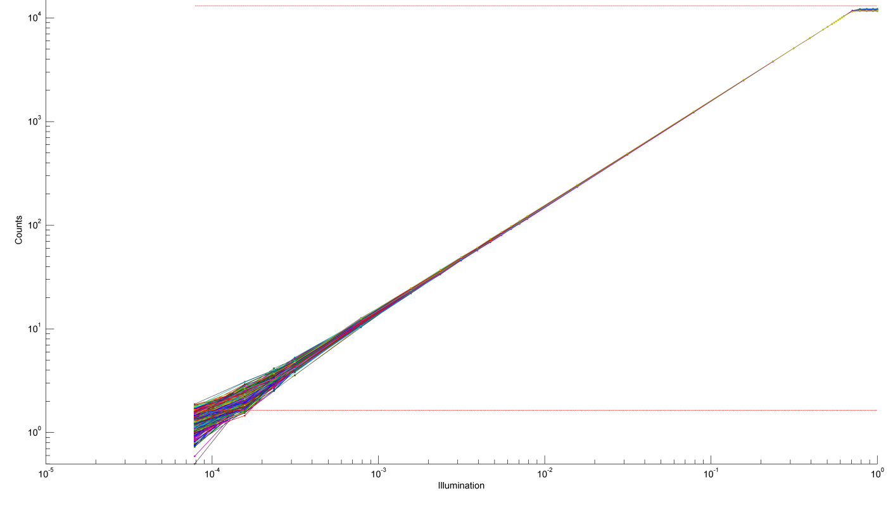
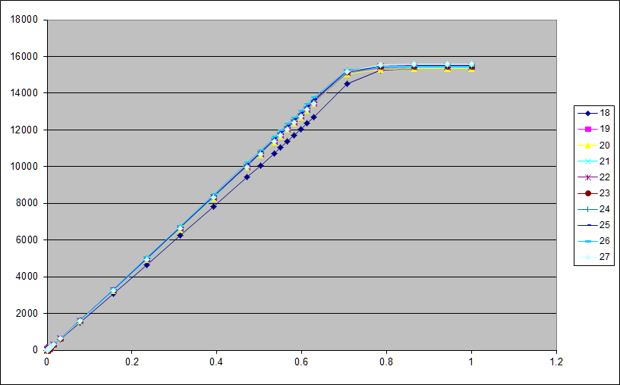
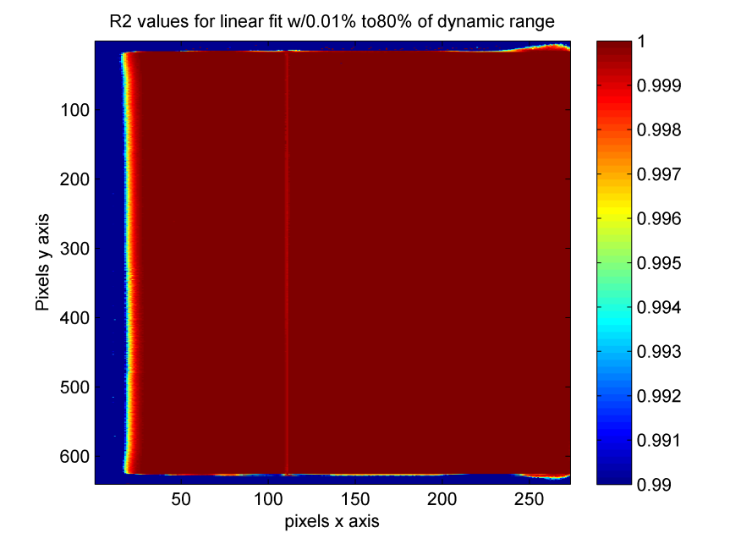
Radiometric characteristics: Linearity
Log scale
Linear scale
R² values for linear fit 0-80% of range

Slide 14
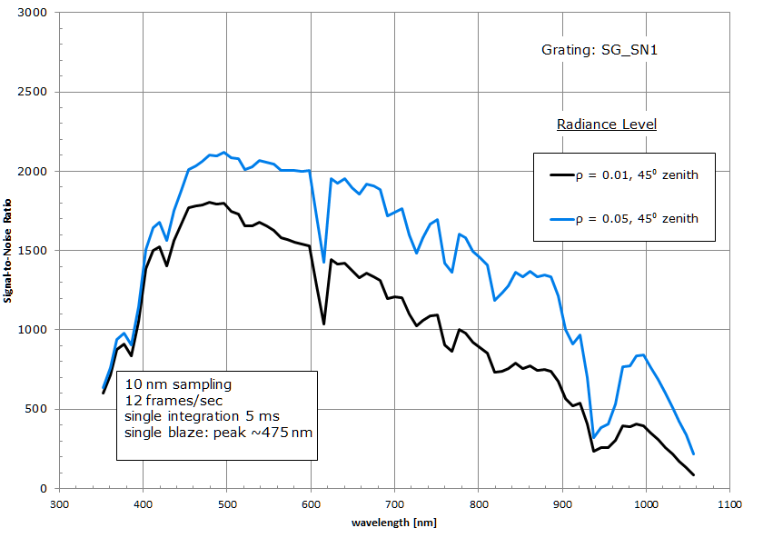
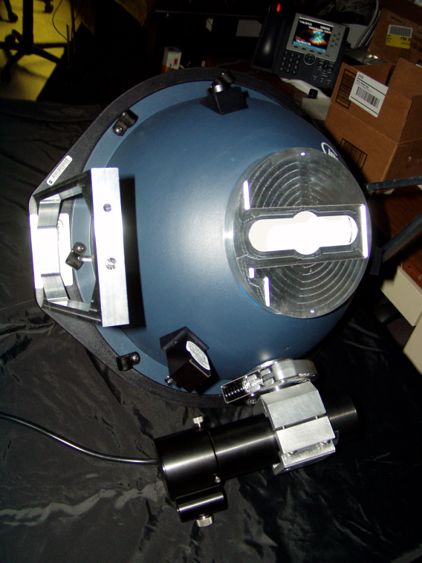
Predicted flight SNR based on lab calibration
Integrating sphere for spectral and radiometric field calibration
Predicted in-flight PRISM SNR incorporating measured data from known radiance of NIST-traceable lamp illuminated spectralon panel.

Slide 15
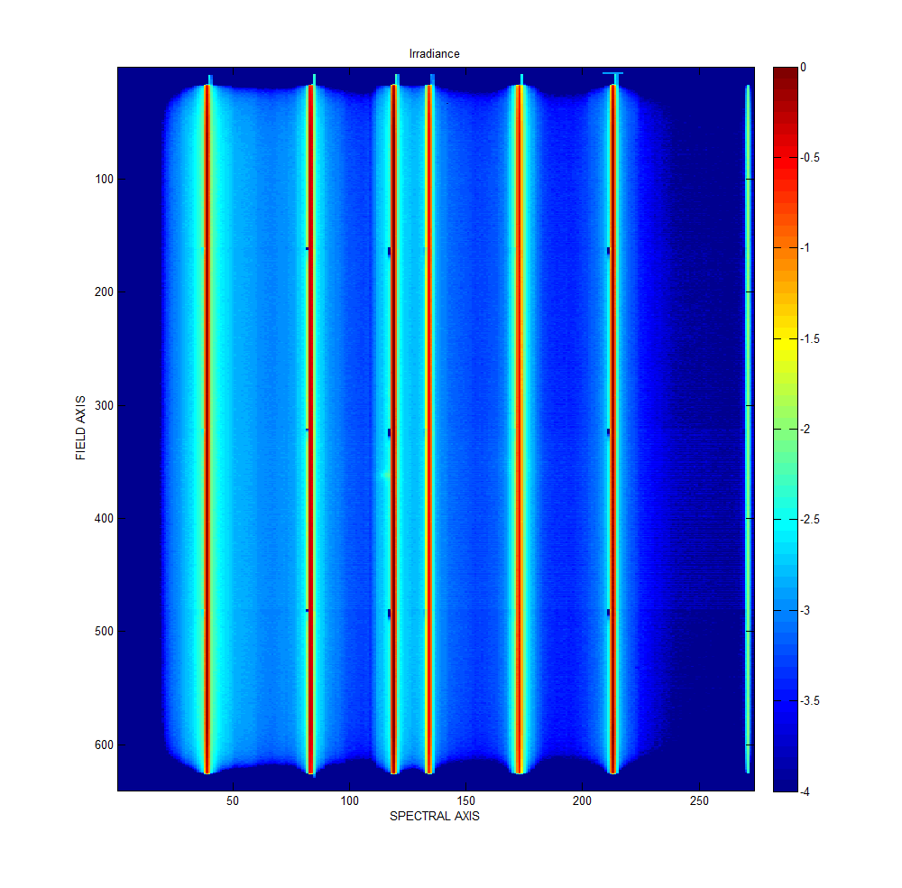
Stray light assessment
Image of several laser lines covering the entire field of view.
(image taken at room temperature, small residual imperfections disappear at operating temperature)
Order-sorting filter seam location

Slide 16
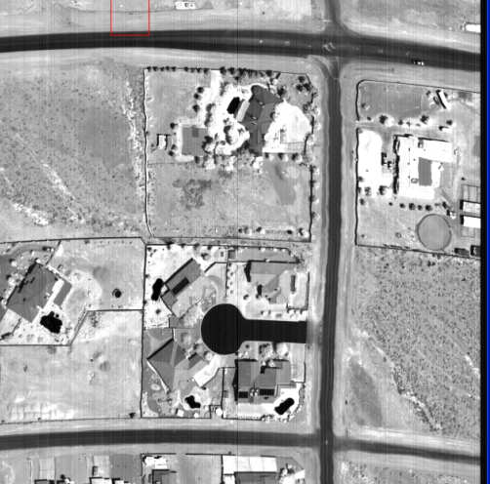
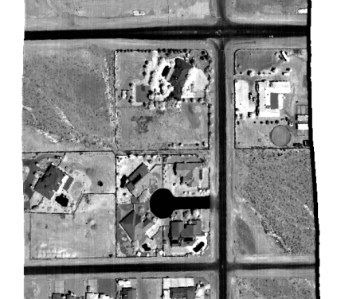
Slit curvature projected on ground (corrected in post-processing)
Agrees well with theoretical prediction of 0.82º
Example orthorectification with camera model
raw corrected

Slide 17
SWIR geometry and spatial characteristics
Boresight alignment of SWIR radiometer (blue) and spectrometer (red)
Cross-track, spectrometer channels 321-323
Along-track, without motion blur

Slide 18
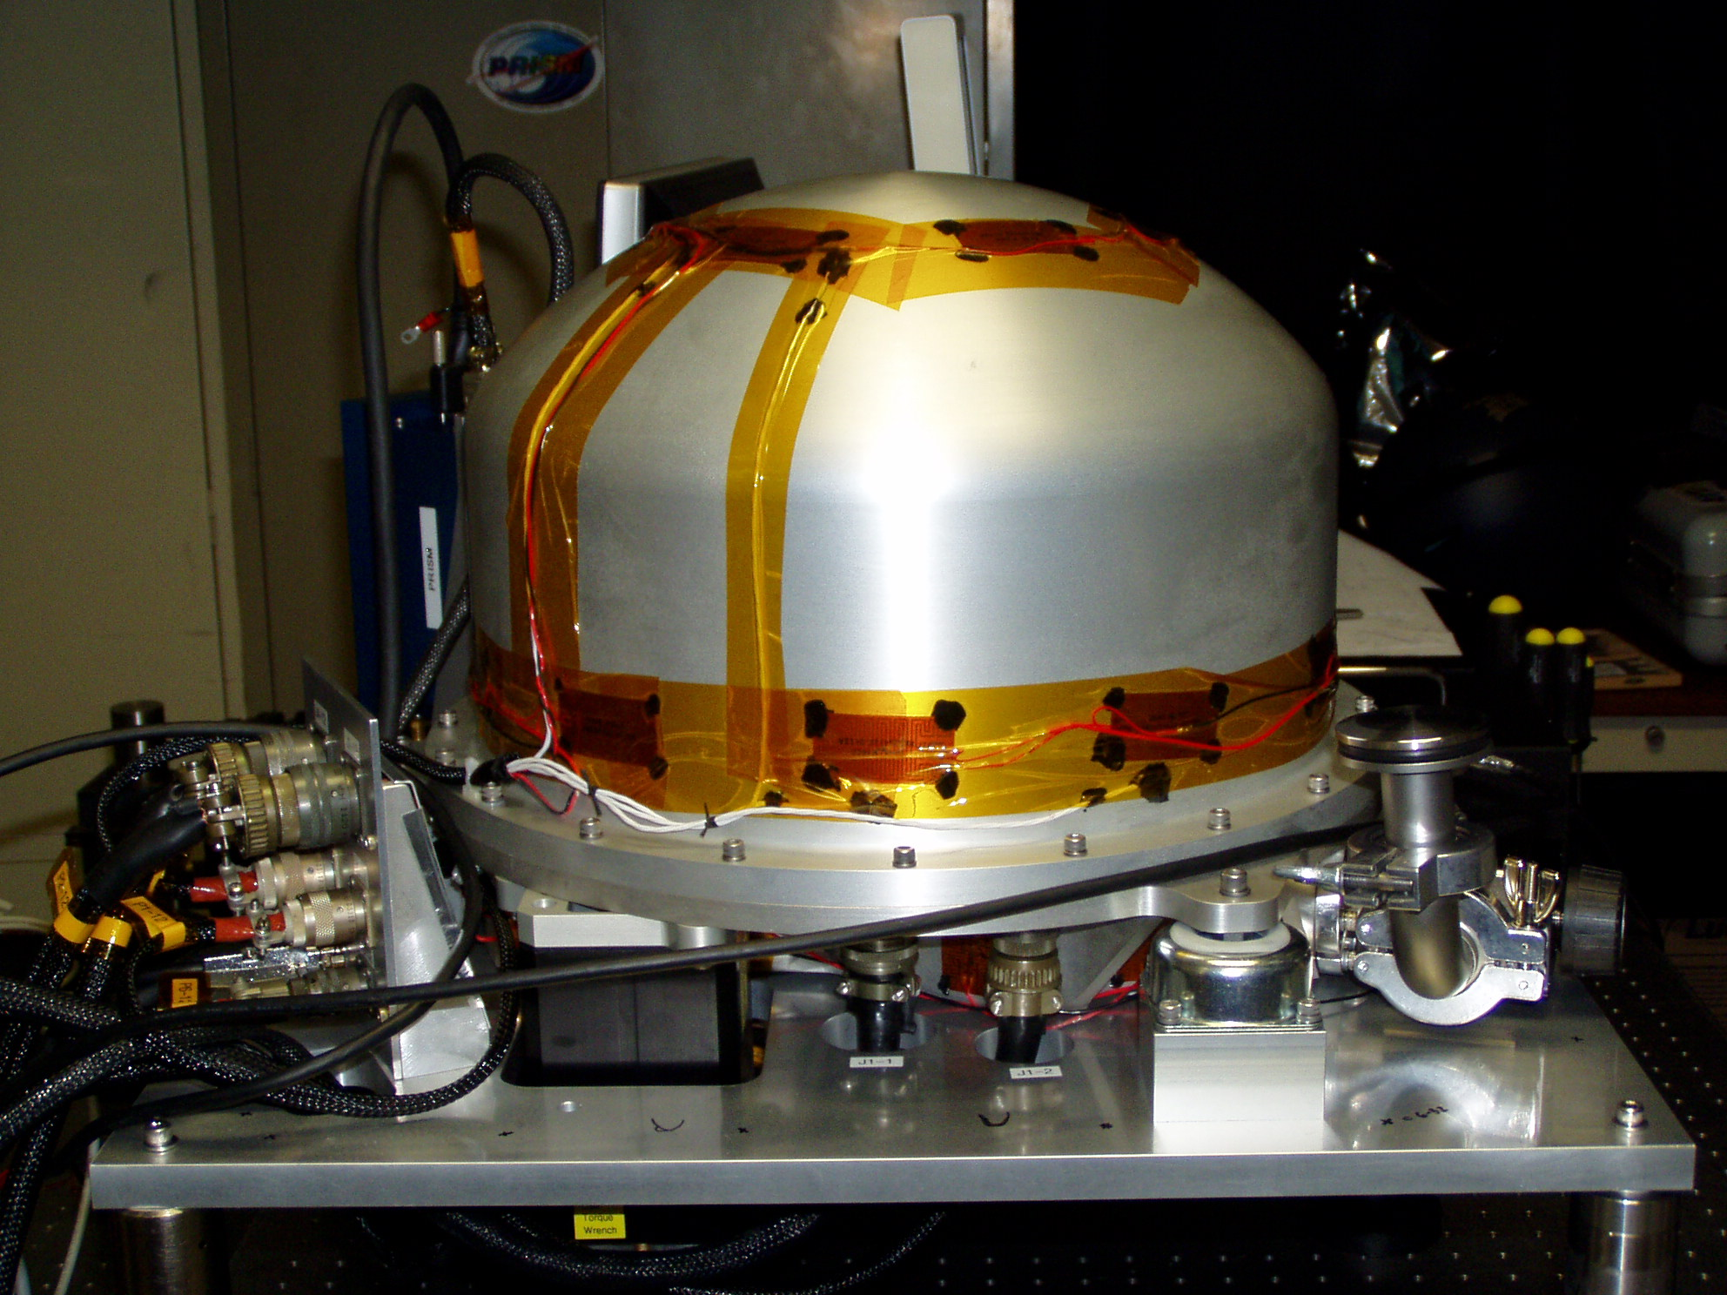
SENSOR HEAD AND AIRCRAFT MOUNTING PLATE
Detector electronics
Heater strips
Vibration isolators
Aircraft mounting plate
22”
Connector plate
INS/GPS unit

Slide 19
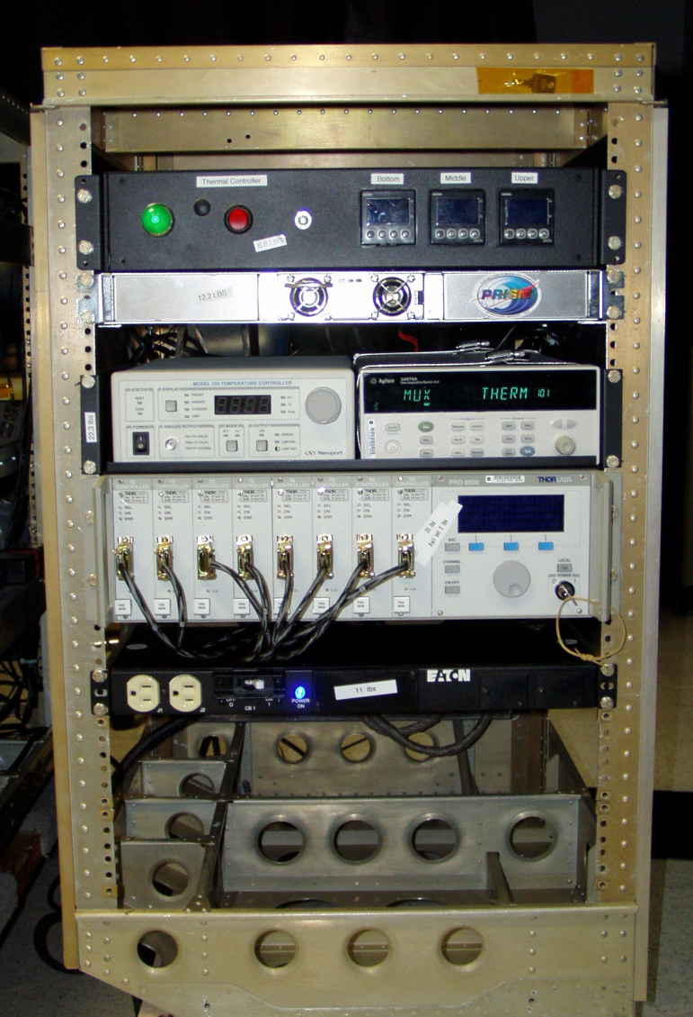
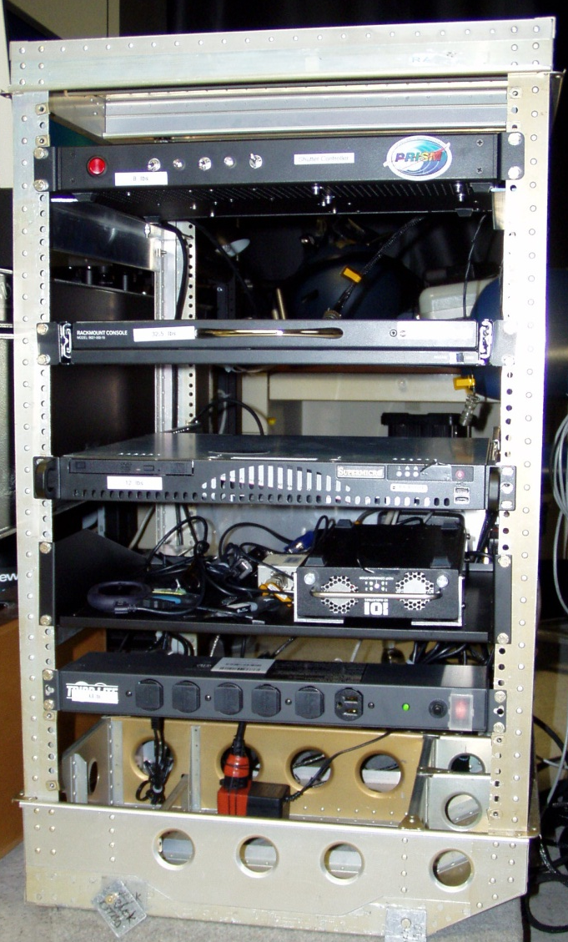
ELECTRONICS
Shutter control
External heater control
External heater PS
Keyboard & monitor
Housekeepingdata logging
Computer
Internal thermal control
Data recorder
Operator rack
Control rack

Slide 20
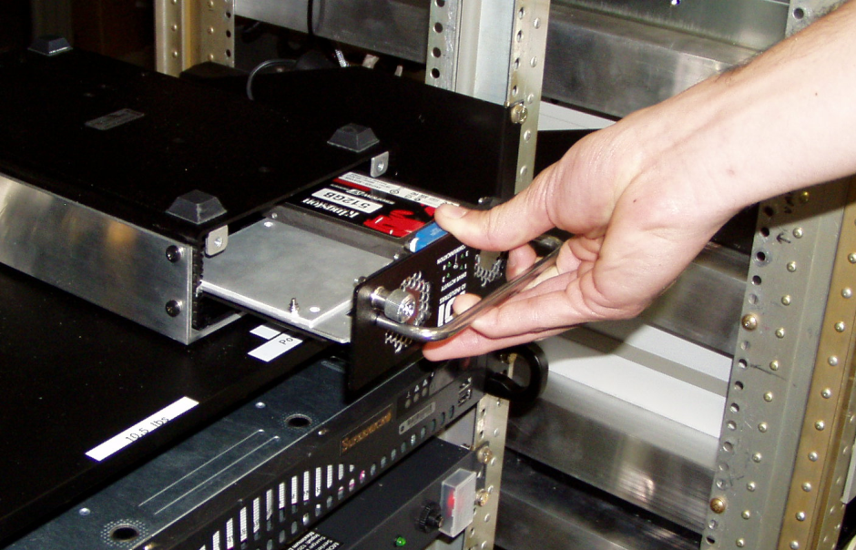
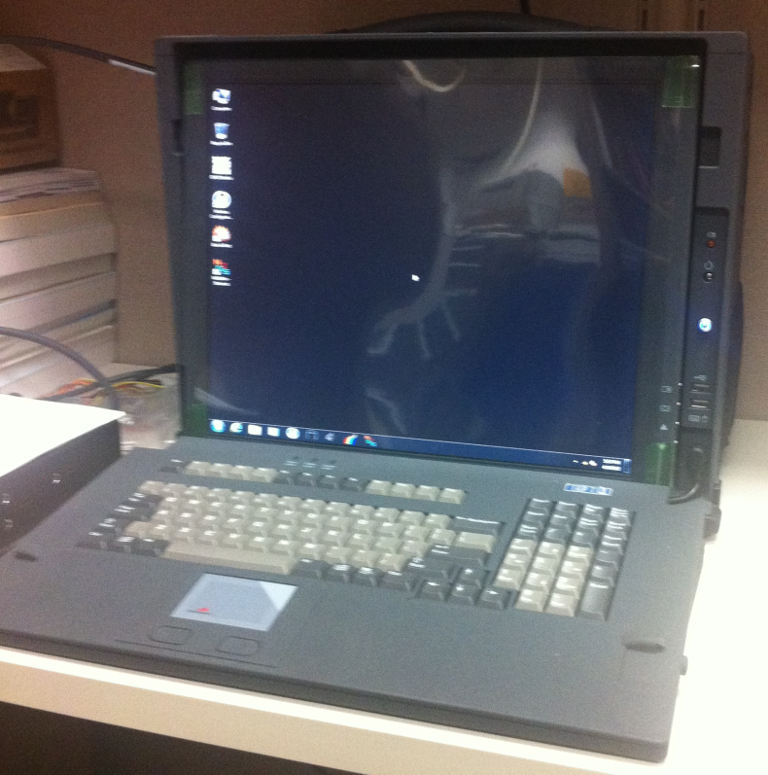
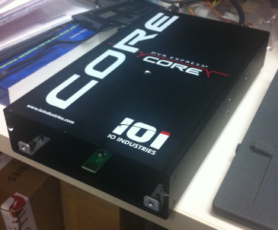
RAPID DATA TRANSFER
Remove drive
1.5TB portable solid state drive (3x512 GB)
Insert into download module
Read into portable computer
“Hotel kit” allows downloading speed equal to or slightly faster than recording speed, giving same day data access to investigators (4-lane SATA to RAID array), 4-5x faster than download speed to typical computer hard drive.

Slide 21
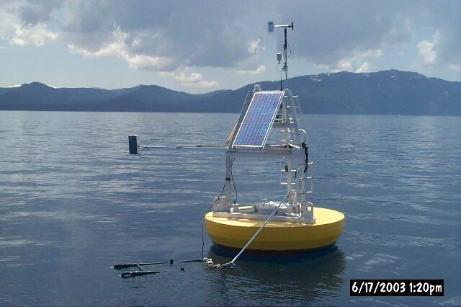
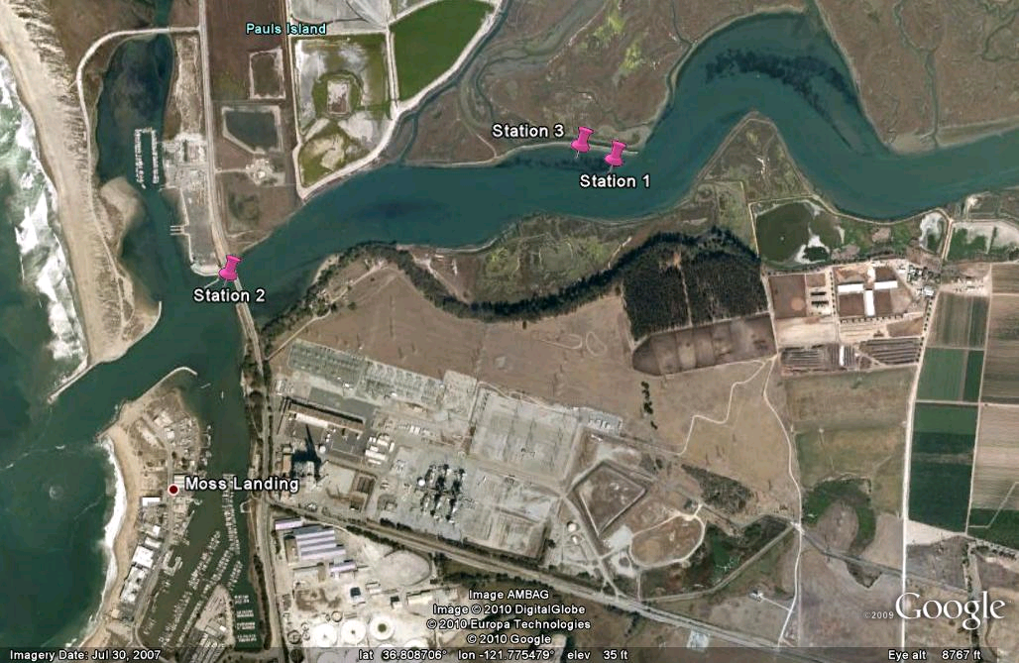
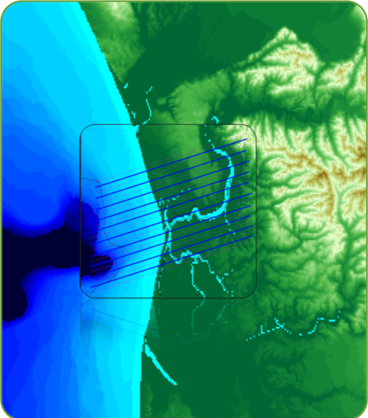
TEST FLIGHT SCHEDULE
Calibration/engineering flight May 2012:
  Ivanpah Playa (spatial properties, radiometry high-R targets)
  Lake Tahoe (low R water target)
From left to right, Ivanpah Playa calibration site marked with tarps, dark tile targets, portable solar radiometers.
Lake Tahoe buoy
First test/science flight July 2012:
  Monterey Bay/Elkhorn Slough: seagrass coastal habitat

