Slide 1

SeaBASS Updates, Spring 2020
OCRT Meeting
Chris Proctor, NASA GSFC / SSAI
Inia Soto Ramos, NASA GSFC / USRA
Recent SeaBASS staff changes
Checklists/Guidelines – new submission requirements
File extension update (.sb) & file naming recommendations
New metadata headers (/instrument_model, etc.)
Upcoming changes
https://seabass.gsfc.nasa.gov

Slide 2

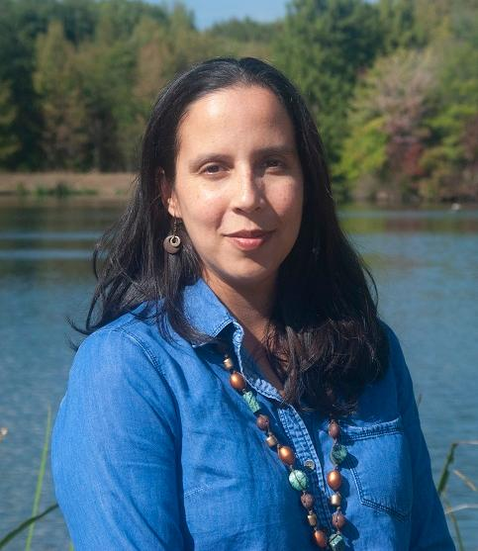

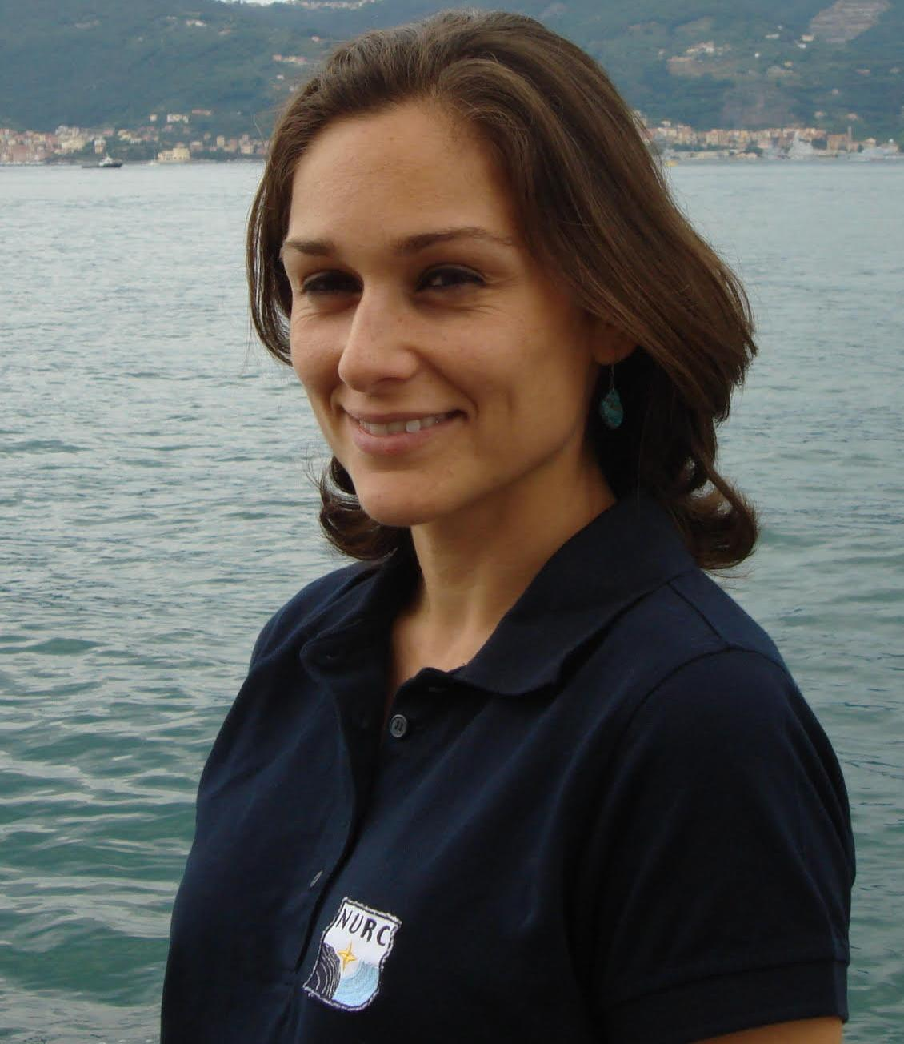
The SeaBASS Team
Chris Proctor
SeaBASS manager
Inia Soto Ramos
Data manager
David Norris
Developer
Violeta Sanjuan Calzado
NOMAD lead

Slide 3
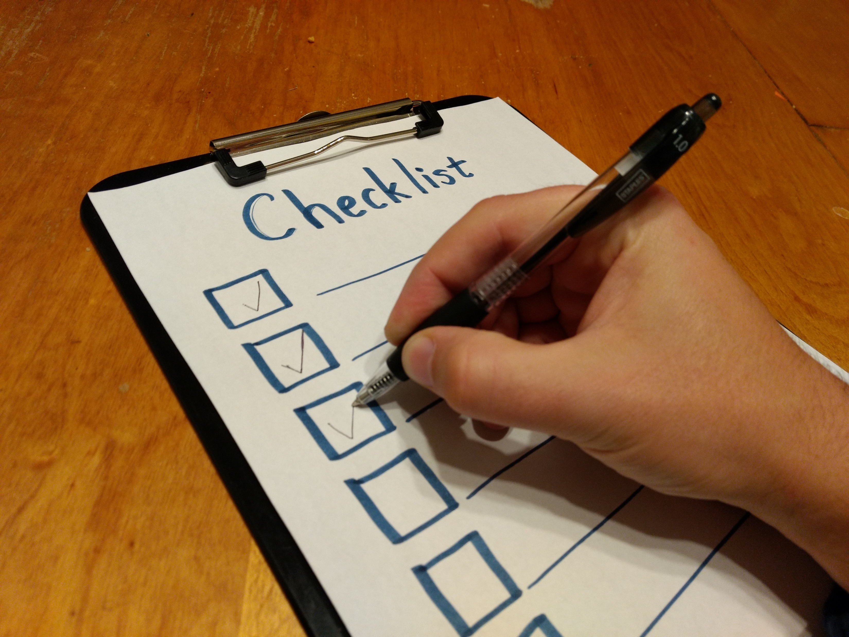
New: data submission special requirements
https://seabass.gsfc.nasa.gov/wiki/data_submission_special_requirements
Or find the link in the main menu, under “Contribute Data” -> “Documentation Guidelines”
For commonly submitted measurements:
1) Required Extra Documents – new checklists
2) Special Notes – reminders & tips
3) Example Submissions
Goals:
improve SeaBASS data quality & consistency
make quality easier to assess
clarify reporting requirements to reduce unnecessary back and forth during data submission process

Slide 4
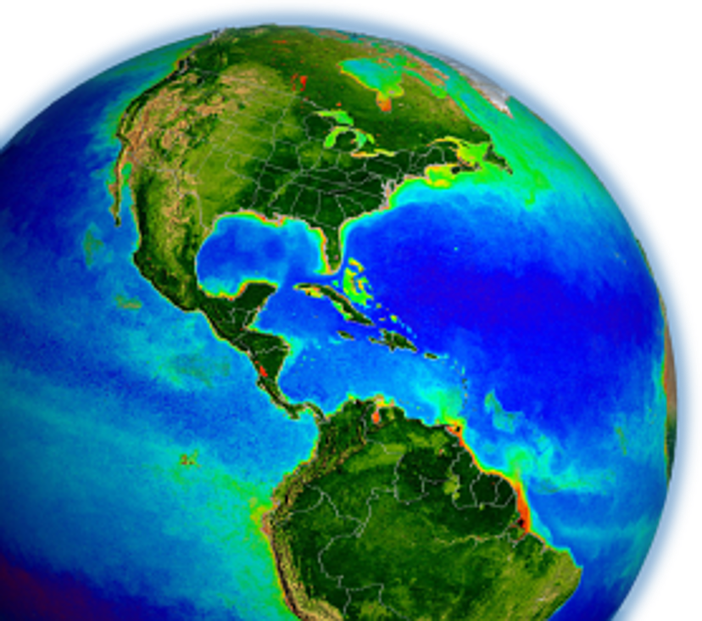
New submission requirements
New requirement: some SeaBASS submissions now require filling in a checklist
Checklists supplement open-ended documentation (or may replace it in some cases)
Why?
What goes in them?
How do I submit them?
Violeta Sanjuan Calzado is spearheading the development of a new algorithm development dataset (i.e., NOMAD) using SeaBASS datasets. With the need to add uncertainties, she has also been leading review of QC standards
Guidelines & Checklists were developed with Field Support Group from Ocean Biology Processing Group, leading community protocols

Slide 5
Current documents requirements
SeaBASS documentation requirements have always been open-ended since there is no one size-fits-all approach for reporting calibration details and data analysis
External documents fill in information that doesn’t easily fit into SeaBASS metadata headers
However, due to the open-ended format, everyone reports details differently, in a different order, and sometimes key details are skipped
Checklists standardize specific data types, making it easier and faster to assess dataset details and quality

Slide 6
Background, updated community protocols
New "Checklist" documents will help organize methods and processing details related to protocols best practices
Many community protocols have recently or are currently being updated:
Inherent Optical Property Measurements and Protocols: Absorption Coefficient (November 2018)
Beam Transmission and Attenuation Coefficients: Instruments, Characterization, Field Measurements and Data Analysis Protocols (April 2019)
Protocols for Satellite Ocean Color Data Validation: In situ Optical Radiometry (In Press)
Best Practices for the Collection and Processing of Ship-Based Underway Flow-Through Optical Data (In Press)
Measurement Protocol of Absorption by Chromophoric Dissolved Organic Matter (CDOM) and Other Dissolved Materials (DRAFT)
Noteworthy and Supplemental Topics on Ocean Colour Radiometry Protocols (DRAFT) (led by Sanjuan & Craig)

Slide 7
Requirements for PACE algorithm development
Updated checklists and reporting requirements come as a result of community updates on measurements protocols, as well as PACE mission requirements for validation, algorithm development, and NOMAD
Protocols updates need to be reflected in SeaBASS submissions
Tighter QA/QC in view of PACE cal/val and algorithm development
Will enable better dataset flagging for QC or special data characteristics (Search engine QC flagging, NOMAD datasets)
Uncertainty traceability on all validation products

Slide 8
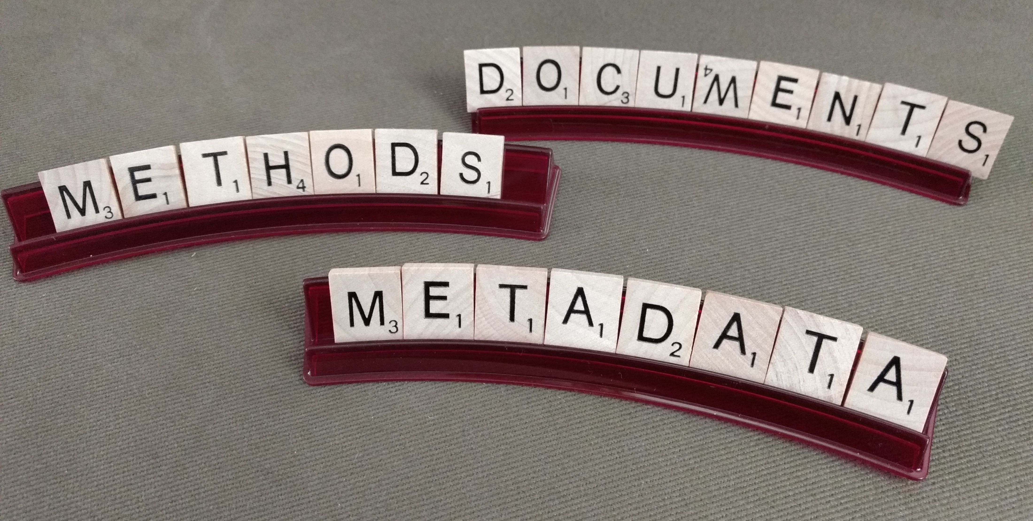
Documentation and metadata
What does a checklist look like?
They are tailored to specific measurements, but generally contain entries related to:
sample collection methods
measurement methods
data processing methods
Using HPLC as an example, measurement and analysis info sections are filled in by the NASA GSFC Lab. You just need to fill out the Sample collection method section:
Filter type/pore size:
Vacuum pressure:
Replicates collected (# or no):
Flash frozen in liquid nitrogen? (y/n):
Long-term storage conditions/temperature:

Slide 9
Data submission special requirements
How do I use these new checklists in my submission?
Visit the SeaBASS Data Submission Special Requirements page
See if your measurement type is listed
If so, check if its “required extra documents” section has a checklist to download
If so, fill it out the best you can
Add it to your other documentation and reference it in your /documents= metadata header
https://seabass.gsfc.nasa.gov/wiki/data_submission_special_requirements
Or find the link in the main menu, under “Contribute Data” -> “Documentation Guidelines”

Slide 10
Summary & Feedback
Please refer to SeaBASS website for detailed requirement on submission guidelines for each product
Enforced QA/QC is required for algorithm development within PACE for uncertainty estimates
Data collection and processing can account for significant error budget
SeaBASS requires full traceability of acquisition methods and data processing to ensure quality standards
Submission checklists/guidelines are open for feedback and suggestions from the community
seabass@seabass.gsfc.nasa.gov
https://seabass.gsfc.nasa.gov/wiki/data_submission_special_requirements
Notes:
Link seabass requirement submissions to IOCCG standards?

Slide 11
Special notes & example submissions
Special Notes & Example Submission sections includes guidance and reminders
Special Notes includes:
Reminders to provide measurement-specific metadata, e.g. for HPLC:
  /HPLC_lab=
  /HPLC_lab_technician=
Tips for reporting special measurement fields, e.g.
  syntax if reporting size-fractionation
  syntax if reporting below_detection_limit
  other relevant special fields
Example Submission includes:
Example data files and documentation in case you wish to model

Slide 12
".sb" file name extension
“.sb” is now the official SeaBASS file extension
SeaBASS files are simple ASCII text files. A text editor might suggest naming your file with .txt, .dat, .csv, etc. However, you can name it .sb when you create it, or rename it
Please name new files with .sb, or SeaBASS staff will rename them for you, and adjust the metadata header /data_file_name=
This ".sb" extension only applies to data files, not documentation or cal files
All historical files in the archive have been renamed to end in .sb

Slide 13
File naming recommendations
Filenames should be unique and informative
Bad example:
0001s004.sb
To build a better name, build a pattern incorporating extra information, such as Experiment, Cruise, Instrument, Platform, Date, etc.
Also, to indicate versioning, indicate the release number as the suffix "_R#"
Good example:
EXPORTS-EXPORTSNP_HPLC_process_20180814_R0.sb (preliminary)
EXPORTS-EXPORTSNP_HPLC_process_20180814_R1.sb (first release)
EXPORTS-EXPORTSNP_HPLC_process_20180814_R2.sb (revised data)

Slide 14
New optional metadata headers
Please provide the instrument and calibration information in your metadata headers when applicable:
/instrument_model
/instrument_manufacturer
/calibration_date
/begin_header
/investigators=John_Smith,Mary_Johnson
/affiliations=State_University
/contact=jsmith@state.edu
/experiment=EXAMPLE_A
/cruise=cal0101
/station=93
/data_file_name=EXAMPLE_cal0101_chl_200103_R1.sb
/documents=cal0101_readme.txt
/calibration_files=turner_cals_12.txt
/instrument_model=10AU_field_fluorometer
/instrument_manufacturer=turner_designs
/calibration_date=20010123
/data_type=pigment
/start_date=20010314
/end_date=20010314
/start_time=16:01:30[GMT]
/end_time=16:30:45[GMT]
/north_latitude=42.135[DEG]
/south_latitude=42.055[DEG]
/east_longitude=-72.375[DEG]
/west_longitude=-72.420[DEG]
! Comments
! Comment lines can include extra info
/missing=-9999
/below_detection_limit=-8888
/delimiter=comma
/fields=time,depth,CHL,CHL_SD,PHAEO,Tpg
/units=hh:mm:ss,m,mg/m^3,mg/m^3,mg/m^3
/end_header
For example:
/instrument_model=PRR-800
/instrument_manufacturer=Biospherical_Instruments_Inc.
/calibration_date=20190230

Slide 15
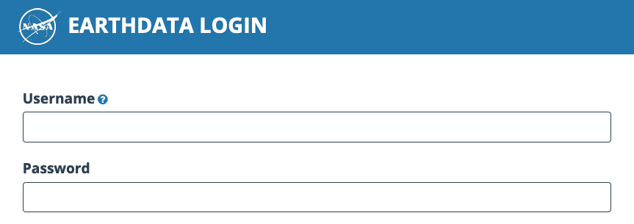
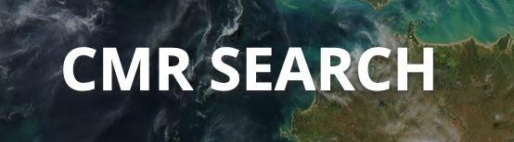
Upcoming changes
A project is underway to update several back-end systems used for ordering and distributing SeaBASS files
In the future, Earthdata logins will be required to download SeaBASS data. More information will be provided when we are closer to implementing this change
SeaBASS data are also in the process of being added to NASA’s Common Metadata Repository, which will offer an additional way to discover and cross-reference datasets and files

Slide 16
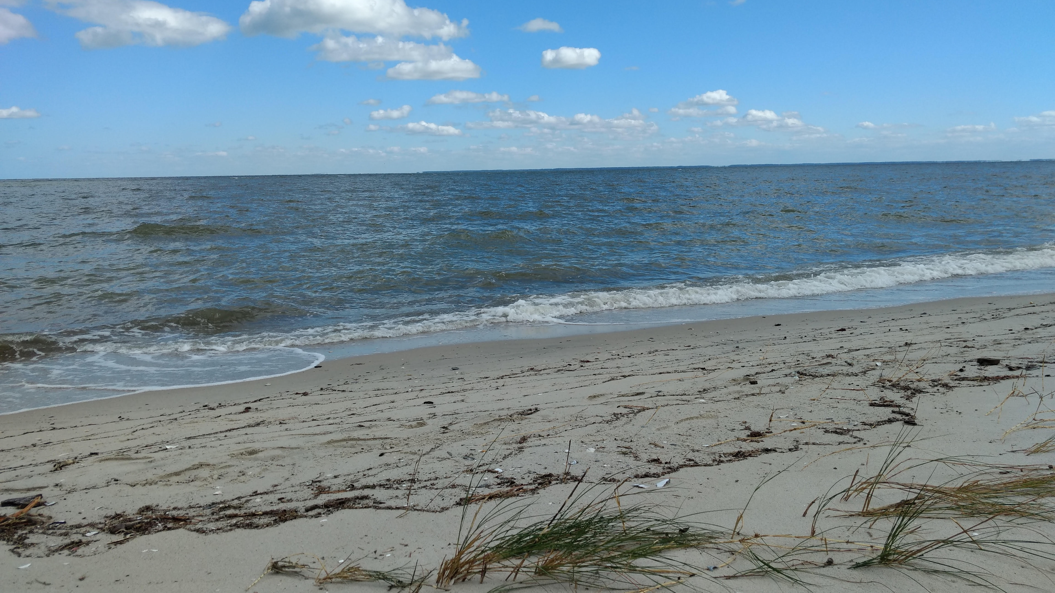
Thank you
Questions / Feedback?

Slide 17
Extra slides
Excess slides with extra details about specific measurement types and their checklists

Slide 18
HPLC
Short survey filled out by data submitter:
Sample collection method​s
- Filter type/pore size, Vacuum pressure, Replicates collected, Flash frozen?, Long term storage conditions
Filled out by HPLC Lab (i.e., NASA GSFC Lab does this for you):
Sample measurement and analysis
- Extraction, solvent, volume added/delivery method, disruption method, time, soak time, clarification method
HPLC analytical method
- Method reference, column temperature, mobile phase, Flow rate, Gradient, wavelengths monitored, spectra collected? If so, what wavelengths, Internal standard used, name
Instrument: Make and model, Injector type, Pump type, sample compartment refrigerated?, Heated/thermostatted column compartment? Detector type
Instrument calibration: Frequency, Source of standards, Single point or multi-point calibration, How are calibration factors (or response factors. RF) calculated? Is calibration accuracy monitored between calibrations?
If so, how and how often? Noise at each wavelength

Slide 19
Filter pad absorption
Sample collection
Water bottles, underway
Filtration vacuum
Blank filters
Replicates
Samples measured fresh, frozen,
Storage conditions (container, preservation method, temperature)
Sample measurement
Instrument make, model and accessories
Instrument calibration, performance tests and maintenance performed
Measurement method: transmittance, transmittance-reflectance, inside sphere…
Measurement protocol references (if any)
Air scans
Data analysis
Blank and air scans
Correction or null methods applied
Beta factor used with reference
Look at submission examples on SeaBASS website

Slide 20
CDOM
Sample collection
Niskin bottle, surface pump, bucket…
Location (coastal, offshore, estuarine, etc.) and depths
Filtration system: vacuum pump, peristaltic, syringe, vacuum jar, etc.) type of filter and pore size
Sample storage (e.g. refrigerated, frozen, acidified, etc.) and in what type of bottle (e.g. amber glass, high or low density poly-ethylene (HDPE, LDPE), Nalgene, etc.)
Sample measurement
Spectrophotometer used (dual or single beam, waveguide, integrating sphere, etc.), cuvette size (benchtop) , effective pathlength (on waveguide)
Instrument settings: (integration time, scan speed, slit width, smoothing, wavelength range and increment, etc.)
Samples re-filtered before the spectrophotometric analysis?

Slide 21
CDOM
Reporting
Raw scans of absorbance should be reported for each all measurements. When multiple scans measured, the average absorbance can be reported along with their standard deviation
Documentation file should be provided describing the methods for collection, filtration, analysis protocols
Absorption coefficient may be reported after null correction, smoothing, truncated wavelengths, etc. has been applied... Fully documented
Standardization on variable names for CDOM: wavelength, abs_ag, abs_ag_sd, ag

Slide 22
POC
Filter diameter and nominal pore size
Make and type (e.g., Whatman GF/F), filter pre-treated?
Sampling and processing
Method of filtration: filtration volume (volfilt), sample replicates, Standard deviation or % cv of replicates reported
Post sampling processing
Acidification step: Mode of application (i.e., fumes vs. solution)
Drying method and temperature (length of time in oven, desiccator, etc)
Elemental analysis
Instrument make and model, Calibration standard, Reference material used and performance metric results relative to reference
Blank corrections
DOC/DON adsorption (“filtrate”) blank correction should be measured and applied (Moran et al. 1999). Were samples blank corrected?

Slide 23
Radiometry
Instrument
Model and manufacturer, instrument characteristics including spatial, spectral electrical and physical.
Report instrument characterization including spectral range, spectral resolution, spectral accuracy, field of view, linearity, cosine response, thermal response, immersion effects.
Calibration: report absolute radiometric calibration for radiance and equation, and absolute calibration for irradiance and equation.
Deployment conditions
Deployment type: buoy mode, profiler (single cast), profiler (multi cast).
Deployment strategy, pressure tare, dark readings.
Remember to include "optional" metadata headers: Wind speed, Cloud cover, (Ship heading & SZA)

Slide 24
Radiometry
Data analysis
Conversion data counts to engineering units: conversions from raw binary optical data into counts. Apply calibration equation.
Dark correction: specify the correction scheme used to correct light values for dark values.
Deglitch shutter data: specify deglitching scheme used for dark values, if any
Smooth shutter darks: specify, if any.
Interpolate shutter darks as a function of measurement time to match the number of dark and light data measurements.
Dark correction of light data
Temperature correction of light data. Report temperature correction equation.
Time interpolation if any (better not interpolated). Detail interpolation scheme applied.
Notes:
Add marlon report

