Slide 1
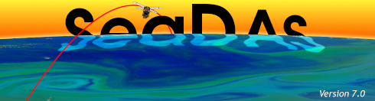
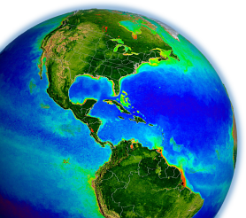
a new look for an old favorite
…or …
a marriage made in a coffee house…
23 Apr 2012
NASA OCRT Meeting

Slide 2
Something Old
…or I liked the old SeaDAS! Why change?
Originally developed to support ONE mission
  Each new mission added complexity to the code
      A maintenance challenge
Old IDL widget ‘styling’
  Original code developed under IDL version 4
  Hard to add or improve visualization/analysis features
Cost
  Requires an IDL license for the user
  Run-time license fixed at version 7.0
A redesign from scratch within IDL had other issues:
  Time consuming
  Small development staff

Slide 3
Something New
… well, not exactly new …
ESA’s Basic ERS & Envisat (A) ATSR and Meris Toolbox…better known as BEAM
  Over a decade of German Engineering
  A well designed interface
  Java-based, so natively multi-platform
    Even Windows!
    (but data processing is not, so early on there will be no processing support on Windows)

Slide 4
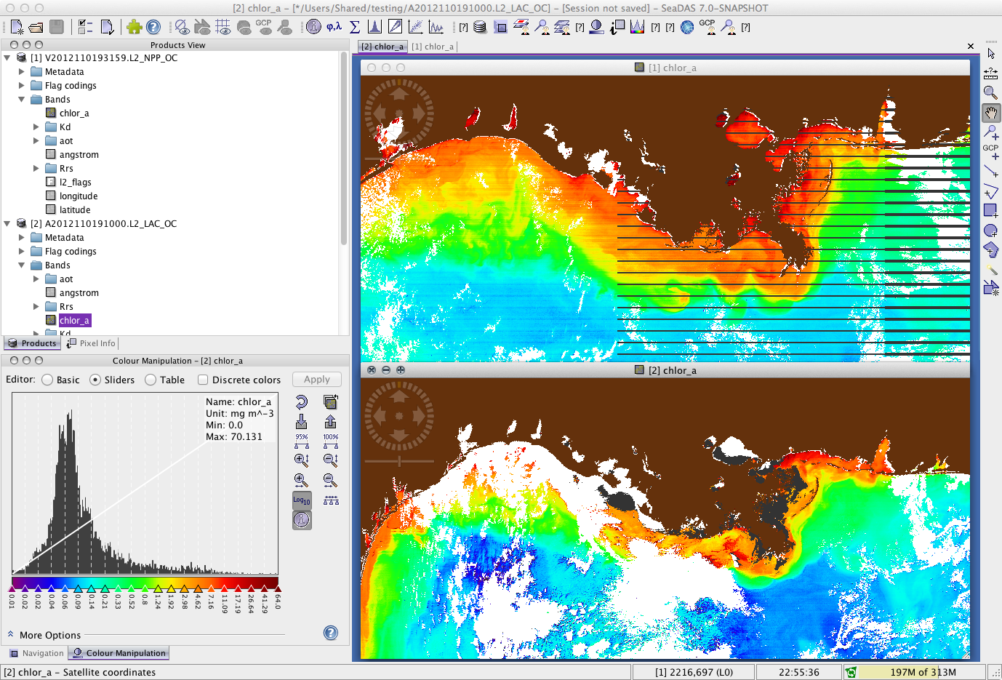

Slide 5
Something Borrowed
SeaDAS 7 is a fork of BEAM
The benefits
  Building on top of an already mature package
    NOT re-inventing the wheel
  Close collaboration with the BEAM developers
    Two teams
      Effectively increasing the size of the development staff
    Allows us to focus on what we know best

Slide 6
Something Blue
…OK – this one is a bit of a stretch…but to keep with the theme…
BEAM’s color manipulation tool was …
…in need of a ‘basic’ feature…

Slide 7
What has been done…
Product Reader
Ship Track
Color Manipulation
Data Processing
  Includes GUI and non-GUI controls

Slide 8
Product Reader
BEAM had rudimentary support for OBPG products – OK, just one – the Level-2 files
We’ve added support for:
  L1[A,B]
    SeaWiFS
    CZCS
    MODIS (L1B)
    OCTS
    OSMI
    MOS
    VIIRS (L1B)
  L2 (improved support over the existing BEAM implementation)
  L3 (including MEaSUREs products from UCSB)
    SMI files
    Bin files (although this one is a tad sluggish)
  SeaDAS “mapped” files
    Currently only the default Cylindrical projection is correctly navigated

Slide 9
Ship Track
…only it’s not called “ship track” anymore…
Notes:
Here’s where we benefited greatly from the collaboration with Brockmann Consult

Slide 10
Color Manipulation
Improvements to BEAM 4.9 implementation
  Log10 scaling
  Added a basic min/max, linear/log, color palette interface
  Added user preferences for product scaling and palette

Slide 11
Data Processing
Close coordination of science code and SeaDAS GUI development
  GUI design defined by the program
    New features / parameters are automatically included – greatly simplifying maintenance

Slide 12
Easily navigated tabbed UI
Editable parameter file interface

Slide 13
Clean ‘tree’ design
Product selector grouped by logical categories:
Radiances/Reflectaces
Derived Geophysical Parameters
Inherent Optical Properties
Ancillary/Meterological
Atmospheric Corr. Intermediates
Uncertainties/Error Estimates

Slide 14
Variety of selectors depending upon what the parameter requires:
Drop-down menus
Integer/Float entry
Boolean check-boxes
Bit-wise selector

Slide 15
Not all the processor GUIs are as complex as l2gen…

Slide 16
What’s still to come…
Coastline / Landmask* (*not based on flags)
User Defined Functions
  Beyond simple band math
Text Annotation
Contour Overlay
Vector Overlay

Slide 17
…but what about the IDL version?
Not going away anytime soon
    but no major updates – it is what it is
Processing code updates will continue

Slide 18
…oh, and thanks go out to …
Brockmann Consult
  Carsten Brockmann
  Norman Fomferra
The SeaDAS Irregulars
  Aynur Abdurazik
  Matt Elliot
  Danny Knowles
  Don Shea

