Slide 1
Distribution of NPP/VIIRS data through the NOAA Archives
NASA Ocean Color Research Team Meeting
23 April 2012, Seattle, Washington
Presenter: Axel Graumann, NOAA/NESDIS/NCDC
Additional contributors: Viva Banzon, Jonathan Blythe, Deirdre Byrne, Kenneth Casey, Paul DiGiacomo, Mitchell Goldberg, Kent Hughes, Edward Kearns, Mike Soracco, Tom Schott, Rick Stumpf, Ron Vogel, Menghua Wang, Cara Wilson, Banghua Yan

Slide 2
Overview of NPP, JPSS & VIIRS
Suomi National Polar-Orbiting Partnership (NPP) Mission, launched 28 October 2011
Bridge to the Joint Polar Satellite System (JPSS)
“The JPSS Program is a collaborative effort between NOAA and NASA with NOAA having overall responsibility, and NASA acting as NOAA’s acquisition agent and system integrator.” (JPSS Management Control Plan)
The VIIRS (Visible Infrared Imager Radiometer Suite) sensor on NPP, future JPSS-1 provides ocean color and SST
Global coverage and resolution - 750m (M bands)/375m (I bands)
Official NPP Mission data is archived and distributed by the NOAA National Data Centers
Big question: When are data available? When declared “beta” (see slide 6)

Slide 3
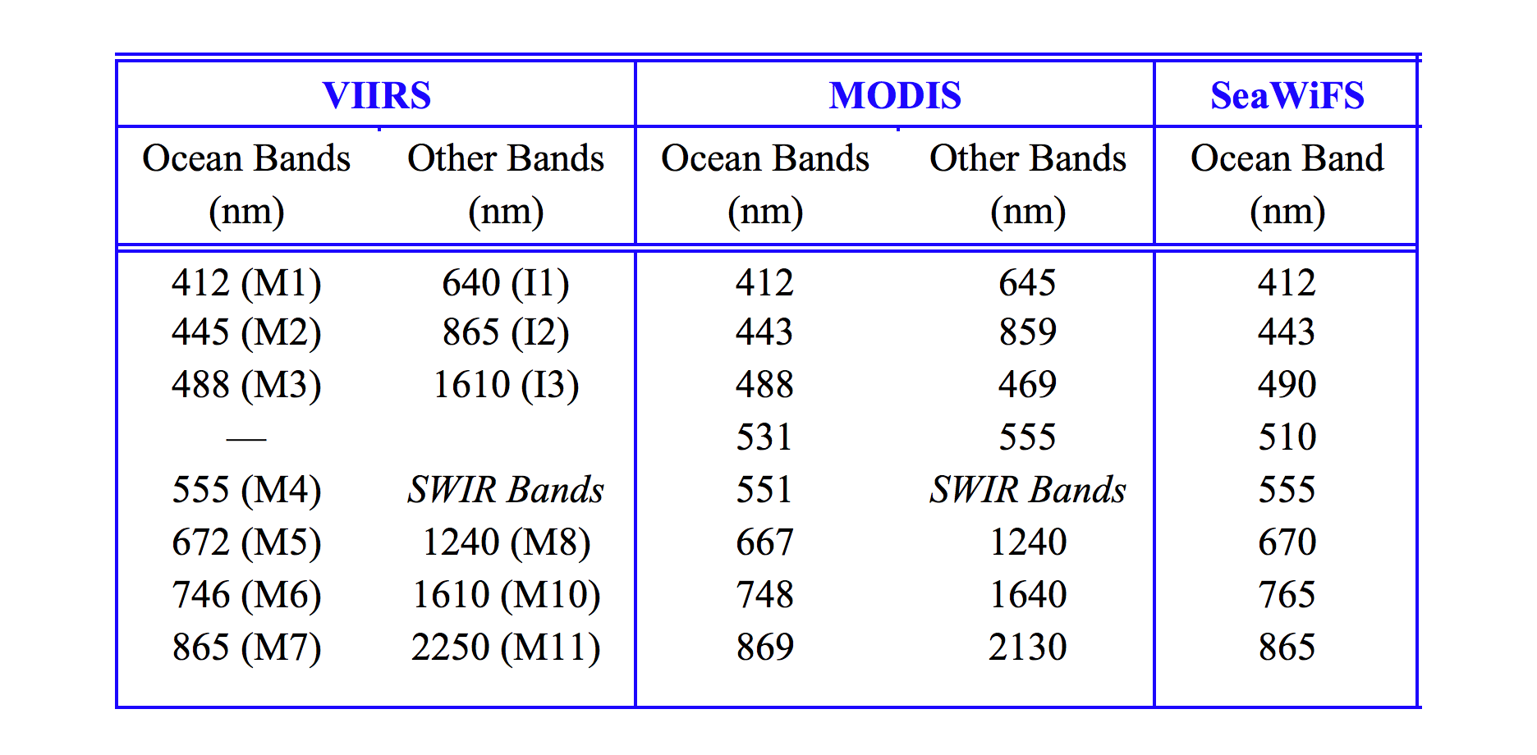
VIIRS Spectral Bands for Ocean Color
VIIRS on Suomi NPP
has Ocean and SWIR spectral bands similar to MODIS
Spatial resolution for VIIRS M-band: 750 m, I-band: 375 m

Slide 4
NOAA NPP/VIIRS Data Access Sectors
Archive Sector
  Long-term repository of NPP mission data
Science Sector
  Data/product development; transition
  to operations; mission-level reprocessing
  and generation of science quality data
Operational Sector
  Generation and provision of near-real time
  regional and global operational data (NESDIS.Data.Access@noaa.gov)
Direct Broadcast Sector
  Provision of real time data on regional basis
Archive
Science Sector
Direct Broadcast
Operational Sector

Slide 5
NOAA NPP/VIIRS Archive Sector
Where does NPP mission data live?
The NOAA National Data Centers
share an IT – infrastructure called the
Comprehensive Large Array-Data
Stewardship System (CLASS)
CLASS serves as the official repository
of NPP mission data, including VIIRS
On-line search, order, and distribution of all archived VIIRS mission data is available through CLASS: www.class.noaa.gov
Archive
Science Sector
Direct Broadcast
Operational Sector
See our poster for information on the other sectors which provide various other data/ products with varying latencies, formats, etc.

Slide 6
NPP VIIRS/Ocean Color Products Overview
What NPP VIIRS mission data is available?
*VIIRS Ocean Color EDRs: Normalized water-leaving radiances at VIIRS M1 to M5 bands & Chlorophyll-a. Other EDRs: Absorption & Backscattering coefficients at VIIRS M1-M5 bands.
How is the NPP mission data generated?
The official NPP mission RDRs, SDRs, and EDRs are presently generated via the JPSS Interface Data Processing Segment (IDPS)
What other VIIRS data and information is (will be) available?
Also available in CLASS are ancillary and auxiliary supporting data.
Global Level 3 data will be available through NOAA CoastWatch (coastwatch.noaa.gov/)
and archived in CLASS (~spring 2013)
Additional EDRs will be available over time based on demand & resources.
Official NPP VIIRS Ocean Color Data Products |  | Availability
Level 0 | Raw Data Record (RDR) | April/May 2012
Level 1B | Sensor Data Record (SDR) | April/May 2012
Level 2 | Environmental Data Record (EDR)* | ~October 2012 (ocean color)

Slide 7
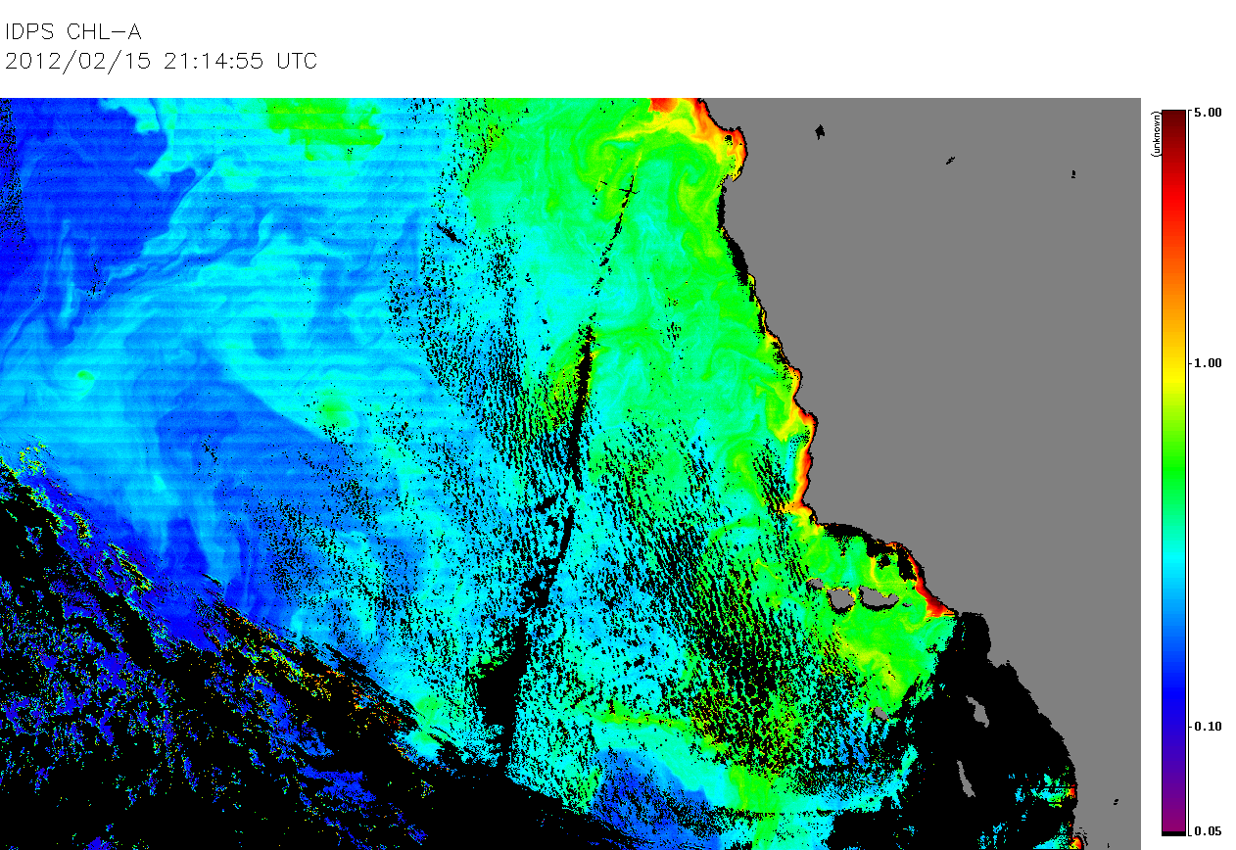
NOAA VIIRS Data in the NOAA Archive
  Official NPP project data files (from IDPS) are in HDF5 format
  Under VIIRS there are about 65 products (datatypes)
    3 levels of operational data
    (RDRs, SDRs, and EDRs)
    SDR and EDR channels (bands) in separate files
    RDR Science Data includes all bands in one file
    Additional files include ancillary data, auxiliary data, release packages (software, documentation, etc.)
  Later products will be in NetCDF, CoastWatch HDF, etc.
VIIRS Chlorophyll-a (IDPS)
February 15, 2012

Slide 8
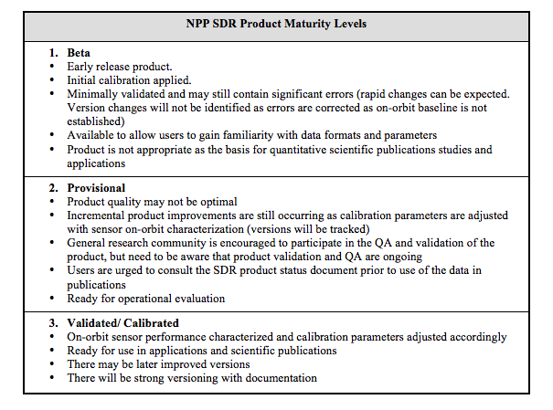
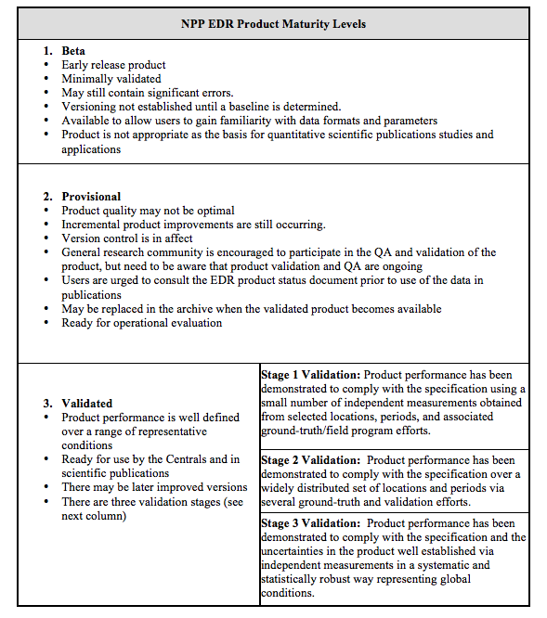
Data Product Maturity Definitions
NPP SDR Product Maturity Levels:
Beta
Provisional
Validated/Calibrated
NPP EDR Product Maturity Levels:
Beta
Provisional
Validated (3 stages)

Slide 9
Example NPP VIIRS Daily File Number and Volume by Product (datatype)
Descriptive Name Files Volume
VIIRS Moderate Resolution Band 01 SDR 254 6 GBs
VIIRS Moderate Resolution Band 02 SDR 254 6 GBs
VIIRS Moderate Resolution Band 03 SDR 254 9 GBs
VIIRS Moderate Resolution Band 04 SDR 254 9 GBs
VIIRS Moderate Resolution Band 05 SDR 254 9. GBs
VIIRS Moderate Resolution Band 06 SDR 254 6 GBs
VIIRS Moderate Resolution Band 07 SDR 254 17 GBs
VIIRS Moderate Bands SDR Geolocation 254 79 GBs
VIIRS Sea Surface Temperature EDR 254 19 GBs
VIIRS Ocean Color/Chlorophyll EDR 254 93 GBs
VIIRS Science RDR 254 57 GBs

Slide 10
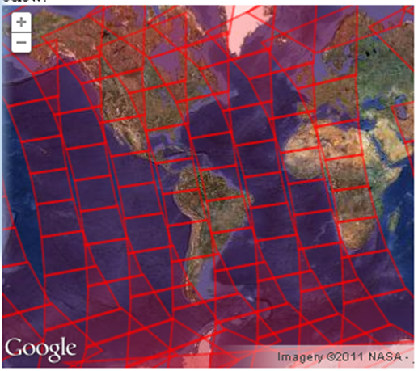
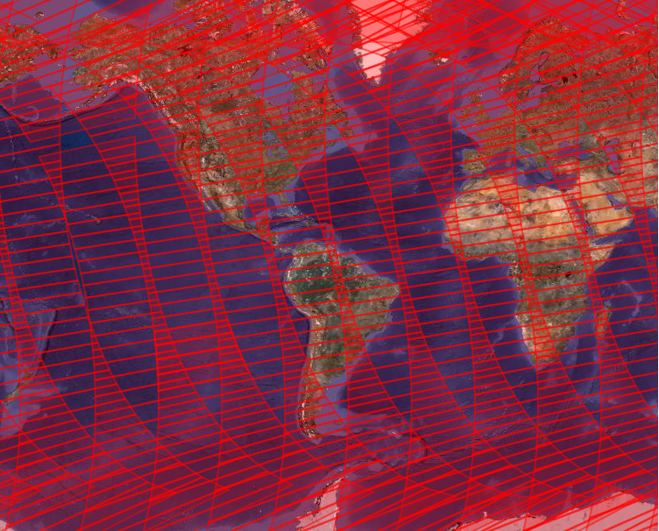
Granule comparison between MODIS and VIIRS
Coverage of MODIS Granules
Granule length: 5 min
Coverage of VIIRS Granules
Granule length: 85.7 sec
VIIRS archived data are grouped into aggregates
One aggregate equals four granules
Aggregate length is 5.7 min (342.8 sec)
Bottom line: VIIRS files are larger than MODIS files!
72 granules per orbit or 18 aggregates per orbit

Slide 11
NOAA VIIRS Ocean Color Data Access
Some general notes on the design
and capabilities of CLASS:
The NOAA CLASS data storage system is not designed for real-time operations.
At least six hours elapse before data are ingested into CLASS from the NPP IDPS. (Other sectors support real-time)
Users must create an account to be able to access the data.
Different levels of services:
Ad hoc, large and subscription
Direct download is currently not supported
Archive
Science Sector
Direct Broadcast
Operational Sector

Slide 12
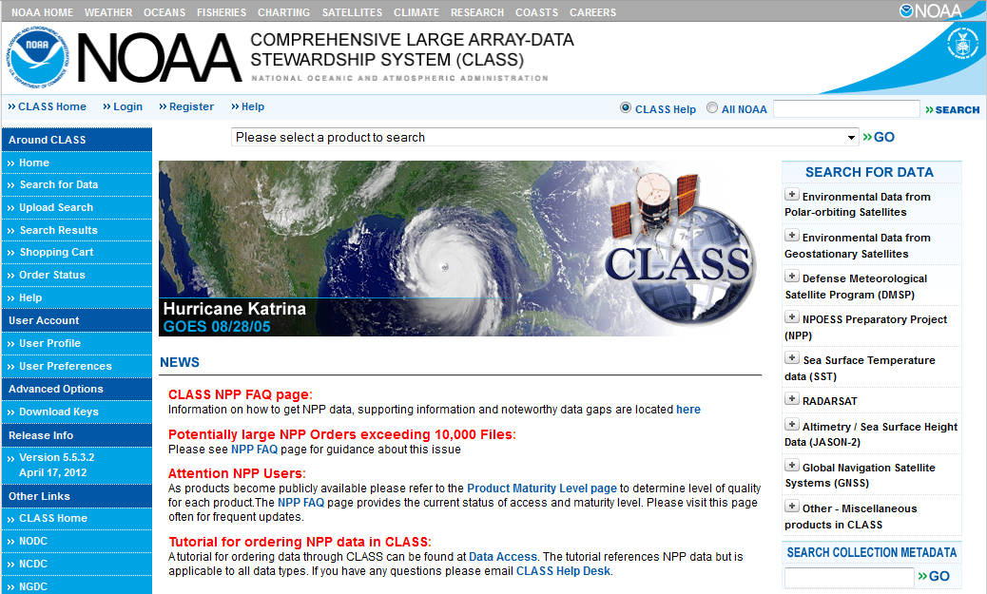
CLASS Home Page
www.class.noaa.gov

Slide 13
NOAA VIIRS Ocean Color Data Access
How do I order from CLASS?
Step 1: Register for a user id account at www.class.noaa.gov
– minimal information: your name, e-mail address, a password
Step 2: Select from the drop down product menu and highlight NPP VIIRS
Step 3: From the the search interface find data of interest. Select
geographic region, enter start/end dates and times, and select one or
more data types (different products or spectral bands).
Step 4: Determine if you need greater access or a subscription
CLASS order types: | Anticipated Order Delivery | File Limit | Must contact the Help Desk
Ad hoc orders | Usually within 24 hours | Up to 100 files | No
Large orders (bulk) | up to one week | up to 3000 | Yes
Subscription (standing orders) | 12 hours | No limit | Yes
Note: Always provide your user ID when contacting the CLASS helpdesk

Slide 14
NOAA VIIRS Ocean Color Data Access:
Assistance and support
For technical questions regarding how to use CLASS:
class.help@noaa.gov
axel.graumann@noaa.gov
Notes on using CLASS:
NPP Access tutorial (see link at www.class.noaa.gov in the News section:
( http://www.class.ncdc.noaa.gov/notification/pdfs/
CLASS_Tutorial_NPPDataAccess_20110909.pdf)
Check the NPP FAQ page for operational start dates, data gaps, product
maturity levels, etc.
(http://www.class.ncdc.noaa.gov/notification/faq_npp.htm)
Visit as at the poster session if you like a hands-on review of CLASS

Slide 15
So now you’ve acquired some VIIRS data …
JPSS Software Processing Packages
Algorithm Development Library (ADL) (see poster by Jiang et al.)
(https://jpss-adl-wiki.ssec.wisc.edu/mediawiki)
  Provides the science community with a simple method for testing and proving algorithms to be used in Interface Data Processing Segment (IDPS)
  ADL includes all source codes, lookup tables, and test data
  Users can run ADL in their own Linux systems
There are other VIIRS data processing systems used by various groups (e.g., NOAA-MSL12, NASA-l2gen, NRL-APS).
What’s coming up?
CoastWatch will produce & distribute global Level 3 products (daily, weekly and monthly), initially at reduced resolution (~spring 2013), eventually at full resolution.
Dedicated NOAA ocean color website w/VIIRS information, FAQ, data links et al.

