Slide 1
Uncertainty estimates in input (Rrs) and output ocean color data: a brief review
Stéphane Maritorena – ERI/UCSB

Slide 2
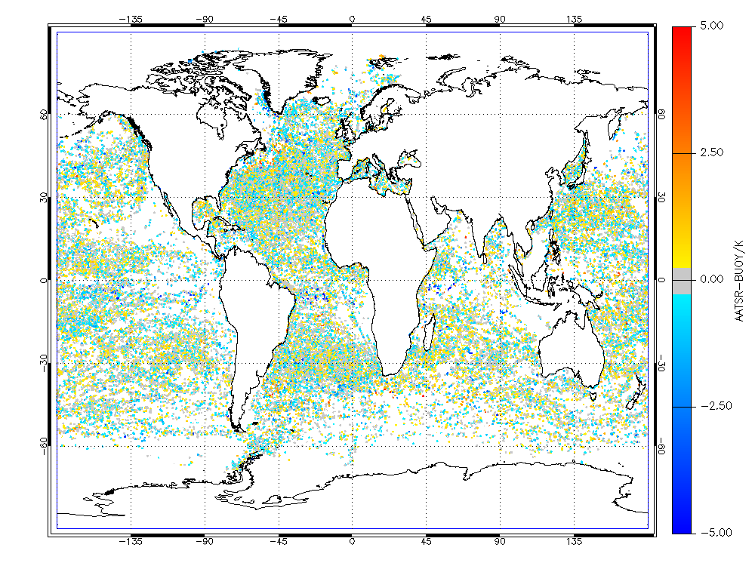
Uncertainties in output products
Ideally, the uncertainties associated with ocean color products should be determined through comparisons with in situ measurements (matchups)
That’s how things are done for SST. Millions of matchups points because thousands of floats and buoys routinely measure SST.
We don’t have that luxury (yet…) with ocean color data
1984 Matchups with SeaWiFS CHL over 13-year period
Matchups in ocean color are a snapshot. They give a global, general accuracy estimate for a product but does not take into account spatial and temporal variability.
Uncertainty at the pixel level is what is required
AASTER matchups (from GHRSST)
SeaWiFS matchups (GSFC/OBPG)

Slide 3
Uncertainties in output products
Methods exist that produce uncertainty estimates when using semi-analytical algorithms
Uncertainty estimates for OC products have been documented in several recent papers.
Several approaches:
Error propagation (QAA, Lee et al., 2010)
Covariance matrix in non-linear least-squares techniques (Maritorena et al., 2002, Maritorena & Siegel, 2005; Maritorena et al., 2010; Van der Woerd & Pasterkamp, 2008; Salama et al., 2009;…). Used in other disciplines.
Wang et al. (2005) developed an approach specific to the Linear Matrix Inversion scheme they use.
Bayesian approaches
These approaches do not return the same things: confidence intervals, standard errors, standard-deviations, errors,….

Slide 4
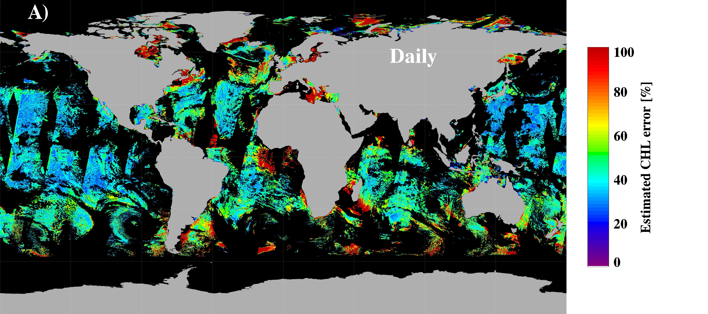
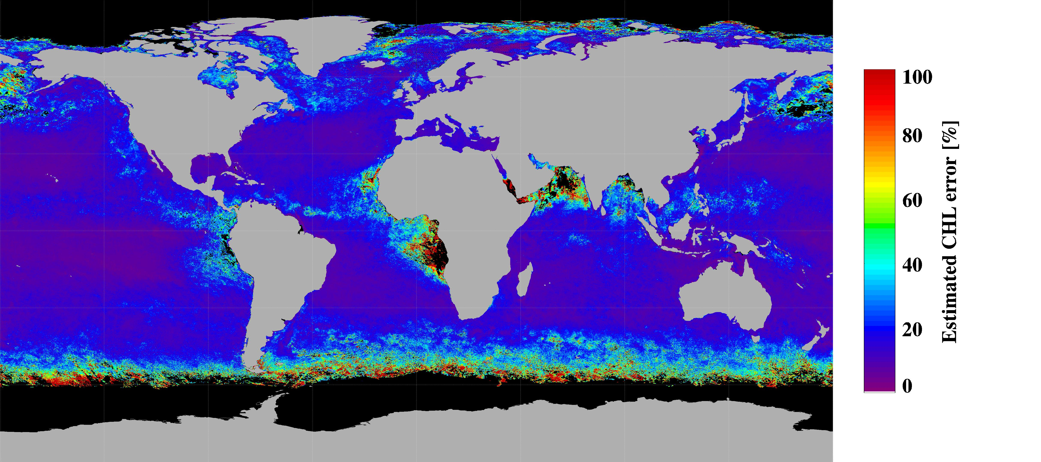
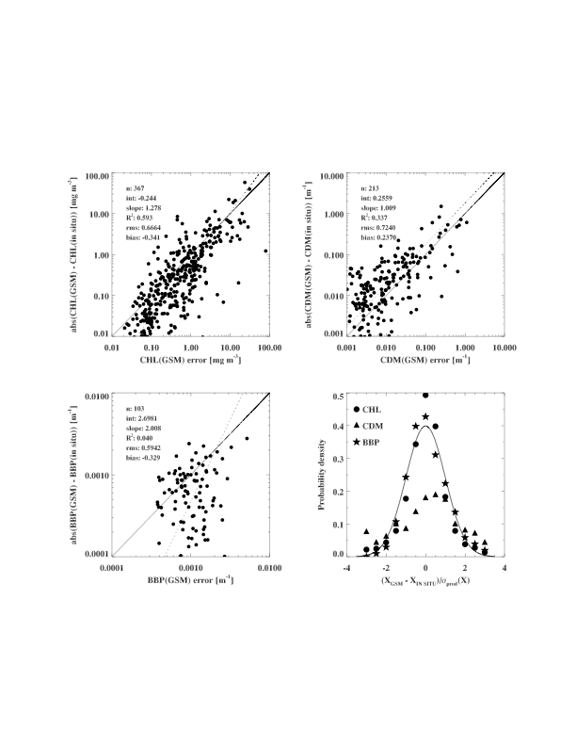
Uncertainties of output products - non-linear least-squares
Several variants exist. Routinely used in atmospheric science.
Based on how well the model represents the Rrs data (projection of mean square of residuals in variables space), not a direct determination of the actual uncertainties of the retrieved variables.
In Levenberg-Marquardt like techniques, the variance of the retrieved variables is given by the diagonal elements of the covariance matrix.
For GSM, validation of the uncertainty estimates was done using the NOMADv2 data set (Maritorena et al., 2010)
Aug. 18, 2005
August 2005

Slide 5
Uncertainties in output products
Wang et al. (2005) proposed a new approach using a SAA model and a linear matrix inversion.
Method has similarities with non-linear least-squares
Uncertainties of the retrievals are estimated from the statistics of the ensemble of solutions that satisfy a goodness of fit criterion (on Rrs).
Too computationally demanding to be applied to satellite imagery?

Slide 6
Error propagation
Lee et al., 2010. Estimation of uncertainties associated with the parameters and IOPs derived by QAA.
QAA is a sequential model (sequential steps). From the uncertainties associated with the initial variables in QAA (a(λ₀) and η) errors in subsequent variables are estimated through a series of analytical expressions.
Sensitivity to noise of the different components of the model.

Slide 7
Bayesian approach for error estimation
Bayesian approach is a statistical approach that allows regularizing ill-conditioned problems.
Bayes theorem : f(p/d)=C.h(d/p).k(p)
f(p/d) : probability density of parameters knowing the data
h(d/p) : probability density of data knowing the parameters
k(p) : a priori probability density of the parameters
C : normalization constant
k(p) allows regularizing ill-posed problems (ill-conditioned or under-determined problems). This term includes all the a priori uncertainties.
Benefits: The number of parameters to be retrieved is not limited. Possibility to process a number of parameters larger than the number of data and to propagate all the a priori errors.
Issues :
1/ Bayesian approach could give biased estimators if a priori knowledge is biased.
2/ if too many parameters to be retrieved and non linear forward model, convergence difficulties can appear.
Salama & Shen, 2010; Salama & Su, 2010
Notes:
Applicable to empirical models?

Slide 8
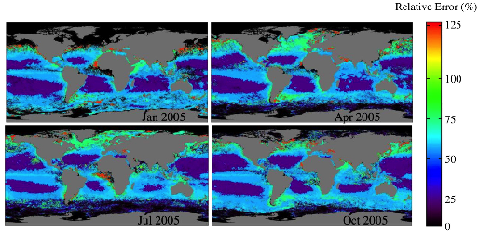
Uncertainties in empirically derived variables
Moore et al., 2009.
CHL uncertainties for different optical water types.
Eight optical classes based on Rrs (NOMAD).
Uncertainty for each class from matchup data.
Membership to the different water types is used to produce a “composite” uncertainty for each pixel of an image.
Other approaches?

Slide 9
Uncertainties in the input data
Uncertainties in Rrs
Not easy
Easy way is to use matchups statistics (A. Mangin’s presentation 2 years ago; Maritorena et al., 2010). Comparison between GSM modeled Rrs and in situ (model error)
Error propagation studies: TOA radiances, noise in the NIR bands, propagation through atmospheric correction -> errors in Rrs
Uncertainty estimates by comparing different sensors?

Slide 10
Back to Jeremy’s initial topics
“Uncertainty” is a vague term. This can cover many different things (errors, standard deviations, confidence intervals,…). Need to define what we are talking about.
Input Rrs uncertainties
Output IOP uncertainties
Identify and discuss methods for including uncertainties within a SAA
What methods can we implement in the short term?
What method requires further investigation or additional information?
Uncertainties for empirical models?

