Slide 1
Presented at
2019 NASA Ocean Color Research Team (OCRT) Meeting
March 8, 2019
Quality of satellite R_{rs} spectrum and the diffuse attenuation coefficient
Jianwei Wei
University of Massachusetts Boston
School for the Environment
In collaboration with: ZhongPing Lee (UMASS), Junfang Lin (Dalhousie Univ.), Michael Ondrusek (NOAA)

Slide 2


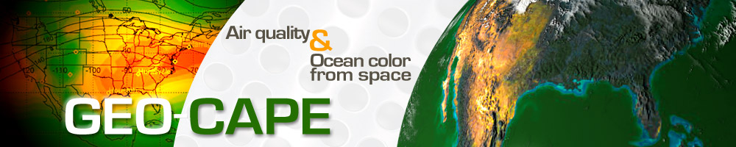
Acknowledgements
NASA Suomi National Polar-orbiting Partnership
NASA Ocean Biology and Biogeochemistry
NASA OCRT Meeting, April 8, 2019

Slide 3
First topic:
Background
Remote sensing reflectance (R_{rs}) is an important optical property.
A huge amount of satellite ocean color data have been collected over the global oceans since 1978, and continue to be accumulated.
Atmospheric correction and others are vital and complex.
Quality management is critical. Quality control (QC): l2_flags & masks.
flags & masks
We developed a quality assurance (QA) model to provide confidence that the satellite ocean color data quality requirement is fulfilled.
NASA OCRT Meeting, April 8, 2019

Slide 4
Look-up table for R_{rs} spectral shapes
Normalized remote sensing reflectance (nR_{rs})
The LUT consists of:
Reference (centroid) spectra: nRrs_ref
Upper boundary: nRrs_upper
Lower boundary: nRrs_lower
NASA OCRT Meeting, April 8, 2019

Slide 5
Optical water type (OWT) classifications
Multi-band R_{rs} spectra (412, 443, 488, 510, 531, 547, 555, 667, 683 nm) are extracted from in situ hyperspectral R_{rs} data.
These multi-spectral R_{rs} are classified into 23 optical water types based on the similarity of R_{rs} spectral shapes.
(Summer, 2012)
NASA OCRT Meeting, April 8, 2019

Slide 6
Assigning a QA score to satellite R_{rs} spectrum
QA scores vary from 0 to 1:
1 ---- highest quality
0 ---- lowest quality
NASA OCRT Meeting, April 8, 2019

Slide 7
Monitoring of satellite R_{rs} data quality in global oceans (for level-3 daily products)
2005-181
2010-181
2015-181
NASA OCRT Meeting, April 8, 2019

Slide 8
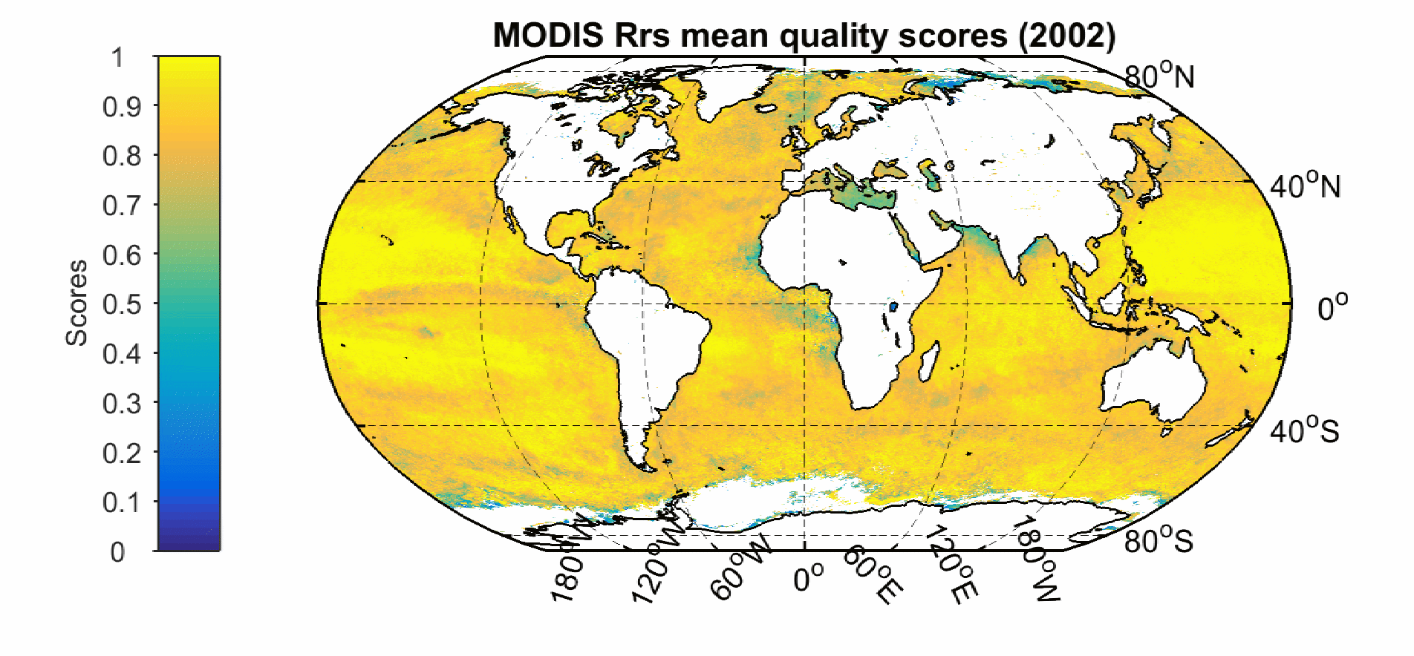
Evolution of satellite R_{rs} spectra quality
The QA scores are derived for the NASA R2014 data products.
The animation is available online:
http://oceanoptics.umb.edu/files/2015/01/MODISA_testAnimated-1icxwl9.gif
NASA OCRT Meeting, April 8, 2019

Slide 9
Change of satellite R_{rs} spectra in global oceans
R_{rs}(412)/R_{rs}(443)
nR_{rs} spectra
2005
Georges Bank
2005
2010
2010
satellite
QA model
decrease
2015
2015
NASA OCRT Meeting, April 8, 2019

Slide 10
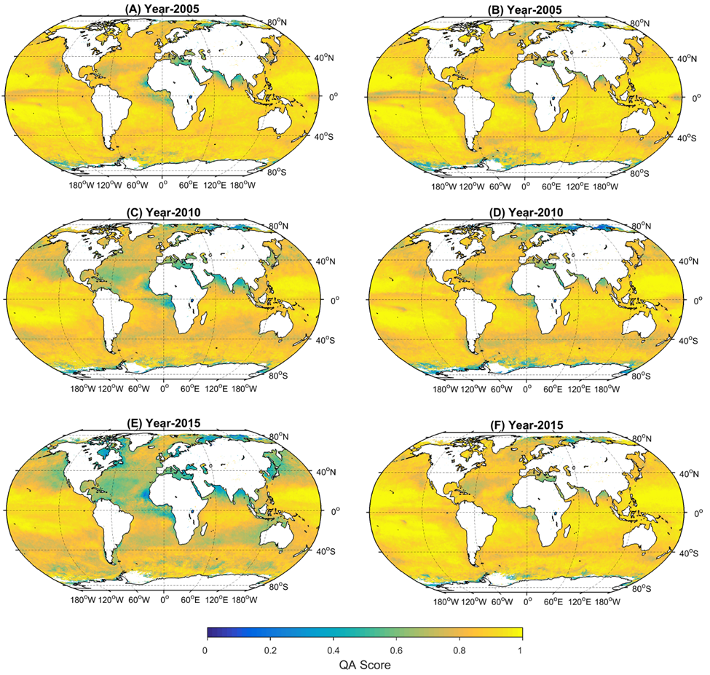
The recent reprocessing R2018 improved the satellite data quality
2005
2005
R2014
R2018
2010
2010
2015
2015
decrease
stable
NASA OCRT Meeting, April 8, 2019

Slide 11
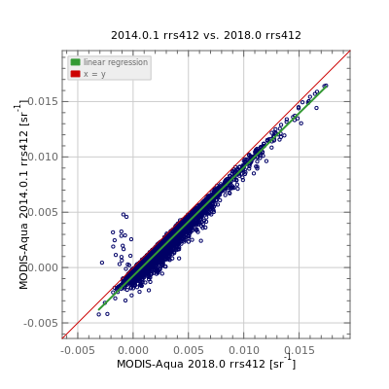
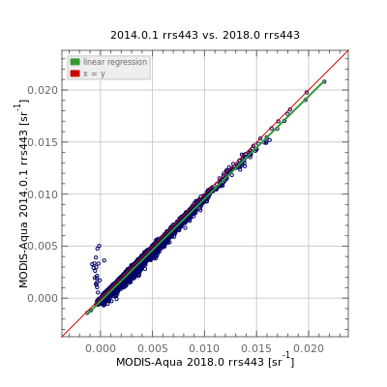
Comparison of MODISA and in situ R_{rs} matchup data
SeaBASS & AERONET-OC sites
R2014
R_{rs}(412)
R2018
R2014
R_{rs}(443)
R2018
NASA OCRT Meeting, April 8, 2019
Credit: NASA OBPG and SeaBASS (https://seabass.gsfc.nasa.gov)

Slide 12
Validation statistics for MODISA R_{rs} data
The R2018 R_{rs} retrievals show significant reduction in the median bias and median absolute error (MAE) relative to in situ measurements, especially in 412 nm band. This is primarily an impact of the revised MOBY measurements.
 | Bias |  | Absolute error
 | R2014 | R2018 | R2014 | R2018
R_{rs}(412) | -29% | 0% | 0.0010 | 0.0007
R_{rs}(443) | -9% | 1% | 0.0006 | 0.0005
R_{rs}(488) | -15% | -11% | 0.0006 | 0.0005
R_{rs}(531) | -12% | -10% | 0.0006 | 0.0005
R_{rs}(547) | -10% | -10% | 0.0005 | 0.0005
R_{rs}(667) | -20% | -17% | 0.0002 | 0.0002
R_{rs}(412/R_{rs}(443) | -18% | -2% | 0.22 | 0.11
* The satellite & in situ R_{rs} matchup data are accessed from SeaBASS.
NASA OCRT Meeting, April 8, 2019

Slide 13
Quality assurance of the R_{rs} data in global oceans
R_{rs}(412)/R_{rs}(443)
R2014
R2014-QA’ed
R2018
NASA OCRT Meeting, April 8, 2019

Slide 14
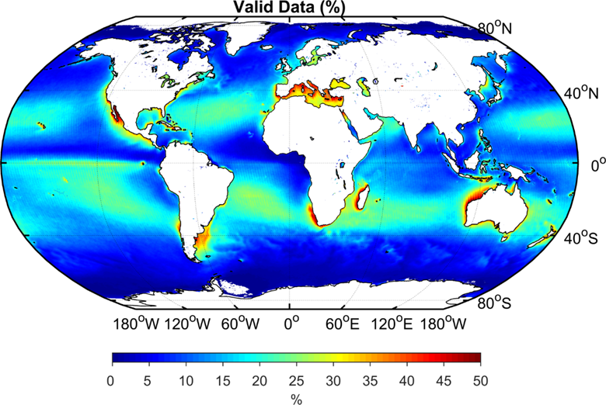
Percentage of available satellite observations
Keep in mind that the coastal oceans and the subtropical gyres have the largest numbers of available observations (>25%).
The QA procedure will reduce the number of available observations …

Slide 15
Summary
The quality assurance (QA) model provides a confidence that the ocean color data quality requirement is (or not) fulfilled.
It allows to monitor and diagnose the change of satellite R_{rs} spectral shapes.
Quality assurance is necessary to improve the satellite data consistency, particularly for the coastal oceans and subtropical gyres.
We have analyzed the MODIS Aqua R_{rs} spectrum quality. Further efforts are necessary to take into account multiple satellite ocean color missions.
NASA OCRT Meeting, April 8, 2019

Slide 16
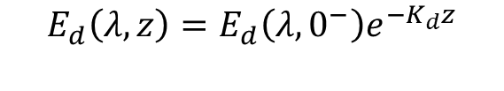

Second topic:
Background
Diffuse attenuation coefficient is an important optical property determining the light penetration and light availability in the upper ocean.
$$E_{d}\left(λ,z\right)=E_{d}\left(λ,0^{−}\right)e^{−K_{d}z}$$
Morel (1988):
$$Chl=Fun\left(\frac{Rrs\left(490\right)}{Rrs\left(555\right)}\right)$$
Austin and Petzold (1986):
NASA OCRT Meeting, April 8, 2019

Slide 17
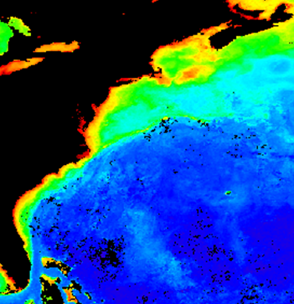
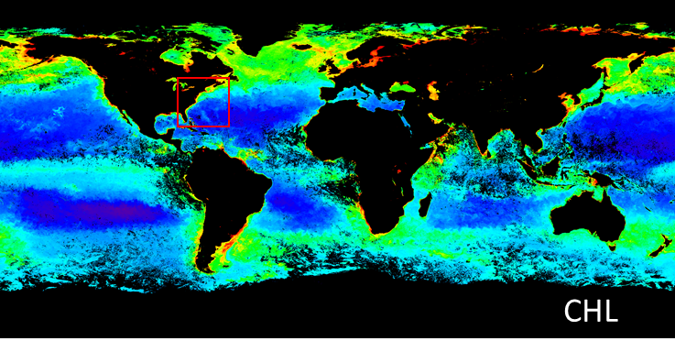
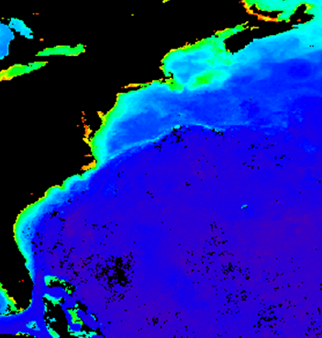
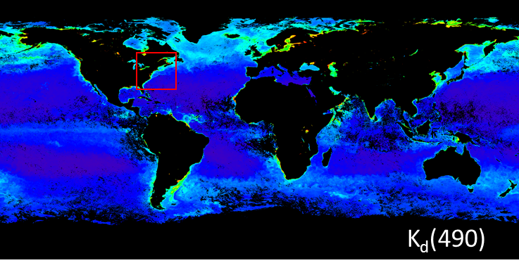
Background

Slide 18
Background
The standard K_{d}(490) and Chl products are 100% co-varying in coastal oceans; but …
AOP: sun angle dependent
Nearly independent of sun angle
The two sides do not match in optical attributes.
NASA OCRT Meeting, April 8, 2019

Slide 19
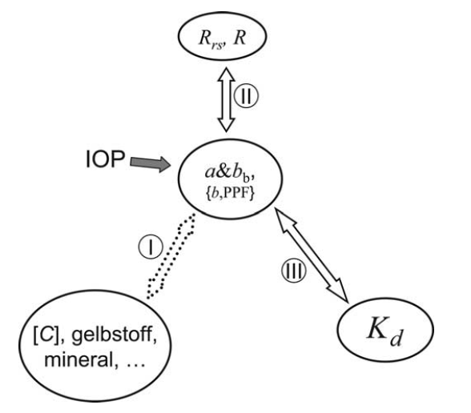
It is imperative to generate a more consistent, and un-equivocal, ocean color K_{d} product
（Lee et al, 2005）
NASA OCRT Meeting, April 8, 2019
Notes:
f is the fraction of direct sunlight

Slide 20
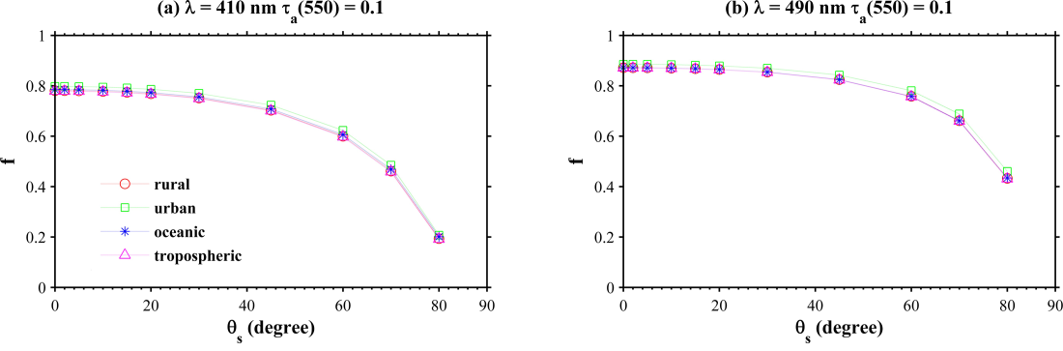
Normalized diffuse attenuation coefficient (nK_{d})
(Gordon 1989)
f?
Hydrolight-SBDART coupled radiative transfer model
Considered variable types of aerosols and optical depths
Considered a wide range of water IOPs
NASA OCRT Meeting, April 8, 2019
Notes:
f is the fraction of direct sunlight

Slide 21
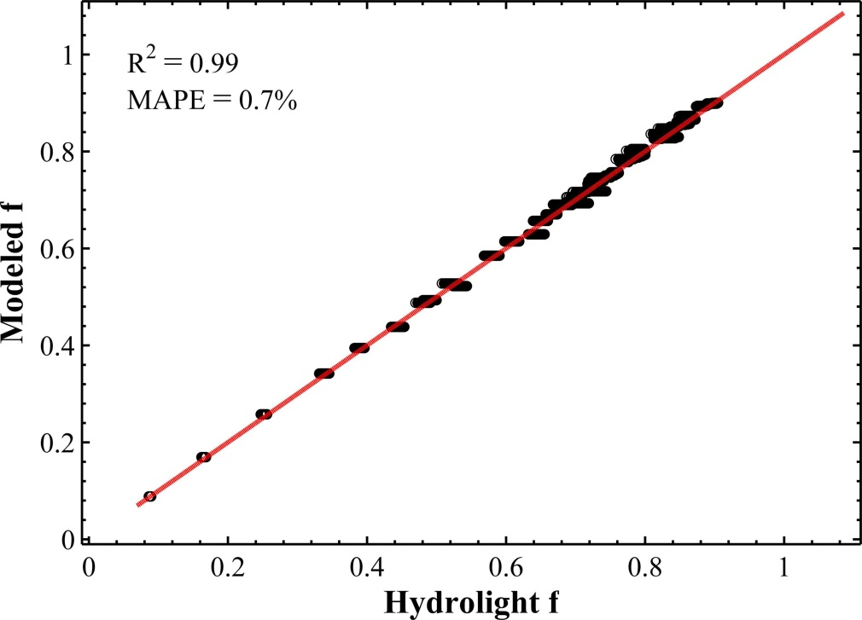
Modeling f as a function of θ and λ
NASA OCRT Meeting, April 8, 2019

Slide 22
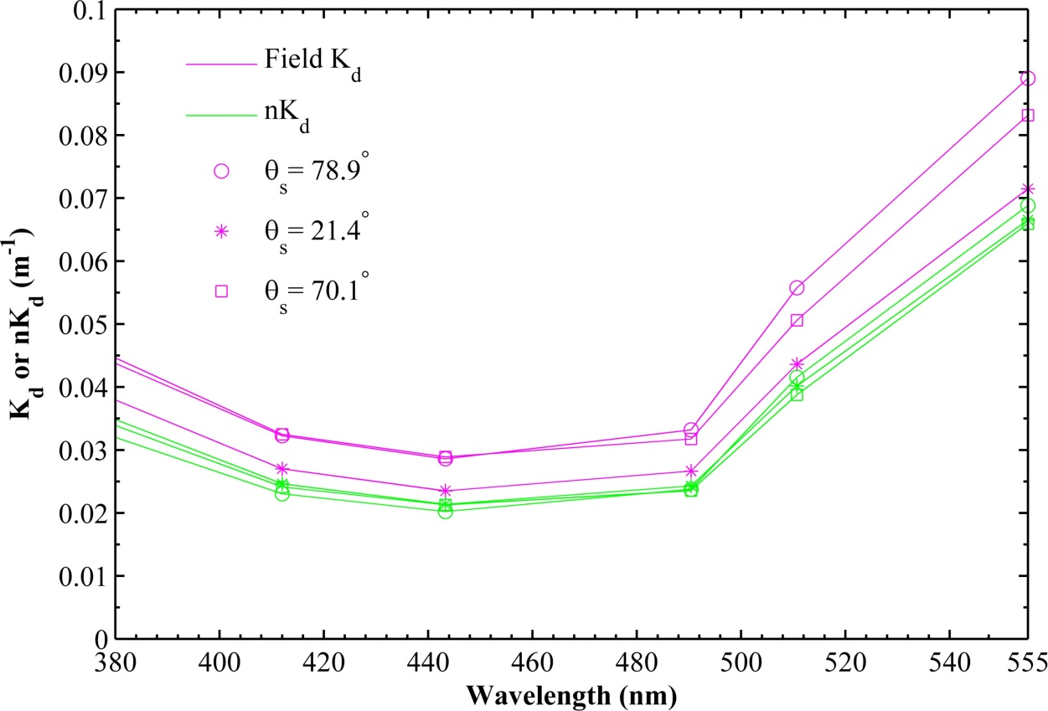
K_{d} & D₀
nK_{d}
NASA OCRT Meeting, April 8, 2019

Slide 23
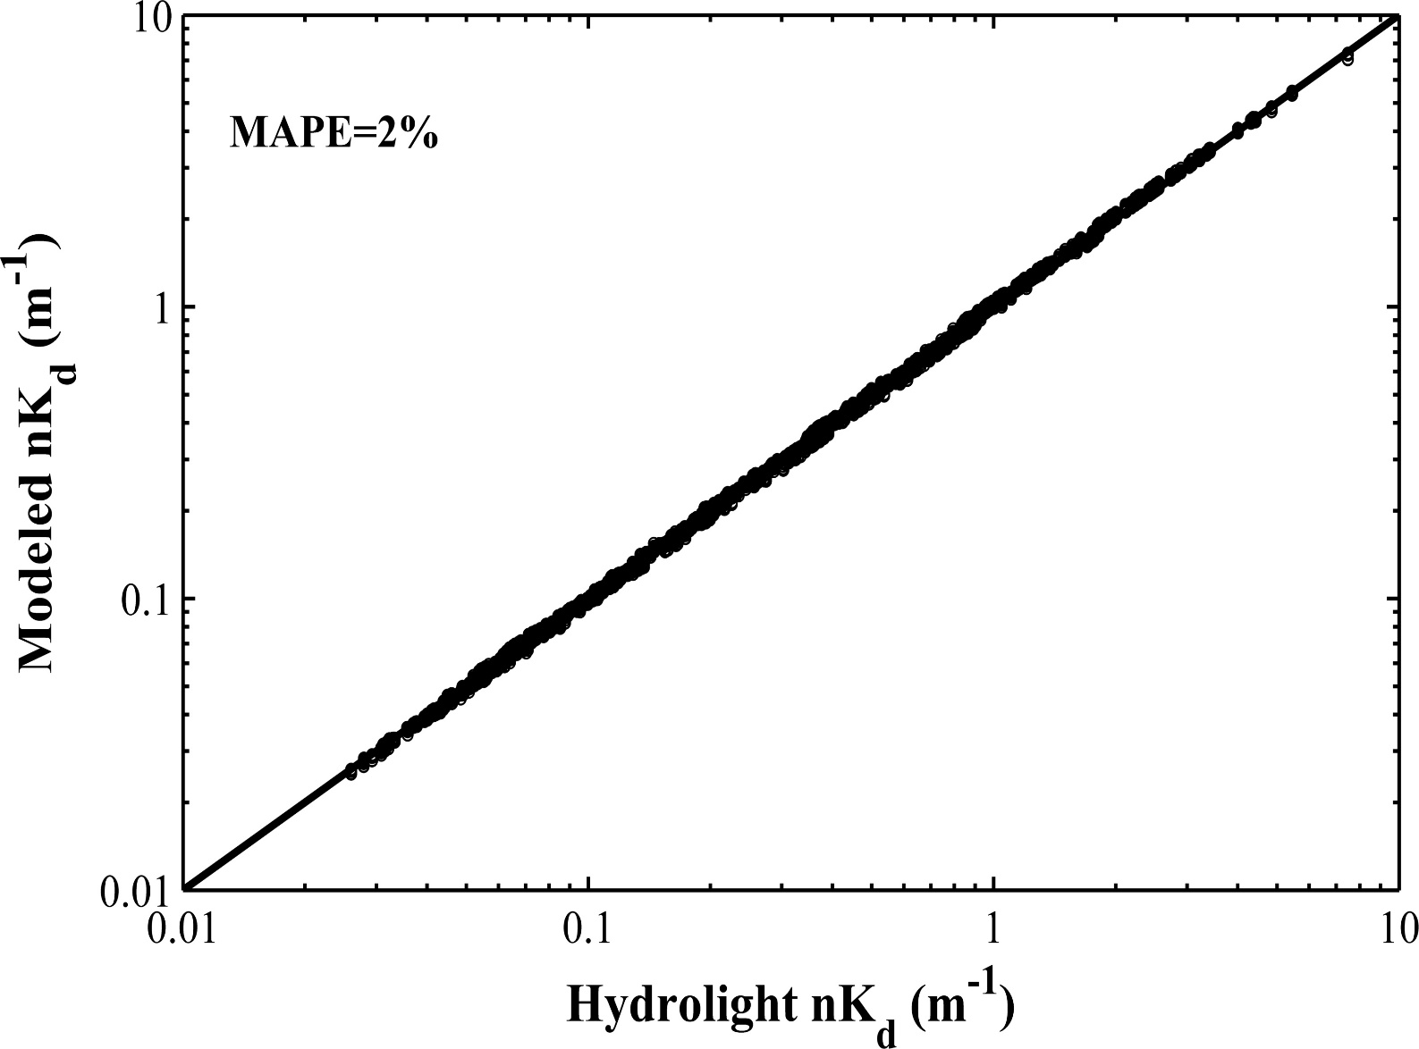
nK_{d} = Fun(a, b_{b})
NASA OCRT Meeting, April 8, 2019

Slide 24
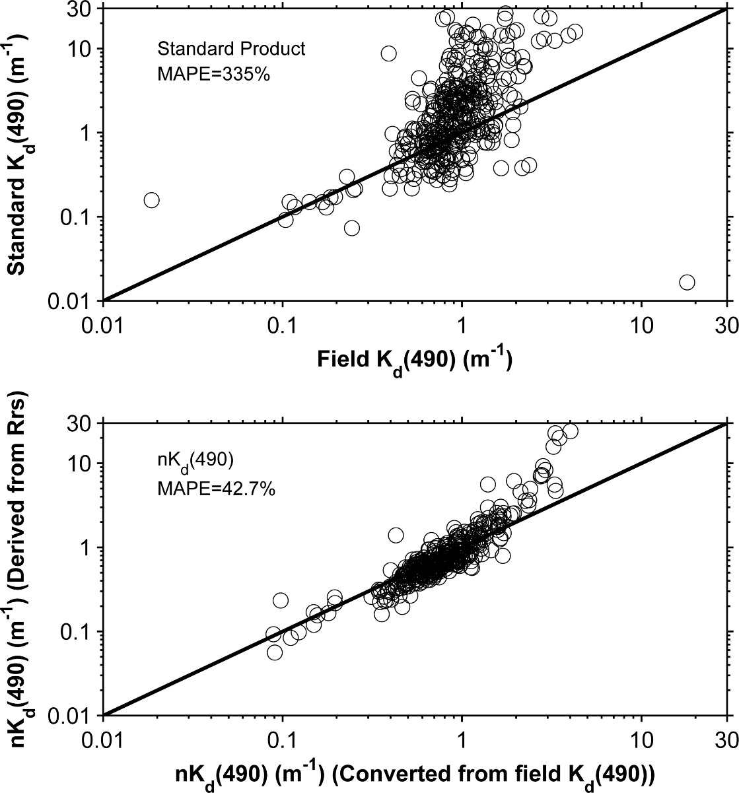
Remote Sensing nK_{d}:
R_{rs} → a & b_{b} → nK_{d}
Chesapeake Bay
NASA OCRT Meeting, April 8, 2019
Notes:
Measurement in Chesapeake Bay

Slide 25
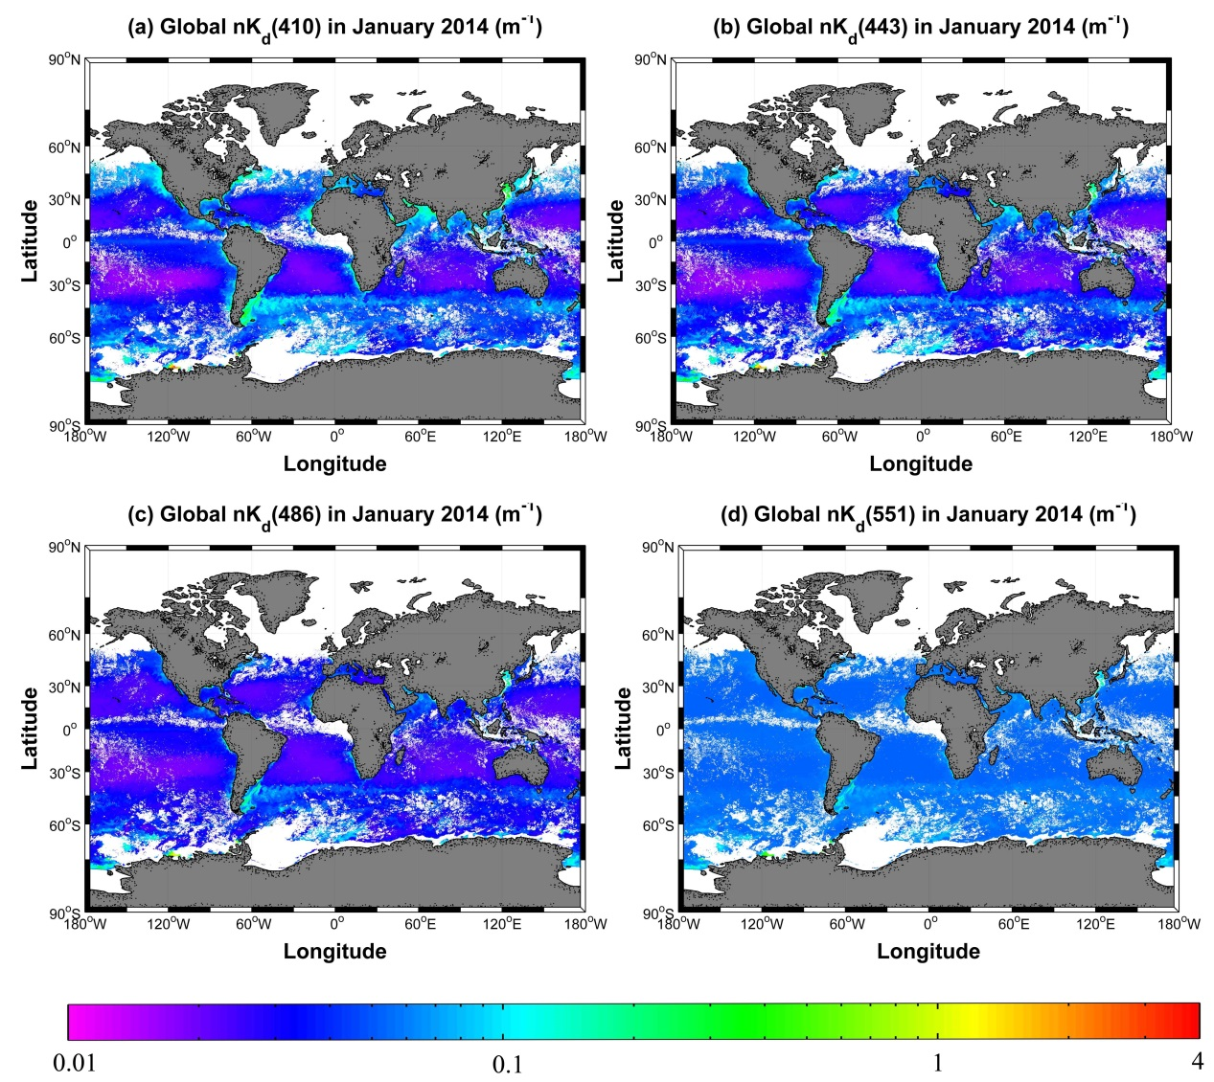
Examples of global nK_{d} product for NPP VIIRS
NASA OCRT Meeting, April 8, 2019

Slide 26
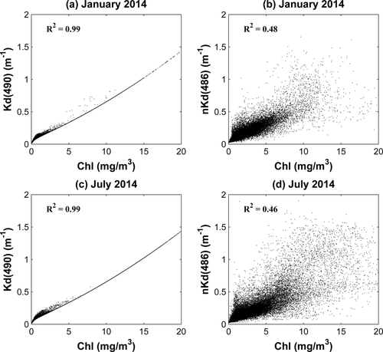
K vs CHL

Slide 27
Summary
Traditional ratio-derived K_{d}(490) product overlooked its AOP characteristics.
The empirical K_{d}(490) product has exactly the same spatial pattern as the Chl product in coastal region, which is not supported by ocean optics theory and observations
nK_{d} corrects the AOP feature, and may be treated as an IOP.
NASA OCRT Meeting, April 8, 2019

Slide 28
References
Wei J., Z. P. Lee, and S. Shang (2016). A system to measure the data quality of spectral remote sensing reflectance of aquatic environments. Journal of Geophysical Research, 121, doi:10.1002/2016JC012126
Lin, J., Z. P. Lee, M. Ondrusek, and K. Du (2016), Remote sensing of normalized diffuse attenuation coefficient of downwelling irradiance, Journal of Geophysical Research, 121(9), 6717-6730, doi:10.1002/2016JC011895
Thank you
NASA OCRT Meeting, April 8, 2019

