Slide 1
EOSDIS Cloud Evolution (ExCEL) Project
Mark McInerney
Deputy Project Manager – Technical
Earth Science Data & Information System (ESDIS)
March 2017

Slide 2
Takeaway
1
ESDIS is undertaking a commercial cloud prototyping activity for EOSDIS, this presentation summarizes the overall effort
Results from the prototype efforts will inform to what extent commercial cloud environments are utilized for EOSDIS in the future.
7
Cloud Evolution (ExCEL) Project
2

Slide 3
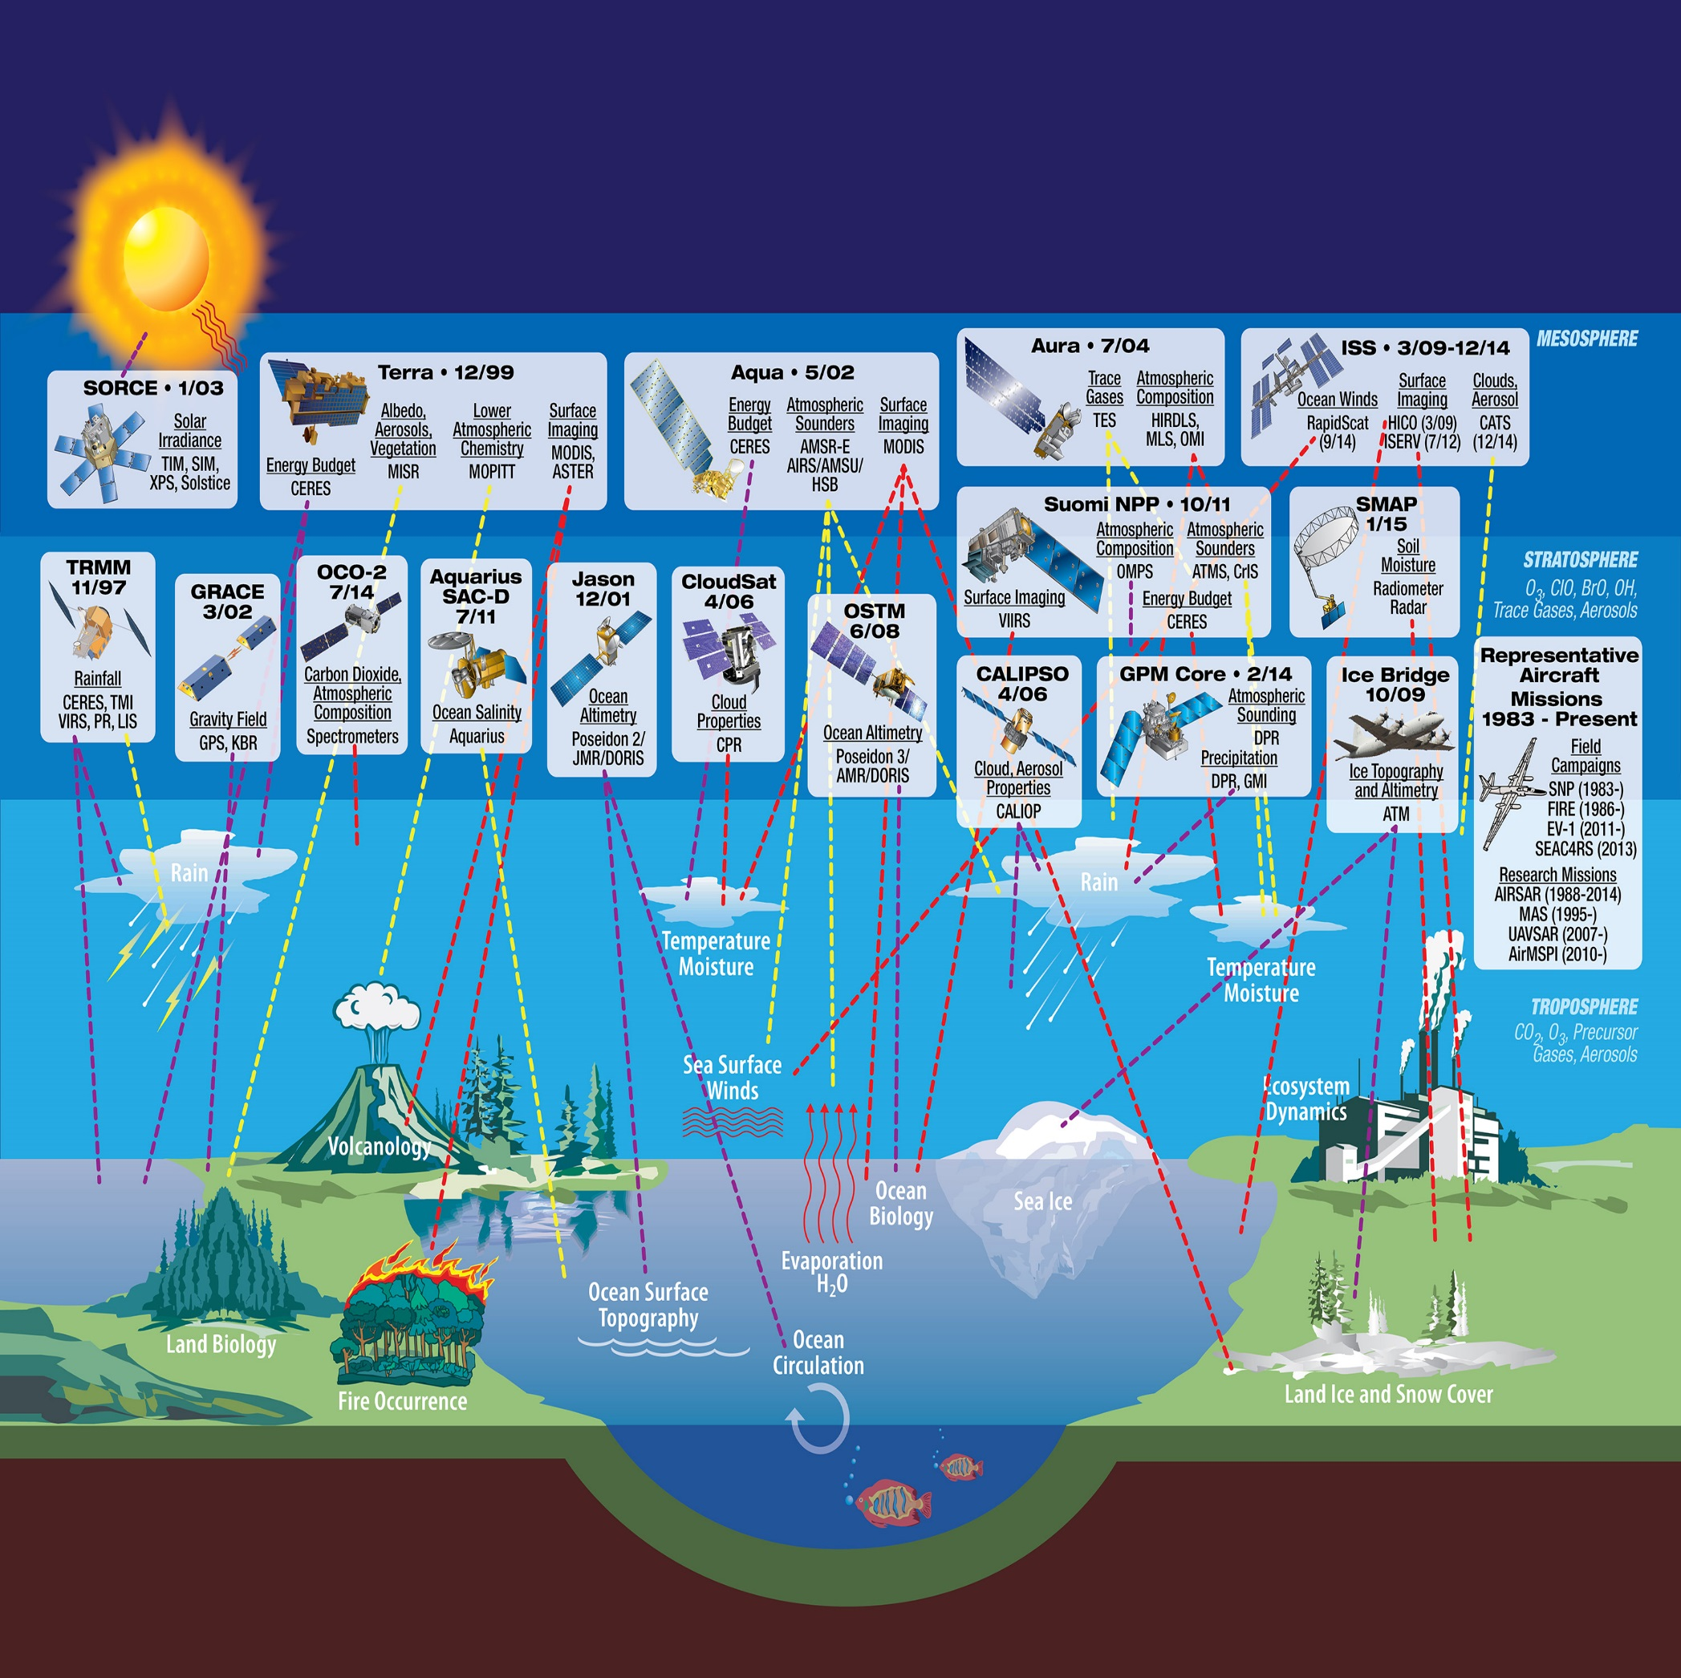
Background: Data Collection Systems
1
7
Cloud Evolution (ExCEL) Project
EOSDIS manages a very diverse set of Satellite data, Airborne Missions, Field Campaigns, and in-situ measurements.
3

Slide 4
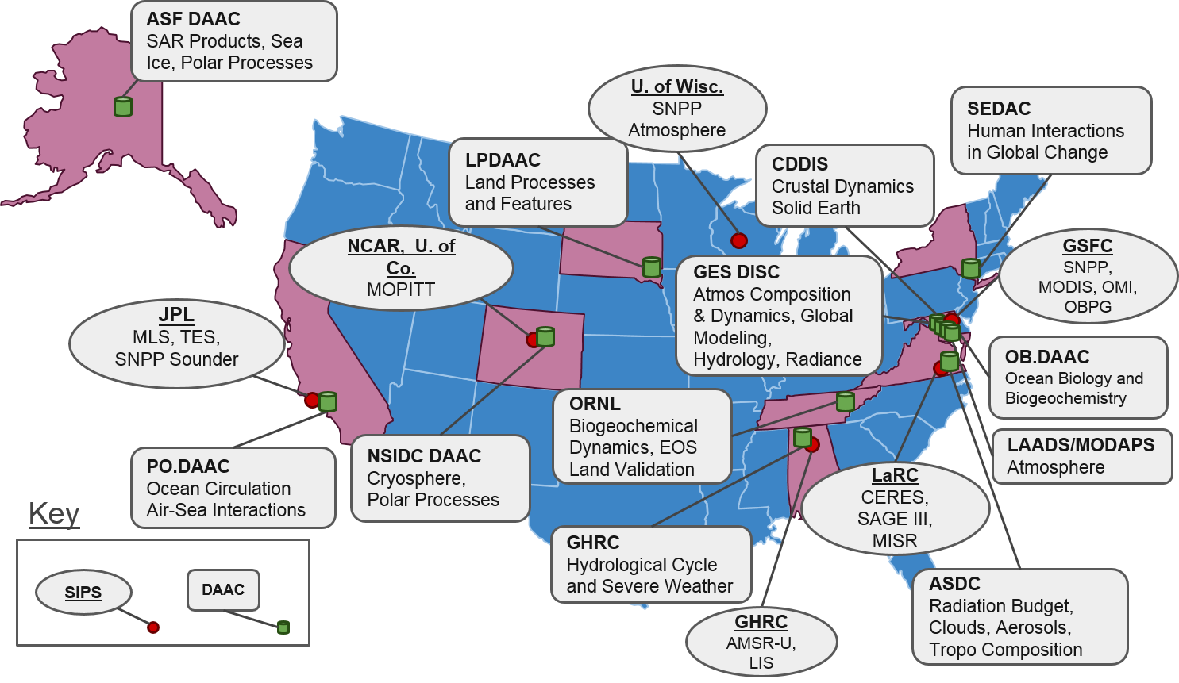
Background: The EOSDIS Enterprise
Distributed Active Archive Centers (DAACs) , collocated with centers of science discipline expertise, archive and distribute standard data products produced by Science Investigator-led Processing Systems (SIPS)
1
6
12
Cloud Evolution (ExCEL) Project
4

Slide 5
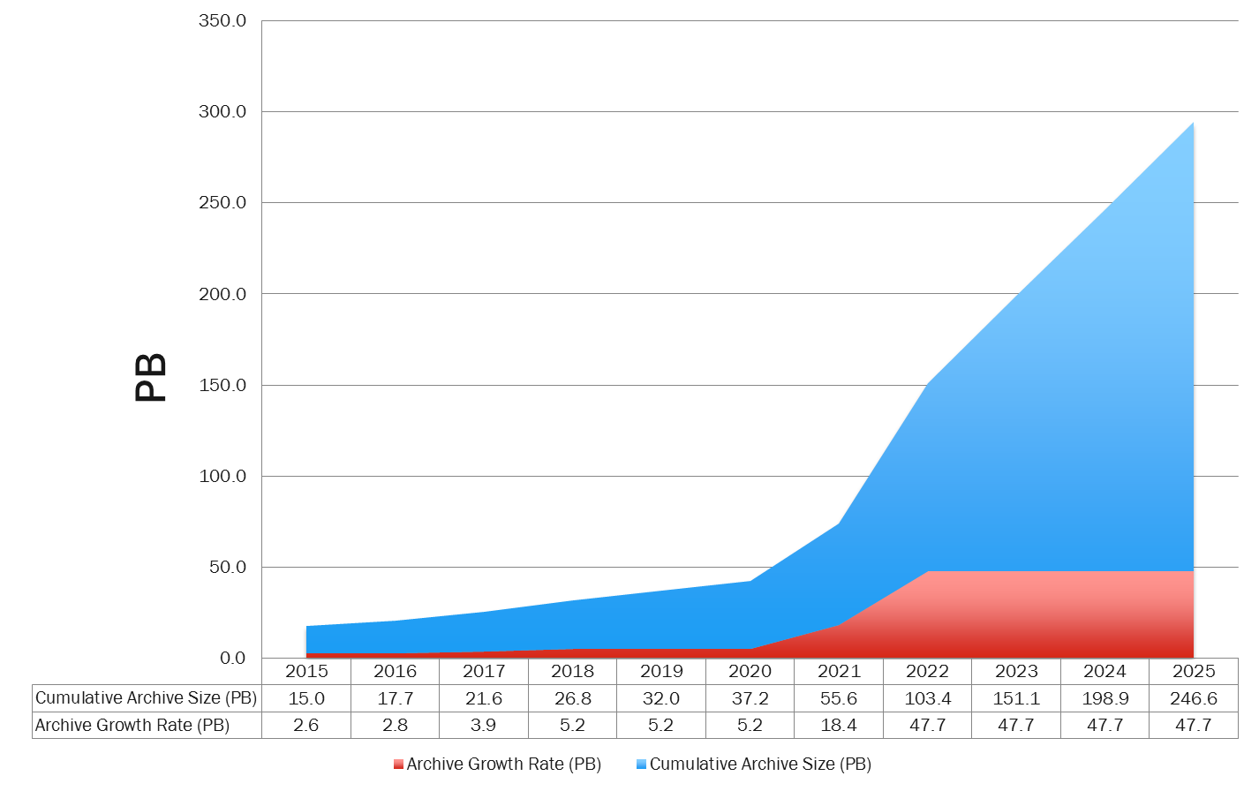
Background: Current and Estimated Archive Growth
Today
Cloud Evolution (ExCEL) Project
5

Slide 6
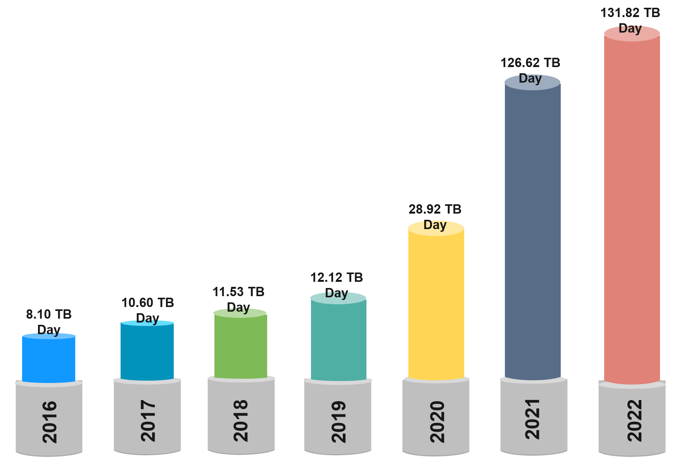
Motivation
* 47 PB annually
Growth of Mission Data & Processing: Projected rapid archive growth and the need to effectively process significantly larger volumes of new mission data requires rethinking existing architectures. Est 132 TB daily ingest by 2022!
Data Systems: More cost effective, flexible, and scalable data system ingest, archive, and distribution solutions are needed to keep pace with new mission advancement and capabilities
Science Users: Significantly larger data volumes requires additional ways to access and utilize this data, with “Data Close to Compute”
Cloud Evolution (ExCEL) Project
6
Estimated Daily Data Volume Over 5 Years

Slide 7
Conceptual “Data Close to Compute”
EOSDIS Applications & Services
Large Volume Data Storage
Application and service layer using AWS compute, storage (S3, S3IA, Glacier), and cloud native technologies
Centralized mission observation & model datasets stored in auto graduated AWS object storage (S3, S3-IA, Glacier)
Archive
Search
Catalog
Scalable Compute
Ingest
Data
Compute
Access
Provision, Access, and terminate dynamically based on need. Cost by use
Cloud Native
Compute
Processing
Applications
Cloud Native Compute
Non-ESDIS / Public Applications & Services
Analytics
Cloud vendor service software stacks and microservices easing deployment of user based applications
Science community brings algorithms to the data. Support for NASA & non-NASA
Cloud Evolution (ExCEL) Project
7

Slide 8
Cloud Benefits for Data Systems (EOSDIS)
Cost-Effective: Only pay for the compute and storage needed. Easy to separate and fund by project/function.
Cost-Effective
Scalable Performance
Scalable Performance: Data Close to compute, auto scaling, elastic load balancing, scale up or down based on need.
Flexibility: Maximum flexibility selecting operating systems, compute (CPU), programming languages, databases, and more based on mission need.
Flexibility
Deployment Speed: With an established cloud platform development is faster, access; to compute, storage, and IT Services requires only funding. Significantly simplifying procurement and provisioning.
Deployment Speed
Accessibility: Centralized, redundant, enterprise level holdings in the cloud allows for “additional” more effective ways of accessing extremely large datasets of new missions.
Accessibility
Cloud Evolution (ExCEL) Project
8

Slide 9
Cloud Benefits for Science Users
Lower Barrier of Entry
Lower Barrier of Entry: Science users will have direct access to data without having to transfer, procure, and manage systems.
Scalable Performance: Enabling dynamic scaling to throttling or bursting science processing based on need, especially effective for datasets too large for download.
Scalable Performance
Cost: Capabilities can be purchased by science users based on need, including use of spot markets. Users do not need local data copies to conduct work.
Cost
Repeatability & Sharing: Complex processing routines can be shared, allowing science users to quickly and efficiently repeat/reprocess experiments at low cost.
Repeatability & Sharing
Promoting Science Discovery
Promoting Science Discovery: With volumes of earth science data close to scalable compute, scientist only need to bring their analysis, helping expedite science discovery.
Cloud Evolution (ExCEL) Project
9

Slide 10
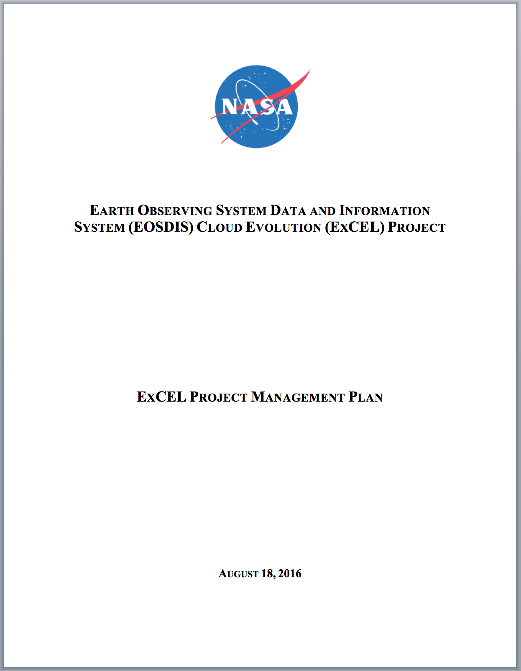
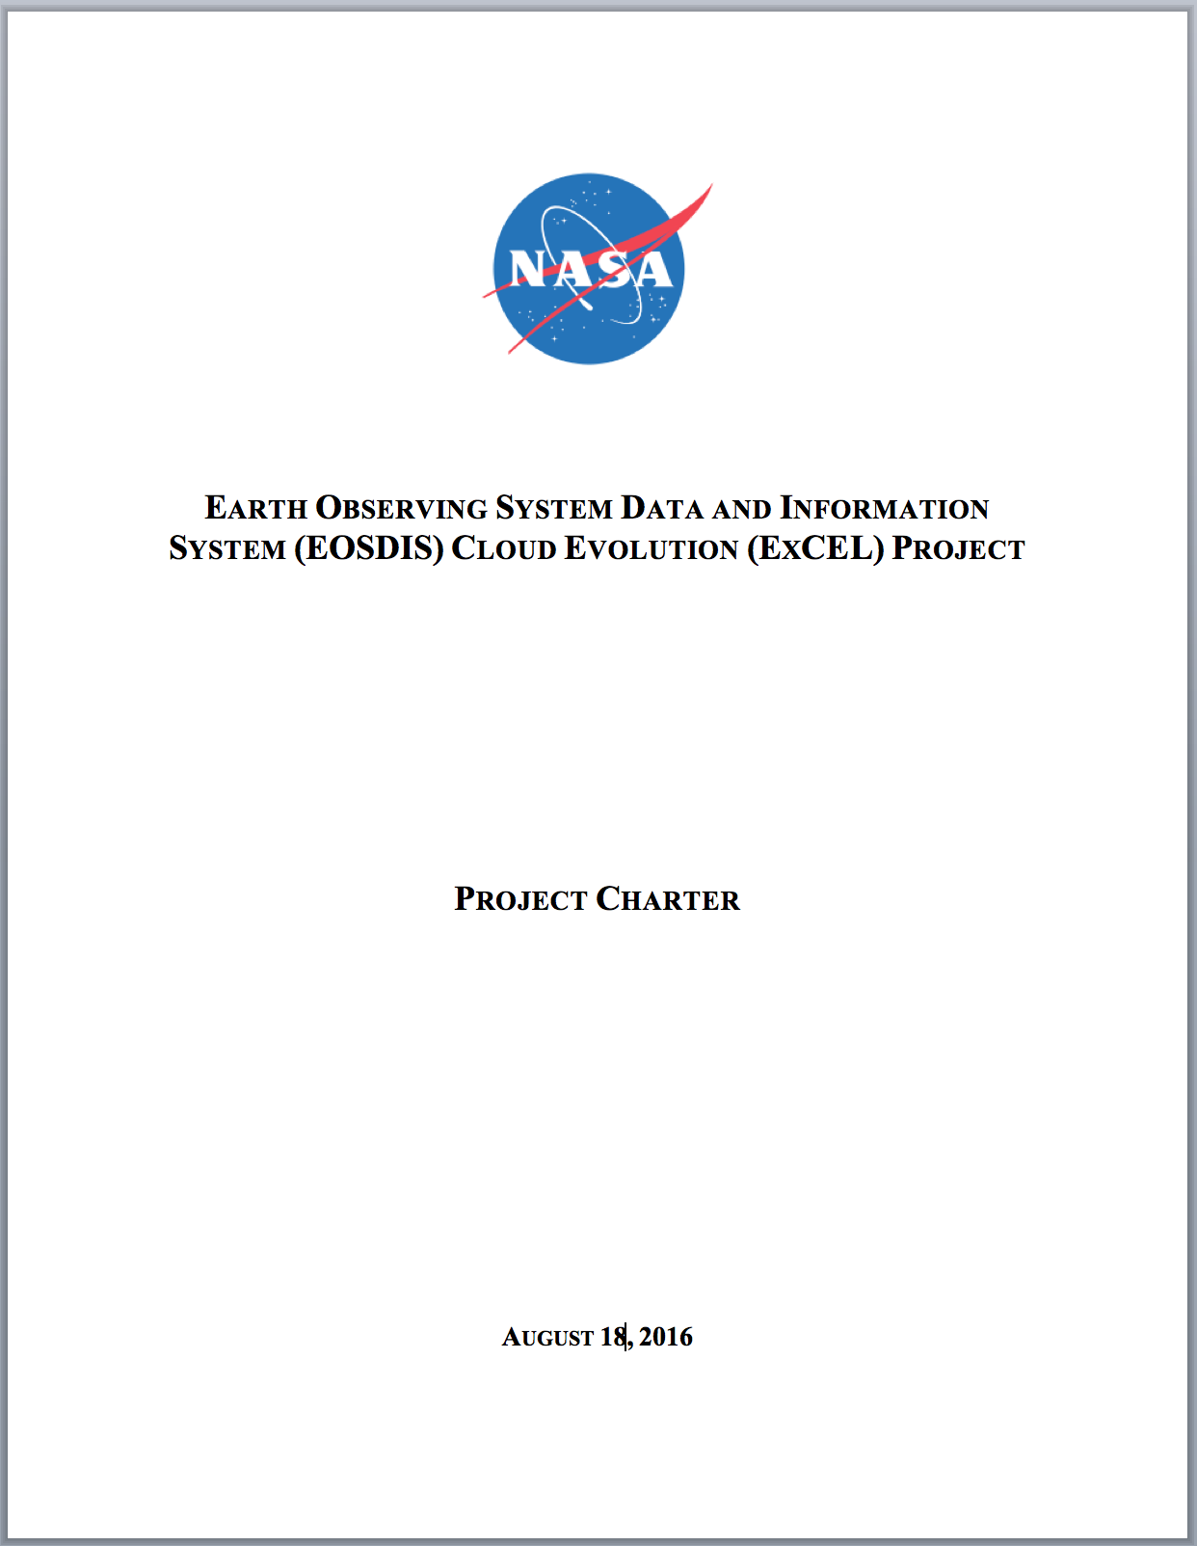
ExCEL Project Management Plan
1
ExCEL is a 12 month effort to evaluate commercial cloud technologies for foundational EOSDIS business and technical capabilities
Partners / Collaborators:
Alaska Satellite Facility (ASF)
Marshall Space Flight Center (MSFC)
Jet Propulsion Laboratory (JPL)
U.S. Geological Survey
NASA Office of the Chief Information Officer (OCIO)
Period of Performance for core capabilities work is Sep 2016 to Sep 2017
7
Cloud Evolution (ExCEL) Project
10

Slide 11
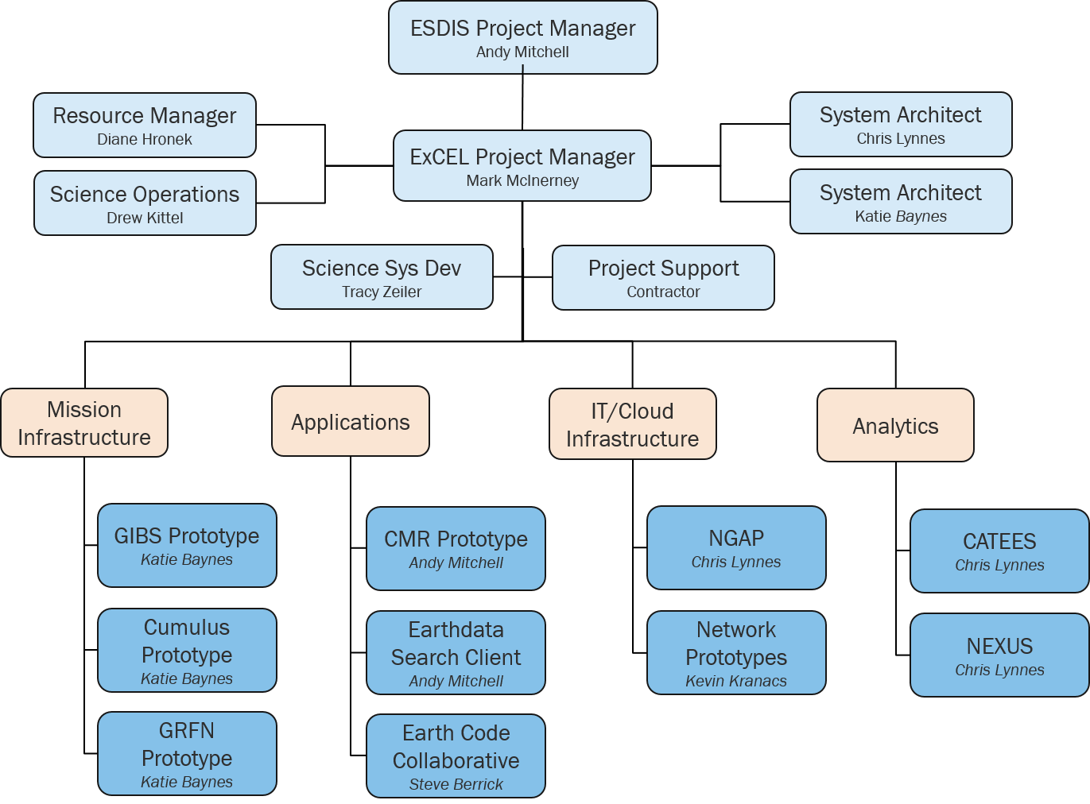
ExCEL Project Organization Chart
*
* Co-lead effort Between Katie Baynes and Rahul Ramachandran, Marshall Space Flight Center
Cloud Evolution (ExCEL) Project
11

Slide 12
ExCEL Technical Foundational Capabilities
Data Ingest: Multi-mission, multi-disciplines data ingest into the cloud
Data Ingest
Data Management: Development/execution of information lifecycle needs of NASA mission based earth science data sets
Data Distribution: Distribution includes raw data, sub-setting, visualization, and more
Data Management
Data Distribution
NGAP
AWS
Data Archive
* Analytics
Networking
IT Security
EOSDIS Technical Capabilities
Data Archive: Preserve and protect NASA mission based earth science data assets
Analytics: Cloud based on-the-fly data analysis and API access to analytic optimized cloud storage
Platform: Cloud infrastructure capabilities on Amazon Web Services (AWS) and the EOSDIS NASA Compliant General Application Platform, including networking and IT Security
Cloud Evolution (ExCEL) Project
* Important, although not considered foundational in ExCEL project
12

Slide 13
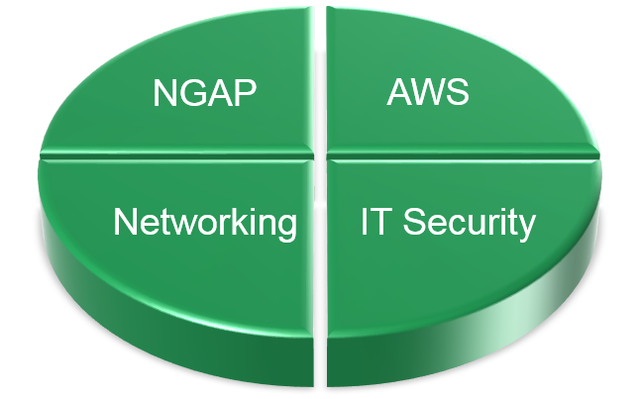
ExCEL Cloud Platform Capabilities
Cloud Platform Service Capabilities
All components of a centralized and compliant cloud infrastructure. This includes robust/flexible networking capabilities, tactical/compliance IT Security capabilities, and cloud native computing and storage distribution capabilities
Partnerships and Access to Commercial Cloud
OCIO’s Cloud Service Program Office (CSPO) provides IT Security support, cloud infrastructure support, business level support, and contractual support to Amazon Web Services (AWS)
Test and Operational Cloud Platforms
ExCEL Cloud Platform
Capabilities
NASA’s Compliant General Application Platform (NGAP) is built off CSPO’s General Purpose Managed Cloud Environment (GPMCE) and provides test/operational cloud based Platform-as-a-Service (PaaS) and Infrastructure-as-a-Service (IaaS) for EOSDIS
Cloud Evolution (ExCEL) Project
13

Slide 14
Technical Foundational Capability Mapping
Cumulus
Mapping EOSDIS technical foundational capabilities to ExCEL project prototype activates
Data
Ingest
Data
Archive
GIBS
Data Distribution
Data Distribution
EDSC
CMR
Data Management
Data Management
Data Management
Data Management
Earthdata Search Client, data search
Common Metadata Repository
Global Imagery Browse Services
Prototype addressing core EOSDIS DAAC
Cloud Evolution (ExCEL) Project
14

Slide 15
ExCEL Business Foundational Capabilities
TM
Total Economic Impact
A Forrester assessment and justification analysis of evolving into a cloud focused infrastructure base on four elements: benefits, costs, risks, and flexibility
Cloud Resource Management Tools
Automated monitoring & management tools unifying IT, security, and financial resources across the EOSDIS cloud platform
Enterprise Governance
Establish governance processes between EOSDIS, stakeholders, and partners to effectively govern the centralized cloud platform for the EOSDIS enterprise
Business Processes
Standard Operating Procedures
Through governance, business management, and established tools develop procedures to operate EOSDIS in a centralized cloud platform
Business Management
Establish resources and new business processes to effectively manage a centralized cloud platform at ESDIS for the EOSDIS enterprise
Cloud Evolution (ExCEL) Project
15

Slide 16
Decision Considerations
High level decision consideration for individual project prototypes and capabilities to operationalize into AWS (commercial cloud)
1
01
Cost
Is AWS (commercial cloud) affordable?
02
Is NASA IT Security compliance and tactical operations achievable in AWS (commercial cloud)?
IT Security
03
Is performance equal to or better than current on-premises solutions?
Performance
04
Can we operate “Operationally” in AWS (commercial cloud), technical and business?
Operational
Cloud Evolution (ExCEL) Project
16

Slide 17
Defining Success
(01) Full Scale Deployment (?)
01
Full scale enterprise deployment of EOSDIS services and infrastructure to the cloud
02
(02) Partial Deployment (?)
Select deployment of EOSDIS services and/or infrastructure to the cloud
(03) Cloud Stand-down (?)
Determining Project Success
03
No EOSDIS services or infrastructure operationally migrated to the cloud
Project success is determined by viable outcomes of fully completed project prototypes and business analysis.
- or -
Technical and business results of the ExCEL project needed for stretegic decision on EOSDIS and the cloud.
04
(04) Decision Point (?)
More prototyping required, or cloud hybrid, or other next steps based on ExCEL prototyping and business analysis results
Cloud Evolution (ExCEL) Project
17

Slide 18
Technical Accomplishment
Hardened Amazon cloud platform developed to host EOSDIS applications (NGAP)
Operational Deployment of Earthdata Search Client (EDSC) in NGAP – September 2016
https://search.earthdata.nasa.gov
Completed prototype developed serving public science data from NGAP (AWS S3 Object Storage) [Sentinel-1 Radar Data / Prototype NISAR Data)
Serverless architecture prototyped for ingest archive (Phase-1 Cumulus)
Order-of-magnitude speedup achieved in cloud analytics prototype
1
7
Cloud Evolution (ExCEL) Project
18

Slide 19
Business Accomplishments
Approval to run under NASA OCIO’s Authorization to Operate (ATO)
Achieved a 26.6% 5PB volume/time discount on AWS S3/S3IA object storage to support the prototyping activities.
Larger discounts possible based on volume/time for operations
In partnership with OCIO Cloud Service Program Office (CSPO) established automated daily/monthly cloud cost accounting.
Tagging by AWS service and EOSDIS project/capability
Contract with Forrester for quantitative assessment of benefits, costs, risks, and flexibility (pending)
1
7
Cloud Evolution (ExCEL) Project
19

Slide 20
Foundational Capabilities Deployment Schedule
Common Metadata Repository (CMR) prototype “scheduled” deployment April 30, 2017
CMR
Global Imagery Browse Services, “scheduled” deployment October 29, 2017
GIBS
Today
AUG 2016
SEP
2016
OCT
2016
NOV
2016
DEC
2016
JAN
2017
FEB
2017
MAR
2017
APR 2017
May
2017
JUN 2017
JUL
2017
AUG
2017
SEP
2017
OCT
2017
NOV
2017
DEC
2017
2018
Global Hydrological Resource Center (GHRC)
Physical Oceanography (PO DAAC)
National Snow and Ice Data Center (NSIDC) End Q1 2018
Land Processes (LP DAAC)
Cumulus
EDSC
Prototype addressing Foundational EOSDIS Distributed Active Archive Centers (DAAC) Capabilities, 4 phased Deployment
Earth Data Search Client (ESDC) prototype “deployed” to cloud September 2016
Cloud Evolution (ExCEL) Project
20

Slide 21
Questions?
Mark McInerney
Deputy Project Manager – Technical
Earth Science Data & Information System (ESDIS)
February 2017

Slide 22
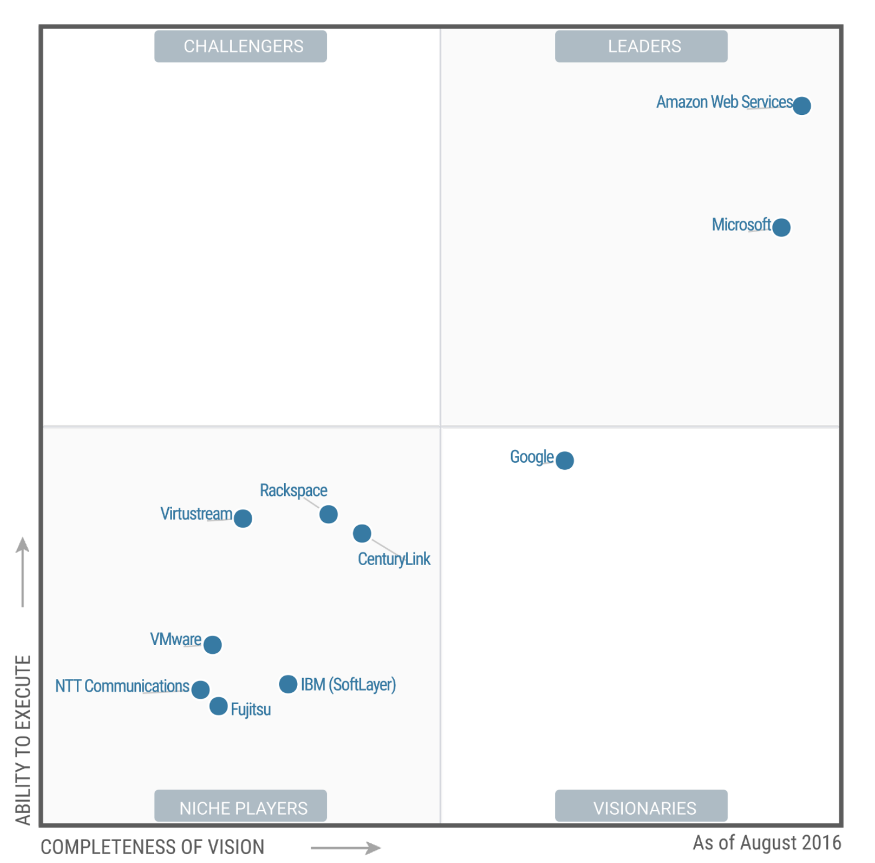
Why Amazon Web Services (AWS)
NASA OCIO Cloud Service Program Office (CPSO) currently offers Amazon Web Services.
CSPO is actively working to bring Microsoft cloud capabilities to it’s service offerings
AWS is the proven industry leader in cloud.
Gartner
Cloud Evolution (ExCEL) Project
22

Slide 23
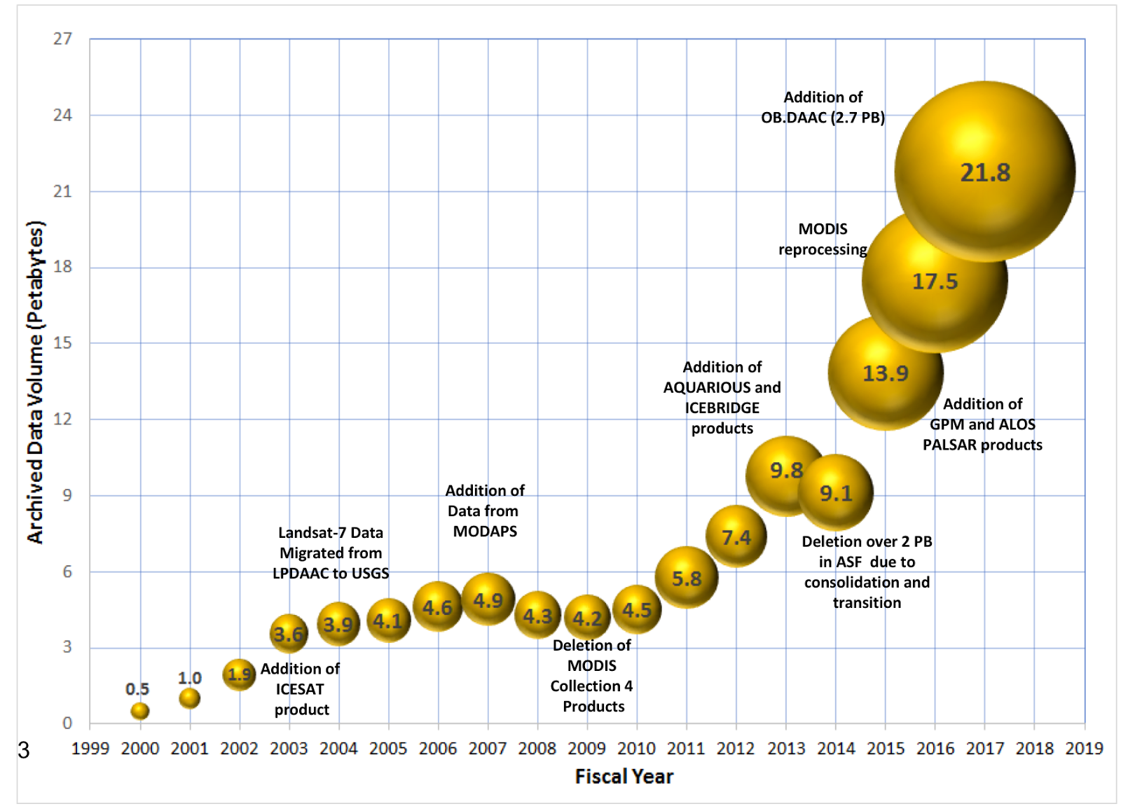
Background: Current Archive Volume
1
7
Cloud Evolution (ExCEL) Project
23

Slide 24
ESDIS Missions, Last 5 Years
Missions | Launch Date | Daily Data Volume | DAAC(s)
S-NPP | Oct 28, 2011 | 1,700 GB/day | GES DISC, OB, LP, NSIDC, LAADS, ASDC
Shizuku (GCOM-W1) | May 18, 2012 | 8 GB/day | GHRC / NSIDC
GPM | Feb 27, 2014 | 410 MB/day | GES DISC
Sentinel-1A | Apr 3, 2014 | 1,800 GB/day | ASF
OCO-2 | Jul 2, 2014 | 82 GB/day | GES DISC
RapidScat on ISS | Sept 20, 2014 | 3.3 GB/day | PO
CATS on ISS | Jan 10, 2015 | 14 GB/day | ASDC
SMAP | Jan 31, 2015 | 350 GB/day | ASF / NSIDC
DSCOVR | Feb 11, 2015 | 859 MB/day | ASDC
Sentinel-3A | Feb 16, 2016 | 939 GB/day | OB, LAADS
Sentinel-1B | April 22, 2016 | 1,800 GB/day | ASF
CYGNSS (EV-M) | Oct 28, 2016 | 9,872 MB/day | PO
SAGE-III on ISS | Feb 19, 2017 | 174MB/day | ASDC
LIS on ISS | Feb 19, 2017 | 100 MB/day | GHRC
TOTAL |  | 6.7 TB/day
1
7
Cloud Evolution (ExCEL) Project
24

Slide 25
ESDIS Missions, Next 5 Years
Missions | Launch Date | Daily Data Volume | DAAC(s)
Sentinel-5P | June 2017 | 626 GB/day | ASF
JPSS-1 | July-Sept 2017 | 1,700 GB/day | GES DISC, OB, LP, NSIDC, LAADS, ASDC
Sentinel-3B | Nov 2017 | 128 GB/day | OB, LAADS
OCO-3 on ISS | 2018 | 38 GB/day | GES DISC
GRACE FO | Feb 2018 | 19 MB/day | PO
TSIS on ISS | Apr 2018 | 541 MB/day | GES DISC
ICESat-2 | Sept 2018 | 891 GB/day | NSIDC
ECOSTRESS | 2019 | 585 GB/day | LP
GEDI on ISS | Mar 2019 | 3.5 GB/day | LP
CLARREO-PF on ISS | 2020 | 314 GB/day | ASDC(TBD)
MAIA | Sept 2020 | 77 GB/day | ASDC(TBD)
SWOT | Oct 2020 | 16 TB/day | PO
TEMPO | 2021 | 1.7 TB/day | ASDC
NISAR | Dec 2021 | 95 TB/day | ASF
JPSS-2 | Oct 2021-Feb 2022 | 1,700 GB/day | GES DISC, OB, LP, NSIDC, LAADS, ASDC
PACE | Jun 2022 | 3.5 TB/day | OB
TOTAL |  | 122 TB/day
1
7
*
Cloud Evolution (ExCEL) Project
25

Slide 26
ExCEL Efforts and Project Prototypes
NGAP
NASA Compliant General Application Platform (NGAP), an operational, dev-ops, and sandbox AWS cloud based operating environment.
1
2
ASF WOS Prototype
AWS/NGAP Web Object Storage (WOS) prototyping large volumes of mission data dynamically between AWS S3, S3-IA, and Glacier object storage. Managed out of Alaska Satellite Facility
3
Earthdata Search Client to Cloud
NASA Earth Science data search by keyword and advanced filters such as time and space
ExCEL Project
4
Cumulus
Prototype addressing core EOSDIS capabilities including data ingest, archive, management, and distribution of large volumes of EOS data.
5
Getting Ready for NISAR (Preparation Prototype)
Integrated prototype of science product generation and delivery from a DAAC system focused on coupling ASF DAAC and JPL ARIA systems.
6
CATEES
7
Easy-to-use Python tools packaged to support EOSDIS cross-DAAC science workflows and analytics over large volumes of EOS data in AWS.
ECC to Cloud Study
Earth Code Collaborative (ECC) study to determine cloud ready capabilities to migrate into AWS/NGAP platform.
Cloud Evolution (ExCEL) Project
Core Prototype / Capabilities
26

Slide 27
ExCEL Efforts and Project Prototypes Continued
GIBS in the Cloud
Migrating GIBS to the AWS/NGAP Cloud based on recommendations made in the “GIBS in the Cloud Study”
8
Earthdata Login to Cloud Study
9
Study to determine and recommend migrating the Earthdata Login into AWS/NGAP cloud environment
CMR to Cloud
ExCEL Project
10
ExCEL Project
Migration of the Common Metadata Repository, into the AWS/NGAP platform based on recommendations made in the CMR to Cloud study.
OPeNDAP/HDF Cloud Studies
11
Study to determine and recommend a cloud native integration of OPeNDAP accessing HDF5 and netCDF4 data on AWS/NGAP platform.
NEXUS
12
Prototype to accelerate end-user analysis of remote sensing data, highly parallel to better enable science discovery
13
Network Prototypes
Network prototypes to test cloud security, monitoring, logging, and to perform R&D testing to help meet the goals of all ExCEL project prototypes.
Core Prototype / Capabilities
Cloud Evolution (ExCEL) Project
27

