Slide 1
EOSDIS
FY2013
Annual Metrics Report
Prepared By:
Hyo Duck Chang, Adnet, Inc.
Brian Krupp, Adnet, Inc.
Lalit Wanchoo, Adnet, Inc.
Young-In Won, Wyle, Inc
February 2014

Slide 2
Preface
The Earth Sciences Data and Information System (ESDIS) Project (Code 423) prepared the following report on metrics from across the Earth Observation System Data and Information System (EOSDIS). The 12 Distributed Active Archive Centers (DAACs) of EOSDIS support different scientific disciplines and provide an individualized set of products and services to their science community and the public. Although discipline oriented, the DAACs engage in common data management functions of ingest, archive and distribution, as well as describing their data and services on web sites. Metrics are collected on a daily basis from each DAAC. The ESDIS Project collects these metrics in a tool called the ESDIS Metrics System (EMS). DAAC analysts can view their detailed metrics to assess internal performance and trends. The ESDIS Project combines these metrics, not for comparisons between the DAACs, but as a system level view of EOSDIS performance. This report provides snapshots of metrics as the combination of the individual DAACs and as a system. In keeping with previous years, and in order to support trend comparisons, the metrics data are presented on a fiscal year basis, not by calendar year. These reports are posted online with metrics as far back as 1996. Each report includes some historical trend information. If you have any questions or comments, please contact Jeanne Behnke at (301) 614-5326 or jeanne.behnke@nasa.gov or Kevin Murphy at (301) 614-5580 or kevin.j.murphy@nasa.gov.

Slide 3
Introduction
This report presents statistics on data metrics and web activities at the EOSDIS DAACs during Fiscal Year 2013 (October 1, 2012 through September 30, 2013) from the Earth Science Data and Information System (ESDIS) Metrics System (EMS).
EMS supports the ESDIS project management by collecting and organizing various metrics from the Earth Observing System (EOS) Data and Information System (DIS) DAACs and other sources. The EMS collects and presents data on the usage of products and services delivered via the Internet or managed in EOSDIS archives.
EMS consists of a Data Metrics component and a Web Metrics component. The Data Metrics component provides statistics on data ingest, archive and distribution plus data users profile information. The Web Metrics component provides statistics on web site visits, views and visitors with a variety of related parameters.
This report contains tables and graphs of FY2013 statistics and comparisons to previous years. Values for previous fiscal years are produced from EMS unless noted otherwise. Summary tables, text, graphs, and more detailed statistics tables are also included. As before, metrics for the Near Real-Time (NRT) products are presented in a separate worksheet and a separate summary table for NRT products, called LANCE_Summary, is included. Note that NRT metrics are not used in the distribution trend analyses presented in this report. All bots-related distributions (downloads by Internet search engines for indexing purposes) are excluded in the ASF metrics. A new worksheet called "Total Archive Trend" showing various input sources used to derive total archive volumes for previous years is added to this year's report.
Definitions for terms used in this report can be found in the Definitions worksheet.

Slide 4
EOSDIS Summary
Unique Data Sets: Total number of unique data sets distributed in the fiscal year.
Distinct Users of EOSDIS Data and Services: Total unique users across EOSDIS Data Users and Web Visitors, per DAAC and summed (does not include LANCE Web Visitors)
Web Site Visits: Sum of web visits for DAACs and LANCE data providers where a visit represents a user session not broken by more than 30 minutes and a duration of at least one minute
Average Archive Growth: Sum across reporting DAACs of the data volume added to the individual archives divided by the days in the year
Total Archive Volume: Sum across reporting DAACs of the data volumes in the archive as of end of the fiscal year
End User Distribution Products: Total number of products distributed from all reporting DAACs and LANCE data providers
End User Average Distribution Volume: Sum across reporting DAACs and LANCE data providers of the data volume distributed for the fiscal year divided by the days in the year

Slide 5
Land Atmosphere Near Real-time Capability
for EOS (LANCE) Summary
Unique Data Sets: Total number of unique data sets distributed in the fiscal year
Distinct Registered LANCE Users: Total number of unique LANCE users who registered and retrieved NRT products from all LANCE data providers, excluding the unregistered users who downloaded imagery products from the MODIS Rapid Response System
Web Site Visits: Sum of web visits for LANCE data providers where a visit represents a user session not broken by more than 30 minutes and a duration of at least one minute
Average Production Growth: Sum of the NRT data volume generated by all LANCE providers divided by the days in the year, including the NRT and NRT2 processing streams
Total Production Volume: Two weeks worth of production volume of the NRT/NRT2 data products, calculated by multiplying Average Production Growth by 14 (days) assuming the deletion of the NRT/NRT2 products two weeks after production
End User Distribution Products: Total number of products distributed from all reporting LANCE data providers
End User Average Distribution Volume: Sum across reporting LANCE data providers of the data volume distributed for the fiscal year divided by the days in the year

Slide 6
Data Metrics
Ingest
Archive
Total Archive
Data Users
  Distinct Users
  Repeat Users
  Top 20 Countries
  Foreign Distribution
  Distribution
    By Data Center
    Volume by Domain
    Products by Domain
    Top 20 Countries
    Top 10 Products
    Unique Product Count
    Near Real-time Products
  Production
  Distribution

Slide 7
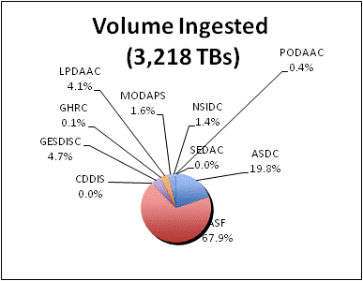
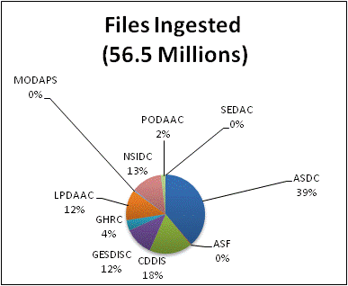
Ingest
Ingest is the amount of data coming into a DAAC over a period of time and includes all product levels. For this report, the data is presented as the amount of data entered into each DAAC during FY2013. The sum of all DAACs is the total ingest for EOSDIS. OBPG and ORNL are unable to provide ingest metrics at this time.

Slide 8
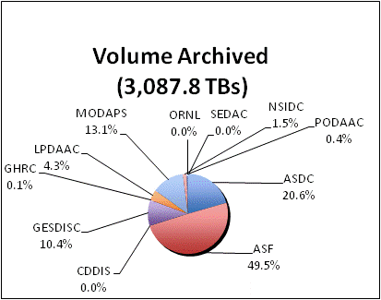
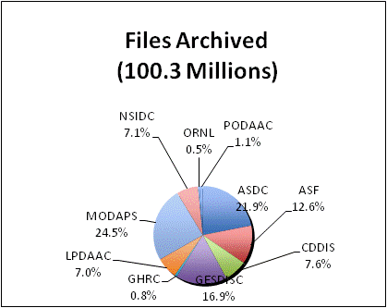
Archive
This table shows the amount of data added to the archive during FY2013 and includes all products levels. Archive metrics for OBPG and NSIDC V0 are not available at this time.

Slide 9
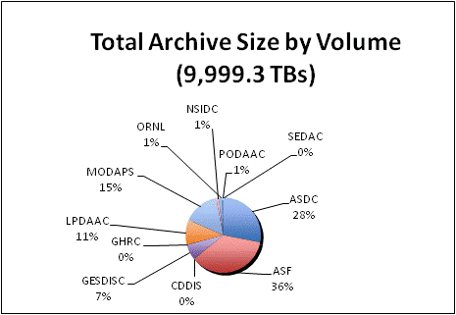
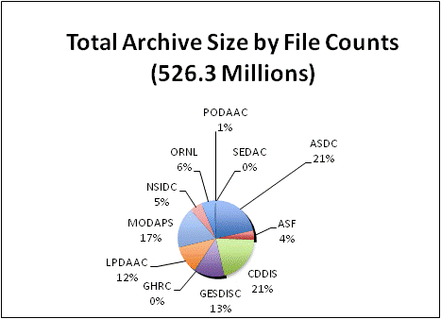
Total Archive Size
The Total Archive Size describes the EOSDIS archive at the end of FY2013. This includes all data (including ancillary) but not data marked for deletion.
* ASDC archive size is based on the archive values for LaRC ANGe and LaRC ECS provided by John Kusterer of ASDC
** CDDIS archive size was derived from the archive values as of 10/23/2013 provided by CDDIS
*** Archive values were provided by B. McMurry of ORNL
on 11/04/2013

Slide 10
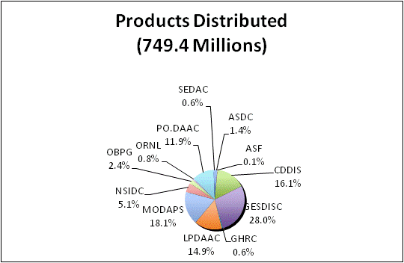
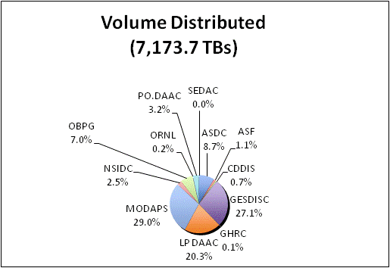
Distribution By DAAC
Distribution presents the amount of data successfully distributed to Public Users.

Slide 11
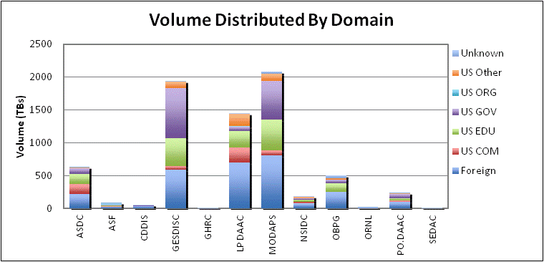
Volume Distributed By Domain
Volume Distribution presents the volume of data successfully distributed to Public Users by Domain.

Slide 12
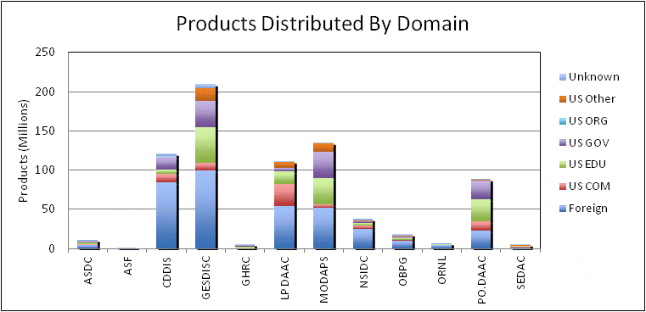
Product Distribution By Domain
Product Distribution presents the number of products successfully distributed to Public Users by Domain.

Slide 13
Data Distribution - Top 20 Countries
* Some products are inherently larger than other files in size and therefore may skew the results.
** When counting # of products, metadata files are excluded.

Slide 14
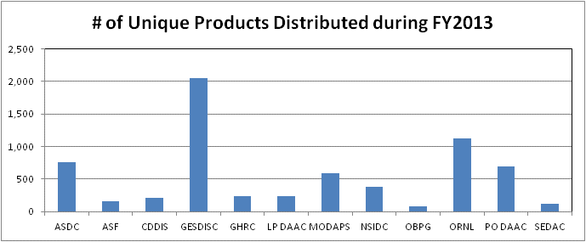
Distribution of Unique Data Products
Tables below show the number of unique data products distributed to public users during FY2013. In counting unique products, metadata were excluded. NRT products are not included.

Slide 15
Data Distribution - Top 10 Products
* Some products are inherently larger than other files in size and therefore may skew the results.
** When counting # of files, metadata files are excluded.

Slide 16
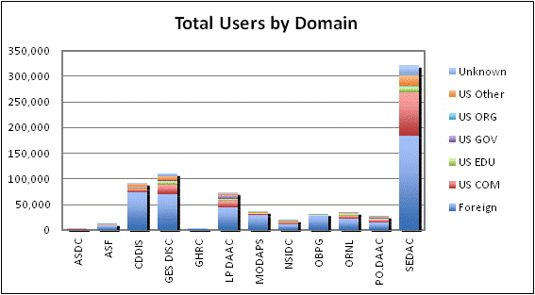
Distinct Data Users
Distinct Data Users presents the number of distinct public users who received data product files.

Slide 17
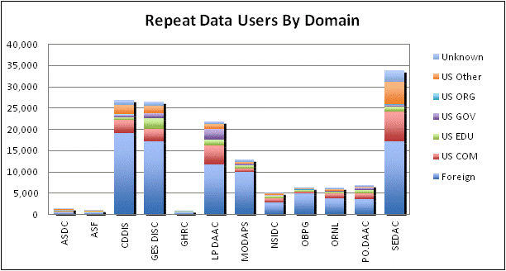
Repeat Data Users
Repeat users are distinct Public users who received data on more than one day in the fiscal year.

Slide 18
Data Users - Top 20 Countries

Slide 19
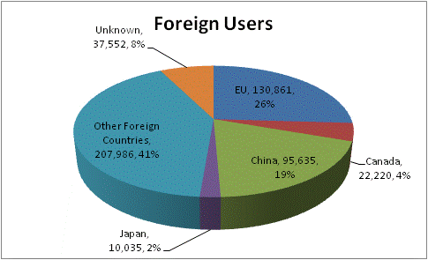
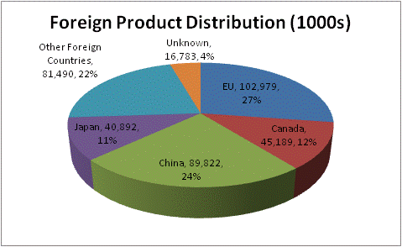
Foreign Distribution
Distribution metrics for foreign public users are compared. Statistics are based on country information provided by the 12 EOSDIS DAACs.
* EU includes 27 European Union member countries.
** China includes only People’s Republic of China and does not include Taiwan or Hong Kong.
*** This represents the data users whose countries are unknown

Slide 20
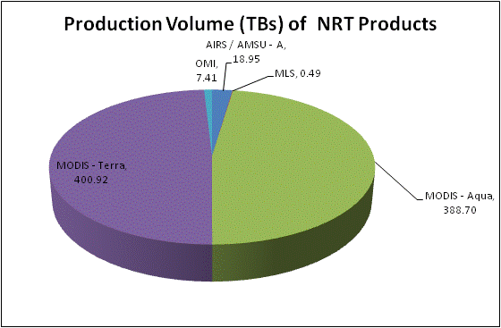
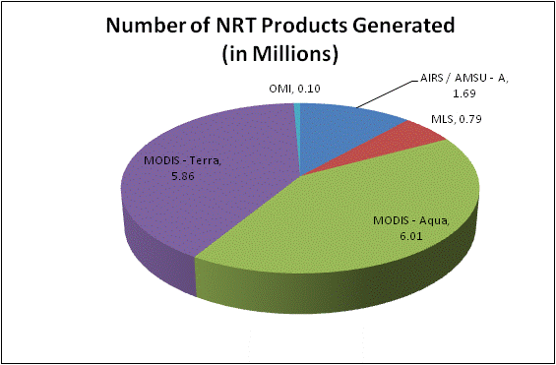
Production of Near Real-Time Products
Near Real-Time (NRT) production represents the amount of data generated by the Land Atmosphere Near Real-time Capability for EOS (LANCE) data providers, including the two identical processing systems, NRT and NRT2.
Volume and file count include the data products deleted from archive

Slide 21
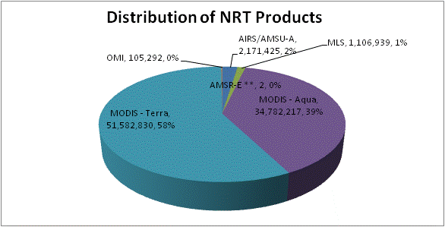
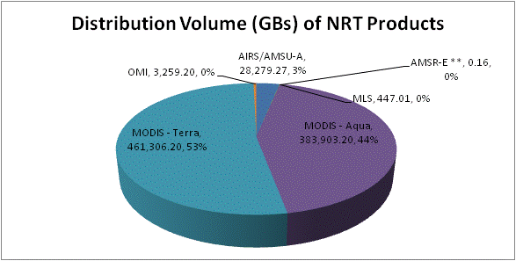
Distribution of Near Real-Time Products
Near Real-time (NRT) Distribution provides the amount of data successfully distributed to registered users of the Land Atmosphere Near Real-time Capability for EOS (LANCE). LANCE provides access to near real-time data (<3 hours from observation) from MODIS, AMSR-E, AIRS, MLS and OMI instruments. Metrics for distribution volume, numbers of files distributed and users are presented.
* Excludes metadata
** Includes the NRT products from MODAPS
*** Represents the number of unique IP hosts/e-mail addresses used to retrieve NRT products, excluding registered users
**** Represents the number of the registered users who retrieved data for each instrument. It must be noted that sum of theses users
may be greater than the total number of unique registered users since one user could retrieve data for multiple instruments

Slide 22
Web Metrics
Visitors and Visits
Repeat Visitors
Top 20 Domains
Top 20 Countries
LANCE Web Metrics

Slide 23
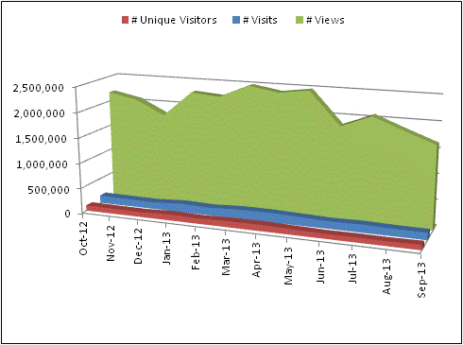
Web Visitors and Visits
EOSDIS web activity is measured by number of Visits made, the number of pages Viewed and the number of distinct Visitors. Visits of at least one minute are considered to represent significant work accomplished, and many of the shorter visits are of less than a second. Eleven of the twelve EOSDIS DAACs report web metrics at this time; all except OBPG. Note that the sum of monthly visitors could be greater than the number of unique visitor for a given year since one user could be counted more than once if he/she visited the same website in different months.

Slide 24
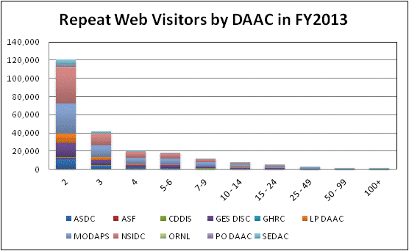
Repeat Web Visitors
EOSDIS Web Visitors are characterized by the number of visits they make and how frequently they return. Visitors counted in the table below are those that stayed for one minute or more. Repeat Visitors are counted from the start of the Fiscal Year. Metrics data is collected per data center and summed for an EOSDIS total.
FY2013 Web Visitors for Visits of one minute or more

Slide 25
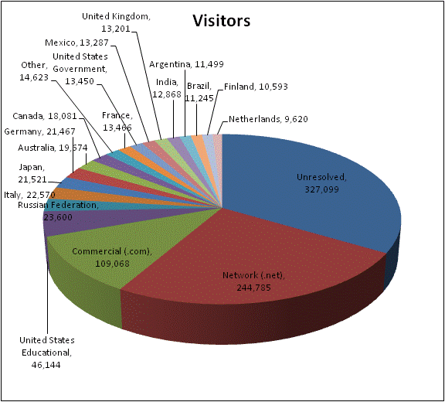
Top 20 Domains By # of Web Visitors
The FY2013 Top 20 Domains for visits >= 1 minute is sorted by the # of Visitors. Data came from 11 DAACs (all DAACs on Slide # 10 except OBPG provide web metrics). All statistics are based on domains resolved by NetInsight, using host information. Domain information was obtained using a NASA DNS translation program.

Slide 26
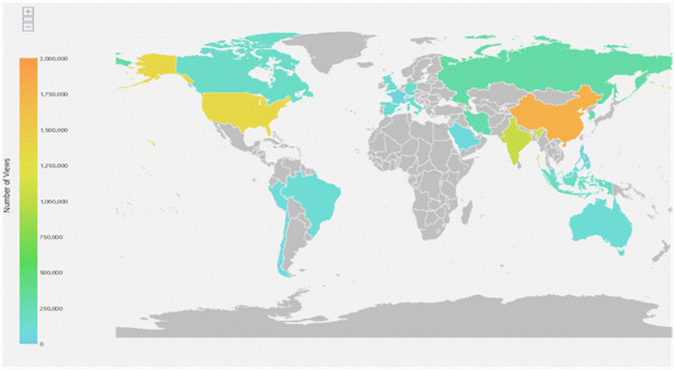
Top 20 Countries By # Web Visits
The FY2013 Top 20 Countries for visits >= 1 minute is sorted by the # of Visits. Data came from 11 DAACs (all DAACs on Slide # 10 except OBPG provide web metrics). Country information is based on the NetInsight geographical data from Quova, the Neustar IP Intelligence and IP Geolocation Service.

Slide 27
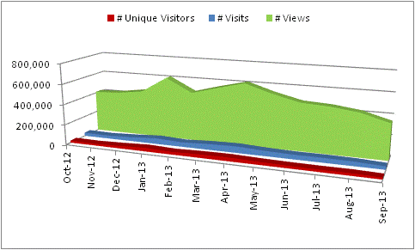
LANCE Web Metrics
LANCE web activity is measured by number of visits made, the number of pages viewed and the number of distinct visitors for the LANCE website. The number of hosts counts the distinct IP addresses of the visitors. Repeat visitors is a count of those visitors who made at least two visits since the start of web activity measurements or in the fiscal year.
Web metrics are presented for visits of one minute or greater. Visits of at least one minute are considered to represent significant work accomplished, and many of the shorter visits are of less than a second. The sum of monthly visitors could be greater than the number of unique visitors for a given year since one user could be counted more than once in the monthly visitor count if he/she visited the LANCE websites in different months.
27

Slide 28
Total Users and Trends
Total Users
Total Archive Trend
Data Volume Distribution Trend
Data Product Distribution Trend
Top 10 Products Trend FY2012 - FY2013
Known U.S. - Foreign Product Distribution Trend
Web Trends (Visits and Visitors)

Slide 29
Total Users
Total Users is an estimate formed by combining the distinct Data Users and distinct Web Visitors, removing the overlap. The common element for these counts is the IP address (Host); therefore, the comparison is made without using the additional details provided by the Data User email address or the Web Visitor browser. Not being able to compare the users directly likely results in an undercount. Web Visitors included in the count are for those visitors with visits of one minute or longer. To minimize the undercount, the final Total Users value includes the total Web Visitors (IP address plus browser), plus the distinct Data Users (counted by IP Address).

Slide 30
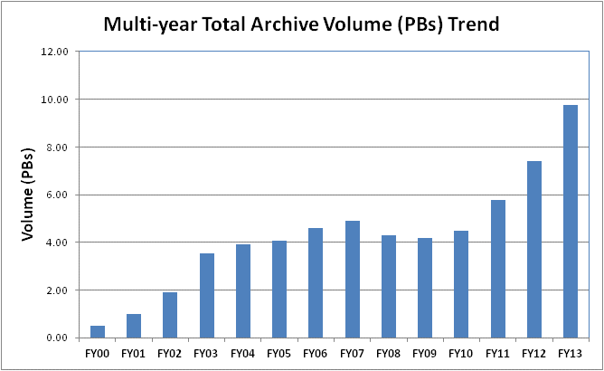
Total Archive Trend
The total archive trend is based on data and reports produced during individual fiscal years, rather than from EMS. EMS does not contain sufficient information to recreate the archive size for previous years due to episodic deletions from the archive and not all archive information is supplied to EMS by the DAACs. Since products are deleted at the DAACs and not always reported to EMS, It may not able to completely reproduce what was in the archive in previous years.
The trend data were compiled in FY2013 with the expectation it will be updated yearly with data captured in that year's EOSDIS Annual Report in the Total Archive Size worksheet. The sources of data for earlier years , which are not presented here, are available from the Excel version of this report.

Slide 31
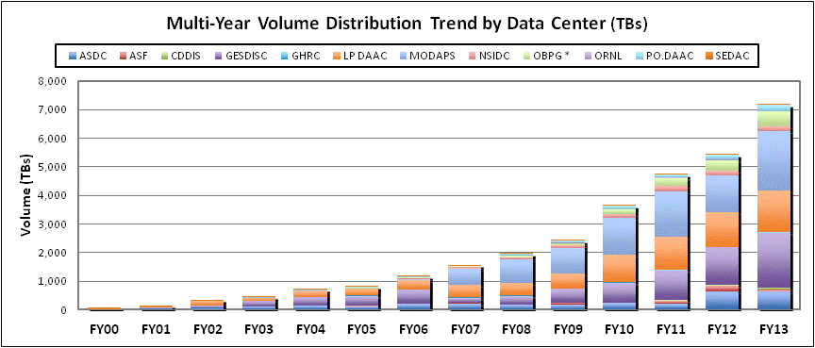
Data Volume Distribution Trend
The Volume Distribution Trend presents distributed volume counts from EMS by DAAC. OBPG distribution metrics from the Ocean Color web site are included beginning in FY2004. CDDIS data became available in FY2009.

Slide 32
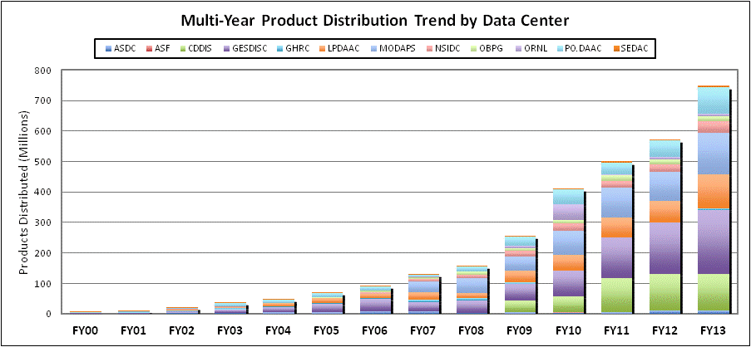
Data Product Distribution Trend
The Product Distribution Trend presents distributed product counts from EMS by DAAC. OBPG distribution metrics from the Ocean Color web site are included beginning in FY2004. CDDIS data became available in FY2009.

Slide 33
Top 10 Products Trend by Volume
FY2012 – FY2013
*Some products are inherently larger than other files in size and therefore may skew the results.

Slide 34
Top 10 Products Trend by # of Files
FY2012 – FY2013
** When counting # of files, metadata files are not included.

Slide 35
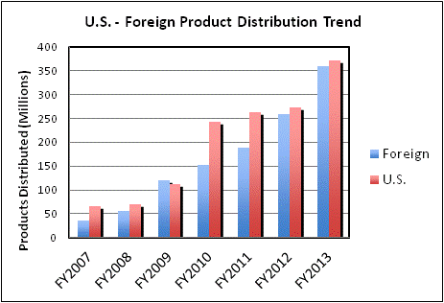
Known U.S. – Foreign
Product Distribution Trend
Note: Metrics do not include product distribution where the destination country could not be determined.

Slide 36
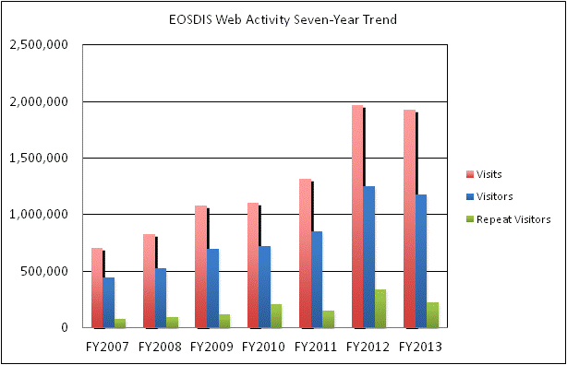
Web Trends
Web metrics data for EOSDIS became available as of FY2007. Data for FY2007 is complete for 7 DAACs and FY2008 is complete for 8 DAACs. Since FY2009, 11 DAACs provided web metrics. These metrics are for visits of one minute or more. Repeat visitors are counted as 2 or more visits since web activity measurements began for that DAAC.

Slide 37
Definitions (1 of 3)

Slide 38
Definitions (2 of 3)

Slide 39
Definitions (3 of 3)

