Slide 1






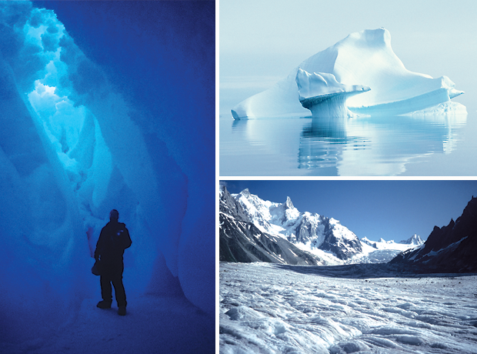
Data Set Casting
An overview of the xml used for casting data sets
Notes:
Presentation covers –
What is a data set cast
An example of a cast
Concerns and issues

Slide 2
Data Set Casting
Data sets are cast to:
  Enable discovery of data
  Link services and data
  Encourage sharing of data
Each data set is “entry” within a feed
Data sets are combined to create “feeds”
  A data set may appear in multiple feeds
Notes:
Key features of a data set cast are the need to aggregate entries and search on them.

Slide 3
Concerns and Issues
Data set identifiers
Representation of a data set
  Incorporating standards (ISO TC211)
  Duplication of content
  Redefining xml schema types
  Including data set information vs. proving a link
  Portability to different syndication formats
Elements for matching and searching
  Need more than spatial, temporal, GCMD parameter, and ISO topic category

Slide 4
Example: Feed
<?xml version="1.0" encoding="UTF-8"?>
<atom:feed xmlns:atom="http://www.w3.org/2005/Atom">
<atom:author>
<atom:name>National Snow and Ice Data Center</atom:name>
<atom:uri>http://nsidc.org</atom:uri>
<atom:email>nsidc@nsidc.org</atom:email>
</atom:author>
<atom:category term="data set"></atom:category>
<atom:id>nsidc.org,2010,dataset</atom:id>
<atom:link rel="self" href="http://nsidc.org/feeds/data/datasets.xml"
type="application/atom+xml"></atom:link>
<atom:title>NSIDC Data Sets</atom:title>
<atom:updated>2010-10-13T11:51:02.253321-06:30</atom:updated>
<atom:entry>

Slide 5
Example: Entry
<atom:entry>
<!-- Categories not carried at the entry level- datacast xml takes care of that -->
<atom:author>
<atom:name>George A. Riggs</atom:name>
</atom:author>
. . .
<atom:name>Vince V. Salomonson</atom:name>
</atom:author>
<atom:id>http://nsidc.org/data/myd29v5.html</atom:id>
<atom:link href="http://nsidc.org/data/myd29v5.html"></atom:link>
<!-- Dates are problematic must be ISO datetime values -->
<atom:published>2006-12-18T00:00:00Z</atom:published>
<atom:summary><![CDATA[MODIS/Aqua Sea Ice Extent 5-Min L2 Swath 1km (MYD29) data set contains fields for sea ice by reflectance, sea ice by reflectance pixel Quality Assessment (QA), Ice Surface Temperature (IST), IST pixel QA, latitudes, and longitudes in compressed Hierarchical Data Format-Earth Observing System (HDF-EOS) format, along with corresponding metadata. Latitude and longitude geolocation fields are at 5 km resolution, while all other fields are at 1 km resolution. The sea ice algorithm uses a Normalized Difference Snow Index (NDSI) modified for sea ice to distinguish sea ice from open ocean based on reflective characteristics.
Data are stored in HDF-EOS format, and are available from 4 July 2002 to present via FTP. Data can also be obtained in GeoTIFF format by ordering the data through the Data Pool.
]]></atom:summary>
<atom:title>MODIS/Aqua Sea Ice Extent 5-Min L2 Swath 1km, Version 5
</atom:title>
<atom:updated>2010-10-13T12:01:01.123-06:30</atom:updated>

Slide 6
Example: Cast Entry
<dcast:datacast xmlns:dcast="http://www.nsidc.org/libre/schema/DataCast"
xmlns:gco="http://www.isotc211.org/2005/gco" xmlns:gmd="http://www.isotc211.org/2005/gmd"
xmlns:gml="http://www.opengis.net/gml" xmlns:gsr="http://www.isotc211.org/2005/gsr"
xmlns:gss="http://www.isotc211.org/2005/gss" xmlns:gts="http://www.isotc211.org/2005/gts"
xmlns:xlink="http://www.w3.org/1999/xlink" xmlns:xsi="http://www.w3.org/2001/XMLSchema-instance"
xsi:schemaLocation="http://www.nsidc.org/libre/schema/DataCast datacast.xsd ">

Slide 7
Example: Cast Identity
<identity>
<entry_id>http://nsidc.org/data/myd29v5.html</entry_id>
<title> <![CDATA[MODIS/Aqua Sea Ice Extent 5-Min L2 Swath 1km, Version 5]]></title>
<progress>underDevelopment</progress>
<summary> <![CDATA[ODIS/Aqua Sea Ice Extent 5-Min L2 Swath 1km (MYD29) data set contains fields for sea ice by reflectance, sea ice by reflectance pixel Quality Assessment (QA), Ice Surface Temperature (IST), IST pixel QA, latitudes, and longitudes in compressed Hierarchical Data
Format-Earth Observing System (HDF-EOS) format, along with corresponding metadata. Latitude and longitude geolocation fields are at 5 km resolution, while all other fields are at 1 km resolution. The sea ice algorithm uses a Normalized Difference Snow Index (NDSI) modified for sea ice to distinguish sea ice from open ocean based on reflective characteristics.
Data are stored in HDF-EOS format, and are available from 4 July 2002
to
present via FTP. Data can also be obtained in GeoTIFF format by
ordering the data through the Data Pool.]]>
</summary>
<language>eng</language>
<creator>George A. Riggs</creator>…
<release_date>2006-12-18</release_date>
<release_place>Boulder, CO</release_place>
<publisher>National Snow and Ice Data Center</publisher>
<version>5</version>
<online_resource>http://nsidc.org/data/myd29v5.html</online_resource>
</identity>

Slide 8
Example: Cast Facets
<facets>
<parameter><![CDATA[EARTH SCIENCE > Cryosphere > Sea Ice > Ice Extent]]></parameter>
<parameter><![CDATA[EARTH SCIENCE > Oceans > Sea Ice > Ice Extent]]></parameter>
<location><![CDATA[GEOGRAPHIC REGION > POLAR]]></location>
<iso_topic_category>imageryBaseMapsEarthCover</iso_topic_category>
<extent>
<gmd:geographicElement>
<gmd:EX_GeographicBoundingBox id="boundingGeographicBoundingBox">
<gmd:westBoundLongitude><gco:Decimal>-180</gco:Decimal>
</gmd:westBoundLongitude>
<gmd:eastBoundLongitude><gco:Decimal>180</gco:Decimal>
</gmd:eastBoundLongitude>
<gmd:southBoundLatitude><gco:Decimal>-90</gco:Decimal>
</gmd:southBoundLatitude>
<gmd:northBoundLatitude><gco:Decimal>90</gco:Decimal>
</gmd:northBoundLatitude>
</gmd:EX_GeographicBoundingBox>
</gmd:geographicElement>
Notes:
<gmd:temporalElement>
<gmd:EX_TemporalExtent id="boundingTemporalExtent">
<gmd:extent>
<gmd:TimePeriod>
<gmd:beginPosition>20020704</gmd:beginPosition>
<gmd:endPosition>Unknown</gmd:endPosition>
</gmd:TimePeriod>
</gmd:extent>
</gmd:EX_TemporalExtent>
</gmd:temporalElement>
</extent>
</facets>

Slide 9
Example: Cast Facets
<gmd:temporalElement>
<gmd:EX_TemporalExtent id="boundingTemporalExtent">
<gmd:extent>
<gmd:TimePeriod>
<gmd:beginPosition>20020704</gmd:beginPosition>
<gmd:endPosition>Unknown</gmd:endPosition>
</gmd:TimePeriod>
</gmd:extent>
</gmd:EX_TemporalExtent>
</gmd:temporalElement>
</extent>
</facets>

Slide 10
Example: Cast Contacts
<gmd:contact>
<gmd:CI_ResponsibleParty>
<gmd:individualName>
<gco:CharacterString>NSIDC USER SERVICES</gco:CharacterString>
</gmd:individualName>
<gmd:organisationName>
<gco:CharacterString>National Snow and Ice Data Center</gco:CharacterString>
</gmd:organisationName>
. . .
<gmd:phone>
<gmd:CI_Telephone>
<gmd:voice>
<gco:CharacterString>+1 (303) 492-6199</gco:CharacterString>
</gmd:voice>
codeListValue="pointOfContact">pointOfContact</gmd:CI_RoleCode>
</gmd:role>
</gmd:CI_ResponsibleParty>
</gmd:contact>

Slide 11
Example: Rights and Metadata
<rights>
<access_restrictions />
<use_constraints />
</rights>
<metadata>
<metadata_authority>NSIDC</metadata_authority>
<metadata_version>0.1</metadata_version>
<last_revision>2010-10-18</last_revision>
</metadata>
</dcast:datacast>
</atom:entry>
</atom:feed>

