Slide 1
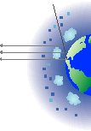
ATMOSPHERIC SCIENCE DATA CENTER
MEaSUREs Proposals and Interactions at the ASDC
ESDSWG
October 21, 2010

Slide 2
ATMOSPHERIC SCIENCE DATA CENTER
MEaSUREs Proposals at the ASDC: Status
The ASDC hosts 3 awardees from the MEaSUREs 2006 solicitation (announced October 2007)
NVAP: Thomas Vonder Haar/Science and Technology Corp. “Improvement of the NVAP Global Water Vapor Data Set for Climate, Hydrological, and Weather Studies” (Forsythe now ASDC POC)
ISCCP: William Rossow/The City University of New York/The City College “Global Cloud Process Studies in the Context of Decadal Climate Variability: Enhancement and Continuation of Data Analysis for the International Satellite Cloud Climatalogy Project”

Slide 3
ATMOSPHERIC SCIENCE DATA CENTER
MEaSUREs Proposals at the ASDC: Status
The ASDC hosts 3 awardees from the MEaSUREs 2006 solicitation (announced October 2007)
Airborne Data for Assessing Models (ADAM): Gao Chen/NASA Langley Research Center “Creating a Unified Airborne Database for Assessment and Validation of Global Models of Atmospheric Composition”

Slide 4
ATMOSPHERIC SCIENCE DATA CENTER
MEaSUREs Proposals at the ASDC: Status
Both NVAP and ISCCP are led by remote PIs and operate in the classic SIPS-DAAC mode
PI performs processing at separate facility
ASDC ingests, archives and distributes data, provides web presence and user services
ADAM (Airborne Data for Assessing Models) is led by a local PI and is hosted in a more collaborative and interactive way

Slide 5
ATMOSPHERIC SCIENCE DATA CENTER
Item | NVAP | ISCCP | ADAM
When were first contacts between ASDC and PIs made? | February 2009 to Vonder Haar; March 2010 with John Forsythe | February 2009 | February 2009
What products at ASDC are similar to MEaSUREs products? | Similar to current NVAP set: The final result will be a 24-year global water vapor dataset spanning 1987 - 2010 called NVAP-MEaSUREs (NVAP-M). | Similar to current ISCCP data set: PI will create an alternate collection with 10 km spatial sampling instead of current 30 km. If possible extend the ISCCP record back to at least 1981, possibly even to 1979. | The MEaSUREs product is built from “raw data” already at the ASDC from previous field campaigns. The data sets will be in standardized formats.

Slide 6
ATMOSPHERIC SCIENCE DATA CENTER
Item | NVAP | ISCCP | ADAM
What products at ASDC are likely to be used along with MEaSUREs products? | The heritage NVAP dataset (1988-2001) at ASDC will likely be compared to the new reanalyzed / extended dataset | New dataset will produce a much more effective merger of ISCCP products with newer cloud observations, particularly the profiling information from TRMM, AIRS, MLS, CloudSat and Calipso | Other (NOAA, NSF) aircraft campaign data which “intersects” initial ADAM sets and is put into the formats can be readily subsetted, intercompared, and merged. International entities show interest.

Slide 7
ATMOSPHERIC SCIENCE DATA CENTER
Item | NVAP | ISCCP | ADAM
What is implication on interoperability from the user’s POV? | The most used field (Total precipitable water) can be handled similarly as familiar heritage datasets | Users are expected to be able to merge ISCCP with newer cloud data sets. | Interoperability through use of NetCDF and ICARTT enhance measurement assessment
Have data formats been chosen? What approach was or is used to make the selection? | Formats are expected to be very similar to heritage product – leverage previous utilities, etc | Formats are expected to be very similar to heritage product – leverage previous utilities, etc. | User community requested NetCDF and the ICARTT formats

Slide 8
ATMOSPHERIC SCIENCE DATA CENTER
Item | NVAP | ISCPP | ADAM
What metadata standards have been agreed upon? | Same as heritage product | Same as heritage product | Metadata for ICARTT is contained in mandatory fileheader

Slide 9
ATMOSPHERIC SCIENCE DATA CENTER
Item | NVAP | ISCCP | ADAM
How are search, access and use of data facilitated by metadata? |  |  | Metadata contains type of data, brief description of measurement technique, PI contact info, limit of detection and uncertainty (option)

Slide 10
ATMOSPHERIC SCIENCE DATA CENTER
Item | NVAP | ISCCP | ADAM
What are approaches to data provenance? |  |  | All data have been vetted by PI; user is encouraged to contact PI for proper use; readme files and site banner publicize data quality, anomalies

Slide 11
ATMOSPHERIC SCIENCE DATA CENTER
Item | NVAP | ISCCP | ADAM
Are there formal agreements between MEaSUREs projects and ASDC? | Leverage existing agreements | Leverage existing agreements | No. Continue standing relationship developed in previous field experiments. ASDC participates in reviews, meet with PI, defines architecture of web server and application hosts, attended ADAM UWG.

Slide 12
ATMOSPHERIC SCIENCE DATA CENTER
Back up material

Slide 13
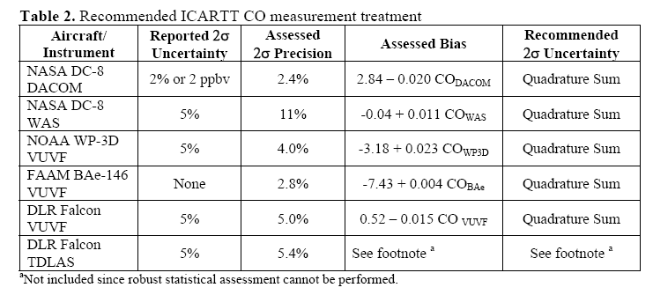
ATMOSPHERIC SCIENCE DATA CENTER
ADAM MeASUREs Results: TAbMEP Assessment Report for Measurement Uncertainty and Consistency

