Slide 1
Metrics Collection Tool
Dr. C. Wrandle Barth
ADNET Systems
October 21, 2010

Slide 2
Agenda
Thanks to users for NAMS effort
Focus for new users
Brief overview of new web sites and e-Books
How to use MCT
  Basic reporting
  Plans for version 10

Slide 3
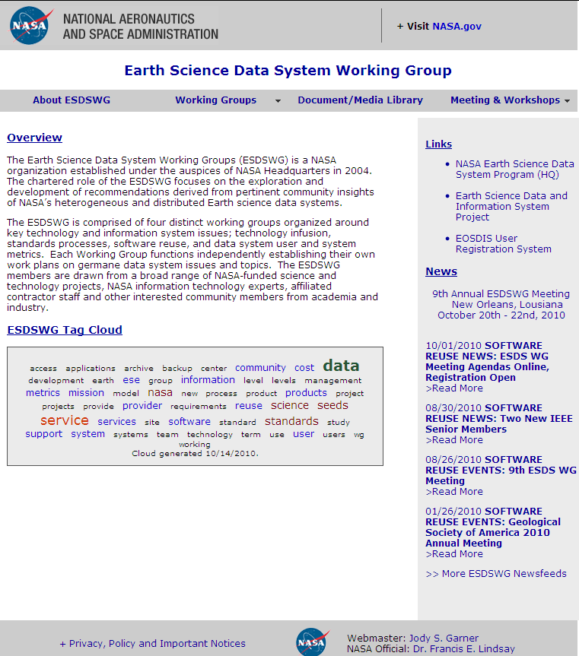
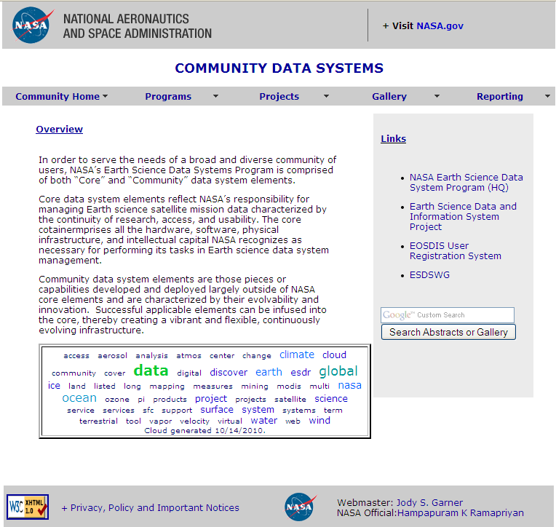
ESDSWG Web Site Split
Existing ESDSWG site focus is now on Working Groups only
New “community” site focus is on projects and reporting

Slide 4
http://esdswg.eosdis.nasa.gov
Information and links to working group activities
Aggregates working group news feeds
Joint meeting news, agendas, presentations
Full indexing of presentations in library

Slide 5
https://community.eosdis.nasa.gov
Project abstracts
Gallery of Impact Metrics Quad Charts (under construction)
Full text search of abstracts and gallery for easy navigation
Gateway to reporting applications
  e-Books
  Metrics Collection Tool

Slide 6
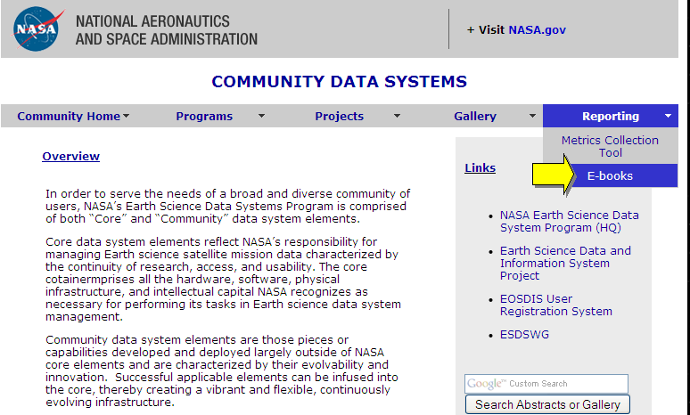
Getting Started
Starting from Community home page:
  https://community.eosdis.nasa.gov

Slide 7
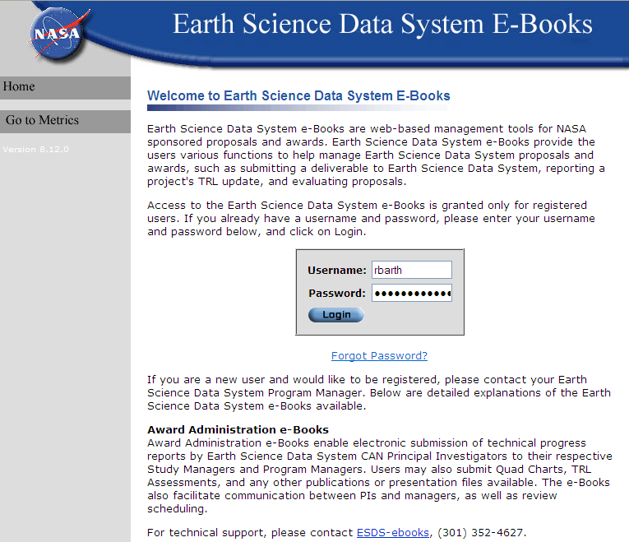
Log into E-Books
Use “forgot password” with registered name and email if needed
Two emails with 60-second pause between
Click contact for additional help

Slide 8
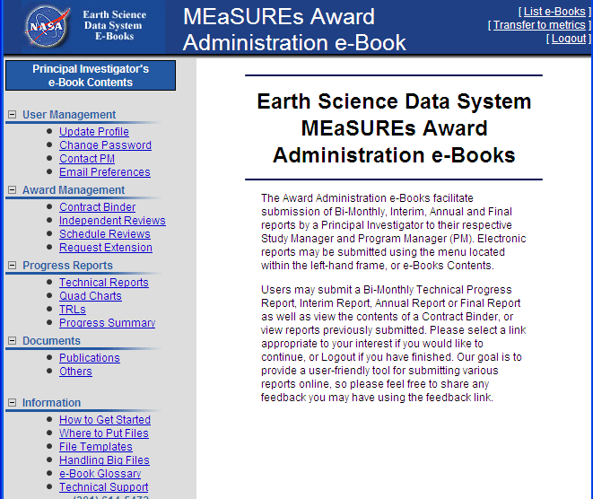
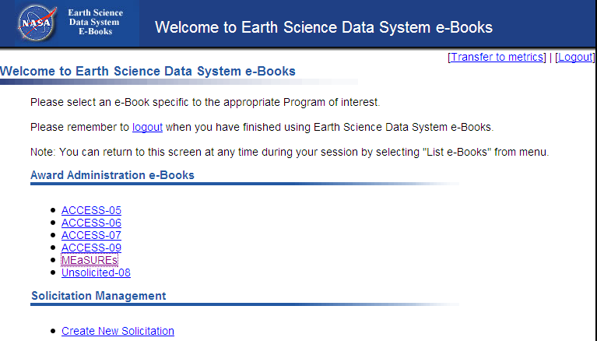

Select Solicitation, Activity

Slide 9
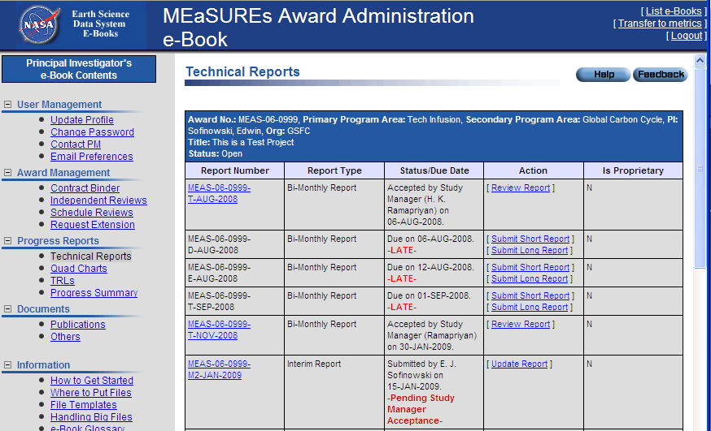
Technical Reports Screen
Reminder email hyperlinks directly to report screen (after login)

Slide 10
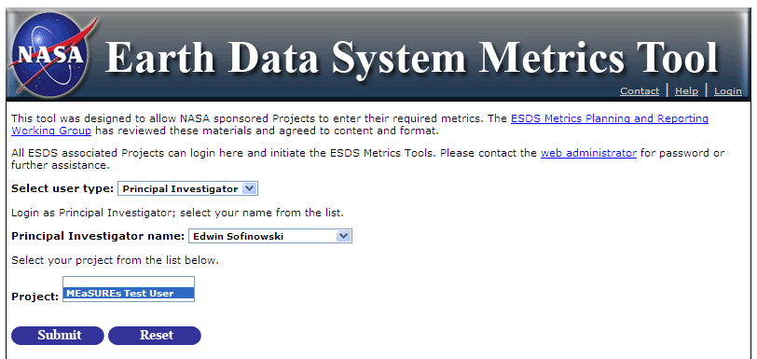
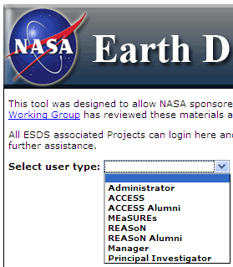
Transfer to MCT from e-Books
Enters directly as “Principle Investigator”
Or login from Community home as PI or Project
Login suppressed for unsupported browsers

Slide 11
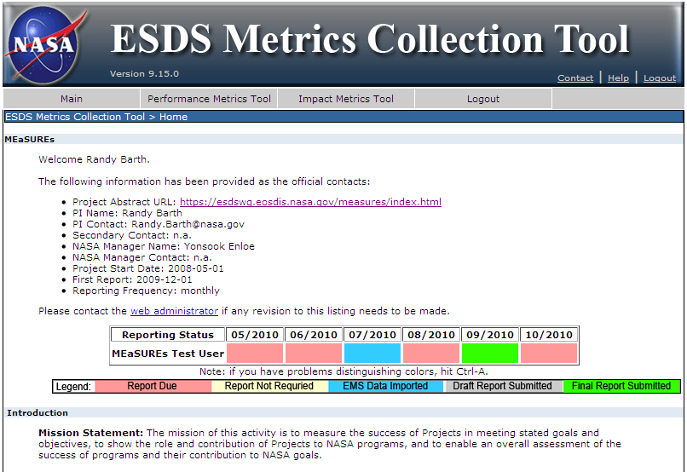


Welcome Page
New: EMS Import as status

Slide 12
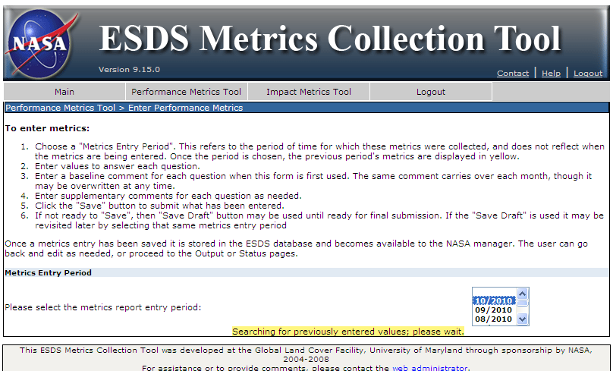
Specify Reporting Period
First select month for report

Slide 13
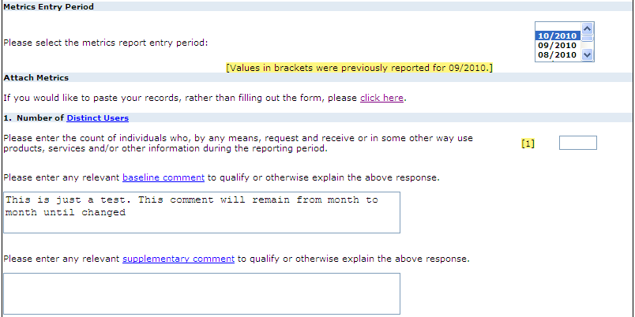
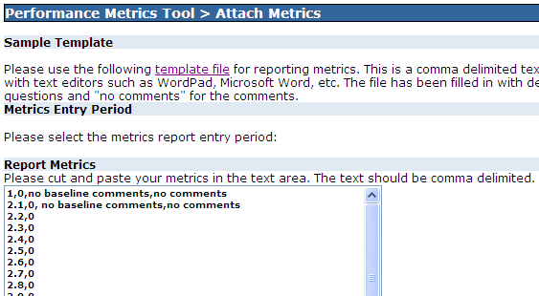
Enter Metrics and Comments
Can provide CSV text file with values
  More robust CSV handling coming in version 10
Most recent previous values displayed bracketed in yellow

Slide 14
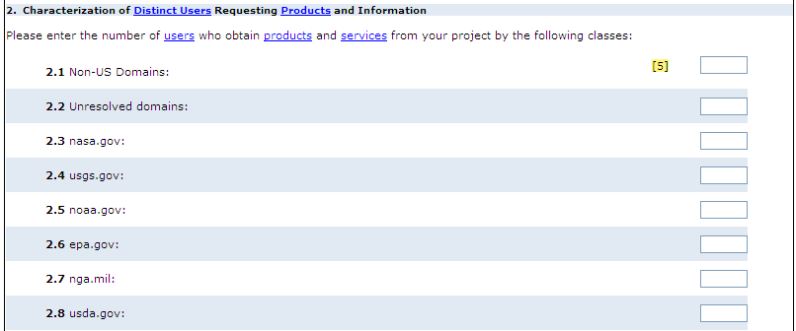
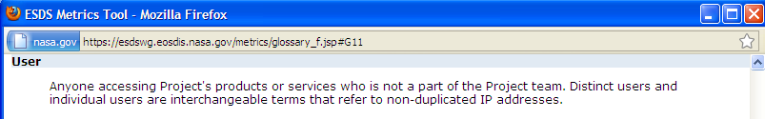
Other Metrics
Question 2 uses highlighting to aid alignment
Highlighted links go to glossary definition
Version 10 to add citation metric if approved

Slide 15
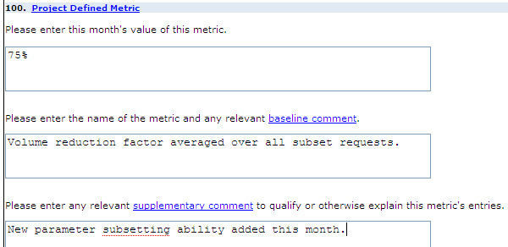
Add Project-Defined Metrics
Use baseline comment to define metric, supplementary for monthly notes
Save draft or save at end

Slide 16
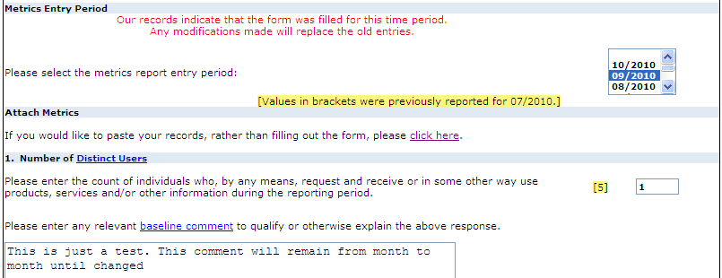
Editing a Previous Report
EMS import is partial; use MCT editing to provide initial baseline comments, monthly supplementary comments, changes in volume of data available (question 6), etc.
Turns status bar from blue to green

Slide 17
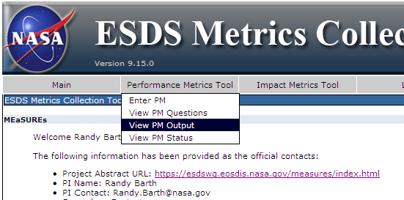
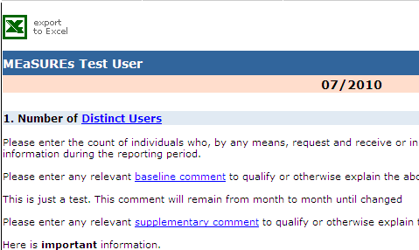
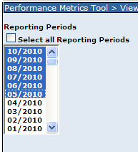
Displaying Previously-Entered Data
From home screen, select “View PM Output”
Select one, many, or all months
Export to Excel produces CSV file (with .xls suffix)

