Slide 1



Web-enabled Landsat data (WELD) Project
a NASA Making Earth System data records for Use in Research Environments (MEASURES) funded project
Quick Overview of WELD Project
&
WELD Product Distribution Metrics
Indrani Kommareddy, David Roy & Junchang Ju
Geographic Information Science Center of Excellence
South Dakota State University, USA

Slide 2

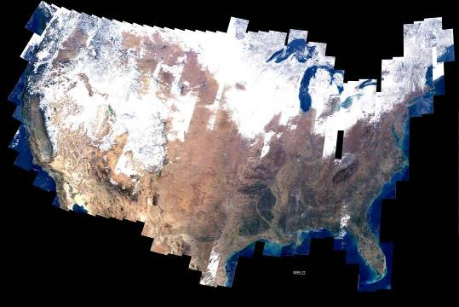
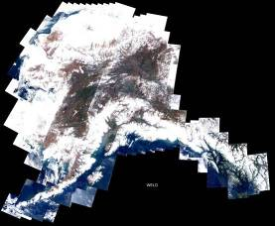
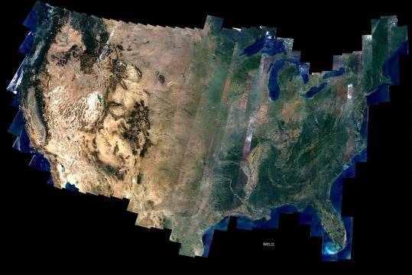
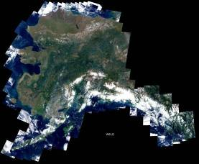
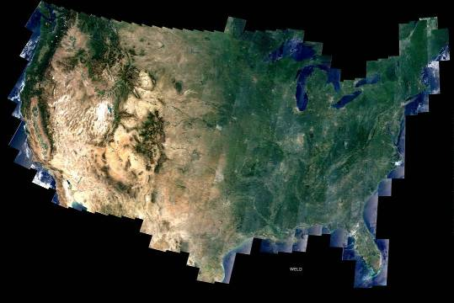
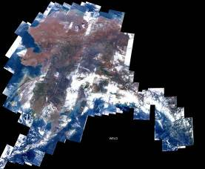
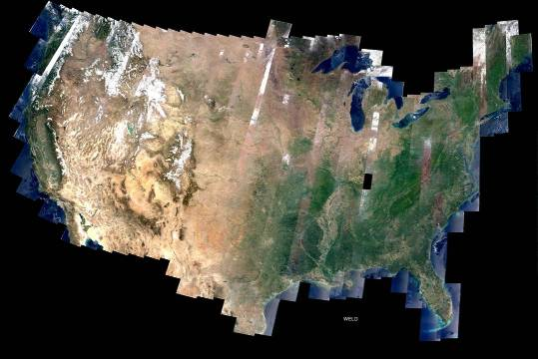
WELD products
Uses Level1 T(L1T) landsat acquisitions
30m Landsat ETM+ composited mosaics
  Weekly
  Monthly
  Seasonal
  Annual
Alaska
Conterminous United States
8 years (2005 - 2012)

Slide 3
WELD ETM+ ARCHIVE at SDSU
October 15th 2010
 | Conterminous United States (459 path/row) <80% cloud | Alaska (232 path/row) <80% cloud
2007 | 7,972 | 1309
2008 | 8,345 | 1,674
2009 | 7,675 | 1,733
2010 | 6,428 | 1,521
36,657 CONUS and Alaska acquisitions ~ US$22 million when each L1T acquisition cost US$600.

Slide 4
Public WELD Product Availability
Version 1.3 placed online at USGS EROS January 15th 2010
  One year: 2008
  Annual, Seasonal, Monthly composited mosaics
  CONUS
  Alaksa
  2.6TB out of the Landsat Data Continuity Mission project (not the DAAC)
Version 1.5 online at USGS EROS October 14th 2010
  Two years: 2008 and 2009
  Annual, Seasonal, Monthly, Weekly composited mosaics
  CONUS
  Alaksa
  8TB out of the Landsat Data Continuity Mission project (not the DAAC)
  Version 1.3 removed

Slide 5
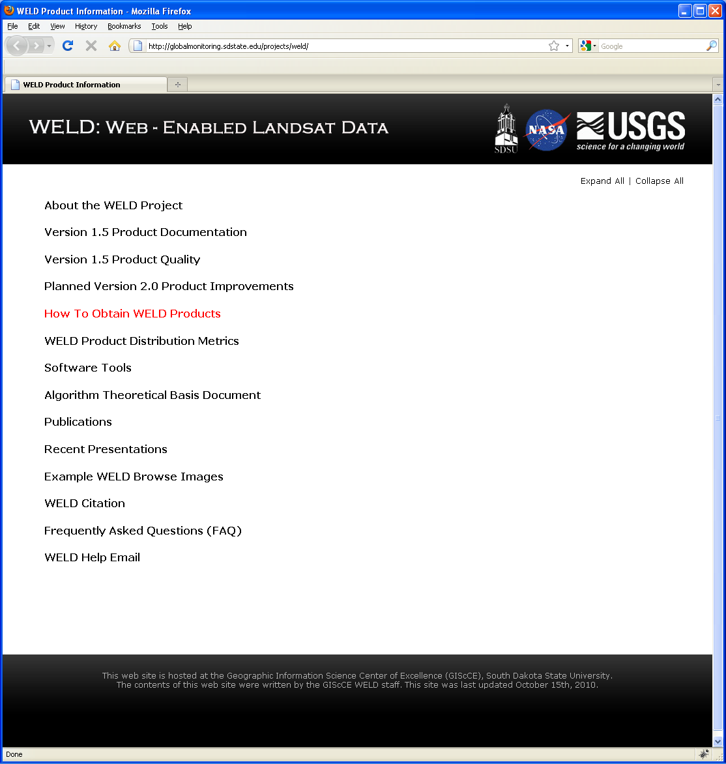
WELD Product Information

Slide 6
Version 1.5 WELD Product Distribution Interfaces
GeoTIFF products are available via HTTP in user defined regions via a What You See Is What You Get (WYSIWYG) WELD distribution interface at http://weld.cr.usgs.gov
HDF tiled WELD products are also available via anonymous FTP at ftp://weldftp.cr.usgs.gov/

Slide 7
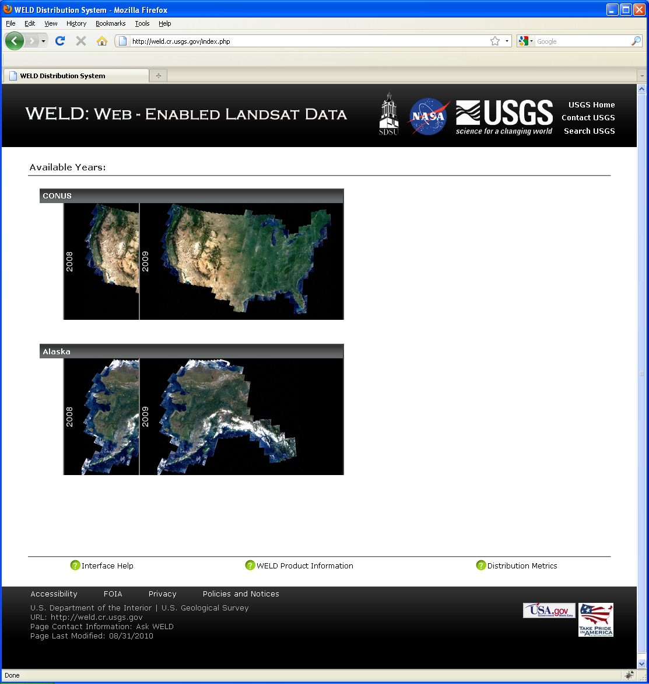
WELD
What You See Is What You Get
(WYSIWYG) interface
http://weld.cr.usgs.gov/

Slide 8
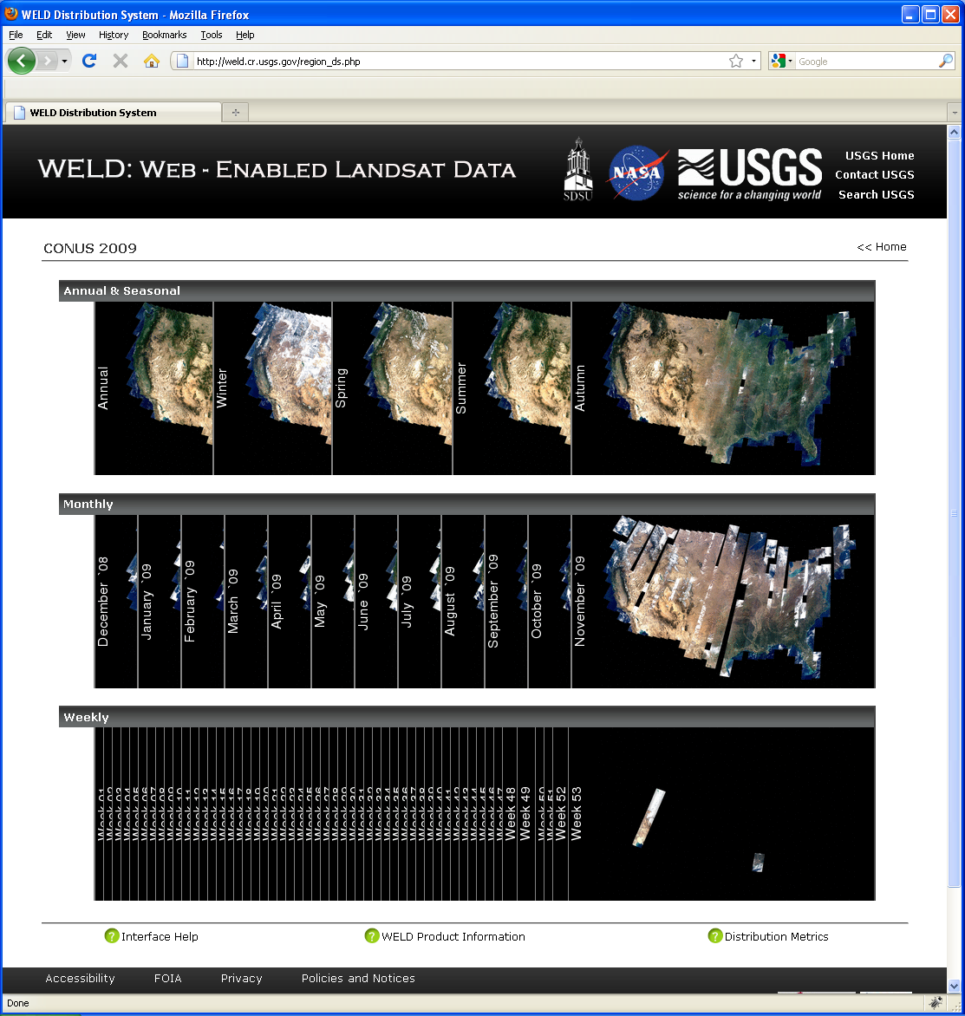

Slide 9
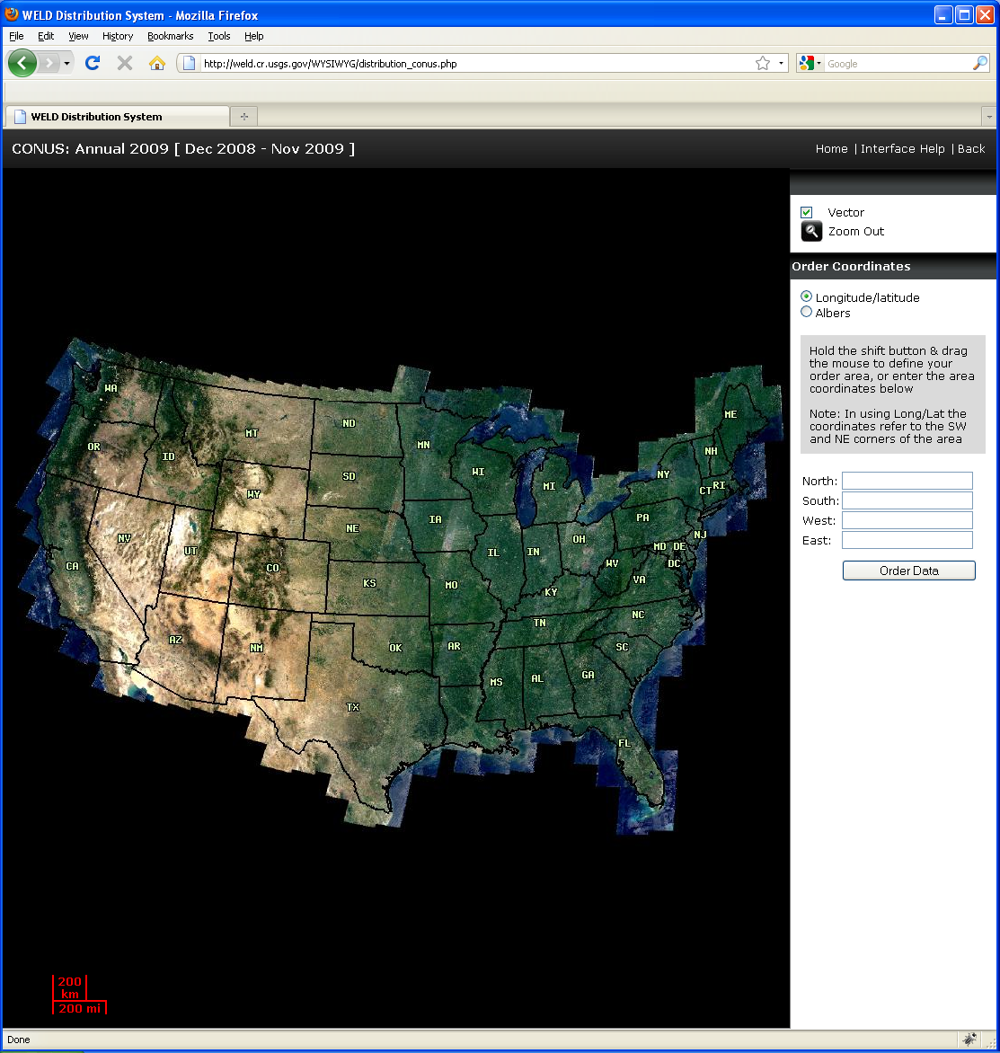

Slide 10
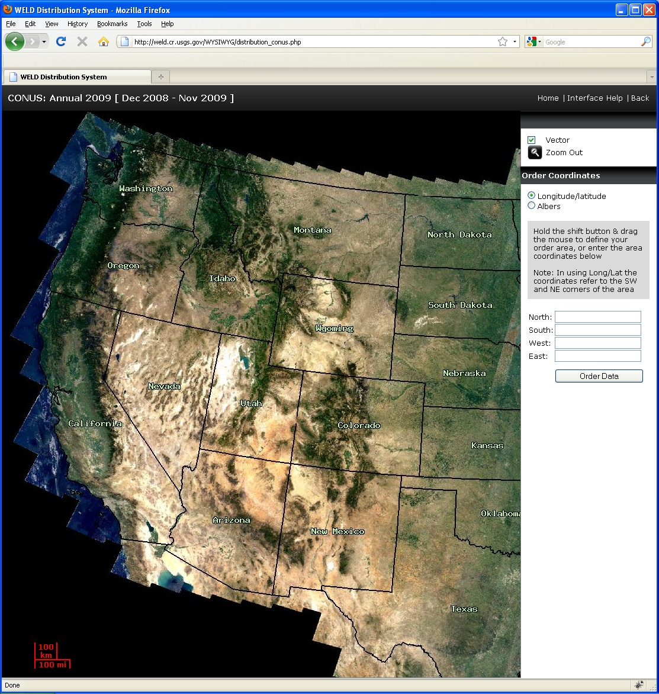

Slide 11
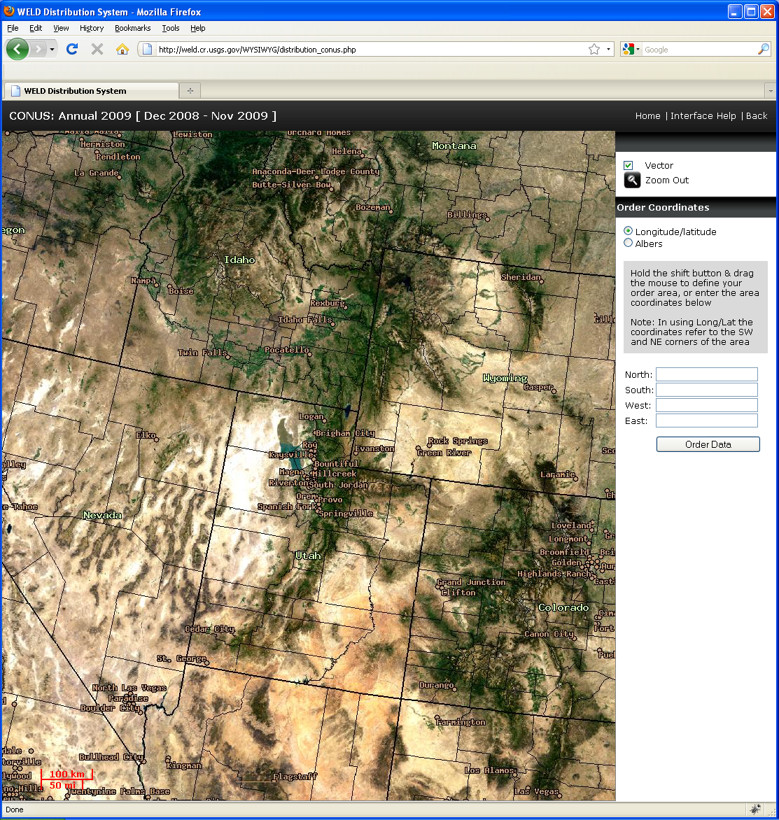

Slide 12
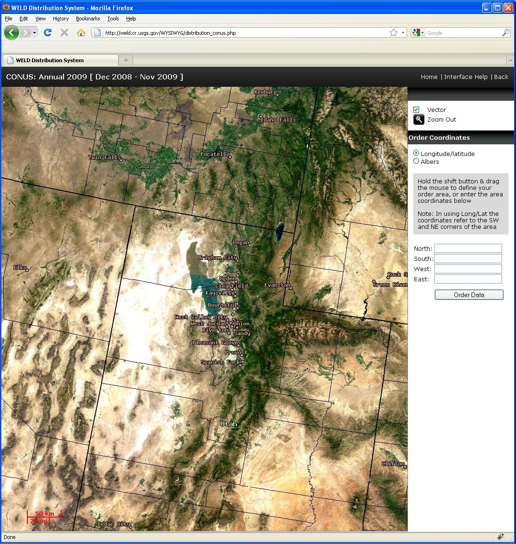

Slide 13
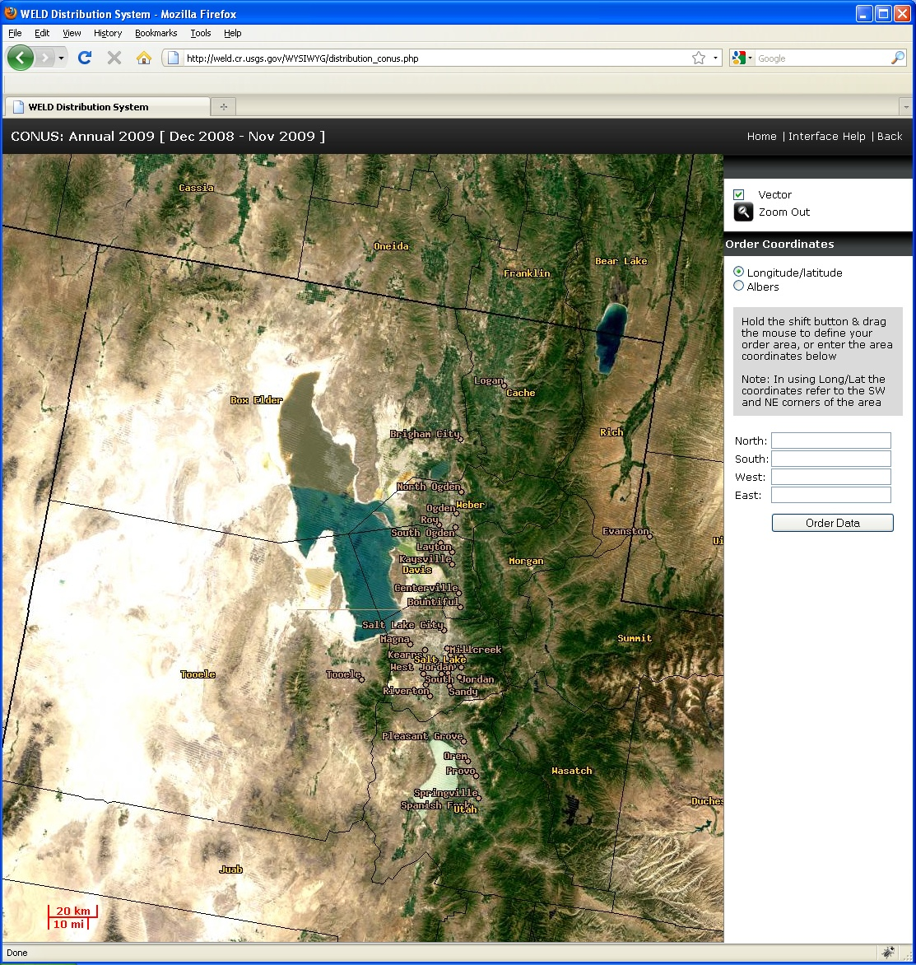

Slide 14
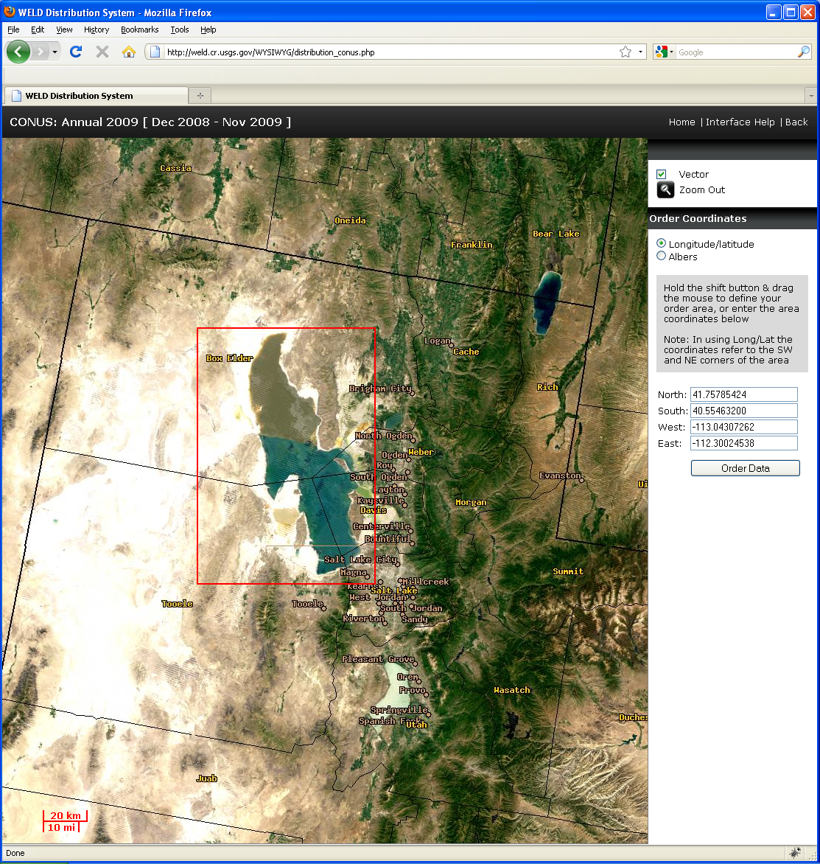
Coordinate system
Coordinates of the selected box

Slide 15
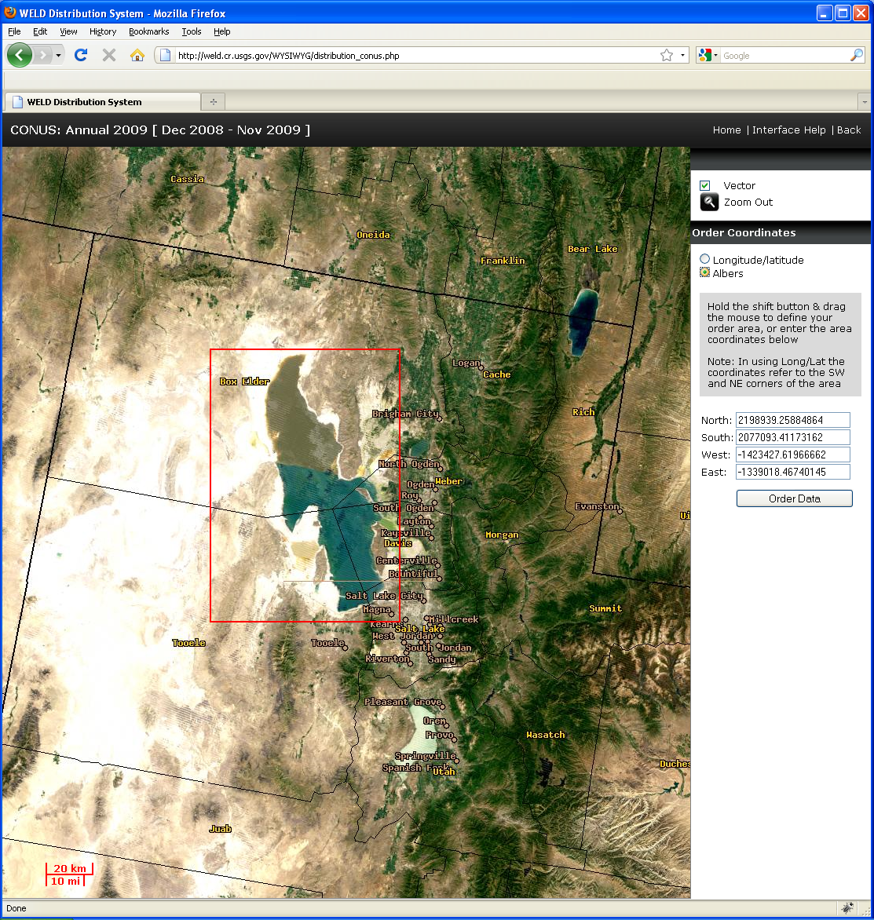
Coordinates of the selected box
Order button

Slide 16
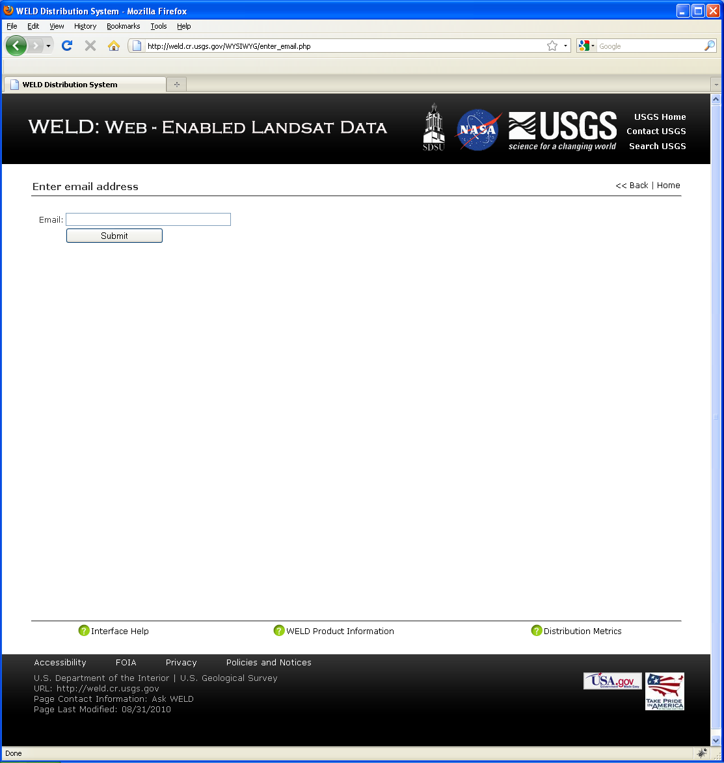

Slide 17
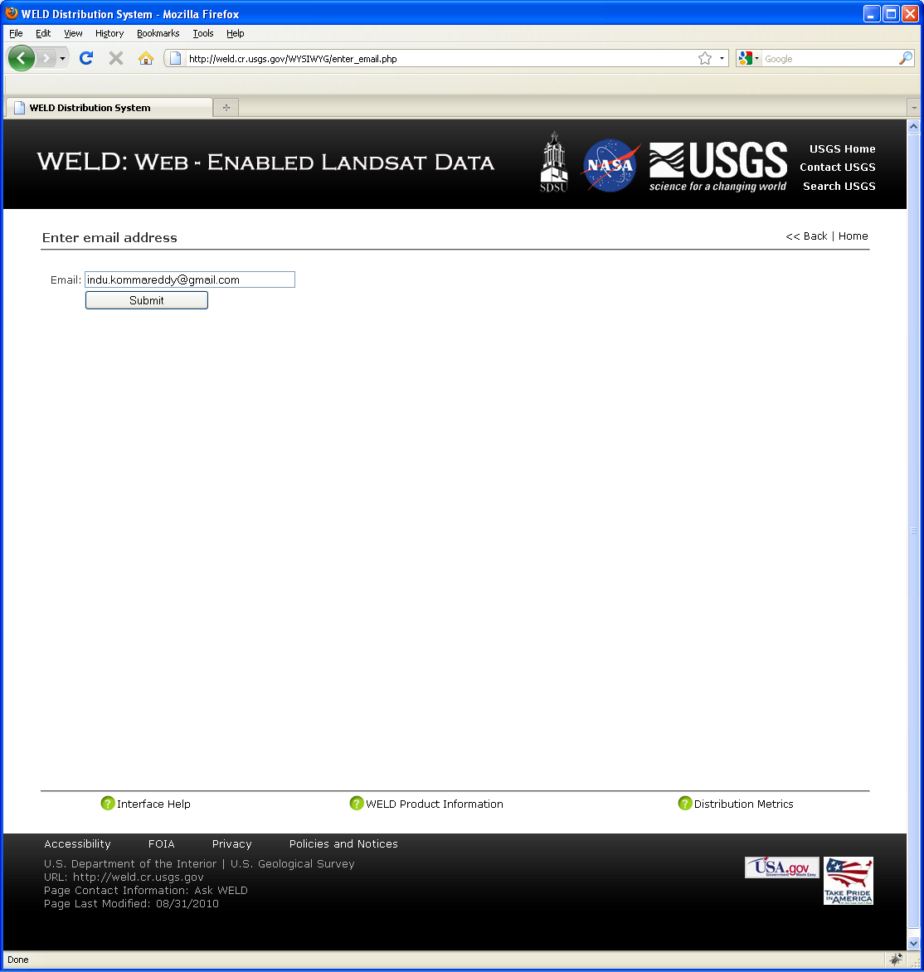

Slide 18
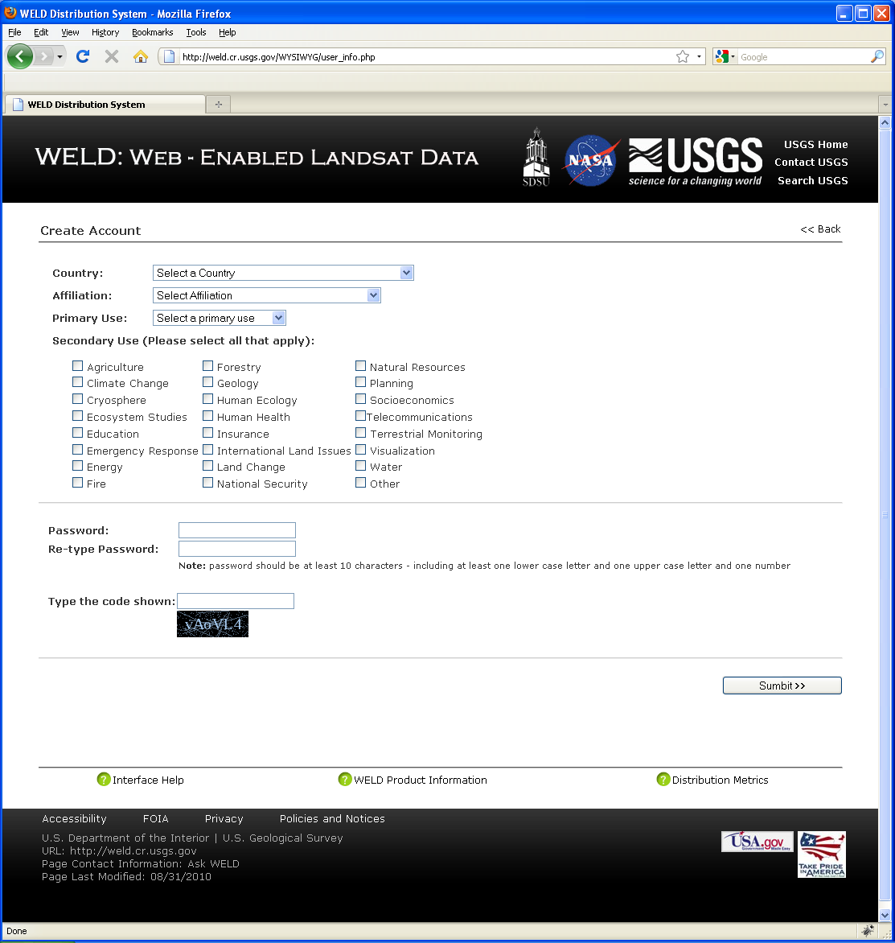

Slide 19
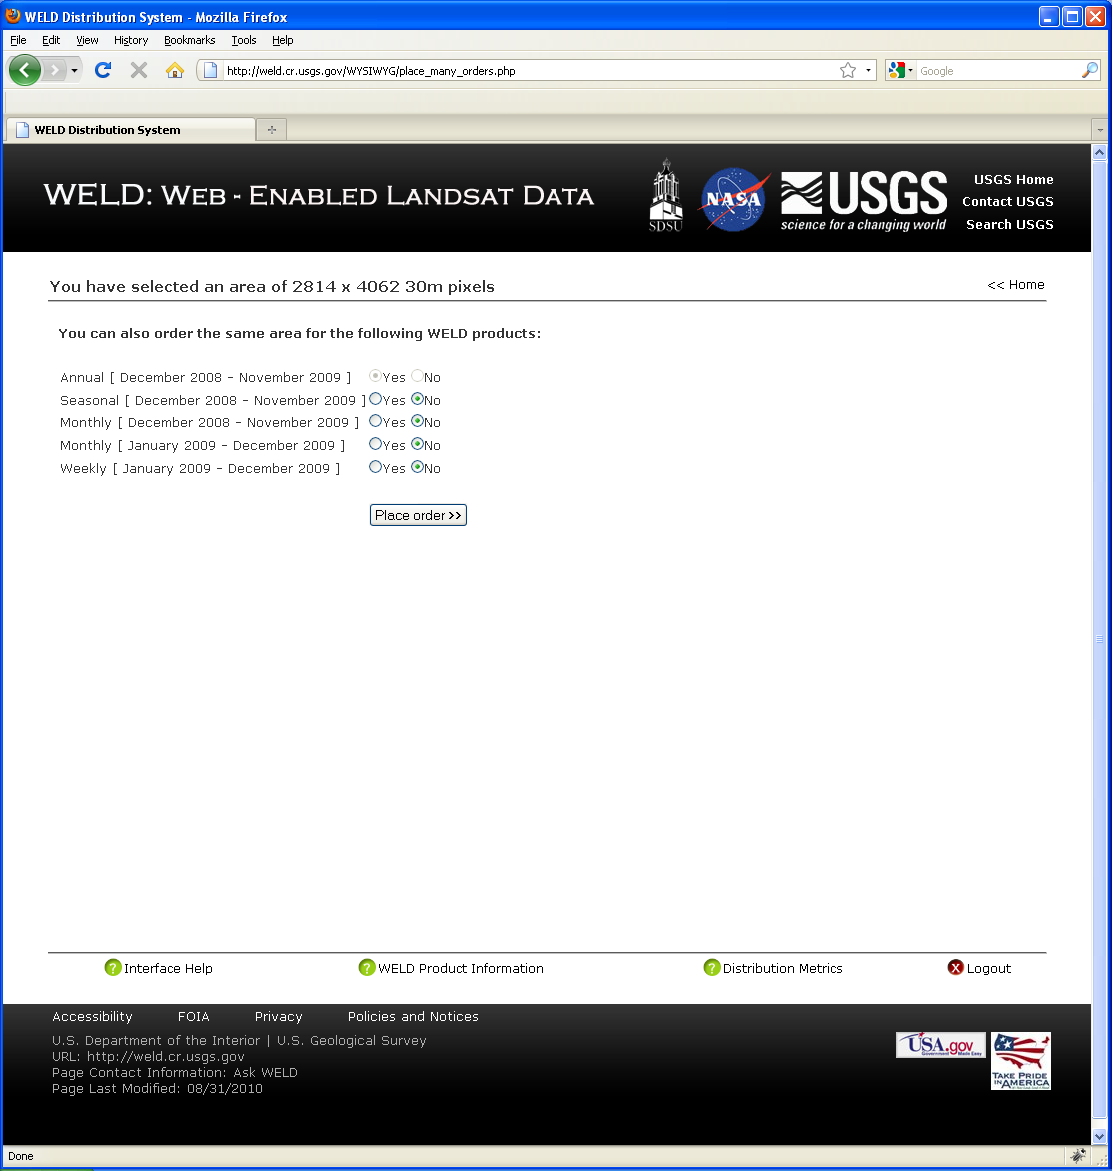

Slide 20
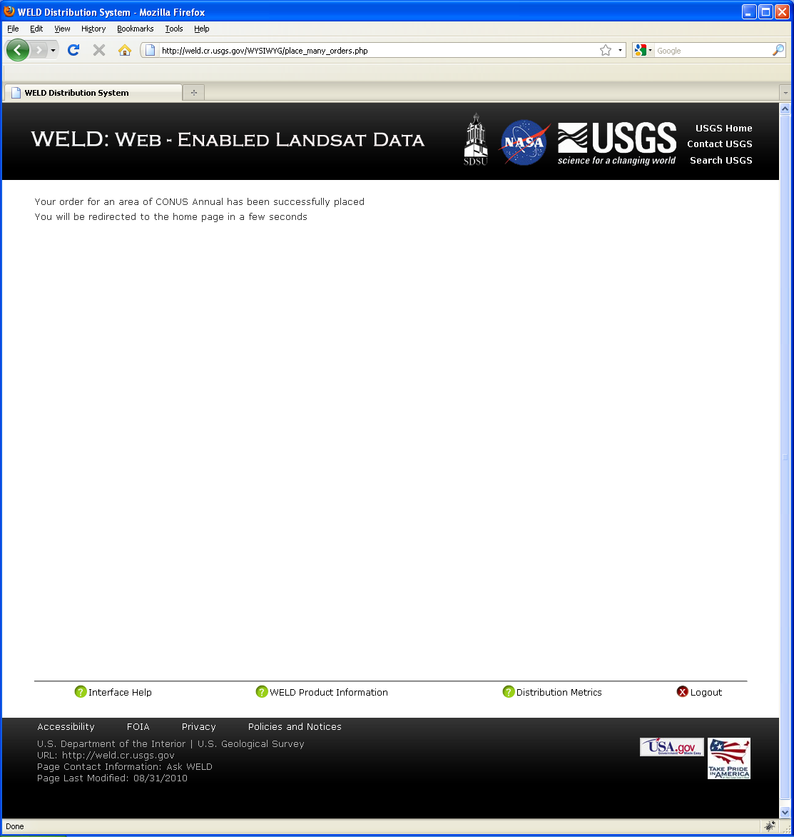

Slide 21
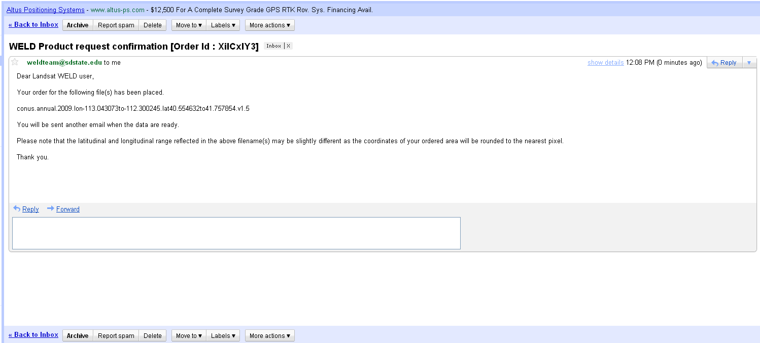

Slide 22
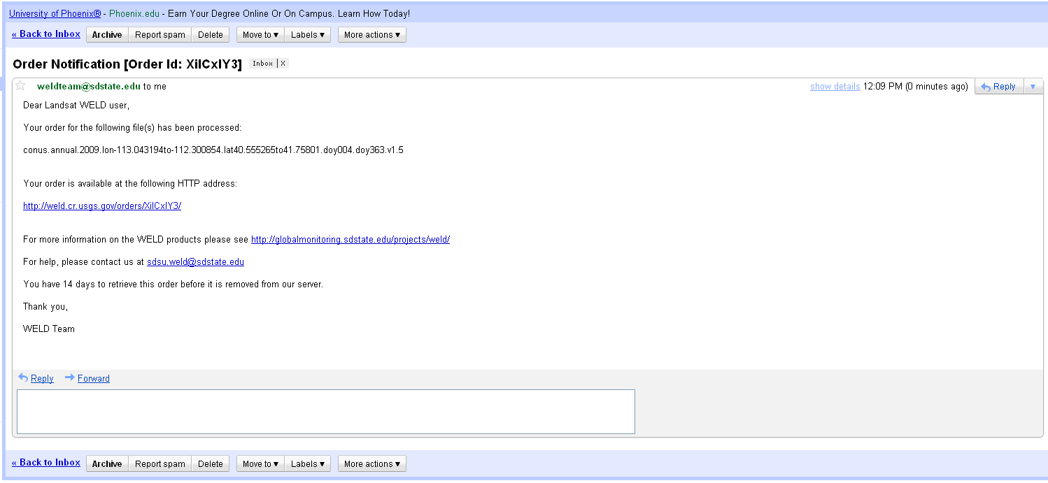

Slide 23
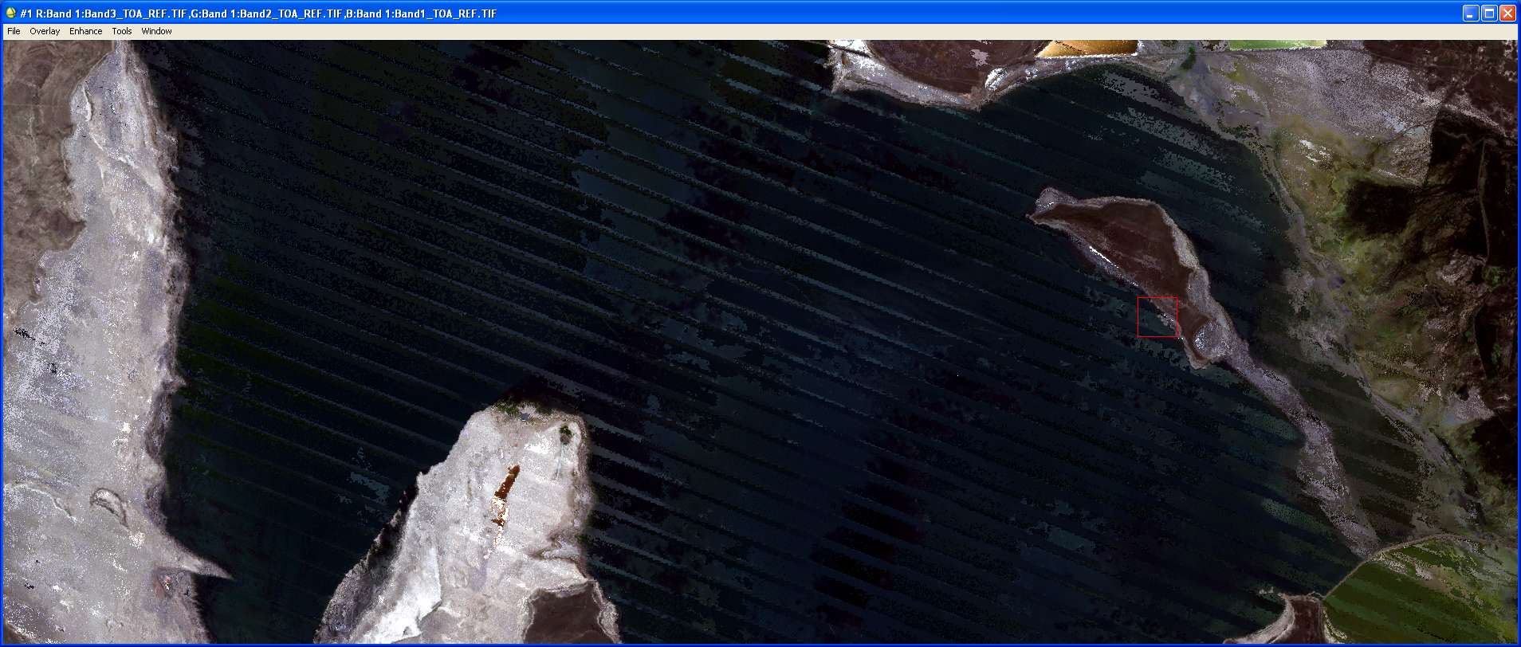
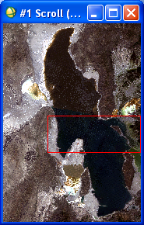
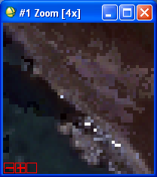

Slide 24
Distribution Metric Reporting
Currently for the
What You See Is What You Get
(WYSIWYG) interface
Yet to be done
FTP metric reporting

Slide 25
Metrics
Total number of orders for each Monthly, seasonal , annual and weekly product.
Number of unique users who ordered products by
  Affiliation
  Country
  Primary product use
  Secondary product use

Slide 26
Average number of 30m pixels ordered per user
Average number of orders placed per user
Number of unique users registered
Number of unique users who ordered data
Total number of orders
Total volume of product orders (in Bytes)

Slide 27
http://weld.cr.usgs.gov/
Distribution Metrics

Slide 28
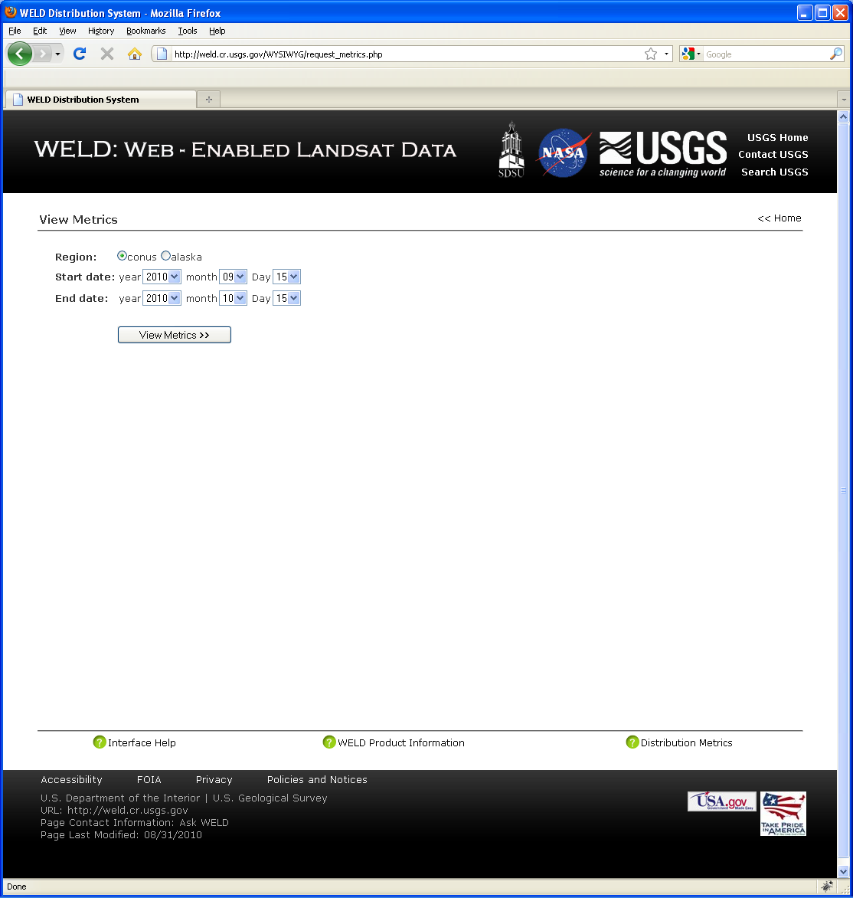

Slide 29
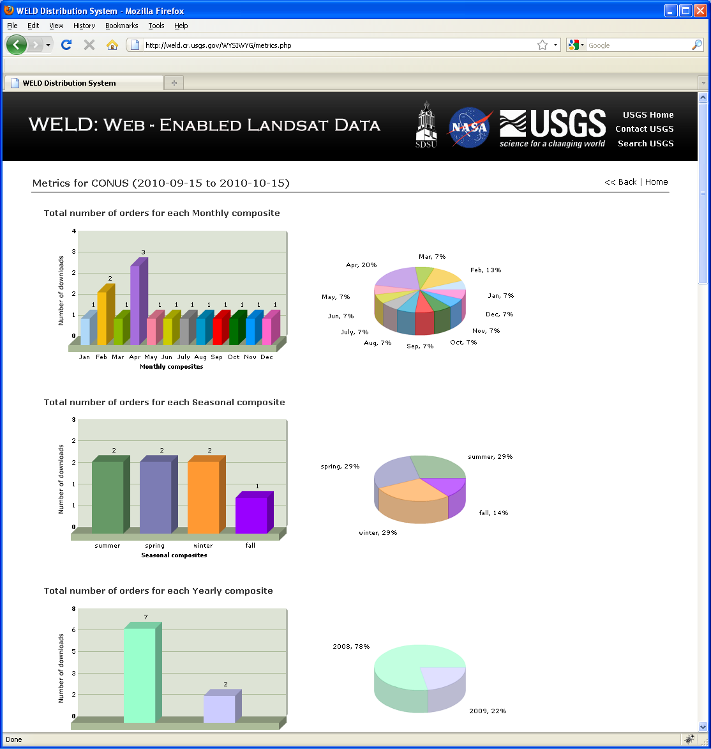

Slide 30
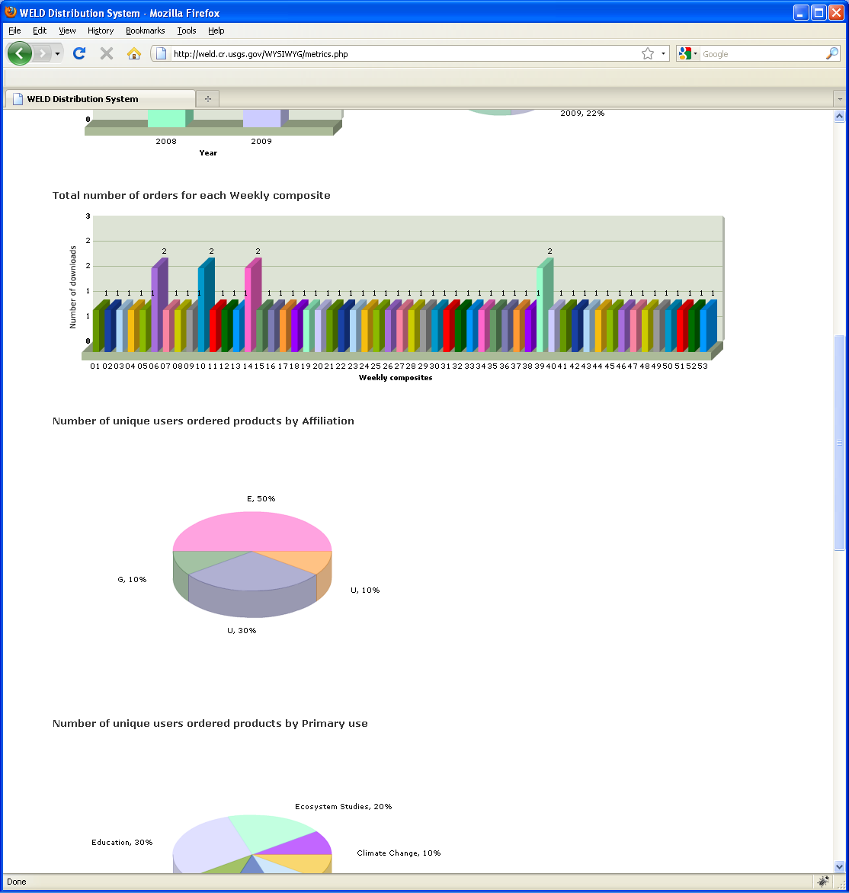

Slide 31
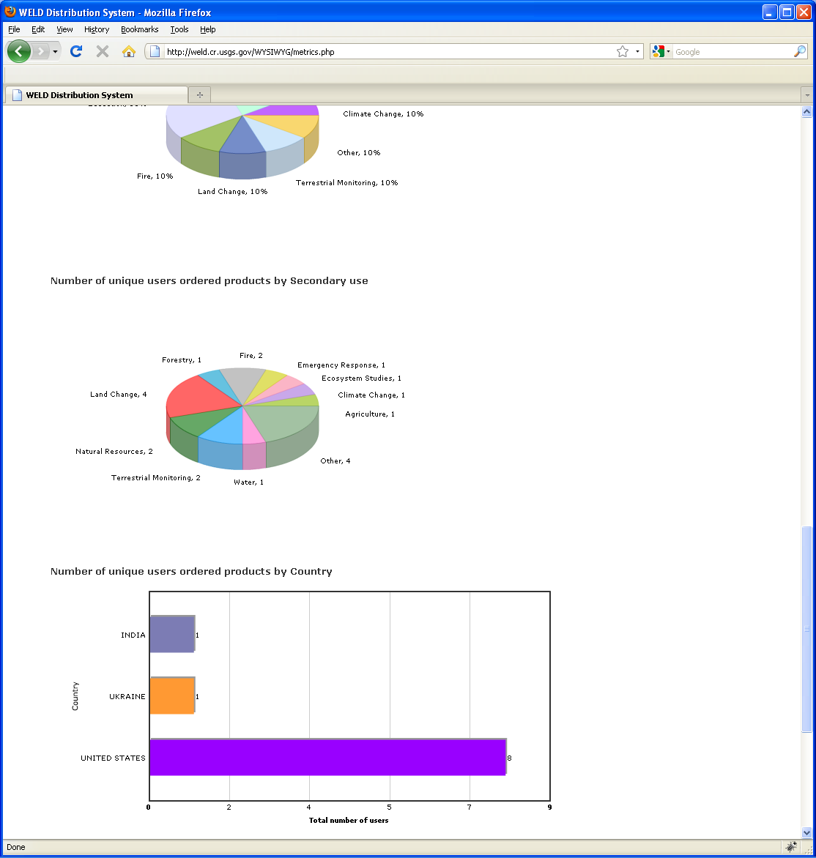

Slide 32
