Slide 1
EOSDIS FY2021
Annual Metrics Report
Prepared By:
Lalit Wanchoo, Adnet Systems, Inc.
Jaclyn Ludema, Adnet Systems, Inc.
Dany Turcios, Adnet Systems, Inc.
November 2021

Slide 2
Preface
The Earth Sciences Data and Information System (ESDIS) Project (Code 423) prepared the following report on metrics from across the Earth Observation System Data and Information System (EOSDIS). The 12 Distributed Active Archive Centers (DAACs) of EOSDIS support different scientific disciplines and provide an individualized set of products and services to their science community and the public. Although discipline oriented, the DAACs engage in common data management functions of ingest, archive and distribution, as well as describing their data and services on web sites. Metrics are collected on a daily basis from each DAAC. The ESDIS Project collects these metrics in a tool called the ESDIS Metrics System (EMS). DAAC analysts can view their detailed metrics to assess internal performance and trends. The ESDIS Project combines these metrics, not for comparisons between the DAACs, but as a system level view of EOSDIS performance. This report provides snapshots of metrics as the combination of the individual DAACs and as a system. In keeping with previous years, and in order to support trend comparisons, the metrics data are presented on a fiscal year basis, not by calendar year. These reports are posted online with metrics as far back as 1996. Each report includes some historical trend information. If you have any questions or comments, please contact Drew Kittel (301) 614-6582 or drew.h.kittel@nasa.gov..

Slide 3
Introduction

Slide 4
New Information
Earthdata Cloud Archive and Distribution Summary
  Available from EMS and Cloud Metrics team (EED-3)
  All reports include cloud metrics from EMS
  Cloud Metrics Team (EED-3) report provided as a summary (earthdata_cloud)
  ASF started reporting cloud metrics to EMS since 2016 and have been included in earlier annual reports.
  From March 2021, ASF separated cloud data for reporting to EMS
  GESDISC, GHRC, LPDAAC, NSIDC, ORNL, and PO.DAAC migrated to cloud during FY 2021.

Slide 5
Report Structure
Three Excel Spreadsheets
  1) Data Ingest, Archive, and Distribution with long-term trends
  2) Web access metrics
  3) Individual DAAC Profiles
One Powerpoint

Slide 6
Contents
EOSDIS Summary
LANCE Summary
Data Metrics (Distribution and Users)
LANCE Metrics
Earthdata Cloud Metrics (Cloud Team)
DOI Summary
Web Metrics
Worldview Web Metrics
Total Users and Multi-year Trends
Earthdata Systems (Earthdata Login, CMR, and EDSC)
DAAC Profiles
Daily Data Availability
Definitions

Slide 7
EOSDIS Summary

Slide 8
Land Atmosphere Near real-time Capability for EOS (LANCE) Summary
Unique Data Sets: Total number of unique data sets distributed in the fiscal year
Distinct Registered LANCE Users: Total number of unique LANCE users who registered and retrieved NRT products from all LANCE data providers, excluding the unregistered users who downloaded imagery products from the MODIS Rapid Response System
Distinct Unregistered LANCE Users: Total number of unique IP Addresses/Emails that retrieved browse imagery products from LANCE data providers, such as Rapid Response Browse Images and excludes the LANCE registered users.
Web Site Sessions: Sum of web sessions for LANCE data providers where a session represents a user session not broken by more than 30 minutes and a duration of at least one minute
Average Production Growth: Sum of the NRT data volume generated by all LANCE providers divided by the days in the year, including the NRT and NRT2 processing streams
Total Production Volume: One year of production volume of the NRT/NRT2 data products.
End User Distribution Products: Total number of products distributed from all reporting LANCE data providers
End User Average Distribution Volume: Sum across reporting LANCE data providers of the data volume distributed for the fiscal year divided by the days in the year

Slide 9
Data Metrics
Ingest
Archive
Total Archive
Distribution
- By DAAC
  - By Mission/Instrument
  - Volume by Domain
  - Products by Domain
  - Products by Product Level
  - Top 20 Countries
  - Unique Product Count
  - Top 10 Products
Data Users
- Distinct Users
- Repeat Users
- Top 20 Countries
- Foreign Users
Distribution
    LANCE (Near Real-time)
    - Products Production
    - Distribution
    Earthdata Cloud Metrics
    Digital Object Identifiers
    - Summary

Slide 10
Ingest
Ingest is the amount of data coming into a DAAC over a period of time and includes all product levels. For this report, the data is presented as the amount of data entered into each DAAC during FY2021 and excludes NRT data. The sum over all data centers is the total ingest for EOSDIS.

Slide 11
Archive
This table shows the amount of data added to the archive during FY2021 and includes all products levels. Archive metrics for NSIDC V0 are not available at this time. NRT data are excluded in this table.

Slide 12
Total Archive Size
The Total Archive Size describes the EOSDIS archive at the end of FY2021. This includes all data (including ancillary) but not data marked for deletion and excludes NRT data.

Slide 13
Distribution By DAAC
Distribution presents the amount of data successfully distributed to Public Users and excluded NRT data.

Slide 14
Distribution By Mission/Instrument
Distribution presents the amount of data successfully distributed to Public Users.

Slide 15
Volume Distributed By Domain
Volume Distribution presents the volume of data successfully distributed to Public Users by Domain.

Slide 16
Product Distribution By Domain
Product Distribution presents the number of products successfully distributed to Public Users by Domain.

Slide 17
Distribution By Product Level
Distribution presents the amount of data successfully distributed to Public Users and excludes NRT products.

Slide 18
Distribution of Unique Data Products
Tables below show the number of unique data products distributed to public users during FY2021. In counting unique products, metadata were excluded. NRT products are not included.

Slide 19
Data Distribution - Top 20 Countries
Affiliations of the users who downloaded data from foreign countries are not known.
* Some products are inherently larger than other files in size and therefore may skew the results.
** When counting # of products, metadata files are excluded.

Slide 20
Data Distribution - Top 10 Products
* Some products are inherently larger than other files in size and therefore may skew the results.
** When counting # of files, metadata files are excluded.

Slide 21
Distinct Data Users
Distinct Data Users presents the number of distinct public users who received data product files.

Slide 22
Repeat Data Users
Repeat users are distinct Public users who received data on more than one day in the fiscal year.

Slide 23
Data Users - Top 20 Countries

Slide 24
Foreign Distribution
Distribution metrics for foreign public users are compared. Statistics are based on country information provided by the 12 EOSDIS DAACs.
1. EU includes 27 European Union member countries, UK and territories under EU countries' and UK's sovereignty
2. China includes only People's Republic of China and does not include Hong Kong and Taiwan
3. This represents the data users whose countries are unknown
4. These represent the user counts across all DAACs and may be fewer than the sum of users from individual DAAC due to multi-DAAC users

Slide 25
Production of Near Real-Time Products
Near Real-Time (NRT) production represents the amount of data generated by the Land Atmosphere Near Real-time Capability for EOS (LANCE) data providers, including the two identical processing systems, NRT and NRT2.
Volume and file count include the data products deleted from archive

Slide 26
Distribution of Near Real-Time Products
Near Real-time (NRT) Distribution provides the amount of data successfully distributed to registered users of the Land Atmosphere Near Real-time Capability for EOS (LANCE). LANCE provides access to near real-time data (<3 hours from observation). Metrics for distribution volume, numbers of files distributed, and users are presented.
* Excludes metadata
** Represents the number of unique IP hosts/e-mail addresses used to retrieve NRT products, excluding registered users
*** Represents the number of the registered users who retrieved data for each instrument. It must be noted that sum of theses users
may be greater than the total number of unique registered users since one user could retrieve data for multiple instruments
1 These products do not have any mission or instrument mapping but have been distributed, such as ancillary data.

Slide 27
Digital Object Identifier Summary

Slide 28
Digital Object Identifier Summary

Slide 29
Earthdata Cloud Archive Metrics

Slide 30
Earthdata Cloud Distribution Metrics

Slide 31
Earthdata Cloud User Metrics

Slide 32
Web Metrics
EOSDIS and Earthdata
  Visitors and Visits
  Repeat Visitors
  Top 20 Domains (NA)
    IPAddress not available
  Top 20 Countries
LANCE Web Metrics
Worldview Web Metrics

Slide 33
Web Visitors and Sessions
EOSDIS web activity is measured by number of Sessions made, the number of pages Viewed and the number of distinct Visitors. Sessions of at least one minute are considered to represent significant work accomplished, and many of the shorter sessions are of less than a second. All twelve EOSDIS DAACs report web metrics at this time. Note that the sum of monthly visitors could be greater than the number of unique visitor for a given year since one user could be counted more than once if he/she visited the same website in different months. Excludes Earthdata and LANCE website activity.
Google Analytics
* Represents the sum of the metrics from all 12 DAACs and excludes Earthdata.

Slide 34
Earthdata Web Visitors and Sessions
EOSDIS web activity is measured by number of Sessions made, the number of pages Viewed and the number of distinct Visitors. Sessions of at least one minute are considered to represent significant work accomplished, and many of the shorter visits are of less than a second. This is for Earthdata website only. Note that the sum of monthly visitors could be greater than the number of unique visitor for a given year since one user could be counted more than once if he/she visited the same website in different months.
Google Analytics

Slide 35
Repeat Web Visitors
EOSDIS Web Visitors are characterized by the number of sessions they make and how frequently they return. Visitors counted in the table below are those that stayed for one minute or more. Repeat Visitors are counted from the start of the Fiscal Year. Metrics data is collected per data center and summed for an EOSDIS total.
FY2021 Web Visitors for Sessions of one minute or more
Google Analytics
represents the sum of the metrics from all 12 data centers and excludes Earthdata and LANCE
Repeat users In Google Analytics, if a user has multiple sessions during the computation time period that user will be
counted for all sessions grouped that are applicable to that user

Slide 36
Top 20 Domains By # of Web Visitors
Google Analytics
No Such Report
IPaddress not available

Slide 37
Earthdata Top 20 Domains By
# of Web Visitors
Google Analytics
No Such Report
IPaddress not available

Slide 38
Top 20 Countries By # Web Visits
The FY2021 Top 20 Countries for sessions >= 1 minute is sorted by the # of sessions. Data came from 12 DAACs and excludes Earthdata and LANCE website. Country information is based on the Google Analytics Geolocation Service.
Google Analytics

Slide 39
Earthdata Top 20 Countries By
# Web Visits
The FY2021 Top 20 Countries for sessions >= 1 minute is sorted by the # of Sessions. Country information is based on the Google Analytics Geolocation Service.
Google Analytics

Slide 40
LANCE Web Metrics
LANCE web activity is measured by number of sessions made, the number of pages viewed and the number of distinct visitors for the LANCE website.
Google Analytics
40

Slide 41
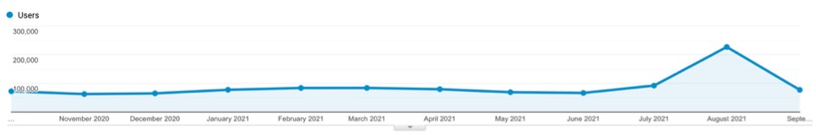
Worldview Web Metrics
Worldview web activity is measured by number of sessions made, the number of pages viewed and the number of distinct visitors accessing the Worldview.
Google Analytics
Fires
41

Slide 42
Total Users and Trends
Total Users
Total Archive Trend
Data Volume Distribution Trend
Data Product Distribution Trend
Data Products by Product Level
Top 10 Products Trend FY2019 - FY2021
Known U.S. - Foreign Product Distribution Trend
Web Trends (Visits and Visitors)

Slide 43
Total Users
Total Users is an estimate formed by combining the distinct Data Users and distinct Web Visitors without removing the overlap (web and Data) and excludes LANCE Unregistered users who downloaded browse imagery. Web Visitors included in the count are for those visitors with sessions of one minute or longer. To minimize the undercount, the final Total Users value includes the total Web Visitors (IP address plus browser), plus the distinct Data Users.

Slide 44
Total Archive Trend
The total archive trend is based on data and reports produced during individual fiscal years, rather than from EMS. EMS does not contain sufficient information to recreate the archive size for previous years due to episodic deletions from the archive and not all archive information is supplied to EMS by the DAACs. Since products are deleted at the DAACs and not always reported to EMS, It may not be able to completely reproduce what was in the archive in previous years.
The trend data were compiled in FY2013 with the expectation it will be updated yearly with data captured in that year's EOSDIS Annual Report in the Total Archive Size worksheet. The sources of data for earlier years, which are not presented here, are available from the Excel version of this report.

Slide 45
Data Volume Distribution Trend
The Volume Distribution Trend presents distributed volume counts from EMS by DAAC. OBPG distribution metrics from the Ocean Color web site are included beginning in FY2004. CDDIS data became available in FY09.

Slide 46
Data Product Distribution Trend
The Product Distribution Trend presents distributed product counts from EMS by DAAC. OBPG distribution metrics from the Ocean Color web site are included beginning in FY2004. CDDIS data became available in FY2009.

Slide 47
Data Product Distribution Trend by Product Level
The Product Distribution Trend by Product Level presents distributed product counts from EMS by product level and includes NRT data products
¹ Other, these products have not been assigned any product level.

Slide 48
Top 10 Products Trend by Volume
FY2020 – FY2021
*Some products are inherently larger than other files in size and therefore may skew the results.
** Does not include metadata files

Slide 49
Top 10 Products Trend by # of Files
FY2020 – FY2021
** When counting # of files, metadata files are not included.

Slide 50
U.S. – Foreign
Product Distribution Trend
* product distribution where the destination could not be determined

Slide 51
Web Trends
Web metrics data for EOSDIS became available as of FY2007, Data for FY2007 is complete for 7 DAACs and FY2008 is complete for 8 DAACs. Since FY2009, 11 DAACs provided webmetrics and from FY 2020 all 12 DAACs have provided the webmetrics data. For FY 2007 to FY 2018 NetInsight data was used, for FY 2019 both NetInsight and Google Analytics data was used, while as from FY 2020 only Google Analytics data was used as the Netinsight was decommissioned from Oct 1, 2019. These web metrics excludes Earthdata & LANCE and are for sessions (visits) of one minute or more. Repeat visitors are counted as 2 or more visits since web activity measurements began for that DAAC.
Google Analytics

Slide 52
Earthdata Web Trends
Web metrics data for Earthdata became available as of FY2012. These metrics are for sessions of one minute or more. Repeat visitors are counted as 2 or more sessions since web activity measurements began for that DAAC.
Google Analytics

Slide 53
Earthdata Systems
Earthdata Login
CMR Collections/Granules
Earthdata Search Client
Earthdata Systems are some of the systems that are under EED-3 and provide metrics on the number of users registering with earthdata login and number of data collections and granules metadata provided by various data providers to the CMR. In addition, Earthdata search client utilization is provided by showing number of sessions and acquisitions.
Provided by EED-3 Staff

Slide 54
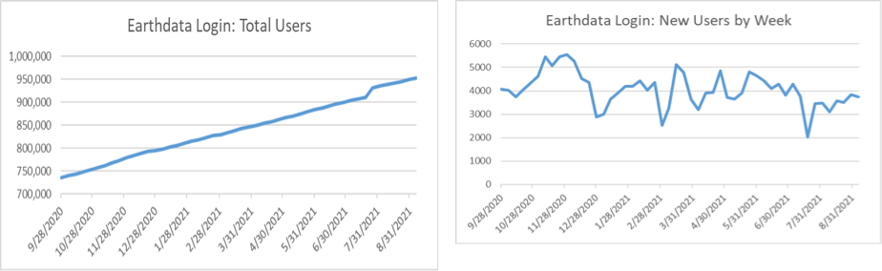
Earthdata Login
The Earthdata Login provides a single mechanism for user registration and profile management for all EOSDIS system components (DAACs, Tools, and Services). Earthdata Login also helps the EOSDIS program better understand the usage of EOSDIS services to improve user experience through customization of tools and improvement of services. Given the utilization of Earthdata Login across EOSDIS system components, Earthdata Login metrics provide one measure of interest in NASA earth science holdings.
The number of new users registered weekly in Earthdata Login varied seasonally and as key events occurred throughout FY2021. The number of new registered users ranged from a low of 2039 for the week ending 7/19/21 to a high of 5536 the week ending 11/30/20, with an average of over 4050 new users per week.
The total number of Earthdata Login registered users increased by 22.1% over the course of FY2021, from 736,132 at the beginning of October 2020 to 964,687 by the end of September 2021.

Slide 55
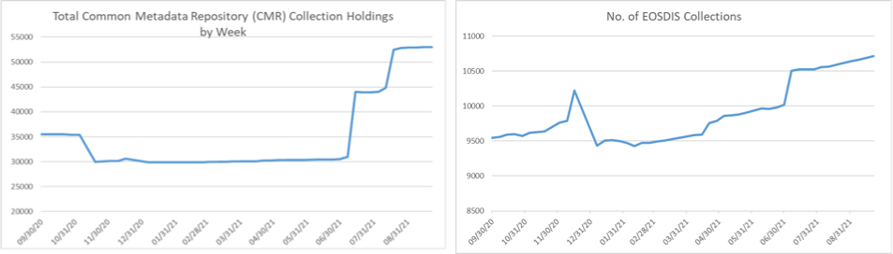
CMR Collections/Granules
While collection metadata provides information about types of data stored in the CMR, granule metadata is the smallest aggregation of data which is independently managed (i.e., described, inventoried, retrievable). These are metadata elements that describe a single granule of a data product. Values of granule metadata apply to all of the data in that one granule. Typical metadata in this category describe spatial and temporal extent of the data as well as the quality and lineage of the data.
The number of total collections, or data set series, holdings in CMR increased by 49.6% in FY 2021, from 35,467 at the beginning of the fiscal year to 53,049 at the end of the fiscal year. There number of collections remained somewhat stable between November 2020 and June 2021 but increased significantly in July 2021 and August 2021. The decrease in collections in November 2020 is due to the deletion of NOAA DIF-9 collections from the Common Metadata Repository (CMR) as approved by NOAA

Slide 56
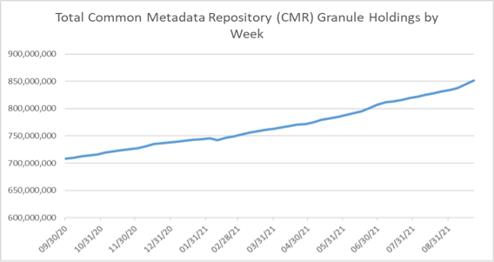
CMR Collections/Granules
The number of granule holdings in CMR increased by 20.7% in FY2021, from 708.2 million in October 2020 to 854.8 million at the end of September 2021. The following chart provides a weekly summary of the CMR granule holdings. Granule holdings increased at a fairly steady rate throughout the year, with the exception of a jump exceeding 1M during the month of June 2021.

Slide 57
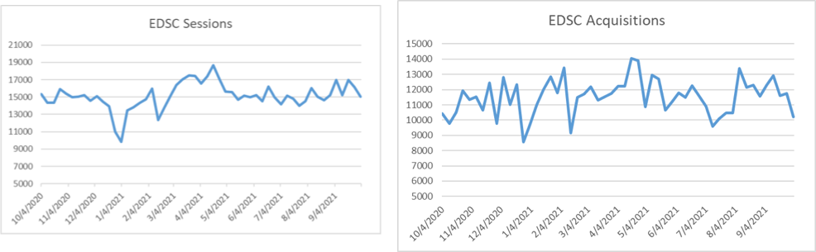
Earthdata Search Client
The Earthdata Search Client (EDSC) is the primary client for accessing NASA Earth Science data via the flagship earthdata.nasa.gov website. Utilization of the EDSC is measured in terms of the number of sessions, or visits by a user over a short period of time, to the site as well as by acquisitions, which represent the number of times data was downloaded via the EDSC.
EDSC sessions fluctuated throughout the year, with a low of EDSC showed steady utilization throughout FY2021 with an average of 15,128 sessions each week. EDSC sessions fluctuated throughout the year, with a low of 9846 during the week ending 1/3/21, and a high of 18,684 during the week ending 4/18/21.
EDSC acquisitions likewise fluctuated throughout the year, with a high of 14,063 during the week ending 4/18/21, a low of 8566 during the week ending 12/27/20, and an average of 11,523 acquisitions per week.

Slide 58
DAAC Profiles
Individual DAACs
LANCE

Slide 72
Script ran at Wed Nov 17 21:23:33 2021
FY21 Daily Data Availability with EMS for Ingest, Archive, and Distribution as provided by the Data Providers

Slide 73
Definitions (1 of 3)

Slide 74
Definitions (2 of 3)

Slide 75
Definitions (3 of 3)

