Slide 1
EOSDIS FY2015
Annual Metrics Report
Prepared By:
Lalit Wanchoo, Adnet, Inc.
Young-In Won, Wyle, Inc.
Durga Kafle, Adnet, Inc.
January 2016

Slide 2
Preface
The Earth Sciences Data and Information System (ESDIS) Project (Code 423) prepared the following report on metrics from across the Earth Observation System Data and Information System (EOSDIS). The 12 Distributed Active Archive Centers (DAACs) of EOSDIS support different scientific disciplines and provide an individualized set of products and services to their science community and the public. Although discipline oriented, the DAACs engage in common data management functions of ingest, archive and distribution, as well as describing their data and services on web sites. Metrics are collected on a daily basis from each DAAC. The ESDIS Project collects these metrics in a tool called the ESDIS Metrics System (EMS). DAAC analysts can view their detailed metrics to assess internal performance and trends. The ESDIS Project combines these metrics, not for comparisons between the DAACs, but as a system level view of EOSDIS performance. This report provides snapshots of metrics as the combination of the individual DAACs and as a system. In keeping with previous years, and in order to support trend comparisons, the metrics data are presented on a fiscal year basis, not by calendar year. These reports are posted online with metrics as far back as 1996. Each report includes some historical trend information. If you have any questions or comments, please contact Jeanne Behnke at (301) 614-5326 or jeanne.behnke@nasa.gov.

Slide 3
Introduction
This report presents statistics on data metrics and web activities at the EOSDIS DAACs during Fiscal Year 2015 (October 1, 2014 through September 30, 2015) from the Earth Science Data and Information System (ESDIS) Metrics System (EMS).
EMS supports the ESDIS project management by collecting and organizing various metrics from the Earth Observing System (EOS) Data and Information System (DIS) DAACs and other sources. The EMS collects and presents data on the usage of products and services delivered via the Internet or managed in EOSDIS archives.
EMS consists of a Data Metrics component and a Web Metrics component. The Data Metrics component provides statistics on data ingest, archive and distribution plus data users profile information. The Web Metrics component provides statistics on web site visits, views and visitors with a variety of related parameters.
This report contains tables and graphs of FY2015 statistics and comparisons to previous years. Values for previous fiscal years are produced from EMS unless noted otherwise. Summary tables, text, graphs, and more detailed statistics tables are also included. As before, metrics for the Near Real-Time (NRT) products are presented in a separate worksheet including unregistered users distribution and a separate summary table for NRT products, called LANCE_Summary, is included. Note that NRT metrics are used in the distribution trend analyses presented in this report. All bots-related distributions (downloads by Internet search engines for indexing purposes) are now included. Also, this year's report includes a data center name change from OBPG to OB.DAAC and the data from all S-NPP instruments archived and distributed by ASDC, MODAPS, and OB.DAAC. Three new worksheets have been added to this year's report and they are: Distribution_Mission_Instrument, Distribution_Mission_Domain, and Distribution_Mission_Level showing the distribution details for Terra, Aqua, and Aura instruments by domain and product levels. One new workbook (FY15Annual_DAAC_Profile) has also been added that provides the summary of archive, distribution, and web metrics for individual DAACs.
Definitions for terms used in this report can be found in the Definitions worksheet.

Slide 4
Contents
EOSDIS Summary
LANCE Summary
Data Metrics (Distribution and Users)
LANCE Metrics
Web Metrics
Total Users and Multi-year Trends
DAAC Profiles (New)
Daily Data Availability
Definitions

Slide 5
EOSDIS Summary
Unique Data Sets: Total number of unique data sets including NRT distributed in the fiscal year.
Distinct Users of EOSDIS Data and Services: Total unique users across EOSDIS Data Users, Web Visitors, and LANCE Registered Users but excludes LANCE Unregistered Users, per DAAC and summed
Web Site Visits: Sum of web visits for DAACs and LANCE data providers where a visit represents a user session not broken by more than 30 minutes and a duration of at least one minute
Average Archive Growth: Sum across reporting DAACs of the data volume added to the individual archives divided by the days in the year (does not include NRT products)
Total Archive Volume: Sum across reporting DAACs of the data volumes in the archive as of end of the fiscal year (does not include NRT products)
End User Distribution Products: Total number of products distributed from all reporting DAACs and LANCE data providers
End User Average Distribution Volume: Sum across reporting DAACs and LANCE data providers of the data volume distributed for the fiscal year divided by the days in the year

Slide 6
Land Atmosphere Near real-time Capability for EOS (LANCE) Summary
Unique Data Sets: Total number of unique data sets distributed in the fiscal year
Distinct Registered LANCE Users: Total number of unique LANCE users who registered and retrieved NRT products from all LANCE data providers, excluding the unregistered users who downloaded imagery products from the MODIS Rapid Response System
Distinct Unregistered LANCE Users: Total number of unique IP Addresses/Emails that retrieved browse imagery products from LANCE data providers, such as Rapid Response Browse Images and excludes the LANCE registered users.
Web Site Visits: Sum of web visits for LANCE data providers where a visit represents a user session not broken by more than 30 minutes and a duration of at least one minute
Average Production Growth: Sum of the NRT data volume generated by all LANCE providers divided by the days in the year, including the NRT and NRT2 processing streams
Total Production Volume: Two weeks worth of production volume of the NRT/NRT2 data products, calculated by multiplying Average Production Growth by 14 (days) assuming the deletion of the NRT/NRT2 products two weeks after production
End User Distribution Products: Total number of products distributed from all reporting LANCE data providers
End User Average Distribution Volume: Sum across reporting LANCE data providers of the data volume distributed for the fiscal year divided by the days in the year

Slide 7
Data Metrics
Ingest
Archive
Total Archive
Distribution
  - By DAAC
  - By Mission/Instrument (New)
  - Volume by Domain
  - Products by Domain
  - Products by Product Level
  - Top 20 Countries
  - Unique Product Count
  - Top 10 Products
Data Users
  Distinct Users
  Repeat Users
  Top 20 Countries
  Foreign Users
  Distribution
    LANCE (Near Real-time)
    - Products Production
    - Distribution

Slide 8
Ingest
Ingest is the amount of data coming into a DAAC over a period of time and includes all product levels. For this report, the data is presented as the amount of data entered into each DAAC during FY2015. The sum of all data centers is the total ingest for EOSDIS. OB.DAAC is unable to provide ingest metrics at this time.

Slide 9
Archive
This table shows the amount of data added to the archive during FY2015 and includes all products levels. Archive metrics for OB.DAAC and NSIDC V0 are not available at this time. NRT data are excluded in this table.
DAAC | Volume (TBs) | Files (Millions)
ASDC | 640.00 | 30.88
ASF | 768.88 | 3.43
CDDIS | 2.78 | 25.57
GESDISC | 500.67 | 10.63
GHRC | 1.11 | 0.76
LPDAAC | 1,649.66 | 59.76
MODAPS | 2,193.38 | 189.90
NSIDC | 59.97 | 16.64
ORNL | 5.54 | 0.35
PODAAC | 33.75 | 2.10
SEDAC | 0.01 | 0.00
Total | 5,855.76 | 340.01

Slide 10
Total Archive Size
The Total Archive Size describes the EOSDIS archive at the end of FY2015. This includes all data (including ancillary) but not data marked for deletion.
DAAC | Volume (TBs) | Files (Millions)
ASDC* | 3,475.00 | 115.26
ASF** | 2,136.66 | 14.54
CDDIS*** | 13.21 | 129.00
GESDISC | 1,161.84 | 82.26
GHRC | 9.90 | 2.75
LPDAAC | 2,468.40 | 120.79
MODAPS | 5,265.47 | 440.62
NSIDC | 177.02 | 46.49
ORNL**** | 183.45 | 57.67
PODAAC | 89.56 | 6.48
SEDAC | 3.37 | 0.00
Total | 14,983.88 | 1,015.86
* ASDC archive size provided by John Kusterer of ASDC
** ASF archive size provided by Netti Labelle-Hamer of ASF
*** CDDIS archive size provided by Carey Noll of CDDIS
**** ORNL archive values were provided by B. McMurry of ORNL

Slide 11
Distribution By DAAC
Distribution presents the amount of data successfully distributed to Public Users.

Slide 12
Distribution By Mission/Instrument
Distribution presents the amount of data successfully distributed to Public Users.
Mission | Instrument | # Files | Volume (TB)
Aqua | AIRS | 39,204,592 | 506.85
 | AMSR-E | 6,891,883 | 90.09
 | CERES | 2,005,900 | 102.93
 | MODIS | 267,842,849 | 2,964.62
Terra | ASTER | 5,837,134 | 64.13
 | CERES | 3,264,876 | 282.57
 | MISR | 2,357,410 | 112.83
 | MODIS | 310,682,308 | 3,249.55
 | MOPITT | 232,447 | 24.24
Aura | HIRDLS | 18,922 | 0.92
 | MLS | 3,420,094 | 25.34
 | OMI | 11,634,182 | 164.48
 | TES | 244,550 | 6.80

Slide 13
Volume Distributed By Domain
Volume Distribution presents the volume of data successfully distributed to Public Users by Domain.
Total Volume Distributed (TB) | ASDC | ASF | CDDIS | GESDISC | GHRC | LP DAAC | MODAPS | NSIDC | OB.DAAC | ORNL | PO.DAAC | SEDAC | Total
Foreign | 328.72 | 71.57 | 67.44 | 794.73 | 5.69 | 1059.14 | 2075.12 | 78.54 | 729.91 | 10.71 | 144.88 | 0.76 | 5,367.21
US COM | 62.22 | 3.43 | 4.67 | 142.80 | 4.31 | 241.26 | 63.01 | 9.69 | 18.66 | 2.35 | 13.82 | 0.65 | 566.86
US EDU | 430.76 | 94.98 | 8.38 | 541.35 | 2.46 | 167.96 | 494.52 | 29.26 | 97.02 | 4.35 | 24.94 | 0.10 | 1,896.09
US GOV | 231.41 | 9.33 | 8.91 | 314.16 | 3.40 | 112.29 | 774.25 | 20.58 | 49.67 | 1.73 | 96.15 | 0.02 | 1,621.91
US ORG | 19.52 | 5.89 | 0.30 | 1.30 | 0.11 | 27.12 | 6.12 | 0.75 | 1.45 | 0.03 | 0.05 | 0.01 | 62.64
US Other | 1.31 | 0.54 | 0.90 | 223.29 | 0.15 | 145.18 | 361.06 | 1.16 | 270.47 | 1.13 | 16.60 | 0.12 | 1,021.92
Unknown | 68.41 | 3.95 | 3.07 | 53.80 | 0.01 | 48.26 | 142.66 | 61.60 | 23.85 | 0.12 | 4.54 | 0.02 | 410.30
Total Volume | 1,142.36 | 189.68 | 93.67 | 2,071.42 | 16.13 | 1,801.23 | 3,916.73 | 201.59 | 1,191.03 | 20.43 | 300.99 | 1.67 | 10,946.92

Slide 14
Product Distribution By Domain
Product Distribution presents the number of products successfully distributed to Public Users by Domain.
Total Products Distributed (Million) | ASDC | ASF | CDDIS | GESDISC | GHRC | LP DAAC | MODAPS | NSIDC | OB.DAAC | ORNL | PO.DAAC | SEDAC | Total
Foreign | 4.82 | 0.93 | 133.24 | 226.45 | 1.97 | 98.60 | 109.98 | 28.88 | 43.20 | 5.16 | 23.59 | 3.62 | 680.43
US COM | 1.14 | 0.13 | 11.62 | 66.77 | 0.54 | 20.45 | 8.32 | 5.27 | 1.65 | 3.70 | 4.71 | 2.85 | 127.15
US EDU | 5.41 | 0.68 | 6.03 | 58.45 | 0.75 | 17.69 | 25.94 | 5.81 | 4.33 | 3.89 | 27.74 | 0.30 | 157.03
US GOV | 2.76 | 0.05 | 13.65 | 20.40 | 3.08 | 18.06 | 195.28 | 2.33 | 2.43 | 0.08 | 18.34 | 0.14 | 276.58
US ORG | 0.07 | 0.09 | 1.49 | 0.36 | 0.01 | 0.70 | 0.03 | 0.07 | 0.22 | 0.00 | 0.09 | 0.04 | 3.18
US Other | 0.01 | 0.09 | 2.76 | 26.34 | 0.03 | 5.50 | 19.01 | 1.20 | 4.26 | 0.21 | 1.96 | 0.61 | 61.99
Unknown | 1.74 | 0.02 | 3.25 | 6.29 | 0.00 | 2.28 | 2.09 | 27.09 | 0.87 | 0.05 | 0.73 | 0.09 | 44.51
Total Products | 15.94 | 2.00 | 172.04 | 405.06 | 6.38 | 163.28 | 360.64 | 70.65 | 56.96 | 13.08 | 77.18 | 7.65 | 1,350.86

Slide 15
Distribution By Product Level
Distribution presents the amount of data successfully distributed to Public Users and excludes NRT products.
Total Products Distributed (millions) | ASDC | ASF | CDDIS | GESDISC | GHRC | LP DAAC | MODAPS | NSIDC | OB.DAAC | ORNL | PO.DAAC | SEDAC | Total
Level 0 | 0.14 | 0.30 | - | 0.52 | 0.40 | - | 0.52 | 0.00 | 1.59 | - | 0.05 | - | 3.51
Level 1 | 1.38 | 1.21 | 134.59 | 14.45 | 1.37 | 3.06 | 62.77 | 4.66 | 5.54 | - | 1.11 | - | 230.15
Level 2 | 12.02 | 0.49 | 35.50 | 53.57 | 2.32 | 35.16 | 227.23 | 13.21 | 24.44 | 0.12 | 39.04 | - | 443.10
Level 3 | 1.15 | 0.00 | 0.01 | 35.09 | 2.30 | 105.20 | 46.74 | 37.51 | 15.59 | 8.32 | 8.55 | - | 260.45
Level 4 | 0.01 | - | - | 297.22 | 0.00 | 15.37 | 22.11 | 0.01 | - | 2.52 | 26.27 | 0.65 | 364.17
Others¹ | 1.25 | - | 1.94 | 4.20 | 0.00 | 4.48 | 1.27 | 15.27 | 9.81 | 2.12 | 2.15 | 7.00 | 49.48
Total Products | 15.94 | 2.00 | 172.04 | 405.06 | 6.38 | 163.28 | 360.64 | 70.65 | 56.96 | 13.08 | 77.18 | 7.65 | 1,350.86

Slide 16
Data Distribution - Top 20 Countries
Affiliations of the users who downloaded data from foreign countries are not known.
Top 20 Countries by Volume Distributed* |  |  |  |  | Top 20 Countries by Products Distributed**
Ranking | Country | Volume (GBs) | Products |  | Ranking | Country | Products | Volume (GBs)
1 | United States | 5,293,476.86 | 625,925,258 |  | 1 | United States | 625,925,258 | 5,293,476.86
2 | Germany | 961,575.73 | 43,432,832 |  | 2 | China | 237,997,509 | 773,416.29
3 | China | 773,416.29 | 237,997,509 |  | 3 | Japan | 61,102,590 | 663,697.83
4 | France | 665,965.40 | 29,023,970 |  | 4 | United Kingdom | 49,171,416 | 493,106.52
5 | Japan | 663,697.83 | 61,102,590 |  | 5 | Germany | 43,432,832 | 961,575.73
6 | United Kingdom | 493,106.52 | 49,171,416 |  | 6 | France | 29,023,970 | 665,965.40
7 | Korea, Republic Of | 289,651.72 | 25,250,214 |  | 7 | Korea, Republic Of | 25,250,214 | 289,651.72
8 | Canada | 228,790.29 | 19,372,606 |  | 8 | Canada | 19,372,606 | 228,790.29
9 | Belgium | 200,002.67 | 7,017,479 |  | 9 | Russian Federation | 18,003,823 | 135,106.39
10 | Australia | 137,072.21 | 11,933,031 |  | 10 | Poland | 17,877,858 | 62,852.91
11 | Russian Federation | 135,106.39 | 18,003,823 |  | 11 | India | 17,640,319 | 51,479.50
12 | Spain | 83,731.74 | 11,235,848 |  | 12 | Switzerland | 17,607,986 | 70,772.14
13 | India | 70,772.14 | 17,607,986 |  | 13 | Brazil | 17,417,532 | 64,523.58
14 | Netherlands | 65,671.71 | 7,328,747 |  | 14 | Turkey | 13,937,441 | 5,645.16
15 | Brazil | 64,523.58 | 17,417,532 |  | 15 | Australia | 11,933,031 | 137,072.21
16 | Italy | 63,321.58 | 9,600,303 |  | 16 | Spain | 11,235,848 | 83,731.74
17 | Poland | 62,852.91 | 17,877,858 |  | 17 | Italy | 9,600,303 | 63,321.58
18 | Switzerland | 51,479.50 | 17,640,319 |  | 18 | Netherlands | 7,328,747 | 65,671.71
19 | Ireland | 43,646.40 | 1,231,668 |  | 19 | Belgium | 7,017,479 | 200,002.67
20 | Denmark | 37,907.46 | 3,134,816 |  | 20 | Czech Republic | 3,591,955 | 8,062.09
* Some products are inherently larger than other files in size and therefore may skew the results.
** When counting # of products, metadata files are excluded.

Slide 17
Distribution of Unique Data Products
Tables below show the number of unique data products distributed to public users during FY2015. In counting unique products, metadata were excluded. NRT products are not included.
ASDC | ASF | CDDIS | GESDISC | GHRC | LP DAAC | MODAPS | NSIDC | OB.DAAC | ORNL | PO.DAAC | SEDAC | Total
1,043 | 158 | 221 | 2,777 | 365 | 456 | 1,033 | 602 | 176 | 1,187 | 984 | 229 | 9,231

Slide 18
Data Distribution - Top 10 Products
Top 10 Products Distributed By Volume*
Rank | Product | Description | GBs | Files **
1 | MOD021KM | MODIS/Terra Level 1B Calibrated Radiances - 1km | 671,724.07 | 7,181,511
2 | MYD021KM | MODIS/AquaLevel 1B Calibrated Radiances - 1km | 626,973.90 | 6,337,638
3 | MYD06_L2 | MODIS/Aqua Level 2 Cloud Product | 336,942.18 | 9,814,519
4 | MOD09GA | MODIS/Terra Surface Reflectance Daily L2G Global 1km and 500m SIN Grid | 335,795.67 | 14,846,650
5 | MOD13Q1 | MODIS/Terra Vegetation Indices 16-Day L3 Global 250m SIN Grid | 315,616.34 | 8,456,418
6 | MOD09GQ | MODIS/Terra Surface Reflectance Daily L2G Global 250m SIN Grid | 305,659.64 | 10,180,916
7 | MYD03 | MODIS/Aqua Geolocation - 1km | 290,110.44 | 12,615,546
8 | VIRL1 | VIIRS/S-NPP Level 1 Data | 269,757.51 | 1,346,926
9 | AIRIBRAD | AIRS/Aqua infrared geolocated radiances | 253,870.60 | 5,269,686
10 | MOD03 | MODIS/Terra Geolocation - 1km | 229,584.71 | 10,942,519
Top 10 Products Distributed By File Count **
Rank | Product | Description | Files** | GBs
1 | MAT1NXSLV | MERRA 2D IAU Diagnostic, Single Level Meteorology, Time Average 1-hourly (2/3x1/2L1) | 156,274,156 | 154,615.42
2 | GNSS_DAILY_D | GNSS Daily Compact Observation Data | 43,841,314 | 19,700.58
3 | MOD11A1 | MODIS/Terra Land Surface Temperature/Emissivity Daily L3 Global 1km SIN Grid | 34,827,539 | 58,496.91
4 | NLDAS_FORA0125_H | NLDAS Primary Forcing Data L4 Hourly 0.125 x 0.125 degree V002 | 34,191,347 | 39,174.53
5 | MOD04_L2 | MODIS/Terra Level 2 Aerosol | 28,465,985 | 42,521.47
6 | MYD11A1 | MODIS/Aqua Land Surface Temperature/Emissivity Daily L3 Global 1km SIN Grid | 23,475,021 | 35,998.96
7 | MYD04_L2 | MODIS/Aqua Level 2 Aerosol | 21,496,377 | 32,553.78
8 | TRMM_3B42 | TRMM 3B42 3-Hour 0.25deg x 0.25deg and Other-GPI Calibration Rainfall | 18,120,743 | 51,735.61
9 | GNSS_DAILY_N | GNSS Daily GPS Broadcast Ephemeris Data | 17,102,848 | 700.97
10 | PODAAC-OSCAR-03D01 | OSCAR third degree resolution ocean surface currents | 16,740,616 | 1,710.98
* Some products are inherently larger than other files in size and therefore may skew the results.
** When counting # of files, metadata files are excluded.

Slide 19
Distinct Data Users
Distinct Data Users presents the number of distinct public users who received data product files.
Distinct Data Users By Domain | ASDC | ASF | CDDIS | GES DISC | GHRC | LP DAAC | MODAPS | NSIDC | OB.DAAC | ORNL | PO.DAAC | SEDAC | Total
Foreign | 1,173 | 4,625 | 105,013 | 96,083 | 2,423 | 135,520 | 44,001 | 14,890 | 30,844 | 22,781 | 18,646 | 395,656 | 871,655
US COM | 493 | 779 | 60,973 | 17,902 | 600 | 13,694 | 1,617 | 5,689 | 1,577 | 5,438 | 5,307 | 231,778 | 345,847
US EDU | 975 | 1,435 | 1,657 | 8,366 | 488 | 10,811 | 1,551 | 2,654 | 1,225 | 3,161 | 2,580 | 17,013 | 51,916
US GOV | 1,022 | 175 | 2,815 | 2,943 | 290 | 3,010 | 872 | 743 | 298 | 590 | 1,706 | 4,277 | 18,741
US ORG | 26 | 73 | 166 | 502 | 15 | 984 | 19 | 70 | 40 | 66 | 46 | 2,772 | 4,779
US Other | 13 | 463 | 5,114 | 10,423 | 256 | 5,780 | 1,911 | 1,463 | 2,842 | 2,613 | 1,897 | 53,136 | 85,911
Unknown | 94 | 164 | 1,913 | 7,011 | 64 | 4,271 | 912 | 775 | 1,897 | 1,116 | 1,038 | 12,502 | 31,757
Total Distinct Data Users | 3,796 | 7,714 | 177,651 | 143,230 | 4,136 | 174,070 | 50,883 | 26,284 | 38,723 | 35,765 | 31,220 | 717,134 | 1,410,606

Slide 20
Repeat Data Users
Repeat users are distinct Public users who received data on more than one day in the fiscal year.
Repeat Data Users By Domain | ASDC | ASF | CDDIS | GES DISC | GHRC | LP DAAC | MODAPS | NSIDC | OB.DAAC | ORNL | PO.DAAC | SEDAC | Total
Foreign | 526 | 1,479 | 26,332 | 23,822 | 404 | 30,714 | 17,249 | 3,601 | 6,136 | 4,673 | 4,442 | 41,732 | 161,110
US COM | 227 | 306 | 6,117 | 4,228 | 96 | 3,914 | 634 | 1,318 | 481 | 1,117 | 1,542 | 23,922 | 43,902
US EDU | 418 | 669 | 645 | 2,740 | 140 | 2,738 | 536 | 674 | 446 | 541 | 674 | 2,542 | 12,763
US GOV | 438 | 67 | 1,075 | 1,316 | 91 | 923 | 369 | 293 | 153 | 150 | 513 | 2,134 | 7,522
US ORG | 12 | 32 | 108 | 141 | 2 | 271 | 8 | 25 | 24 | 4 | 23 | 1,064 | 1,714
US Other | 3 | 133 | 2,164 | 2,336 | 41 | 1,398 | 841 | 343 | 471 | 456 | 405 | 12,749 | 21,340
Unknown | 43 | 77 | 483 | 1,295 | 11 | 929 | 289 | 285 | 486 | 173 | 306 | 1,948 | 6,325
Total Repeat Data Users | 1,667 | 2,763 | 36,924 | 35,878 | 785 | 40,887 | 19,926 | 6,539 | 8,197 | 7,114 | 7,905 | 86,091 | 254,676

Slide 21
Data Users - Top 20 Countries
Top 20 Countries by Number of Users
Ranking | Country | Users
1 | United States | 488,820
2 | China | 103,402
3 | Israel | 62,242
4 | United Kingdom | 59,469
5 | Canada | 44,153
6 | Russian Federation | 41,453
7 | India | 39,569
8 | Germany | 30,826
9 | Australia | 27,283
10 | Brazil | 23,786
11 | France | 22,710
12 | Iran, Islamic Republic Of | 14,377
13 | Italy | 14,359
14 | Japan | 13,990
15 | Philippines | 13,609
16 | Indonesia | 13,581
17 | Spain | 13,496
18 | Netherlands | 12,756
19 | Mexico | 11,202
20 | Colombia | 10,663

Slide 22
Foreign Distribution
Distribution metrics for foreign public users are compared. Statistics are based on country information provided by the 12 EOSDIS DAACs.
1 EU includes 28 European Union member countries.
2 China includes only People’s Republic of China and does not include Taiwan or Hong Kong.
This represents the data users whose countries are unknown
These represent the user counts across all DAACs and may be fewer than the sum of users from individual DAAC due to multi-
DAAC users

Slide 23
Production of Near Real-Time Products
Near Real-Time (NRT) production represents the amount of data generated by the Land Atmosphere Near Real-time Capability for EOS (LANCE) data providers, including the two identical processing systems, NRT and NRT2.
LANCE Provider | Instrument | Volume (TB) | Files (Millions)
GESDISC NRT/NRT2 | AIRS / AMSU - A | 31.48 | 2.80
GESDISC NRT/NRT2 | MLS | 0.48 | 0.76
MODAPS NRT/NRT2 | MODIS - Aqua | 385.43 | 6.26
MODAPS NRT/NRT2 | MODIS - Terra | 424.42 | 6.75
OMI NRT/NRT2 | OMI | 7.18 | 0.10
Total |  | 848.99 | 16.67
Volume and file count include the data products deleted from archive

Slide 24
Distribution of Near Real-Time Products
Near Real-time (NRT) Distribution provides the amount of data successfully distributed to registered users of the Land Atmosphere Near Real-time Capability for EOS (LANCE). LANCE provides access to near real-time data (<3 hours from observation) from MODIS, AIRS, MLS and OMI instruments. Metrics for distribution volume, numbers of files distributed and users are presented.
* Excludes metadata
** Represents the number of unique IP hosts/e-mail addresses used to retrieve NRT products, excluding registered users
*** Represents the number of the registered users who retrieved data for each instrument. It must be noted that sum of theses users
may be greater than the total number of unique registered users since one user could retrieve data for multiple instruments
1 These products do not have any mission or instrument mapping but have been distributed, such as ancillary data.

Slide 25
Web Metrics
Visitors and Visits
Repeat Visitors
Top 20 Domains
Top 20 Countries
LANCE Web Metrics

Slide 26
Web Visitors and Visits
EOSDIS web activity is measured by number of Visits made, the number of pages Viewed and the number of distinct Visitors. Visits of at least one minute are considered to represent significant work accomplished, and many of the shorter visits are of less than a second. Eleven of the twelve EOSDIS DAACs report web metrics at this time; all except OBPG. Note that the sum of monthly visitors could be greater than the number of unique visitor for a given year since one user could be counted more than once if he/she visited the same website in different months. Excludes Earthdata website activity.

Slide 27
Earthdata Web Visitors and Visits
EOSDIS web activity is measured by number of Visits made, the number of pages Viewed and the number of distinct Visitors. Visits of at least one minute are considered to represent significant work accomplished, and many of the shorter visits are of less than a second. This is for Earthdata website only. Note that the sum of monthly visitors could be greater than the number of unique visitor for a given year since one user could be counted more than once if he/she visited the same website in different months.

Slide 28
Repeat Web Visitors
EOSDIS Web Visitors are characterized by the number of visits they make and how frequently they return. Visitors counted in the table below are those that stayed for one minute or more. Repeat Visitors are counted from the start of the Fiscal Year. Metrics data is collected per data center and summed for an EOSDIS total.
FY2014 Web Visitors for Visits of one minute or more
* represents the sum of the metrics from all 11 data centers and excludes Earthdata

Slide 29
Top 20 Domains By # of Web Visitors
The FY2014 Top 20 Domains for visits >= 1 minute is sorted by the # of Visitors. Data came from 11 DAACs (all DAACs on Slide # 10 except OBPG provide web metrics) and excludes Earthdata website. All statistics are based on domains resolved by NetInsight, using host information. Domain information was obtained using a NASA DNS translation program.

Slide 30
Earthdata Top 20 Domains By
# of Web Visitors
The FY2014 Top 20 Domains for visits >= 1 minute is sorted by the # of Visitors. All statistics are based on domains resolved by NetInsight, using host information. Domain information was obtained using a NASA DNS translation program.

Slide 31
Top 20 Countries By # Web Visits
The FY2014 Top 20 Countries for visits >= 1 minute is sorted by the # of Visits. Data came from 11 DAACs (all DAACs on Slide # 10 except OBPG provide web metrics) and excludes Earthdata website. Country information is based on the NetInsight geographical data from Quova, the Neustar IP Intelligence and IP Geolocation Service.

Slide 32
Earthdata Top 20 Countries By
# Web Visits
The FY2014 Top 20 Countries for visits >= 1 minute is sorted by the # of Visits. Country information is based on the NetInsight geographical data from Quova, the Neustar IP Intelligence and IP Geolocation Service.

Slide 33
LANCE Web Metrics
LANCE web activity is measured by number of visits made, the number of pages viewed and the number of distinct visitors for the LANCE website. The number of hosts counts the distinct IP addresses of the visitors. Repeat visitors is a count of those visitors who made at least two visits since the start of web activity measurements or in the fiscal year.
Web metrics are presented for visits of one minute or greater. Visits of at least one minute are considered to represent significant work accomplished, and many of the shorter visits are of less than a second. The sum of monthly visitors could be greater than the number of unique visitors for a given year since one user could be counted more than once in the monthly visitor count if he/she visited the LANCE websites in different months.
Month | # Visits | # Views | # Unique Visitors
Oct-14 | 25,269 | 278,463 | 16,309
Nov-14 | 24,684 | 260,975 | 16,526
Dec-14 | 25,642 | 269,708 | 16,722
Jan-15 | 34,261 | 341,026 | 22,491
Feb-15 | 34,883 | 347,844 | 22,431
Mar-15 | 39,679 | 373,990 | 25,141
Apr-15 | 37,399 | 359,743 | 22,844
May-15 | 28,548 | 281,874 | 17,367
Jun-15 | 24,041 | 234,227 | 13,299
Jul-15 | 29,532 | 277,333 | 16,071
Aug-15 | 26,045 | 237,018 | 15,159
Sep-15 | 19,537 | 181,152 | 12,042
FY2015 | 349,520 | 3,443,353 | 198,199
33

Slide 34
Total Users and Trends
Total Users
Total Archive Trend
Data Volume Distribution Trend
Data Product Distribution Trend
Data Products by Product Level
Top 10 Products Trend FY2013 - FY2015
Known U.S. - Foreign Product Distribution Trend
Web Trends (Visits and Visitors)

Slide 35
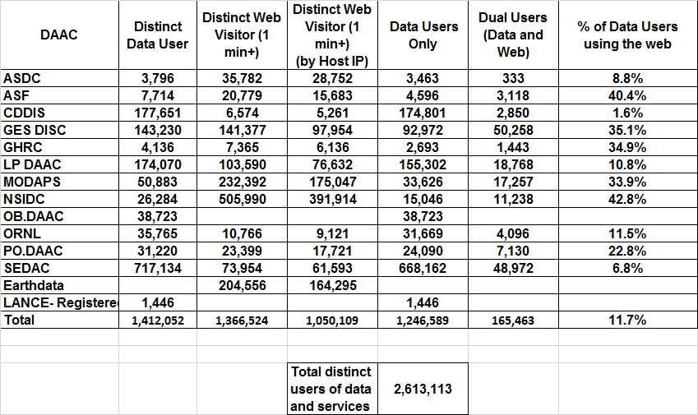
Total Users
Total Users is an estimate formed by combining the distinct Data Users and distinct Web Visitors, removing the overlap and excludes LANCE Unregistered users who downloaded browse imagery. The common element for these counts is the IP address (Host); therefore, the comparison is made without using the additional details provided by the Data User email address or the Web Visitor browser. Not being able to compare the users directly likely results in an undercount. Web Visitors included in the count are for those visitors with visits of one minute or longer. To minimize the undercount, the final Total Users value includes the total Web Visitors (IP address plus browser), plus the distinct Data Users (counted by IP Address).

Slide 36
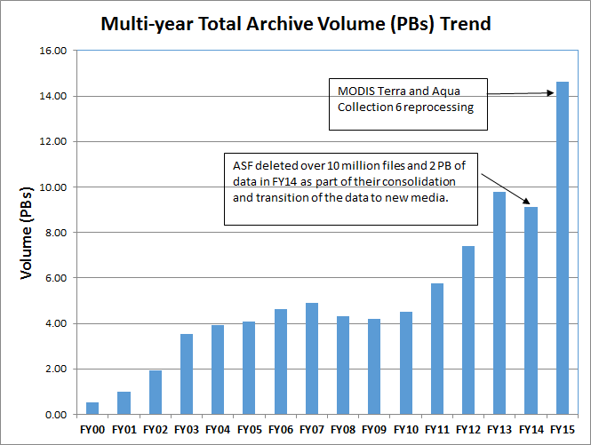
Total Archive Trend
The total archive trend is based on data and reports produced during individual fiscal years, rather than from EMS. EMS does not contain sufficient information to recreate the archive size for previous years due to episodic deletions from the archive and not all archive information is supplied to EMS by the DAACs. Since products are deleted at the DAACs and not always reported to EMS, It may not able to completely reproduce what was in the archive in previous years.
The trend data were compiled in FY2013 with the expectation it will be updated yearly with data captured in that year's EOSDIS Annual Report in the Total Archive Size worksheet. The sources of data for earlier years , which are not presented here, are available from the Excel version of this report.
Volume By FY | Total Volume (PBs)
FY00 | 0.51
FY01 | 0.99
FY02 | 1.92
FY03 | 3.55
FY04 | 3.94
FY05 | 4.06
FY06 | 4.62
FY07 | 4.91
FY08 | 4.29
FY09 | 4.20
FY10 | 4.50
FY11 | 5.76
FY12 | 7.40
FY13 | 9.76
FY14 | 9.12
FY15 | 14.63

Slide 37
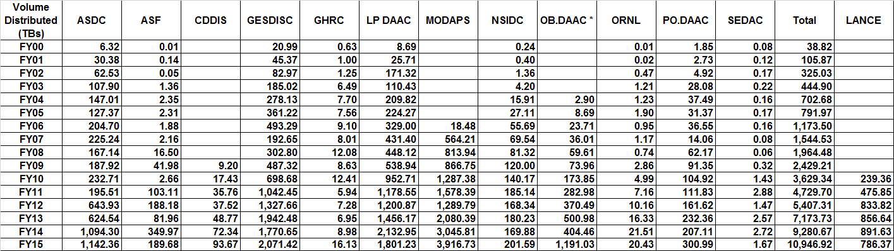
Data Volume Distribution Trend
The Volume Distribution Trend presents distributed volume counts from EMS by DAAC. OBPG distribution metrics from the Ocean Color web site are included beginning in FY2004. CDDIS data became available in FY2009.

Slide 38
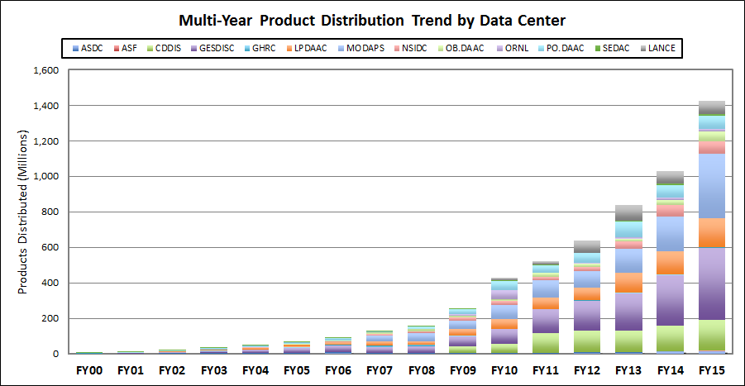
Data Product Distribution Trend
The Product Distribution Trend presents distributed product counts from EMS by DAAC. OBPG distribution metrics from the Ocean Color web site are included beginning in FY2004. CDDIS data became available in FY2009.
Products Distributed (Millions) | ASDC | ASF | CDDIS | GESDISC | GHRC | LPDAAC | MODAPS | NSIDC | OB.DAAC | ORNL | PO.DAAC | SEDAC | Total Products | LANCE
FY00 | 0.22 | 0.00 |  | 2.34 | 0.97 | 0.62 |  | 0.13 |  | 0.01 | 1.05 | 0.19 | 5.52
FY01 | 0.97 | 0.00 |  | 2.64 | 1.03 | 1.24 |  | 0.25 |  | 0.03 | 2.08 | 0.26 | 8.49
FY02 | 3.68 | 0.00 |  | 5.28 | 1.42 | 4.63 |  | 0.40 |  | 0.09 | 3.55 | 0.26 | 19.31
FY03 | 4.15 | 0.03 |  | 10.92 | 4.68 | 3.72 |  | 0.86 |  | 0.11 | 10.45 | 0.30 | 35.21
FY04 | 6.77 | 0.06 |  | 15.67 | 3.40 | 8.90 |  | 0.96 | 0.29 | 0.42 | 10.30 | 0.25 | 47.03
FY05 | 5.70 | 0.06 |  | 26.55 | 3.58 | 15.08 |  | 1.80 | 1.71 | 0.49 | 12.83 | 0.26 | 68.06
FY06 | 7.78 | 0.04 |  | 41.41 | 4.05 | 11.93 | 1.67 | 4.69 | 4.91 | 0.36 | 13.48 | 0.32 | 90.64
FY07 | 7.32 | 0.05 |  | 30.98 | 9.29 | 24.32 | 33.36 | 8.13 | 7.04 | 1.22 | 5.71 | 0.11 | 127.54
FY08 | 3.57 | 0.30 |  | 38.75 | 10.18 | 16.76 | 47.74 | 10.73 | 10.67 | 0.40 | 16.49 | 0.07 | 155.66
FY09 | 5.11 | 0.47 | 37.06 | 54.50 | 5.68 | 38.83 | 47.21 | 17.25 | 8.66 | 7.70 | 31.72 | 0.49 | 254.66
FY10 | 4.41 | 0.10 | 52.60 | 84.22 | 0.66 | 51.95 | 79.76 | 22.90 | 12.43 | 49.88 | 50.33 | 3.57 | 412.80 | 17.26
FY11 | 5.04 | 0.37 | 112.33 | 133.84 | 0.72 | 63.97 | 98.77 | 20.18 | 20.54 | 3.19 | 38.27 | 4.16 | 501.38 | 22.11
FY12 | 10.63 | 0.85 | 120.03 | 168.68 | 0.79 | 70.59 | 95.25 | 24.34 | 16.77 | 6.71 | 54.07 | 1.60 | 570.28 | 65.96
FY13 | 10.21 | 0.67 | 120.93 | 209.91 | 4.43 | 111.74 | 135.29 | 38.22 | 18.29 | 5.76 | 89.25 | 4.69 | 749.40 | 89.75
FY14 | 15.47 | 1.11 | 144.29 | 283.26 | 4.50 | 127.08 | 196.14 | 67.73 | 27.46 | 13.61 | 71.26 | 6.39 | 958.31 | 69.87
FY15 | 15.94 | 2.00 | 172.04 | 405.06 | 6.38 | 163.28 | 360.64 | 70.65 | 56.96 | 13.08 | 77.18 | 7.65 | 1,350.86 | 72.54

Slide 39
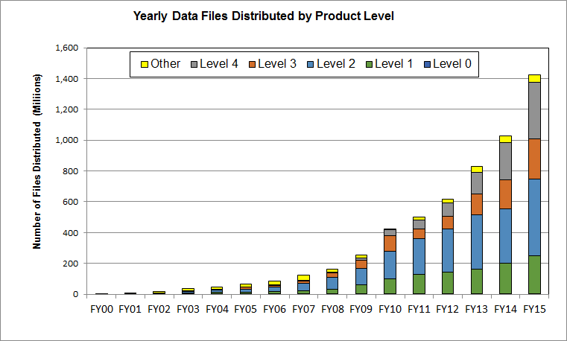
Data Product Distribution Trend by Product Level
The Product Distribution Trend by Product Level presents distributed product counts from EMS by product level and includes NRT data products
¹ Other, these products have not been assigned any product level.

Slide 40
Top 10 Products Trend by Volume
FY2014 – FY2015
FY2014 Top 10 Products Distributed By Volume*
Ranking |  | Product | Description | GBs | Files
1 |  | MYD021KM | MODIS/Aqua Level 1B Calibrated Radiances - 1km | 674,445.29 | 7,142,022
2 |  | MOD021KM | MODIS/Terra Level 1B Calibrated Radiances - 1km | 520,338.84 | 5,973,631
3 |  | MYD06_L2 | MODIS/Aqua Level 2 Cloud Product | 419,037.49 | 12,832,754
4 |  | AIRIBRAD | AIRS/Aqua infrared geolocated radiances | 360,963.04 | 9,339,642
5 |  | MOD09GA | MODIS/Terra Surface Reflectance Daily L2G Global 1km and 500m SIN Grid | 349,747.32 | 7,714,639
6 |  | MYD09GA | MODIS/Aqua Surface Reflectance Daily L2G Global 1km and 500m SIN Grid | 302,803.63 | 4,936,438
7 |  | MYD03 | MODIS/Aqua Geolocation - 1km | 244,608.58 | 11,314,422
8 |  | MOD03 | MODIS/Terra Geolocation - 1km | 238,483.13 | 11,826,890
9 |  | MOD13Q1 | MODIS/Terra Vegetation Indices 16-Day L3 Global 250m SIN Grid | 233,898.69 | 1,708,084
10 |  | CAL_LID_L1-VALSTAGE1-V3 | CALIPSO Lidar Level 1B profile data (CAL_LID_L1-ValStage1-V3) | 213,137.60 | 478,361
FY2015 Top 10 Products Distributed By Volume*
 | Product |  | Description | GBs | Files **
1 | MOD021KM |  | MODIS/Terra Level 1B Calibrated Radiances - 1km | 671,724.07 | 7,181,511
2 | MYD021KM |  | MODIS/AquaLevel 1B Calibrated Radiances - 1km | 626,973.90 | 6,337,638
3 | MYD06_L2 |  | MODIS/Aqua Level 2 Cloud Product | 336,942.18 | 9,814,519
4 | MOD09GA |  | MODIS/Terra Surface Reflectance Daily L2G Global 1km and 500m SIN Grid | 335,795.67 | 14,846,650
5 | MOD13Q1 |  | MODIS/Terra Vegetation Indices 16-Day L3 Global 250m SIN Grid | 315,616.34 | 8,456,418
6 | MOD09GQ |  | MODIS/Terra Surface Reflectance Daily L2G Global 250m SIN Grid | 305,659.64 | 10,180,916
7 | MYD03 |  | MODIS/Aqua Geolocation - 1km | 290,110.44 | 12,615,546
8 | VIRL1 |  | VIIRS/S-NPP Level 1 Data | 269,757.51 | 1,346,926
9 | AIRIBRAD |  | AIRS/Aqua infrared geolocated radiances | 253,870.60 | 5,269,686
10 | MOD03 |  | MODIS/Terra Geolocation - 1km | 229,584.71 | 10,942,519
*Some products are inherently larger than other files in size and therefore may skew the results.
** Does not include metadata files

Slide 41
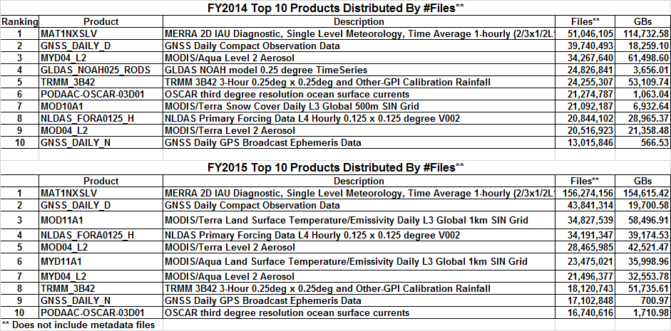
Top 10 Products Trend by # of Files
FY2014 – FY2015
** When counting # of files, metadata files are not included.

Slide 42
Known U.S. – Foreign
Product Distribution Trend
* product distribution where the destination could not be determined

Slide 43
Web Trends
Web metrics data for EOSDIS became available as of FY2007. Data for FY2007 is complete for 7 DAACs and FY2008 is complete for 8 DAACs. Since FY2009, 11 DAACs provided web metrics and excludes Earthdata. These metrics are for visits of one minute or more. Repeat visitors are counted as 2 or more visits since web activity measurements began for that DAAC.
Fiscal Year | Views | Visits | Visitors | Repeat Visitors
FY2007 | 7,599,722 | 707,365 | 443,079 | 77,731
FY2008 | 8,263,283 | 827,714 | 523,416 | 91,801
FY2009 | 11,463,765 | 1,079,317 | 702,058 | 116,886
FY2010 | 13,654,146 | 1,108,858 | 718,944 | 205,378
FY2011 | 18,617,279 | 1,318,598 | 855,976 | 150,076
FY2012 | 23,721,135 | 1,973,920 | 1,248,743 | 339,566
FY2013 | 25,320,299 | 1,929,798 | 1,183,040 | 226,968
FY2014 | 22,466,747 | 1,688,096 | 1,080,386 | 308,670
FY2015 | 18,499,687 | 1,803,274 | 1,161,968 | 332,088

Slide 44
Earthdata Web Trends
Web metrics data for Earthdata became available as of FY2012. These metrics are for visits of one minute or more. Repeat visitors are counted as 2 or more visits since web activity measurements began for that DAAC.
Fiscal Year | Views | Visits | Visitors | Hosts | Repeat Visitors
FY2012 | 500,380 | 88,610 | 63,039 | 52,919 | 14,268
FY2013 | 1,133,023 | 196,014 | 133,861 | 108,179 | 31,994
FY2014 | 1,157,662 | 214,326 | 139,051 | 112,564 | 37,186
FY2015 | 1,641,730 | 289,385 | 204,556 | 164,295 | 53,136

Slide 45
DAAC Profiles (NEW)
Individual DAACs

Slide 46
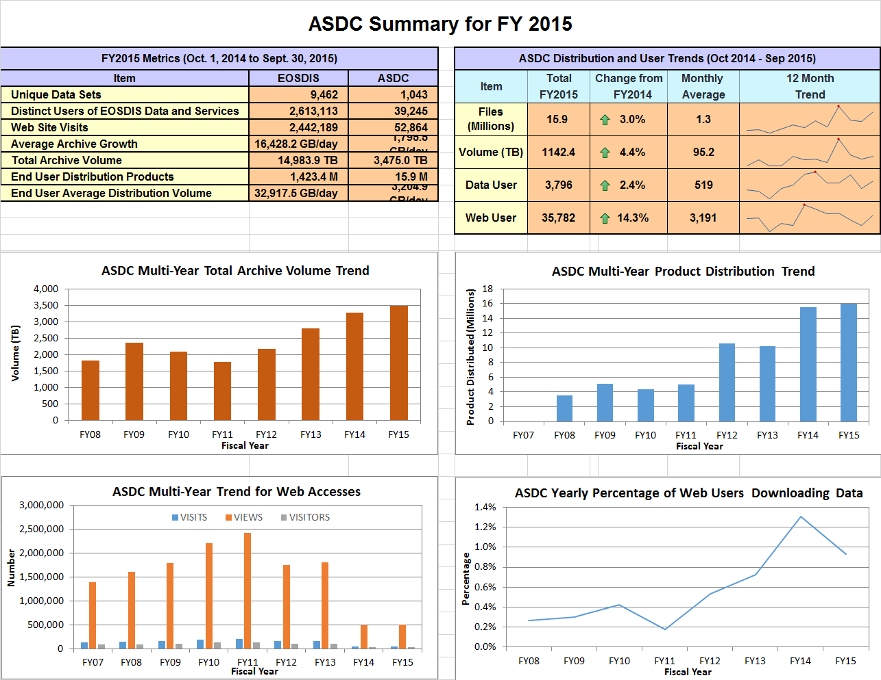

Slide 47
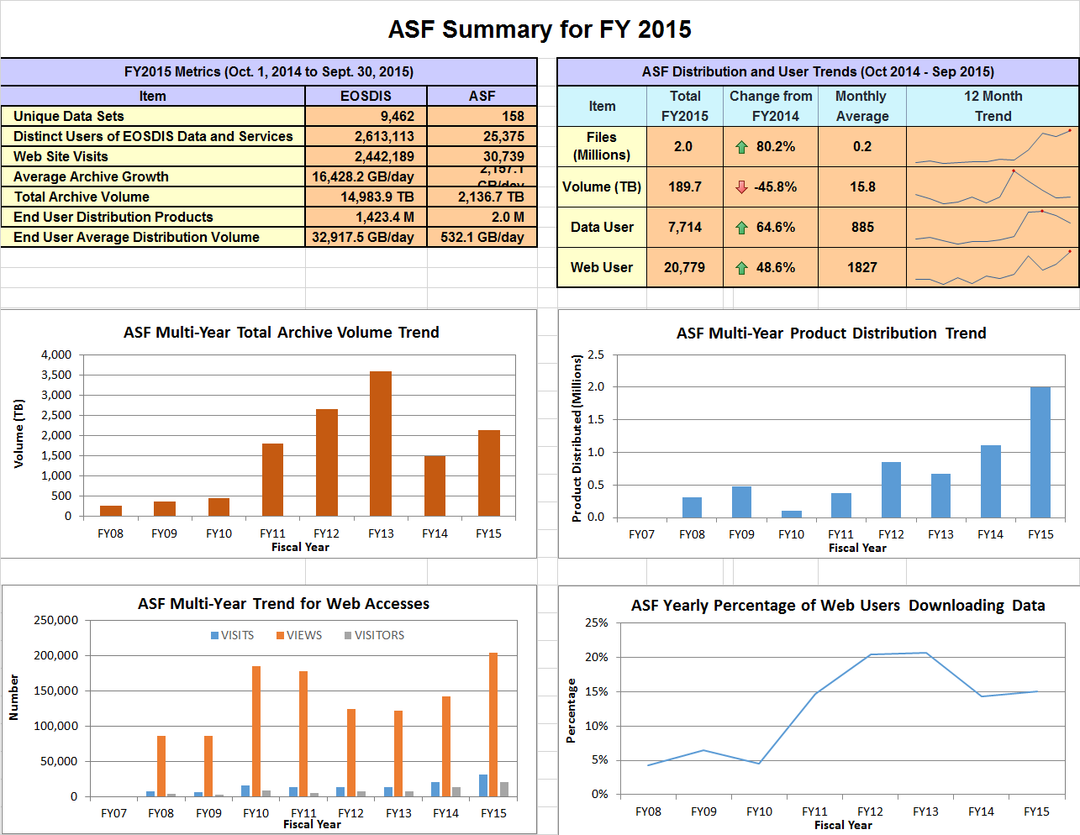

Slide 48
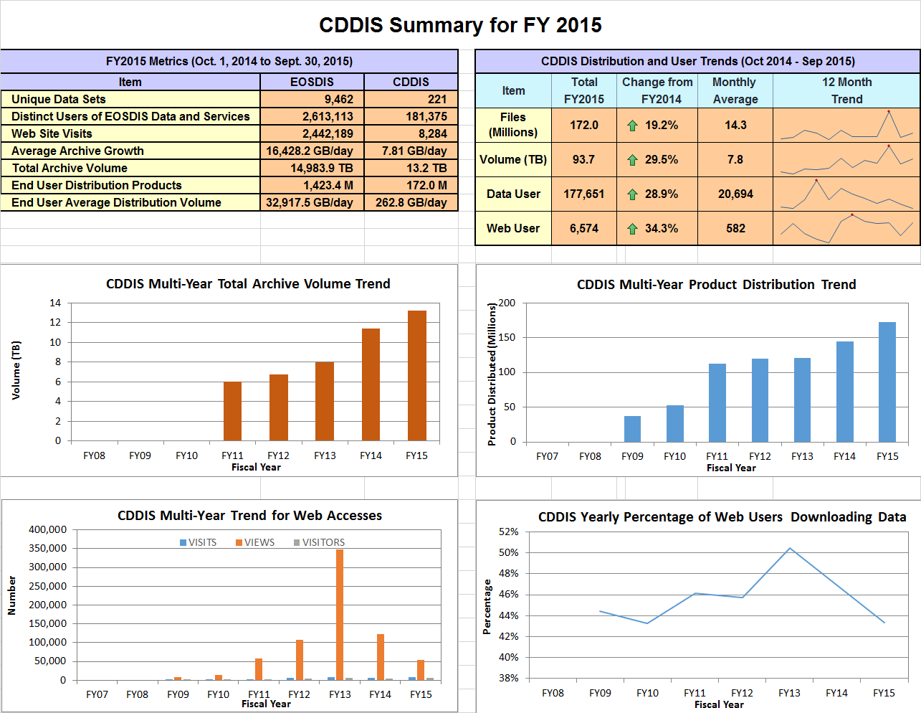

Slide 49
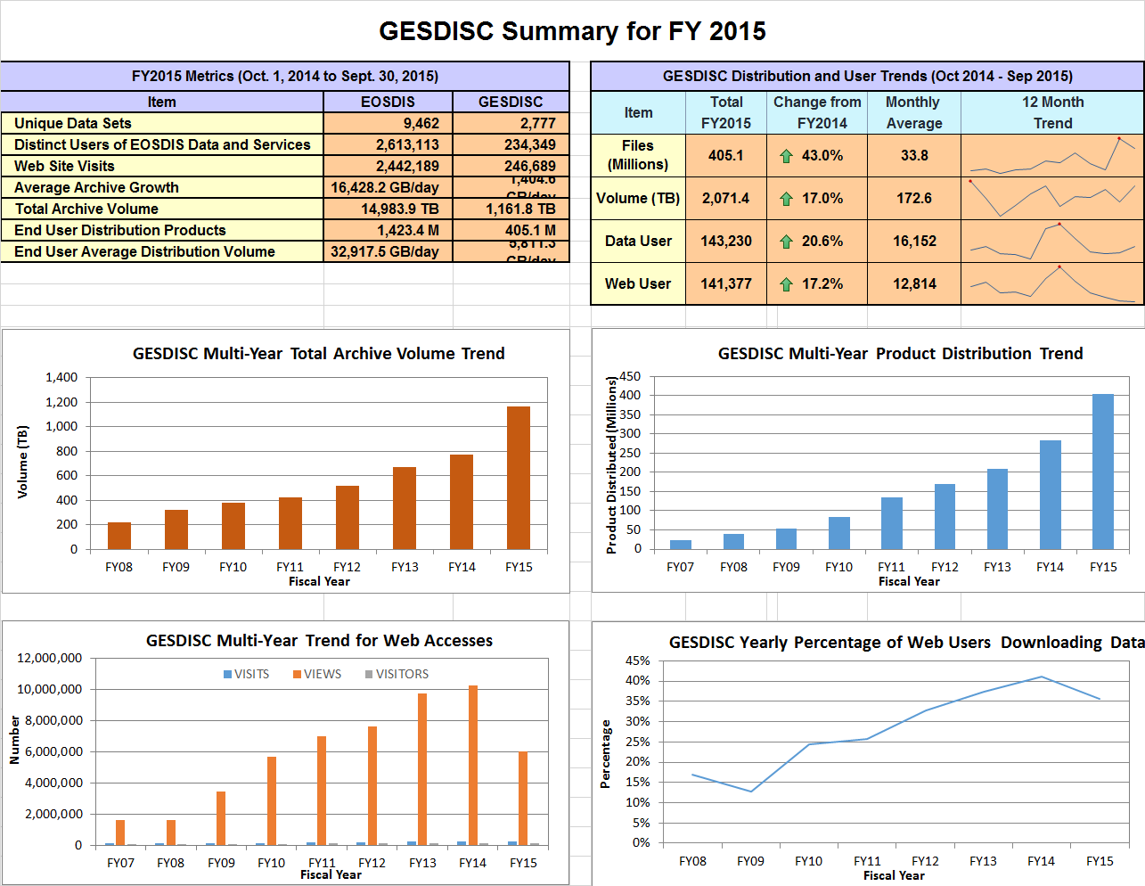

Slide 50
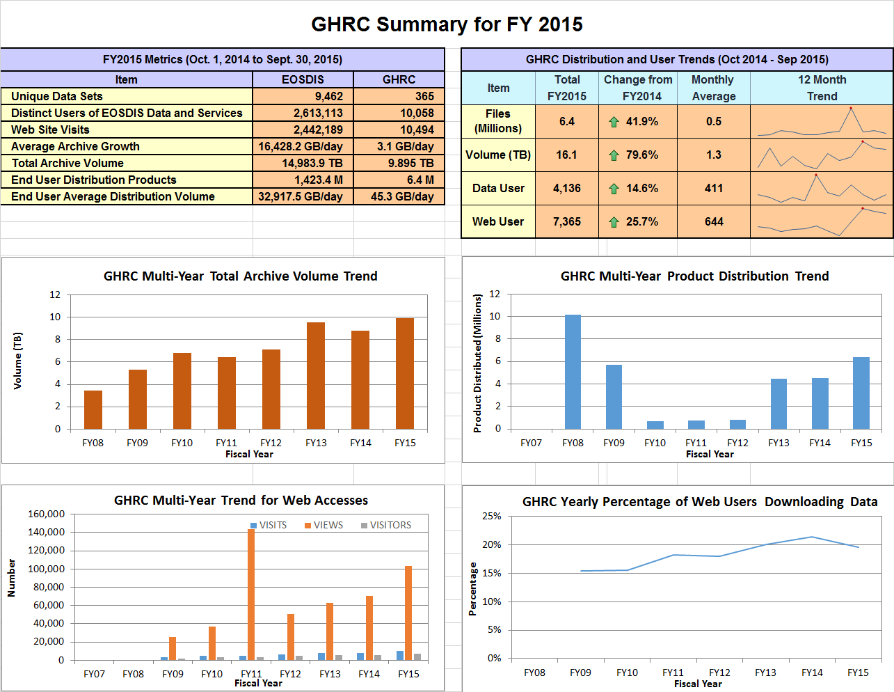

Slide 51
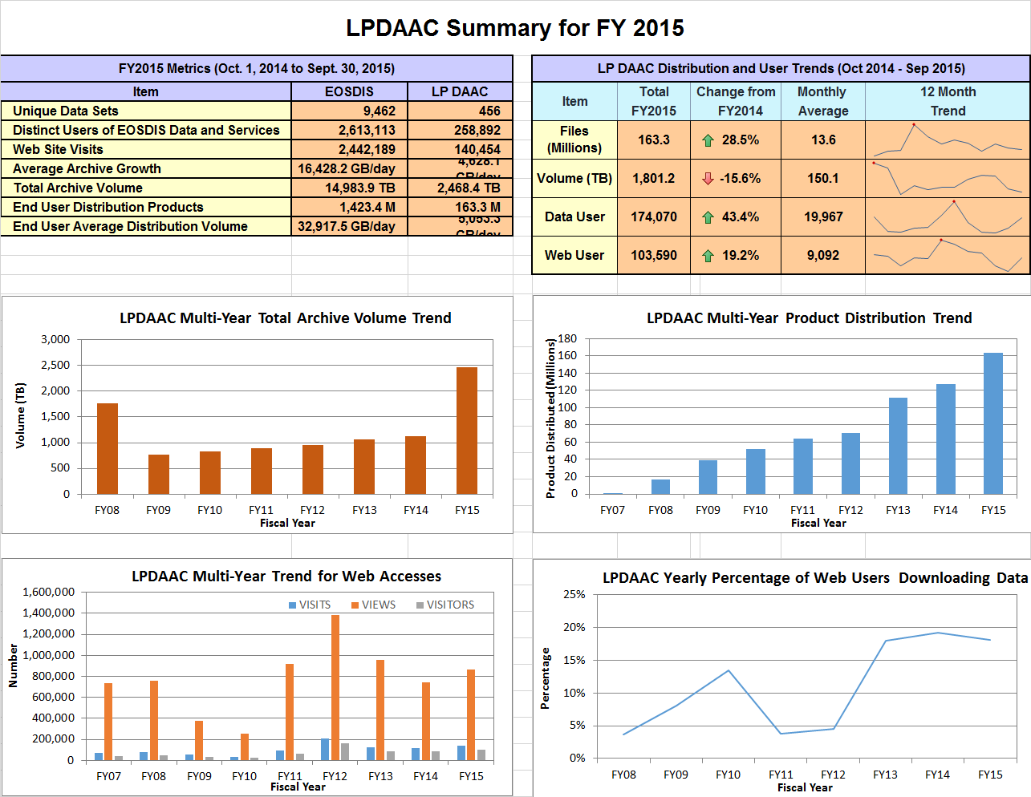

Slide 52
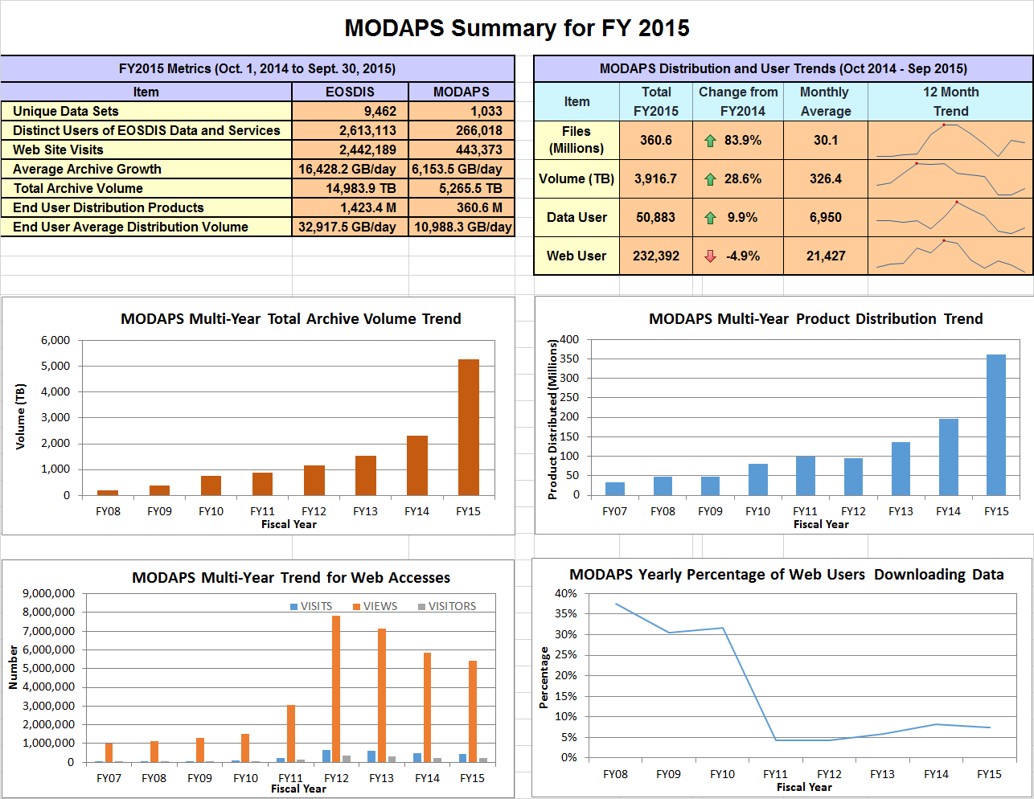

Slide 53
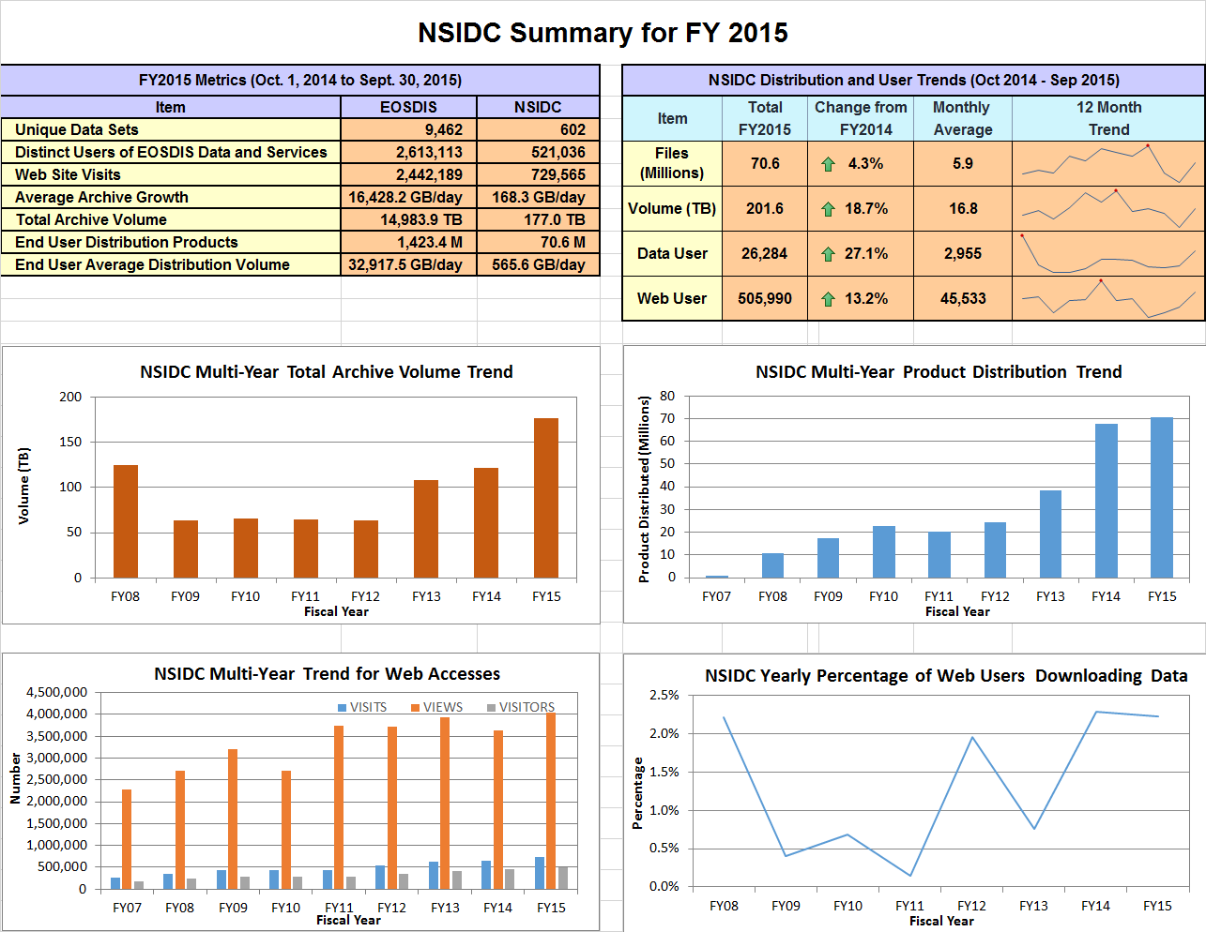

Slide 54
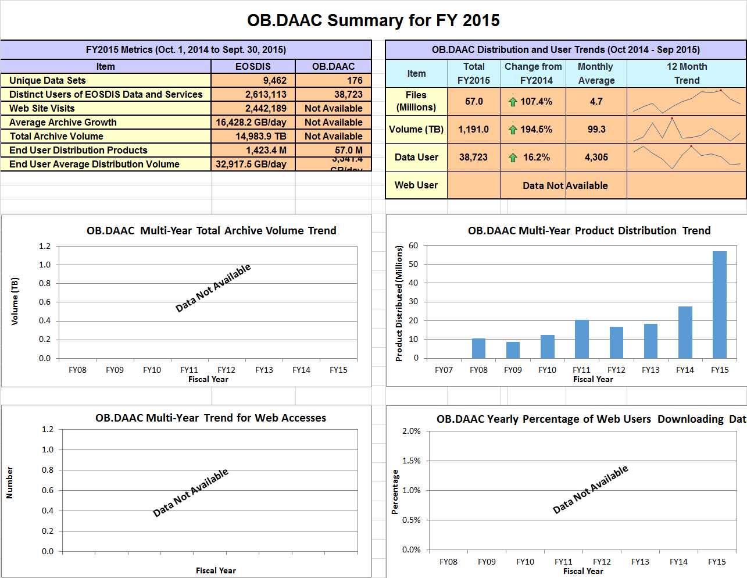

Slide 55
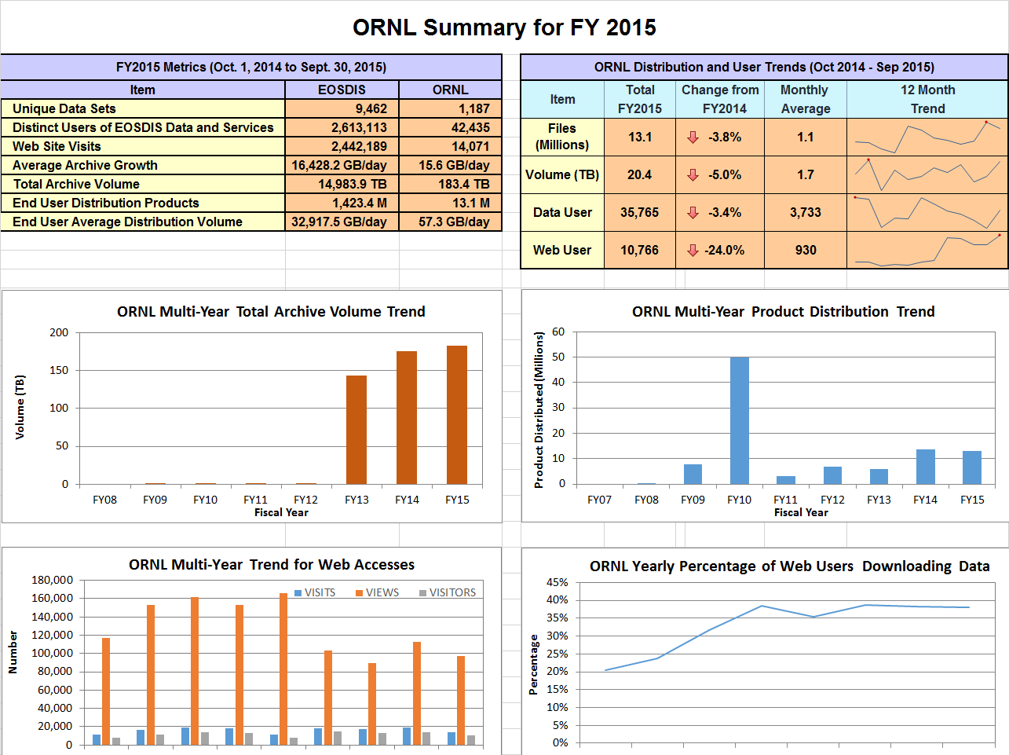

Slide 57
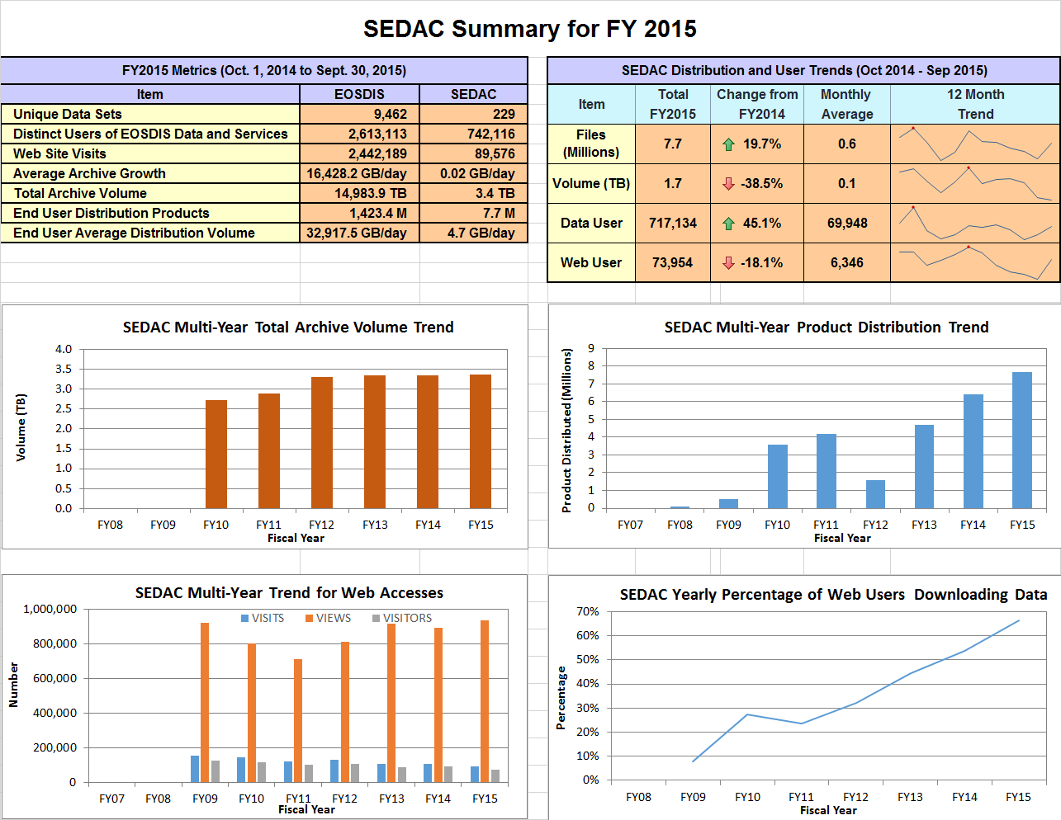

Slide 58
Daily Data Availability in EMS for FY15
Daily data availability for FY15 is a chart showing data availability with EMS for Ingest, Archive, and Distribution as provided by the Data Providers .

Slide 59
Definitions (1 of 3)

Slide 60
Definitions (2 of 3)

Slide 61
Definitions (3 of 3)

