Slide 1
EOSDIS FY2020
Annual Metrics Report
Prepared By:
Lalit Wanchoo, Adnet Systems, Inc.
Durga Kafle, Adnet Systems, Inc.
Ja Soon Shim, Adnet Systems, Inc.
November 2020

Slide 2
Preface
The Earth Sciences Data and Information System (ESDIS) Project (Code 423) prepared the following report on metrics from across the Earth Observation System Data and Information System (EOSDIS). The 12 Distributed Active Archive Centers (DAACs) of EOSDIS support different scientific disciplines and provide an individualized set of products and services to their science community and the public. Although discipline oriented, the DAACs engage in common data management functions of ingest, archive and distribution, as well as describing their data and services on web sites. Metrics are collected on a daily basis from each DAAC. The ESDIS Project collects these metrics in a tool called the ESDIS Metrics System (EMS). DAAC analysts can view their detailed metrics to assess internal performance and trends. The ESDIS Project combines these metrics, not for comparisons between the DAACs, but as a system level view of EOSDIS performance. This report provides snapshots of metrics as the combination of the individual DAACs and as a system. In keeping with previous years, and in order to support trend comparisons, the metrics data are presented on a fiscal year basis, not by calendar year. These reports are posted online with metrics as far back as 1996. Each report includes some historical trend information. If you have any questions or comments, please contact Drew Kittel (301) 614-6582 or drew.h.kittel@nasa.gov..

Slide 3
Introduction
This report presents statistics on data metrics and web activities at the EOSDIS DAACs during Fiscal Year 2020 (October 1, 2019 through September 30, 2020) from the Earth Science Data and Information System (ESDIS) Metrics System (EMS).
EMS supports the ESDIS project management by collecting and organizing various metrics from the Earth Observing System (EOS) Data and Information System (DIS) DAACs and other sources. The EMS collects and presents data on the usage of products and services delivered via the Internet or managed in EOSDIS archives.
EMS consists of a Data Metrics component and a Web Metrics component. The Data Metrics component provides statistics on data ingest, archive and distribution plus data users profile information. The Web Metrics component provides statistics on web site visits, views and visitors with a variety of related parameters.
This report contains tables and graphs of FY2020 statistics and comparisons to previous years. Values for previous fiscal years are produced from EMS unless noted otherwise. Summary tables, text, graphs, and more detailed statistics tables are also included. As before, metrics for the Near Real-Time (NRT) products are presented in a separate worksheet that includes unregistered users distribution and a separate summary table for NRT products, called LANCE_Summary, is included. Note that NRT metrics are used in the distribution trend analyses presented in this report. All bots-related distributions (downloads by Internet search engines for indexing purposes) are included. Also, the data from all S-NPP instruments archived and distributed by ASDC, MODAPS, and OB.DAAC have been included. This year's report include a tab "Top_10_Country_with_NRT" that provides graphical data representation of the data distribution to various countries. This report also includes three worksheets and one workbook that were added in FY2015 Annual Report: i) Distribution_Mission_Instrument, Distribution_Mission_Domain, and Distribution_Mission_Level showing the distribution details for Terra, Aqua, and Aura instruments by domain and product levels, and ii) Workbook (FY20Annual_DAAC_Profile) that provides the summary of archive, distribution, and web metrics for individual DAACs and LANCE. In FY 2020 a new tab "DOI_Summary" was added that provides details of ESDIS Digital Object Identifiers request processing and status. In FY 2019, web metrics was separated out as another spreadsheet that included metrics from NetInsight and Google Analytics, This report continue to include two worksheets titled 'Earthdata Systems' and 'Worldview_WebMetrics'. Earthdata Systems provides metrics on the earthdata login, data collections and granules metadata submitted to Common Metadata Repository (CMR), and earthdata search client sessions/acquisitions. These reports were provided by the EED-2 staff. Worldview_WebMetrics provides the metrics on the visit, views, and visitors accessing worldview. In FY 20 NetInsight was decommissioned and web metrics were from Google Analytics only.

Slide 4
Additional Information
Digital Object Identifiers (DOI) Summary
FY 2020 OB.DAAC included in web-metrics
FY2020 Web-metrics from Google Analytics. NetInsight have been decommissioned from October 1, 2019

Slide 5
Report Structure
Three Excel Spreadsheets
  1) Data Ingest, Archive, and Distribution with long-term trends
  2) Web access metrics
  3) Individual DAAC Profiles
One Powerpoint

Slide 6
Impact on The Annual Report
Total Users
  Total Users = Data Users (distribution) + Web Users (GA)- Dual Users
  Dual Users (Web and Data Users) identified by comparing IPaddress
  IPaddress not available in GA so no Dual User Information
  Total Users=Data User + Web Users
No Domain Report for Web-metrics
GA users are cookie ID based rather than IPaddress
Repeat users are higher because of GA procedure counts repeat user in each category of sessions
Country resolution is significantly better (unknown under 1%)

Slide 7
Contents
EOSDIS Summary
LANCE Summary
Data Metrics (Distribution and Users)
LANCE Metrics
DOI Summary
Web Metrics
Worldview Web Metrics
Total Users and Multi-year Trends
Earthdata Systems (Earthdata Login, CMR, and EDSC)
DAAC Profiles
Daily Data Availability
Definitions

Slide 8
EOSDIS Summary
Unique Data Sets: Total number of unique data sets including NRT distributed in the fiscal year.
Distinct Users of EOSDIS Data and Services: Total unique users across EOSDIS Data Users, Web Visitors, and LANCE Registered Users but excludes LANCE Unregistered Users, per DAAC and summed.
Web Site Sessions: Sum of web sessions for DAACs and LANCE data providers where a session represents a user session not broken by more than 30 minutes and a duration of at least one minute
Average Archive Growth: Sum across reporting DAACs of the data volume added to the individual archives divided by the days in the year (does not include NRT products)
Total Archive Volume: Sum across reporting DAACs of the data volumes in the archive as of end of the fiscal year (does not include NRT products)
End User Distribution Products: Total number of products distributed from all reporting DAACs and LANCE data providers
End User Average Distribution Volume: Sum across reporting DAACs and LANCE data providers of the data volume distributed for the fiscal year divided by the days in the year

Slide 9
Land Atmosphere Near real-time Capability for EOS (LANCE) Summary
Unique Data Sets: Total number of unique data sets distributed in the fiscal year
Distinct Registered LANCE Users: Total number of unique LANCE users who registered and retrieved NRT products from all LANCE data providers, excluding the unregistered users who downloaded imagery products from the MODIS Rapid Response System
Distinct Unregistered LANCE Users: Total number of unique IP Addresses/Emails that retrieved browse imagery products from LANCE data providers, such as Rapid Response Browse Images and excludes the LANCE registered users.
Web Site Sessions: Sum of web sessions for LANCE data providers where a session represents a user session not broken by more than 30 minutes and a duration of at least one minute
Average Production Growth: Sum of the NRT data volume generated by all LANCE providers divided by the days in the year, including the NRT and NRT2 processing streams
Total Production Volume: One year of production volume of the NRT/NRT2 data products.
End User Distribution Products: Total number of products distributed from all reporting LANCE data providers
End User Average Distribution Volume: Sum across reporting LANCE data providers of the data volume distributed for the fiscal year divided by the days in the year

Slide 10
Data Metrics
Ingest
Archive
Total Archive
Distribution
- By DAAC
  - By Mission/Instrument
  - Volume by Domain
  - Products by Domain
  - Products by Product Level
  - Top 20 Countries
  - Unique Product Count
  - Top 10 Products
Data Users
- Distinct Users
- Repeat Users
- Top 20 Countries
- Foreign Users
Distribution
    LANCE (Near Real-time)
    - Products Production
    - Distribution
    Digital Object Identifiers
    - Summary

Slide 11
Ingest
Ingest is the amount of data coming into a DAAC over a period of time and includes all product levels. For this report, the data is presented as the amount of data entered into each DAAC during FY2020 and excludes NRT data. The sum over all data centers is the total ingest for EOSDIS.

Slide 12
Archive
This table shows the amount of data added to the archive during FY2020 and includes all products levels. Archive metrics for NSIDC V0 are not available at this time. NRT data are excluded in this table.
Notes:
Notes:
¹Provided by John M. Kusterer of ASDC by an email on 10/29/2020
²Provided by Sandra Belvin of CDDIS by an email on 10/21/2020
³Provided by Tammy Walker of ORNL by an email on 11/2/2020
⁴Provided by Suresh Vannan of PO.DAAC by an email on 10/22/2020

Slide 13
Total Archive Size
The Total Archive Size describes the EOSDIS archive at the end of FY2020. This includes all data (including ancillary) but not data marked for deletion and excludes NRT data.
Notes:
Notes:
1 Provided by John M. Kusterer of ASDC by an email on 10/29/2020
2 Provided by Sandra Belvin of CDDIS by an email on 10/21/2020
3 Provided by Leigh Sinclair of GHRC by an email 10/15/2020
4 Provided by Daniel Crumly of NSIDC by an email on 10/27/2020
5 Provided by Tammy Walker of ORNL by an email on 11/2/2020
6 Provided by Suresh Vannan of PO.DAAC by an email on 10/22/2020

Slide 14
Distribution By DAAC
Distribution presents the amount of data successfully distributed to Public Users and excluded NRT data.

Slide 15
Distribution By Mission/Instrument
Distribution presents the amount of data successfully distributed to Public Users.

Slide 16
Volume Distributed By Domain
Volume Distribution presents the volume of data successfully distributed to Public Users by Domain.

Slide 17
Product Distribution By Domain
Product Distribution presents the number of products successfully distributed to Public Users by Domain.

Slide 18
Distribution By Product Level
Distribution presents the amount of data successfully distributed to Public Users and excludes NRT products.

Slide 19
Distribution of Unique Data Products
Tables below show the number of unique data products distributed to public users during FY2020. In counting unique products, metadata were excluded. NRT products are not included.

Slide 20
Data Distribution - Top 20 Countries
Affiliations of the users who downloaded data from foreign countries are not known.
* Some products are inherently larger than other files in size and therefore may skew the results.
** When counting # of products, metadata files are excluded.

Slide 21
Data Distribution - Top 10 Products
* Some products are inherently larger than other files in size and therefore may skew the results.
** When counting # of files, metadata files are excluded.

Slide 22
Distinct Data Users
Distinct Data Users presents the number of distinct public users who received data product files.

Slide 23
Repeat Data Users
Repeat users are distinct Public users who received data on more than one day in the fiscal year.

Slide 24
Data Users - Top 20 Countries

Slide 25
Foreign Distribution
Distribution metrics for foreign public users are compared. Statistics are based on country information provided by the 12 EOSDIS DAACs.
1. EU includes 27 European Union member countries, UK and territories under EU countries' and UK's sovereignty
2. China includes only People's Republic of China and does not include Hong Kong and Taiwan
3. This represents the data users whose countries are unknown
4. These represent the user counts across all DAACs and may be fewer than the sum of users from individual DAAC due to multi-DAAC users

Slide 26
Production of Near Real-Time Products
Near Real-Time (NRT) production represents the amount of data generated by the Land Atmosphere Near Real-time Capability for EOS (LANCE) data providers, including the two identical processing systems, NRT and NRT2.
Volume and file count include the data products deleted from archive

Slide 27
Distribution of Near Real-Time Products
Near Real-time (NRT) Distribution provides the amount of data successfully distributed to registered users of the Land Atmosphere Near Real-time Capability for EOS (LANCE). LANCE provides access to near real-time data (<3 hours from observation). Metrics for distribution volume, numbers of files distributed, and users are presented.
* Excludes metadata
** Represents the number of unique IP hosts/e-mail addresses used to retrieve NRT products, excluding registered users
*** Represents the number of the registered users who retrieved data for each instrument. It must be noted that sum of theses users
may be greater than the total number of unique registered users since one user could retrieve data for multiple instruments
1 These products do not have any mission or instrument mapping but have been distributed, such as ancillary data.

Slide 28
Digital Object Identifier Summary

Slide 29
Digital Object Identifier Summary
Total DOIs to be Registered: ~13,000

Slide 30
Web Metrics
EOSDIS and Earthdata
  Visitors and Visits
  Repeat Visitors
  Top 20 Domains
  Top 20 Countries
LANCE Web Metrics
Worldview Web Metrics

Slide 31
Web Visitors and Sessions
EOSDIS web activity is measured by number of Sessions made, the number of pages Viewed and the number of distinct Visitors. Sessions of at least one minute are considered to represent significant work accomplished, and many of the shorter sessions are of less than a second. All twelve EOSDIS DAACs report web metrics at this time. Note that the sum of monthly visitors could be greater than the number of unique visitor for a given year since one user could be counted more than once if he/she visited the same website in different months. Excludes Earthdata and LANCE website activity.
Google Analytics
* Represents the sum of the metrics from all 12 DAACs and excludes Earthdata.

Slide 32
Earthdata Web Visitors and Sessions
EOSDIS web activity is measured by number of Sessions made, the number of pages Viewed and the number of distinct Visitors. Sessions of at least one minute are considered to represent significant work accomplished, and many of the shorter visits are of less than a second. This is for Earthdata website only. Note that the sum of monthly visitors could be greater than the number of unique visitor for a given year since one user could be counted more than once if he/she visited the same website in different months.
Google Analytics

Slide 33
Repeat Web Visitors
EOSDIS Web Visitors are characterized by the number of sessions they make and how frequently they return. Visitors counted in the table below are those that stayed for one minute or more. Repeat Visitors are counted from the start of the Fiscal Year. Metrics data is collected per data center and summed for an EOSDIS total.
FY2020 Web Visitors for Sessions of one minute or more
Google Analytics
represents the sum of the metrics from all 12 data centers and excludes Earthdata and LANCE
Repeat users In Google Analytics, if a user has multiple sessions during the computation time period that user will be
counted for all sessions grouped that are applicable to that user

Slide 34
Top 20 Domains By # of Web Visitors
Google Analytics
No Such Report
IPaddress not available

Slide 35
Earthdata Top 20 Domains By
# of Web Visitors
Google Analytics
No Such Report
IPaddress not available

Slide 36
Top 20 Countries By # Web Visits
The FY2020 Top 20 Countries for sessions >= 1 minute is sorted by the # of sessions. Data came from 12 DAACs and excludes Earthdata and LANCE website. Country information is based on the Google Analytics Geolocation Service.
Google Analytics

Slide 37
Earthdata Top 20 Countries By
# Web Visits
The FY2020 Top 20 Countries for sessions >= 1 minute is sorted by the # of Sessions. Country information is based on the Google Analytics Geolocation Service.
Google Analytics

Slide 38
LANCE Web Metrics
LANCE web activity is measured by number of sessions made, the number of pages viewed and the number of distinct visitors for the LANCE website.
Google Analytics
38

Slide 39
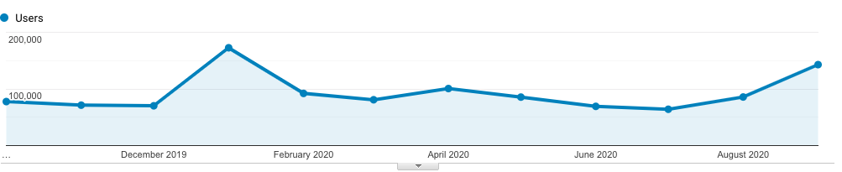
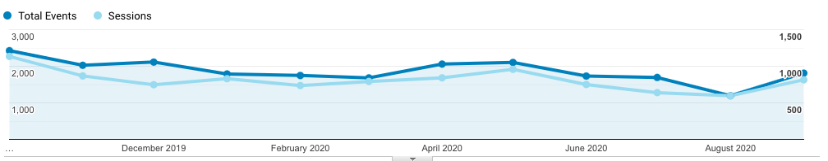
Worldview Web Metrics
Worldview web activity is measured by number of sessions made, the number of pages viewed and the number of distinct visitors accessing the Worldview.
Google Analytics
Fires in Australia
39

Slide 40
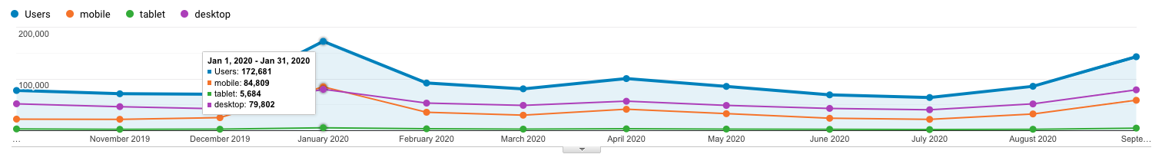
Worldview # of User Downloading Data
Visits represent the number of users who accessed the data download feature from Worldview as opposed to total number of visitors who accessed Worldview.
An event is any on-page action other than loading a page. If the target has more to do with interacting with the page or performing an on-page action, like entering form data, starting a video or making a selection choice, then it should be defined as an event.
Google Analytics
Fires in Australia
40

Slide 41
Total Users and Trends
Total Users
Total Archive Trend
Data Volume Distribution Trend
Data Product Distribution Trend
Data Products by Product Level
Top 10 Products Trend FY2019 - FY2020
Known U.S. - Foreign Product Distribution Trend
Web Trends (Visits and Visitors)

Slide 42
Total Users
Total Users is an estimate formed by combining the distinct Data Users and distinct Web Visitors without removing the overlap (web and Data) and excludes LANCE Unregistered users who downloaded browse imagery. Web Visitors included in the count are for those visitors with sessions of one minute or longer. To minimize the undercount, the final Total Users value includes the total Web Visitors (IP address plus browser), plus the distinct Data Users.

Slide 43
Total Archive Trend
The total archive trend is based on data and reports produced during individual fiscal years, rather than from EMS. EMS does not contain sufficient information to recreate the archive size for previous years due to episodic deletions from the archive and not all archive information is supplied to EMS by the DAACs. Since products are deleted at the DAACs and not always reported to EMS, It may not able to completely reproduce what was in the archive in previous years.
The trend data were compiled in FY2013 with the expectation it will be updated yearly with data captured in that year's EOSDIS Annual Report in the Total Archive Size worksheet. The sources of data for earlier years, which are not presented here, are available from the Excel version of this report.

Slide 44
Data Volume Distribution Trend
The Volume Distribution Trend presents distributed volume counts from EMS by DAAC. OBPG distribution metrics from the Ocean Color web site are included beginning in FY2004. CDDIS data became available in FY09.

Slide 45
Data Product Distribution Trend
The Product Distribution Trend presents distributed product counts from EMS by DAAC. OBPG distribution metrics from the Ocean Color web site are included beginning in FY2004. CDDIS data became available in FY2009.

Slide 46
Data Product Distribution Trend by Product Level
The Product Distribution Trend by Product Level presents distributed product counts from EMS by product level and includes NRT data products
¹ Other, these products have not been assigned any product level.

Slide 47
Top 10 Products Trend by Volume
FY2019 – FY2020
*Some products are inherently larger than other files in size and therefore may skew the results.
** Does not include metadata files

Slide 48
Top 10 Products Trend by # of Files
FY2019 – FY2020
** When counting # of files, metadata files are not included.

Slide 49
U.S. – Foreign
Product Distribution Trend
* product distribution where the destination could not be determined

Slide 50
Web Trends
Web metrics data for EOSDIS became available as of FY2007, Data for FY2007 is complete for 7 DAACs and FY2008 is complete for 8 DAACs. Since FY2009, 11 DAACs provided webmetrics and from FY 2020 all 12 DAACs have provided the webmetrics data. For FY 2007 to FY 2018 NetInsight data was used, for FY 2019 both NetInsight and Google Analytics data was used, while as from FY 2020 only Google Analytics data was used as the Netinsight was decommissioned from Oct 1, 2019. These web metrics excludes Earthdata & LANCE and are for sessions (visits) of one minute or more. Repeat visitors are counted as 2 or more visits since web activity measurements began for that DAAC.
Google Analytics

Slide 51
Earthdata Web Trends
Web metrics data for Earthdata became available as of FY2012. These metrics are for sessions of one minute or more. Repeat visitors are counted as 2 or more sessions since web activity measurements began for that DAAC.
Google Analytics
In FY 2020 Earthdata website has gone through significant restructure and some of pages have been deleted. This reduced number of pages tag as such lower numbers.

Slide 52
Earthdata Systems
Earthdata Login
CMR Collections/Granules
Earthdata Search Client
Provided by EED-2 Staff

Slide 53
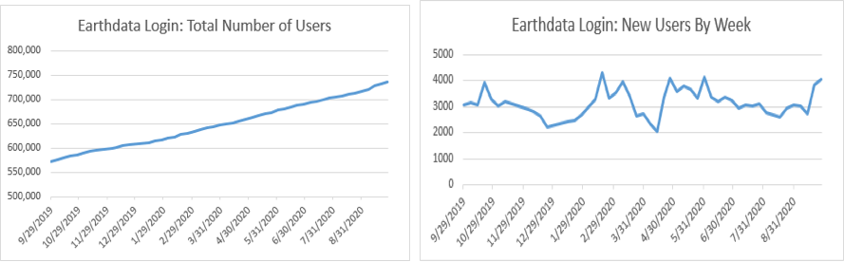
Earthdata Login
The Earthdata Login provides a single mechanism for user registration and profile management for all EOSDIS system components (DAACs, Tools, and Services). Earthdata Login also helps the EOSDIS program better understand the usage of EOSDIS services to improve user experience through customization of tools and improvement of services. Given the utilization of Earthdata Login across EOSDIS system components, Earthdata Login metrics provide one measure of interest in NASA earth science holdings.
The number of new users registered weekly in Earthdata Login varied seasonally and as key events occurred throughout FY2020. The number of new registered users ranged from a low of 2061 for the week ending 4/13/20 (as many organizations were adjusting their working models due to the COVID-19 pandemic) to a high of 4324 the week ending 2/17/20, with an average of over 3150 new users per week. New user registrations continued to show strong growth with at least 2061 new users added each week outside of the year-end holiday period.
The total number of Earthdata Login registered users increased by 22.1% over the course of FY2020, from 573,109 at the beginning of October 2019 to 736,132 by the end of September 2020.

Slide 54
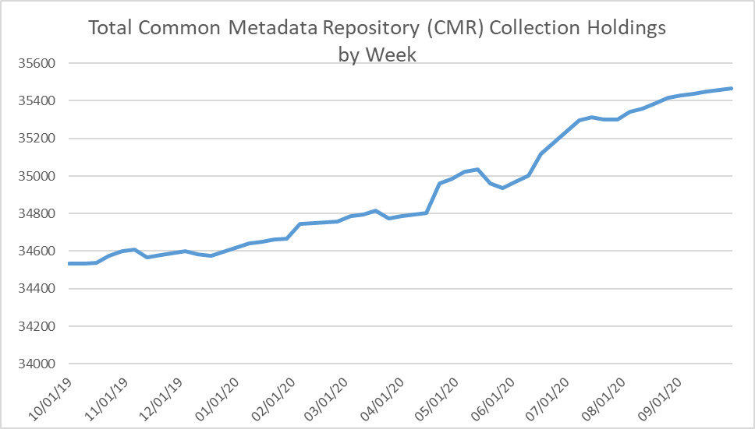
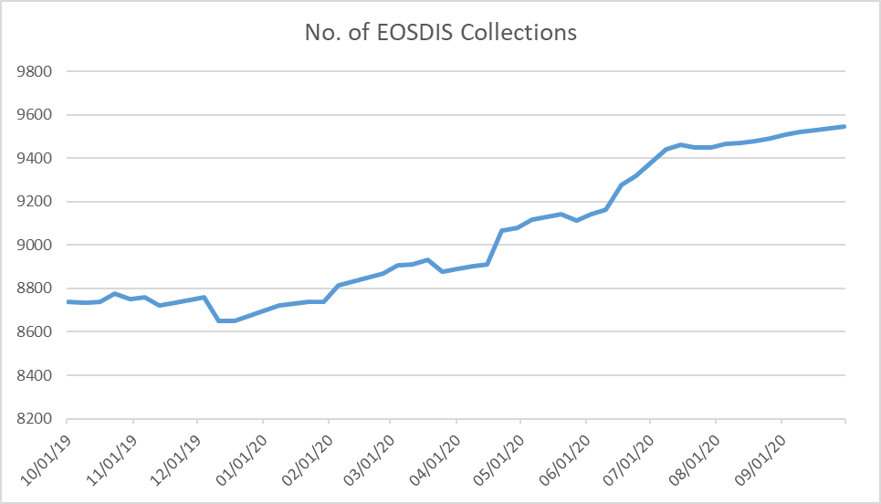
CMR Collections/Granules
While collection metadata provides information about types of data stored in the CMR, granule metadata is the smallest aggregation of data which is independently managed (i.e., described, inventoried, retrievable). These are metadata elements that describe a single granule of a data product. Values of granule metadata apply to all of the data in that one granule. Typical metadata in this category describe spatial and temporal extent of the data as well as the quality and lineage of the data.
The number of total collection, or data set series, holdings in CMR increased by 1.1% in FY 2019, from 34,172 at the beginning of the fiscal year to 34,535 at the end of the fiscal year. The number of collections fluctuated throughout the year due to collections being added and removed in the November 2018 through April 2019 time frames but had a fairly steady upwards trend from early May through the end of September.
The number of EOSDIS collection holdings in CMR, however, increased by 9.2%, from 8738 in October 2019 to 9544 at the end of September 2020. The number of collections had a fairly steady upwards trend throughout the year.

Slide 55
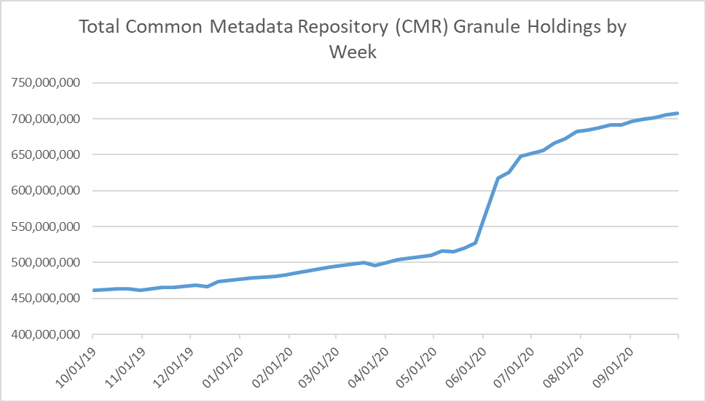
CMR Collections/Granules
The number of granule holdings in CMR increased by 53.5% in FY2020, from 461.4M in October 2019 to 708.2M at the end of September 2020. The chart provides a weekly summary of the CMR granule holdings. Granule holdings increased at a fairly steady rate throughout the year, with the exception of a jump exceeding 100M during the month of June 2020.

Slide 56
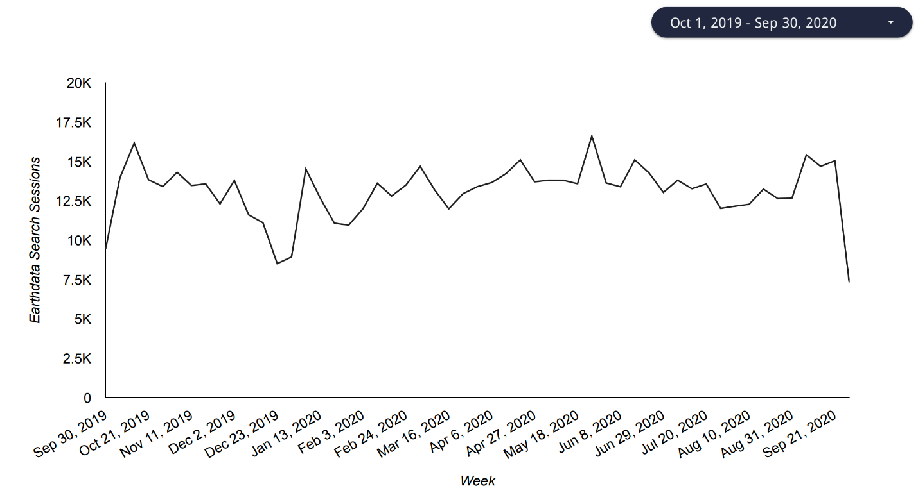
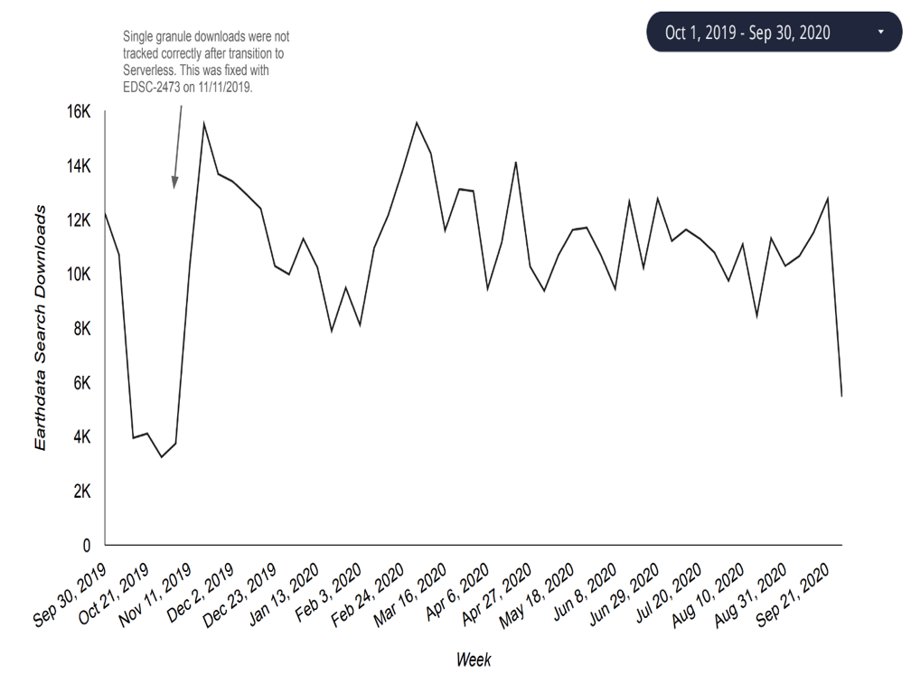
Earthdata Search Client
The Earthdata Search Client (EDSC) is the primary client for accessing NASA Earth Science data via the flagship earthdata.nasa.gov website. Utilization of the EDSC is measured in terms of the number of sessions, or visits by a user over a short period of time, to the site as well as by acquisitions, which represent the number of times data was downloaded via the EDSC.
EDSC showed steady utilization throughout FY2020. EDSC sessions fluctuated throughout the year, with a low of about 7,500 on September 30, 2020, and a high of about 17,000 on May 18, 2020.
EDSC acquisitions likewise fluctuated throughout the year. Disregarding the erroneous readings prior to 11/11/2019 (as noted on the graph), EDSC acquisitions fluctuated from a high of around 16,000 in April 2020 to a low of around 6,000 in late September 2020.

Slide 57
DAAC Profiles
Individual DAACs
LANCE

Slide 72
Definitions (1 of 3)

Slide 73
Definitions (2 of 3)

Slide 74
Definitions (3 of 3)

